Slide 1

Smarthome ford charger UX/UI PROJECT
First Steps
karacankos@gmail.com
karacankos@gmail.com
https://www.linkedin.com/in/omer-karacan/
https://www.instagram.com/karacanos/

Slide 2
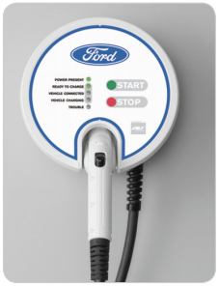
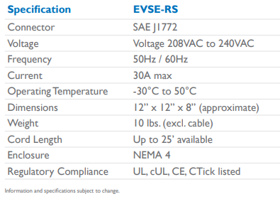
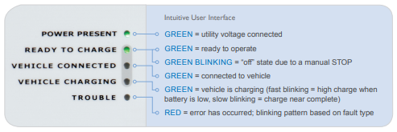
FORD Charging station - Project
Project Web Services
Use Case
Report Factory Setting
Use Case
Run-time Status Report
Domain Model
UX
https://www.evsolutions.com/Upload/Product/635652466512570000.pdf

Slide 3
SYSTEM Behavior Chargıng Process
UX
Model version: 2022.03
e: power_on
t: power_on
Events:
Power_on
Ready_to_charge
Vehicle_disconnected
Start_charging
Stop_charging
Vehicle_connected
Failure_fixed
Failure
Power_off
Car charging state
POWER OFF
e: ready_to_charge
t: ready_to_charge
e: power_off
t: power_off
e: vehicle_disconnected
t: ready_to_charge
power present
ready to charge
INITIAL_STATE
e: vehicle_connected
t: vehicle_connected
vehicle connected
e: failure_fixed
t: ready_to_charge
States:
INITIAL_STATE
POWER_OFF
POWER_PRESENT
READY_TO_CHARGE
VEHICLE_CONNECTED
VEHICLE_CHARGING
TROUBLE
e: failure
t: failure
e: stop_charging
t: vehicle_connected
trouble
vehicle charging
e: start_charging
t: start_charging

Slide 4
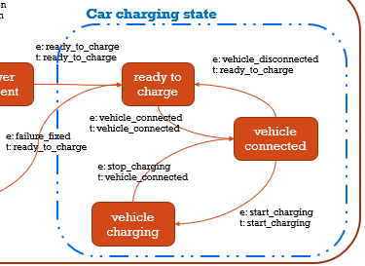
Car charging state State/Event Table test cases
REVISIT
Test Case | TC #1 | TC #2 | TC #3 | TC #4
Start state | Ready to charge | Vehicle connected | vehicle charging | Vehicle connected
Event/Input | Vehicle_connected | Start_charging | Stop_charging | Vehicle_disconnected
Expected Output | «Vehicle connected» | «vehicle charging» | «Vehicle connected» | «Vehicle disconnected»
End state | Vehicle connected | vehicle charging | Vehicle connected | Ready to charge

Slide 5
Demo – Generıc (SprIng-)ApplIcatIon
UX/UI for BEX Projects

Slide 6





Demo – Generıc (SprIng-)ApplIcatIon
ca. 15 min.
<SpringBootApplication,
generic-application>
gapp
3 roles
<external-db>
UX/UI
<Repository>
GappRepository
<Service>
GappService
<Controller>
GappController
Tester
Java Persistence (JAP) API
<entity>
GappData
<embedded-db>
Hibernate
Developer
<external-db>
MySQL
<persistency>
data storage
<algorithm>
business logic
<endpoints>
gapp APIs

Slide 7
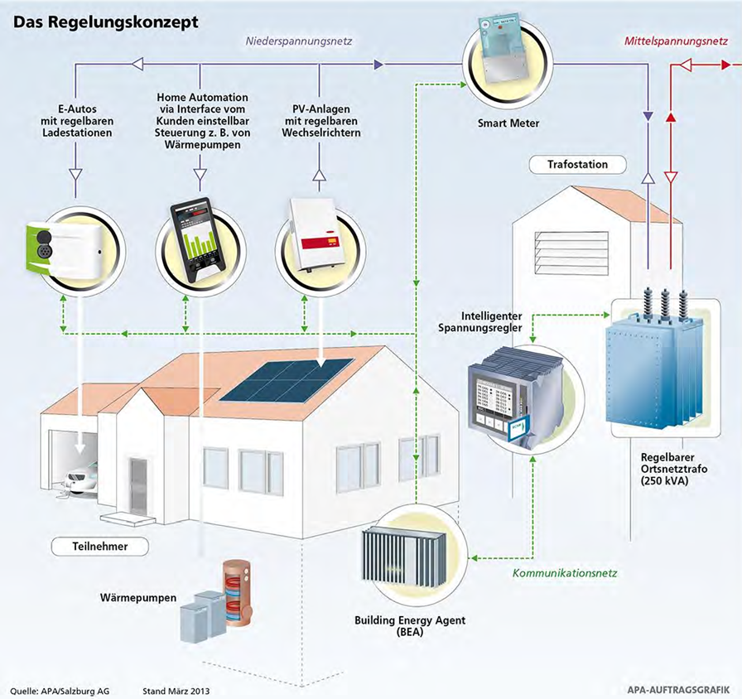
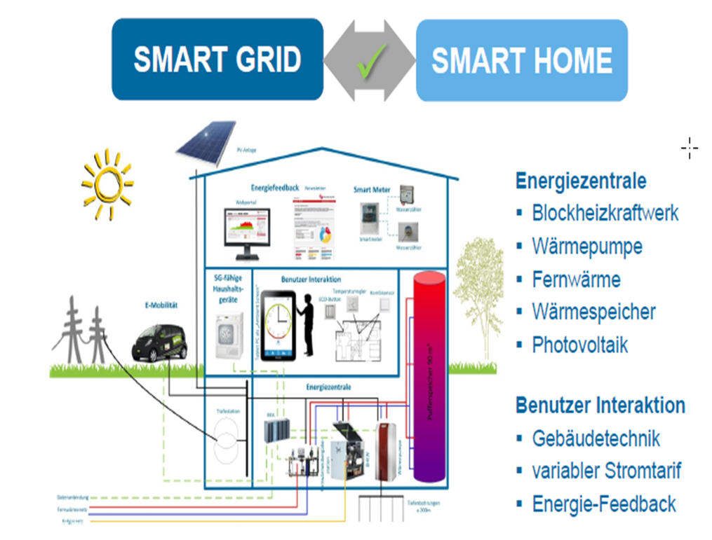
GAPP KONTEXT – SMART HOME
Charging Station

Slide 8
FORD CHARGER based on Generıc SprIng ApplIcatIon
Backend for Ford Charger UX/UI Project

Slide 9
FORD CHARGER ApplIcatIon
CHECK: https://objectbox.io/how-ev-charging-benefits-from-edge-computing/
T.b.d.
ca. 15 min.
<SpringBootApplication,
charger-station-application>
cs
3 roles
<external-db>
UX/UI
<Repository>
GappRepository
<Service>
GappService
<Controller>
GappController
Tester
Java Persistence (JAP) API
<entity>
GappData
<embedded-db>
Hibernate
Developer
<external-db>
MySQL
<persistency>
data storage
<algorithm>
business logic
<endpoints>
gapp APIs

Slide 10
BACKYARD
Wichtige Informationen

Slide 11
Notes
FORD – Charging Station
https://www.evsolutions.com/Upload/Product/635652466512570000.pdf

