Slide 1
Tutorial 2
Scope:
Java Collections and their iterations
Complexity, Searching &Sorting

Slide 2
Java Collections
Collection | Description | Key Methods
Map | Stores key-value pairs, no duplicate keys | put(K key, V value), get(Object key), containsKey(Object key), remove(Object key), keySet(), values()
Set | Stores unique elements, no duplicates allowed | add(E e), remove(Object o), contains(Object o), size(), isEmpty(), clear()
List | Ordered collection, allows duplicates | add(E e), get(int index), remove(int index), size(), set(int index, E e), contains(Object o)
Stack | LIFO (Last In, First Out) structure, extends Vector | push(E e), pop(), peek(), isEmpty(), search(Object o)
Queue | FIFO (First In, First Out) structure | add(E e), offer(E e), remove(), poll(), peek(), isEmpty()

Slide 3
Java interfaces
Collection | Common Implementations
Map<K, V> | HashMap<K, V>, TreeMap<K, V>, LinkedHashMap<K, V>, Hashtable<K, V>
Set | HashSet<E>, TreeSet<E>, LinkedHashSet<E>
List | ArrayList<E>, LinkedList<E>, Vector<E>
Stack | Stack<E>, ArrayDeque<E>
Queue | LinkedList<E>, PriorityQueue<E>, ArrayDeque<E>

Slide 4
Iterator
Why Use Iterator Instead of for-each?
Removing Elements: for-each can’t remove items during iteration, but Iterator allows it using remove().
More Control: Iterator gives manual control with hasNext() and next(), allowing conditional iteration and early exit.
Custom Logic: For complex iteration logic, Iterator is better than the simplicity of for-each.
Legacy APIs: Some older APIs only provide Iterator, not for-each.

Slide 5
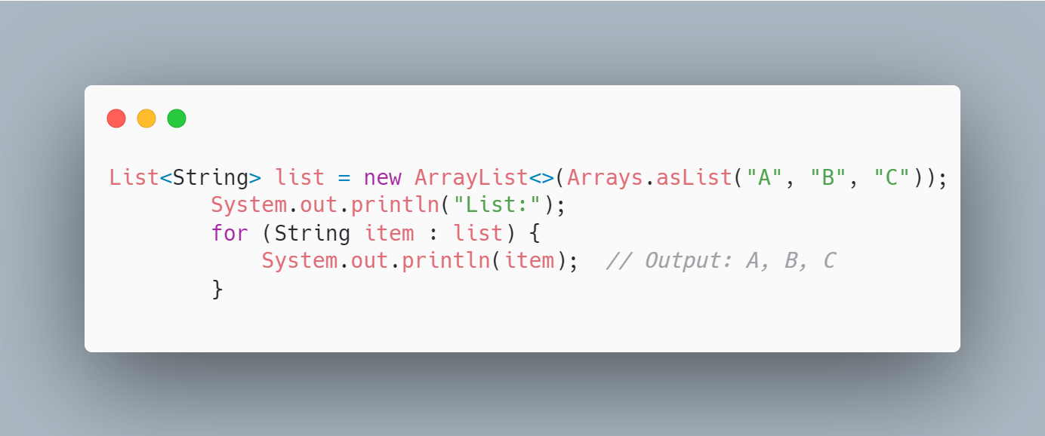
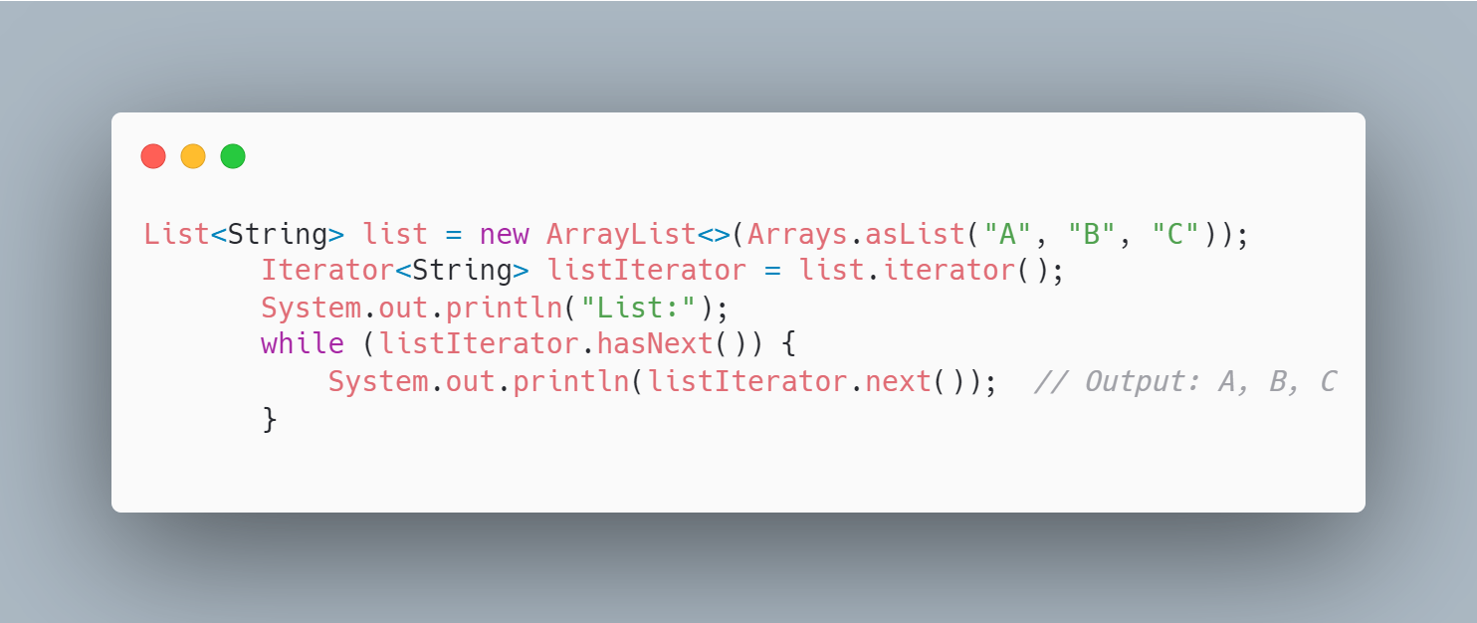
Iterator - ForEach

Slide 6
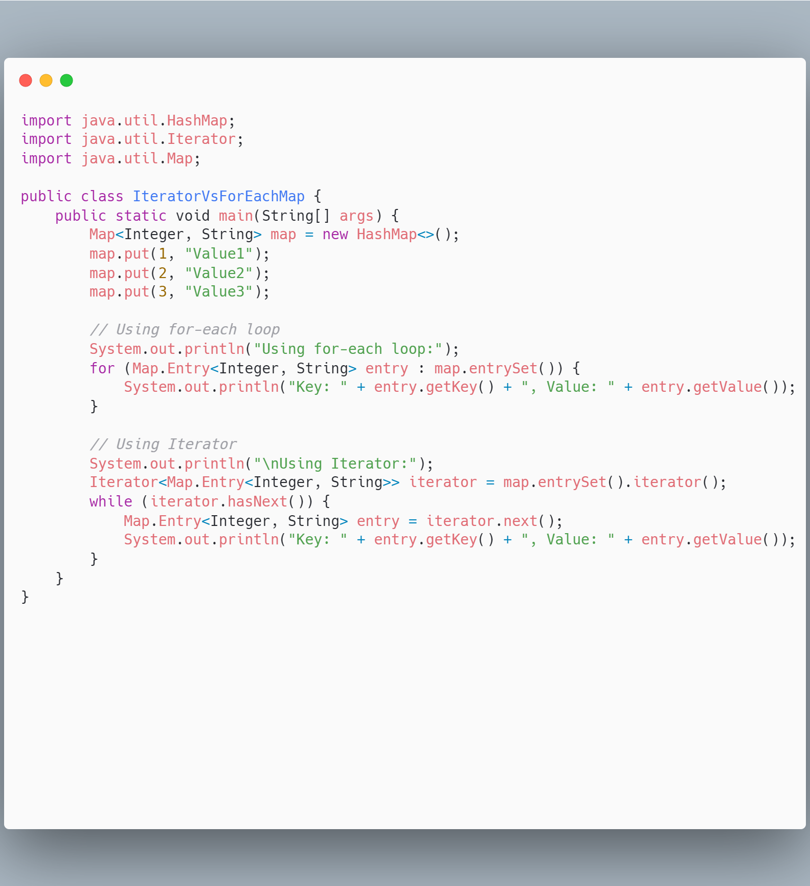
Iterator - ForEach

Slide 7
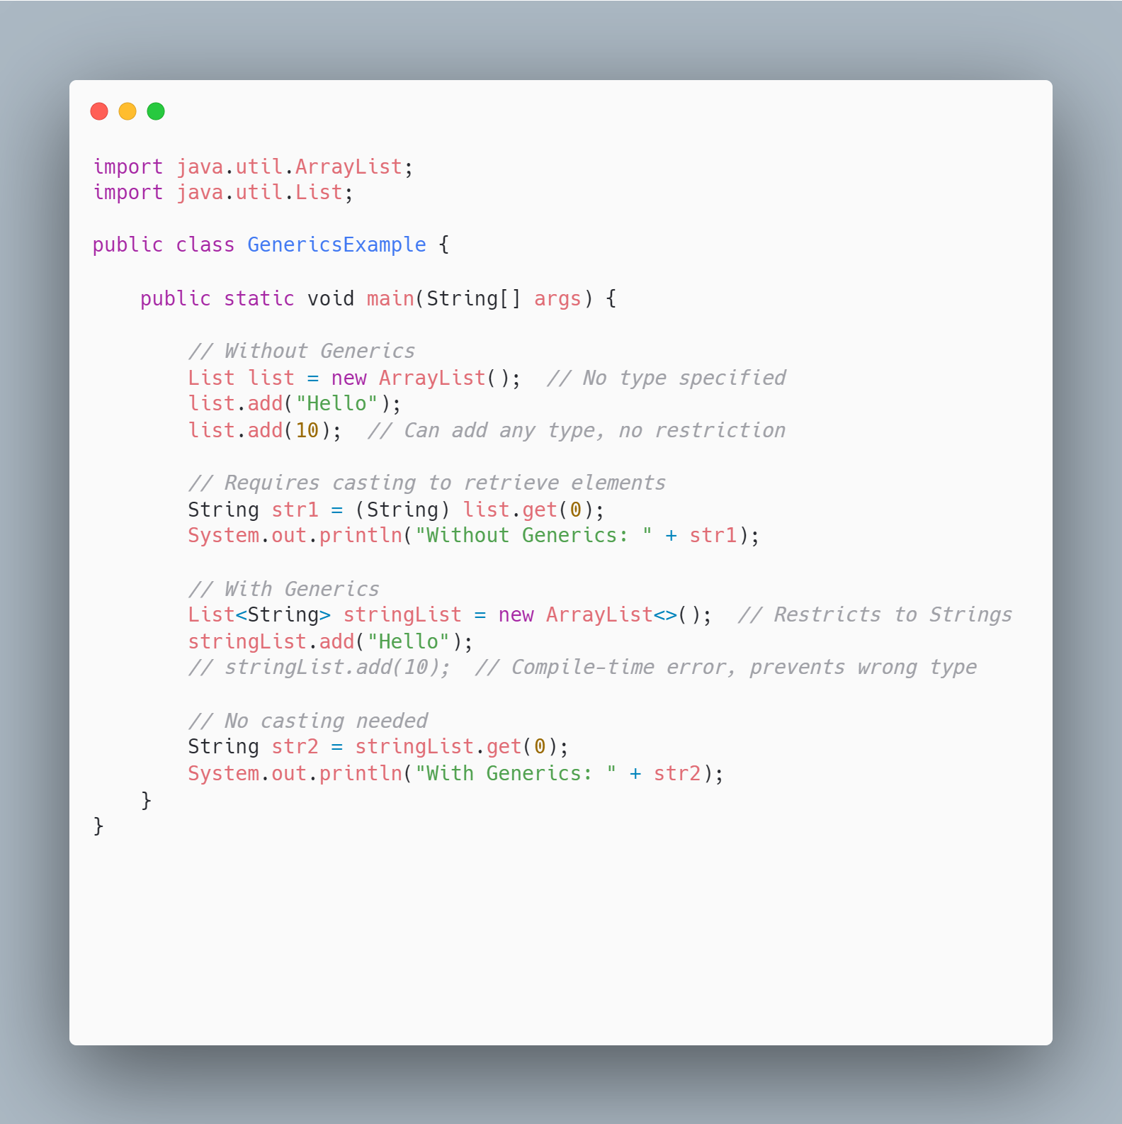
Generics

Slide 8
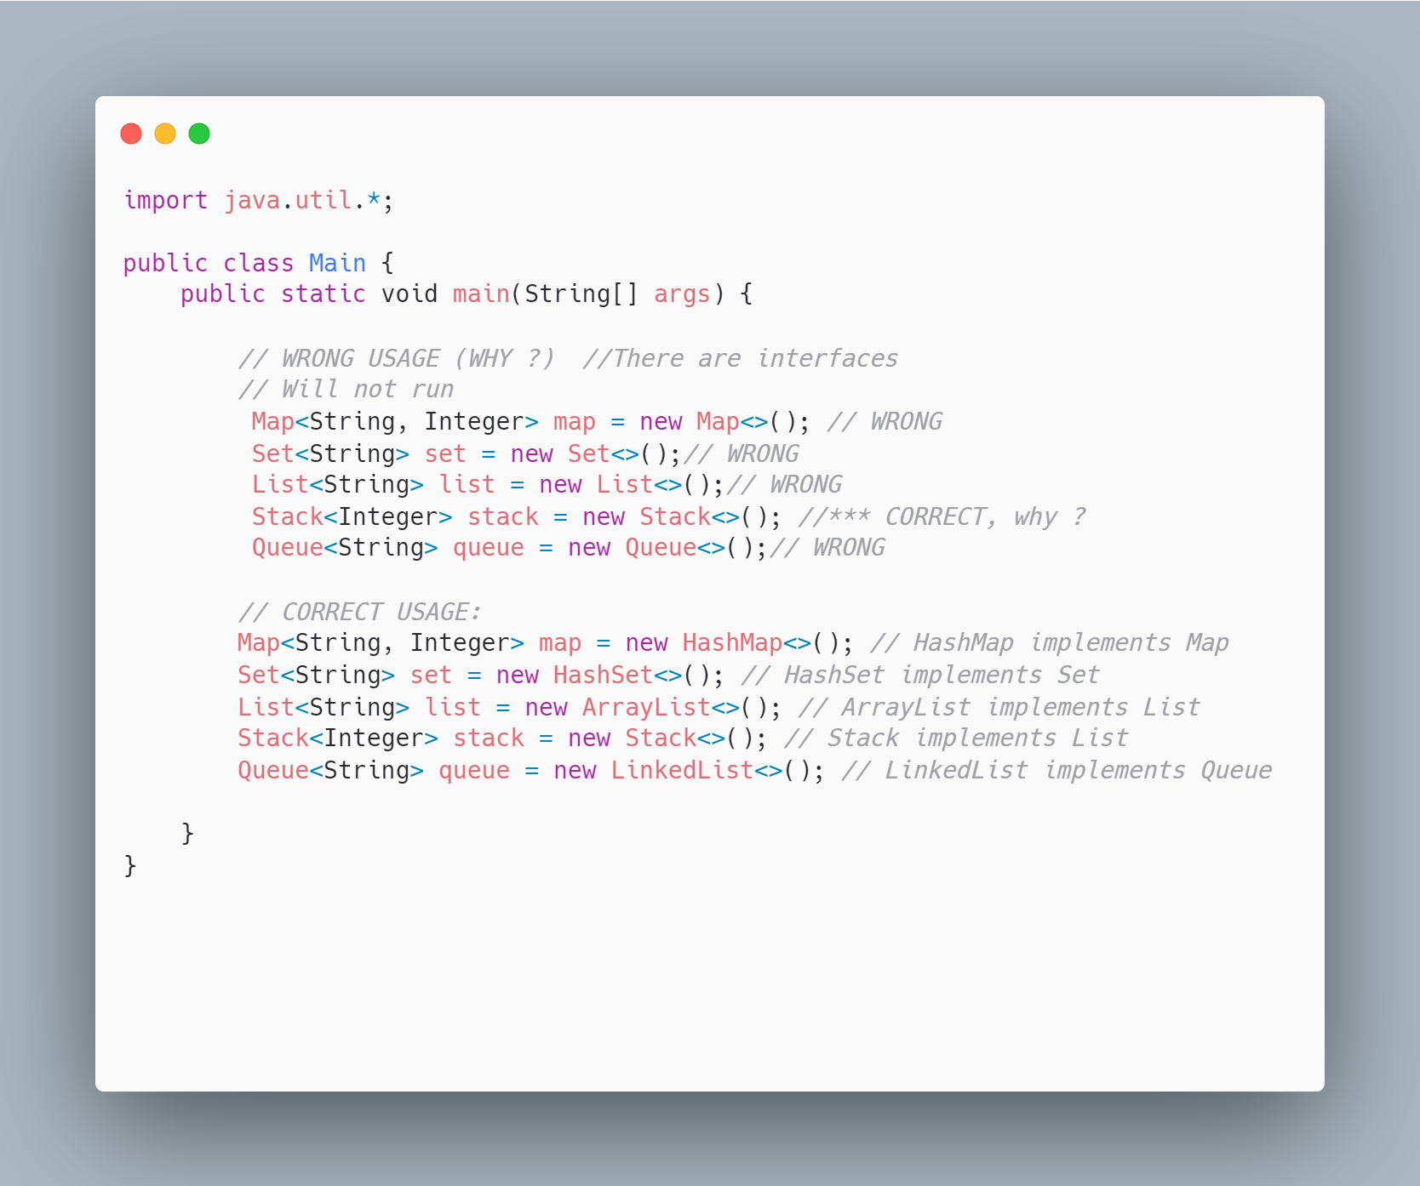
Interface
An interface in Java defines a set of methods that a class must implement. It only provides method signatures, not their implementations.

Slide 9
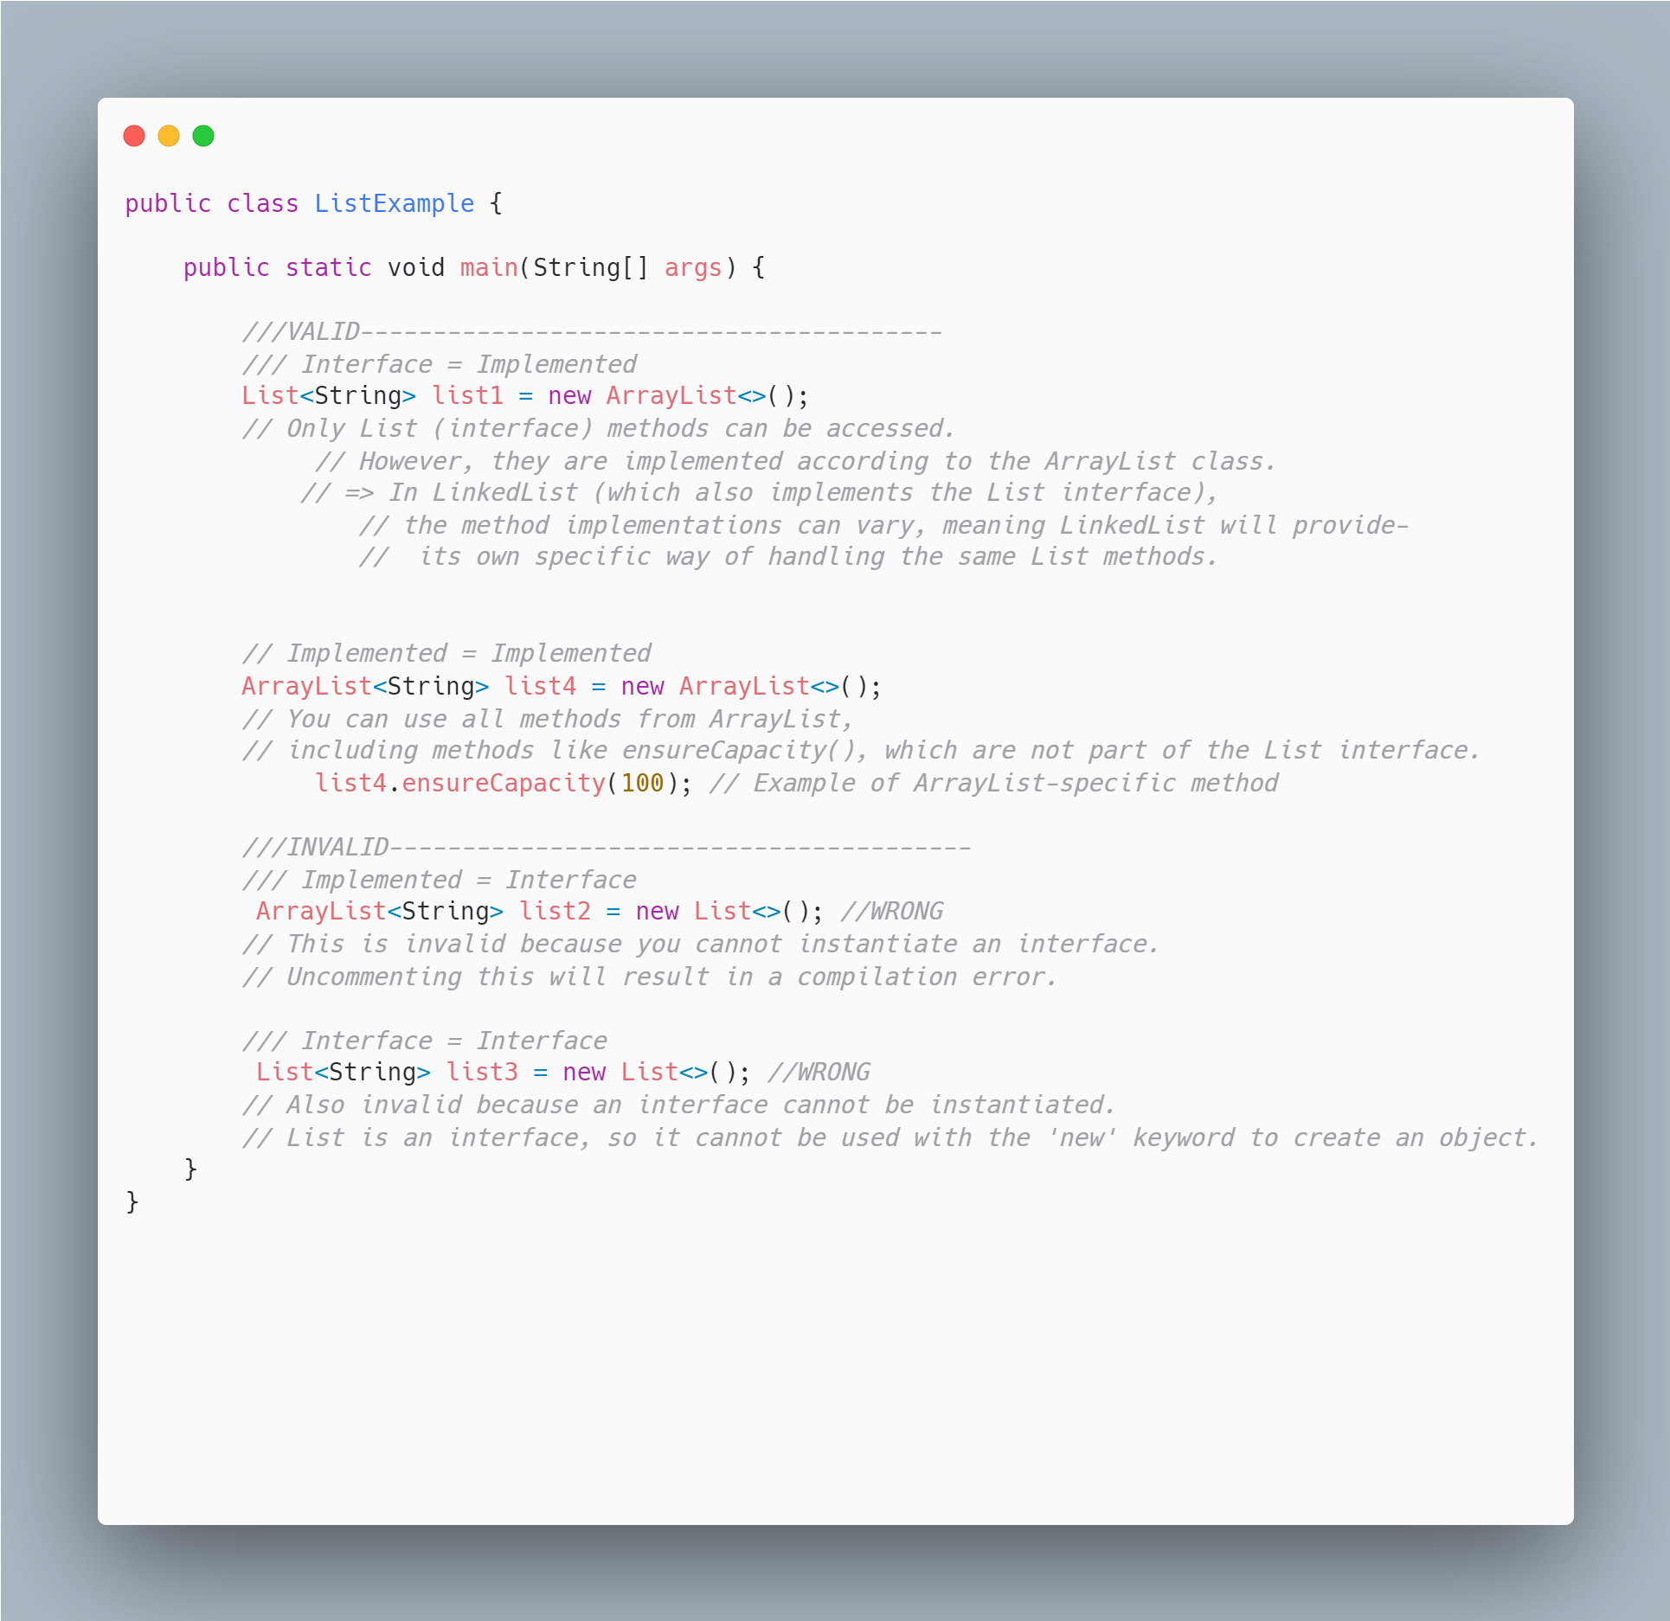
Collection Syntax

Slide 10
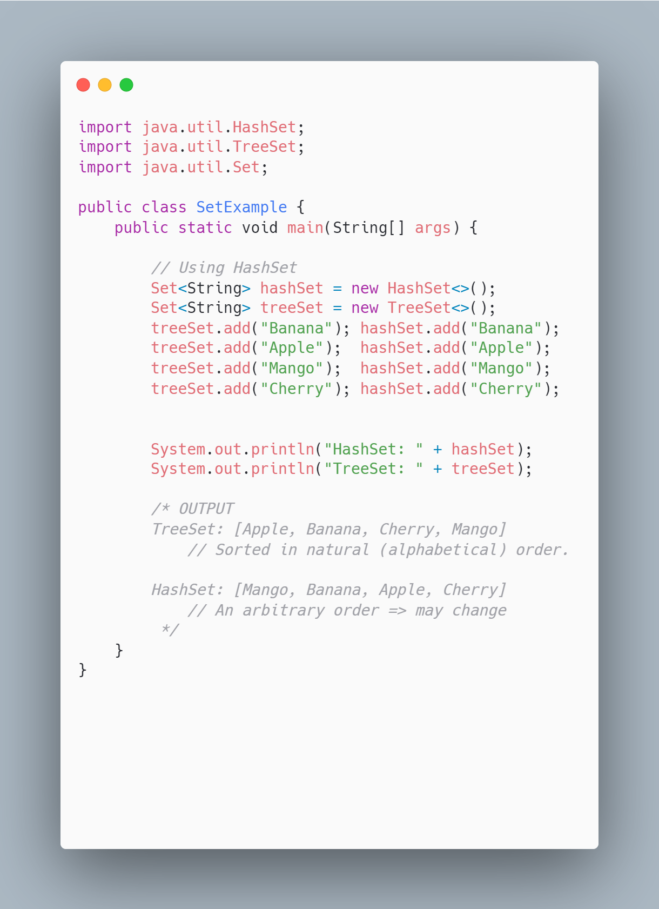
Same method, different implementation

Slide 11
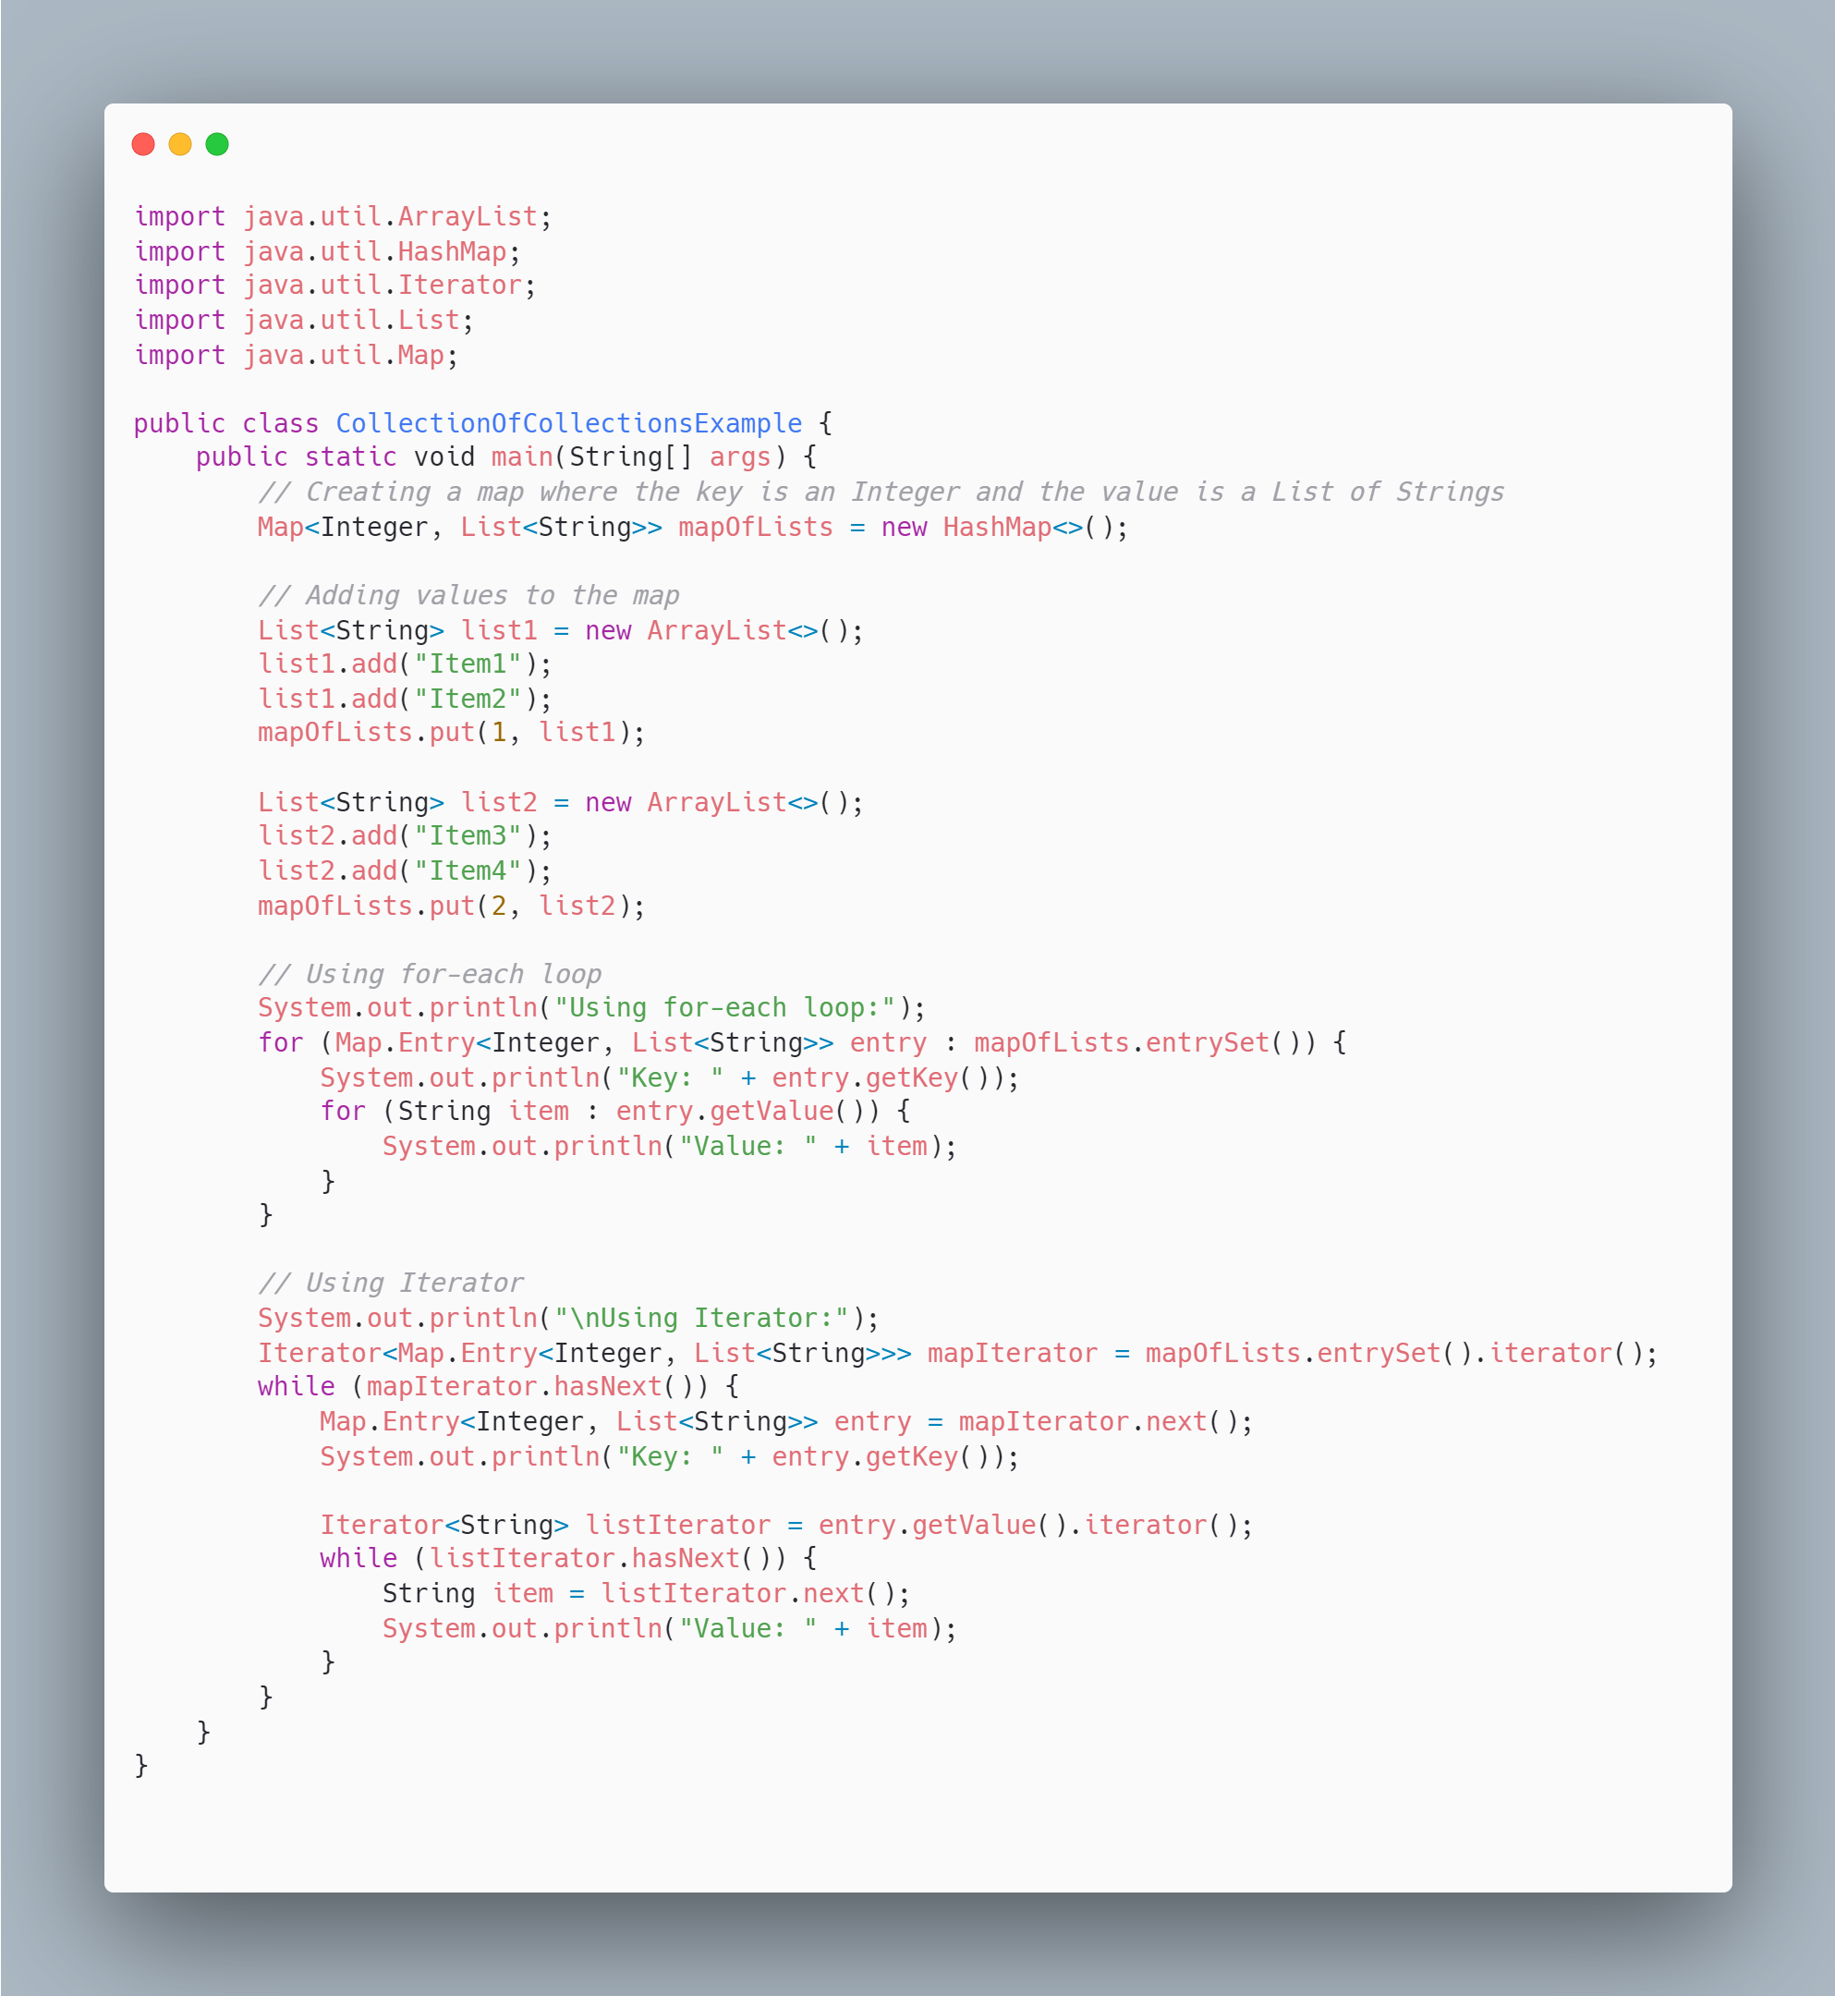
Study for home :Collections

Slide 12
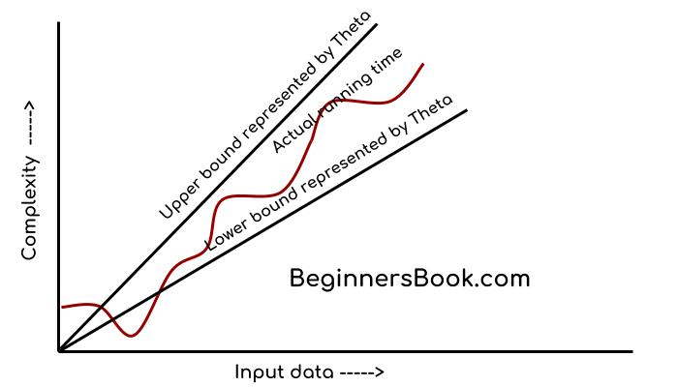
Complexity
Upper Bound (O): Maximum possible time.
Lower Bound (Ω): Minimum possible time.
Tight Bound (Θ): Average, typical time.
Image: here.
d

Slide 13
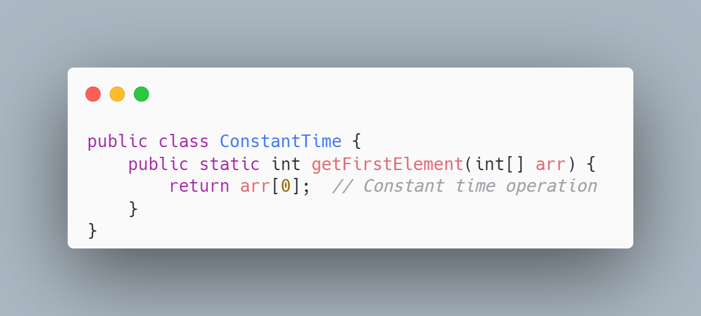
1. Constant Time (O(1), Ω(1), Θ(1))
Upper Bound: O(1)
This operation always takes the same amount of time, regardless of the array size. Accessing the first element is a direct memory access.
Lower Bound: Ω(1)
The best case is the same: accessing the first element is constant time.
Average Case: Θ(1)
The typical or average case also involves only one step, making the time constant.

Slide 14
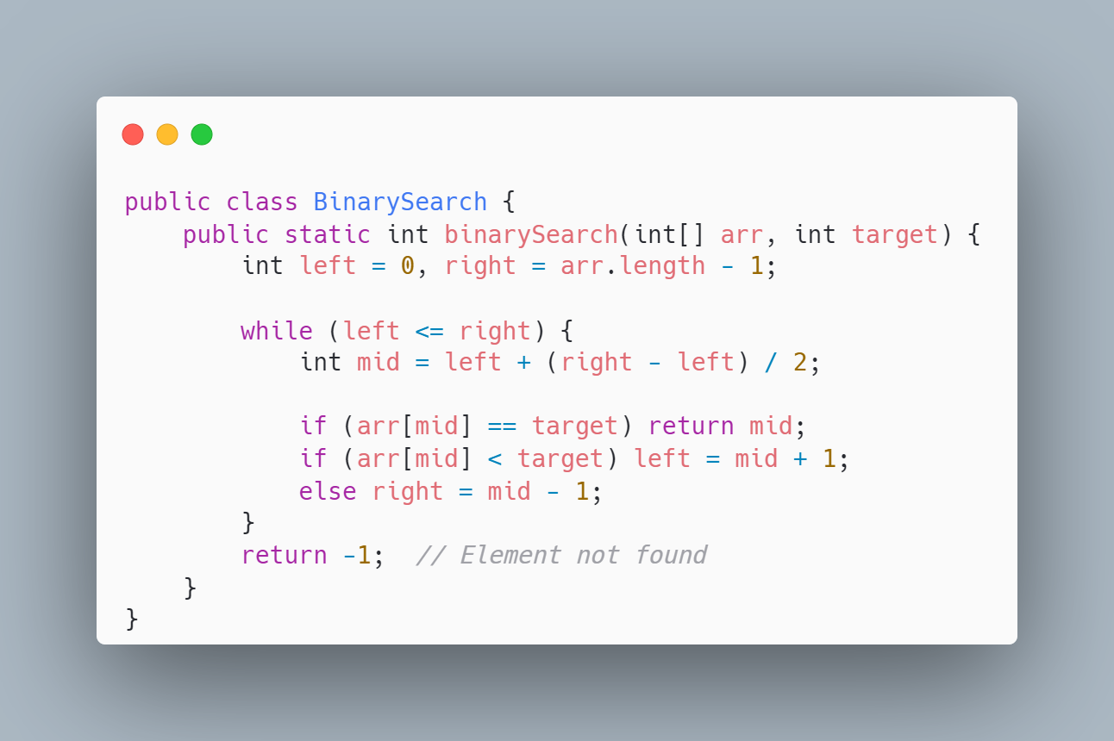
2. Binary Search (O(log n), Ω(1), Θ(log n))
Upper Bound: O(log n)
In the worst case, you keep halving the search space until it becomes small. Halving occurs log n times, so the maximum number of steps is proportional to log n.
Lower Bound: Ω(1)
The best case occurs when the middle element is the target, so you find it in one step.
Average Case: Θ(log n)
Typically, you’ll have to search through half the array repeatedly, which means logarithmic time is also the average case.

Slide 15
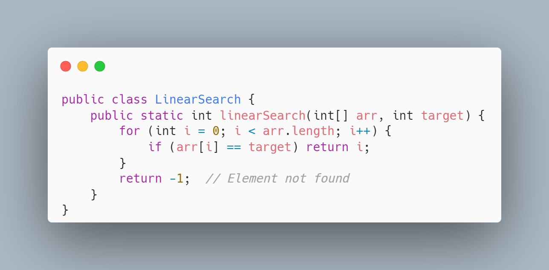
3. Linear Search (O(n), Ω(1), Θ(n))
Upper Bound: O(n)
In the worst case, the target element could be the last element or not present at all, so you’d have to check all n elements.
Lower Bound: Ω(1)
The best case happens when the target is the first element, found in one comparison.
Average Case: Θ(n)
On average, the target will be found halfway through the array, meaning you’ll need to search through n/2 elements, which simplifies to n.

Slide 16
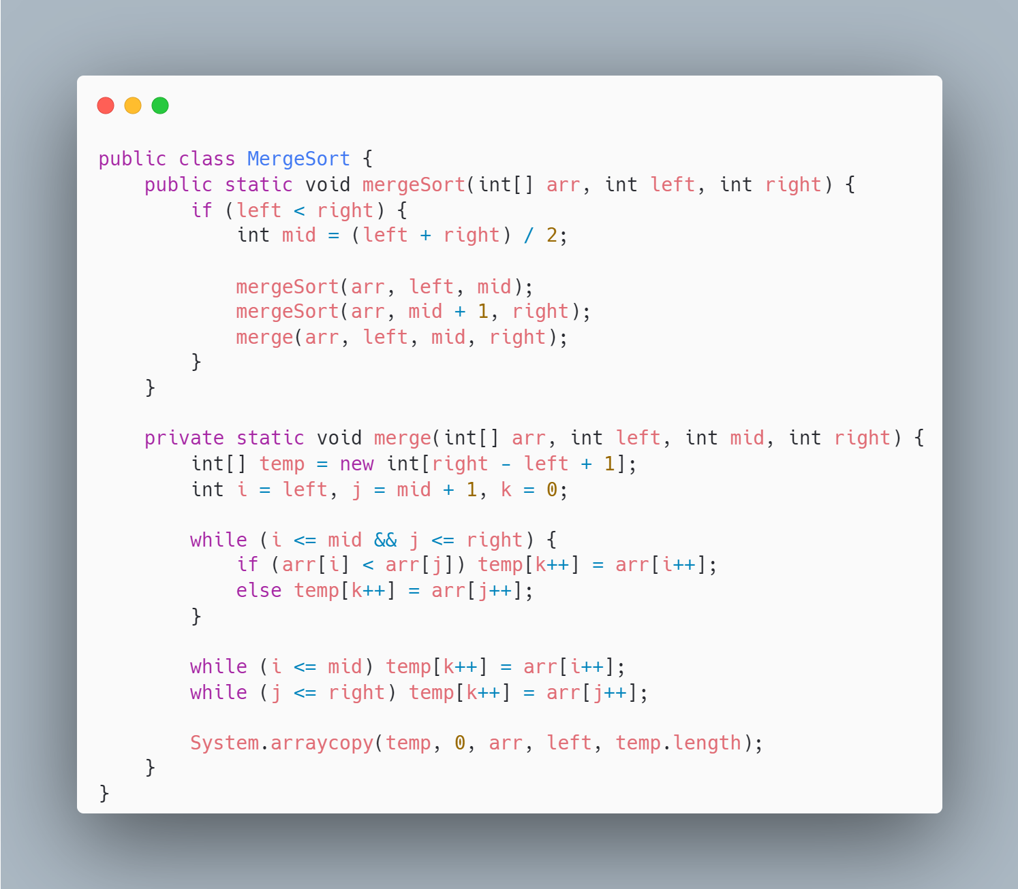
4. Merge Sort (O(n log n), Ω(n log n), Θ(n log n))
Upper Bound: O(n log n)
In the worst case, the array is split into halves log n times (because each division halves the size). Each level of recursion requires n comparisons to merge the arrays, so the time complexity becomes n log n.
Lower Bound: Ω(n log n)
Even in the best case, the array must be split and merged the same way, resulting in n log n comparisons.
Average Case: Θ(n log n)
Whether the input is random or ordered, the process of splitting and merging remains the same, meaning the average case is also n log n.

Slide 17
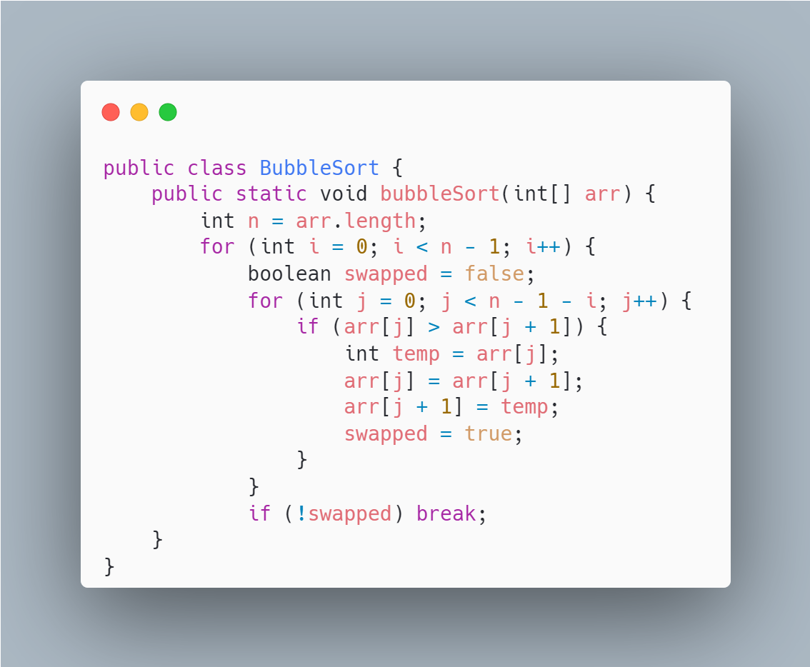
5. Bubble Sort (O(n^2), Ω(n), Θ(n^2))
Upper Bound: O(n^2)
In the worst case (when the array is in reverse order), the algorithm has to make n passes, each involving up to n comparisons, leading to n^2 comparisons.
Lower Bound: Ω(n)
In the best case (if the array is already sorted), a single pass through the array is enough to verify that no swaps are needed, resulting in n comparisons.
Average Case: Θ(n^2)
Typically, the algorithm will need multiple passes and comparisons, which results in quadratic time complexity.

Slide 18
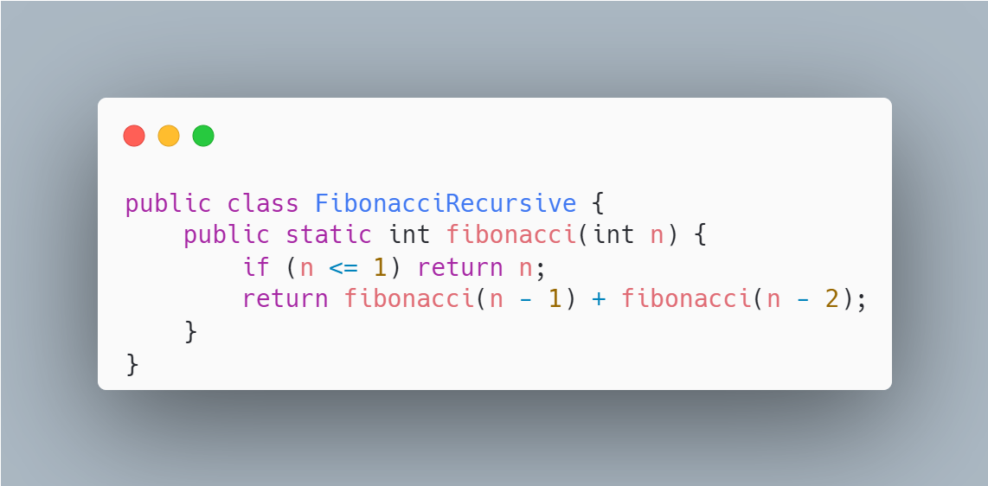
6. Fibonacci (Recursive) (O(2^n), Ω(2^n), Θ(2^n))
Upper Bound: O(2^n)
I In the worst case, the recursion tree grows exponentially. Each call to fibonacci makes two recursive calls, leading to 2^n growth.
Lower Bound: Ω(2^n)
Even in the best case, the recursive structure does not change, and the number of function calls remains exponential..
Average Case: Θ(2^n)
The average case behaves similarly to the worst case because the recursive structure leads to exponential growth in function calls in both cases.

Slide 19
Summary : The order of growth of functions
Algorithm | Upper Bound (O) | Lower Bound (Ω) | Average Case (Θ)
Constant Time | O(1) | Ω(1) | Θ(1)
Binary Search | O(log n) | Ω(1) | Θ(log n)
Linear Search | O(n) | Ω(1) | Θ(n)
Merge Sort | O(n log n) | Ω(n log n) | Θ(n log n)
Bubble Sort | O(n^2) | Ω(n) | Θ(n^2)
Fibonacci (Recursive) | O(2^n) | Ω(2^n) | Θ(2^n)

Slide 20
Task 1 (ArrayList):
Develop a program Main.java that will:
- Create an ArrayList of 2 elements
- Add items to the ArrayList:
- Try to insert strings (i.e., String() object) as well as integers (i.e., Integer())
- E.g., list.add(new String("x"));, list.add(2, new Integer(10));
- And print the list
- Remove an item and print the list and check if the item you removed exists
- Using contains() check if the list contains a specified element of your choice and print the output (tip: should be a Boolean true or false)
- Using the ListIterator, use a while loop and print every element of your list
- Try also if you can do that using any other type of a loop (e.g., for)
- Create an object array from the ArrayList you have.

Slide 21
Task 2 (LinkedList):
Develop a program IntegerList.java that will create a LinkedList and add 4 Integer objects to it:
- Print the size of the LinkedList
- Add integer objects at the beginning and the end of the LinkedList and print them
- Tip: You might have to use getFirst() and getLast() methods of the LinkedList class — check the documentation.
- Remove the first and last elements of the list and print the list
- Remove the first instance of Integer(1) object and print the list
- Add a String named as “NewYork” and Long objects to the LinkedList and print the list - Get the index of the “New York” String object and print it
- Remove the 3rd object in the LinkedList and print the list
- Set the value of the second item to "one" and print the list
- Clone the LinkedList object (tip: using list.clone()) and print it.

Slide 22
Task 3 (Set):
Develop a program SetTest.java that will:
Create a HashSet of 5 elements
Try to add both String and Integer objects to the HashSet (e.g., set.add("hello");, set.add(42);)
Print the HashSet
Add new elements to the HashSet
Add 3 new elements to the set and print the updated set
Remove an element from the HashSet
Remove one element and check if the removal was successful by printing the updated HashSet
Check if a specific element is present
Use the contains() method to check if a specific element exists in the set (tip: Should return a Boolean value)
Iterate over the elements in the HashSet and print them
Use a for-each loop to print every element in the set
Test the behaviour of adding duplicate elements
Add a duplicate element and print the HashSet to see if duplicates are stored
Create a TreeSet from the HashSet
Convert your HashSet to a TreeSet and print the elements in natural order.

Slide 23
Task 4 – Searching & Sorting
Exercise 1:
-Step 1:
For this exercise, you need to read the file cars.csv and create an array list to insert each car. The CSV file has the following columns: - price, brand, model, year, mileage, color, vin
While you are reading the file, you need to ignore the first row since it contains the column’s names. Also, note that each column is separated with a comma ,. Use the class Car.java that is uploaded on Blackboard.
Step 2:
Use Merge sort to sort the list of cars based on the field year in descending order. (From the newest to older).
Then print the newest car (considering there is only one with that year) and then change the year field to 2022.
Step 3:
Write a method public Car[] duplicatesBinarySearch(int year) that uses Binary search to find the car/cars with the given manufacture year. You need to take into consideration that some cars have the same manufacture year.
Step 4:
Use the above method to get the following data and print: 1. The details of the car with a year 2013 2. The details of the cars with a year 2015
Exercise 2:
Write a code that implements the Quicksort algorithm that uses the median as a pivot.
Then sort the following array int[] unsorted = {3, 10, 1, 45, 14, 22, 5, 36}.

