Slide 1
Tutorial 1 link: https://github.com/kos00pas/ECE318_Documentations.git
Goal : Learn Loops and iterate in a 2D Array
Examples
Loops : For & For-Each
Loops : While & Do While
Loops: Break & Continue
Loops : Iterate in 2D array
Using ArrayList and Looping

Slide 2
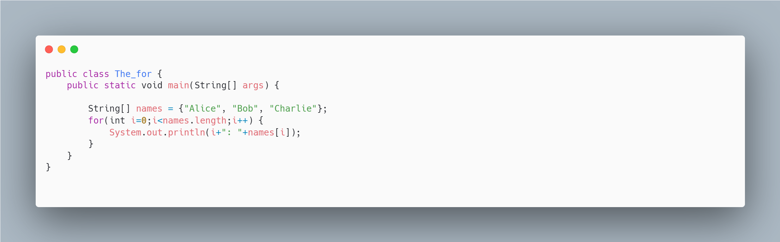
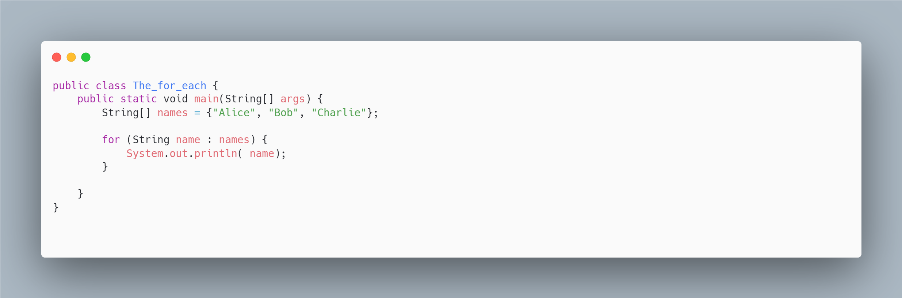
Loops : For & For-Each

Slide 3
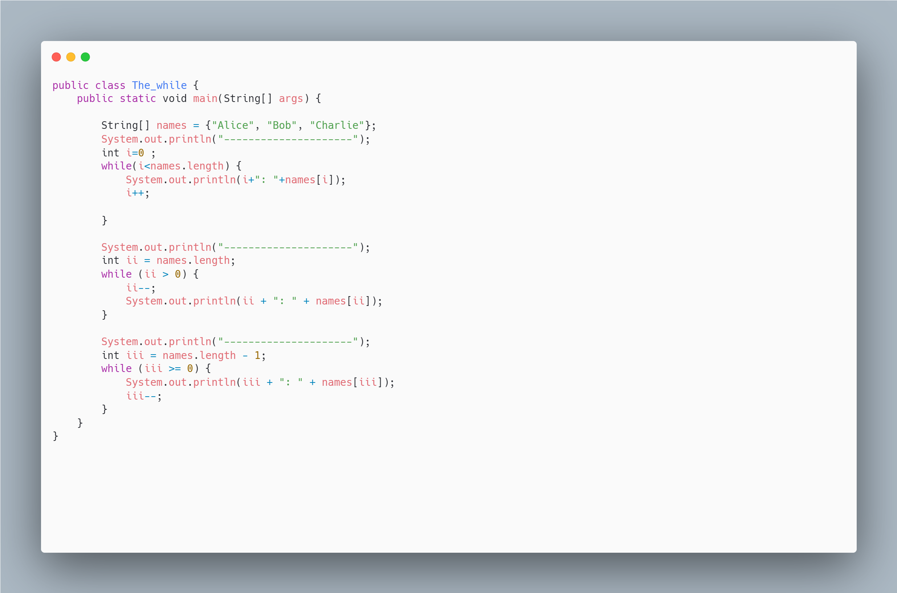
Loops : While

Slide 4
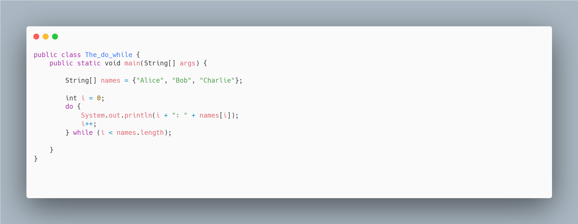
Loops : Do While

Slide 5
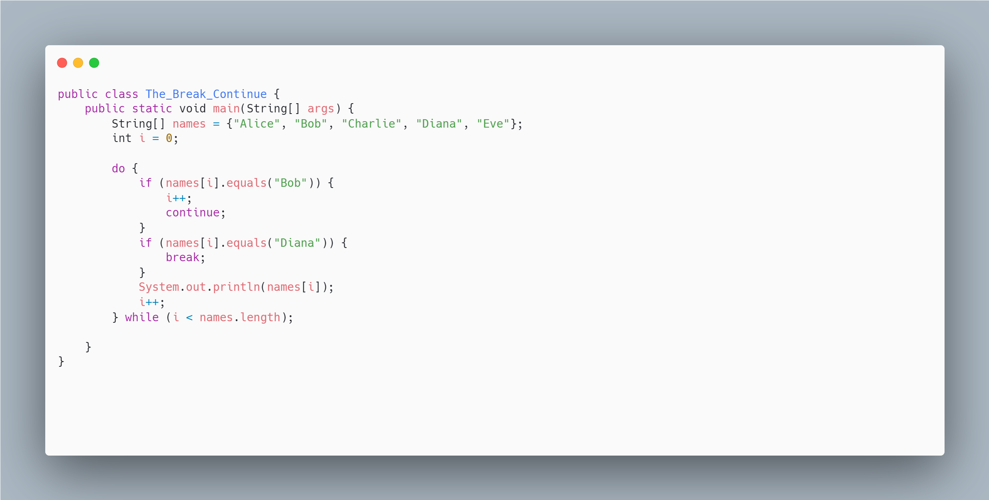
Loops: Break & Continue

Slide 6
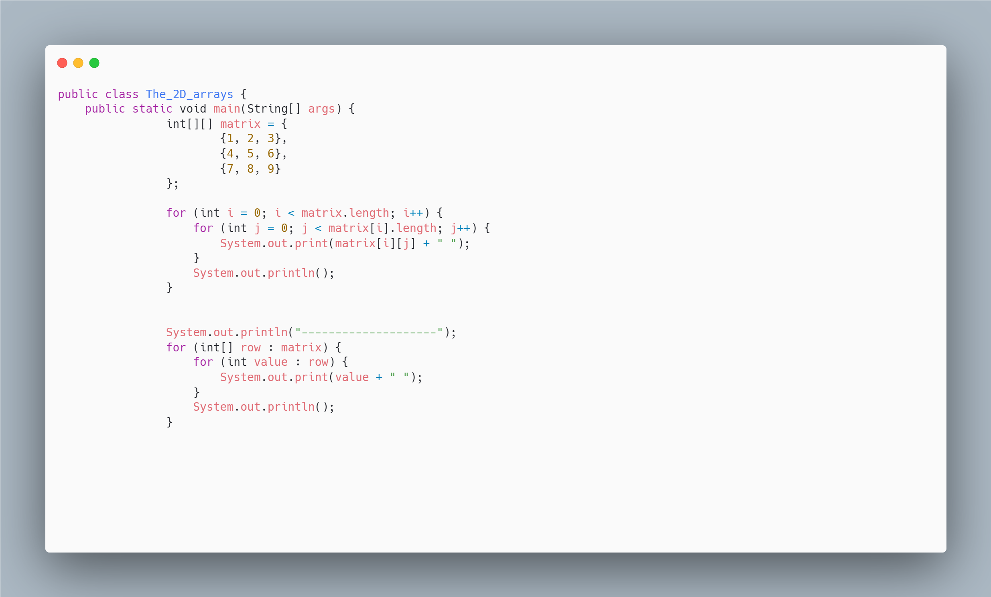
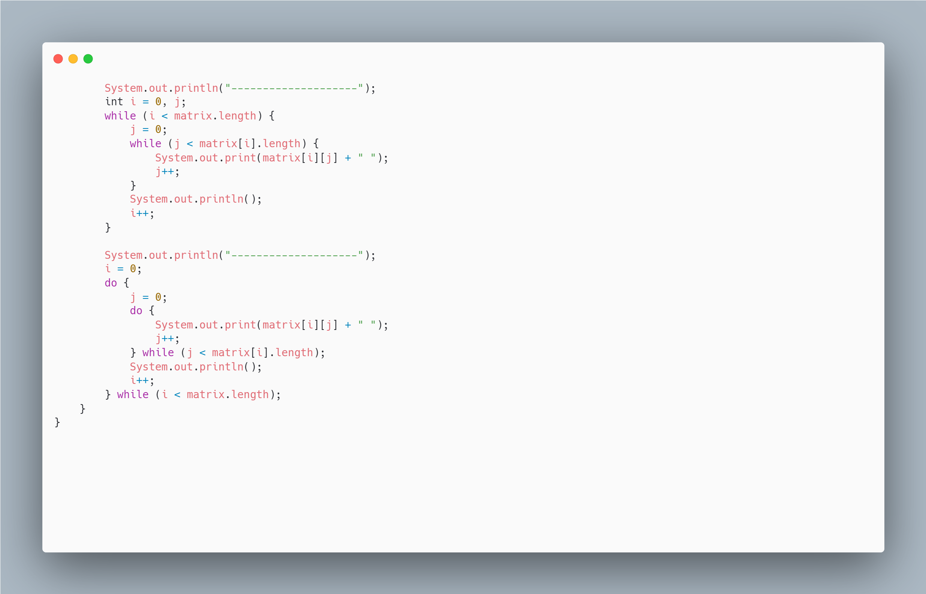
Loops : Iterate in 2D array

Slide 7
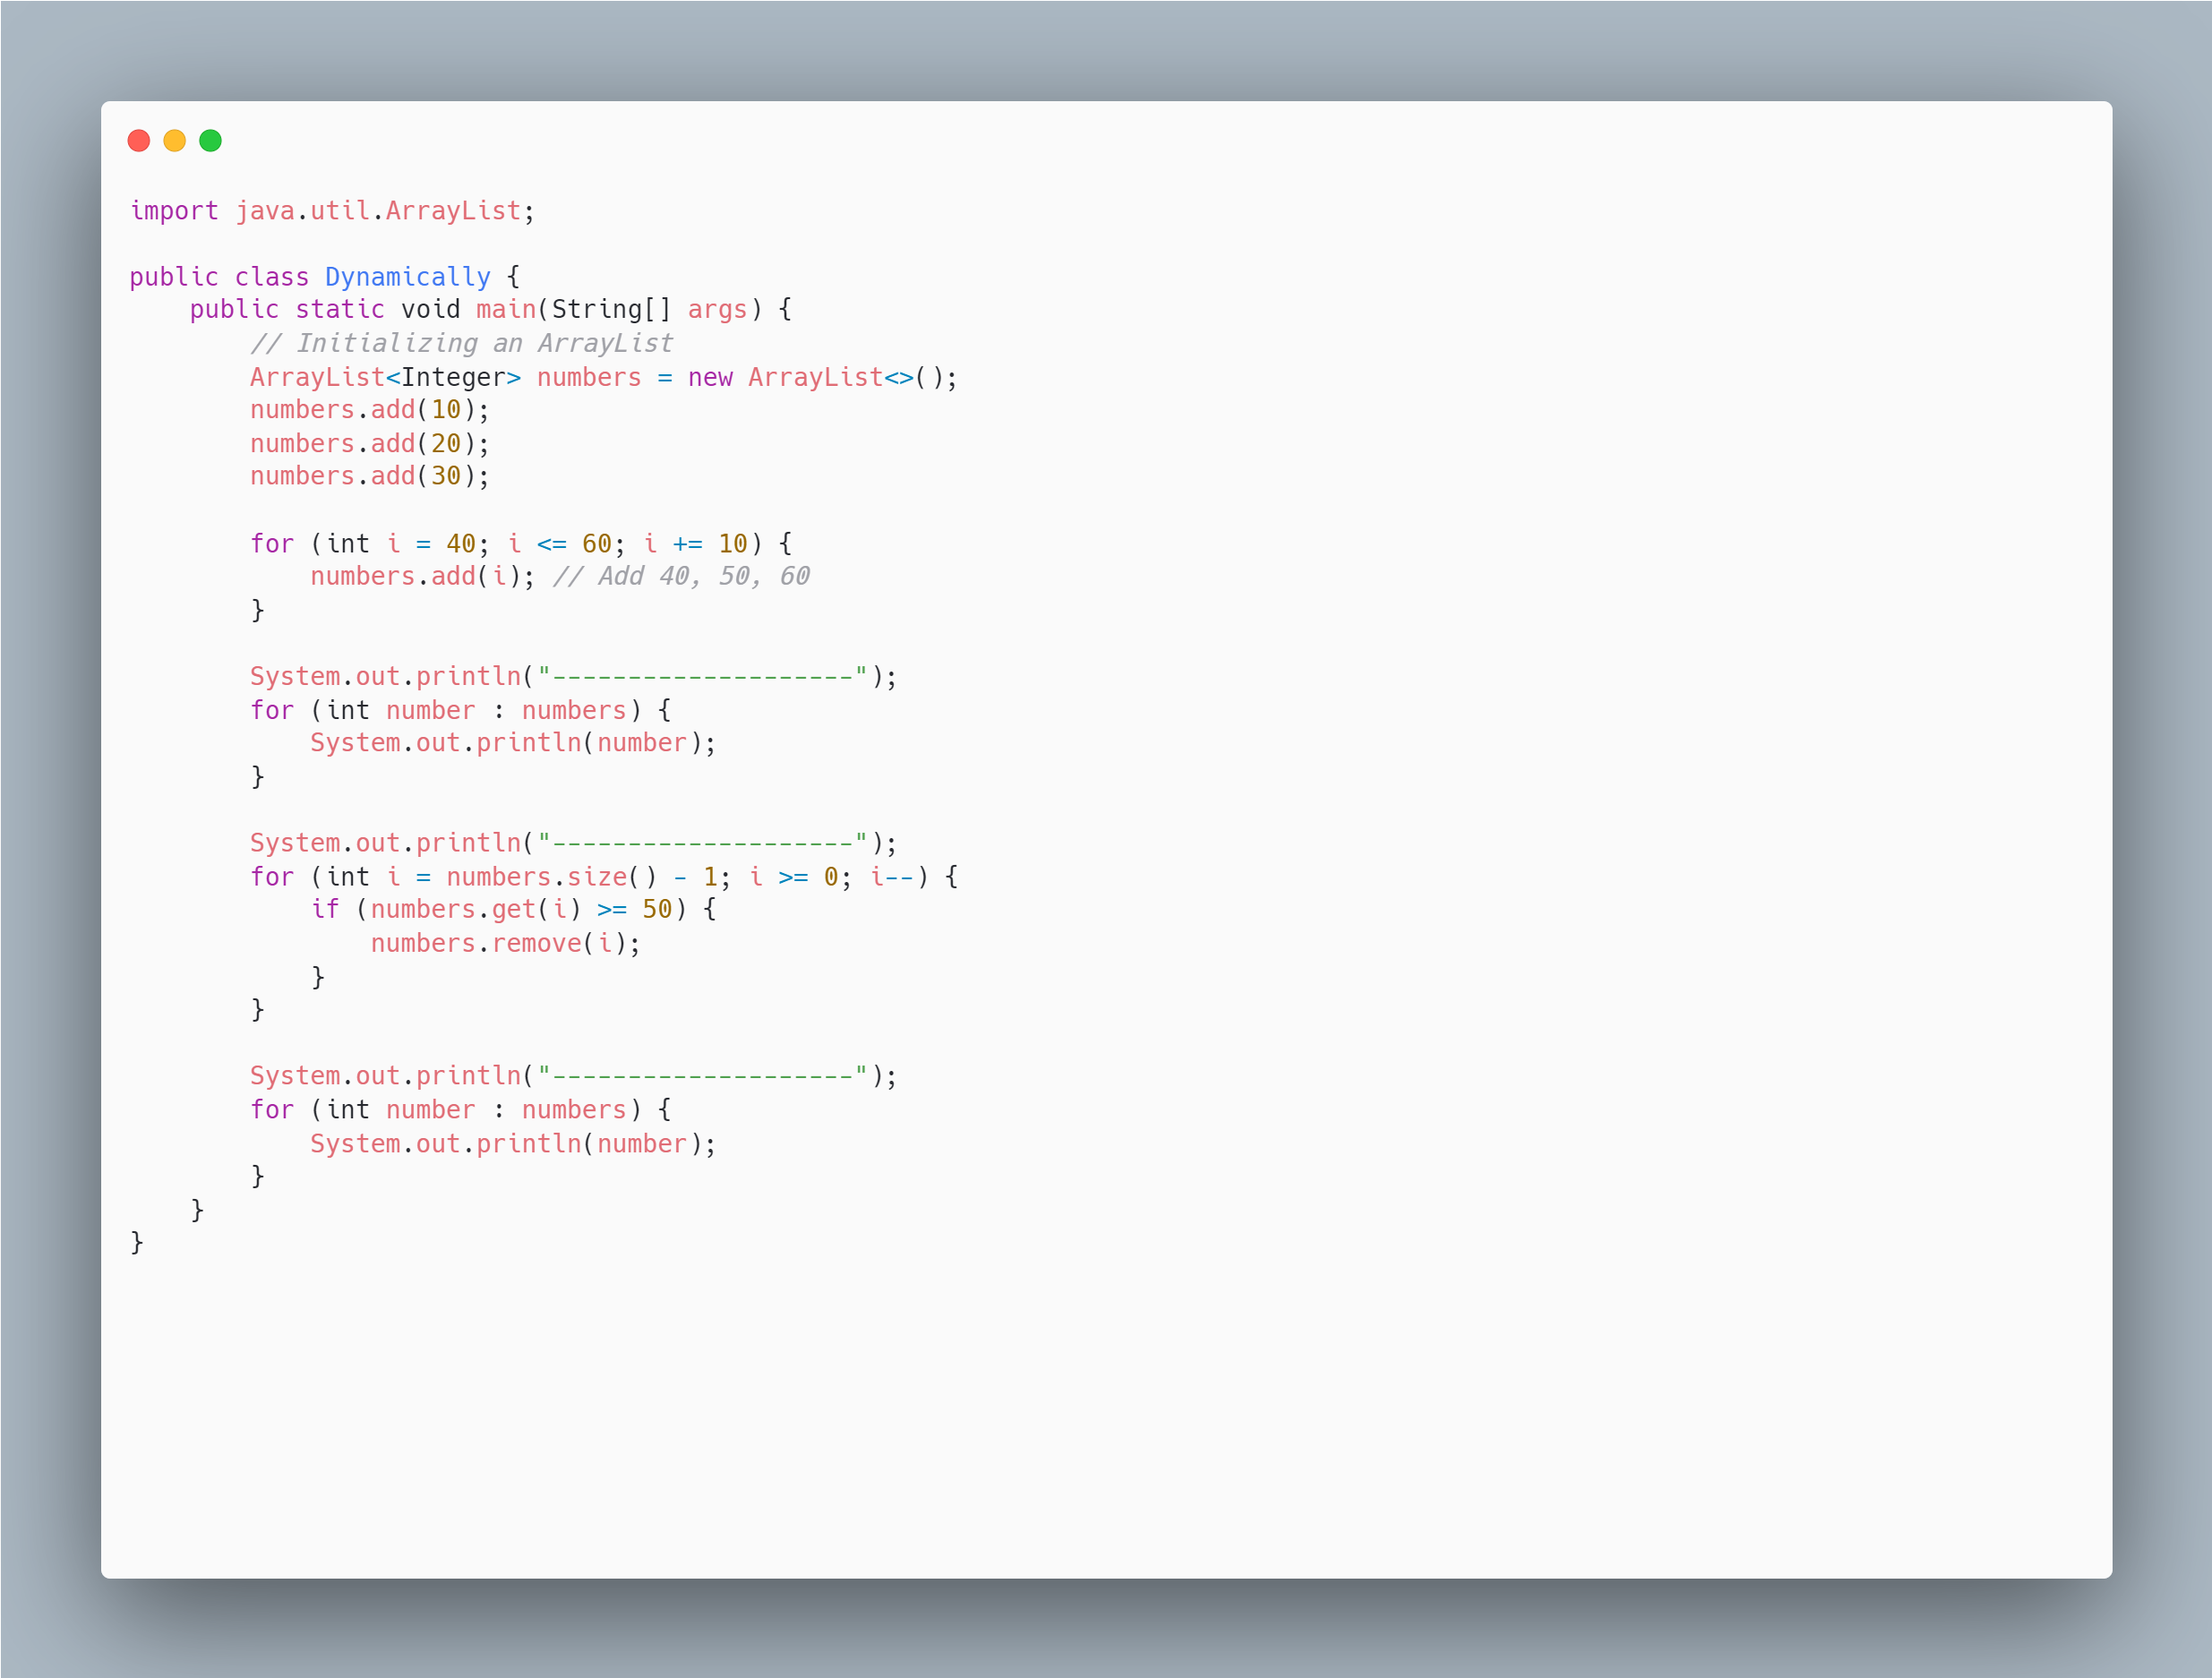
Using ArrayList and Looping

Slide 8
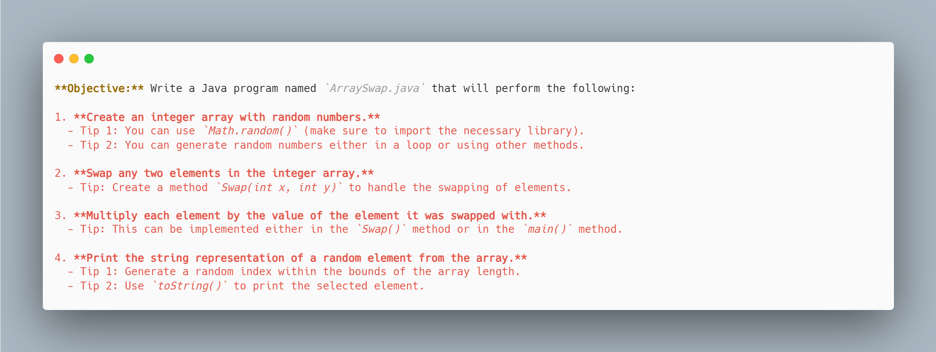
Task: Arrays and Loops - Swap

