Slide 1
First Tutorial
link : https://github.com/kos00pas/ECE318_Documentations/blob/main/Tutorial_0/Tutorial_0.md
First Tutorial
Educational Licence
Jetbrains Toolbox
Download Intellij IDEA Ultimate
Create a project
Setup SDK/JDK
Setup SDK/JDK for the PC
Your First Run
Compile and Intrepreter
Examples
Task:
Further Study:
Your first shortcuts in Intellij IDEA Ultimate

Slide 2
Educational Licence
Open the link and fill out the form using your UCY email address
https://www.jetbrains.com/shop/eform/students

Slide 3
Jetbrains Toolbox
Download the application :
https://www.jetbrains.com/toolbox-app/

Slide 4
Download Intellij IDEA Ultimate
Open JetBrains Toolbox
Find Intellij IDEA Ultimate and click Install
Activate educational licence

Slide 5
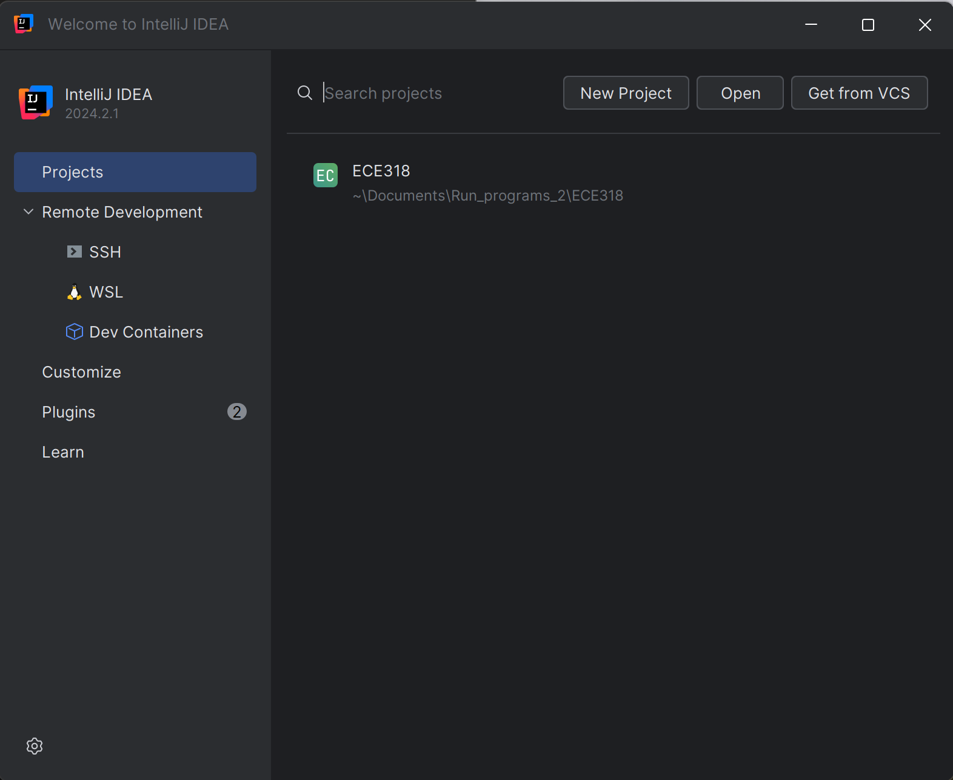
Create a project
Open Intellij IDEA Ultimate
Log in with UCY email
In the window Welcome to Intelij IDEA window select New Project

Slide 6
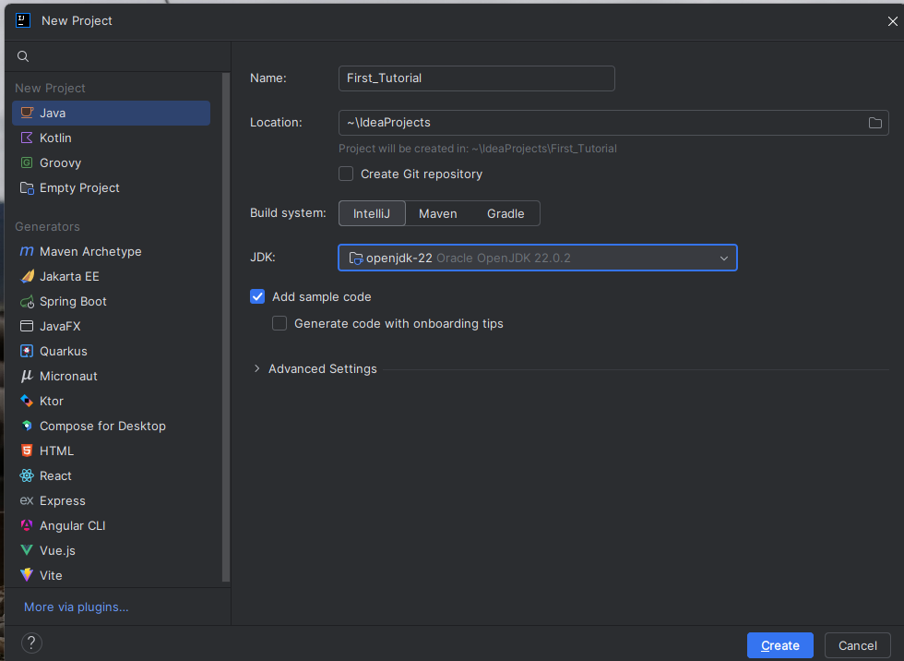
Setup SDK/JDK
The window below will appear:
Name your project , e.g. “First Tutorial”
Select a location for ECE318 projects and the specific project.
Click on the JDK option and select Download JDK
Note : JDK acts as an SDK within IntelliJ.

Slide 7
Setup SDK/JDK for the PC
Open the Environment Variables:
Press Windows key + S and type Environment Variables.
Click Edit the System Environment Variables.
Edit the PATH Variable:
In the System Properties window, click Environment Variables.
Under System variables, locate and select Path, then click Edit.
Click New and add this path: C:\Users\<user_name>\.jdks\openjdk-22.0.2\bin
Click OK to save and close all windows.
Verify the Setup:
Open a new PowerShell or Command Prompt and run: javac -version

Slide 8
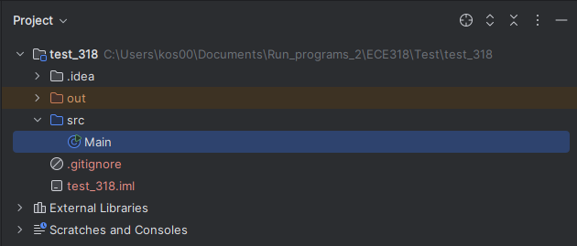
Your First Run
This is the structure of a project
Click the green button to run the code:

Slide 9
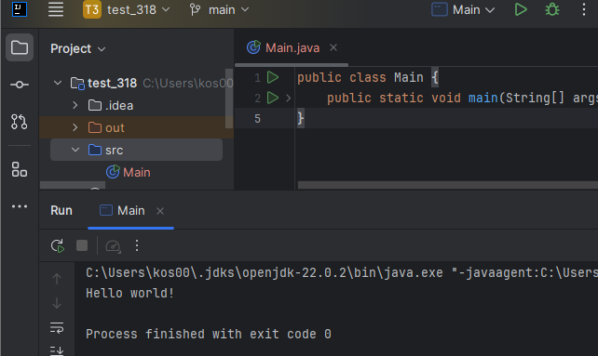

Slide 10
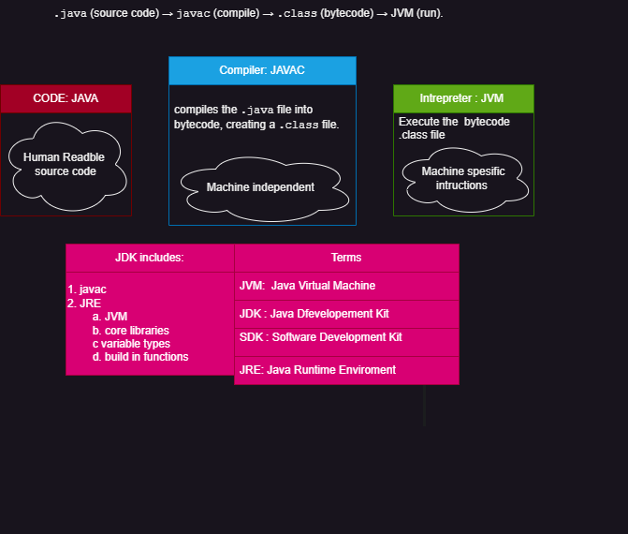
Compile and Intrepreter

Slide 11
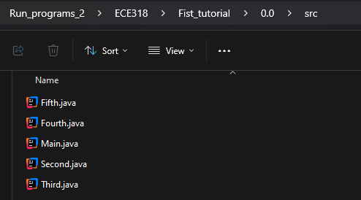
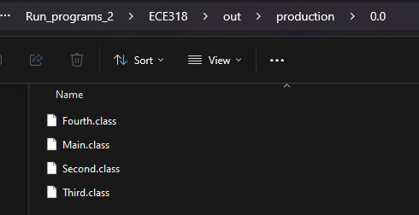

Slide 12
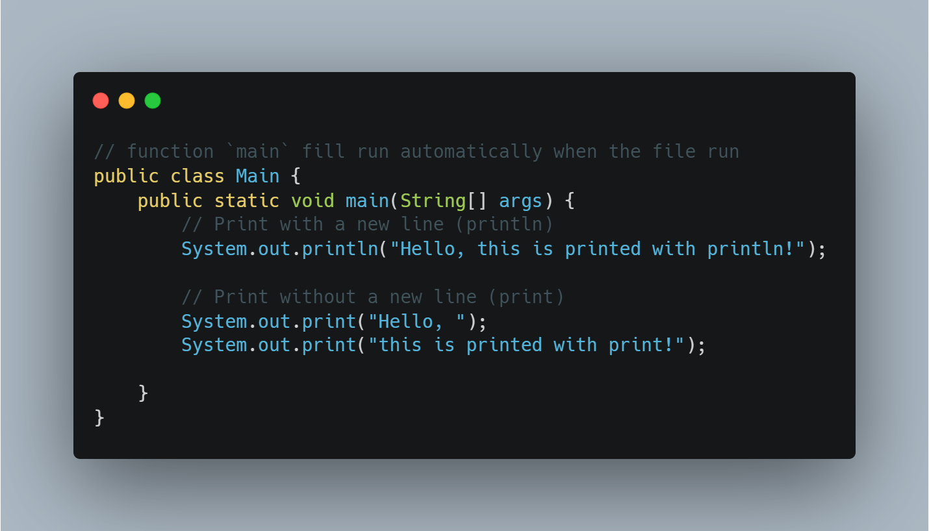
Examples

Slide 13
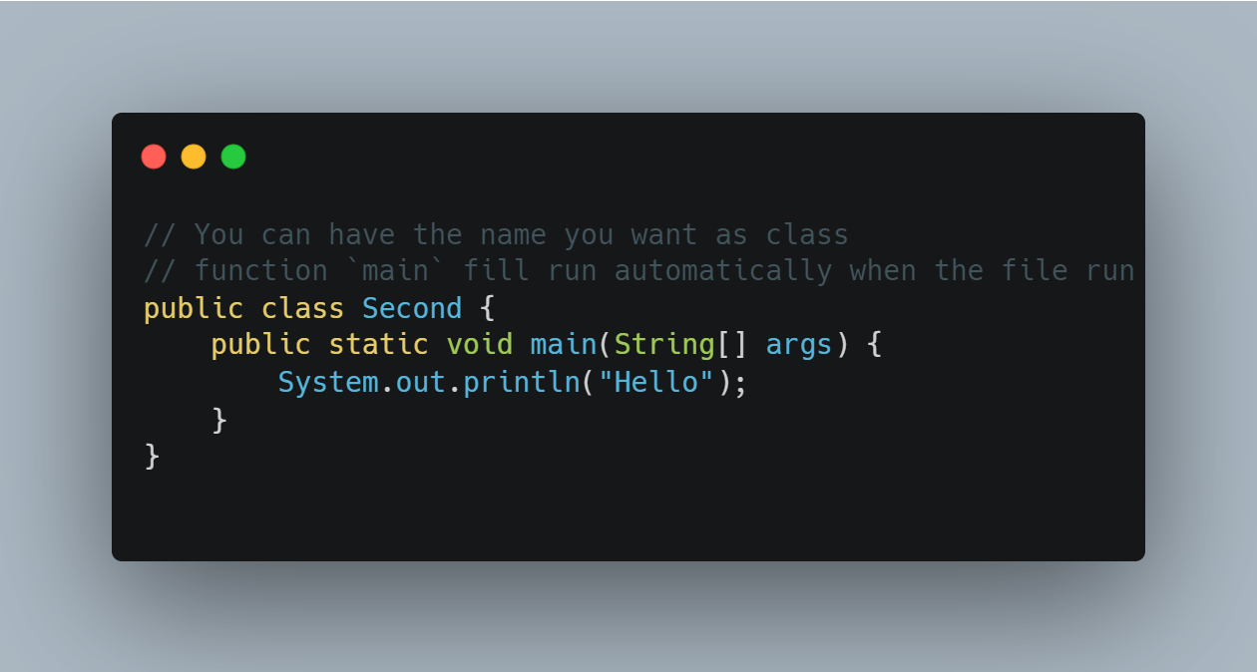

Slide 14
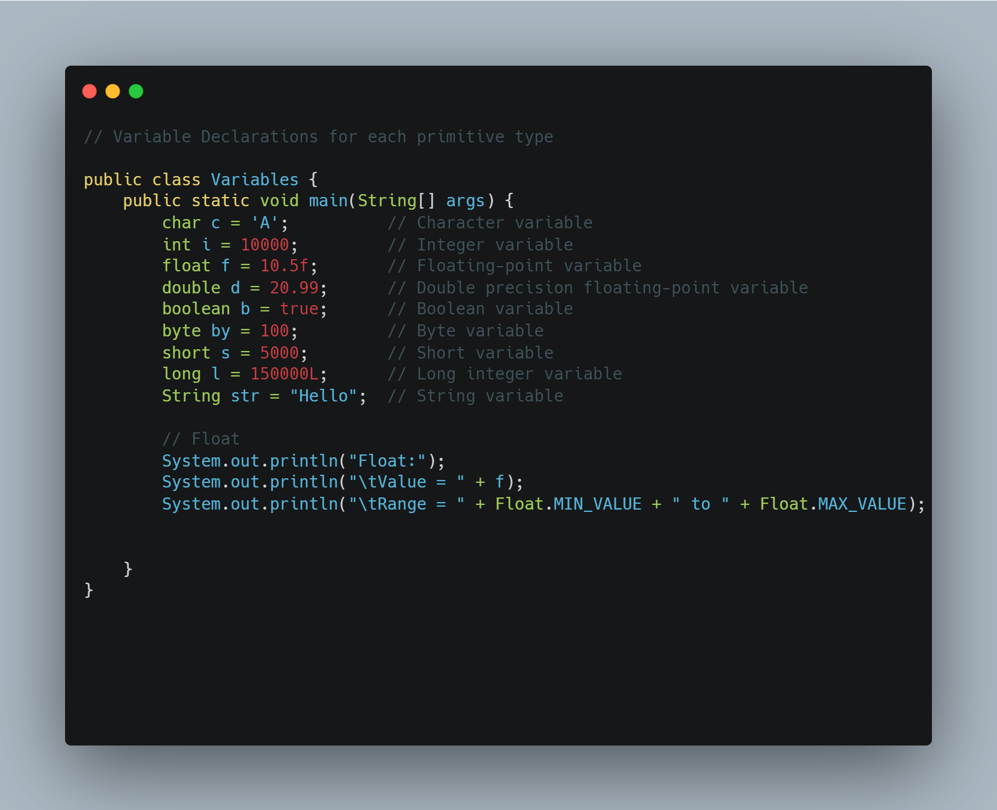

Slide 15
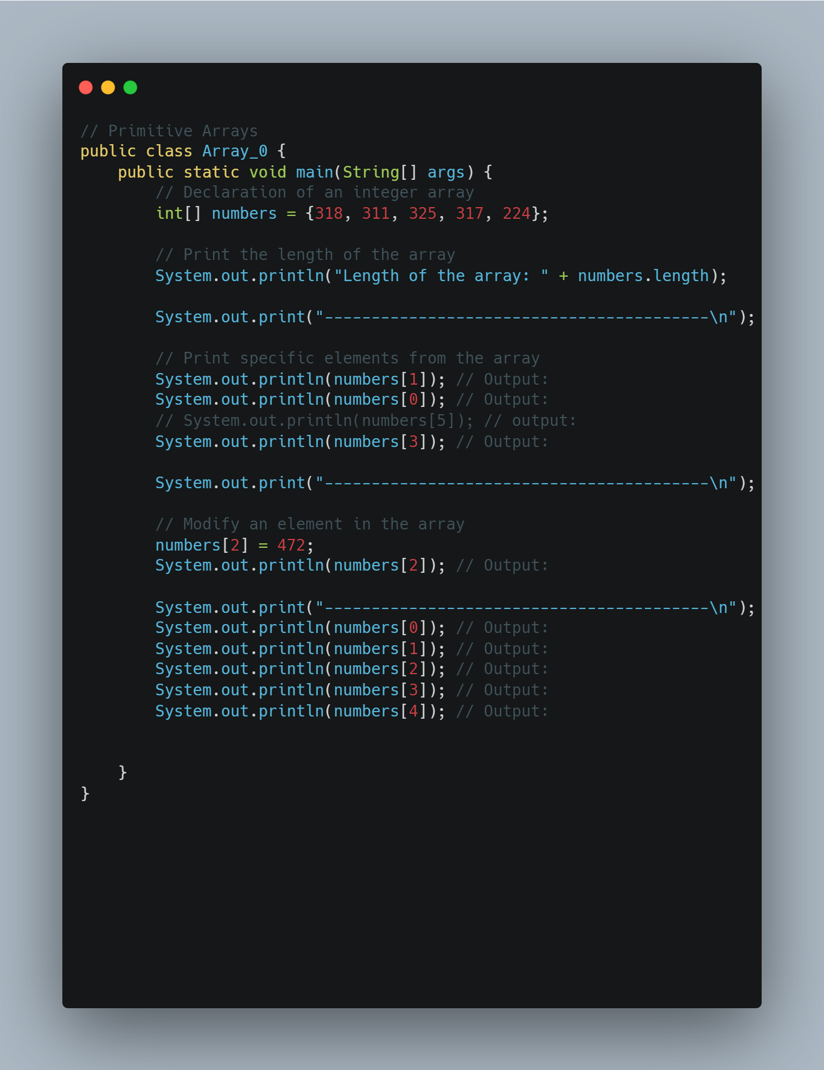

Slide 16
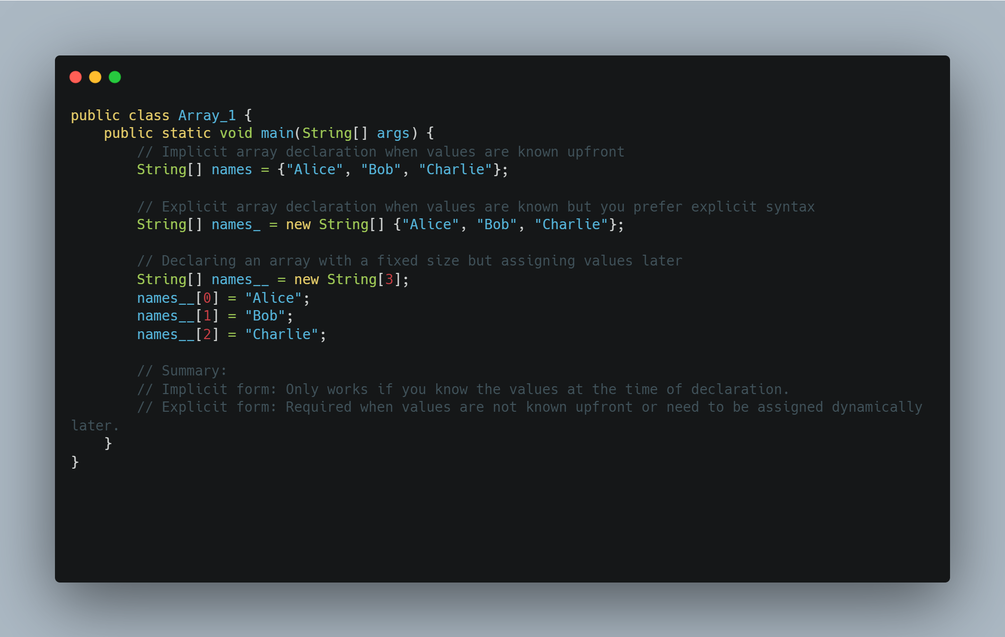

Slide 17
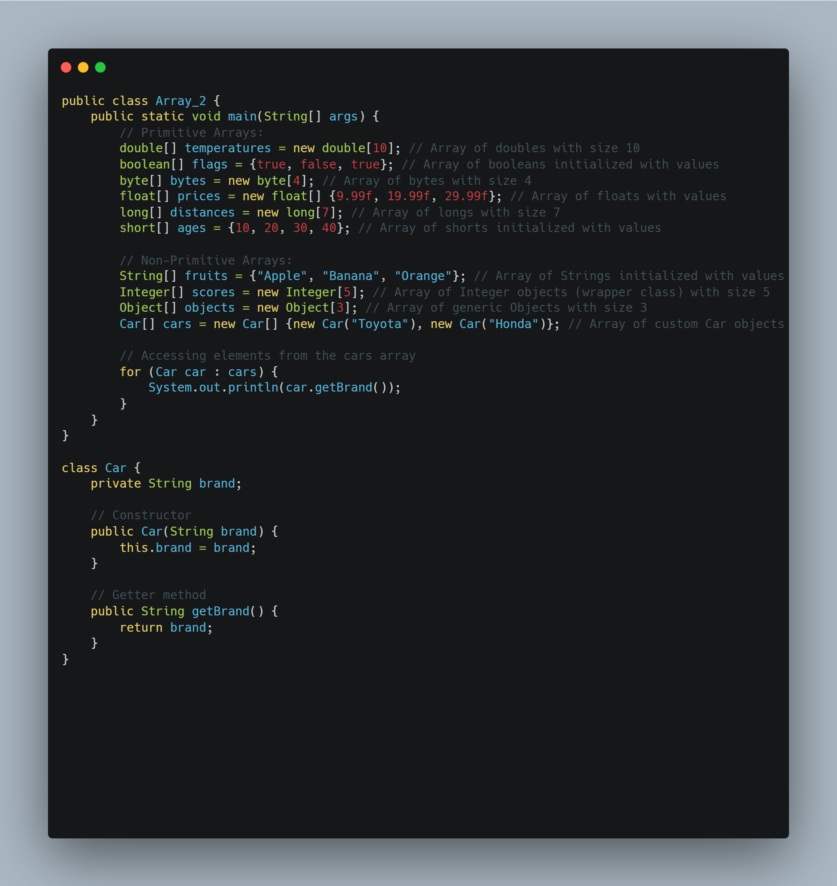

Slide 18
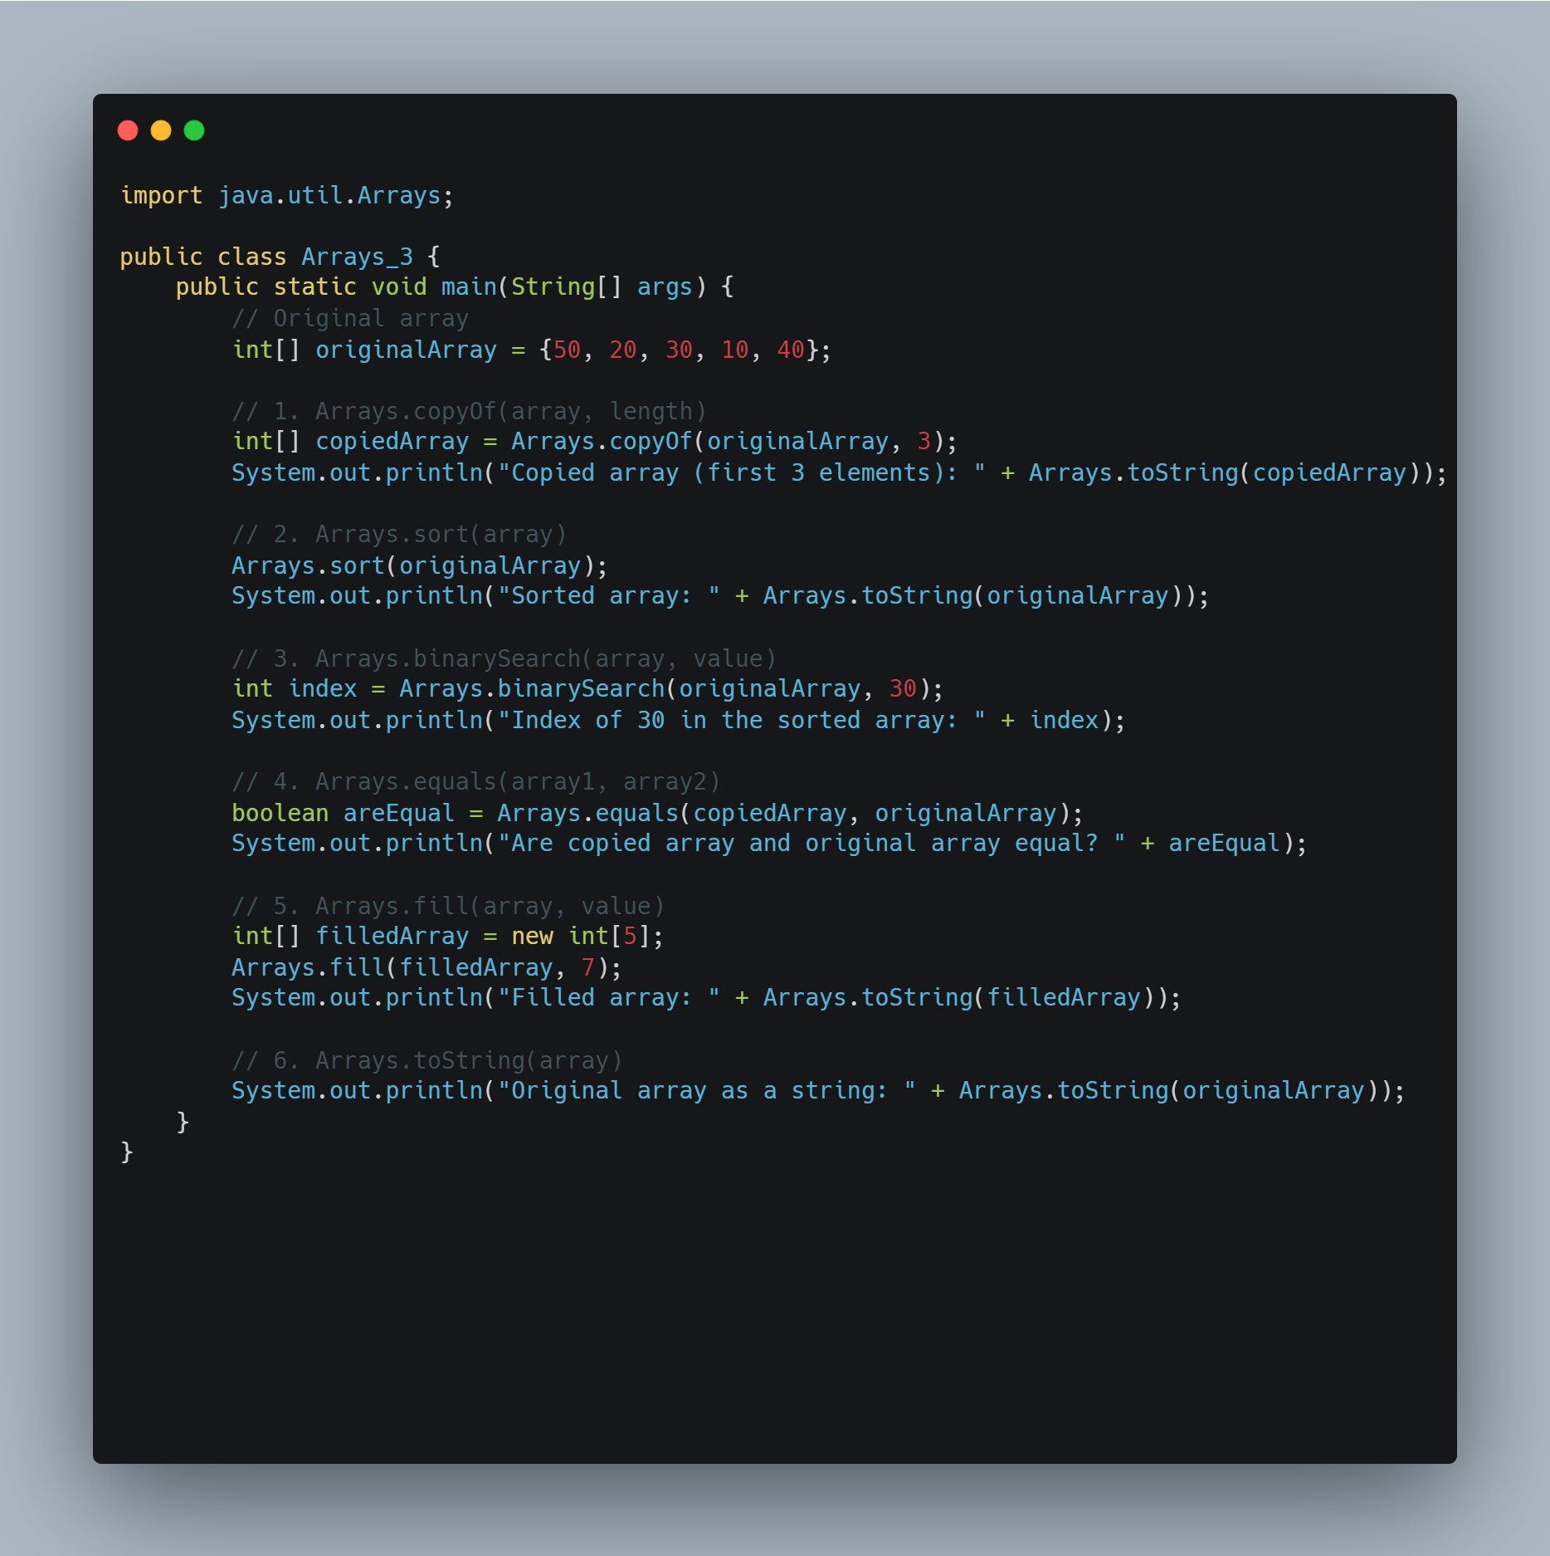

Slide 19
Task:
Run the above and interact with the outputs.
Create a program with the name MyRecord.java that will print your information.
The program should print out the following information using System.out.println();:
Name and Surname (e.g., Angelos Marnerides)
Date of birth (e.g., 01/05/1980)
Town (e.g., Larnaca)
Sex (e.g., M or F)
Course codes taken for this semester (e.g., ECE318, ECE311)
You should store the corresponding information in arrays and then printing the array(s).

Slide 20
Further Study:
variables : - https://docs.oracle.com/javase/tutorial/java/nutsandbolts/datatypes.html
Arrays :
https://docs.oracle.com/javase/tutorial/java/nutsandbolts/arrays.html
https://www.geeksforgeeks.org/array-class-in-java/?ref=lbp
java.util:
https://docs.oracle.com/javase/8/docs/api/java/util/package-summary.html

Slide 21
Your first shortcuts in Intellij IDEA Ultimate
Set up mouse wheel for zoom in/out:
File -> project structure
Go to File > Settings -> Editor > General.
Find the section : Mouse Control.
Check the box Change font size (Zoom) with Ctrl+Mouse Wheel.
Click Apply and then OK.
Comments
//
Ctrl + / -> comment a line or multiple
Ctrl + Shift + / -> comment with */
Add ‘;’ in the end of a line:
Ctrl+ Shift + Enter
Close and open Project Window
Open : Alt + 1
Close: Shift + Esc
Run code
Ctrl+Shift+ f10 -> run current code
Fn+ Shift + f10 -> Run the last run code

