Slide 1

Seminar 1. Basic Interaction with Java
ECE 318 Programming Principles for Engineers
Prof. Angelos Marnerides
Mr. Kostas Pashiourtides

Slide 2
Seminar overview - guide
This practical guide aims to help you understand the basics of Java and get some exposure to simple use of arrays and basic print statements.
Before proceeding and doing something in practice:
Go through all the slides in Topic 1 and then the first 10 slides in Topic 2_1
Ensure that you go through the guides provided in the next slide
For the Wednesday seminar:
Try the drills on your own device and your own pace – use the seminar to ask the TA for any issues – feel free to try the drills during the seminar

Slide 3
Useful
Useful and vital
IntelliJ and the Java environment installation guide: https://www.jetbrains.com/help/idea/installation-guide.html
Useful and optional
How to navigate the MS DOS filesystem on your Windows machine / simple operations: https://blogs.umass.edu/Techbytes/2014/11/14/file-navigation-with-windows-command-prompt/
How to navigate your MacOS terminal: https://tutorials.codebar.io/command-line/introduction/tutorial.html
How to navigate your GNU/Linux terminal: https://ubuntu.com/tutorials/command-line-for-beginners#1-overview

Slide 4


IntelliJ and Debugging

Slide 5

JAVA Development Kit
Java Runtime Environment (JRE)
Includes the code behind all variable types and built-in functions (e.g. println)
Also includes the Java Virtual Machine (JVM) which allows Java code to run on any platform!
A Java Compiler (javac)
A compiler that translates java code into code that a computer can execute

Slide 6

Verify that you have the JAVA compiler
Change directory to the sdk folder:
cd C:\Program Files\Java\jdk1.8.0_161\bin
run the compiler with argument -version to find the version:
javac -version

Slide 7
Some useful terminal/cmd commands
Change directory/folder: cd
Example: “cd C:\” - changes our current terminal to the directory C:\
List contents of a directory: ls (for unix), dir (for windows)
Example: “ls C:\” - lists/prints all the files and folders in the directory C:\

Slide 8
Anatomy of a Java program
Documentation Section (vital – for good practice)
Package Declaration (optional)
Import Statements (vital)
Interface Section (optional)
Class Definition (vital)
Class Variables and Constants (vital)
Main method Class (vital)
Methods & Behaviours (vital)

Slide 9
Example of a program
Open the MyCalculator.java file (provided in the Labs folder in the Teams channel Folder Seminars/Seminar1-2/) in Notepad or a text editor (ideally not MS word!) and navigate through the code and the comments – identify the structure of the code.
After that, discuss with your tutor if questions rise.
Proceed to the next step!

Slide 10
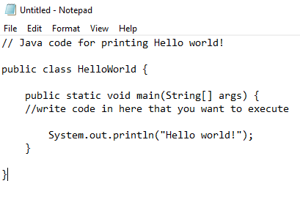
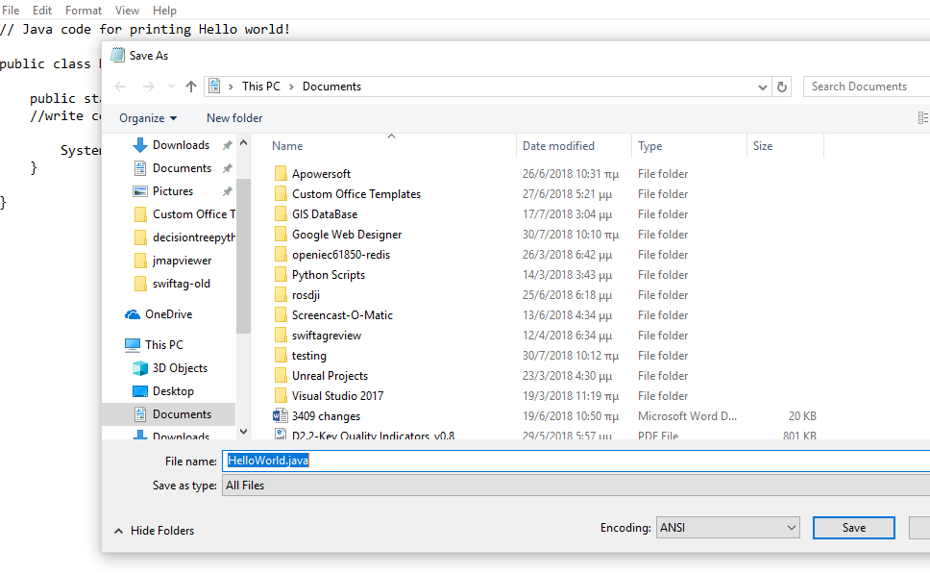

Hello JAVA
// Java code for printing Hello world! public class HelloWorld { public static void main(String[] args) { //write code in here that you want to execute System.out.println("Hello world!"); } }
The name of the class should be the same with the name of the FILE !!

Slide 11
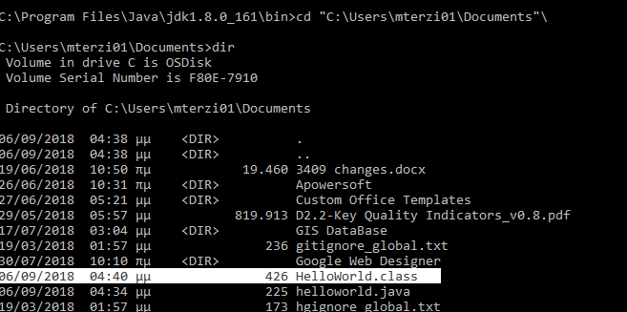
Compiling
To compile use javac <complete path to file.java>
\
If the compiling was successful, a file.class will be created

Slide 12
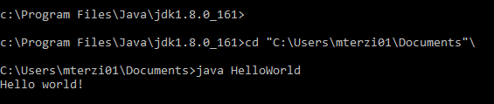
Running
cd to the directory where you saved the HelloWorld.java file
To run the program:
java HelloWorld

Slide 13

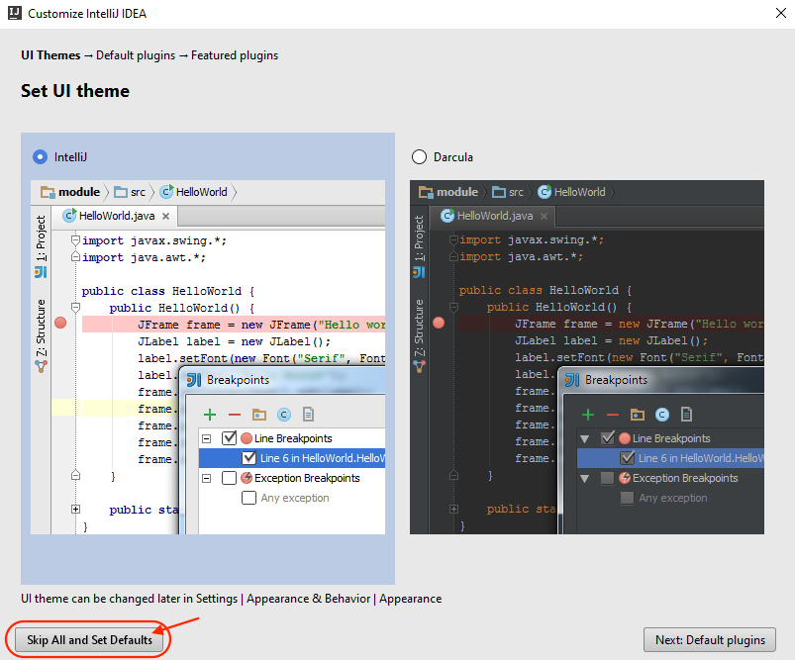
IntelliJ IDEA
Developed by
first version released in January 2001
Available for Windows, macOS, Linux
https://www.jetbrains.com/idea/documentation/

Slide 14
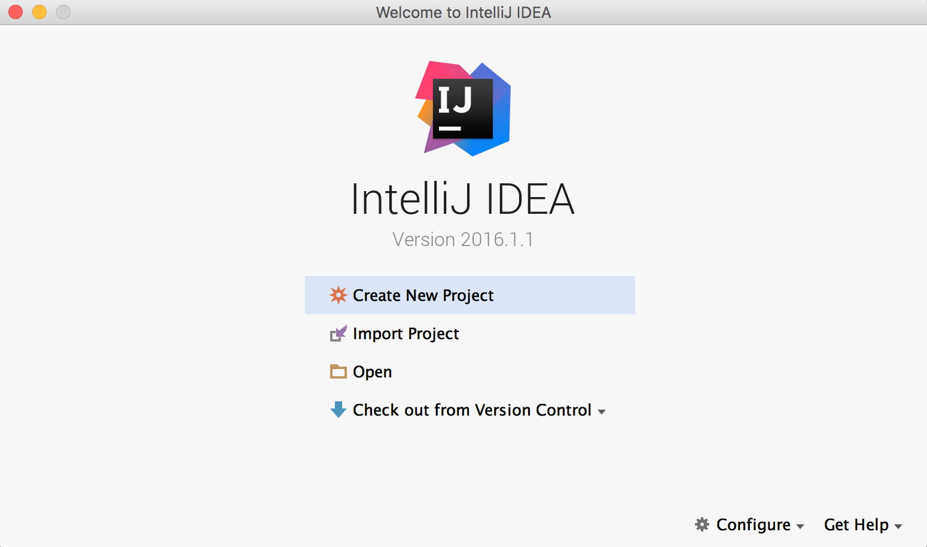
“Hello World” with IntelliJ IDEA
Create a new project

Slide 15
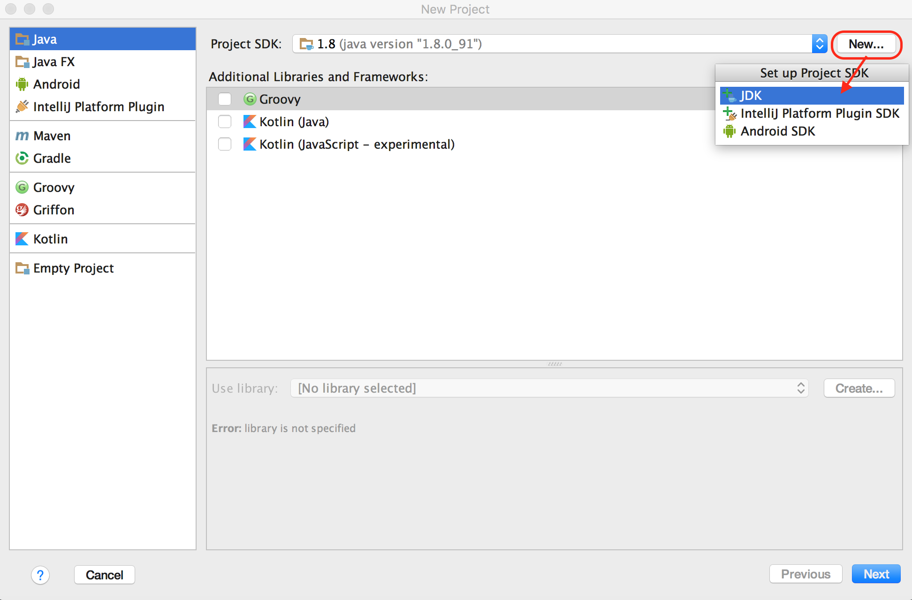
Select the Java SDK
The sdk is at
C:/ProgramFiles/Java/
choose jdk 1.8

Slide 16
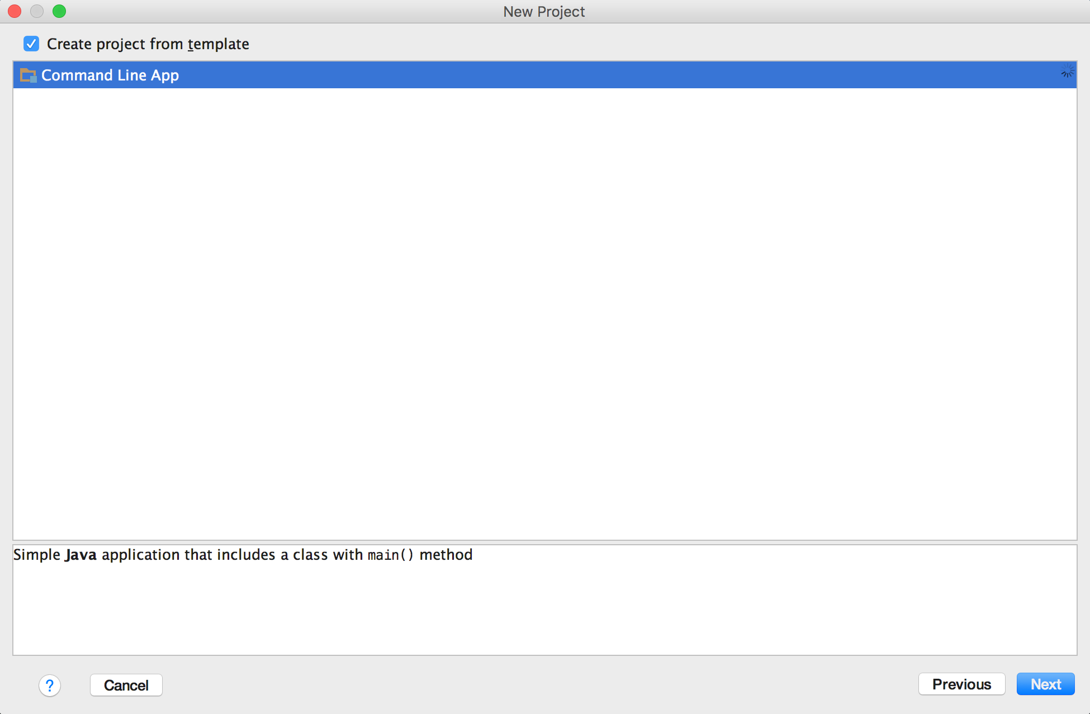
Select Command Line App Template

Slide 17
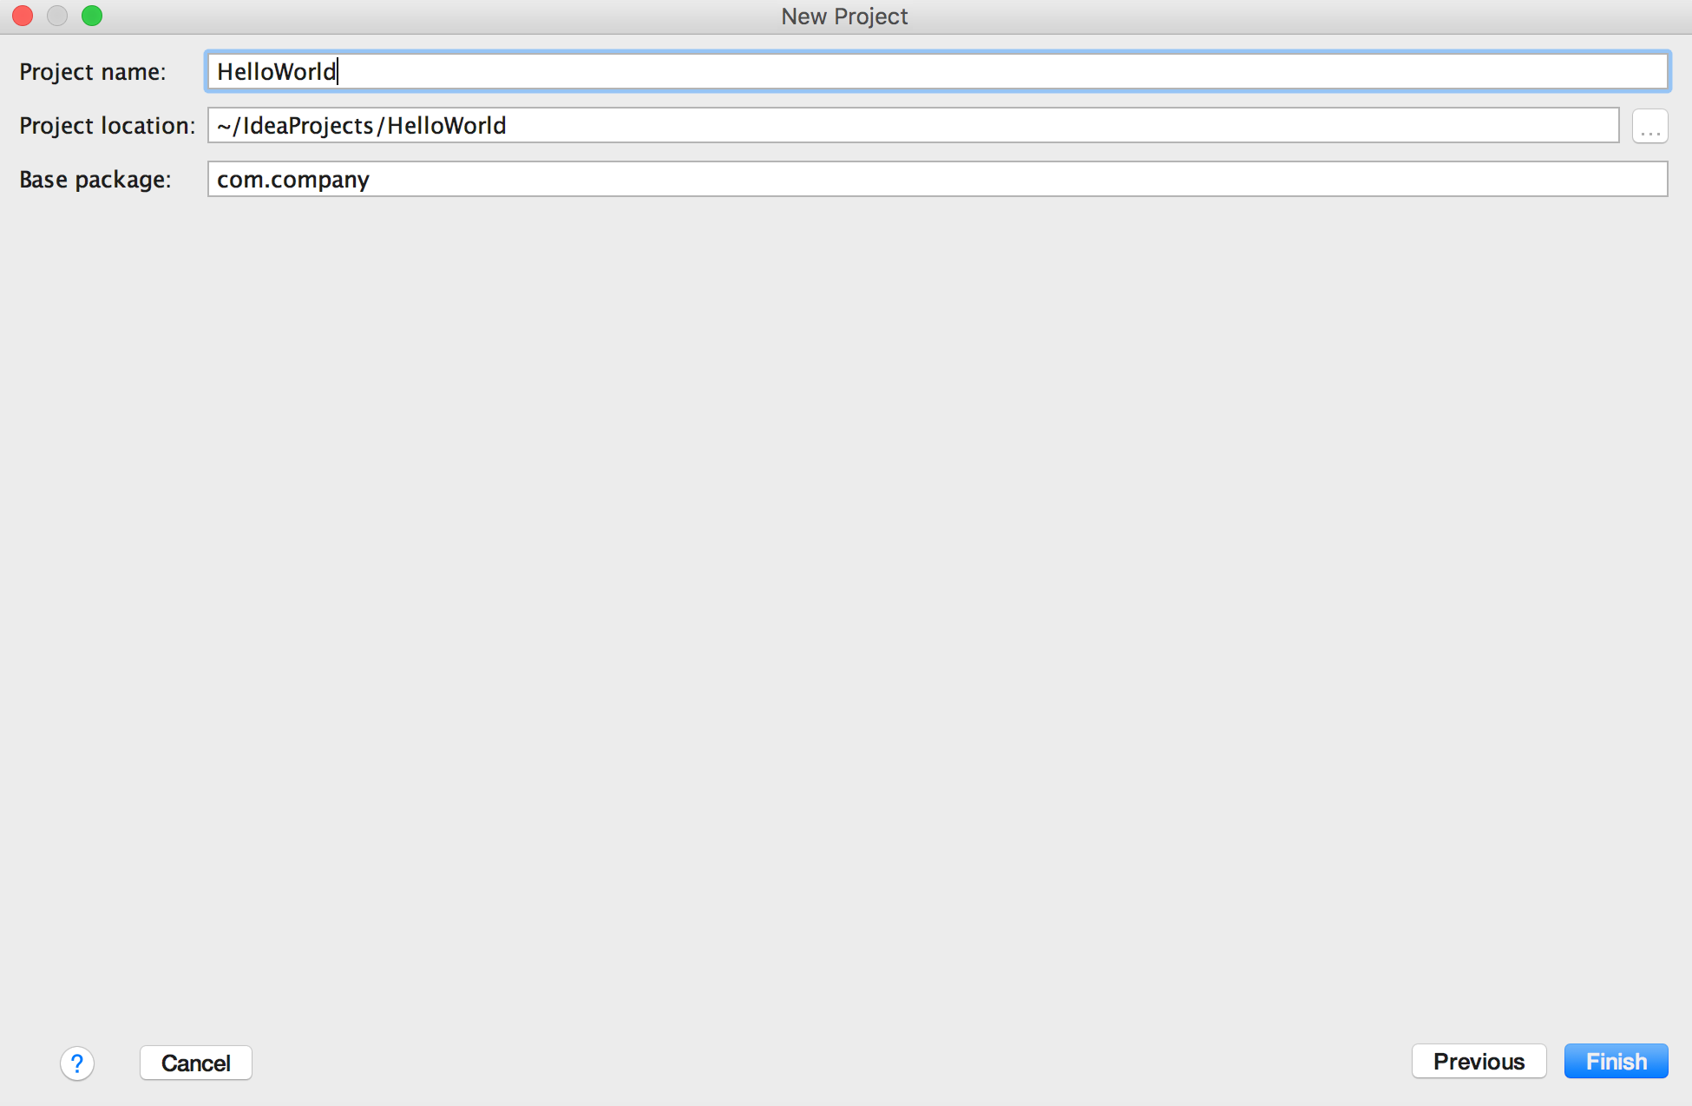
Name Your Project

Slide 18
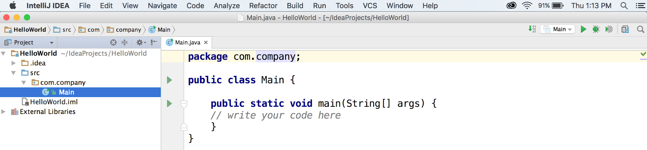
The IntelliJ Environment
The package
The actual code
The project structure

Slide 19
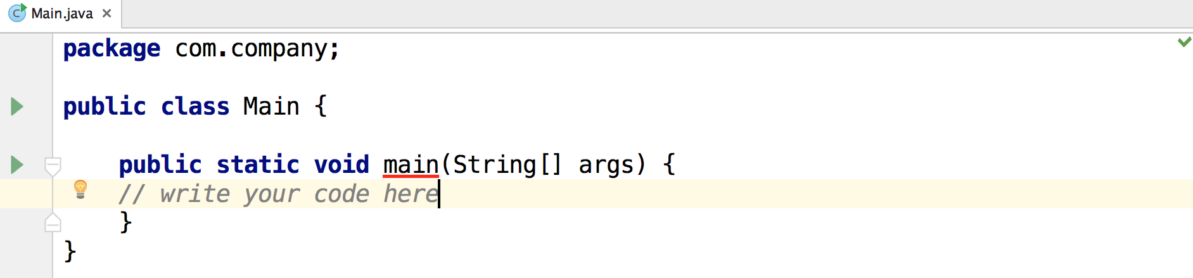
Main class, main function
Notes:
whenever you write a program, your computer needs to know where to start running your code, and by default it will always start at this main function.So inside this function is where you’ll place all the lines of code you want to execute, like println’s or function calls.

Slide 20
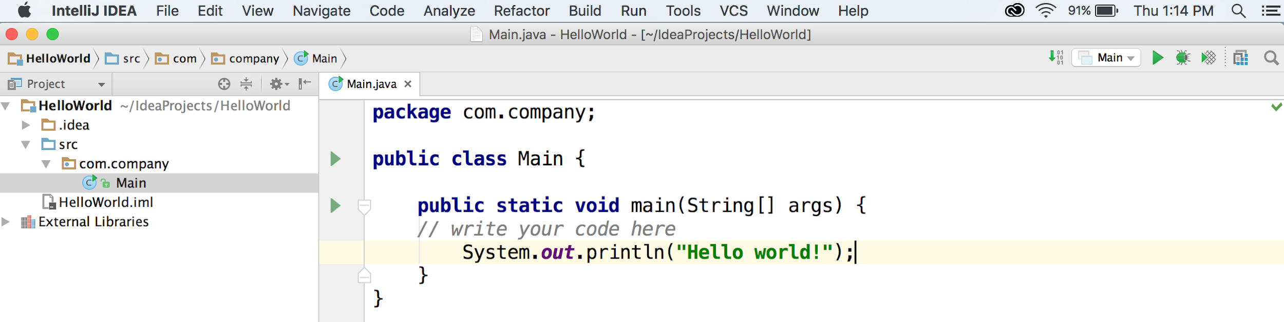
Hello World!
And once you write new code, it's always good practice to save it (File > Save or cmd/ctrl + s).

Slide 21
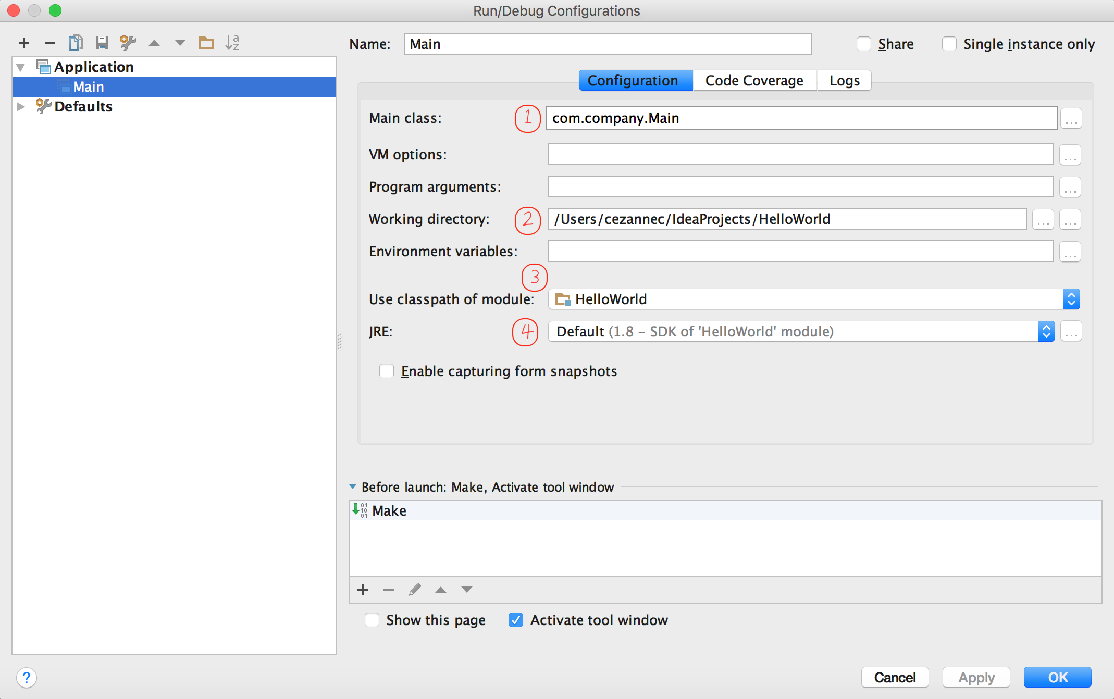
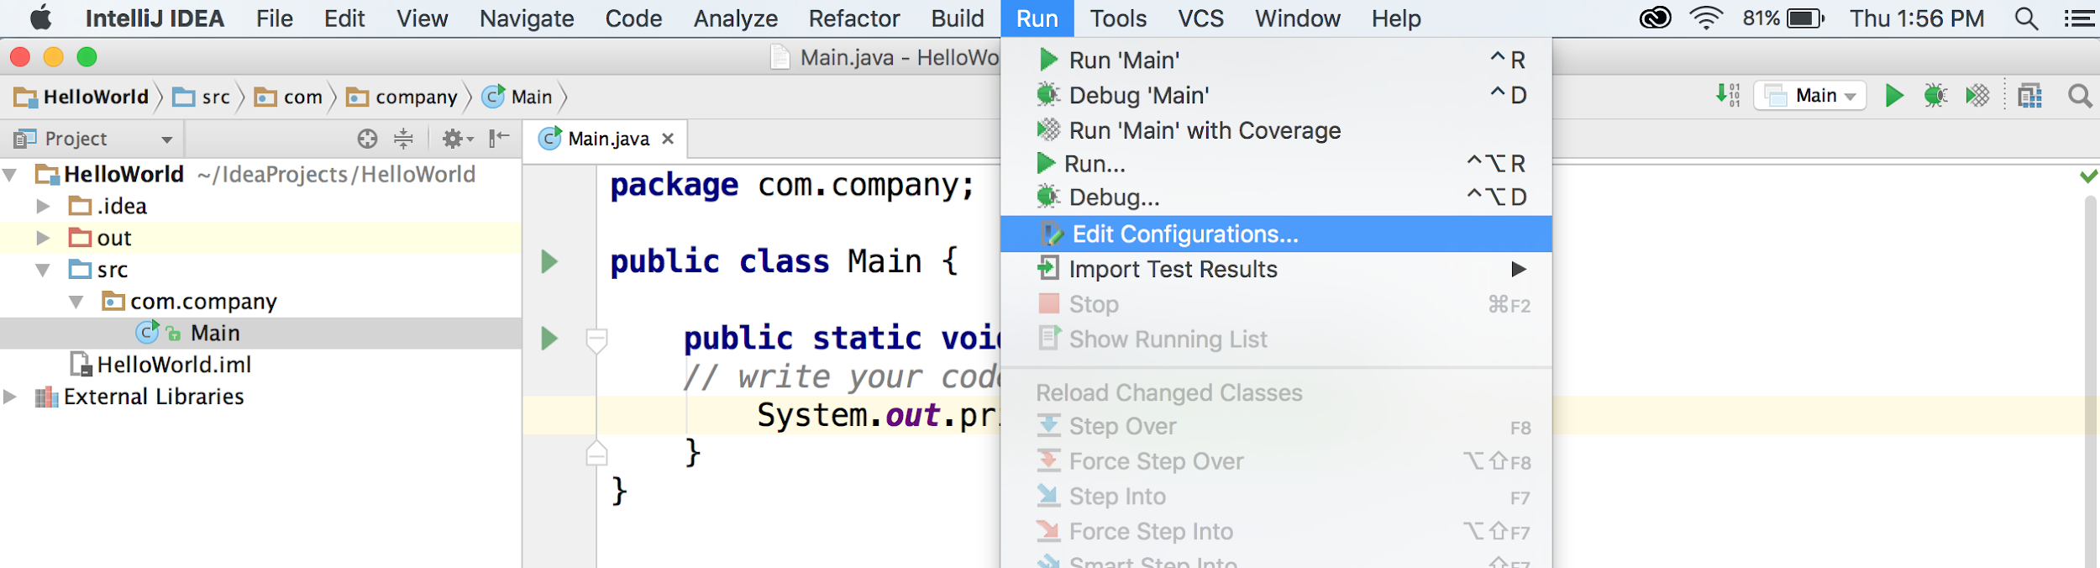
Edit Configurations
Notes:
First is the name of the Main class that you want to run. Second is the working directory, which is where you are saving this project. Third is the classpath of your module, which should have your project folder selected (the folder named Hello World). And fourth is the version of the Java Runtime Environment that you’re running, which should be version 8 that you’ve downloaded.

Slide 22
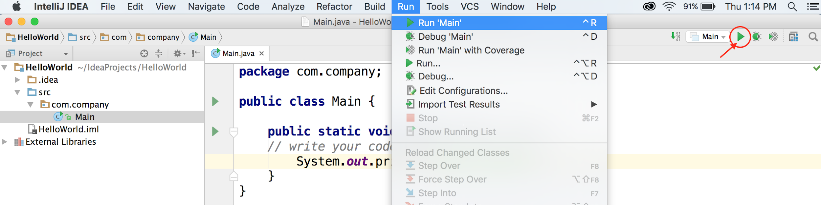
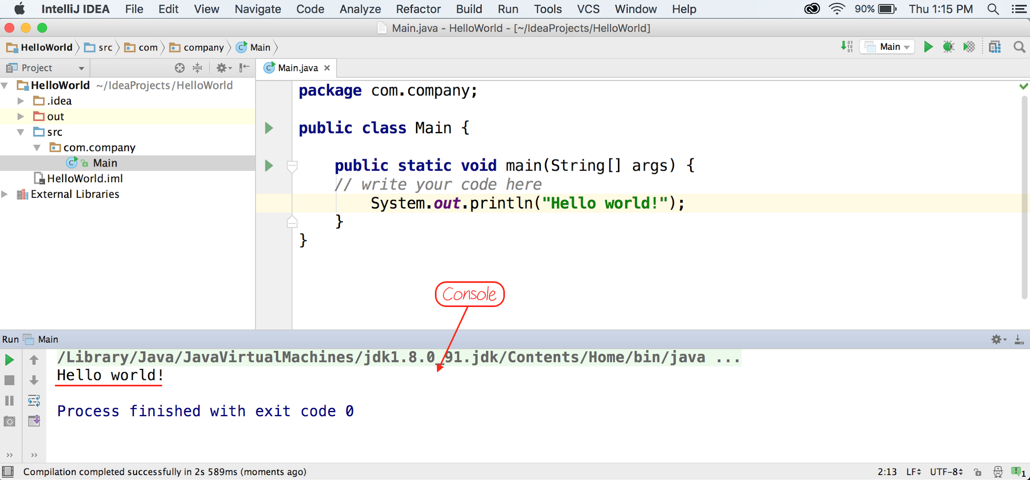
Run!

Slide 23
Task:
Run the MyCalculator.java and interact with the output.
Create a program with the name MyRecord.java that will print your information.
Should print out using System.out.prinln(); :
Name and Surname next to each other (i.e., Angelos Marnerides)
Date of birth (i.e., 01/05/1980)
Town (e.g., Larnaca)
Sex (e.g., M or F)
Course codes taken for this semester next to each other (e.g., ECE318, ECE311)
Tip: you should consider the corresponding information to be stored in within an array(s) and then printing the array (s).

