Slide 1
Tutorial 4
Class declaration
Package & Module
Composition
Inheritance
Interface
Access Modifiers

Slide 2
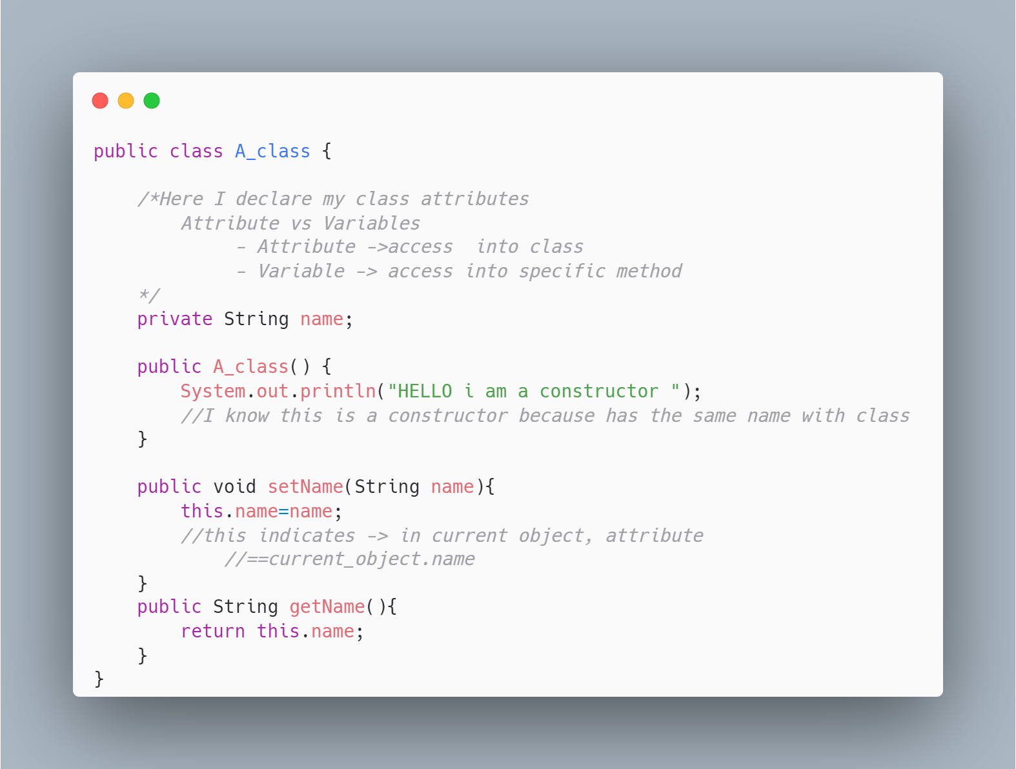
Class declaration

Slide 3
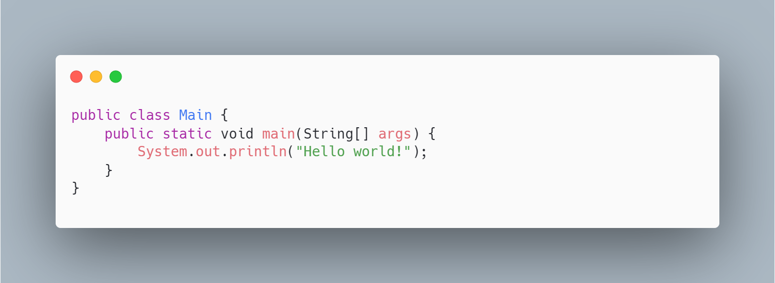
Where I run main ?
Compiler is searching for main method
Preferable :
to have a Main.java with the psvm function
** psvm == public static void main()
Tip: You can also include other methods there

Slide 4
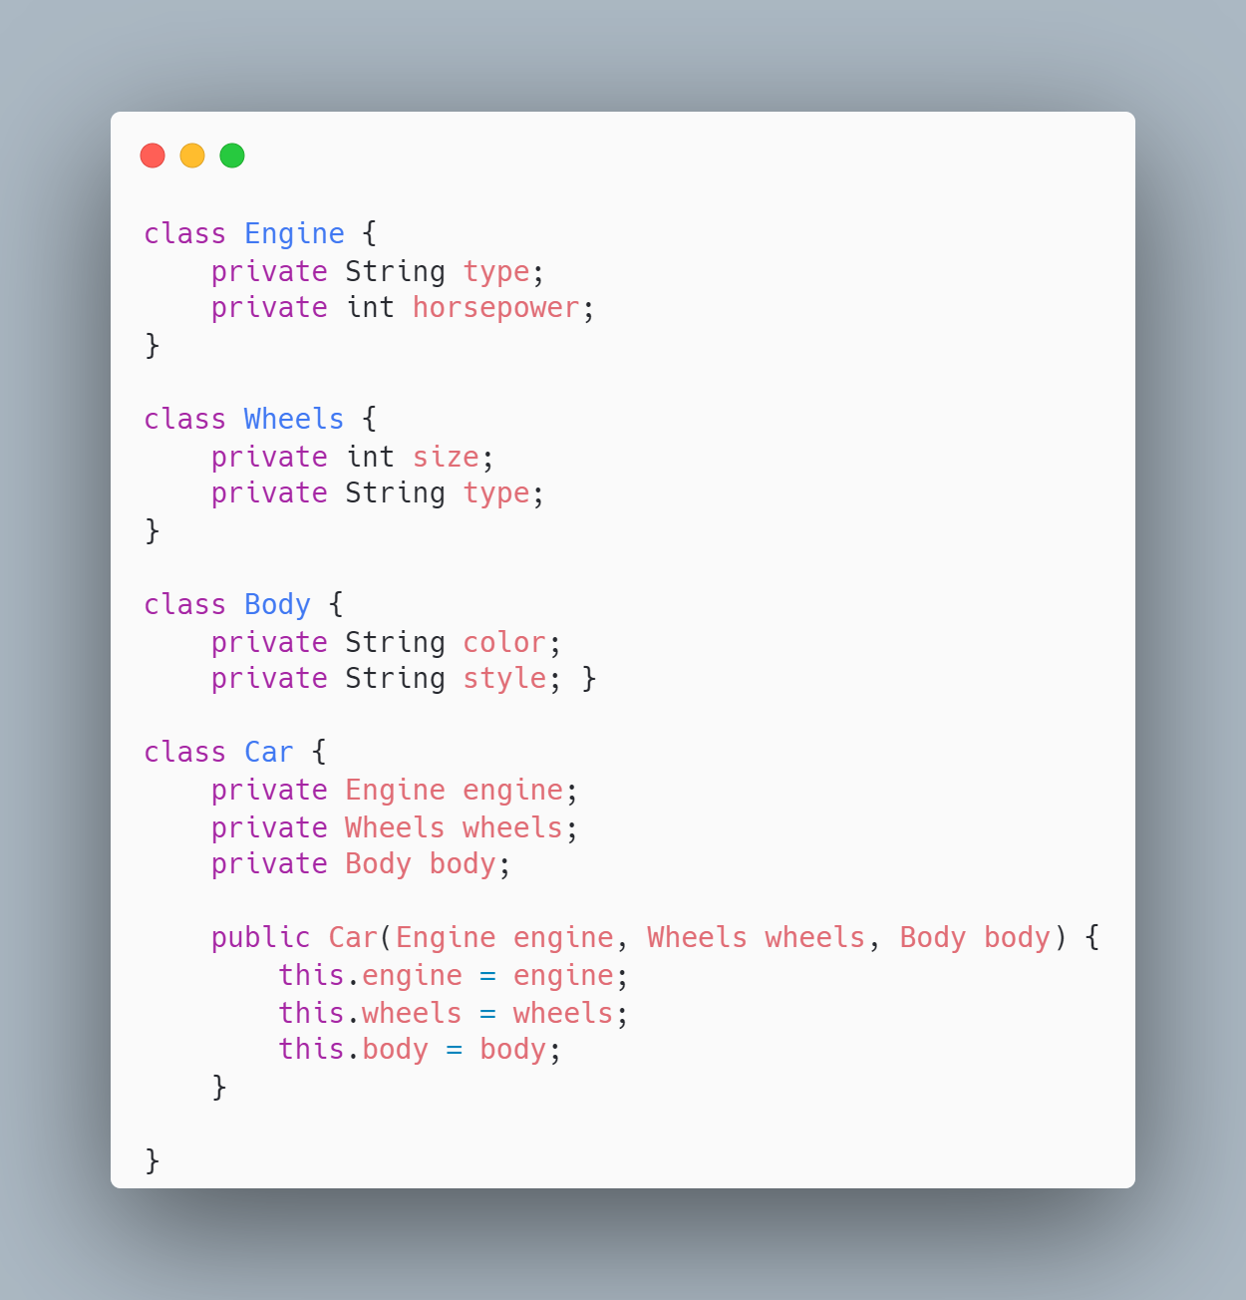
Can i class have as attribute another class?
Called : Composition

Slide 5
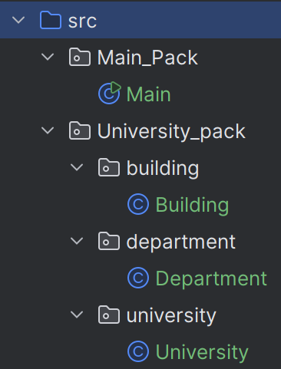
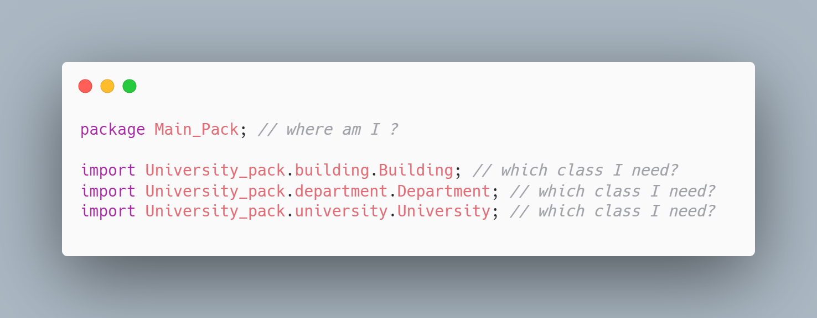
Packages and modules
if I have this structure and this beginning of a .java:
where am I ?

Slide 6
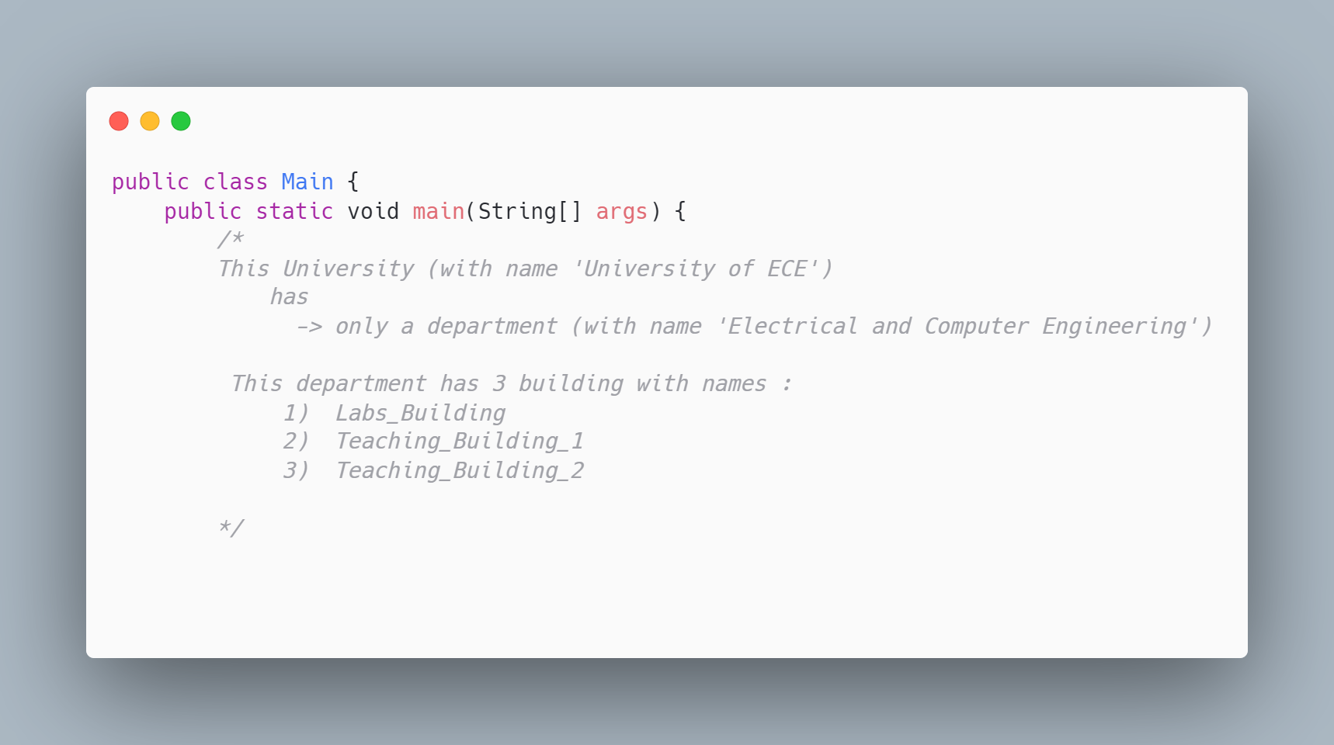
Example of Composition
University , Department and Buildings

Slide 7
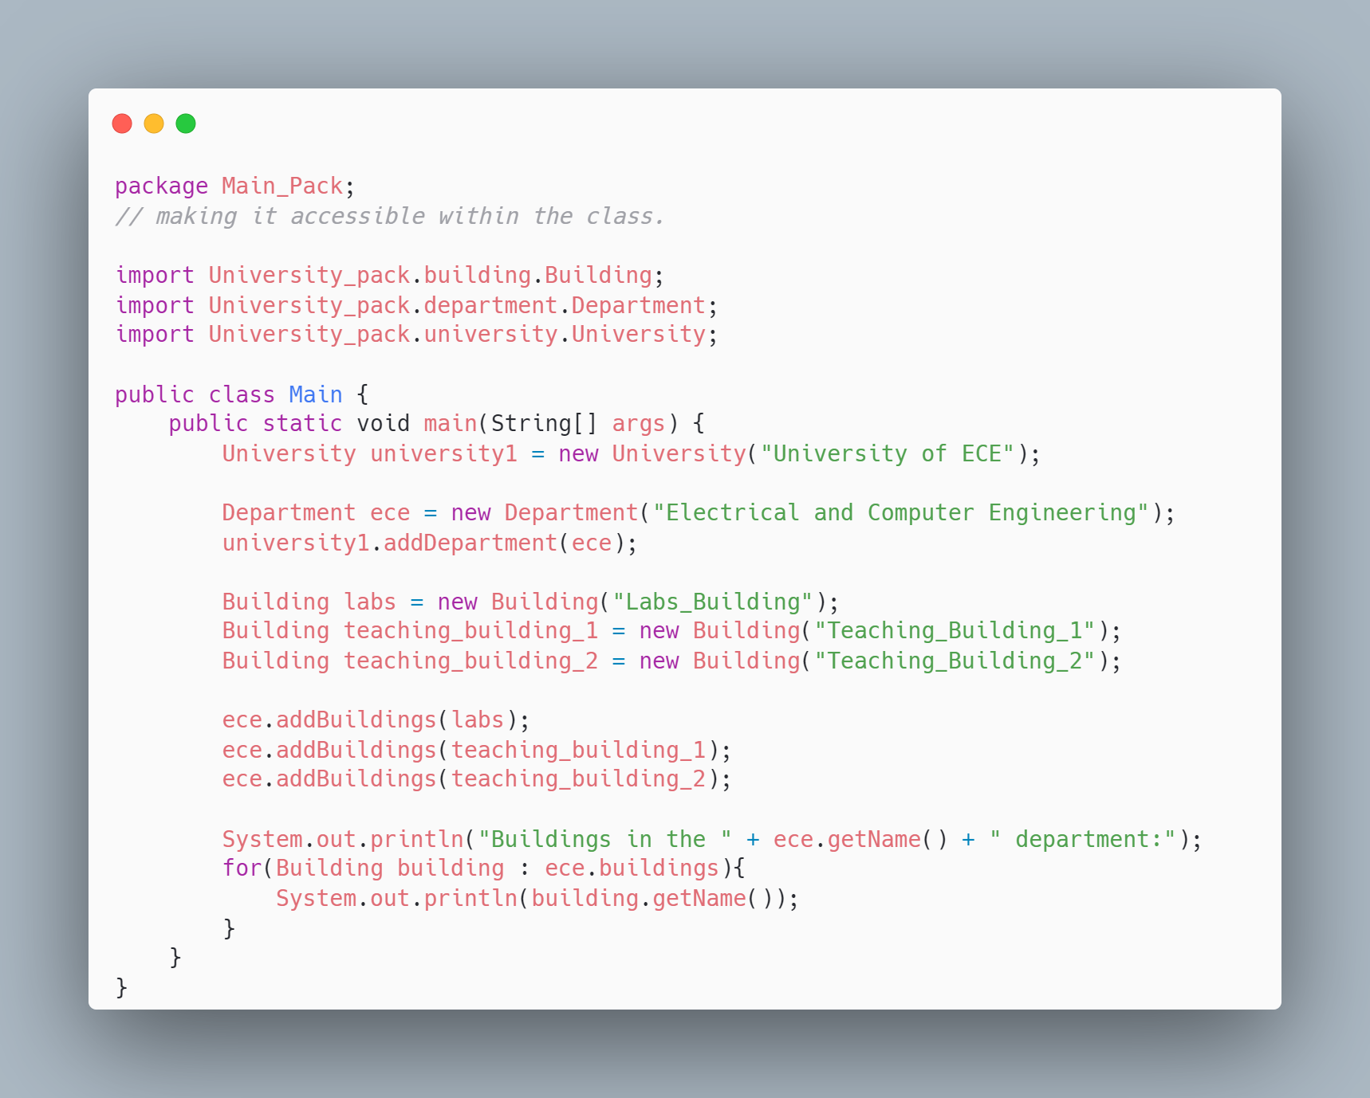
Example of Composition
University , Department and Buildings

Slide 8
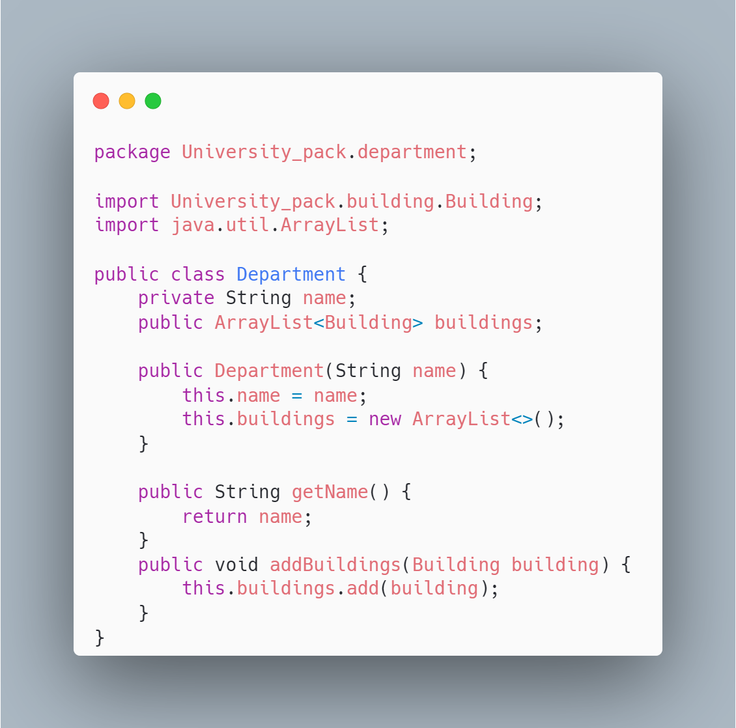
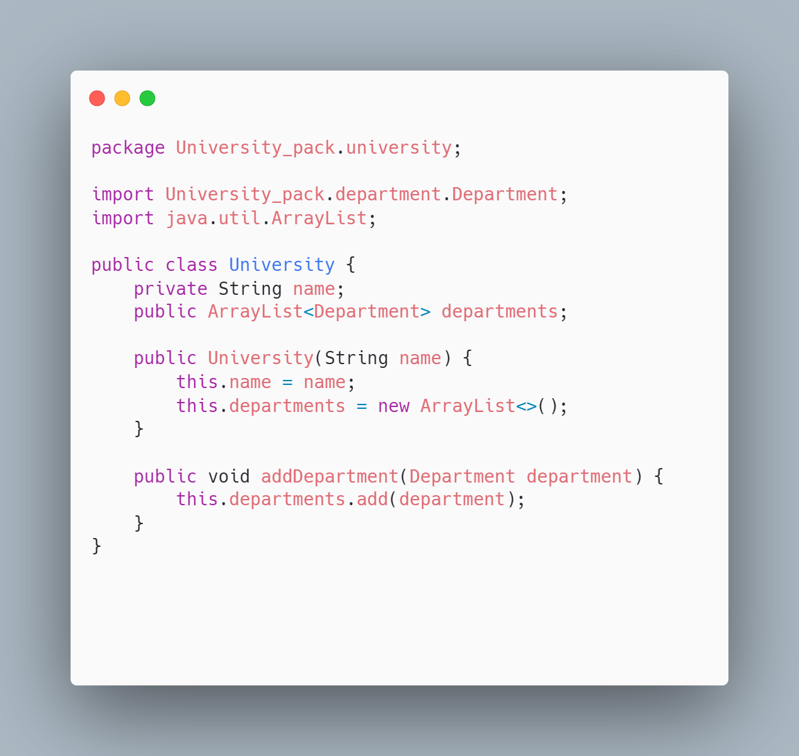
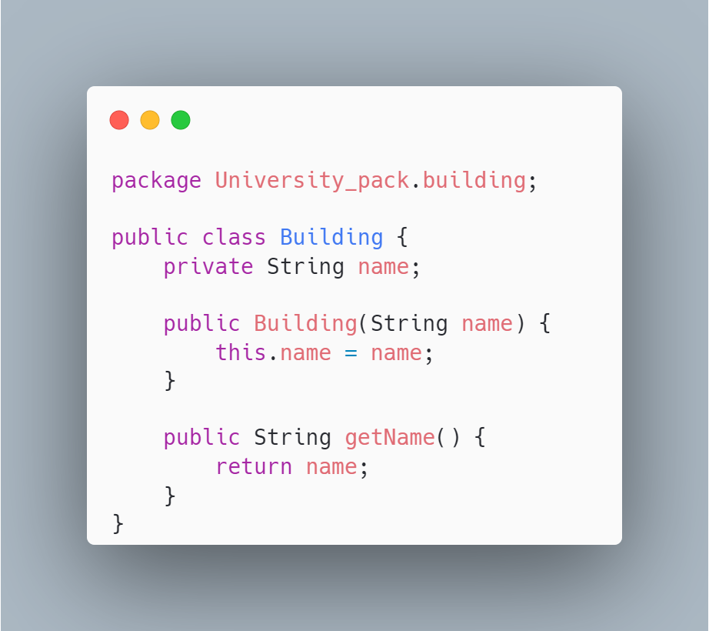
Example of Composition
University , Department and Buildings

Slide 9
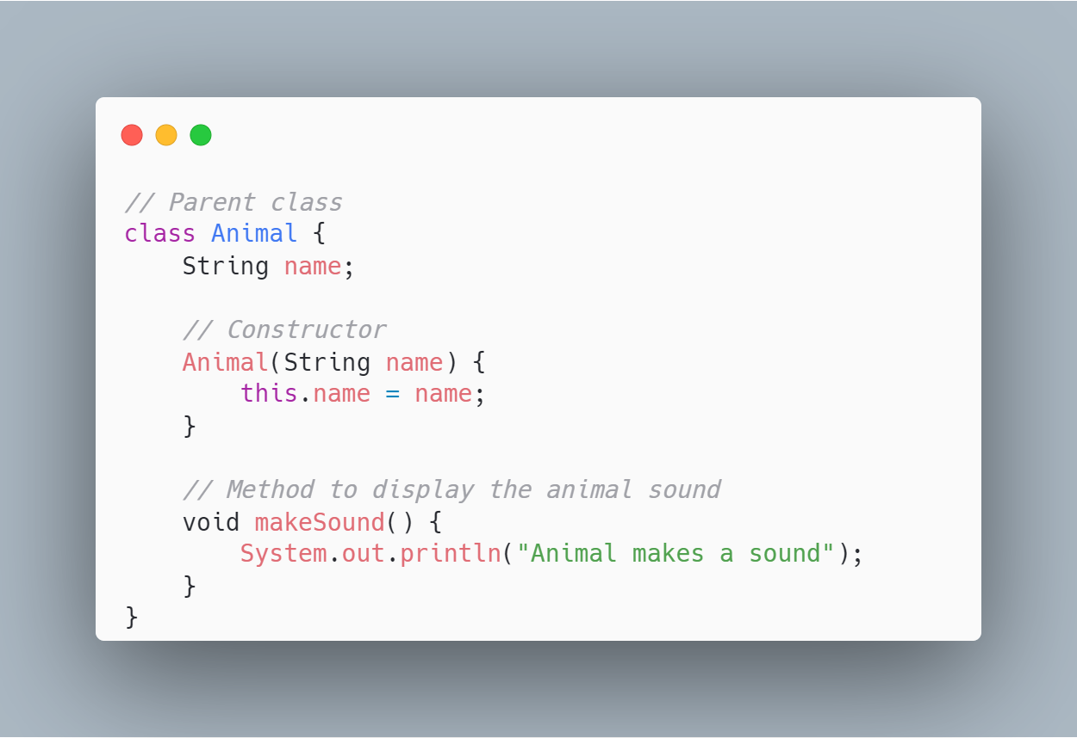
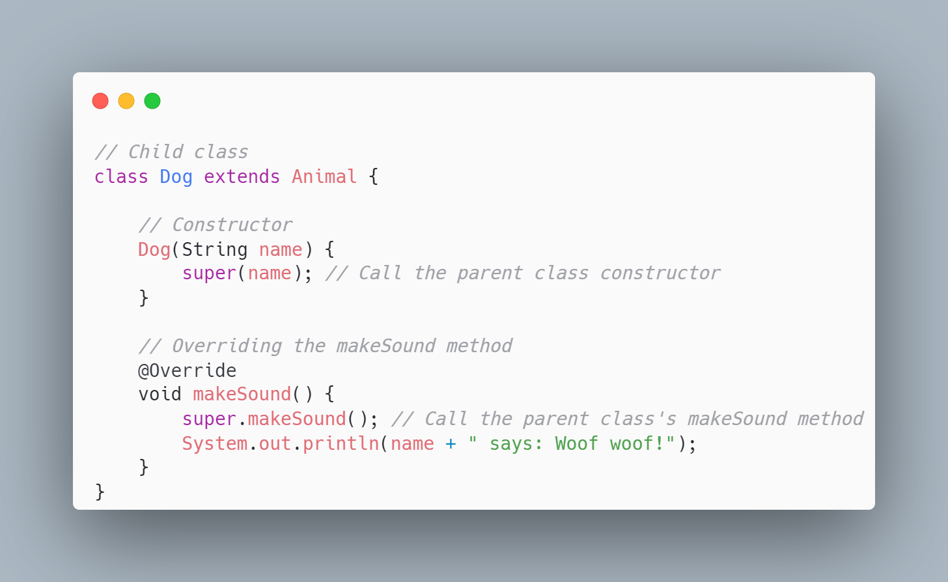
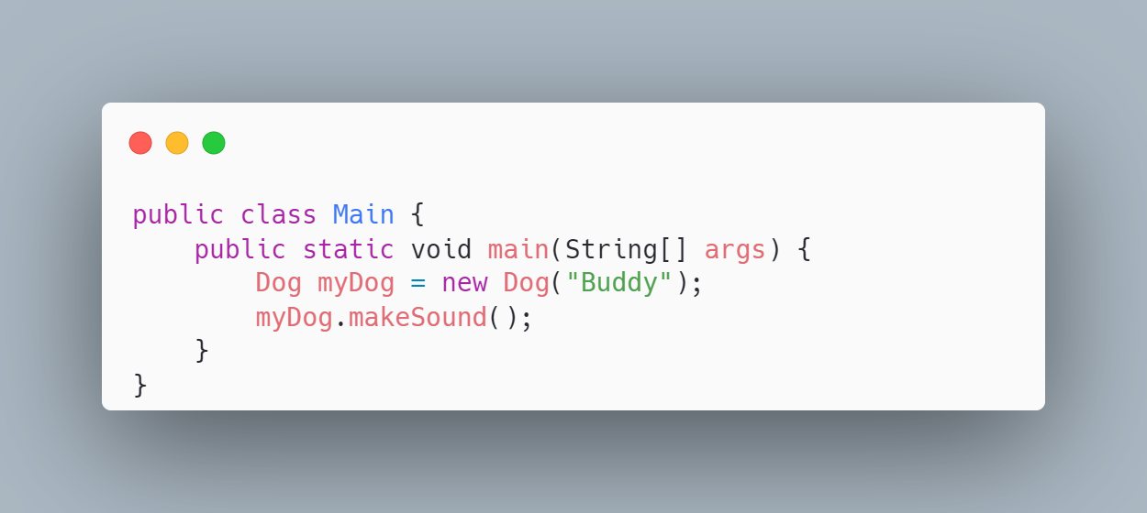
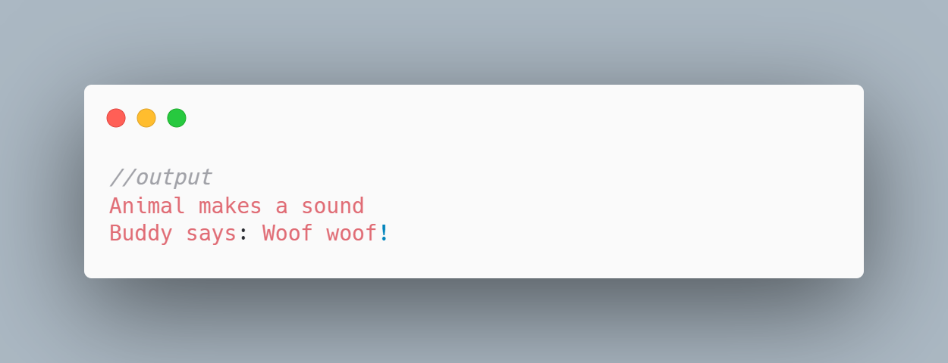
Inheritance

Slide 10
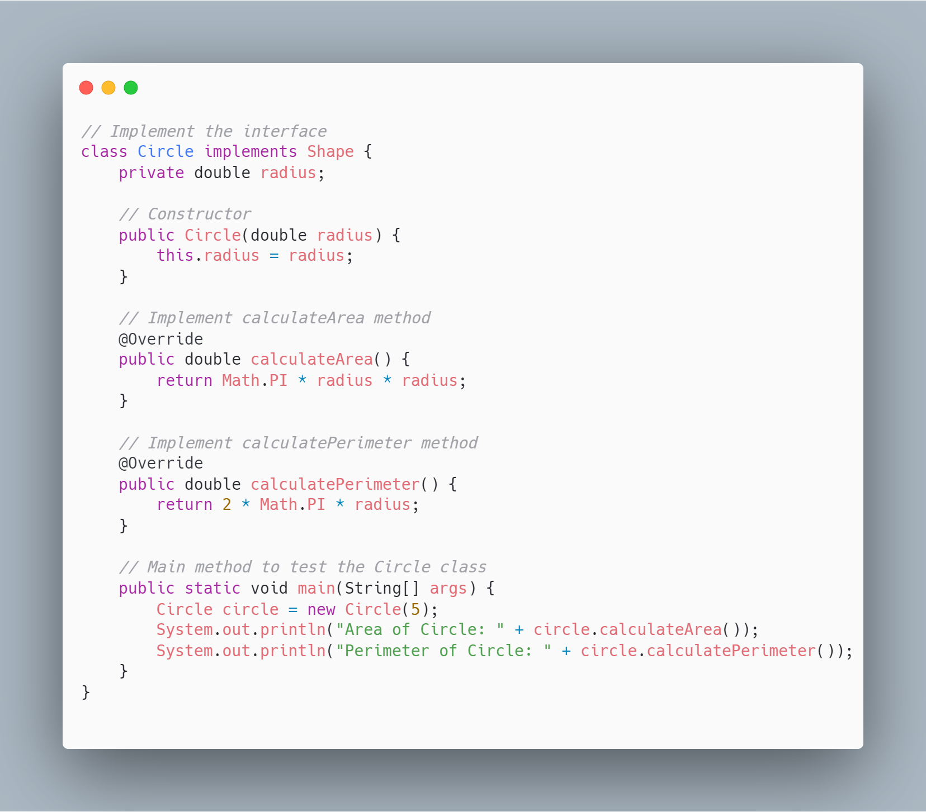
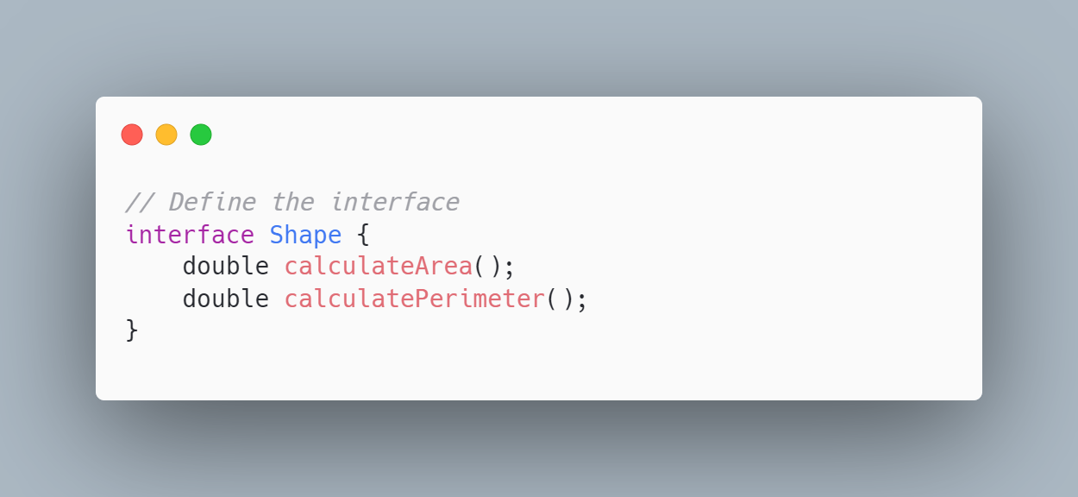
Interface

Slide 11
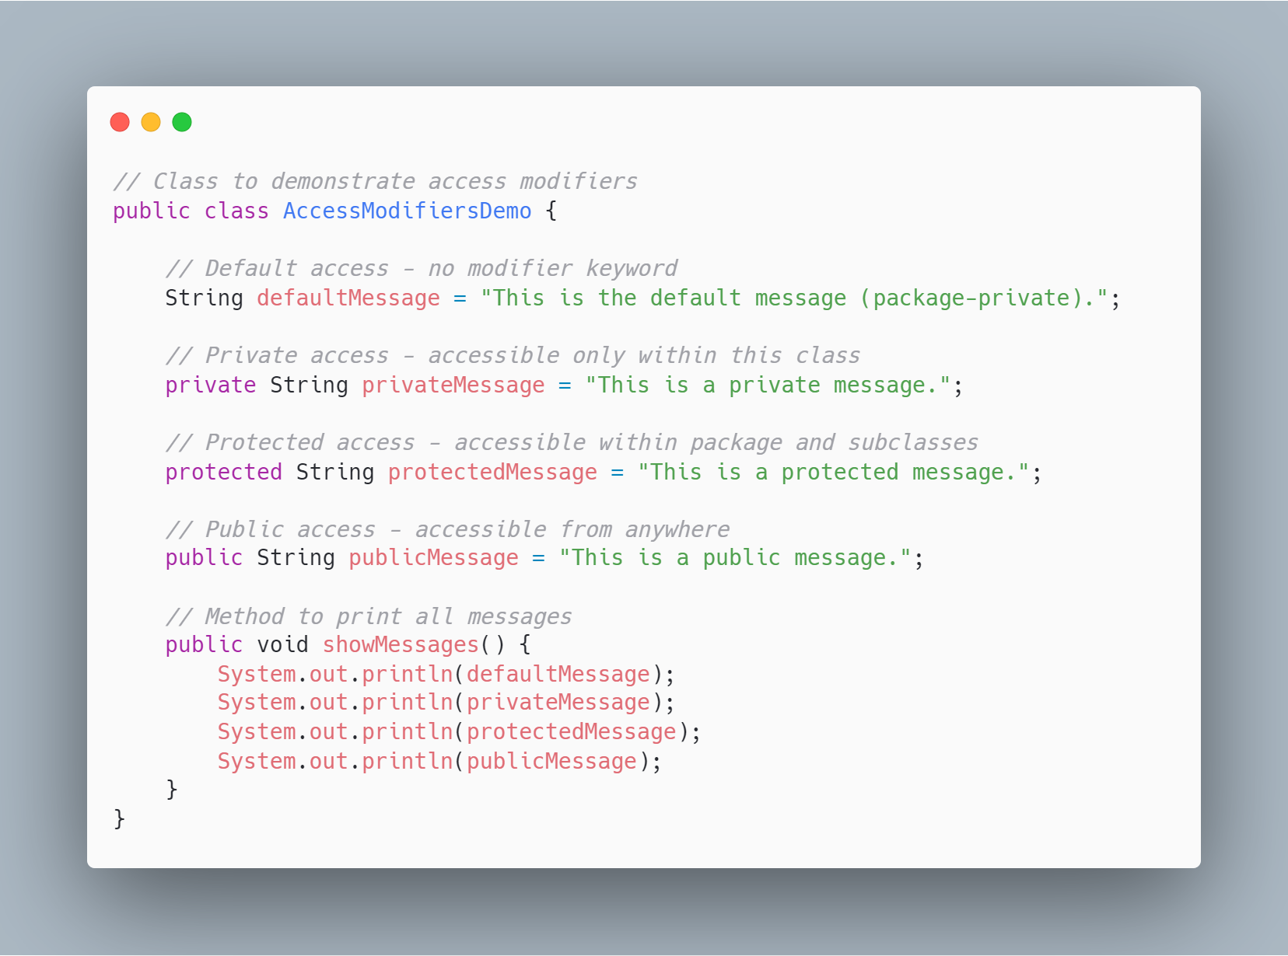
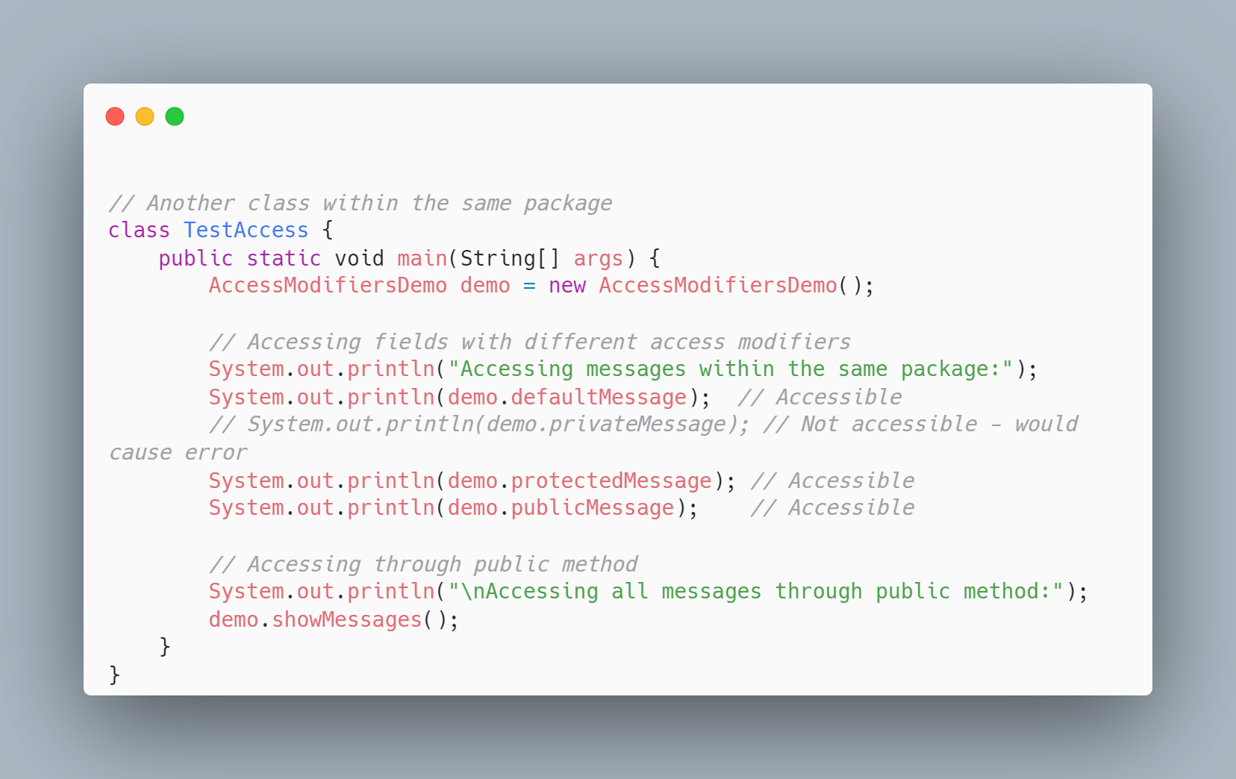
Access Modifiers

Slide 12
Task
Go back to Tutorial_3 and have a look at the two examples
make the Tutorial’s 3 task
Study 4 Principles of Java
Abstraction: https://www.geeksforgeeks.org/abstraction-in-java-2/
Encapsulation: https://www.geeksforgeeks.org/encapsulation-in-java/
Inheritance: https://www.geeksforgeeks.org/inheritance-in-java/
Polymorphism: https://www.geeksforgeeks.org/polymorphism-in-java/
Write a program to interact with 4 Principles of Java

