Slide 1
Confidential
CLAUDE CODE SKILL
PPT Generator
Turn an idea into a finished, editable deck — in any visual style
Built with Claude Code | June 2026

Slide 2
THE IDEA
Confidential
The Content–Look Split
Write the words once; the look is a setting you flip anytime.
● Content as a structured spec — authored once
● Renderer → native PowerPoint file
● Content and style fully separate
● Any template via a one-field change
● No repeated design, no reformatting
2

Slide 3
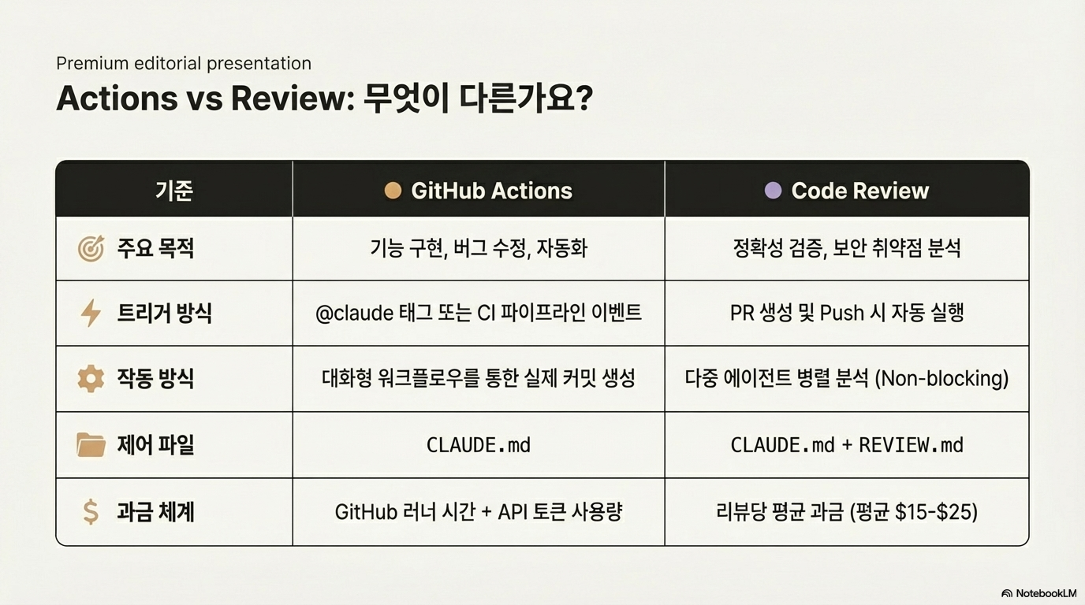

Slide 4
AT A GLANCE
Confidential
One Spec, Many Decks
A single JSON file drives every slide — and every template.
6
13
1
100%
Templates
Layouts
JSON spec
Editable
one-field swap
for every slide job
single source of truth
real .pptx output
3

Slide 6
WORKFLOW
Confidential
Five Steps from Idea to File
The skill does the content design, not just text dumping.
● Topic, audience, and length
● Template matched to tone
● Slides as a JSON spec
– Right layout per slide — the craft
● Validation, then render
● Fast restyle and refinement
4

Slide 7
WORKFLOW
Confidential
The Five-Step Workflow
Drawn as real PowerPoint shapes, so every box stays editable.
Understand
Topic & audience
Template
Pick the look
Design
Author the spec
Render
Validate & build
Iterate
Restyle & refine
5

Slide 8
Two Halves of Every Deck
Confidential
Content stays put; the template carries the design.
Content — the spec
Look — the template
● Each slide's words
● Layout per slide
● Structure and story
● Written once, stable
● Color palette and fonts
● Accent treatment
● Uniform across all slides
● One-field swap
6

Slide 9
TEMPLATES
Confidential
A Look for Every Room
Six built-in templates, each tuned to a different audience.
Template | Look | Best for
corporate | Navy + orange on white | Business, exec, sales
minimal | Black on white, whitespace | Design-forward, product
dark | Dark slate + mint accent | Tech keynotes, demos
vibrant | Purple + coral, bold | Pitches, marketing
academic | Serif, muted, dense | Lectures, research
report | Black header, page numbers | Formal, confidential
7

Slide 10
LAYOUTS
Confidential
A Layout for Every Job
Thirteen layouts so the slide fits the message, not the reverse.
Framing & text
Data & visuals
● title, section, closing
● bullets, content
● two_column, comparison
● quote
● metrics — KPI cards
● table — data grids
● chart, diagram
● image — pictures + text
8

Slide 11
COVERAGE
Confidential
Layouts Across Three Jobs
Framing, text, and data — all covered from one spec.
9

Slide 12
Confidential
“
Slides support the speaker — they aren't the document. One idea per slide.
— The skill's design guidance
10

Slide 13
ORIGINS
Confidential
Presenton Roots, Local Engine
Same content-first pipeline — fully local, no server.
● Presenton's pipeline: content → layout → render
● Same approach, no server
● Editable .pptx via python-pptx
● Fully local — no API, no data egress
11

Slide 14
Confidential
Your Next Deck
Just describe the topic — the skill handles the rest.

