Slide 1

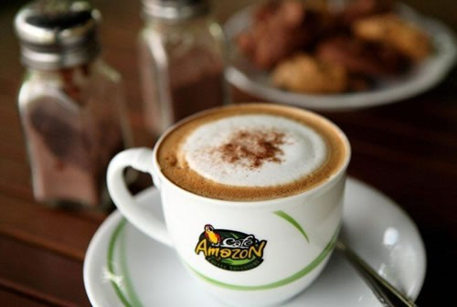
Marketing Mixes
Place or Distribution
Amazon Café
Professor: CHHEAV Narath
Group 1
MUTH Sumontheany
NITH Kosal
PHON Sophara
LOEUNG Lyfan
UNG Soksathremy
LOAS Noeun

Slide 2
Content
Introduction
Place Strategy
2.1. Circuit or Distribution type
2.2. Intensive distribution
2.3. Distribution by Franchise
2.4. Channel distribution
3. Conclusion

Slide 3


1. Introduction
Established by PPT Thailand in 2002
Launched in Cambodia in 2013 by PPT Cambodia
Today, there were a total of 112 Café Amazon shops all over Cambodia

Slide 4


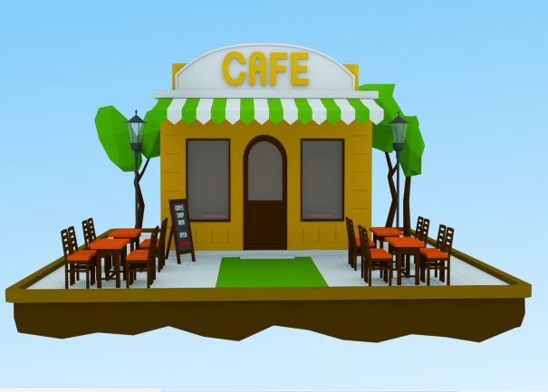
2. Place Strategy
2.1. Circuit or Distribution type
Un niveau intérimaire

Slide 5
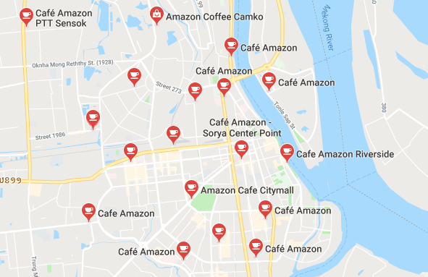
2.2. Intensive distribution
A brand of Amazon coffee, everyone can be purchased through as many outlets coffee in a giving geographic trading area in Phnom Penh.
High school, university, hotel, trading area..

Slide 6
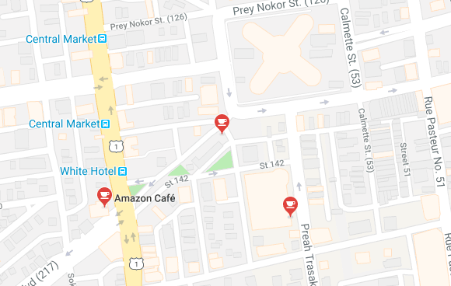
2.2. Intensive distribution
Advantages: brand images, everyone knew this brand easily.
For example: some outlets stay very closed to each other.

Slide 7
2.3. Distribution Franchise
Stand Alone & Shop
Stand Alone
Size of building: 100 - 200 sq-m
Design fee 1280$ - 3200$.
Brand name 3200$.
Franchise fee 16000$.
Renovate 3 years.
Shop or With PTT gas station
Size of building 40 sq.m.
Design fee 1280$ - 3200$.
Brand name 3200$.
Franchise fee 16000$.
Renovate 3 years.
Dong Didayana Amazon Café Aeon branch, they can sell at least 1000 units per day.
Plan at least 2000 units per day.
By using franchise strategy, Amazon Café the popular one and also the market leader in sector coffee, Cambodia.
Notes:
By using franchise strategy, Amazon Café it’s the most popular coffee brand in Cambodia.

Slide 8
Benefits for franchisees Café Amazon
Privilege
Rights
Using brands, trademarks
Rights
Using the POS system
Shop management training
Design shop / prepare before opening shop
Organize marketing activities
Help opening shop / giving advice
Using recipes / buying raw materials, CaféAmazon products
Operating Guide Café Amazon

Slide 9
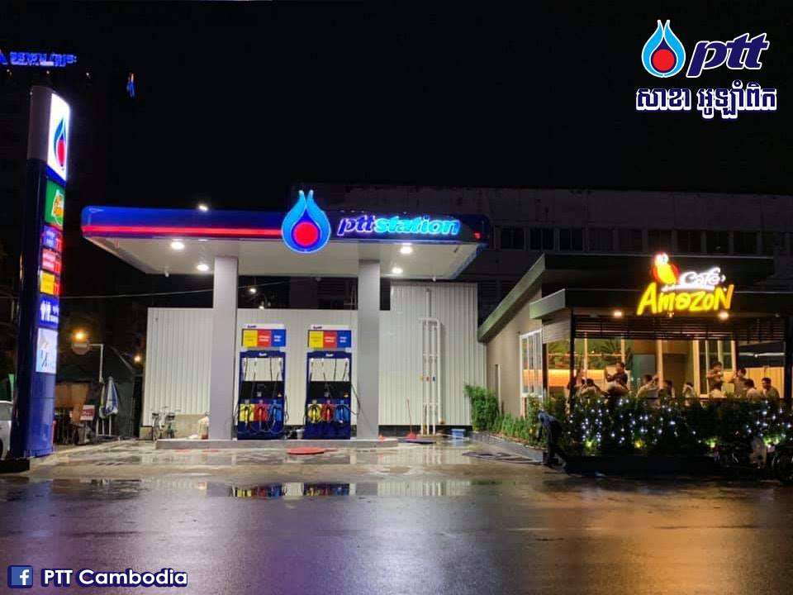
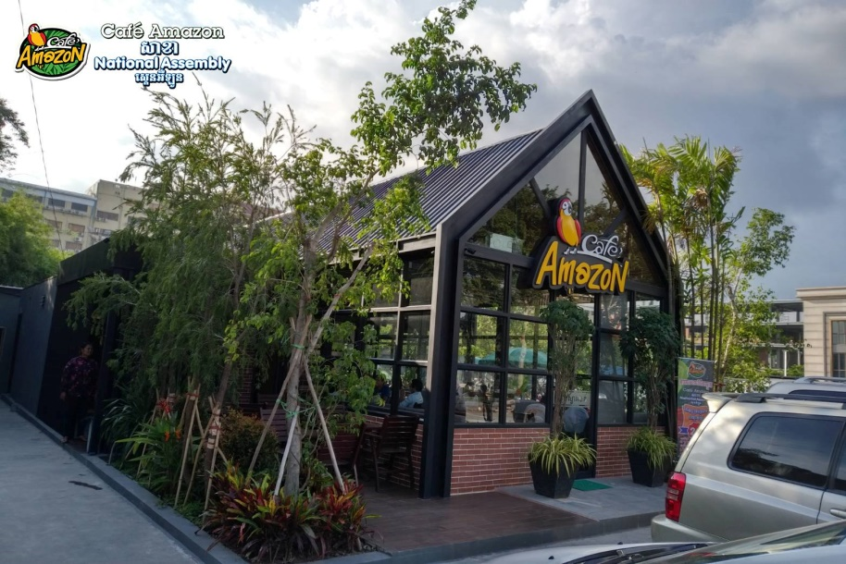
2.4. Distribution Channel
Stand-alone shop
PTT gas station
There are 112 branches of Café Amazon in Cambodia, 83 in Phnom Penh.

Slide 10
6. Conclusion

Slide 11


