Slide 1
Rural Development Bank Project
Nith Kosal
Future Forum, March 10, 2020

Slide 2
Table of Contents
Motivation
Why should I tune into this talk?
What is the problem?
Why is it an interesting problem?
Research Question
Vision
How does the policy proposes to work?

Slide 3
Motivation
The RDB has a significant role in providing financial support to the agricultural and agro-processing value chain, but it focused mainly on the rice sector.
In 2018, the RDB was provided US$ 159.11 million of total loans to local enterprises linked to the agriculture sector. The total loans have contributed to the rice sector (76.13%), rubber, maize, cassava, pepper, coffee and sugar cane (14.89%), and microfinance, animal-raising, and others (8.97%).

Slide 4
Motivation (Con’t)
The domestic supply of nutrition has limited. In 2018, Cambodia just produced livestock and meat about 231, 283 tonnes, or 81% for domestic consumption and imported 54,149 tonnes to meet local demand, according to the MAFF.
Only 70% of Cambodia's market for vegetables and fruits produced locally. It estimated that the Kingdom imports fruits and vegetables worth more than US$ 300 million annually.

Slide 5
Motivation (Con’t)
In 2018, agro-processing contributed only 2.4% or 2,385.9 billion riels of the GDP, and agriculture contributed about 22% or 21,912.6 billion riels to the GDP, according to the NIS.
By 2015, the Ministry of Industry and Handicraft recorded that 77.6% of 41,674 registered SMEs are carrying out in the agro-processing (food, beverage, and tobacco industries). Yet, just 10% of Cambodia's agricultural merchandise is processed – a figure that has remained moderately reliable since 1998.

Slide 6
Research Question
How should the Rural Development Bank use its resources to boost the efficiency of agricultural and agro-processing development in Cambodia?

Slide 7
Vision
Farmers become a businessman or businesswoman
The RDB should provide financial support with specific programs: Every region has unique characteristics and unique needs.
The RDB should provide financial support indirectly to farmers and community farm groups.
The RDB should provide financial support to vulnerability agro-processing.
Be a financial and business consultant to farmer and agro-processing industry

Slide 8
How does the policy proposes to work?
The RDB have a small budget. In 2018, 76.13% of total loans ( US$ 159.11 million) provided to the rice sector.
In the short and short and medium term, it will have a negative impact on the financial access of the broker or company in the rice sector.
The agricultural price policy can reduce the work of brokers and businesses in the agricultural value chain.
It will allow farmers to sell their products directly to the market

Slide 9
Direct marketing strategies allow producers to receive a better price by selling products directly to consumers, who increasingly demand fresh and "local" food due to the growing concern for a healthier diet (Govindasamy, Hos- sain, and Adelaja 1999, Uva 2002).
However, farmer or argo-processing will meet a risk management, competition among producers and competition among farmers markets, a low profit margin, and intermittent operation, labor requirements (Uematsu & Mishra, 2011), financial management.

Slide 10
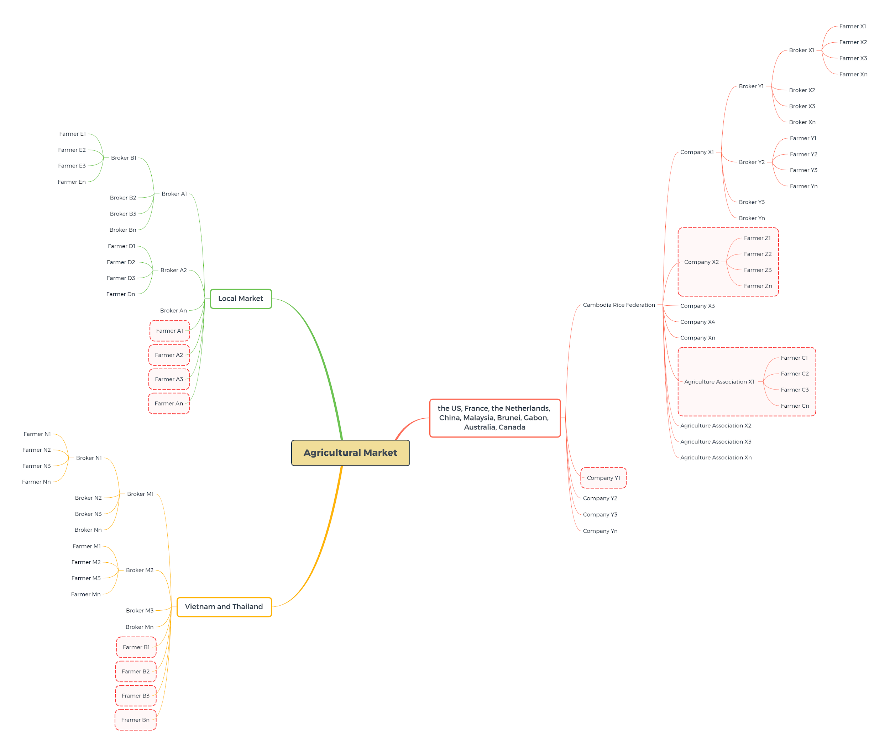
Raw Material Process

Slide 11
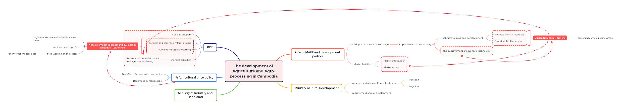
The development of Agriculture and Agro-processing

Slide 12
The creation of a favorable environment for opening and maintaining the agricultural business and ensuring effective public financial support for its development at the beginning of activities.
The consequences of the financial mechanism effective implementation are achieving a strong consumer, investment, innovation, institutional and social effects in rural areas.

