Slide 1
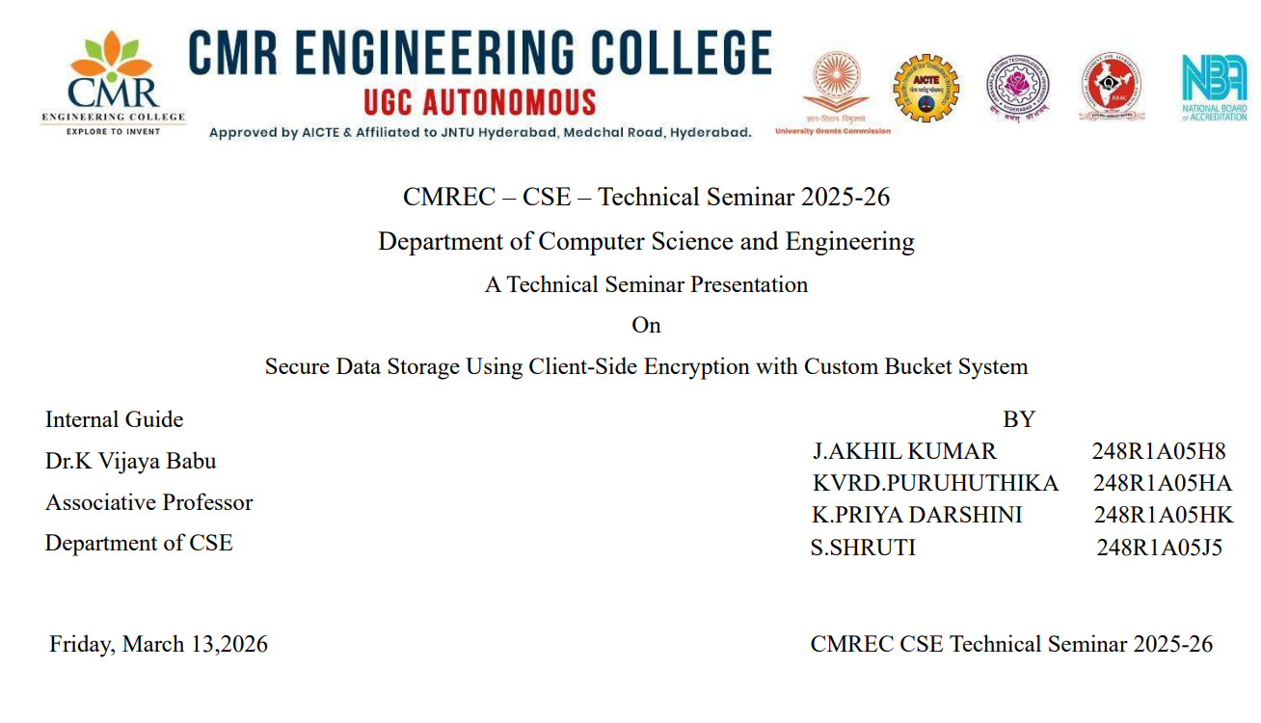

Slide 2
Abstract
With the rapid growth of cloud computing, ensuring data security has become a critical concern, especially when storing sensitive information on cloud platforms such as Amazon Web Services (AWS) S3. This project focuses on implementing client-side encryption to enhance the security of data before it is uploaded to AWS S3. In this approach, data is encrypted at the user’s end using strong cryptographic techniques, ensuring that only encrypted data is stored in the cloud. Unlike server-side encryption, client-side encryption provides complete control over encryption keys, thereby reducing the risk of unauthorized access and data breaches.The system uses encryption algorithms to convert plaintext data into ciphertext before transmission, and only authorized users with the correct decryption keys can access the original content. This ensures data confidentiality even if the cloud storage is compromised. The project demonstrates how client-side encryption can be integrated with AWS S3 services to create a secure and reliable storage solution. Overall, this approach significantly enhances data privacy, security, and trust in cloud storage systems, making it suitable for handling sensitive and critical information.

Slide 3
Agenda / Outline
Abstract
Introduction
Literature Review
Existing System
Objectives & Constraints
Feasibility Analysis
Proposed System
Conclusion

Slide 4
Introduction
Cloud storage has become an essential part of modern computing due to its high scalability, flexibility, and ease of access from anywhere in the world. Services like Amazon S3 are widely used by organizations and individuals to store vast amounts of data, including highly sensitive information such as personal records, financial data, and confidential business documents. However, as the reliance on cloud storage increases, so do the risks associated with data security. One of the major concerns is the possibility of data breaches and unauthorized access, which can lead to serious consequences such as data loss, privacy violations, and financial damage. Although cloud providers offer server-side encryption to protect stored data, it is not always considered completely secure because the encryption process is managed by the service provider itself, leaving a level of dependency and potential vulnerability. This approach guarantees that only encrypted data is stored in the cloud, and only authorized users with the correct decryption keys can access the original information. As a result, even if unauthorized access occurs, the data remains unreadable and secure. This project is motivated by the need to enhance data protection in cloud environments by implementing client-side encryption, thereby providing an additional layer of security and greater control to users over their sensitive information.

Slide 5
Literature Review (Papers)
Paper Title | Authors | Year | Key Idea
Secure Cloud Storage | Smith et al. | 2021 | Encrypt before upload
Client-Side Encryption | Kumar & Singh | 2022 | End-to-end security
AWS Security Practices | Amazon | 2023 | Multi-layer security

Slide 6
Literature Review (Sources)
Source | Description | Findings
IEEE Papers | Cloud security research | Improves confidentiality
Journals | Data protection methods | Client-side is safer
Standards | AWS & NIST | Recommend encryption

Slide 7
Literature Review Summary
Encryption plays a critical role in securing data stored in cloud environments by protecting it from unauthorized access, breaches, and potential misuse. Among the various approaches, client-side encryption is considered more secure because it allows users to encrypt their data before uploading it to cloud platforms such as Amazon S3, ensuring that only encrypted information is stored remotely. This gives users complete control over their encryption keys and reduces dependence on the cloud service provider for data security. However, despite its advantages, client-side encryption introduces several challenges that cannot be ignored. One of the major issues is key management, which involves securely generating, storing, and distributing encryption keys without compromising them. If keys are lost or mishandled, data recovery becomes extremely difficult or even impossible. Additionally, implementing client-side encryption increases system complexity, as developers must integrate encryption algorithms, manage keys, and ensure compatibility with cloud services. These factors can make the system harder to design, maintain, and scale efficiently. Therefore, there is a growing need for simplified and user-friendly solutions that can provide strong encryption while minimizing complexity, ensuring both high security and ease of use in cloud data storage systems.

Slide 8
Existing System
In the current system, data is typically uploaded directly to Amazon S3, where users may optionally enable server-side encryption to protect stored information. While this method provides a basic level of security, the encryption process is handled entirely by AWS, including the generation, storage, and management of encryption keys. As a result, users have limited control over how their data is secured, which can raise concerns regarding privacy and trust. Since the cloud provider manages the keys, there is a dependency on its internal security mechanisms, and users must rely on the provider to prevent unauthorized access or potential insider threats. Additionally, data may be exposed during transmission if not properly secured before upload. This centralized control over encryption reduces transparency and flexibility for users who require higher levels of data protection. Therefore, although server-side encryption offers convenience, it does not provide complete control or assurance of security from the user’s perspective, highlighting the need for more secure approaches such as client-side encryption.

Slide 9
Limitations
Lack of full user control over encryption keys and security settings
Possible data exposure during transmission or processing
Risk of unauthorized access, including insider threats
Limited flexibility and customization in security mechanisms
Dependency on Amazon S3 for key management

Slide 10
Proposed System
The proposed system focuses on enhancing data security by implementing client-side encryption before uploading files to cloud storage services such as Amazon S3. In this approach, data is encrypted on the user’s device using strong encryption algorithms before it is transmitted to the cloud, ensuring that only encrypted (ciphertext) data is stored in the cloud environment. This significantly reduces the risk of data breaches, as even if unauthorized users gain access to the stored data, they will not be able to interpret it without the correct decryption keys. The system also ensures that only authorized users who possess the appropriate keys can decrypt and access the original data, thereby maintaining strict confidentiality and privacy. Additionally, this method eliminates dependency on the cloud provider for encryption management, giving users complete control over their security mechanisms. By securing data at the source and throughout its lifecycle, the proposed system provides a more robust and reliable solution for protecting sensitive information in cloud storage environments.

Slide 11
Objectives
Implement client-side encryption to secure data before uploading
Ensure sensitive data remains encrypted in Amazon S3
Improve data privacy and confidentiality
Increase user control over encryption keys and security
Reduce risks of data breaches and unauthorized access
Maintain a balance between security and system performance

Slide 12
Constraints
High complexity in implementing encryption algorithms correctly
Challenges in secure encryption key generation and management
Additional processing time due to encryption and decryption
Limited project duration and strict deadlines
Need to balance development time with testing and deployment
Resource constraints due to Amazon S3 free-tier limitations
Limited system resources (CPU, memory, storage) for handling encryption tasks

Slide 13
Technical Feasibility
Implementation is feasible using strong encryption algorithms like AES and RSA
Supported by programming languages such as Python and Java
Easy integration with Amazon S3 using AWS SDKs
No requirement for specialized or high-end hardware
Can be developed using standard development tools and libraries

Slide 14
Economic Feasibility
Cost-effective solution using Amazon S3 free-tier services
Utilizes open-source encryption libraries, reducing software costs
No need for expensive hardware or infrastructure
Minimal operational and maintenance expenses
Suitable for student projects and small-scale implementations

Slide 15
Operational & Schedule Feasibility
Simple and user-friendly system design
Easy for users to upload and manage encrypted data
Minimal training required for operation
Can be efficiently implemented with proper planning
Fits within the given academic project timeline
Smooth integration with Amazon S3
Supports quick deployment and testing within schedule

Slide 16
Conclusion
Client-side encryption significantly enhances data security and privacy in cloud storage by ensuring that data is encrypted before it is uploaded to services like Amazon S3. This approach gives users full control over their encryption keys and protects sensitive information from unauthorized access, even if the cloud storage is compromised. The project successfully demonstrates a secure and practical solution for safeguarding cloud data using encryption techniques. Additionally, it lays a strong foundation for future improvements, such as advanced key management systems, multi-user access control, and integration with emerging security technologies, making it adaptable and scalable for real-world applications.

Slide 17
References
Amazon Web Services official documentation for S3 and security practices
IEEE Xplore digital library for research papers
National Institute of Standards and Technology (NIST) guidelines for encryption standards
Cloud security journals and publications for latest trends
Research articles on encryption techniques and secure data storage

