Slide 1

Data-Driven Analysis of Major Factors Influencing Traffic Crash Severity
DATS 6501: Data Science Capstone
Mid-term
February 28, 2024
Kentaro Osawa, Bharat Premnath

Slide 2
Introduction
Traffic crashes cause human suffering as well as economic losses
In the world, approximately 1.19 million people die and 20 – 50 million people suffer non-fatal injuries from road traffic crashes each year. [1]
In the U.S., estimated 47,795 people died in traffic crashes in 2022. [2]
In the U.S., traffic fatalities have remained flat or increased. [2]
According to NHTSA, traffic crashes cost American society $340 billion in 2019. [3]

Slide 3
Introduction
It is important that governments take effective countermeasures to decrease the number of traffic crashes.
In this project, we will apply our knowledge and skills in data science to analyze traffic crash data in Chicago, with the aim of proposing effective countermeasures.
The scope of this project is as follows:
Finding major factors in the severity of traffic crashes
Creating and interpreting ML models
Creating a risk map showing the expected traffic crash counts in each community area in Chicago
Creating Generalized Linear Model (GLM)

Slide 4
Literature Review (1)
There are several previous research investigating significant factors in crash severity.
Building ML models from several feature subsets and considering the feature subset of the best model as the significant factors [4]
Building ML models and evaluating the feature importance of the best model [5, 6]
Decision Tree and Random Forest are often used in those research.
There are common key factors across multiple previous studies (e.g., day of the week, geographical location), but different factors have been suggested as the main ones depending on the study.
Since the target variable, the traffic crash severity, can be highly imbalanced, it is important to handle this imbalance [6]

Slide 5
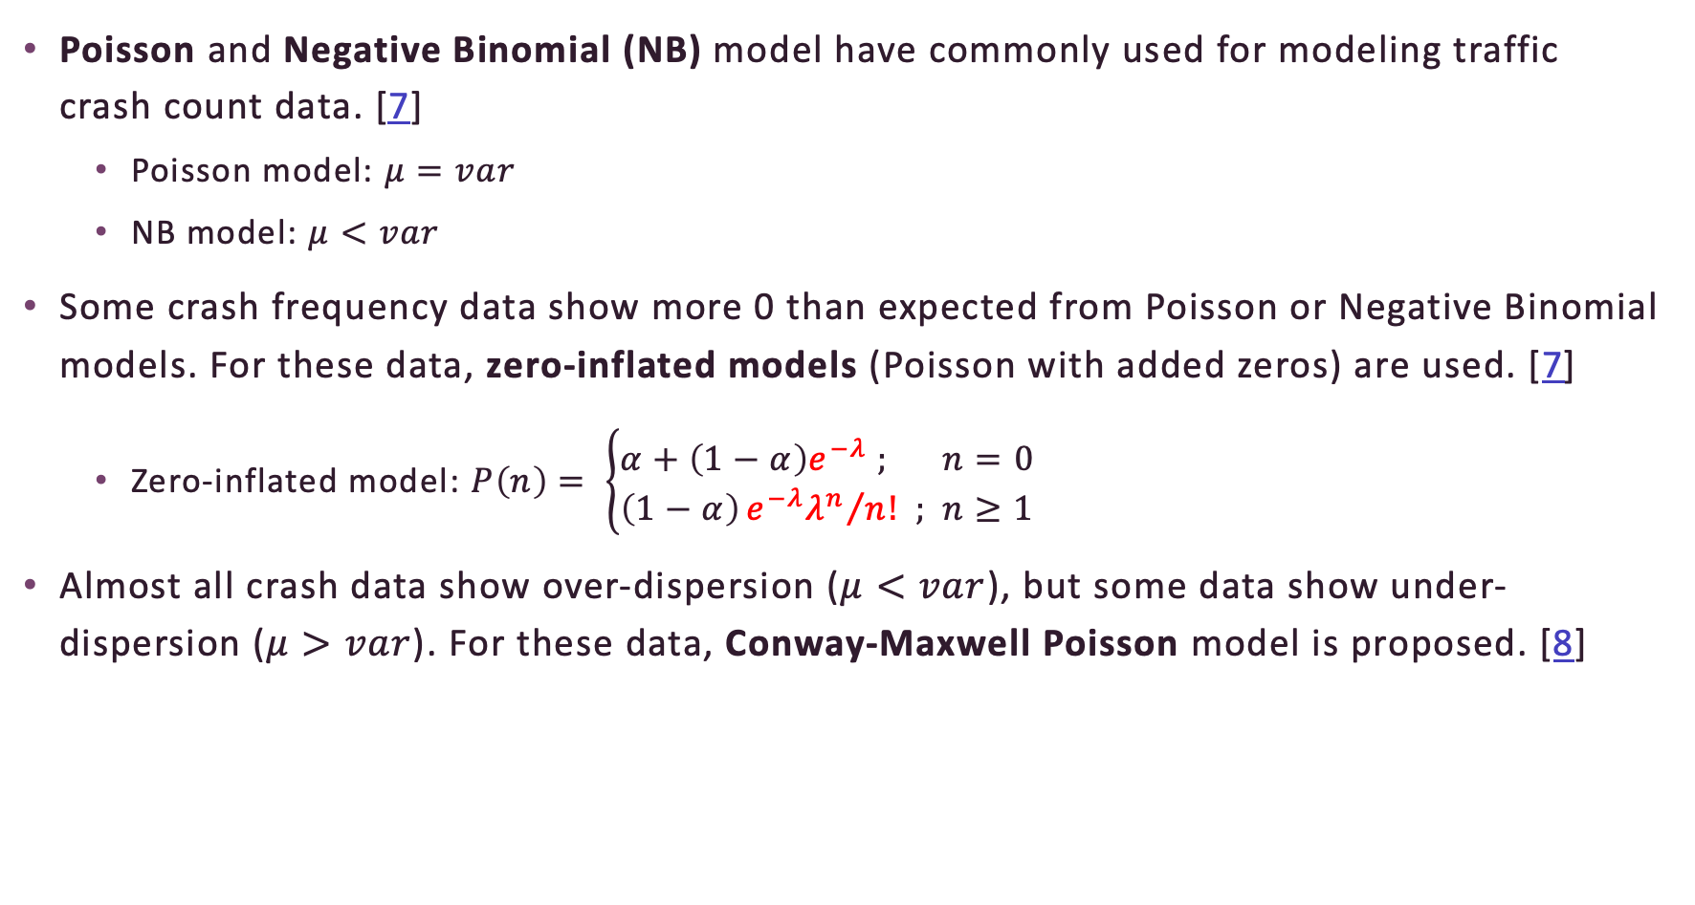
Literature Review (2)
Poisson and Negative Binomial (NB) model have commonly used for modeling traffic crash count data. [7]
Poisson model: $μ=var$
NB model: $μ<var$
Some crash frequency data show more 0 than expected from Poisson or Negative Binomial models. For these data, zero-inflated models (Poisson with added zeros) are used. [7]
Zero-inflated model: $P\left(n\right)= \left\{\begin{aligned}α+\left(1−α\right)e^{−λ} ; n=0 \\ \left(1−α\right){e^{−λ}λ^{n}}/{n!} ; n≥1\end{aligned}\right.$
Almost all crash data show over-dispersion ($μ<var$), but some data show under-dispersion ($μ>var$). For these data, Conway-Maxwell Poisson model is proposed. [8]

Slide 6
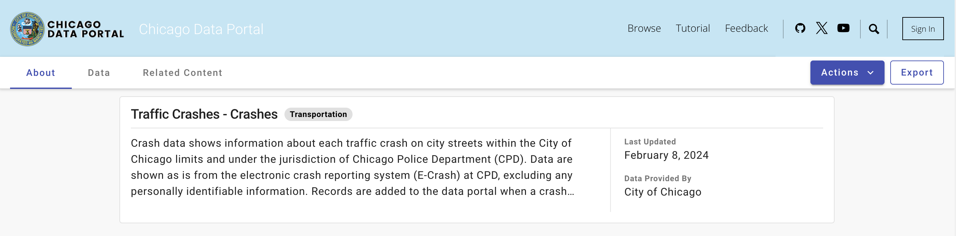
Methodology – Data Collection
The dataset is acquired from Chicago Data Portal [9]
The dataset is updated daily
Chicago Data Portal Website [9]

Slide 7
Methodology – Data Description
799,526 observations
Contains traffic crash details from 2015 to present (Jan 22, 2024)
48 features
17 numerical features
# of fatalities, # of total injuries
latitude, longitude
31 categorical features
day of the week
weather condition, lighting condition

Slide 8

Methodology – Data Preprocessing
Preparing two preprocessed data: for classification models and for GLMs
Data preprocessing for classification models
Data preprocessing for GLMs
Removing irrelevant features
Handling missing value
Dropping features with a proportion of missing values > 50%
Dropping observations with missing values
Creating the target variable Severity
1: No injuries
2: 1-2 injuries
3: $≥$ 3 injuries or $≥$ 1 fatality
Removing irrelevant features
Handling missing value
Creating features
Severity, Community area
Creating count data data-frame
Each row is # of crashes for each type of Severity in each community area in 2 hours interval.

Slide 9
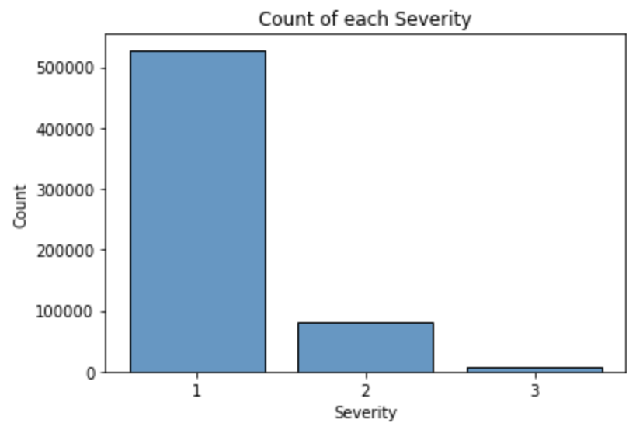
Methodology – Modeling (1)
Classification models
Building ML models
Decision Tree, Random Forest, Boosting, Neural network
Handling class imbalance
Evaluating models
Accuracy, Precision, Recall, F1-score
Interpret models
Visualizing the contribution of each features using SHAP (Shapely Additive exPlanations)

Slide 10
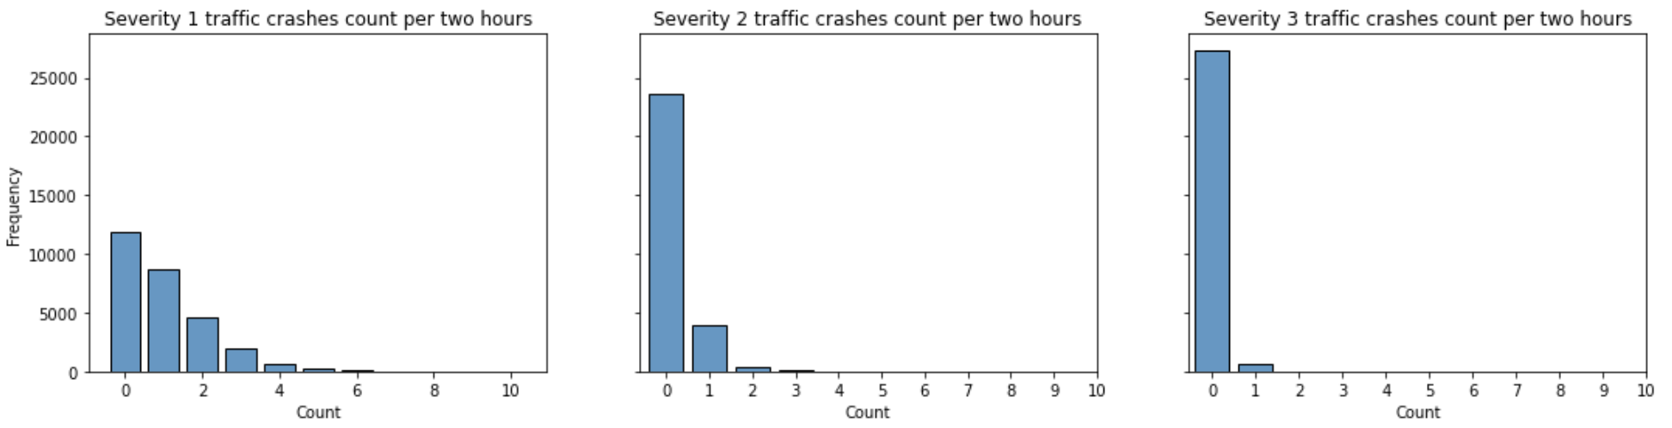
Methodology – Data Modeling (2)
GLMs
Building GLMs
To find the expected value of count of crashes by using month , day of the week, severity and community area as features.
Assuming Poisson model, Negative Binomial model, or Zero-inflated model
Evaluating models
AIC, BIC
Distribution of traffic accident occurrences for each severity level in Austin

Slide 11
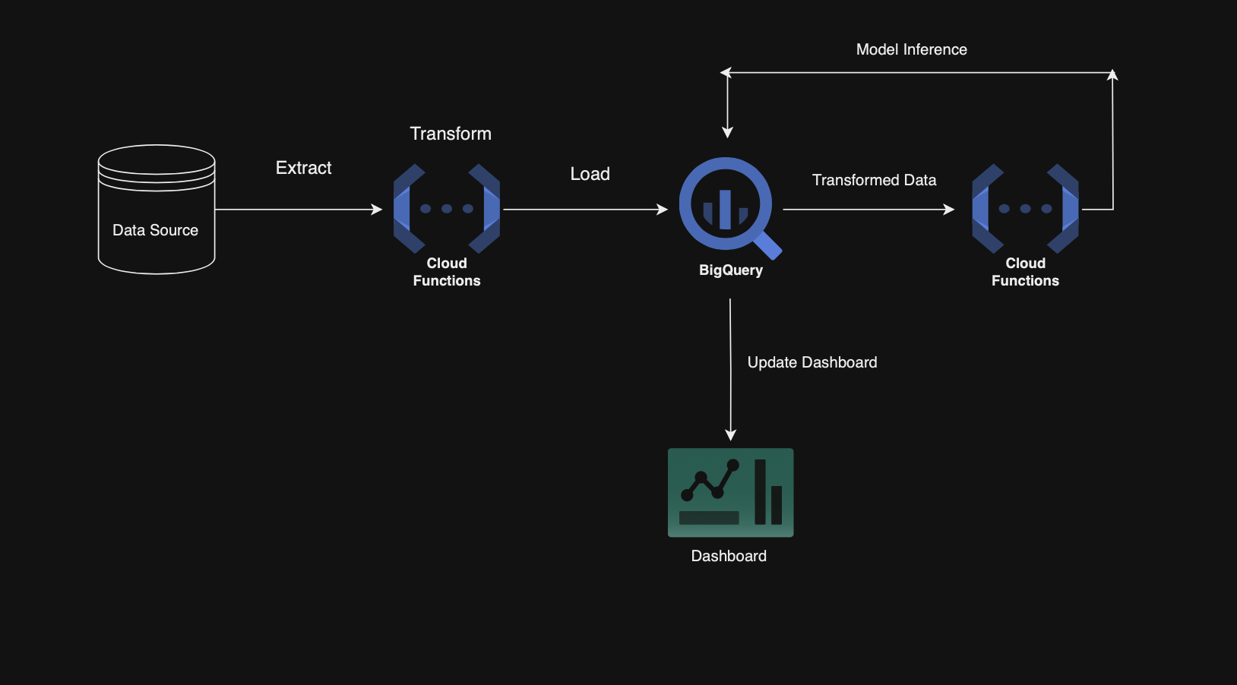
ETL pipeline and Dashboard
Purpose :
To track changes in the risk map over time
To detect if there is any change with contributors to the severity of crashes.

Slide 12
Reference
[1] WHO website (https://www.who.int/news-room/fact-sheets/detail/road-traffic-injuries)
[2] National Highway Traffic Safety Administration (NHTSA) report (https://crashstats.nhtsa.dot.gov/Api/Public/ViewPublication/813428)
[3] NHTSA website (https://www.nhtsa.gov/press-releases/traffic-crashes-cost-america-billions-2019)
[4] Bhuiyan, H., Ara, J., Hasib, K. M., Sourav, M. I. H., Karim, F. B., Sik-Lanyi, C., ... & Yasmin, S. (2022). Crash severity analysis and risk factors identification based on an alternate data source: a case study of developing country. Scientific reports, 12(1), 21243.
[5] Ghandour, A. J., Hammoud, H., & Al-Hajj, S. (2020). Analyzing factors associated with fatal road crashes: a machine learning approach. International journal of environmental research and public health, 17(11), 4111.
[6] Fiorentini, N., & Losa, M. (2020). Handling imbalanced data in road crash severity prediction by machine learning algorithms. Infrastructures, 5(7), 61
[7] Lord, D., Washington, S. P., & Ivan, J. N. (2005). Poisson, Poisson-gamma and zero-inflated regression models of motor vehicle crashes: balancing statistical fit and theory. Accident Analysis & Prevention, 37(1), 35-46.
[8] Lord, D., Guikema, S. D., & Geedipally, S. R. (2008). Application of the Conway–Maxwell–Poisson generalized linear model for analyzing motor vehicle crashes. Accident Analysis & Prevention, 40(3), 1123-1134.
[9] Chicago Data Portal (https://data.cityofchicago.org/Transportation/Traffic-Crashes-Crashes/85ca-t3if/about_data)

Slide 13
Thank you for listening!

