Slide 1





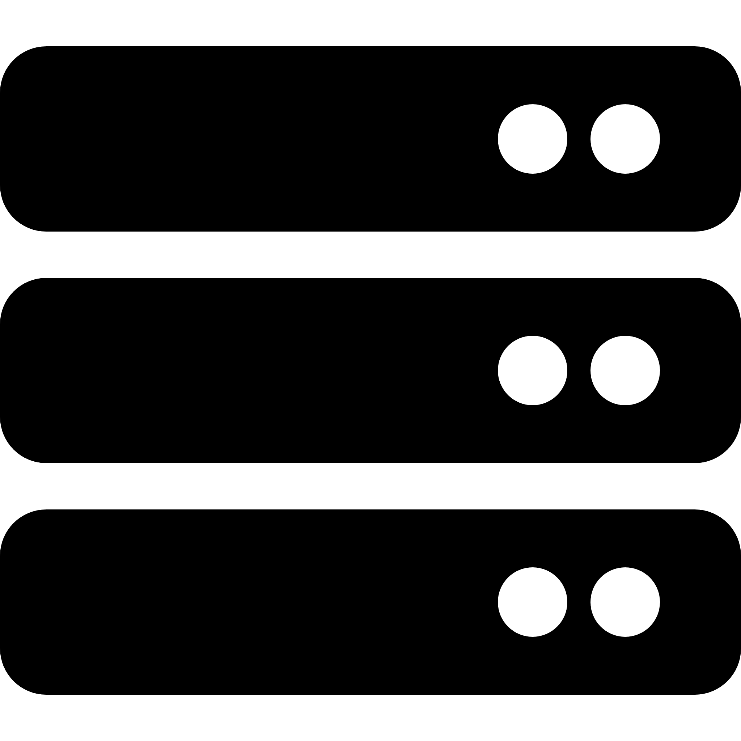


Client
Desktop/Mobile
Server
Tomcat
Datenbank
PostgreSQL

