Slide 1
PROPOSED METHOD
MC-ESO
Multi-Channel Epidemic Spread Optimizer
A population-based black-box optimizer inspired by
multi-route epidemic transmission
Kosei Matsuzaki

Slide 2
Outline
1
Background
2
Purpose & Significance
3
Proposed Method
4
Experiments
5
Results
6
Discussion
7
Conclusion
2 / 35

Slide 3
1
Background
The shared weakness of existing methods, and what motivated this work
3 / 35

Slide 4
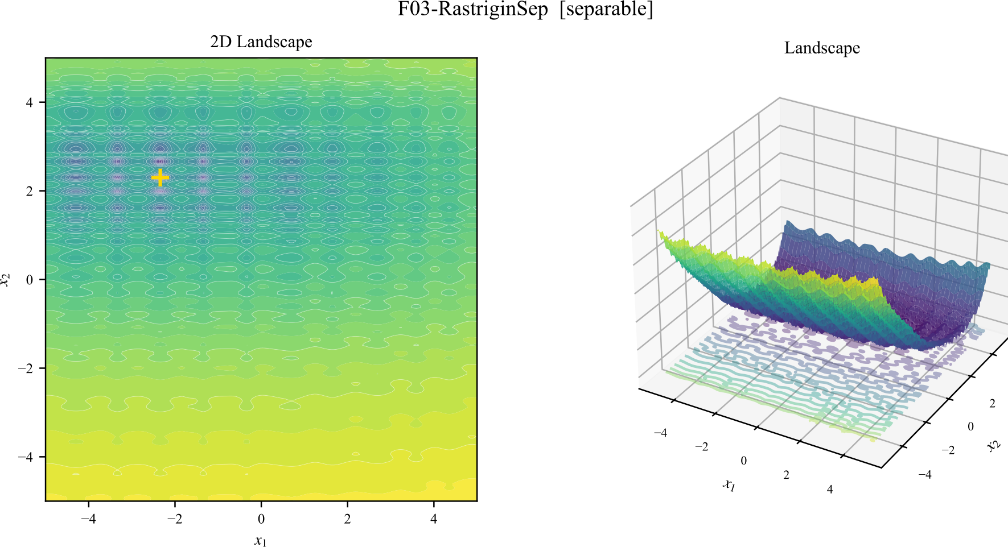
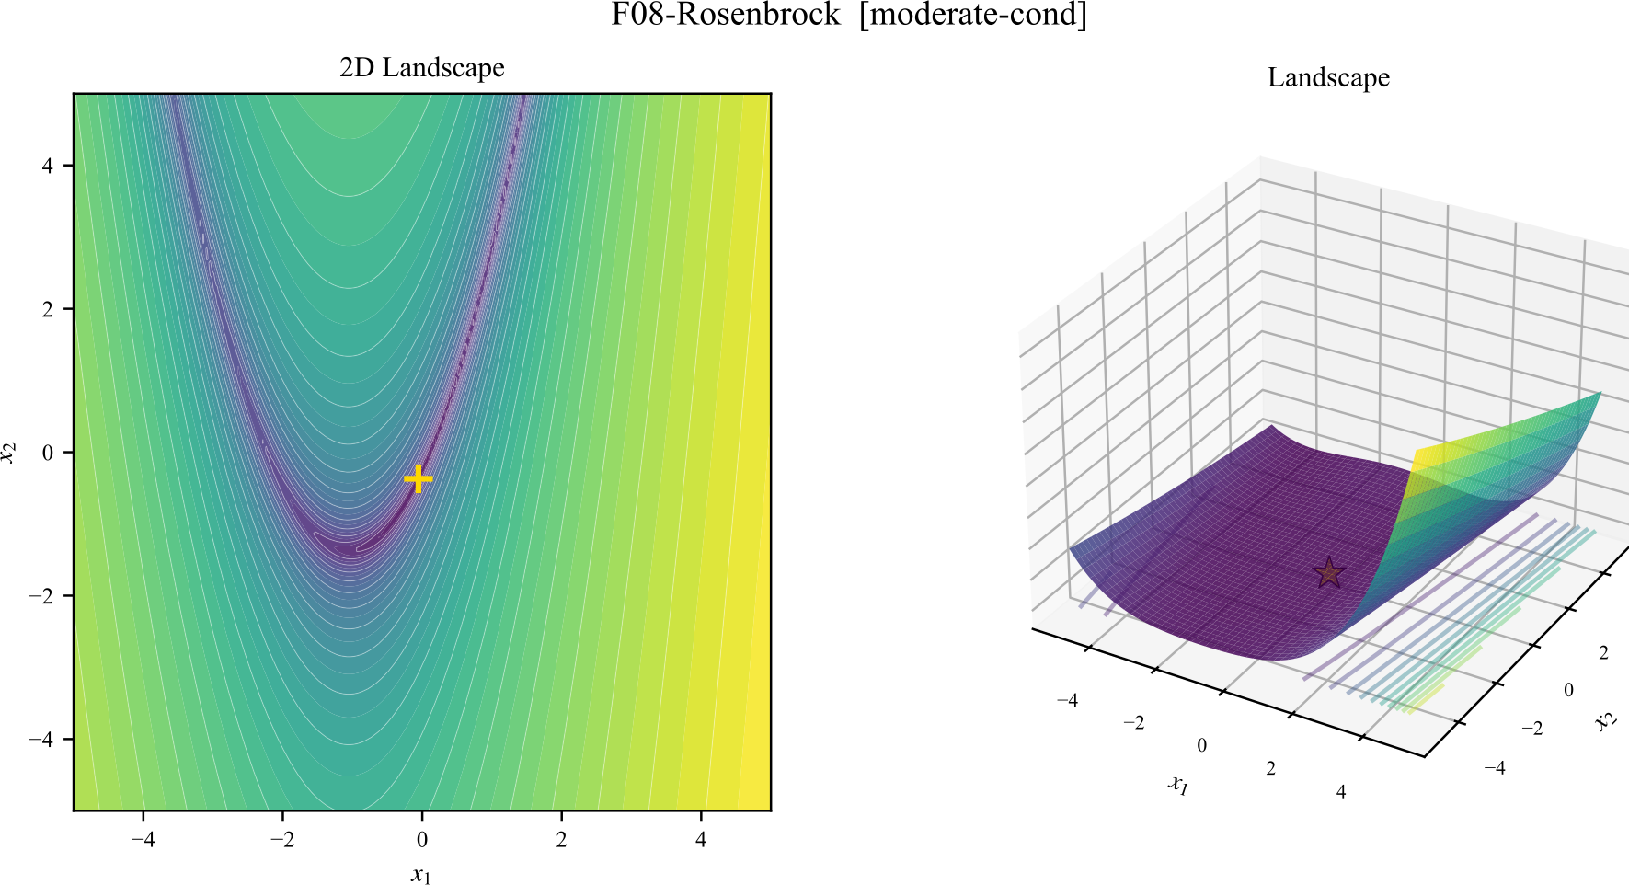
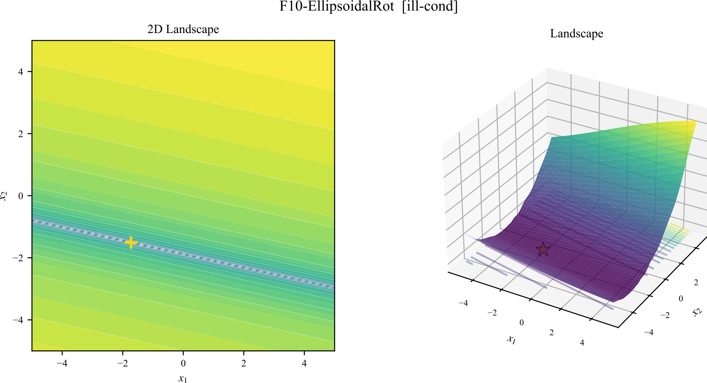
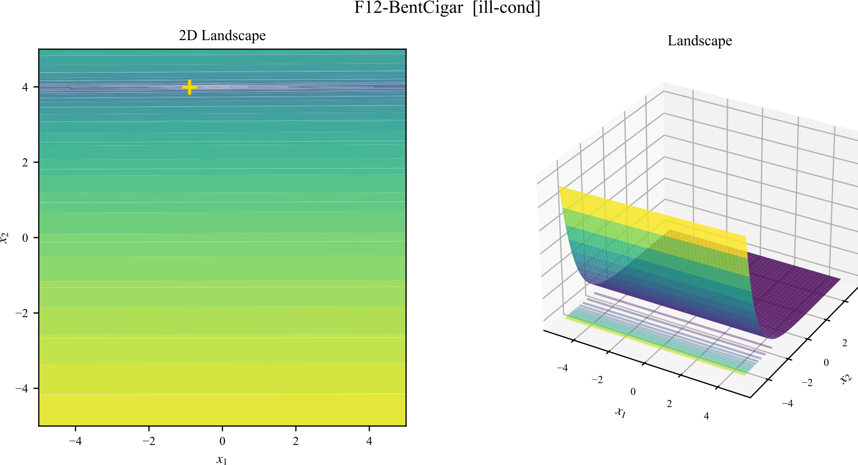
Black-box functions come in many flavours of hard
Multimodal — many local optima
Narrow curved valley
Ill-conditioned & rotated
Extreme anisotropy
1 — Background
4 / 35

Slide 5
Every existing method has a class of problems it can't solve
CMA-ES
DE
Gets trapped in local optima on multimodal landscapes
Struggles when the problem is strongly anisotropic
PSO
SaVOA
Stagnates on narrow valleys
Single channel — can't both escape AND refine
1 — Background
5 / 35

Slide 6
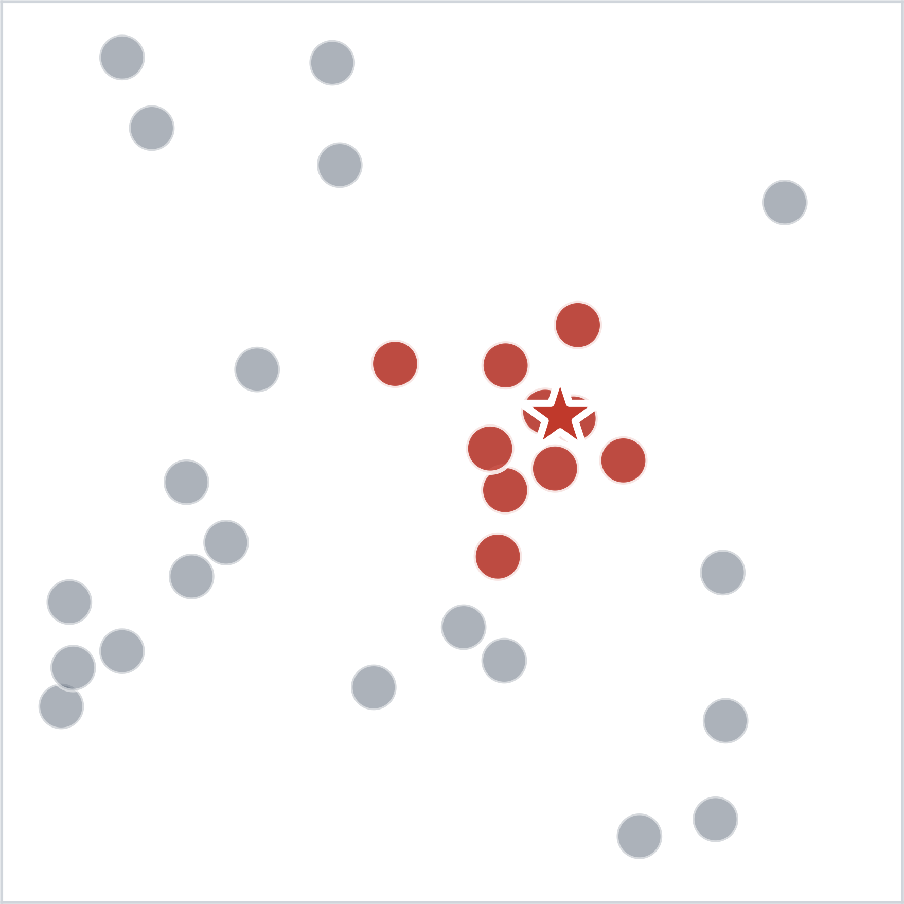
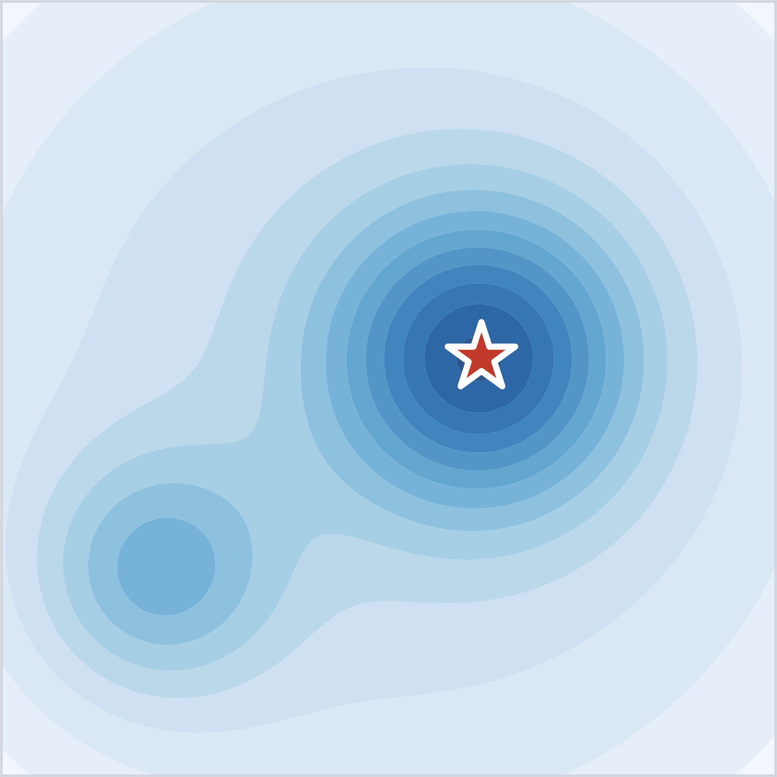
Epidemic spread and optimization share the same structure
Epidemic spread
Viral particle
Optimization
Sample point
Host-density map
Objective landscape
Outbreak in dense area
Finding the optimum
→ Borrow how an epidemic concentrates on dense regions
1 — Background
6 / 35

Slide 7
2
Purpose & Significance
What we ask, and why it matters
7 / 35

Slide 8
Goal & contributions
GOAL
Build a search method that performs reasonably on every function
Novelty
First metaheuristic to combine multiple transmission routes (epidemic-inspired)
Mechanism
Channel mixing + population control + step-size adaptation
Outcome
High success rate across the BBOB benchmark — see next slide
2 — Purpose & Significance
8 / 35

Slide 9
Result preview — overall and per-category SR@1e-4
26 BBOB functions × 10 runs each — higher = solves more functions
MC-ESO
DE
PSO
SaVOA
CMA-ES
91.9%
91.9%
73.1%
73.1%
71.2%
Category
MC-ESO
DE
PSO
SaVOA
CMA-ES
Separable
100%
98%
98%
82%
72%
Moderate cond.
98%
95%
100%
100%
93%
Ill-conditioned
94%
100%
40%
52%
100%
Multimodal
92%
98%
80%
68%
44%
Weak structure
74%
66%
42%
58%
40%
→ MC-ESO is the only method that stays ≥ 74% in every category
2 — Purpose & Significance
9 / 35

Slide 10
3
Proposed Method
MC-ESO — generation flow, three channels, three population mechanisms
10 / 35

Slide 11
One generation: 5 steps, each with its own innovation
1
Spawn
Three transmission channels
Contact / Droplet / Airborne in parallel
2
Evaluate
(no new mechanism)
Fitness call only
3
Update strain pool
Strain coexistence
Keep up to 6 spatially-separated elites
4
Select population
Host competition
μ+λ greedy with parent rollback
5
Restart?
Spillover + σ adaptation
Escalating re-seed when stagnated
→ The next slides detail each innovation (rows 1, 3, 4, 5)
3 — Proposed Method
11 / 35

Slide 12


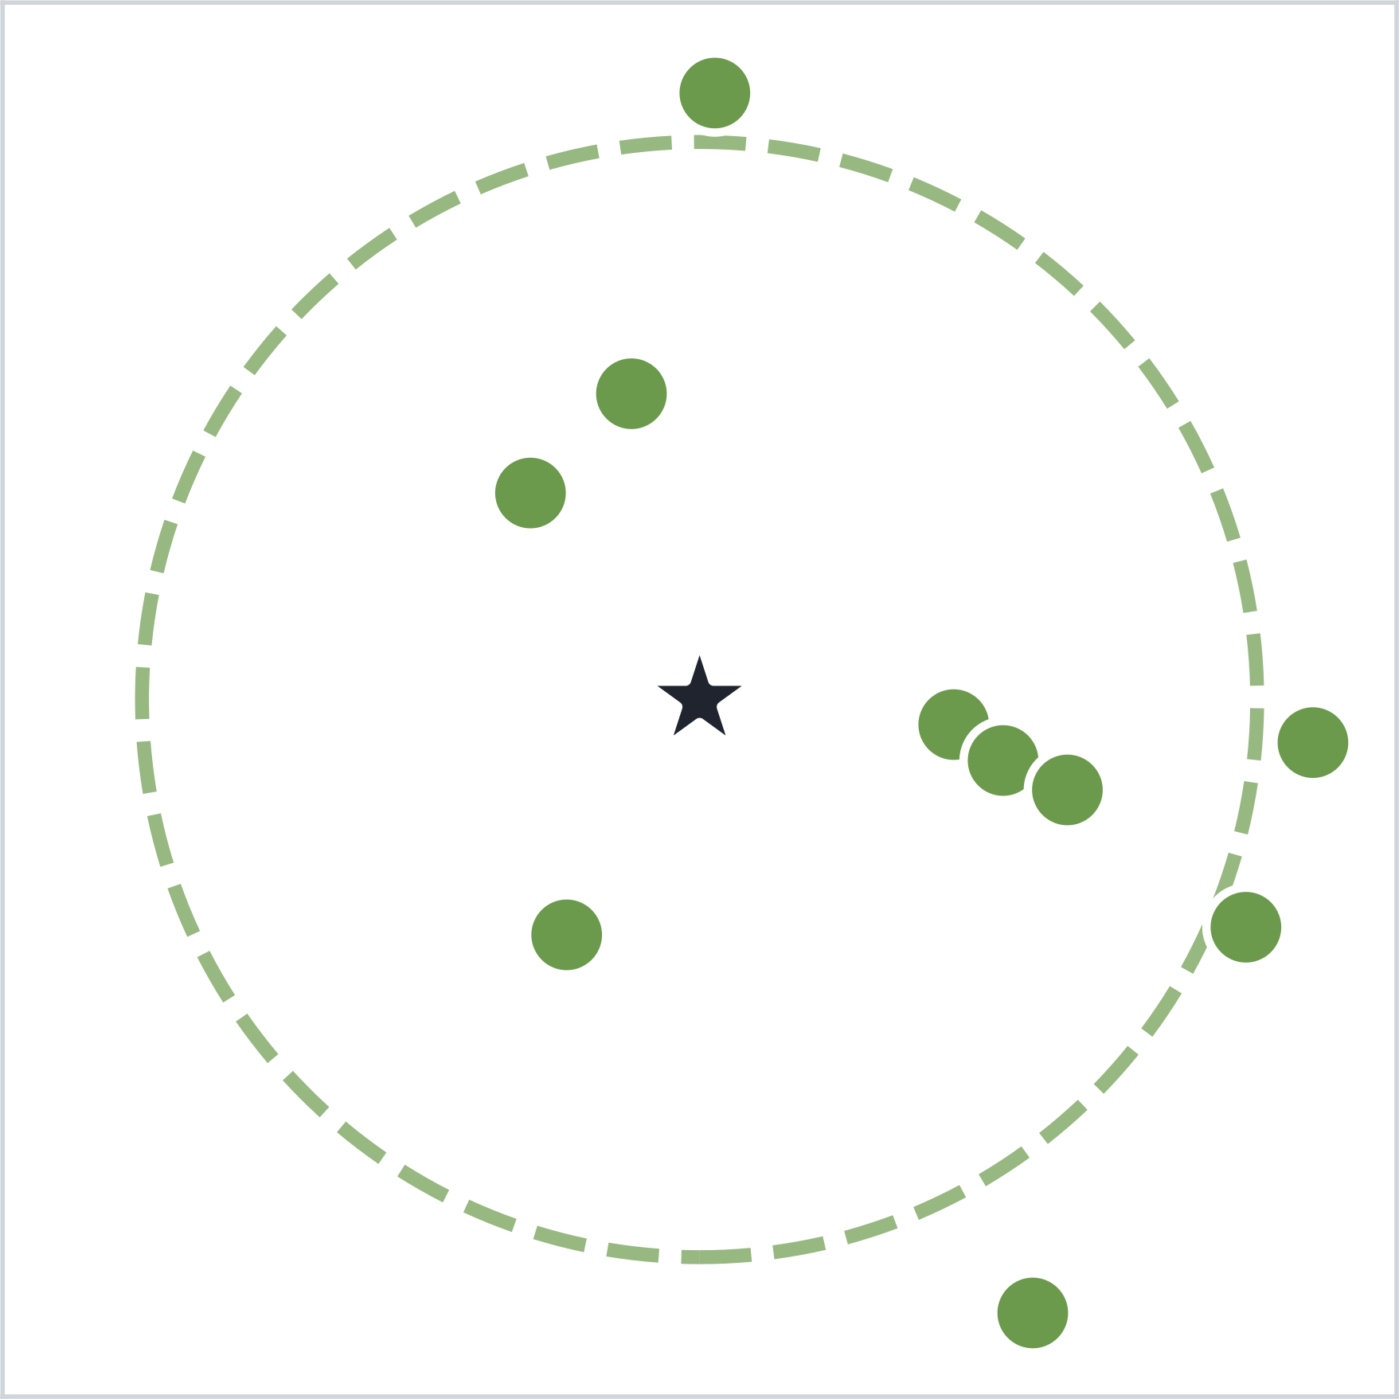
Three transmission channels
Close-contact
Droplet
Airborne
p = 30 %
p = 40 %
p = 30 %
Mimics: Person-to-person touch
Mimics: Coughs / sneezes carry the virus to neighbours
Mimics: Aerosols drift far from any source
Spawn near the source — exploit the local basin
Pull toward another elite strain — implicit anisotropy
Spawn far from the population — escape when stuck
3 — Proposed Method
12 / 35

Slide 13
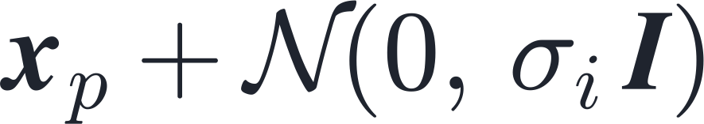
Channel — Close-contact
Close-contact
FORMULA
ROLE
1.
Pick a parent x_p from the population
2.
Sample a Gaussian step with width σᵢ
3.
σᵢ shrinks with fitness and parent age
4.
→ Refines the basin the parent sits in
3 — Proposed Method
13 / 35

Slide 14
Channel — Droplet
Droplet
FORMULA
ROLE
1.
Pull the parent toward another elite strain
2.
Perturb with a population differential vector
3.
No covariance matrix is learned explicitly
4.
→ Implicit anisotropy — alignment is automatic
3 — Proposed Method
14 / 35

Slide 15
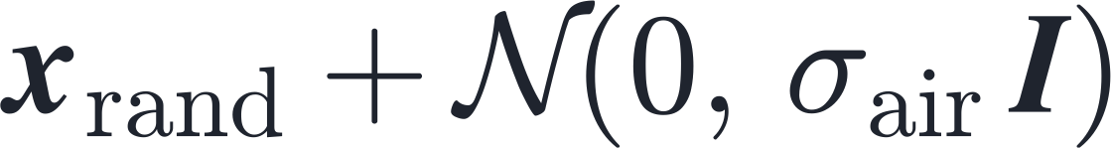
Channel — Airborne
Airborne
FORMULA
ROLE
1.
Sample a random location, independent of any parent
2.
Use a wide step width σ_air (much larger than σᵢ)
3.
Independent of where the population currently sits
4.
→ Escape route when the swarm is trapped
3 — Proposed Method
15 / 35

Slide 16
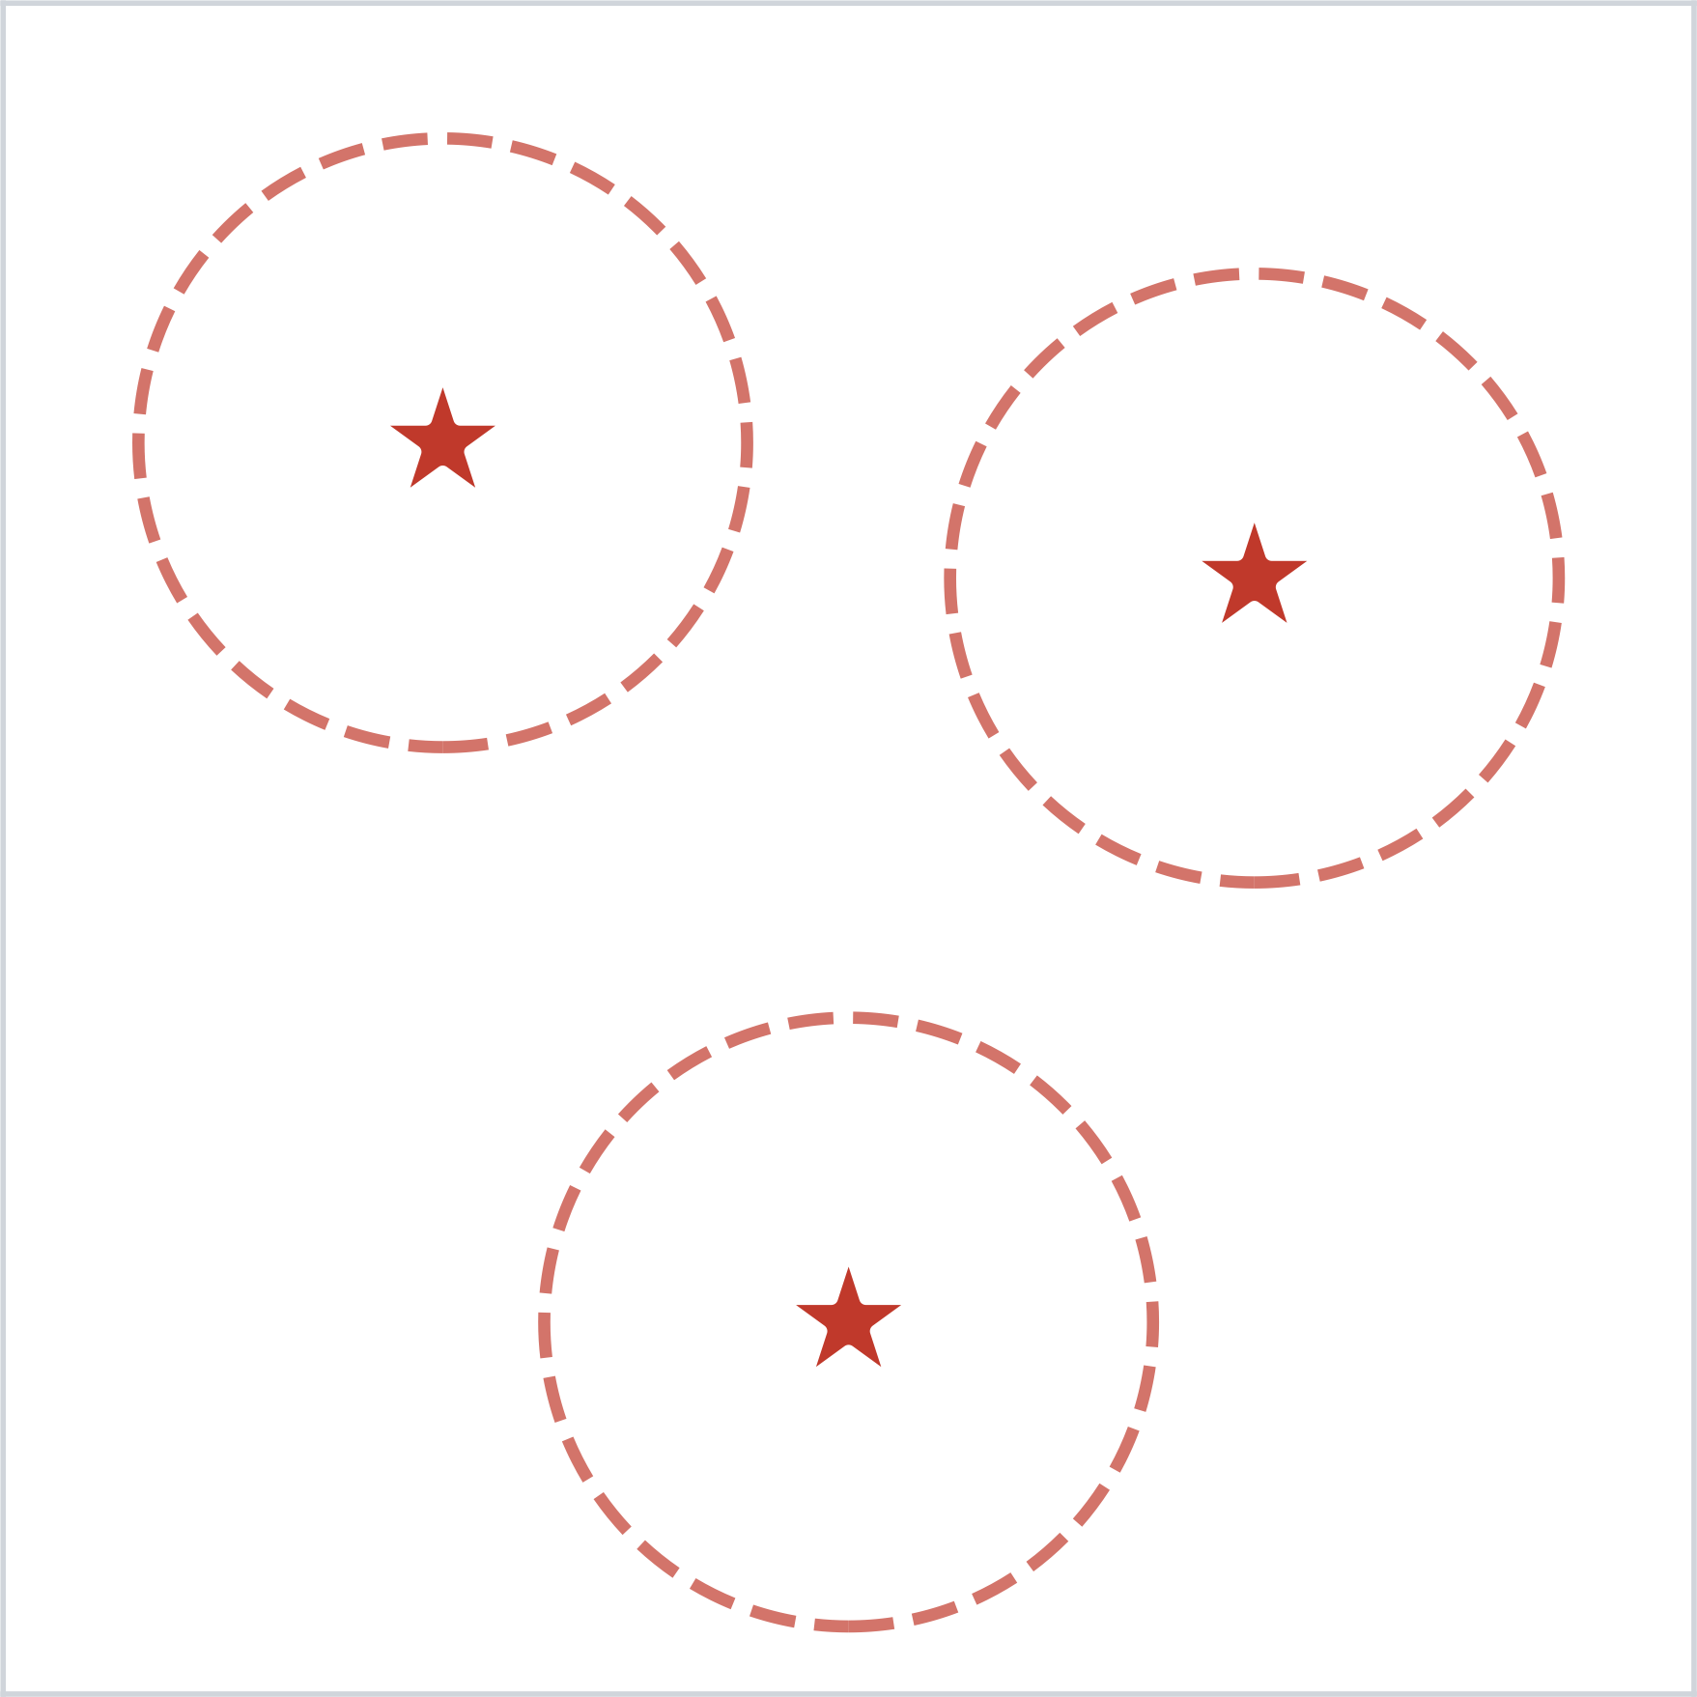
Population mechanism — Strain coexistence
Strain coexistence
Keep up to 6 spatially-separated elite strains
Instead of locking onto a single source, we protect several elite strains that are spaced apart. → The droplet channel can pull toward any of them, so the search stays diverse on multimodal landscapes.
niche_radius = 1.0 n_elite_max = 6
3 — Proposed Method
16 / 35

Slide 17
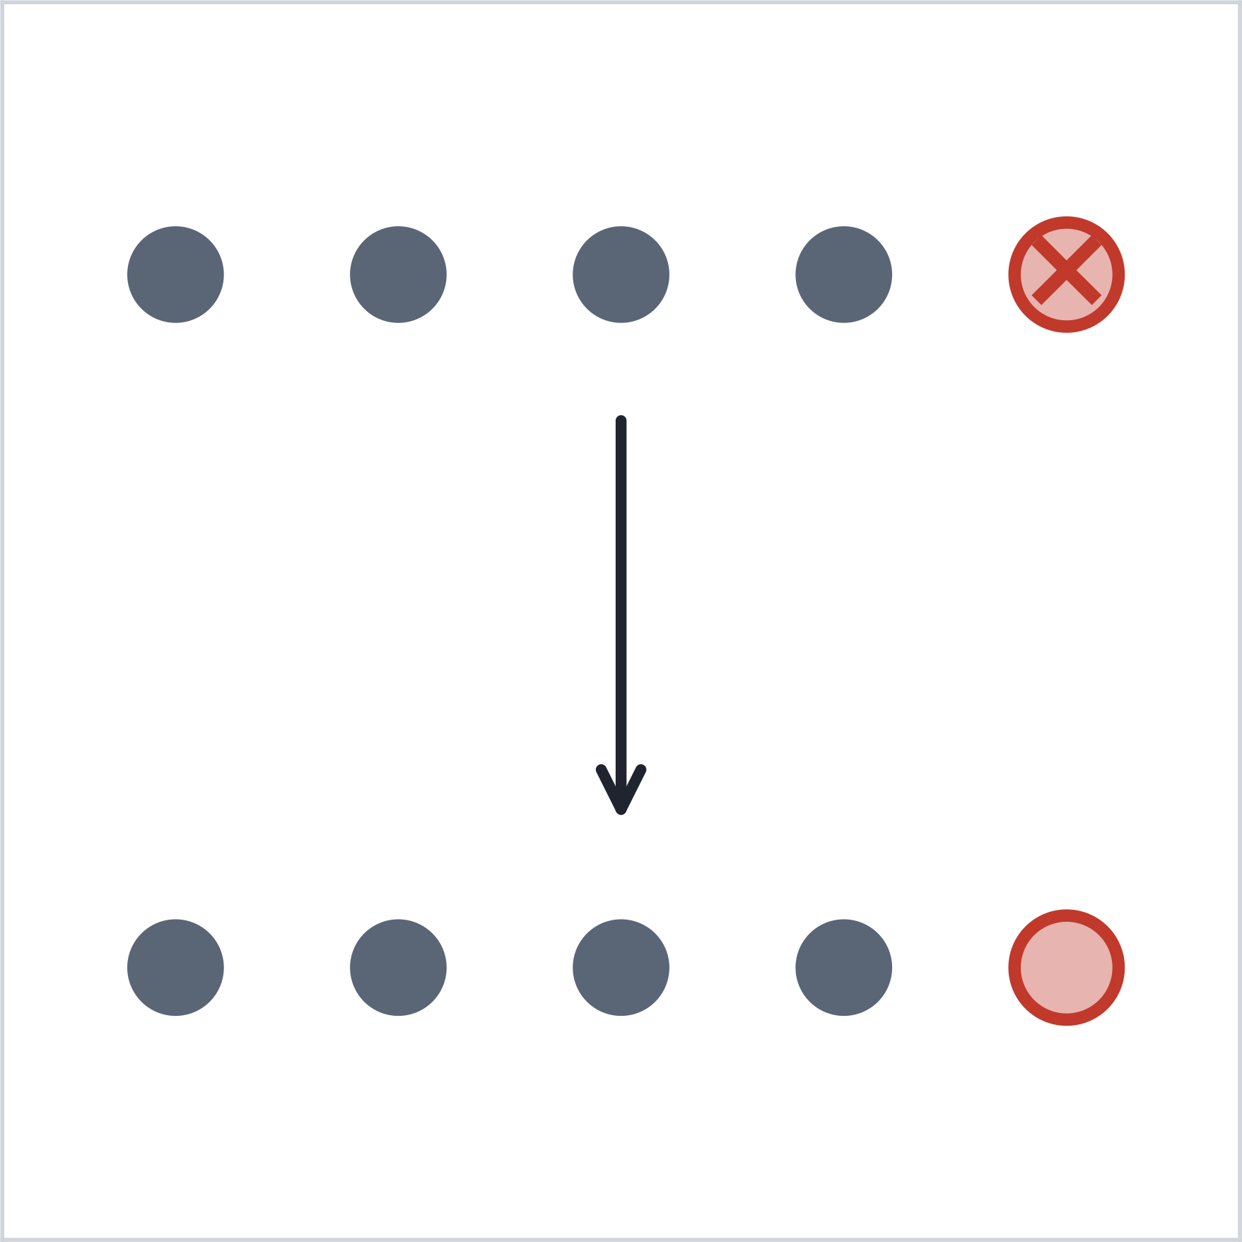
Population mechanism — Host competition
Host competition
Each generation: kill the bottom 25%, then rollback if children are worse
Kill the worst quartile of the population. Insert new children into the empty slots — but if a child is worse than its parent, revert. → The population improves monotonically; no regression allowed.
kill_fraction = 25%
3 — Proposed Method
17 / 35

Slide 18
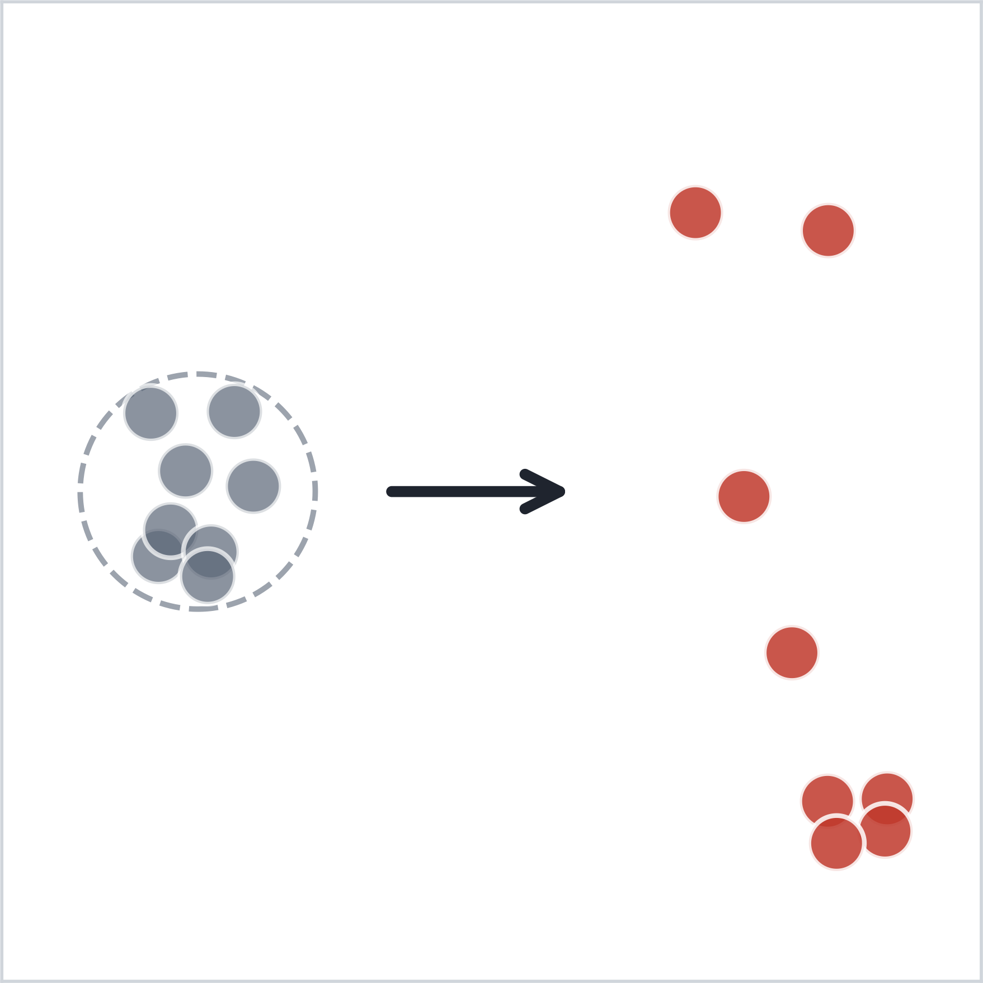
Population mechanism — Spillover
Spillover
Escalating re-seed when improvement stalls
Reset strength grows with the stagnation streak: • Stage 0: replace 75% of the population uniformly • Stage 1: replace 100% (best preserved) • Stage 2: also discard the best, reset σ (basin switch)
no_improve ≥ 300 AND f_best > 1e-8
3 — Proposed Method
18 / 35

Slide 19
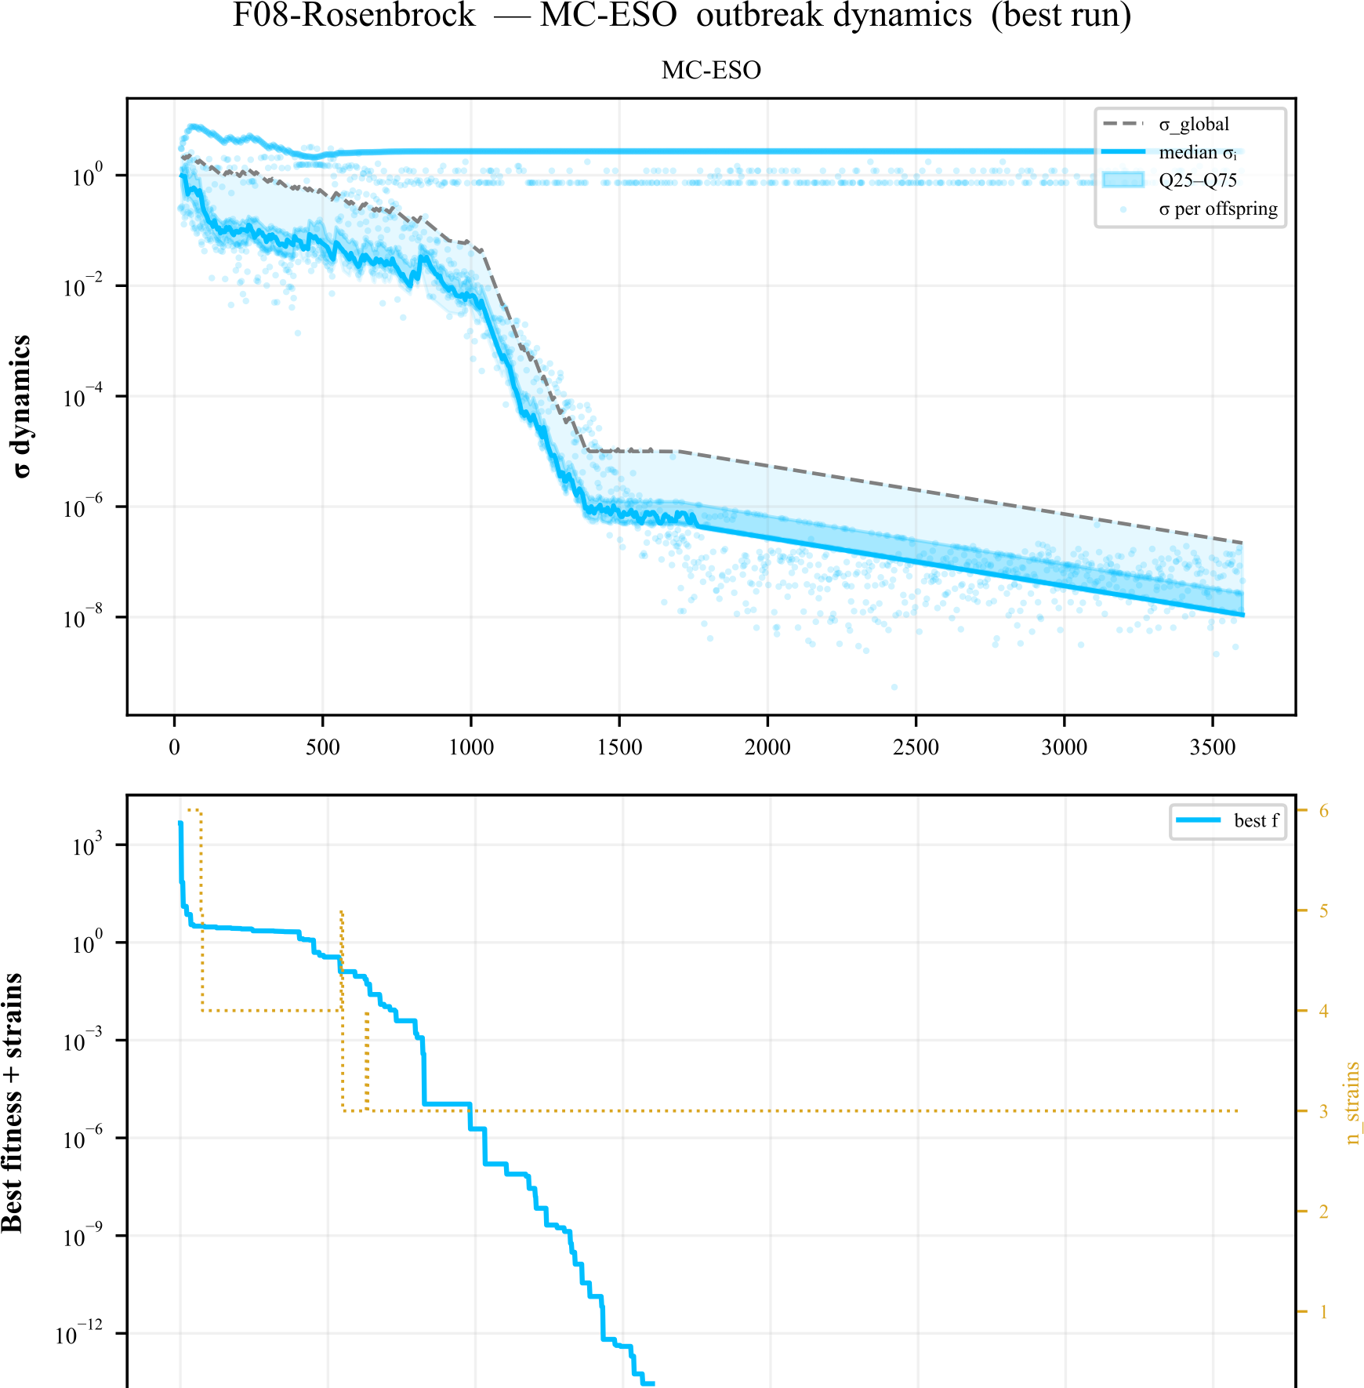
Step-size σ adaptation
Example: σ trajectory of one MC-ESO run on F08-Rosenbrock
Expand on improvement, shrink on stagnation, drill hard at the end.
3 — Proposed Method
19 / 35

Slide 20
4
Experiments
BBOB benchmark — conditions and baselines
20 / 35

Slide 21
Experimental setup
Benchmark
BBOB (24 functions) + 2 classical (C01–C02)
Dimension
d = 2, search domain [−5, 5]ᵈ
Budget
5,000 evaluations per run
Repetitions
50 independent runs per (function, method)
Success
Run succeeds if best f ≤ target threshold (1e−1 … 1e−10)
Metric
SR@1e-k = success rate at threshold 10⁻ᵏ
4 — Experiments
21 / 35

Slide 22
Comparison methods (details in appendix)
MC-ESO
Three transmission channels (contact + droplet + airborne) in parallel
CMA-ES
Learns a covariance matrix; reshapes sampling to fit the landscape
PSO
Particles move toward their own best and the swarm's best
SaVOA
Virus-inspired (single channel) with self-adaptive step size
4 — Experiments
22 / 35

Slide 23
5
Results
Success rate across all functions; the hard cases
23 / 35

Slide 24
Average success rate over 26 BBOB functions
26 functions × 50 runs × SR@1e-4 (= fraction reaching target precision)
MC-ESO
93.5%
PSO
74.6%
SaVOA
74.3%
CMA-ES
70.6%
→ MC-ESO leads every baseline by at least 19 percentage points
5 — Results
24 / 35

Slide 25
Full BBOB — success rate at multiple precision thresholds
SR @ 1e-2
SR @ 1e-4
SR @ 1e-7
SR @ 1e-10
2472 / 2600
2432 / 2600
2290 / 2600
2184 / 2600
95.1%
93.5%
88.1%
84.0%
Top method on 21 / 26 functions (6 outright + 15 tied)
5 — Results
25 / 35

Slide 26
Where MC-ESO still struggles
The 3 weakest cases — all of them are open problems for every method
Function
SR @ 1e-4
Type
Why it's hard
F24 Lunacek bi-Rastrigin
16%
Double funnel
Deeper funnel is the wrong basin (deceptive)
F23 Katsuura
58%
Fractal
Self-similar; no smoothing scale exists
F18 Schaffer F7 (ill)
88%
Ill-cond. multimodal
Many local optima inside a narrow valley
F04 Büche-Rastrigin
92%
Asymmetric multimodal
Dense grid of local optima, asymmetric
These remain open problems across the entire metaheuristic literature
5 — Results
26 / 35

Slide 27
6
Discussion
Why it works, and where it loses
27 / 35

Slide 28
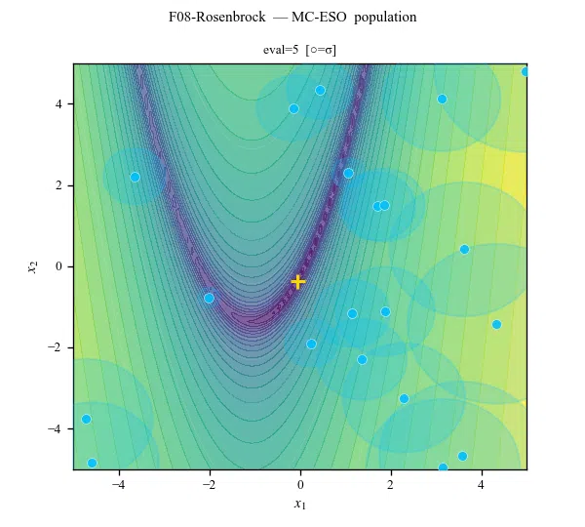
Why does it work — ① Implicit anisotropy
The droplet channel picks up the landscape's anisotropy for free
The differential vector used by the droplet channel naturally aligns with the dominant spread direction of the population. → Same benefit as CMA-ES, without explicit covariance. • Extra cost: zero • Helps on: narrow valleys like F08 Rosenbrock
6 — Discussion
From the F08-Rosenbrock run
28 / 35

Slide 29
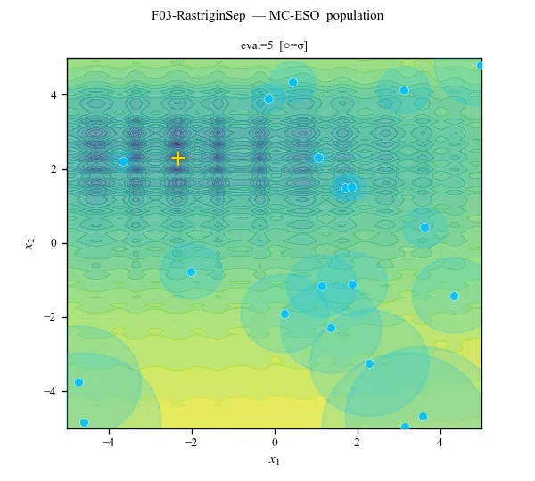
Why does it work — ② Multimodal coverage
Strain coexistence keeps multiple peaks alive simultaneously
Instead of locking onto a single source, MC-ESO keeps up to 6 spatially-separated elite strains. → A single trapped optimum no longer terminates the search. • Extra cost: light (distance check only) • Helps on: rugged multimodal like F03 Rastrigin
6 — Discussion
From the F03-RastriginSep run
29 / 35

Slide 30
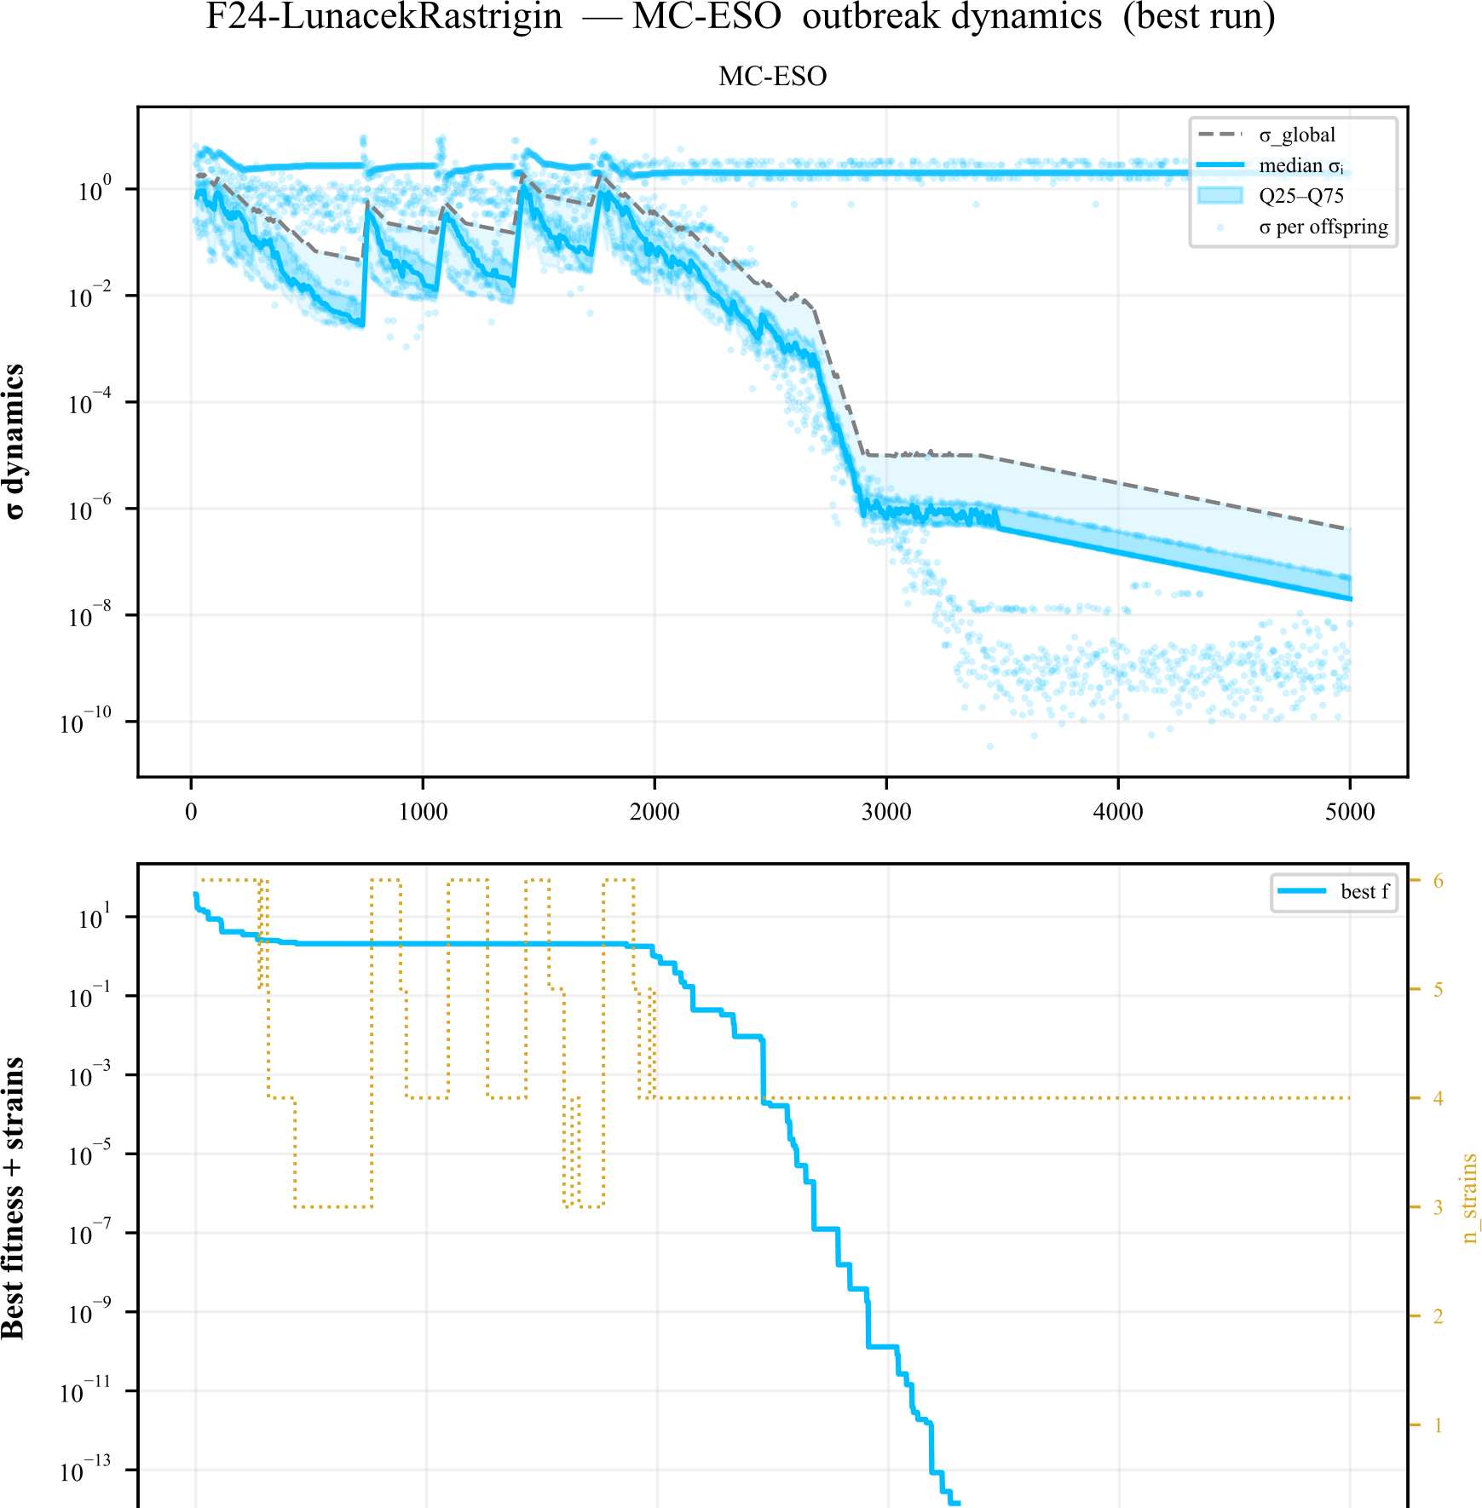
Why does it work — ③ Adaptive disruption
Spillover explosively re-seeds a stuck population
When improvement stalls for long, the reset strength escalates with each successive failure. → The algorithm doesn't just wait — it switches basins by itself. • Helps on: multi-basin landscapes like F24
6 — Discussion
From the F24-LunacekRastrigin run
30 / 35

Slide 31
Limitations
•
Hand-tuned channel ratios (30:40:30)
•
Deceptive funnels (F24, F23)
•
Only d = 2 reported
•
No gradient hybridization
6 — Discussion
31 / 35

Slide 32
7
Conclusion
Summary
32 / 35

Slide 33
Conclusion
Idea
Multi-route reproduction inspired by epidemic spread
Mechanism
3 transmission channels + 3 population mechanisms + adaptive σ
Result
Average SR = 93.5% on BBOB-26 — outperforms all 3 baselines
Thank you.
7 — Conclusion
33 / 35

Slide 34
Appendix — SaVOA (Self-adaptive Virus Optimization)
The closest prior work — also virus-inspired, but with a single channel
Inspiration
Viral infection and self-replication
Reproduction
Single Gaussian sample around the parent (contact channel only)
σ update
Self-adaptive — each agent learns its own step size
Population
Simple generational replacement. No niching, no escalating restart.
vs. MC-ESO
• 1 channel → 3 (contact + droplet + airborne) • Adds 3 population mechanisms (strain coexistence, host competition, spillover)
Appendix
34 / 35

Slide 35
Appendix — Other baselines
CMA-ES
Covariance Matrix Adaptation Evolution Strategy (de facto standard)
• Learns the shape of the sampling Gaussian itself • Excellent on elongated / rotated landscapes • Tends to get trapped in local optima on multimodal functions
PSO
Particle Swarm Optimization
• Each particle moves toward its own best and the swarm best • Strong on smooth problems / stagnates on high-dim narrow valleys
Appendix
35 / 35

