Slide 1
PROGRESS REPORT #2
MC-ESO
Multi-Channel Epidemic Spread Optimizer
Diagnosis-driven refinements since 5/18
M1 Kosei Matsuzaki / 2026-07-14

Slide 2
1
Recap
Where the 5/18 report left off

Slide 3
Motivation & goal
Every method has a landscape it fails on
mean SR@1e-10 / BBOB-24 / dim 2
Method
Weak function shape
SR@1e-10
CMA-ES / L-SHADE
Multimodal (F15–F24)
32% / 42%
PSO / SaVOA
Ill-conditioned (F10–F14)
7% / 18%
DE
Bent-valley / asymmetric (F06–F09)
91% (rest ≈100)
GOAL
Mimic multi-route viral spread — robust across every function shape
1 — Recap
3 / 45

Slide 4
How MC-ESO works
Droplet
Close-contact
Airborne
Transmission
channels
three parallel
reproduction routes
Strain coexistence
Restart (spillover)
Drilling
Population
strategies
how the swarm
is steered
1 — Recap
4 / 45

Slide 5
Previous results (5/18)
Best at SR@1e-4 — but DE led at 1e-10
BBOB-24 [10] / dim 2 / n = 30
method
1e-4
1e-10
MC-ESO
95.2
86.2
DE
91.2
89.8
SaVOA
71.5
59.5
PSO
72.5
48.9
CMA-ES
70.0
64.3
1 — Recap
5 / 45

Slide 6
2
Direction
Where to grow — and what we chose

Slide 7
Performance first
Fix the SR@1e-10 gaps before chasing multiple optima
A. Performance
B. Multimodality
CHOSEN
PARTIAL
› Fill deep-precision gaps on F11–F14
› SR@1e-10 never lowered
› Find many optima in parallel
› Sequential niching — SR-safe only
Primary metric = SR@1e-10
Deeper work deferred → §5
2 — Direction
7 / 45

Slide 8
3
Improvements
Four changes — what, why, and the numbers

Slide 9
Four changes since 5/18
Cumulative — each builds on the last
6/12
6/24
7/03
7/03
Informed restart
reservoir re-ignition + basin repulsion
Adaptive floor
eigenvalue-ratio anisotropy
Channel router
per-landscape air-budget routing
Route-gated best2
2nd difference on droplet route
3 — Improvements
9 / 45

Slide 10
Cumulative ablation — +6.0 pt
SR@1e-10 86.9 → 92.9%
BBOB-24 / dim 2 / n = 20
Now strong at both ends — coarse discovery kept (1e-4 saturated), deep precision gained (1e-10 +6, past DE)
Sanity: abl0 86.9% ≈ the 86.2% measured on 5/18 (n=30)
3 — Improvements
10 / 45

Slide 11
① Informed restart
Droplet
Close-contact
Airborne
Transmission
channels
three parallel
reproduction routes
Strain coexistence
Restart (spillover)
Drilling
Population
strategies
how the swarm
is steered
3 — Improvements
11 / 45

Slide 12
① Informed restart
A stalled sub-population re-seeds — real run on F04
3 — Improvements
12 / 45

Slide 13

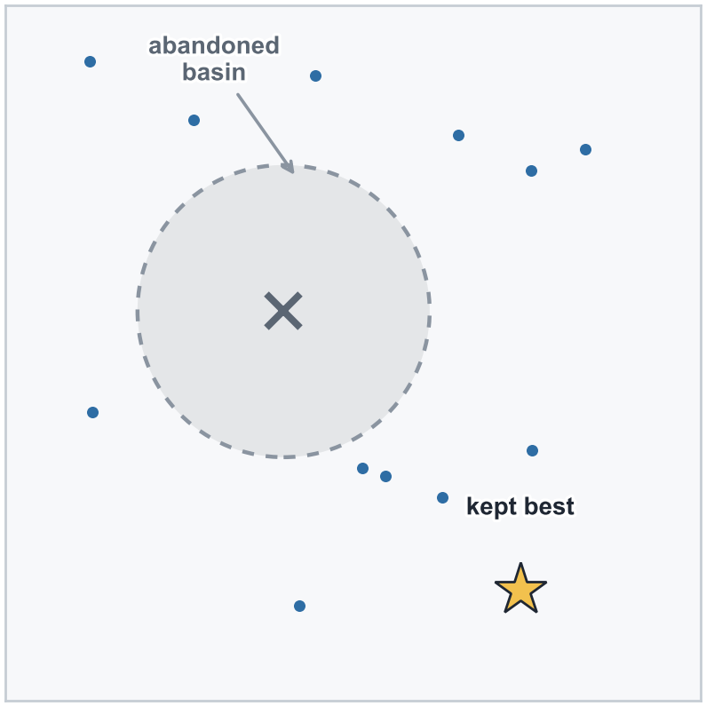
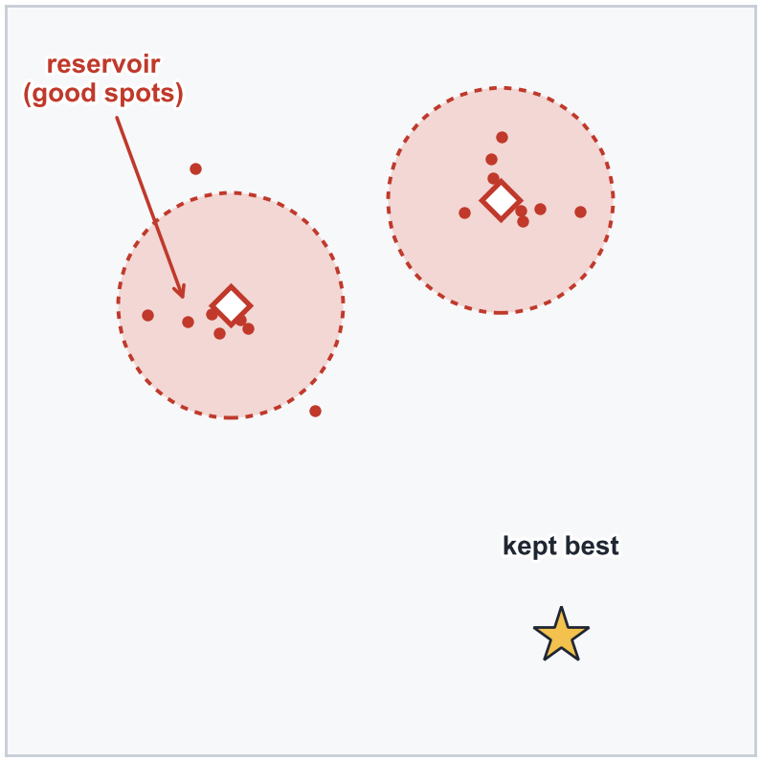
① Informed restart — how it works
Re-seed from what the search already found, not blindly
REPELLED
RE-IGNITE
+
no improvement 300 evals
&
f_best/|f_init| > 1e-8
uniform, but repelled from remembered basins
re-light around archived elites — good spots found
3 — Improvements
13 / 45

Slide 14
① Informed restart — result
F04-BucheRastrigin / seed 200
F18-SchafferF7ill / seed 1100
3 — Improvements
14 / 45

Slide 15
① Informed restart — per-function SR
Net ±0 on BBOB-24 — the payoff is multimodal escape
change-ablation / BBOB-24 / dim 2 / n = 20
3 — Improvements
15 / 45

Slide 16
② Adaptive anisotropy floor
Droplet
Close-contact
Airborne
Transmission
channels
three parallel
reproduction routes
Strain coexistence
Restart (spillover)
Drilling
Population
strategies
how the swarm
is steered
3 — Improvements
16 / 45

Slide 17
② Adaptive anisotropy floor
Close-contact noise adapts to the landscape shape
3 — Improvements
17 / 45

Slide 18



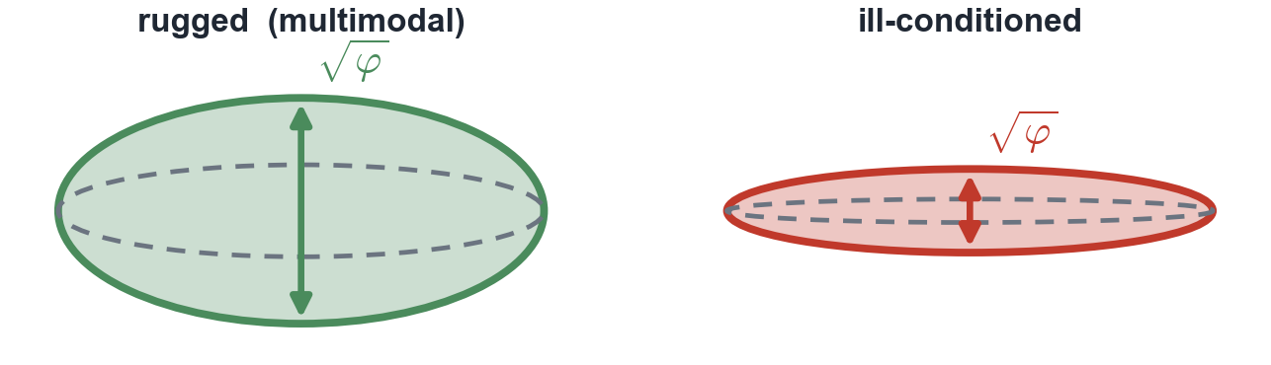
② Adaptive anisotropy floor — the math
Only the floor φ is new — the pipeline is unchanged
Close-contact channel — same flow as before
EIGEN-DECOMPOSE
FLOOR THE AXES
SAMPLE CHILD
population spread → axes V, variances λ
lift any collapsed axis up to the floor φ
draw from the floored ellipse (step σ_i, noise z)
The floor φ is now adaptive
EMA = exponential moving average — smooths out transient blips
3 — Improvements
18 / 45

Slide 19
② Adaptive anisotropy floor — result
F10-EllipsoidalRot / seed 300
F19-GriewankRosenbrock / seed 1400
3 — Improvements
19 / 45

Slide 20
② Adaptive anisotropy floor — per-function SR
Net +3.1 pt — the largest single step
change-ablation / BBOB-24 / dim 2 / n = 20 / functions whose SR@1e-10 moved
3 — Improvements
20 / 45

Slide 21
③ Channel router
Droplet
Close-contact
Airborne
Transmission
channels
three parallel
reproduction routes
Strain coexistence
Restart (spillover)
Drilling
Population
strategies
how the swarm
is steered
3 — Improvements
21 / 45

Slide 22
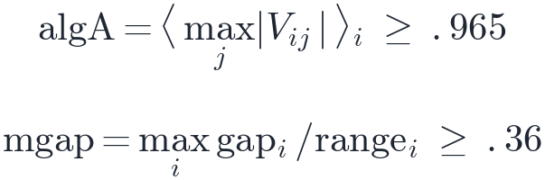

③ Channel router
Each run locks one route, read off its covariance shape
DROPLET
CLOSE
KEEP-AIR
3 — Improvements
22 / 45

Slide 23
③ Channel router — result
F11-Discus / seed 600
F16-Weierstrass / seed 1200
3 — Improvements
23 / 45

Slide 24
③ Channel router — per-function SR
Lifts exactly what it routes — net +0.8 pt
change-ablation / BBOB-24 / dim 2 / n = 20 / functions whose SR@1e-10 moved
3 — Improvements
24 / 45

Slide 25
④ Route-gated best2
Droplet
Close-contact
Airborne
Transmission
channels
three parallel
reproduction routes
Strain coexistence
Restart (spillover)
Drilling
Population
strategies
how the swarm
is steered
3 — Improvements
25 / 45

Slide 26
④ Route-gated best2
A 2nd difference vector — only on droplet-routed runs
DROPLET Route?
NO
YES
off route — bit-identical to base
on route — 2nd donor pair escapes
3 — Improvements
26 / 45

Slide 27
④ Route-gated best2 — result
F13-SharpRidge / seed 300
F14-DiffPowers / seed 500
3 — Improvements
27 / 45

Slide 28
④ Route-gated best2 — per-function SR
F13/F14 jump to 100% — net +2.1 pt
change-ablation / BBOB-24 / dim 2 / n = 20 / functions whose SR@1e-10 moved
3 — Improvements
28 / 45

Slide 29
The four changes together
SR@1e-10 by function, base → MC-ESO
change-ablation / BBOB-24 / dim 2 / n = 20 / base → +restart → +floor → +router → +best2
3 — Improvements
29 / 45

Slide 30
Ill-conditioned valleys converge ~2× faster
Same SR, about half the evaluations
evals-to-success / same ablation ladder / BBOB-24 / dim 2 / n = 20
3 — Improvements
30 / 45

Slide 31
4
Comparison
MC-ESO vs existing methods

Slide 32
The comparison set
Five baselines — colours match the curves that follow
IPOP-CMA-ES [1]
CMA-ES with restarts + growing population
weak: multimodal
PSO [2]
Inertia-weighted particle swarm
weak: ill-conditioned
DE [3]
DE/rand/1/bin — the droplet channel's ancestor
weak: multimodal
SaVOA [4]
Self-adaptive virus optimization
weak: ill-conditioned
NM-Restart [5]
Restarted Nelder–Mead simplex
strong: low-dim
Others (CMA-ES / BIPOP / L-SHADE / NCDE) → appendix
4 — Comparison
32 / 45

Slide 33
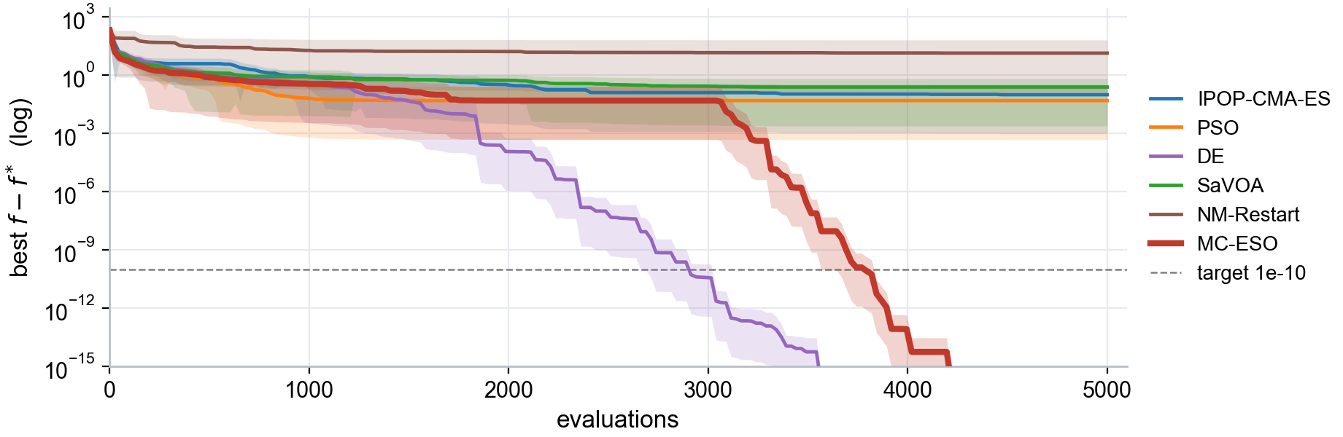
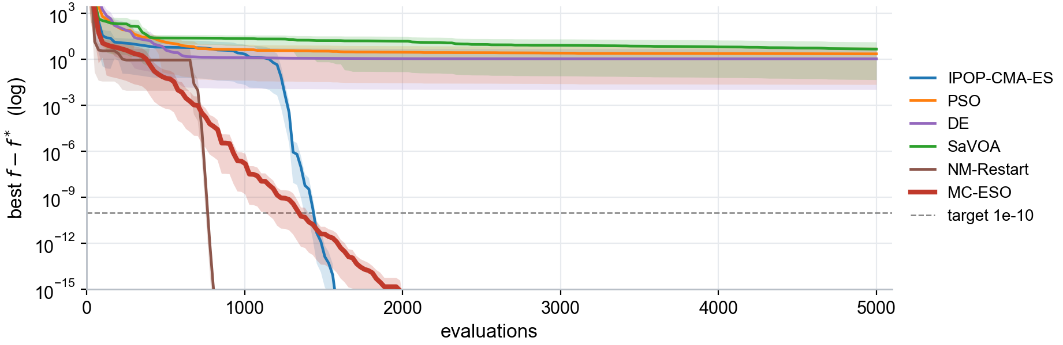
Where baselines struggle — multimodal & ill-conditioned
F03 / Rastrigin (separable) — multimodal
F11 / Discus — ill-conditioned
4 — Comparison
33 / 45

Slide 34
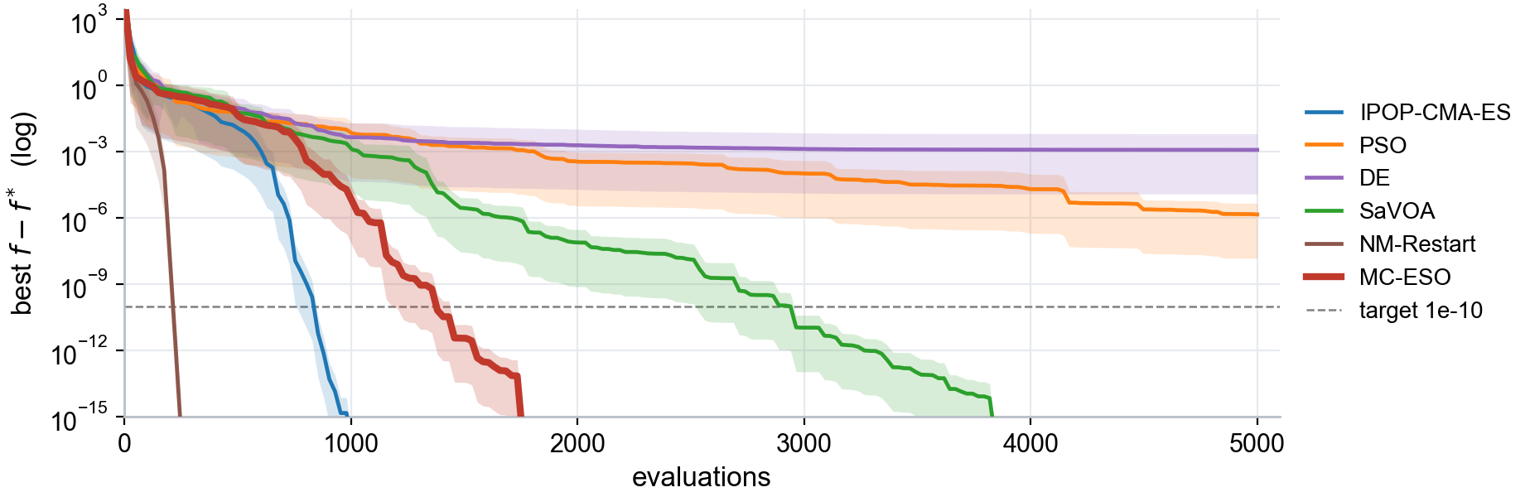
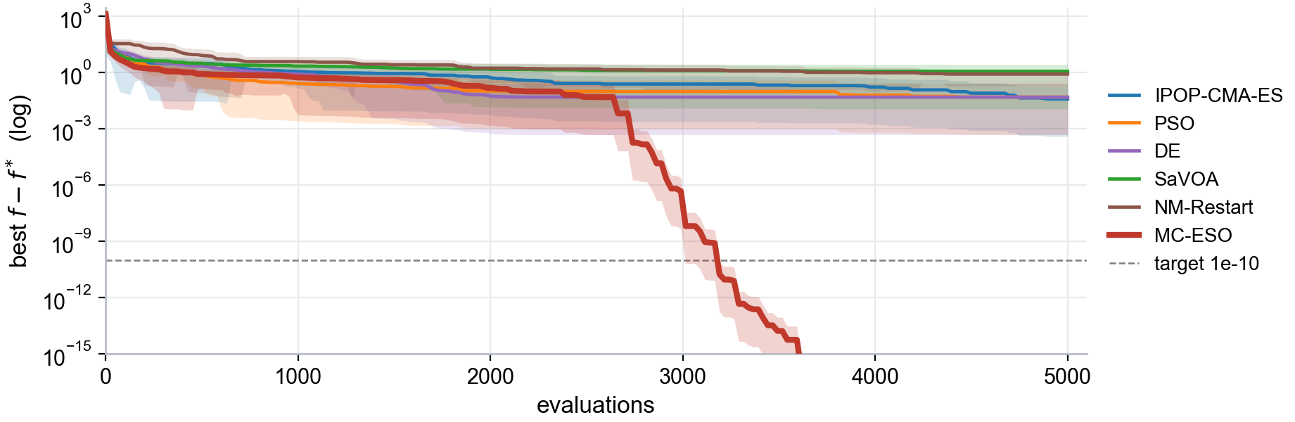
Where baselines struggle — bent valley & hardest case
F08 / Rosenbrock — bent valley
F15 / Rastrigin (rotated) — hardest
4 — Comparison
34 / 45

Slide 35
Standing today — first at deep precision
SR@1e-10 92.9% — DE overtaken
each cell: SR@1e-10 (left) / evals-to-success (right) / BBOB-24 / dim 2 / n = 20
Wilcoxon — vs each baseline
win
tie
loss
DE
2
21
1
IPOP-CMA-ES
6
18
NM-Restart
10
13
1
SaVOA
11
12
1
PSO
18
6
4 — Comparison
35 / 45

Slide 36
5
Multimodality
The deferred axis — partial progress

Slide 37
Multimodality — SR hides the gap
SR is 100%, yet few optima are found (low PR)
C01 Himmelblau
C02 Six-hump
C03 Shubert
K = 4 optima
K = 2 optima
K = 18 optima
SR@1e-10 100%
SR@1e-10 100%
SR@1e-10 100%
PR@1e-4 0.28
PR@1e-4 0.60
PR@1e-4 0.06
5 — Multimodality
37 / 45

Slide 38
Sequential niching
Droplet
Close-contact
Airborne
Transmission
channels
three parallel
reproduction routes
Strain coexistence
Restart (spillover)
Drilling
Population
strategies
how the swarm
is steered
5 — Multimodality
38 / 45

Slide 39
Sequential niching — more optima, SR untouched
One run captures optima one at a time — SR@1e-10 stays 100%
① drill a basin to 1e-10 — like base
② σ-exhausted → repelled restart to the next optimum
5 — Multimodality
39 / 45

Slide 40
6
Wrap-up
Summary and what remains

Slide 41
Summary
The whole cycle in three lines
Idea
Mechanism
Result
› Uniform channel mix →
› landscape-aware routing
› informed restart
› adaptive floor
› channel router
› route-gated best2
› SR@1e-10 86.9 → 92.9%
› top of 10 methods
› valleys 2× faster
› multi-solution ↑, SR kept
6 — Wrap-up
41 / 45

Slide 42
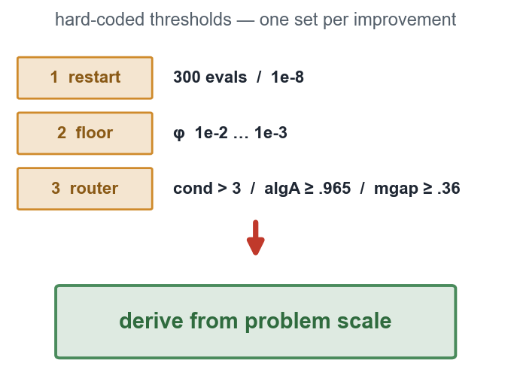
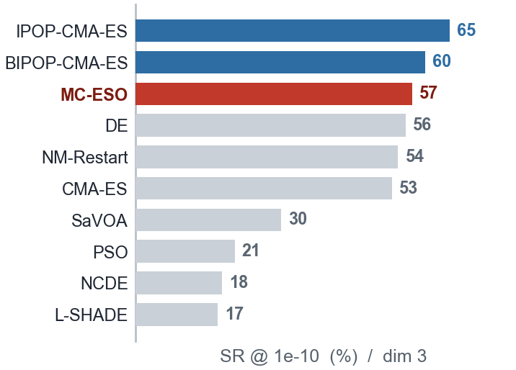
Remaining work
Three directions
Generalize the constants
Robustness
Higher dimensions
thresholds may be BBOB-tuned — make them scale-derived
partial multi-solution / robust to mild noise, severe open
at 3D the CMA-ES restart family overtakes MC-ESO at 1e-10
6 — Wrap-up
42 / 45

Slide 43
References
[1] A. Auger, N. Hansen. "A restart CMA-ES with increasing population size." IEEE CEC, 2005.
[2] J. Kennedy, R. Eberhart. "Particle swarm optimization." IEEE ICNN, 1995.
[3] R. Storn, K. Price. "Differential evolution." J. Global Optimization, 1997.
[4] Y.-C. Liang, J. R. Cuevas Juárez. "A self-adaptive virus optimization algorithm." Soft Computing, 2020.
[5] J. A. Nelder, R. Mead. "A simplex method for function minimization." The Computer Journal, 1965.
[6] N. Hansen, A. Ostermeier. "Completely derandomized self-adaptation in evolution strategies." Evolutionary Computation, 2001.
[7] N. Hansen. "Benchmarking a BI-population CMA-ES on the BBOB-2009 testbed." GECCO Workshop, 2009.
[8] R. Tanabe, A. Fukunaga. "Improving SHADE using linear population size reduction." IEEE CEC, 2014.
[9] B.-Y. Qu, P. N. Suganthan, J.-J. Liang. "DE with neighborhood mutation for multimodal optimization." IEEE TEVC, 2012.
[10] N. Hansen, A. Auger, R. Ros, O. Mersmann, T. Tušar, D. Brockhoff. "COCO: comparing continuous optimizers in a black-box setting." Optim. Methods & Software, 2021.
References
43 / 45

Slide 44
Appendix — the other baselines
In the full comparison; omitted from charts for legibility
CMA-ES [6]
Plain covariance-matrix ES with multistart — the IPOP base without population doubling.
BIPOP-CMA-ES [7]
CMA-ES restarts alternating large / small population regimes to keep the budgets balanced.
L-SHADE [8]
Success-history adaptive DE with linear population reduction (CEC2014 winner).
NCDE [9]
Neighborhood-based crowding DE — a niching specialist, used only for the multi-optima (PR / MMOsr) comparison.
Appendix
44 / 45

Slide 45
Appendix — landscape-signal measurements
All 35 functions in BBOB category order — the diagnostic behind the channel router
cond = log10 eigenvalue ratio, PR = participation ratio [1,2], algA = axis alignment [.71,1], offd = corr. off-diag RMS [0,1], divs = variance/span, kurt = excess kurtosis, mgap = max normalized gap, nelt = mean niche count, spil = spillover count values = median over exploration generations (σ > drilling)
highlighted cells = router triggers: cond ≥ 3.0 → droplet (checked first) algA > 0.965 ∧ mgap > 0.36 → close else → keep-air (= base)
base MC-ESO (unmodified) / dim 2 / n = 8
function
route
cond
PR
algA
offd
divs
kurt
mgap
nelt
spil
function
route
cond
PR
algA
offd
divs
kurt
mgap
nelt
spil
Separable — F01–05
Weak structure — F20–24
F01-Sphere
-
0.38
1.71
0.917
0.268
0.002
−0.13
0.301
1.60
4.0
F20-Schwefel
keep-air
1.16
1.14
0.956
0.691
0.024
−0.27
0.313
2.38
6.5
F02-EllipsoidalSep
droplet?
5.62
1.00
1.000
0.406
0.005
1.24
0.380
1.95
3.4
F21-Gallagher101
-
1.31
1.10
0.799
0.897
0.017
−0.48
0.275
2.56
4.0
F03-RastriginSep
-
1.03
1.19
0.994
0.294
0.018
0.08
0.397
2.50
4.1
F22-Gallagher21
-
2.74
1.00
0.900
0.993
0.012
−0.56
0.239
2.29
4.1
F04-BucheRastrigin
close
0.91
1.25
0.988
0.315
0.010
0.48
0.411
2.03
7.5
F23-Katsuura
-
0.67
1.43
0.912
0.435
0.144
−0.09
0.282
5.49
3.4
F05-LinearSlope
-
2.28
1.01
0.999
0.437
0.003
−0.09
0.290
1.71
4.2
F24-LunacekRastrigin
keep-air
0.64
1.47
0.876
0.498
0.076
0.21
0.325
4.31
13.1
Moderate — F06–09
Custom (multi-optimum) — C01–11
F06-AttractiveSector
close?
1.26
1.11
0.957
0.698
0.002
0.43
0.349
1.48
2.9
C01-Himmelblau
-
0.83
1.30
0.933
0.547
0.001
1.32
0.603
1.81
2.4
F07-StepEllipsoidal
-
1.57
1.05
0.781
0.944
0.009
−0.62
0.241
2.12
5.0
C02-SixHumpCamel
-
1.28
1.21
0.980
0.609
0.053
−0.56
0.574
2.19
3.6
F08-Rosenbrock
-
2.56
1.01
0.897
0.986
0.007
−0.18
0.272
2.12
3.4
C03-Shubert
-
0.65
1.45
0.940
0.385
0.038
1.15
0.533
3.00
3.5
F09-RosenbrockRot
-
2.55
1.01
0.962
0.963
0.006
−0.07
0.293
2.00
3.4
C04-FiveWell
-
0.46
1.62
0.915
0.309
0.002
−0.13
0.310
1.99
3.5
Ill-conditioned — F10–14
C05-Eggholder
keep-air
1.33
1.12
0.823
0.754
0.001
0.75
0.394
1.96
11.6
F10-EllipsoidalRot
droplet?
5.53
1.00
0.977
1.000
0.009
−0.28
0.243
1.96
3.1
C06-Michalewicz
-
0.62
1.46
0.971
0.255
0.002
0.44
0.363
2.15
3.9
F11-Discus
droplet
5.42
1.00
0.953
1.000
0.009
−0.26
0.239
1.99
3.2
C07-BukinN6
-
4.15
1.00
0.993
0.992
0.001
1.26
0.335
1.67
13.0
F12-BentCigar
droplet
5.64
1.00
1.000
0.956
0.009
−0.29
0.271
2.09
3.8
C08-StyblinskiTang
-
0.49
1.59
0.935
0.313
0.001
0.79
0.415
1.65
3.9
F13-SharpRidge
droplet
4.89
1.00
0.956
1.000
0.005
0.13
0.257
1.67
6.0
C09-Easom
-
0.32
1.78
0.873
0.252
0.250
−0.73
0.252
5.30
7.6
F14-DiffPowers
droplet
3.34
1.00
0.965
0.993
0.002
−0.34
0.246
1.50
3.6
C10-SchafferN2
-
0.34
1.76
0.894
0.258
0.031
−0.50
0.248
2.72
4.0
Multimodal — F15–19
C11-DeJongF5
keep-air
0.54
1.53
0.951
0.300
0.006
−0.07
0.340
2.68
7.8
F15-RastriginRot
keep-air
1.07
1.18
0.861
0.774
0.018
0.01
0.343
2.33
4.4
F16-Weierstrass
close
1.63
1.05
0.994
0.486
0.050
0.21
0.427
3.35
4.1
F17-SchafferF7
keep-air
0.95
1.23
0.974
0.474
0.003
0.02
0.290
1.72
2.8
F18-SchafferF7ill
?
2.63
1.00
0.974
0.978
0.008
−0.24
0.268
1.95
2.6
F19-GriewankRosenbrock
keep-air
0.73
1.38
0.951
0.513
0.101
−0.14
0.311
4.29
5.2
Appendix
45 / 45

