Slide 1
412 project
Support Vector Machıne ALGORITHM

Slide 2
INTRODUCTION
In machine learning, support vector machines are supervised learning models with associated learning algorithms that analyze data used for classification and regression analysis. However, they are mostly used in classification problems.
It can solve linear and non-linear problems and work well for many practical problems
SVM is effective in cases where the number of dimensions is greater than the number of samples.
Nowadays, SVMs are used in many classification problems from face recognition systems to voice analysis.

Slide 3
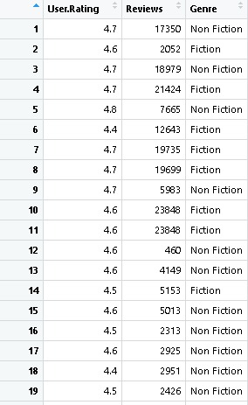
Best Sellers Book Dataset
#Dataset on Amazon's Top 50 bestselling books from 2009 to 2019. Contains 550 rows
#Data has been categorized into fiction and non-fiction depend on Genre
# Importing the dataset
bestseller_books<- read.csv("bestsellers with categories.csv", header = TRUE, sep = ",")
bestseller_books <- bestseller_books[3:5]
# Taking columns 3-5 for implementation
bestseller_books

Slide 4
# Normally we encoding the target feature as factor but here it has already been factor
bestseller_books$Genre
bestseller_books$Genre[bestseller_books$Genre == "Non Fiction"] <- 0
bestseller_books$Genre[bestseller_books$Genre == "Fiction"] <- 1
# This code converted the genre part in the categories into numerical expressions
bestseller_books$Genre<-as.numeric(bestseller_books$Genre)
bestseller_books$Genre

Slide 5
#We see the structure of our data.
str(bestseller_books)
# We downloaded the caTools function from the package programs and called this function from the library.
# Splitting the dataset into the Training set and Test set
install.packages('caTools')
library(caTools)

Slide 6
# Ensure the results are same for everybody
set.seed(150)
split = sample.split(bestseller_books$Genre, SplitRatio = 0.75)
training_set = subset(bestseller_books, split == TRUE)
test_set = subset(bestseller_books, split == FALSE)
split
training_set
test_set

Slide 7
# Fitting SVM to the Training set
# We downloaded the e1071 function from the package programs and called this function from the library.
install.packages('e1071')
library(e1071)

Slide 8
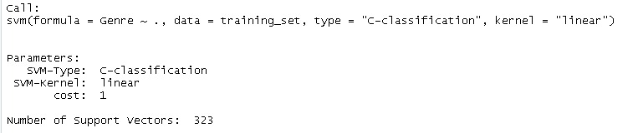
#Linear Support Vector Machines Classifier
classifier <- svm(formula =Genre ~ .,
data = training_set,
type = 'C-classification',
kernel = 'linear')
classifier

Slide 9
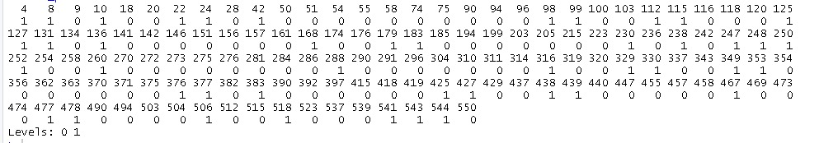
# Predicting the Test set results
book_prediction = predict(classifier, newdata = training_set)
book_prediction

Slide 10

# Making the Confusion Matrix
confusion_matrix = table(test_set[, 3],book_prediction)
confusion_matrix

Slide 11
#We determine performance of the model by calculating accuracy
accurancy_rate<-sum(diag(confusion_matrix))/sum(confusion_matrix)
accurancy_rate
#We calculate missclassification by using accurancy
1-accurancy_rate

Slide 12
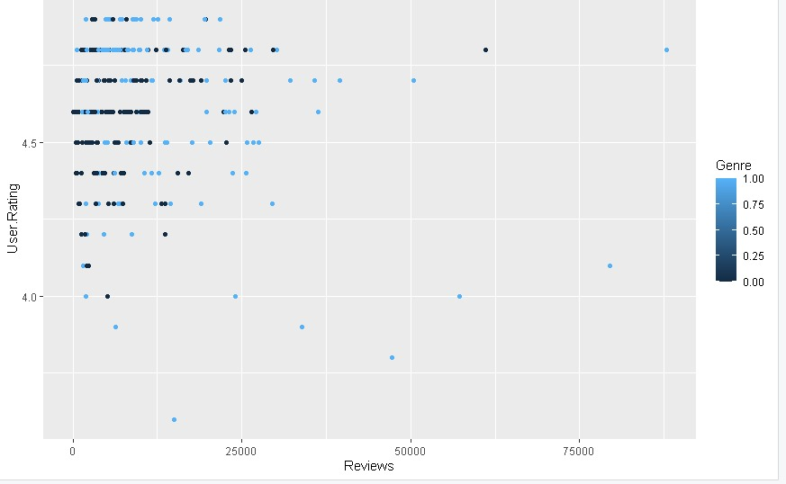
#Visualization of data with SVM classification
# We showed our data on the graph using the ggplot2 package.
library(ggplot2)
ggplot(data = training_set)+
geom_point(aes(x =Reviews,
y =User.Rating,color=Genre))

Slide 13
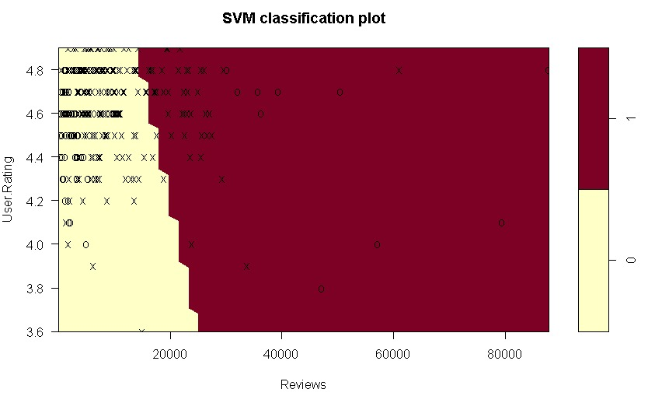
# We showed the graph of the data that we separated as training set and test set with the classifier structure we created using the SVM algorithm. We allocated it linearly.
plot(classifier,training_set)

Slide 14
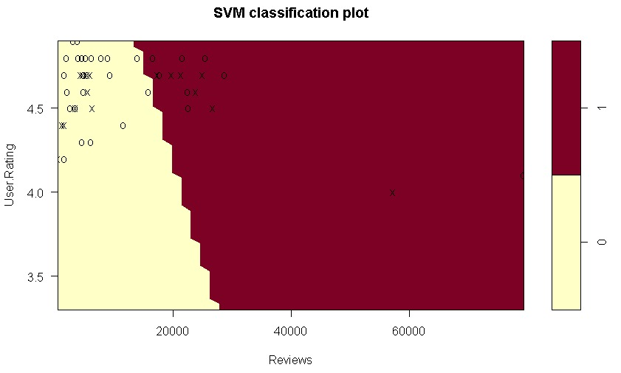
plot(classifier,test_set),

Slide 15
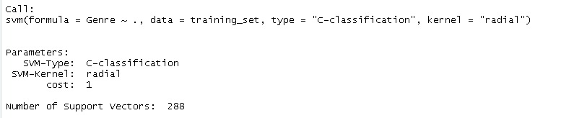
#Non-Linear(Radial) Support Vector Machine Classifier
classifier_5 <- svm(formula =Genre ~ .,
data = training_set,
type = 'C-classification',
kernel = "radial")
classifier_5

Slide 16
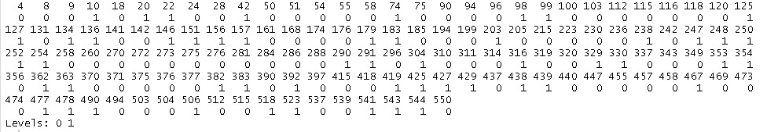
# Predicting the Test set results
book_prediction_5 = predict(classifier_5, newdata = test_set)
book_prediction_5

Slide 17

# Making the Confusion Matrix
confusion_matrix_5 = table(test_set[, 3],book_prediction_5)
confusion_matrix_5

Slide 18
#We determine performance of the model by calculating accuracy.
accurancy_rate_5<-sum(diag(confusion_matrix_5))/sum(confusion_matrix_5)
accurancy_rate_5
#We calculate missclassification by using accurancy
1-accurancy_rate_5

Slide 19
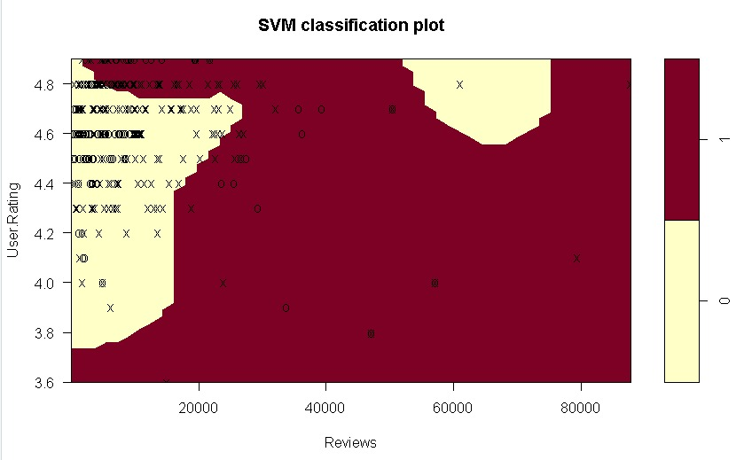
plot(classifier_5,training_set)

Slide 20
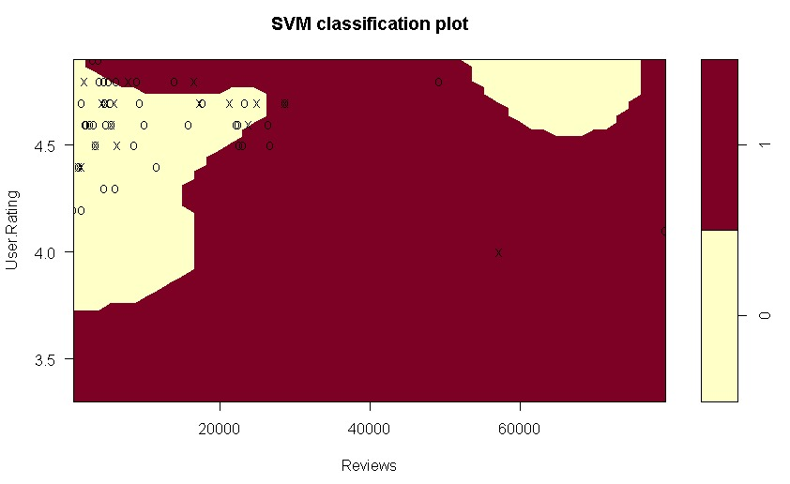
plot(classifier_5,test_set)

Slide 21
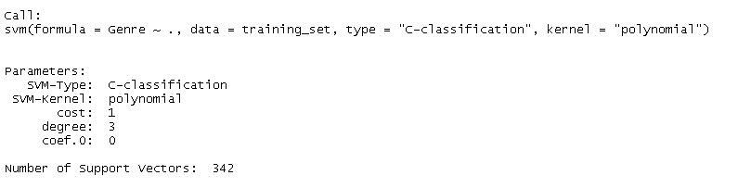
#Non-Linear(Polynomial) Support Vector Machine Classifier
classifier_6 <- svm(formula =Genre ~ .,
data = training_set,
type = 'C-classification',
kernel = "polynomial")
classifier_6

Slide 22
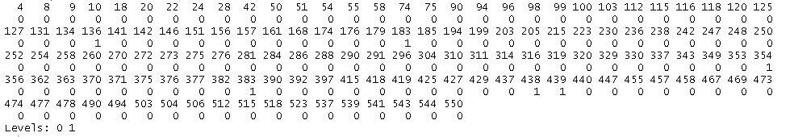

# Predicting the Test set results
book_prediction_6 = predict(classifier_6, newdata = test_set)
book_prediction_6
# Making the Confusion Matrix
confusion_matrix_6 = table(test_set[, 3],book_prediction_6)
confusion_matrix_6

Slide 23
#We determine performance of the model by calculating accuracy.
accurancy_rate_6<-sum(diag(confusion_matrix_6))/sum(confusion_matrix_6)
accurancy_rate_6
#We calculate missclassification by using accurancy
1-accurancy_rate_6

Slide 24
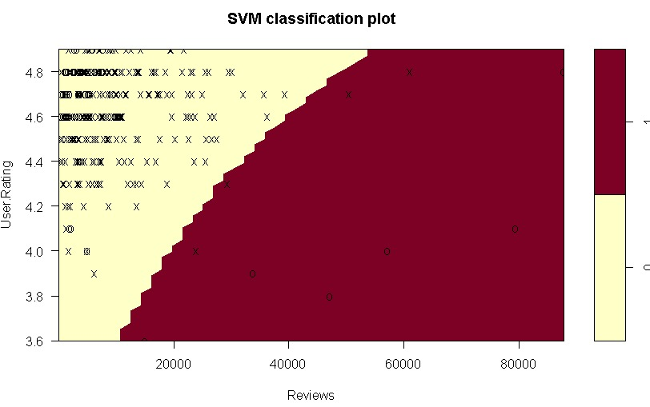
plot(classifier_6,training_set)

Slide 25
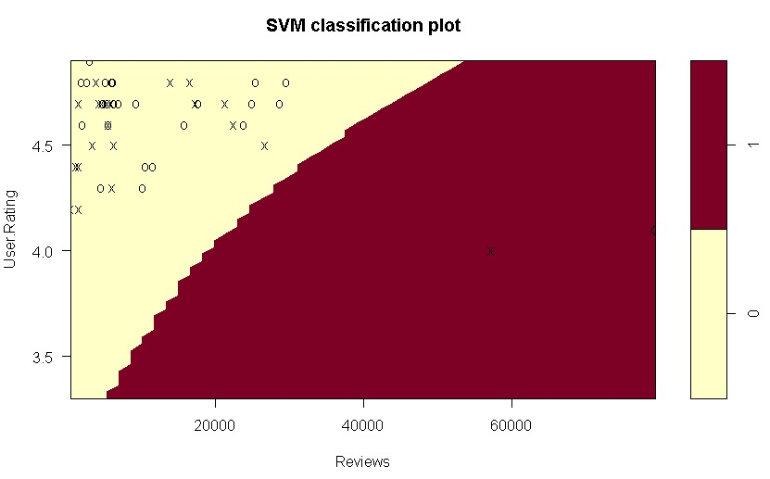
plot(classifier_,test_set)

Slide 26
CONCLUSION
For Best Sellers Book Dataset
In this model, we classified the data in our rewiew and user.rating columns in our book dataset according to the type of our book using the kernel method with linear and non-linear separation forms. In the non-linear part, we classified these data with radial and polynomial shapes. These classifications could not be classified 100 percent accurately due to the density of our data. We found the accuracy rates of all of these classification methods we applied. Our accuracy rates are listed in the following order.
Lineer=0,6449275
Radial=0,7463768
Polynomial=0,6086957
By comparing these rates, we decided that the best way of separation was Radial.

Slide 27
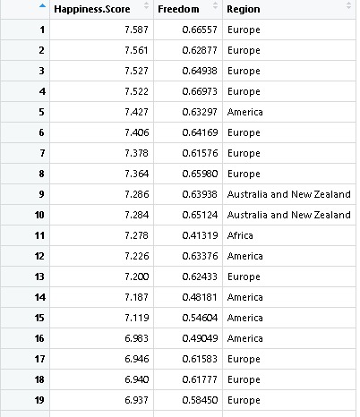
HAPPINESS DATASETS
#The World Happiness Report is a landmark survey of the state of global happiness.
#The first report was published in 2012, the second in 2013, the third in 2015, and the fourth in the 2016 Update.
#The World Happiness 2017, which ranks 155 countries by their happiness levels, was released at the United Nations at an event celebrating International Day of Happiness on March 20th.
# Importing the dataset
happiness <- read.csv("happiness.csv", header = TRUE, sep = ",")
happiness <- happiness[3:5]
happiness
# Taking columns 3-5 for implementation

Slide 28
# Normally we encoding the target feature as factor but here it has already been factor
happiness$Region
happiness$Region[happiness$Region == "Australia and New Zealand"] <- 1
happiness$Region[happiness$Region == "Europe"] <- 2
happiness$Region[happiness$Region == "Asia"] <- 3
happiness$Region[happiness$Region == "America"] <- 4
happiness$Region[happiness$Region == "Africa"] <- 5

Slide 29

#This code converted the genre part in the categories into numerical expressions.
happiness$Region<-as.numeric(happiness$Region)
happiness$Region
#We see the structure of our data.
str(happiness)

Slide 30
# We downloaded the caTools function from the package programs and called this function from the library.
# Splitting the dataset into the Training set and Test set
install.packages('caTools')
library(caTools)

Slide 31
# Ensure the results are same for everybody
set.seed(100)
split = sample.split(happiness$Region, SplitRatio = 0.70)
training_set_2 = subset(happiness, split == TRUE)
test_set_2 = subset(happiness, split == FALSE)
split
training_set_2
test_set_2

Slide 32
# We downloaded the e1071 function from the package programs and called this function from the library.
# Fitting SVM to the Training set
install.packages('e1071')
library(e1071)

Slide 33
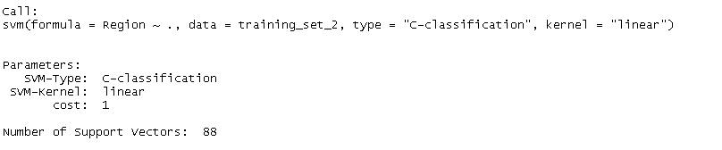
#Linear Support Vector Machines Classifier
classifier_happiness <- svm(formula =Region ~ .,
data = training_set_2,
type = 'C-classification',
kernel = 'linear')
classifier_happiness

Slide 34
# Predicting the Test set results
region_prediction = predict(classifier_happiness, newdata = test_set_2)
region_prediction

Slide 35
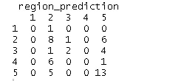
# Making the Confusion Matrix
confusion_matrix_2 = table(test_set_2[, 3],region_prediction)
confusion_matrix_2

Slide 36
#We determine performance of the model by calculating accuracy.
accurancy_rate_2<-sum(diag(confusion_matrix_2))/sum(confusion_matrix_2)
accurancy_rate_2
#We calculate missclassification by using accurancy
1-accurancy_rate_2

Slide 37
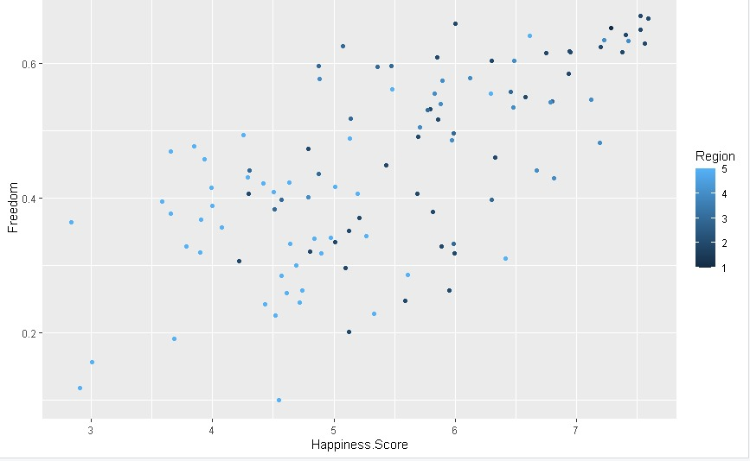
#Visualization of data with SVM classification
# We showed our data on the graph using the ggplot2 package.
library(ggplot2)
ggplot(data = training_set_2)+
geom_point(aes(x =Happiness.Score,
y =Freedom,color=Region))

Slide 38
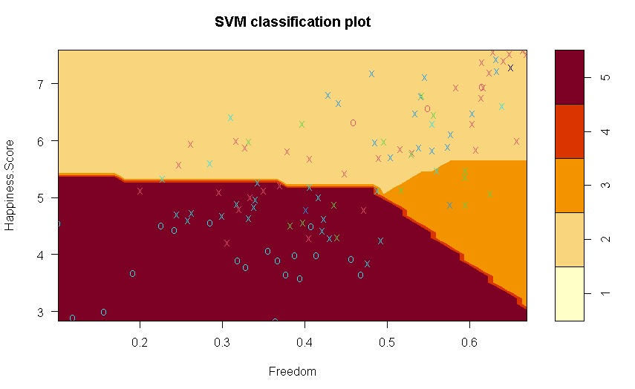
plot(classifier_happiness,training_set_2)

Slide 39
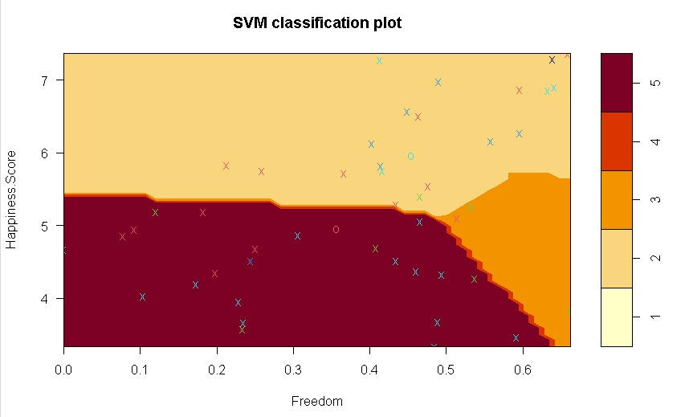
plot(classifier_happiness,test_set_2)

Slide 40
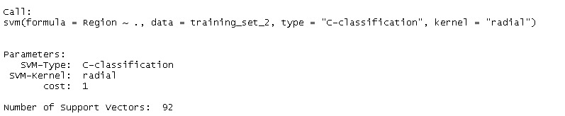
#Non-Linear(Radial) Support Vector Machine Classifier
classifier_happiness_5 <- svm(formula =Region ~ .,
data = training_set_2,
type = 'C-classification',
kernel = "radial")
classifier_happiness_5

Slide 41
# Predicting the Test set results
region_prediction_2 = predict(classifier_happiness_5, newdata = test_set_2)
region_prediction_2

Slide 42
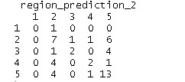
# Making the Confusion Matrix
confusion_matrix_3 = table(test_set_2[, 3],region_prediction_2)
confusion_matrix_3

Slide 43
#We determine performance of the model by calculating accuracy.
accurancy_rate_3<-sum(diag(confusion_matrix_3))/sum(confusion_matrix_3)
accurancy_rate_3
#We calculate missclassification by using accurancy
1-accurancy_rate_3

Slide 44
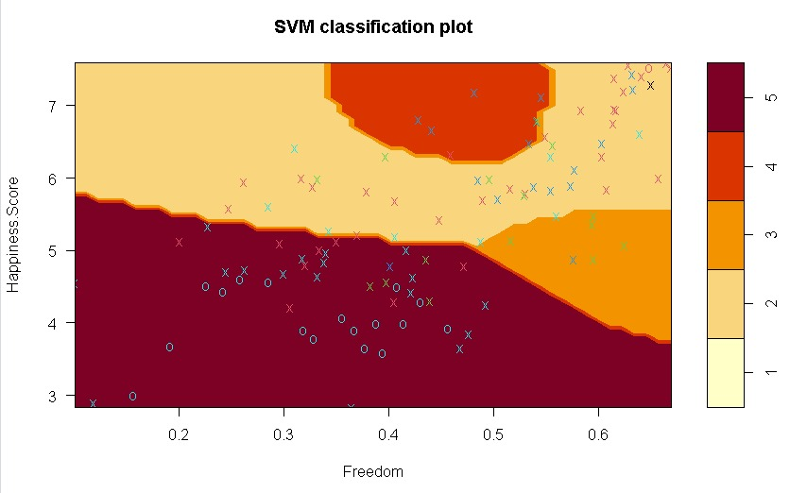
plot(classifier_happiness_5,training_set_2)

Slide 45
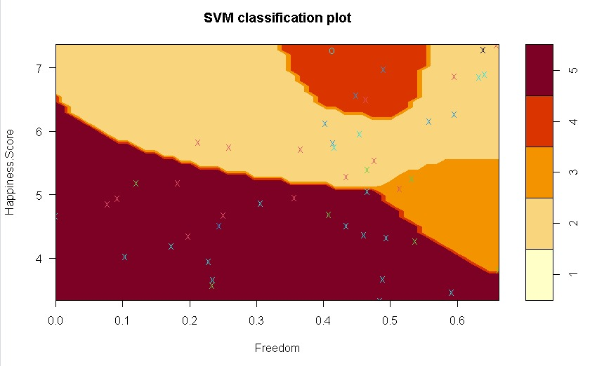
plot(classifier_happiness_5,test_set_2)

Slide 46
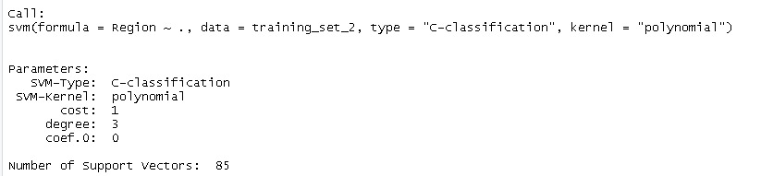
#Non-Linear(Polynomial) Support Vector Machine Classifier
classifier_happiness_6 <- svm(formula =Region ~ .,
data = training_set_2,
type = 'C-classification',
kernel = "polynomial")
classifier_happiness_6

Slide 47
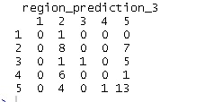
# Predicting the Test set results
region_prediction_3 = predict(classifier_happiness_6, newdata = test_set_2)
region_prediction_3
# Making the Confusion Matrix
confusion_matrix_4 = table(test_set_2[, 3],region_prediction_3)
confusion_matrix_4

Slide 48
#We determine performance of the model by calculating accuracy.
accurancy_rate_4<-sum(diag(confusion_matrix_4))/sum(confusion_matrix_4)
accurancy_rate_4
#We calculate missclassification by using accurancy
1-accurancy_rate_4

Slide 49
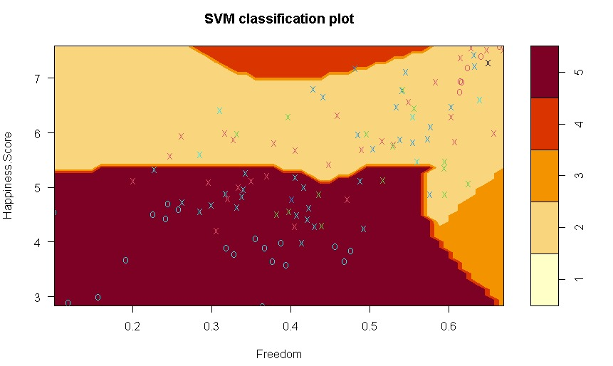
plot(classifier_happiness_6,training_set_2)

Slide 50
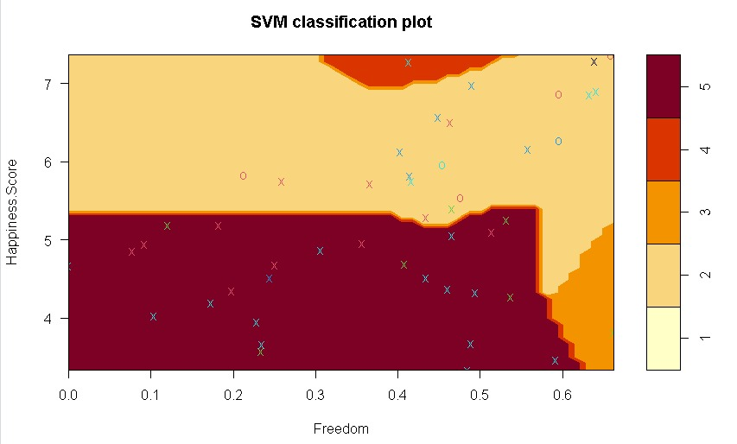
plot(classifier_happiness_6,test_set_2)

Slide 51
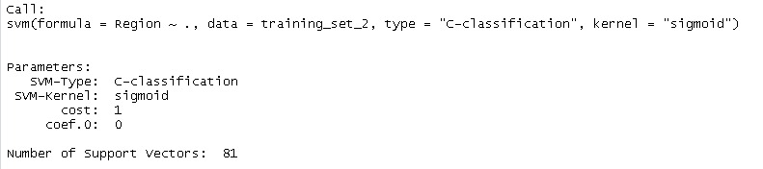
#Non-Linear(Sigmoid) Support Vector Machine Classifier
classifier_happiness_7 <- svm(formula =Region ~ .,
data = training_set_2,
type = 'C-classification',
kernel = "sigmoid")
classifier_happiness_7

Slide 52
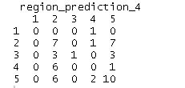
# Predicting the Test set results
region_prediction_4 = predict(classifier_happiness_7, newdata = test_set_2)
region_prediction_4
# Making the Confusion Matrix
confusion_matrix_5 = table(test_set_2[, 3],region_prediction_4)
confusion_matrix_5

Slide 53
#We determine performance of the model by calculating accuracy.
accurancy_rate_5<-sum(diag(confusion_matrix_5))/sum(confusion_matrix_5)
accurancy_rate_5
#We calculate missclassification by using accurancy
1-accurancy_rate_5

Slide 54
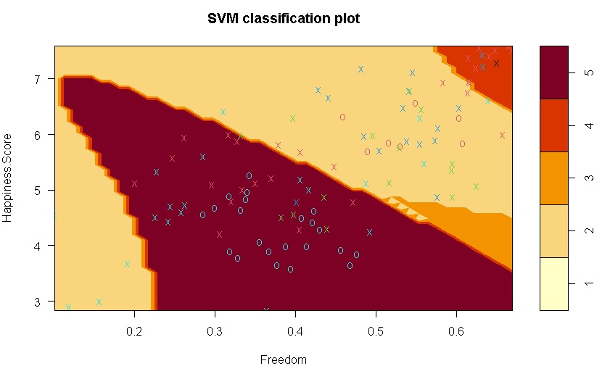
plot(classifier_happiness_7,training_set_2)

Slide 55
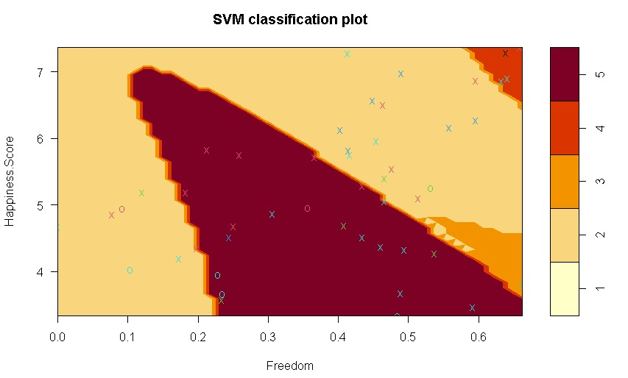
plot(classifier_happiness_7,test_set_2)

Slide 56
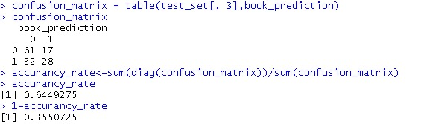
PERFORMANCE OF THE MODEL For Bestseller Books Dataset
Linear Classification
The estimation accuracy rate of our model is 0.6449275.Since it is not a bad prediction.

Slide 57
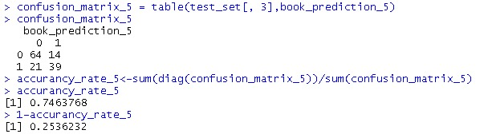
Non-Linear Radial Classification
The estimation accuracy rate of our model is 0.7463768. Since it is a good prediction.

Slide 58
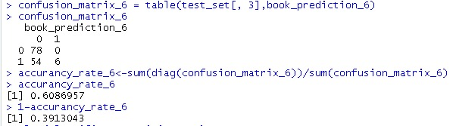
Non-Linear Polynomial Classification
The estimation accuracy rate of our model is 0.6086957. Since it is a not bad prediction.
When we examine these 3 classification methods, we observe that the best result is non-linear radial classification

Slide 59
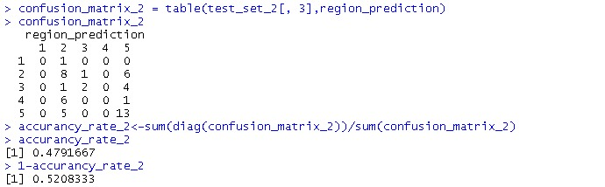
FOR HAPPINESS DATASETS
Linear Classification
The estimation accuracy rate of our model is 0.4791667. Since it is a bad prediction.

Slide 60
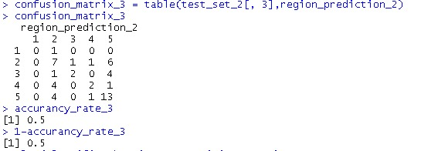
Non-Linear Radial Classification
The estimation accuracy rate of our model is 0.5. Since it is a bad prediction.

Slide 61
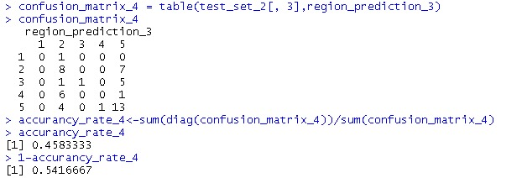
Non-Linear Polynomial Classification
The estimation accuracy rate of our model is 0.4583333. Since it is a bad prediction.

Slide 62
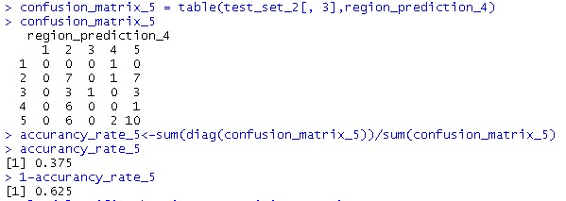
Non-Linear Sigmoid Classification
The estimation accuracy rate of our model is 0.375. Since it is a very bad prediction.
When we examine these 4 classification methods, we observe that all of the methods gives bad accurancy rate.Therefore,SVM algorithm is not successable on happiness datasets.

Slide 63
For Happiness Dataset
We classified the areas by looking at the independence and happiness ratios of the people residing in these countries in this model. We are able to come up with more accurate ratios that involve many locations in this classification when it's compared with the previous one. The reason that we were getting lower ratios in the previous dataset is that the classification number was higher. In addition, we have added the Sigmoid Method in the non-linear section and this method is being used generall for more than 2 classifications. Later on the accuracy of these classifications have sorted out as down below.
Lineer=0,4791667
Radial=0,5
Polynomial=0,4583333
Sigmoid=0,375
By comparing these rates, we decided that the best way of separation was radial.

Slide 64
References
https://tr.wikipedia.org/wiki/Destek_vekt%C3%B6r_makinesi#:~:text=Destek%20vekt%C3%B6r%20makinesi%20
http://uc-r.github.io/svm
https://www.datacamp.com/community/tutorials/support-vector-machines-r?utm_source=adwords_ppc&utm_campaignid=1455363063&utm_adgroupid=65083631748&utm_device=c&utm_keyword=&utm_matchtype=b&utm_network=g&utm_adpostion=&utm_creative=332602034364&utm_targetid=dsa-429603003980&utm_loc_interest_ms=&utm_loc_physical_ms=1012782&gclid=Cj0KCQiAoab_BRCxARIsANMx4S5MGe6d3KuPb_vpIEhWTf83WwY5mK8ad1hYIx4ItW6fU2mFxD-AODsaAnpCEALw_wcB
https://www.kaggle.com/datasets?sort=votes
https://www.geeksforgeeks.org/classifying-data-using-support-vector-machinessvms-in-r/
Lecture Notes

