Slide 1
Technical Implementation Plan & Proposal
Multi-Tenant Marketing Intelligence Dashboard
Prepared for: Client RFP — Multi-Tenant SaaS Dashboard
Version: 1.0
Date: September 2026
Classification: Confidential — Client Proposal
Notes:
Source: Implementation-Plan-Multi-Tenant-Dashboard-New.docx

Slide 2
Table of Contents
Executive Summary
Solution Architecture Overview
Technology Stack & Justification
Multi-Tenancy Strategy
Database Design
Authentication & Authorization
Data Pipeline Architecture
API Design
Frontend & Dashboard Architecture
Natural-Language Insights Layer
Security Architecture
02
Notes:
Source: Implementation-Plan-Multi-Tenant-Dashboard-New.docx

Slide 3
Table of Contents
Scalability & Performance
Observability & Monitoring
Testing Strategy
CI/CD & Deployment
Phased Delivery Plan
Risk Assessment & Mitigation
Cost Estimation
Post-Launch & Maintenance
Phase 2 Roadmap
Assumptions & Clarification Points
Answers to Proposal Questions
03
Notes:
Source: Implementation-Plan-Multi-Tenant-Dashboard-New.docx

Slide 4
1. Executive Summary
We propose to build a unified marketing intelligence platform — a multi-tenant SaaS dashboard that consolidates marketing data from Meta, Instagram, LinkedIn, and Google Analytics 4 into a single, intuitive interface. The platform eliminates the pain of manually collecting and reconciling reports across fragmented marketing tools, giving marketing teams a single source of truth with historical depth and — in Phase 2 — AI-driven actionable insights.
04
Notes:
Source: Implementation-Plan-Multi-Tenant-Dashboard-New.docx

Slide 5
1. Executive Summary
Value Proposition
Value | Description
Unified Visibility | Single pane of glass across Meta, Instagram, LinkedIn, and GA4 — no more tab-switching or CSV exports
Historical Durability | A real stored data layer. Metrics persisted beyond platform API retention limits, enabling true YoY comparisons
Automated Sync | Configurable scheduling (1–24hr) with auto token refresh. Zero manual intervention under normal operation
05
Notes:
Source: Implementation-Plan-Multi-Tenant-Dashboard-New.docx

Slide 6
1. Executive Summary
Value Proposition
Value | Description
Enterprise Multi-Tenancy | Database-level tenant isolation (PostgreSQL RLS) from day one — not bolted on later
AI-Ready Architecture | Natural language query engine designed into the data model, deployable after core dashboard stabilizes
Persona-Driven UX | Purpose-built views for Marketing Managers, CMOs, Business Owners, and Agencies with multi-client support
06
Notes:
Source: Implementation-Plan-Multi-Tenant-Dashboard-New.docx

Slide 7
1. Executive Summary
Delivery Approach
We execute across six sequenced phases over 16 weeks, following the client’s stated priority order:
Foundation → Integrations → Pipeline → Dashboard → Reliability → AI Insights
(W1-3) (W4-6) (W7-8) (W9-11) (W12-13) (W14-16)
Each phase produces a deployable increment with defined acceptance criteria. Multi-tenancy and security are foundational — they are built first, not hardened later.
07
Notes:
Source: Implementation-Plan-Multi-Tenant-Dashboard-New.docx

Slide 8
1. Executive Summary
Key Architectural Decisions
PostgreSQL with Row-Level Security for tenant isolation at the database kernel level
NestJS (Node.js/TypeScript) backend for structured, type-safe API development
Next.js 14 frontend with SSR for performance and SEO-ready dashboards
BullMQ + Redis for reliable job scheduling and async data pipeline processing
AWS (ECS Fargate, RDS, ElastiCache) for managed, scalable infrastructure
LangChain + GPT-4o for the natural-language insights layer with Text-to-SQL
08
Notes:
Source: Implementation-Plan-Multi-Tenant-Dashboard-New.docx

Slide 9
2. Solution Architecture Overview
Design Principles
Principle | Implementation
Data-at-rest, not live-pull | Dashboard reads from stored PostgreSQL data, never calls platform APIs on page load
Tenant isolation as infrastructure | RLS policies enforce isolation at the database level, independent of application logic correctness
Connector abstraction | Each platform integration implements a common interface; adding a new platform is a single module
Horizontal scalability | API servers and pipeline workers scale independently based on load vs. queue depth
Graceful degradation | Token expiry, API outages, and rate limits are handled with retry, backoff, and clear user-facing status
09
Notes:
Source: Implementation-Plan-Multi-Tenant-Dashboard-New.docx

Slide 10
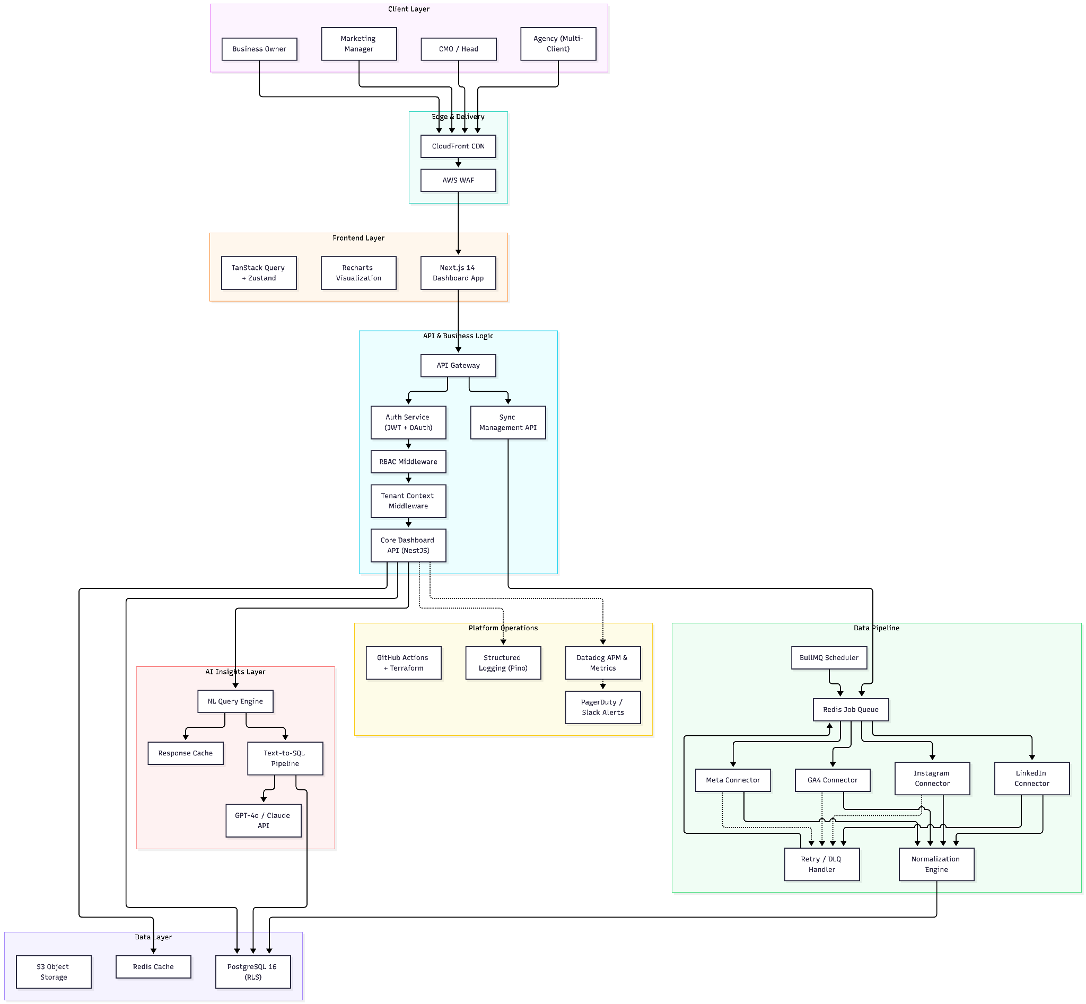
2. Solution Architecture Overview
High-Level Architecture
10
Notes:
Source: Implementation-Plan-Multi-Tenant-Dashboard-New.docx

Slide 11
2. Solution Architecture Overview
Data Flow Patterns
Pattern 1 — Dashboard Read Path:
User → CDN → Next.js SSR → API Gateway → Tenant Middleware → Core API → Redis Cache (hit?) → PostgreSQL → Response
Pattern 2 — Data Ingestion Path:
Scheduler → Redis Queue → Worker picks job → Check token → Refresh if needed → Call Platform API → Validate response → Normalize → Upsert to PostgreSQL → Update sync_logs → Emit metric
Pattern 3 — AI Query Path:
11
Notes:
Source: Implementation-Plan-Multi-Tenant-Dashboard-New.docx

Slide 12
2. Solution Architecture Overview
Data Flow Patterns
User query → NL Engine → Inject tenant context + schema → LLM generates SQL → Validate SQL (SELECT only, tenant-scoped) → Execute against read replica → LLM synthesizes natural language response → Cache → Return
12
Notes:
Source: Implementation-Plan-Multi-Tenant-Dashboard-New.docx

Slide 13
3. Technology Stack & Justification
Layer | Technology | Why This Choice for This Project
Backend Framework | NestJS 5 (Node.js 22, TypeScript) | Structured module system with built-in DI, guards, interceptors, and decorators. The module-per-feature pattern maps cleanly to this project’s domains (auth, connectors, metrics, sync). First-class TypeScript eliminates an entire class of bugs. Built-in scheduling (@nestjs/schedule) and queue (@nestjs/bullmq) support reduces integration overhead.
13
Notes:
Source: Implementation-Plan-Multi-Tenant-Dashboard-New.docx

Slide 14
3. Technology Stack & Justification
Layer | Technology | Why This Choice for This Project
Primary Database | PostgreSQL 16 | Native Row-Level Security (RLS) — the single most important capability for this project. RLS enforces tenant isolation at the database engine level, meaning even application bugs cannot leak cross-tenant data. JSONB support handles semi-structured platform-specific API responses. Mature partitioning for time-series metrics data.
ORM / Query Builder | Prisma 6 | Type-safe query builder with auto-generated TypeScript types from schema. Schema-first migrations align with this project’s need for strict, auditable schema evolution. Raw SQL escape hatch for complex analytics queries.
14
Notes:
Source: Implementation-Plan-Multi-Tenant-Dashboard-New.docx

Slide 15
3. Technology Stack & Justification
Layer | Technology | Why This Choice for This Project
Cache & Queue | Redis 7 (via ElastiCache) | Dual purpose: (1) BullMQ job queue for reliable async pipeline processing with retries, backoff, and dead letter queues, and (2) API response caching to serve dashboard reads from memory when data hasn’t changed since last sync.
Frontend Framework | Next.js 14 (App Router, React 18) | SSR for initial dashboard load performance (critical for large datasets). API routes for lightweight BFF pattern. React ecosystem provides the richest charting/visualization library options. Vercel-compatible but self-hostable on AWS.
15
Notes:
Source: Implementation-Plan-Multi-Tenant-Dashboard-New.docx

Slide 16
3. Technology Stack & Justification
Layer | Technology | Why This Choice for This Project
Charting | Recharts + Tremor | Recharts for custom data visualizations (line, bar, area, pie). Tremor for pre-built dashboard components (KPI cards, sparklines, metric badges). Both are React-native with excellent TypeScript support.
Styling | Tailwind CSS 4 + shadcn/ui | Utility-first CSS for rapid, consistent UI development. shadcn/ui provides accessible, unstyled component primitives that match the “simple, professional” product principle.
16
Notes:
Source: Implementation-Plan-Multi-Tenant-Dashboard-New.docx

Slide 17
3. Technology Stack & Justification
Layer | Technology | Why This Choice for This Project
Infrastructure | AWS (ECS Fargate, RDS, ElastiCache, S3, CloudFront) | Managed services reduce operational burden. Fargate eliminates server management. RDS provides automated backups, point-in-time recovery, and read replicas. ElastiCache for managed Redis. CloudFront for global edge caching. Well-established pricing model for per-tenant cost estimation.
IaC | Terraform | Declarative infrastructure management. Environment parity (dev/staging/prod) from identical configuration. State locking prevents concurrent drift.
CI/CD | GitHub Actions | Native GitHub integration. Matrix builds for parallel test execution. Environment-based deployment approvals. Reusable workflow definitions.
17
Notes:
Source: Implementation-Plan-Multi-Tenant-Dashboard-New.docx

Slide 18
3. Technology Stack & Justification
Layer | Technology | Why This Choice for This Project
AI/LLM | LangChain.js + OpenAI GPT-4o | LangChain provides structured prompt templating, chain composition, and output parsing. GPT-4o balances reasoning capability (critical for SQL generation) with cost and latency. Swappable — Claude or Gemini can substitute if cost or capability needs shift.
Observability | Datadog (APM, Logs, Metrics) | Unified platform for traces, metrics, and logs. Pre-built integrations for NestJS, PostgreSQL, Redis. Custom dashboards for sync pipeline health. Alerting with PagerDuty/Slack integration.
Error Tracking | Sentry | Real-time error aggregation with source maps. Release tracking correlates errors to deployments.
18
Notes:
Source: Implementation-Plan-Multi-Tenant-Dashboard-New.docx

Slide 19
3. Technology Stack & Justification
Stack Alternatives Considered
Alternative | Why Not
Supabase | Excellent for rapid prototyping but limits control over RLS policy complexity, migration workflows, and background job architecture. The sync pipeline’s needs (complex retry logic, rate limit coordination, multi-step normalization) exceed what Supabase Edge Functions offer. Good for simpler CRUD apps, but this project needs fine-grained architectural control.
Firebase | NoSQL data model doesn’t suit the highly relational nature of org→account→platform→metric→post hierarchies. Firestore security rules are less expressive than PostgreSQL RLS for complex tenant scoping.
19
Notes:
Source: Implementation-Plan-Multi-Tenant-Dashboard-New.docx

Slide 20
3. Technology Stack & Justification
Stack Alternatives Considered
Alternative | Why Not
Django/Python | Strong ORM and admin, but the async I/O patterns needed for concurrent platform API calls and real-time dashboard updates are more natural in Node.js. The team’s primary expertise is TypeScript-first.
Schema-per-tenant | Operationally expensive: migrations must run against every schema, connection pooling becomes complex, and adding a tenant requires DDL. RLS achieves equivalent isolation with a single schema.
20
Notes:
Source: Implementation-Plan-Multi-Tenant-Dashboard-New.docx

Slide 21
4. Multi-Tenancy Strategy
Approach: Shared Database, Shared Schema, Row-Level Security
We implement database-level tenant isolation using PostgreSQL Row-Level Security (RLS) in a shared schema. Every tenant-scoped table includes an organization_id column, and RLS policies enforce that queries can only access rows belonging to the authenticated tenant.
21
Notes:
Source: Implementation-Plan-Multi-Tenant-Dashboard-New.docx

Slide 22
4. Multi-Tenancy Strategy
Why RLS Over Alternatives
Approach | Pros | Cons | Verdict
Shared DB + RLS ✅ | Single schema to migrate. Database-enforced isolation. No app-layer trust required. Scales to thousands of tenants. | Requires careful RLS policy design. Slightly more complex queries. | Selected — best balance of security, operational simplicity, and cost
Schema-per-tenant | Strong isolation. Easy per-tenant backup. | Migration nightmare at scale. Connection pool per schema. DDL on tenant creation. | Rejected — operational cost too high beyond ~50 tenants
22
Notes:
Source: Implementation-Plan-Multi-Tenant-Dashboard-New.docx

Slide 23
4. Multi-Tenancy Strategy
Why RLS Over Alternatives
Approach | Pros | Cons | Verdict
Database-per-tenant | Maximum isolation. Independent scaling. | Extremely expensive. Deployment complexity. Cross-tenant analytics impossible. | Rejected — cost-prohibitive for this use case
App-layer filtering only | Simple to implement. | One missing WHERE clause = data leak. No defense in depth. | Rejected — violates the hard isolation requirement
23
Notes:
Source: Implementation-Plan-Multi-Tenant-Dashboard-New.docx

Slide 24
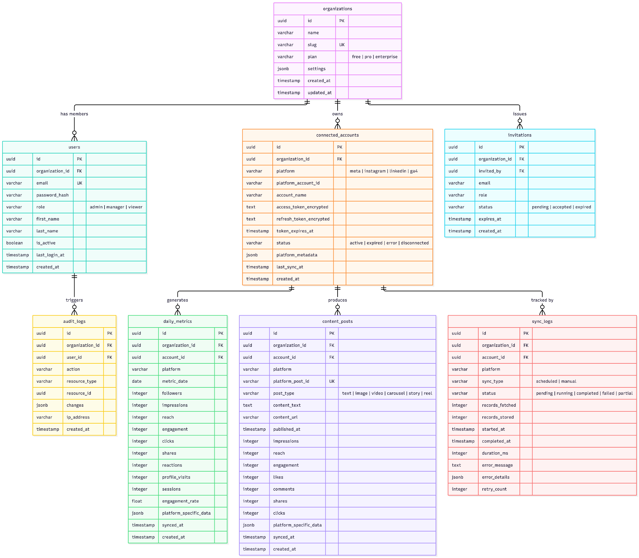
5. Database Design
Entity-Relationship Diagram
24
Notes:
Source: Implementation-Plan-Multi-Tenant-Dashboard-New.docx

Slide 25
5. Database Design
Migration Strategy
Tool: Prisma Migrate (schema-first, generates SQL migrations)
Process: Migration files versioned in git. Applied as pre-deploy hook in CI/CD pipeline
Safety: All migrations tested against staging DB with production-like data volume before prod deploy
Rollback: Every migration has a corresponding down migration. Destructive changes (column drops) are two-phase: deprecate → verify no usage → remove
25
Notes:
Source: Implementation-Plan-Multi-Tenant-Dashboard-New.docx

Slide 26
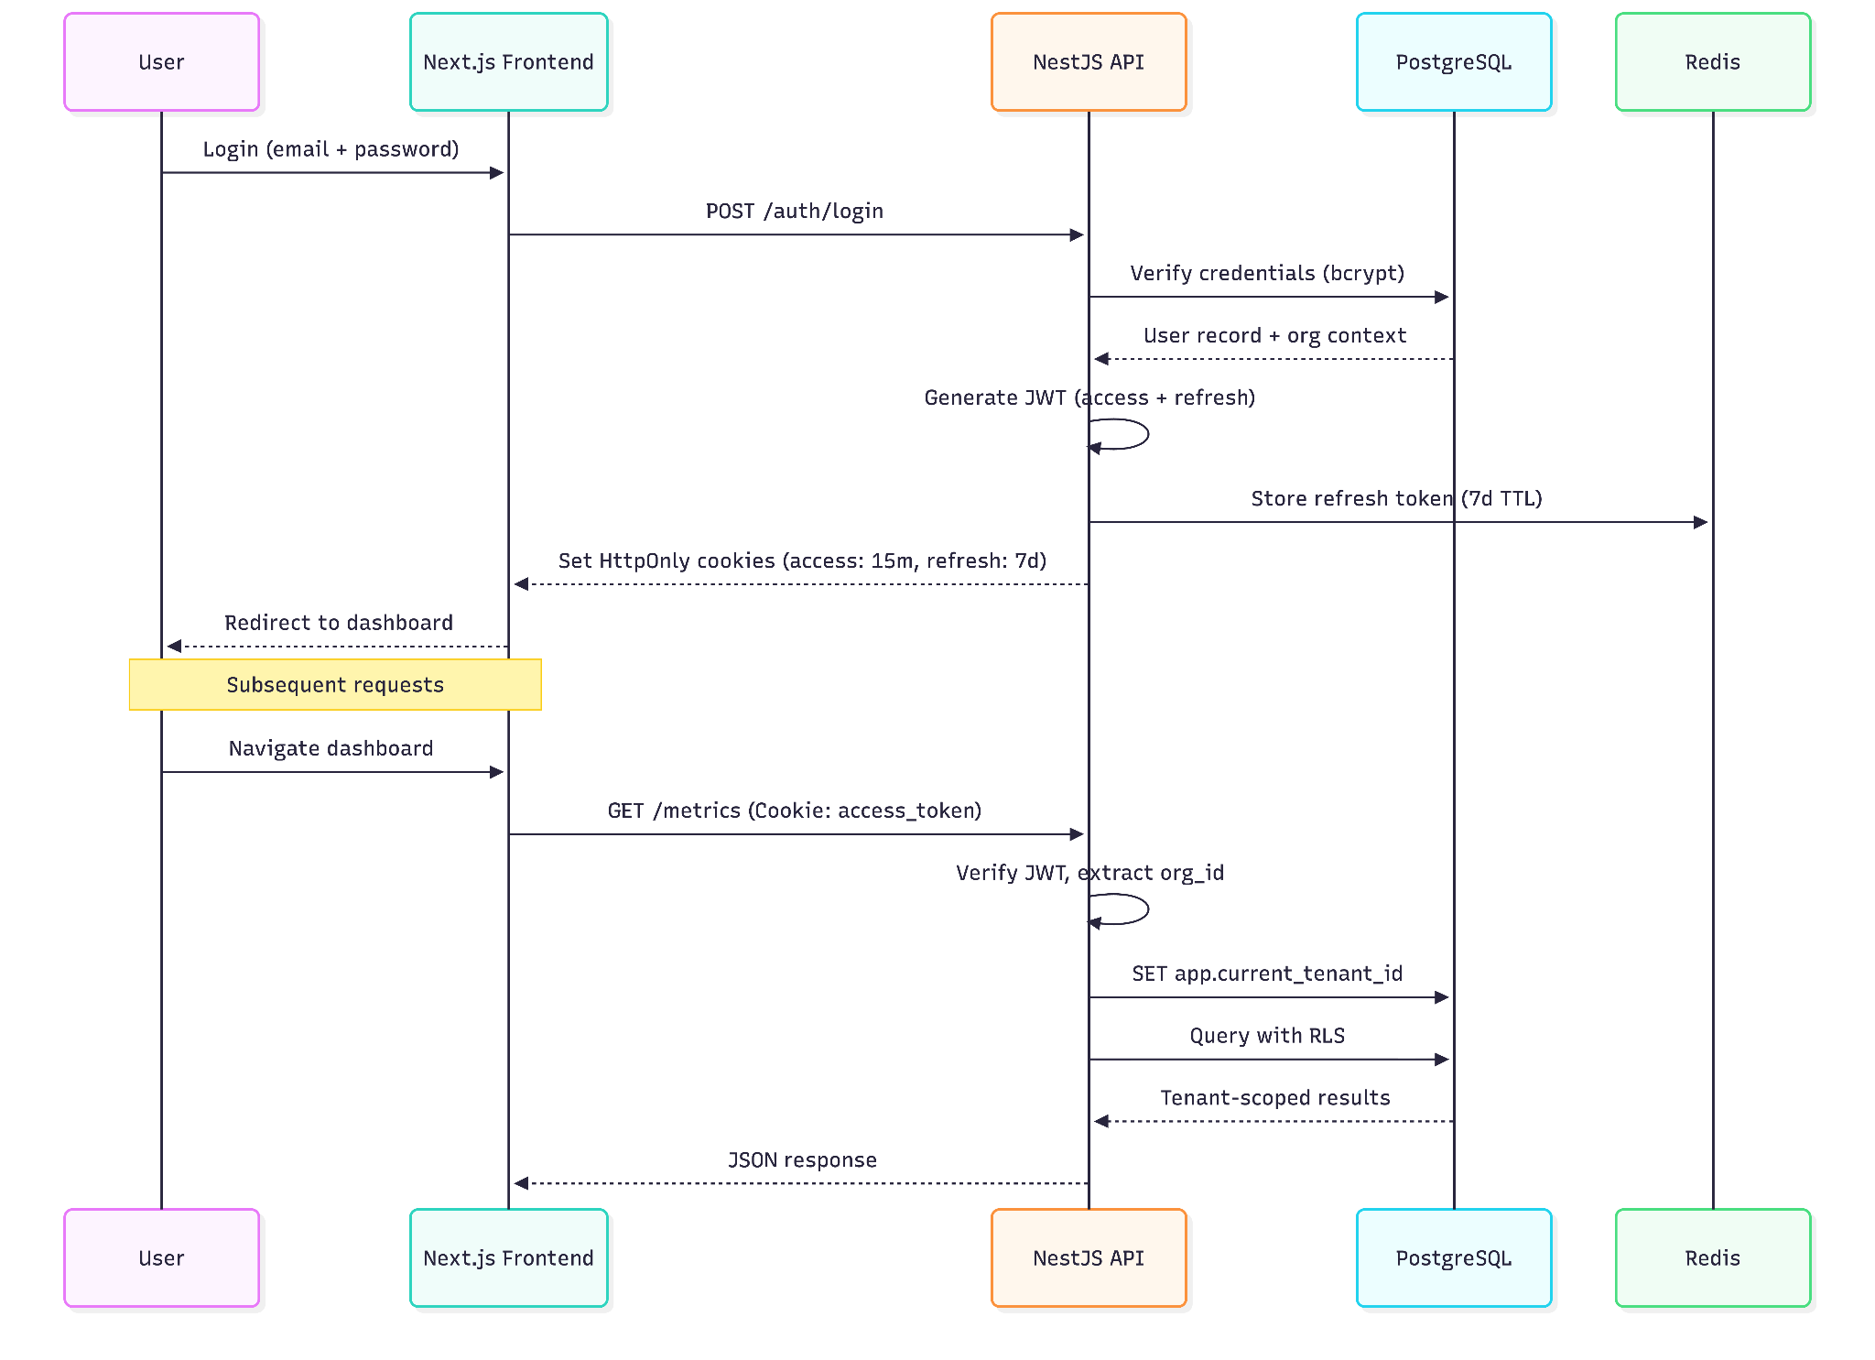
6. Authentication & Authorization
Authentication Architecture
26
Notes:
Source: Implementation-Plan-Multi-Tenant-Dashboard-New.docx

Slide 27
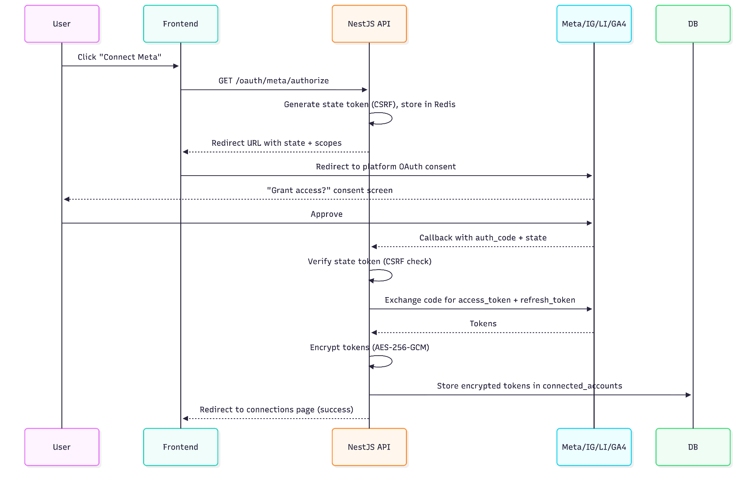
6. Authentication & Authorization
OAuth Flow for Platform Connections
27
Notes:
Source: Implementation-Plan-Multi-Tenant-Dashboard-New.docx

Slide 28
6. Authentication & Authorization
Permission Matrix
Action | Admin | Manager | Viewer
View dashboard & metrics | ✅ | ✅ | ✅
Filter/export data | ✅ | ✅ | ✅
Ask AI questions | ✅ | ✅ | ✅
Trigger manual sync | ✅ | ✅ | ❌
View sync logs | ✅ | ✅ | ❌
28
Notes:
Source: Implementation-Plan-Multi-Tenant-Dashboard-New.docx

Slide 29
6. Authentication & Authorization
Permission Matrix
Action | Admin | Manager | Viewer
Connect/disconnect platforms | ✅ | ❌ | ❌
Invite/remove users | ✅ | ❌ | ❌
Manage organization settings | ✅ | ❌ | ❌
Change user roles | ✅ | ❌ | ❌
29
Notes:
Source: Implementation-Plan-Multi-Tenant-Dashboard-New.docx

Slide 30
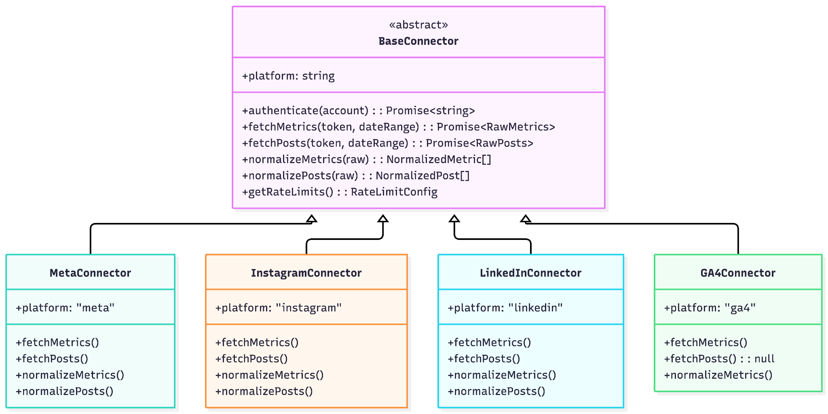
7. Data Pipeline Architecture
Connector Architecture
30
Notes:
Source: Implementation-Plan-Multi-Tenant-Dashboard-New.docx

Slide 31
7. Data Pipeline Architecture
Platform API Details
Platform | API | Rate Limits | Key Metrics Fetched
Meta | Graph API v19.0 | 200 calls/user/hour | Page followers, post reach, impressions, engagement, post-level likes/comments/shares
Instagram | Instagram Graph API (via Meta) | Shared with Meta quota | Followers, reach, impressions, profile visits, post engagement, story/reel metrics
31
Notes:
Source: Implementation-Plan-Multi-Tenant-Dashboard-New.docx

Slide 32
7. Data Pipeline Architecture
Platform API Details
Platform | API | Rate Limits | Key Metrics Fetched
LinkedIn | Marketing API v2 | 100 calls/day per app | Organization followers, post impressions, clicks, reactions, shares, engagement rate
GA4 | Google Analytics Data | 10,000 requests/day per project | Users, sessions, engagement rate, traffic sources, landing pages, device breakdown
32
Notes:
Source: Implementation-Plan-Multi-Tenant-Dashboard-New.docx

Slide 33
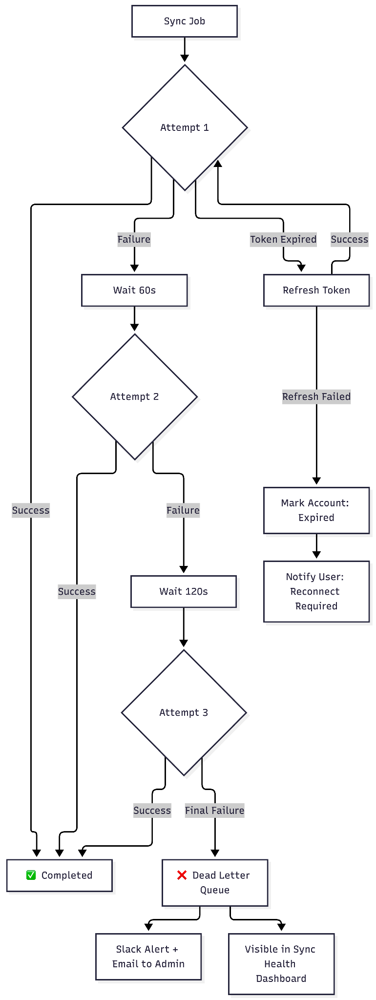
7. Data Pipeline Architecture
Error Handling & Dead Letter Queue
33
Notes:
Source: Implementation-Plan-Multi-Tenant-Dashboard-New.docx

Slide 34
7. Data Pipeline Architecture
Error Handling & Dead Letter Queue
34
Notes:
Source: Implementation-Plan-Multi-Tenant-Dashboard-New.docx

Slide 35
9. Frontend & Dashboard Architecture
Component Architecture
src/
├── app/ # Next.js App Router
│ ├── (auth)/ # Auth layout group
│ │ ├── login/
│ │ └── register/
│ ├── (dashboard)/ # Dashboard layout group
│ │ ├── layout.tsx # Sidebar + header + tenant context
│ │ ├── page.tsx # Overview dashboard
│ │ ├── channels/
│ │ │ └── [platform]/ # Platform-specific view
│ │ ├── posts/ # Content performance
│ │ ├── connections/ # Platform connection management
│ │ ├── insights/ # AI natural language query
│ │ ├── sync/ # Sync status & logs
35
Notes:
Source: Implementation-Plan-Multi-Tenant-Dashboard-New.docx

Slide 36
9. Frontend & Dashboard Architecture
Component Architecture
│ │ └── settings/ # Organization settings
│ └── api/ # BFF API routes (optional)
├── components/
│ ├── charts/ # Recharts wrappers
│ │ ├── MetricLineChart.tsx
│ │ ├── ChannelComparisonBar.tsx
│ │ ├── EngagementPieChart.tsx
│ │ └── PostPerformanceTable.tsx
│ ├── dashboard/ # Dashboard-specific components
│ │ ├── KPICard.tsx
│ │ ├── PlatformStatusBadge.tsx
│ │ ├── DateRangePicker.tsx
│ │ └── MetricSparkline.tsx
│ ├── layout/
36
Notes:
Source: Implementation-Plan-Multi-Tenant-Dashboard-New.docx

Slide 37
9. Frontend & Dashboard Architecture
Component Architecture
│ │ ├── Sidebar.tsx
│ │ ├── Header.tsx
│ │ └── BreadcrumbNav.tsx
│ └── ui/ # shadcn/ui primitives
├── hooks/
│ ├── useMetrics.ts # TanStack Query hooks for metrics API
│ ├── useSyncStatus.ts
│ └── useInsights.ts
├── lib/
│ ├── api-client.ts # Axios/fetch wrapper with auth
│ ├── date-utils.ts
│ └── format-metrics.ts
└── stores/
└── ui-store.ts # Zustand for local UI state
37
Notes:
Source: Implementation-Plan-Multi-Tenant-Dashboard-New.docx

Slide 38
9. Frontend & Dashboard Architecture
Dashboard Views by Persona
Persona | Default View | Key Metrics | Special Features
Marketing Manager | Channel detail with post-level breakdown | Impressions, engagement, reach by post | Post performance ranking, best time to post analysis
CMO / Marketing Head | Executive overview with cross-channel comparison | Total reach, engagement rate, follower growth, ROI trends | Period-over-period comparison, PDF export
Business Owner | Simplified summary with KPI cards | Total leads, traffic, top engagement | Traffic light indicators (up/down/flat), sparklines
Agency | Multi-client switcher → per-client dashboard | All above, per client | Client selector dropdown, client-branded reports
38
Notes:
Source: Implementation-Plan-Multi-Tenant-Dashboard-New.docx

Slide 39
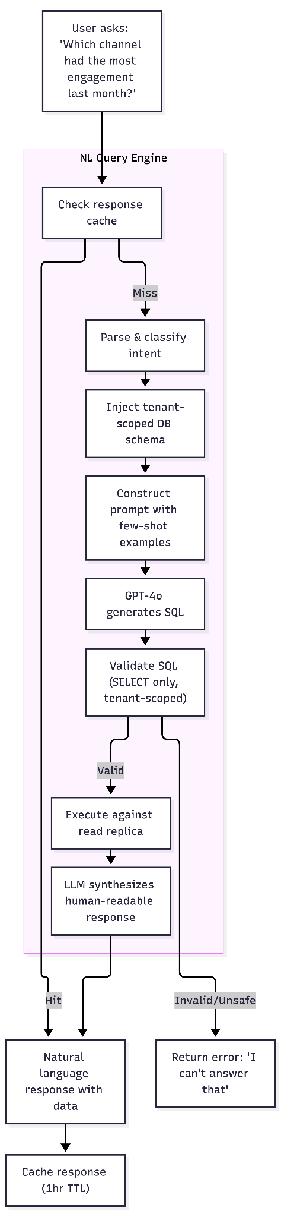
10. Natural-Language Insights Layer
Architecture
39
Notes:
Source: Implementation-Plan-Multi-Tenant-Dashboard-New.docx

Slide 40
10. Natural-Language Insights Layer
Architecture
40
Notes:
Source: Implementation-Plan-Multi-Tenant-Dashboard-New.docx

Slide 41
10. Natural-Language Insights Layer
Cost Management
Model | Cost per 1K tokens (input/output) | Estimated monthly cost (100 tenants, 5 queries/day avg)
GPT-4o | $2.50 / $10.00 | ~$150–250/month
GPT-4o-mini | $0.15 / $0.60 | ~$15–30/month
Claude 3.5 Sonnet | $3.00 / $15.00 | ~$200–350/month
41
Notes:
Source: Implementation-Plan-Multi-Tenant-Dashboard-New.docx

Slide 42
10. Natural-Language Insights Layer
Cost Management
Strategy: Use GPT-4o for SQL generation (accuracy matters), GPT-4o-mini for response synthesis (less complex). Cache aggressively. Set per-tenant daily query limits (free: 10, pro: 100, enterprise: unlimited).
42
Notes:
Source: Implementation-Plan-Multi-Tenant-Dashboard-New.docx

Slide 43
10. Natural-Language Insights Layer
Hallucination Mitigation
Schema-constrained prompting: LLM only sees the exact table/column definitions, not the full database
SQL validation: Generated SQL is parsed and validated before execution
Result grounding: The synthesis prompt includes the raw query results — the LLM explains actual data, not hallucinated numbers
Confidence scoring: If the query returns zero rows or the question doesn’t map to available columns, the system says “I don’t have enough data to answer that” rather than guessing
Show your work: Users can expand to see the generated SQL and raw data table alongside the natural language answer
43
Notes:
Source: Implementation-Plan-Multi-Tenant-Dashboard-New.docx

Slide 44
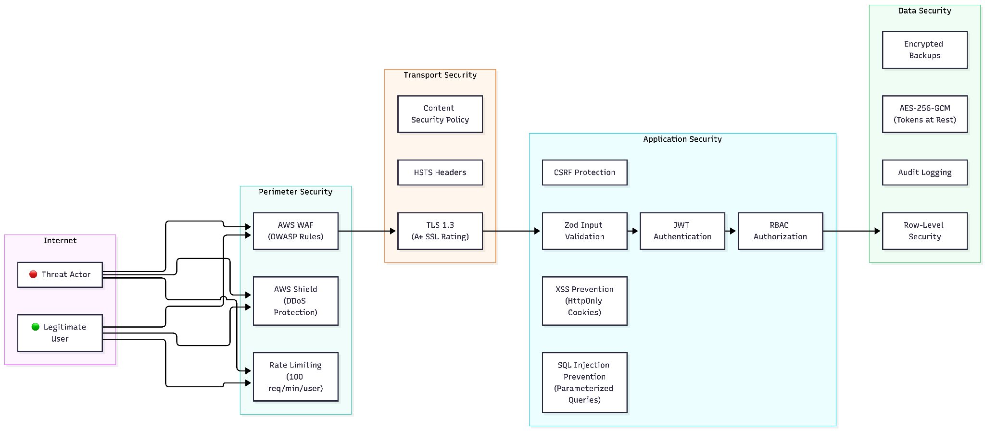
11. Security Architecture
Security Layers
44
Notes:
Source: Implementation-Plan-Multi-Tenant-Dashboard-New.docx

Slide 45
11. Security Architecture
OWASP Top 10 Mitigations
OWASP Risk | Mitigation
A01: Broken Access Control | RLS + RBAC + tenant context middleware + automated isolation tests
A02: Cryptographic Failures | AES-256-GCM for tokens, TLS 1.3 in transit, bcrypt for passwords
A03: Injection | Prisma parameterized queries, Zod input validation, AI SQL validation
A04: Insecure Design | Threat modeling during design phase, principle of least privilege
A05: Security Misconfiguration | Terraform-managed infra, security headers (HSTS, CSP, X-Frame-Options), no default credentials
45
Notes:
Source: Implementation-Plan-Multi-Tenant-Dashboard-New.docx

Slide 46
11. Security Architecture
OWASP Top 10 Mitigations
OWASP Risk | Mitigation
A06: Vulnerable Components | Dependabot/Snyk automated dependency scanning, weekly updates
A07: Auth Failures | Short-lived JWTs (15m), refresh token rotation, rate-limited login, account lockout
A08: Data Integrity Failures | Signed JWTs, verified OAuth state tokens, pipeline data validation
A09: Logging Failures | Structured audit logging for all admin actions, log integrity monitoring
A10: SSRF | URL allowlisting for platform API calls, no user-controlled URL fetching
46
Notes:
Source: Implementation-Plan-Multi-Tenant-Dashboard-New.docx

Slide 47
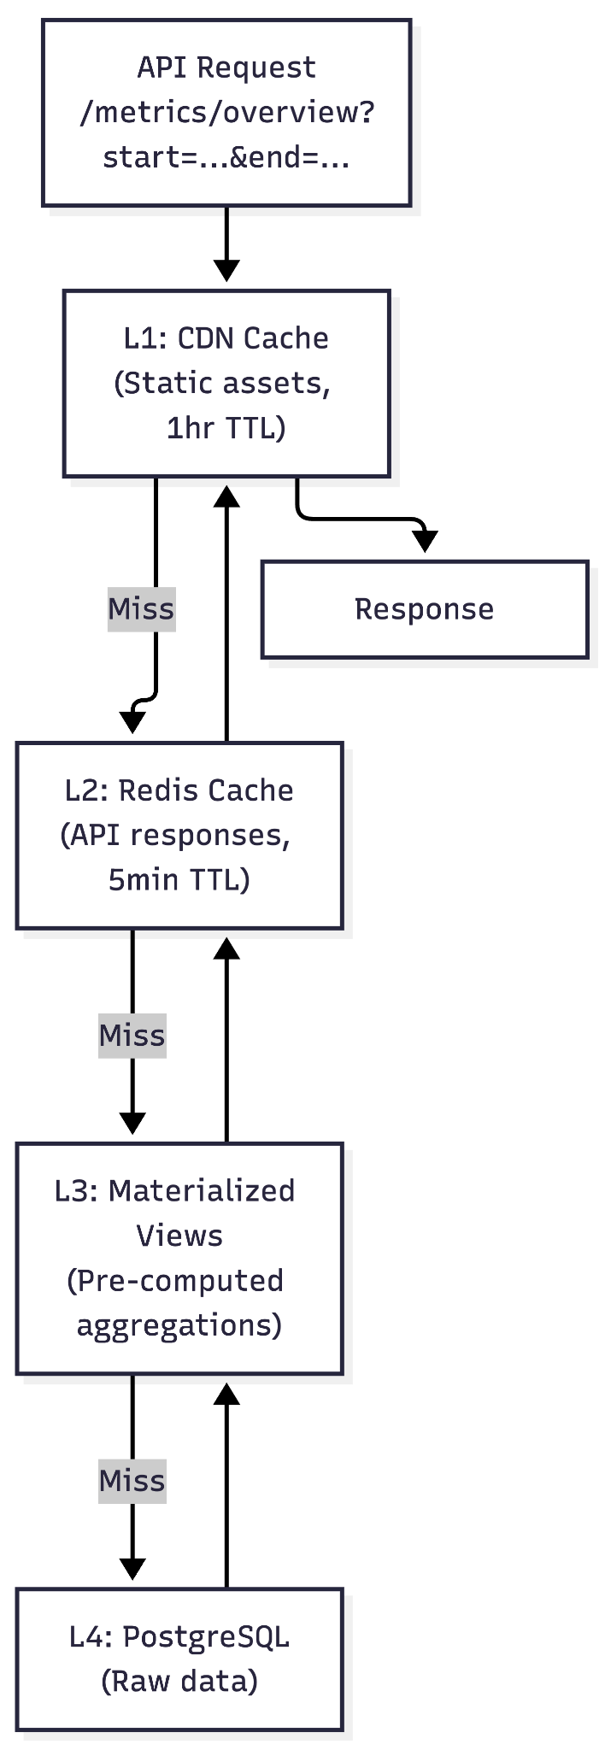
12. Scalability & Performance
Caching Strategy
47
Notes:
Source: Implementation-Plan-Multi-Tenant-Dashboard-New.docx

Slide 48
12. Scalability & Performance
Caching Strategy
48
Notes:
Source: Implementation-Plan-Multi-Tenant-Dashboard-New.docx

Slide 49
12. Scalability & Performance
Database Performance
Technique | Implementation
Connection Pooling | PgBouncer (transaction mode, max 100 connections per pool)
Read Replicas | AI query engine and heavy analytics queries routed to read replica
Materialized Views | Pre-computed monthly/weekly rollups refreshed after sync completion
Table Partitioning | daily_metrics partitioned by month; old partitions detached and archived
Query Optimization | Covering indexes on (org_id, date, platform); EXPLAIN ANALYZE on all key queries
49
Notes:
Source: Implementation-Plan-Multi-Tenant-Dashboard-New.docx

Slide 50
12. Scalability & Performance
Horizontal Scaling
Component | Scaling Trigger | Strategy
API Servers (ECS) | CPU > 70% or P95 latency > 500ms | Auto-scale 2→8 tasks
Pipeline Workers | Queue depth > 100 jobs | Auto-scale 1→4 tasks
PostgreSQL | Read IOPS > 80% capacity | Add read replicas
Redis | Memory > 80% | Upgrade instance size or add cluster nodes
50
Notes:
Source: Implementation-Plan-Multi-Tenant-Dashboard-New.docx

Slide 51
12. Scalability & Performance
Performance SLAs
Metric | Target | Measurement
Dashboard page load (P50) | < 1.5 seconds | Datadog RUM
Dashboard page load (P95) | < 3.0 seconds | Datadog RUM
API response time (P50) | < 200ms | Datadog APM
API response time (P95) | < 500ms | Datadog APM
51
Notes:
Source: Implementation-Plan-Multi-Tenant-Dashboard-New.docx

Slide 52
12. Scalability & Performance
Performance SLAs
Metric | Target | Measurement
AI query response (P50) | < 5 seconds | Custom metric
Data sync latency | < configured frequency + 30min | Sync log analysis
Availability | 99.9% monthly | Uptime monitoring
52
Notes:
Source: Implementation-Plan-Multi-Tenant-Dashboard-New.docx

Slide 53
14. Testing Strategy
Test Pyramid
Level | Tool | Coverage Target | What We Test
Unit | Jest | > 80% line coverage | Normalization logic, date calculations, permission checks, encryption/decryption, data transformations
Integration | Jest + Testcontainers | Key flows | API endpoints with real PostgreSQL (RLS verification), Redis interactions, OAuth flows (mocked platforms)
53
Notes:
Source: Implementation-Plan-Multi-Tenant-Dashboard-New.docx

Slide 54
14. Testing Strategy
Test Pyramid
Level | Tool | Coverage Target | What We Test
E2E | Playwright | Critical paths | Login → Connect platform → View dashboard → Filter data → Trigger sync → Ask AI question
API Contract | Jest + OpenAPI | 100% of endpoints | Request/response shape matches OpenAPI spec
54
Notes:
Source: Implementation-Plan-Multi-Tenant-Dashboard-New.docx

Slide 55
14. Testing Strategy
Test Pyramid
Level | Tool | Coverage Target | What We Test
Security | Custom + OWASP ZAP | All endpoints | Tenant isolation, RBAC enforcement, injection attempts, auth bypass attempts
Performance | k6 | Key endpoints | Dashboard load < 3s P95, API < 500ms P95, 100 concurrent users
55
Notes:
Source: Implementation-Plan-Multi-Tenant-Dashboard-New.docx

Slide 56
15. CI/CD & Deployment
Repository Structure
marketing-intelligence-platform/
├── apps/
│ ├── api/ # NestJS backend
│ │ ├── src/
│ │ ├── prisma/ # Schema + migrations
│ │ ├── Dockerfile
│ │ └── package.json
│ └── web/ # Next.js frontend
│ ├── src/
│ ├── Dockerfile
│ └── package.json
├── packages/
│ ├── shared/ # Shared types, utils, constants
│ └── connectors/ # Platform connector library
├── infra/
56
Notes:
Source: Implementation-Plan-Multi-Tenant-Dashboard-New.docx

Slide 57
15. CI/CD & Deployment
Repository Structure
│ ├── terraform/ # IaC definitions
│ │ ├── modules/
│ │ ├── environments/
│ │ │ ├── dev/
│ │ │ ├── staging/
│ │ │ └── production/
│ │ └── main.tf
│ └── docker-compose.yml # Local development
├── .github/
│ └── workflows/
│ ├── ci.yml
│ ├── deploy-staging.yml
│ └── deploy-production.yml
├── turbo.json # Turborepo config
└── package.json # Root workspace
57
Notes:
Source: Implementation-Plan-Multi-Tenant-Dashboard-New.docx

Slide 58
15. CI/CD & Deployment
Deployment Pipeline
58
Notes:
Source: Implementation-Plan-Multi-Tenant-Dashboard-New.docx

Slide 59
15. CI/CD & Deployment
Environment Management
Environment | Purpose | Infrastructure | Data
Local | Developer workstation | Docker Compose (PG + Redis + MinIO) | Seed data
Dev | Feature testing | Shared AWS (small instances) | Synthetic data
Staging | Pre-production validation | AWS (mirrors prod topology, smaller instances) | Anonymized prod snapshot
Production | Live system | AWS (full-scale, multi-AZ) | Real data
59
Notes:
Source: Implementation-Plan-Multi-Tenant-Dashboard-New.docx

Slide 60
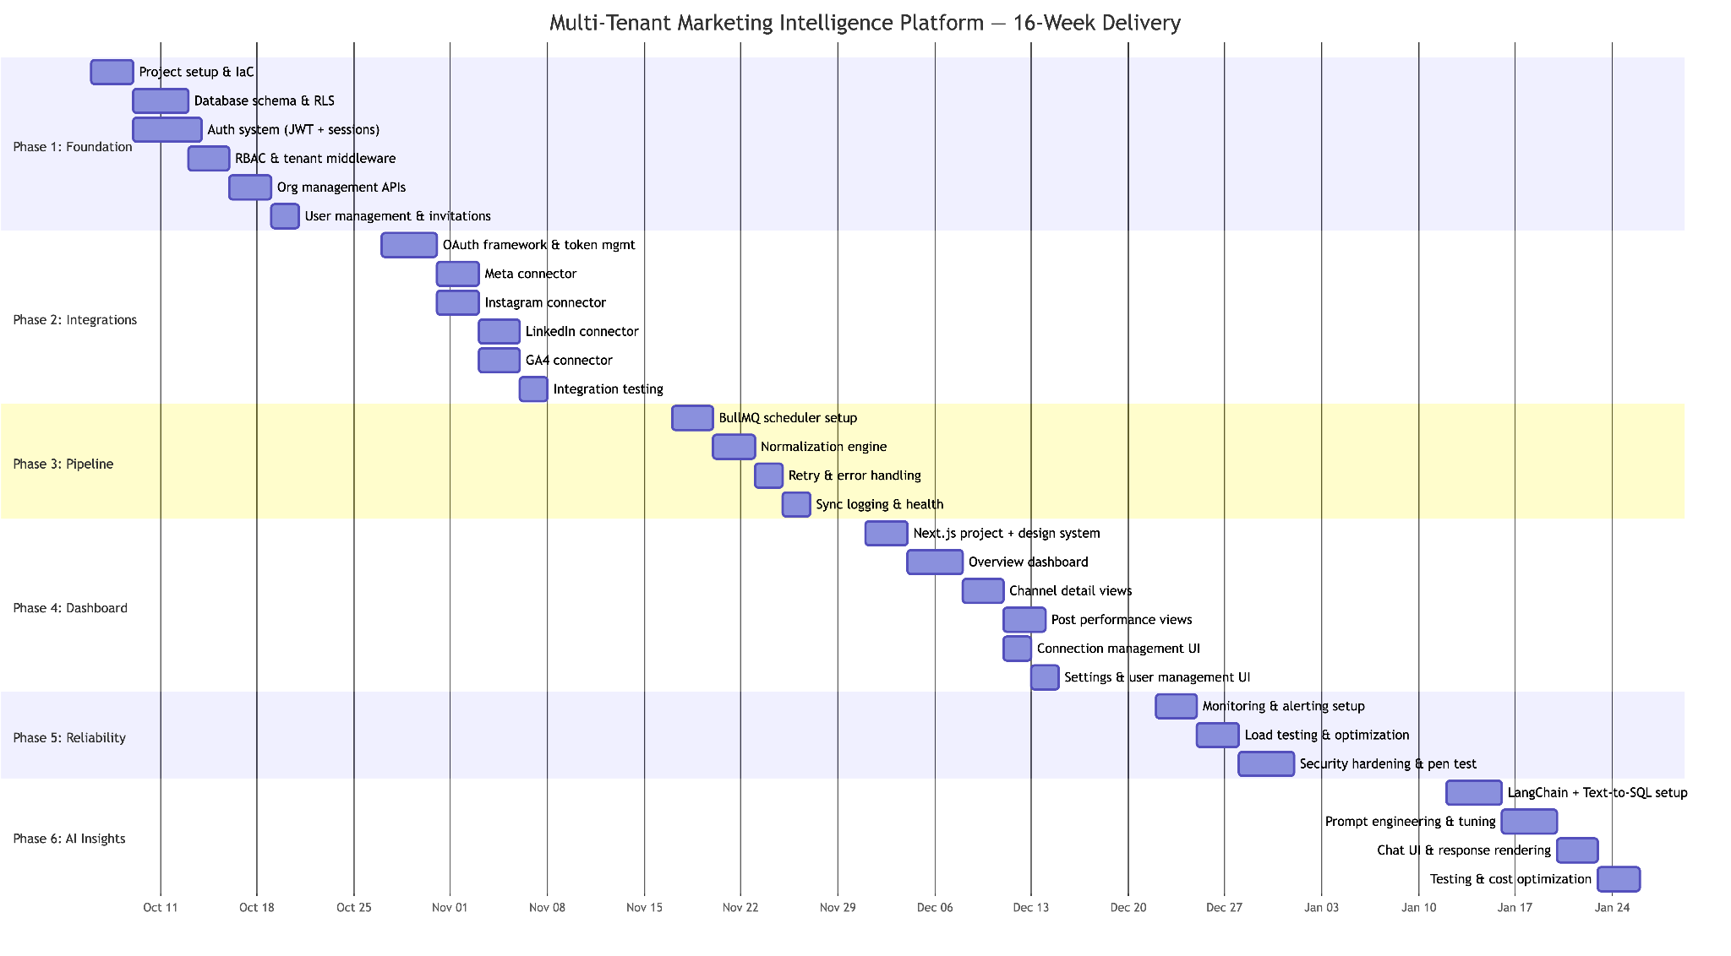
16. Phased Delivery Plan
Overview Timeline
60
Notes:
Source: Implementation-Plan-Multi-Tenant-Dashboard-New.docx

Slide 61
16. Phased Delivery Plan
Phase Detail
61
Notes:
Source: Implementation-Plan-Multi-Tenant-Dashboard-New.docx

Slide 62
16. Phased Delivery Plan
Phase 1: Foundation (Weeks 1–3)
Goal: Establish the multi-tenant core, authentication, and organizational management
62
Notes:
Source: Implementation-Plan-Multi-Tenant-Dashboard-New.docx

Slide 63
16. Phased Delivery Plan
Phase 1: Foundation (Weeks 1–3)
Deliverable | Description | Acceptance Criteria
Project scaffold | Turborepo monorepo with NestJS API + Next.js frontend, Docker Compose for local dev, Terraform for AWS | docker-compose up boots full local stack
Database schema | All core tables created with RLS policies enabled | RLS isolation tests pass (Tenant A cannot see Tenant B)
Auth system | JWT login/logout, refresh token rotation, HttpOnly cookies | Login flow works, tokens rotate correctly
RBAC | Admin/Manager/Viewer role enforcement on all endpoints | Viewer cannot access admin endpoints (403)
63
Notes:
Source: Implementation-Plan-Multi-Tenant-Dashboard-New.docx

Slide 64
16. Phased Delivery Plan
Phase 1: Foundation (Weeks 1–3)
Deliverable | Description | Acceptance Criteria
Tenant middleware | Automatic tenant context setting on every authenticated request | All queries scoped to correct org
Org management | Create org, update settings, view org details | API endpoints functional with tests
User management | Invite user, list users, change role, remove user | Email invitations sent, role changes applied
64
Notes:
Source: Implementation-Plan-Multi-Tenant-Dashboard-New.docx

Slide 65
16. Phased Delivery Plan
Phase 1: Foundation (Weeks 1–3)
Team: 1 Senior Backend + 1 Backend + 1 DevOps
Risk: RLS policy design errors → Mitigated by isolation test suite run on every PR
65
Notes:
Source: Implementation-Plan-Multi-Tenant-Dashboard-New.docx

Slide 66
16. Phased Delivery Plan
Phase 2: Platform Integrations (Weeks 4–6)
Goal: Connect to all four platforms with robust OAuth and token management
66
Notes:
Source: Implementation-Plan-Multi-Tenant-Dashboard-New.docx

Slide 67
16. Phased Delivery Plan
Phase 2: Platform Integrations (Weeks 4–6)
Deliverable | Description | Acceptance Criteria
OAuth framework | Reusable OAuth flow handler supporting any platform | Connect → consent → callback → tokens stored encrypted
Meta connector | Fetch page metrics + post performance via Graph API | 30 days of historical data fetched and normalized
Instagram connector | Fetch account metrics + post performance via IG Graph API | Same as Meta
67
Notes:
Source: Implementation-Plan-Multi-Tenant-Dashboard-New.docx

Slide 68
16. Phased Delivery Plan
Phase 2: Platform Integrations (Weeks 4–6)
Deliverable | Description | Acceptance Criteria
LinkedIn connector | Fetch org metrics + post performance via Marketing API | Same, accounting for LinkedIn’s stricter rate limits
GA4 connector | Fetch analytics data via Data API | Sessions, users, traffic sources, landing pages fetched
Token management | Auto-refresh, expiry detection, reconnect flow | Expired tokens trigger user notification, not silent failure
68
Notes:
Source: Implementation-Plan-Multi-Tenant-Dashboard-New.docx

Slide 69
16. Phased Delivery Plan
Phase 2: Platform Integrations (Weeks 4–6)
Team: 2 Backend + 1 Senior Backend (oversight)
Dependencies: Phase 1 auth and tenant system complete
Risk: Platform API rate limits and approval delays → Each connector designed with configurable backoff; developer app registrations started in Week 1
69
Notes:
Source: Implementation-Plan-Multi-Tenant-Dashboard-New.docx

Slide 70
16. Phased Delivery Plan
Phase 3: Data Pipeline (Weeks 7–8)
Goal: Reliable, automated data ingestion with error handling
70
Notes:
Source: Implementation-Plan-Multi-Tenant-Dashboard-New.docx

Slide 71
16. Phased Delivery Plan
Phase 3: Data Pipeline (Weeks 7–8)
Deliverable | Description | Acceptance Criteria
Scheduler | BullMQ-based configurable scheduler (1–24hr, default 6) | Jobs dispatched on schedule, configurable per account
Normalization | Platform-specific data mapped to unified daily_metrics schema | All four platforms normalize to identical format
Retry logic | Exponential backoff, DLQ for persistent failures | Failed jobs retry 3x, then land in DLQ with alert
Sync logging | Complete sync history with status, duration, record counts | Sync logs queryable by account, date, status
Manual sync | “Sync Now” button triggers immediate sync | Admin/Manager can trigger, Viewer cannot
71
Notes:
Source: Implementation-Plan-Multi-Tenant-Dashboard-New.docx

Slide 72
16. Phased Delivery Plan
Phase 3: Data Pipeline (Weeks 7–8)
Team: 1 Senior Backend + 1 Backend
Dependencies: Phase 2 connectors
Risk: Data quality issues from inconsistent platform APIs → Validation layer with data quality assertions
72
Notes:
Source: Implementation-Plan-Multi-Tenant-Dashboard-New.docx

Slide 73
16. Phased Delivery Plan
Phase 4: Dashboard UI (Weeks 9–11)
Goal: Beautiful, intuitive dashboard serving all four user personas
73
Notes:
Source: Implementation-Plan-Multi-Tenant-Dashboard-New.docx

Slide 74
16. Phased Delivery Plan
Phase 4: Dashboard UI (Weeks 9–11)
Deliverable | Description | Acceptance Criteria
Design system | shadcn/ui + Tailwind setup, component library, dark/light mode | Consistent visual language across all pages
Overview dashboard | KPI cards, cross-platform summary, trend sparklines | Shows key metrics at a glance, date range filtering works
Channel views | Per-platform deep-dive with metric charts | Line charts, bar charts, engagement breakdowns per platform
Post performance | Sortable/filterable post table with engagement metrics | Sort by engagement, filter by platform/date/type
74
Notes:
Source: Implementation-Plan-Multi-Tenant-Dashboard-New.docx

Slide 75
16. Phased Delivery Plan
Phase 4: Dashboard UI (Weeks 9–11)
Deliverable | Description | Acceptance Criteria
Connection management | Connect/disconnect platforms, view connection health | OAuth flows launch from UI, connection status visible
Settings | Org settings, user management, sync frequency configuration | All settings editable by Admin role
Agency multi-client | Client switcher for agency accounts | Agency users can switch between client orgs
75
Notes:
Source: Implementation-Plan-Multi-Tenant-Dashboard-New.docx

Slide 76
16. Phased Delivery Plan
Phase 4: Dashboard UI (Weeks 9–11)
Team: 2 Frontend + 1 Designer + 1 Backend (API support)
Dependencies: Phase 3 pipeline populating data
Risk: UI complexity creep → Strict scope control via design mockup sign-off before development
76
Notes:
Source: Implementation-Plan-Multi-Tenant-Dashboard-New.docx

Slide 77
16. Phased Delivery Plan
Phase 5: Reliability & Hardening (Weeks 12–13)
Goal: Production-ready monitoring, performance, and security
77
Notes:
Source: Implementation-Plan-Multi-Tenant-Dashboard-New.docx

Slide 78
16. Phased Delivery Plan
Phase 5: Reliability & Hardening (Weeks 12–13)
Deliverable | Description | Acceptance Criteria
Monitoring | Datadog APM, metrics, logs for all services | Dashboards for API health, sync pipeline, and database
Alerting | PagerDuty/Slack alerts for critical issues | Alerts fire on error spikes, sync failures, resource exhaustion
Load testing | k6 load tests simulating 100 concurrent users | P95 API < 500ms, dashboard load < 3s
78
Notes:
Source: Implementation-Plan-Multi-Tenant-Dashboard-New.docx

Slide 79
16. Phased Delivery Plan
Phase 5: Reliability & Hardening (Weeks 12–13)
Deliverable | Description | Acceptance Criteria
Performance optimization | Query optimization, caching, materialized views | All slow queries identified and optimized
Security hardening | OWASP ZAP scan, dependency audit, security headers | No high/critical vulnerabilities, A+ SSL rating
Backup & recovery | Automated RDS backups, tested restore procedure | Point-in-time restore tested, RTO < 1 hour
79
Notes:
Source: Implementation-Plan-Multi-Tenant-Dashboard-New.docx

Slide 80
16. Phased Delivery Plan
Phase 5: Reliability & Hardening (Weeks 12–13)
Team: 1 Senior Backend + 1 DevOps + 1 QA
Dependencies: All functional features complete
Risk: Performance issues under load → Early query profiling in Phase 3–4 reduces late-stage surprises
80
Notes:
Source: Implementation-Plan-Multi-Tenant-Dashboard-New.docx

Slide 81
16. Phased Delivery Plan
Phase 6: AI Insights Layer (Weeks 14–16)
Goal: Natural language query engine grounded in real marketing data
81
Notes:
Source: Implementation-Plan-Multi-Tenant-Dashboard-New.docx

Slide 82
16. Phased Delivery Plan
Phase 6: AI Insights Layer (Weeks 14–16)
Deliverable | Description | Acceptance Criteria
LangChain setup | GPT-4o integration with Text-to-SQL chain | LLM generates valid SQL for test questions
Prompt engineering | Schema-aware prompts, few-shot examples, error handling | 90%+ accuracy on benchmark question set
SQL validation | Safety checks on generated SQL (SELECT only, no cross-tenant) | All injection/cross-tenant attack prompts blocked
82
Notes:
Source: Implementation-Plan-Multi-Tenant-Dashboard-New.docx

Slide 83
16. Phased Delivery Plan
Phase 6: AI Insights Layer (Weeks 14–16)
Deliverable | Description | Acceptance Criteria
Chat UI | Natural language input, formatted responses, data tables | Users can type questions and get clear answers
Suggested questions | Context-aware question suggestions based on available data | “Try asking…” prompts appear based on connected platforms
Cost controls | Per-tenant query limits, response caching, model tiering | Costs within $200–300/month at 100 tenants
83
Notes:
Source: Implementation-Plan-Multi-Tenant-Dashboard-New.docx

Slide 84
16. Phased Delivery Plan
Phase 6: AI Insights Layer (Weeks 14–16)
Team: 1 Senior Backend (AI/ML experience) + 1 Frontend + 1 Backend
Dependencies: Phase 4 dashboard as hosting surface, Phase 5 monitoring for cost tracking
Risk: LLM accuracy on complex SQL → Extensive prompt testing, fallback to “I can’t answer that” over hallucination
84
Notes:
Source: Implementation-Plan-Multi-Tenant-Dashboard-New.docx

Slide 85
17. Risk Assessment & Mitigation
# | Risk | Impact | Probability | Mitigation | Contingency
1 | Platform API changes or deprecation | High | Medium | Abstract connector pattern; monitor API changelogs; version-pin API endpoints | Swap connector implementation without affecting rest of system
2 | RLS data leak | Critical | Low | Automated isolation test suite on every PR; database-level enforcement | Immediate hotfix capability; audit log review for exposure assessment
3 | OAuth token expiry causes silent data gaps | High | Medium | Proactive token refresh; expiry monitoring; clear user-facing “Reconnect” alerts | Admin notifications + sync health dashboard shows gaps
4 | Platform API rate limiting throttles sync | Medium | High | Per-platform rate limit tracking; configurable sync frequency; adaptive backoff | Priority queue (manual syncs first); stagger sync times across tenants
85
Notes:
Source: Implementation-Plan-Multi-Tenant-Dashboard-New.docx

Slide 86
17. Risk Assessment & Mitigation
# | Risk | Impact | Probability | Mitigation | Contingency
5 | LLM generates incorrect/misleading insights | High | Medium | SQL validation layer; ground responses in raw data; confidence scoring | Show raw data table alongside AI answer; “I don’t have enough data” fallback
6 | Scope creep in dashboard UI | Medium | High | Design mockup sign-off before development; strict phase boundaries | Feature backlog for post-launch iteration
7 | Platform developer app approval delays | High | Medium | Start platform app registrations in Week 1; use sandbox/test accounts in parallel | Develop against mock APIs; swap in real credentials when approved
8 | Database performance under scale | Medium | Medium | Table partitioning; materialized views; connection pooling; read replicas | Vertical RDS scaling as immediate relief; query optimization sprint
86
Notes:
Source: Implementation-Plan-Multi-Tenant-Dashboard-New.docx

Slide 87
17. Risk Assessment & Mitigation
# | Risk | Impact | Probability | Mitigation | Contingency
9 | LLM API costs exceed projections | Medium | Medium | Response caching; model tiering (GPT-4o for SQL, mini for synthesis); per-tenant limits | Switch to cheaper model; reduce cache TTL; increase query limits
10 | Key team member unavailability | Medium | Low | Documentation-first development; pair programming on critical paths | Cross-trained team members can cover any component
11 | LinkedIn API access restrictions | Medium | Medium | LinkedIn Marketing API requires partner program approval for some endpoints | Start application early; implement with available endpoints first
12 | Multi-tenant performance interference | Medium | Low | Connection pooling per tenant; query timeout limits; resource monitoring | Tenant-level rate limiting; isolate heavy tenants to dedicated resources
87
Notes:
Source: Implementation-Plan-Multi-Tenant-Dashboard-New.docx

Slide 88
18. Cost Estimation
Infrastructure Cost (Monthly, at 100 Tenants)
Service | Instance/Tier | Monthly Cost | Notes
AWS ECS Fargate (API) | 2 tasks × 0.5 vCPU / 1GB | ~$60 | Auto-scales to 8 tasks under load
AWS ECS Fargate (Workers) | 1 task × 0.5 vCPU / 1GB | ~$30 | Scales with queue depth
AWS RDS PostgreSQL | db.t4g.medium (Multi-AZ) | ~$140 | 100GB gp3 storage included
AWS ElastiCache Redis | cache.t4g.small | ~$50 | Single node (HA in prod)
AWS S3 | Standard | ~$5 | Report storage, backups
88
Notes:
Source: Implementation-Plan-Multi-Tenant-Dashboard-New.docx

Slide 89
18. Cost Estimation
Infrastructure Cost (Monthly, at 100 Tenants)
Service | Instance/Tier | Monthly Cost | Notes
AWS CloudFront | Standard | ~$10 | CDN for frontend assets
AWS ALB | Application Load Balancer | ~$25 | Plus per-request charges
Datadog | Pro plan (5 hosts) | ~$115 | APM + Logs + Metrics
Sentry | Team plan | ~$26 | Error tracking
89
Notes:
Source: Implementation-Plan-Multi-Tenant-Dashboard-New.docx

Slide 90
18. Cost Estimation
Infrastructure Cost (Monthly, at 100 Tenants)
Service | Instance/Tier | Monthly Cost | Notes
OpenAI API | GPT-4o + GPT-4o-mini | ~$150–250 | Variable with query volume
Domain + SSL | Route 53 + ACM | ~$5 | Certificate free via ACM
Total |  | ~$616–716/month
Per-tenant cost |  | ~$6–7/month
90
Notes:
Source: Implementation-Plan-Multi-Tenant-Dashboard-New.docx

Slide 91
18. Cost Estimation
Scaling Projections
Tenants | Est. Monthly Infra Cost | Per-Tenant Cost | Notes
10 | ~$400 | ~$40 | Baseline infrastructure floor
100 | ~$650 | ~$6.50 | Optimal efficiency range
500 | ~$1,200 | ~$2.40 | RDS upgrade, additional workers
1,000 | ~$2,500 | ~$2.50 | Read replica, larger cache, more Fargate tasks
5,000 | ~$8,000 | ~$1.60 | Partitioning, dedicated resources for hot tenants
91
Notes:
Source: Implementation-Plan-Multi-Tenant-Dashboard-New.docx

Slide 92
18. Cost Estimation
Scaling Projections
[!NOTE] AI costs scale linearly with query volume, not tenant count. A tenant making 100 AI queries/month costs more in LLM tokens than one making 5. Per-tenant query limits and aggressive caching are critical cost controls.
92
Notes:
Source: Implementation-Plan-Multi-Tenant-Dashboard-New.docx

Slide 93
19. Post-Launch & Maintenance
SLA Commitments
Metric | SLA | Measurement
Platform uptime | 99.9% monthly (< 44min downtime) | Synthetic monitoring
Data sync freshness | Within configured frequency + 30min | Sync log analysis
API response time (P95) | < 500ms | Datadog APM
Critical bug response | < 4 hours (business hours) | Ticketing system
Security vulnerability patch | < 24 hours for critical CVEs | Dependency scanning
93
Notes:
Source: Implementation-Plan-Multi-Tenant-Dashboard-New.docx

Slide 94
19. Post-Launch & Maintenance
Backup & Disaster Recovery
Component | Backup Strategy | RPO | RTO
PostgreSQL | Automated RDS snapshots (daily) + continuous WAL archiving | 5 minutes (PITR) | < 1 hour
Redis | RDB snapshots (hourly) | 1 hour | < 15 minutes
S3 | Cross-region replication | Near-zero | < 30 minutes
94
Notes:
Source: Implementation-Plan-Multi-Tenant-Dashboard-New.docx

Slide 95
19. Post-Launch & Maintenance
Backup & Disaster Recovery
Component | Backup Strategy | RPO | RTO
Application code | Git (GitHub) | Zero | < 30 minutes (rebuild + deploy)
Terraform state | S3 backend with versioning + state locking | Zero | < 15 minutes
95
Notes:
Source: Implementation-Plan-Multi-Tenant-Dashboard-New.docx

Slide 96
19. Post-Launch & Maintenance
Change Request Process
Request: Client submits via dedicated channel (email/portal)
Triage: Assess scope — is it a bug fix, minor change, or feature?
Scope & estimate: For changes beyond maintenance (e.g., adding a new platform), provide effort estimate within 48 hours
Approval: Client approves estimate
Implementation: Follows standard CI/CD pipeline (develop → test → staging → production)
Billing: Bug fixes within SLA scope are included. Feature additions billed at agreed hourly rate or mini-SOW
96
Notes:
Source: Implementation-Plan-Multi-Tenant-Dashboard-New.docx

Slide 97
19. Post-Launch & Maintenance
Platform API Monitoring
Each social platform periodically changes or deprecates API endpoints. We proactively manage this:
Automated API health checks: Daily test calls to each platform API to detect breaking changes early
Changelog monitoring: Subscribe to Meta, LinkedIn, and Google developer blogs and API changelog feeds
Version pinning: All API calls use explicit API version parameters (e.g., Graph API v19.0) to avoid surprise changes
Deprecation alerts: When a platform announces deprecation, we schedule connector updates within the deprecation window
97
Notes:
Source: Implementation-Plan-Multi-Tenant-Dashboard-New.docx

Slide 98
20. Phase 2 Roadmap
The following features are explicitly out of scope for Phase 1 but architecturally planned for:
98
Notes:
Source: Implementation-Plan-Multi-Tenant-Dashboard-New.docx

Slide 99
20. Phase 2 Roadmap
Feature | Priority | Estimated Effort | Dependencies
Meta Ads integration | High | 2–3 weeks | Ads API approval, additional OAuth scopes
Google Ads integration | High | 2–3 weeks | Google Ads API access, conversion tracking schema
LinkedIn Ads integration | Medium | 2 weeks | LinkedIn Marketing Partner approval
Custom report builder | High | 3–4 weeks | Drag-and-drop report designer, PDF export
YouTube Analytics | Medium | 2 weeks | YouTube Data API, additional connector
99
Notes:
Source: Implementation-Plan-Multi-Tenant-Dashboard-New.docx

Slide 100
20. Phase 2 Roadmap
Feature | Priority | Estimated Effort | Dependencies
Google Search Console | Medium | 1–2 weeks | GSC API, additional connector
CRM integration (HubSpot, Salesforce) | Medium | 3–4 weeks | Lead attribution, pipeline mapping
White-label / custom branding | Medium | 2–3 weeks | Per-tenant theming, custom domains (CNAME)
Advanced anomaly detection | Medium | 3–4 weeks | Statistical models, automated alert rules
100
Notes:
Source: Implementation-Plan-Multi-Tenant-Dashboard-New.docx

Slide 101
20. Phase 2 Roadmap
Feature | Priority | Estimated Effort | Dependencies
AI recommendations | High | 4–6 weeks | Actionable recommendations beyond Q&A (e.g., “Post more on Tuesdays”)
Mobile app (React Native) | Low | 8–12 weeks | Shared API, push notifications
Webhook notifications | Low | 1 week | Event system, webhook management UI
101
Notes:
Source: Implementation-Plan-Multi-Tenant-Dashboard-New.docx

Slide 102
20. Phase 2 Roadmap
Feature | Priority | Estimated Effort | Dependencies
Data export API | Medium | 1–2 weeks | CSV/JSON export, scheduled reports
SSO (SAML/OIDC) | Medium | 2–3 weeks | Enterprise auth, identity provider integration
102
Notes:
Source: Implementation-Plan-Multi-Tenant-Dashboard-New.docx

Slide 103
20. Phase 2 Roadmap
Extensibility Architecture
The system is designed for easy platform additions:
// Adding a new platform (e.g., YouTube) requires:
// 1. Create YouTubeConnector extending BaseConnector (1 file)
// 2. Register in connector factory (1 line)
// 3. Add platform enum value (1 line)
// 4. Database migration adds 'youtube' to platform check constraint (1 migration)
// 5. Frontend adds YouTube icon/color to platform components (2-3 files)
// Total effort for a new platform connector: ~1-2 weeks
103
Notes:
Source: Implementation-Plan-Multi-Tenant-Dashboard-New.docx

Slide 104
21. Assumptions & Clarification Points
Assumptions Made
# | Assumption | Impact if Wrong
A1 | Client has or will create developer apps on Meta, LinkedIn, and Google Cloud before Phase 2 starts | Phase 2 blocked; we can assist with app registration
A2 | Instagram data is accessed via Meta Graph API (Business/Creator accounts, not personal) | Different API required for personal accounts
A3 | Initial historical data pull covers 90 days (not years of history) | Longer history = higher API quota usage and longer initial sync
A4 | English-only UI for Phase 1 | i18n adds 1–2 weeks if needed
A5 | Single region deployment (us-east-1) initially | Multi-region adds infrastructure complexity and cost
104
Notes:
Source: Implementation-Plan-Multi-Tenant-Dashboard-New.docx

Slide 105
21. Assumptions & Clarification Points
Assumptions Made
# | Assumption | Impact if Wrong
A6 | No SSO requirement in Phase 1 (email/password auth) | SSO adds 2–3 weeks
A7 | Platform API sandbox/test accounts available for development | Development uses real accounts if sandbox unavailable
A8 | Maximum 50 connected accounts per organization in Phase 1 | Higher limits require queue partitioning adjustments
A9 | Budget allows for Datadog-tier observability (not just CloudWatch) | CloudWatch alternative reduces cost but limits visibility
A10 | Client team has AWS account access for infrastructure provisioning | We can use our AWS account with cross-account access
105
Notes:
Source: Implementation-Plan-Multi-Tenant-Dashboard-New.docx

Slide 106
21. Assumptions & Clarification Points
Clarification Points Needed
# | Question | Impact on Design
C1 | How much historical data should the initial sync pull? (30 days? 90 days? All available?) | Affects initial sync duration, API quota planning, and storage estimates
C2 | Are there specific branding/theming requirements for the dashboard? | Affects UI development scope
C3 | Should agencies be able to have their own billing, or is this managed centrally? | Affects organization hierarchy design
C4 | What is the expected tenant count at launch and 6-month mark? | Affects initial infrastructure sizing
106
Notes:
Source: Implementation-Plan-Multi-Tenant-Dashboard-New.docx

Slide 107
21. Assumptions & Clarification Points
Clarification Points Needed
# | Question | Impact on Design
C5 | Are there any compliance requirements (SOC 2, HIPAA, ISO 27001)? | Affects security controls and audit scope
C6 | Does the client have an existing AWS account, or should we provision new? | Affects IaC setup and billing
C7 | Is there a preference for the frontend hosting (Vercel vs. self-hosted on AWS)? | Affects deployment pipeline design
C8 | Should the AI insights layer support multiple languages or English only? | Affects prompt engineering scope
107
Notes:
Source: Implementation-Plan-Multi-Tenant-Dashboard-New.docx

Slide 108
21. Assumptions & Clarification Points
Clarification Points Needed
# | Question | Impact on Design
C9 | What is the expected data volume per tenant? (Number of posts/day, number of connected accounts) | Affects database sizing and partition strategy
C10 | Is there an existing design system or brand guidelines to follow? | Affects UI development approach
108
Notes:
Source: Implementation-Plan-Multi-Tenant-Dashboard-New.docx

Slide 109
22. Answers to Proposal Questions
Q1: Similar Work
We have built multi-tenant SaaS platforms with OAuth integrations, scheduler/sync patterns, and real tenant isolation. The genuinely hard parts in similar projects have been:
Token lifecycle management across platforms: Each platform (Meta, Google, LinkedIn) has different token expiry behaviors, refresh mechanisms, and error responses. Building a unified abstraction that handles all edge cases (token revocation, scope changes, rate limit responses) took significant iteration.
Tenant isolation confidence: Moving from “we’re pretty sure the WHERE clauses are right” to “we have database-level proof that cross-tenant access is impossible” — implementing and testing RLS policies, then running automated isolation tests on every deployment.
109
Notes:
Source: Implementation-Plan-Multi-Tenant-Dashboard-New.docx

Slide 110
22. Answers to Proposal Questions
Q1: Similar Work
Sync pipeline reliability: The platforms have unpredictable rate limits, occasional outages, and changing response formats. Building a pipeline that gracefully handles all of these without losing data or creating gaps in metrics required extensive error handling, retry logic, and monitoring.
110
Notes:
Source: Implementation-Plan-Multi-Tenant-Dashboard-New.docx

Slide 111
22. Answers to Proposal Questions
Q2: Tech Stack
Backend: NestJS (Node.js/TypeScript) — chosen for its structured module system, first-class TypeScript support, and built-in support for scheduling and queues that this project needs heavily.
Database: PostgreSQL 16 — chosen specifically for native Row-Level Security, which is the foundation of our multi-tenancy strategy. RLS enforces isolation at the database engine level.
Frontend: Next.js 14 (React) — SSR for dashboard performance, vast charting ecosystem, and deployment flexibility.
Full justification in Section 3.
111
Notes:
Source: Implementation-Plan-Multi-Tenant-Dashboard-New.docx

Slide 112
22. Answers to Proposal Questions
Q3: Multi-Tenancy Approach
Shared database with Row-Level Security (RLS) — detailed in Section 4.
We use PostgreSQL RLS policies that filter every query by organization_id using a session-level variable set from the authenticated JWT. This means even if application code has a bug (missing WHERE clause), the database itself will not return cross-tenant data. We have automated tests that verify this isolation on every pull request.
Our experience: RLS holds up well in production. The key is rigorous testing and ensuring the session variable is set correctly on every database connection (including background workers).
112
Notes:
Source: Implementation-Plan-Multi-Tenant-Dashboard-New.docx

Slide 113
22. Answers to Proposal Questions
Q4: Team & Structure
Role | Count | Responsibility | Dedication
Technical Lead / Architect | 1 | Architecture decisions, code review, client communication | Dedicated
Senior Backend Engineer | 1 | Multi-tenancy, auth, data pipeline, AI layer | Dedicated
Backend Engineer | 1 | Platform connectors, API development | Dedicated
Senior Frontend Engineer | 1 | Dashboard UI, data visualization, UX | Dedicated
113
Notes:
Source: Implementation-Plan-Multi-Tenant-Dashboard-New.docx

Slide 114
22. Answers to Proposal Questions
Q4: Team & Structure
Role | Count | Responsibility | Dedication
Frontend Engineer | 1 | UI components, settings, connection management | Dedicated
DevOps Engineer | 1 (part-time) | Infrastructure, CI/CD, monitoring | Shared (50%)
QA Engineer | 1 (part-time) | Test strategy, E2E tests, security testing | Shared (50%)
114
Notes:
Source: Implementation-Plan-Multi-Tenant-Dashboard-New.docx

Slide 115
22. Answers to Proposal Questions
Q4: Team & Structure
This is a dedicated core team (4 FTEs) with shared DevOps and QA support. No one on the core team is split across other client work during active development phases.
115
Notes:
Source: Implementation-Plan-Multi-Tenant-Dashboard-New.docx

Slide 116
22. Answers to Proposal Questions
Q5: Timeline
Phase | Duration | Dates
Phase 1: Foundation | 3 weeks | Weeks 1–3
Phase 2: Platform Integrations | 3 weeks | Weeks 4–6
Phase 3: Data Pipeline | 2 weeks | Weeks 7–8
Phase 4: Dashboard UI | 3 weeks | Weeks 9–11
116
Notes:
Source: Implementation-Plan-Multi-Tenant-Dashboard-New.docx

Slide 117
22. Answers to Proposal Questions
Q5: Timeline
Phase | Duration | Dates
Phase 5: Reliability & Hardening | 2 weeks | Weeks 12–13
Phase 6: AI Insights Layer | 3 weeks | Weeks 14–16
Total | 16 weeks
117
Notes:
Source: Implementation-Plan-Multi-Tenant-Dashboard-New.docx

Slide 118
22. Answers to Proposal Questions
Q5: Timeline
Buffer built in: Phase 5 (reliability) serves as a natural buffer for any Phase 1–4 overruns. If all phases complete on time, Week 12–13 is purely hardening. If any phase slips, hardening absorbs the impact without pushing the AI phase.
118
Notes:
Source: Implementation-Plan-Multi-Tenant-Dashboard-New.docx

Slide 119
22. Answers to Proposal Questions
Q6: Cost
We recommend a time & materials model with phase-based milestones — providing cost predictability while allowing flexibility for the inevitable scope refinements that happen during development.
Infrastructure costs detailed in Section 18. Development costs would be provided separately based on agreed rates.
119
Notes:
Source: Implementation-Plan-Multi-Tenant-Dashboard-New.docx

Slide 120
22. Answers to Proposal Questions
Q7: Maintenance
Post-launch maintenance includes:
Included in SLA: Bug fixes, security patches, dependency updates, platform API compatibility updates, monitoring and alerting response
Change requests: Scoped and estimated within 48 hours. Small changes (add a field, adjust a chart) are typically 2–8 hours. New platform connectors are 1–2 week mini-projects. Priced at agreed hourly rate.
Platform API monitoring: We proactively monitor for API changes and handle updates before they break the product
Detailed in Section 19.
120
Notes:
Source: Implementation-Plan-Multi-Tenant-Dashboard-New.docx

Slide 121
22. Answers to Proposal Questions
Q8: AI-Assisted Delivery
Our team uses AI coding assistants extensively:
Code generation: GitHub Copilot and Claude for boilerplate, test generation, and connector implementations
Architecture review: AI-assisted code review for security and performance patterns
Documentation: AI-assisted API documentation and technical writing
Impact: AI tools have reduced boilerplate development time by approximately 30–40%, allowing us to dedicate more human time to architecture decisions, security review, and edge case handling. This is reflected in our timeline — the 16-week estimate accounts for AI-assisted velocity.
121
Notes:
Source: Implementation-Plan-Multi-Tenant-Dashboard-New.docx

Slide 122
22. Answers to Proposal Questions
Q9: Backend Platform Experience
We have built on both schema-driven platforms (Supabase, Firebase) and fully hand-rolled backends. Our honest assessment for this project:
Supabase would accelerate initial development (auth, RLS, real-time) but would constrain the data pipeline architecture. The sync pipeline’s requirements — complex retry logic, rate limit coordination across four platforms, multi-step normalization, dead letter queues — exceed what Edge Functions can reliably handle.
Our recommendation: hand-rolled NestJS backend with PostgreSQL (using many of the same patterns Supabase implements internally, like RLS). This gives us full control over the pipeline architecture while maintaining the speed benefits of TypeScript and a structured framework. Trade-off: slightly more upfront setup, but significantly more flexibility for the complex async processing this project requires.
122
Notes:
Source: Implementation-Plan-Multi-Tenant-Dashboard-New.docx

Slide 123
22. Answers to Proposal Questions
Q10: Infrastructure & Hosting
AWS — ECS Fargate for containers, RDS PostgreSQL for database, ElastiCache for Redis, S3 for storage, CloudFront for CDN.
Per-tenant infrastructure cost at moderate scale (100 tenants): ~$6–7/month per tenant excluding AI token costs. At 500 tenants: ~$2.40/month per tenant. Detailed breakdown in Section 18.
123
Notes:
Source: Implementation-Plan-Multi-Tenant-Dashboard-New.docx

Slide 124
22. Answers to Proposal Questions
Q11: AI/Agent Build
Yes, we have in-house expertise building AI-powered features. For the natural-language insights layer:
Tech stack: LangChain.js + OpenAI GPT-4o for SQL generation, GPT-4o-mini for response synthesis
Approach: Text-to-SQL with schema-aware prompting, SQL validation layer, tenant-scoped execution
Team: 1 senior engineer with LLM/RAG experience + 1 backend engineer
Effort relative to rest of build: ~20% of total engineering effort (3 weeks out of 16). The data pipeline and multi-tenancy foundation are the heavier lifts.
124
Notes:
Source: Implementation-Plan-Multi-Tenant-Dashboard-New.docx

Slide 125
22. Answers to Proposal Questions
Q11: AI/Agent Build
MCP: We’re familiar with Model Context Protocol and could use it for tool-use patterns, but for this specific use case (structured data → SQL → response), a direct Text-to-SQL pipeline is more appropriate and reliable.
Detailed architecture in Section 10.
125
Notes:
Source: Implementation-Plan-Multi-Tenant-Dashboard-New.docx

Slide 126
22. Answers to Proposal Questions
Q12: Risks
The riskiest parts of this brief as written:
Platform API access and approval timelines — Getting production-level API access (especially LinkedIn Marketing API) can take weeks. This is outside our control and could delay Phase 2 if not started immediately.
Natural-language insights accuracy expectations — LLMs are probabilistic. While we can achieve high accuracy for common questions (“Which channel had the most engagement?”), edge cases and complex multi-step questions will sometimes produce incorrect results. Setting appropriate user expectations and building robust fallbacks is critical.
126
Notes:
Source: Implementation-Plan-Multi-Tenant-Dashboard-New.docx

Slide 127
22. Answers to Proposal Questions
Q12: Risks
The “eventually actionable” aspiration — Moving from Q&A insights to proactive recommendations (“You should post more on Tuesdays because…”) is a significant leap in AI complexity. The brief correctly sequences this later, but it should be treated as a separate project with its own evaluation criteria.
Least-defined parts: - Exact historical data retention expectations (how far back to pull on initial sync?) - Agency multi-client management specifics (billing model, client onboarding flow) - Target tenant count for infrastructure sizing
These are normal gaps at the proposal stage. We’d clarify them in a kickoff workshop before Phase 1 begins.
127
Notes:
Source: Implementation-Plan-Multi-Tenant-Dashboard-New.docx

Slide 128
22. Answers to Proposal Questions
Q12: Risks
[!IMPORTANT] This implementation plan is based on the requirements as stated in the client’s RFP. Assumptions are clearly marked in Section 21. We recommend a 2-hour kickoff workshop to align on clarification points before development begins.
128
Notes:
Source: Implementation-Plan-Multi-Tenant-Dashboard-New.docx

