Slide 1
Wine Review Analysis

Slide 2
Motivations
• Transform wine reviews from data to useful information and understand whether these data frames are worth to reference or not
• Find the best wines worldwide based on reviews, points and prices along with different categories including provinces, regions, wineries, varieties.
• Be beneficial for people who are not familiar with wine and intend to be acknowledged immediately.
• Increase the popularity of wines.

Slide 3
Data Preparation and References
Dataset Link -: https://drive.google.com/drive/folders/1FkmFVL8wlJmQWP1z52TD8PlhOJhitTyI?usp=s
Reference -: CANER DABAKOGLU https://www.kaggle.com/code/cdabakoglu/wine-reviews-visualization-and-nlp/notebook

Slide 4
Import Libraries
(library) pandas
(library) seaborn
(library) numpy
(library) matplotlib
(library) matplotlib.pyplot
(library) norm
(library) statistics
(library) chart_studio.plotly
(library) init_notebook_mode, iplot
(library) plotly.graph_objs
(library) tools
(library) squarify

Slide 5
Clean Dataset

Slide 6
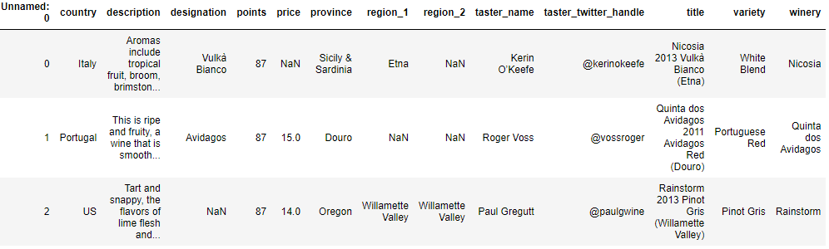
Import and Observe dataset
df = pd.read_csv('wine_reviews_small.csv’)
df.head()

Slide 7
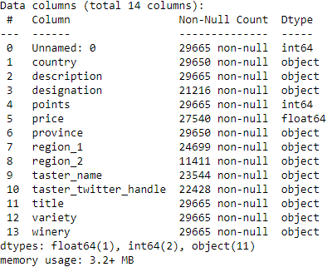
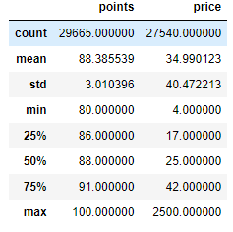
Summarize Data
df.info()
df.describe()

Slide 8
Data Analysis And Visualization

Slide 9

Import Libraires

Slide 10
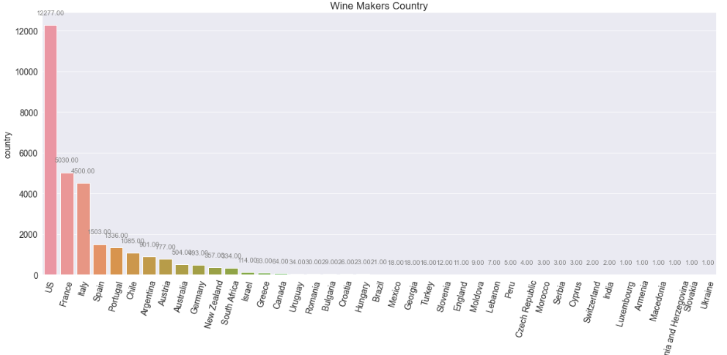
List of all Wine making countries

Slide 11
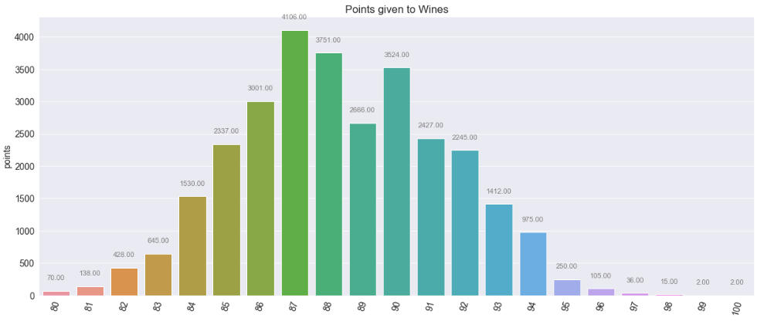
List of Points given to Wines

Slide 12
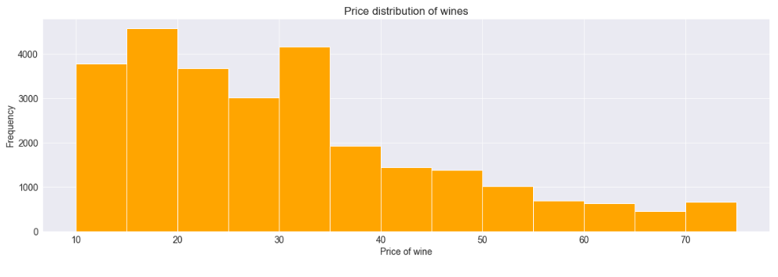
List of Price distribution of wines

Slide 13
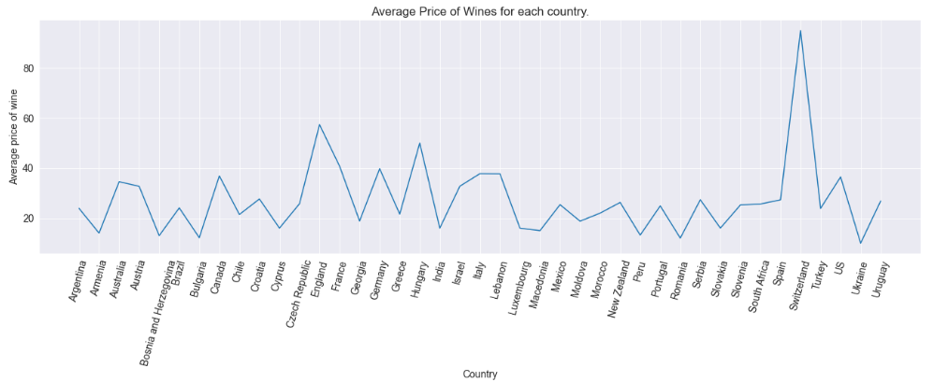
List of Average Price of Wines for each country

Slide 14
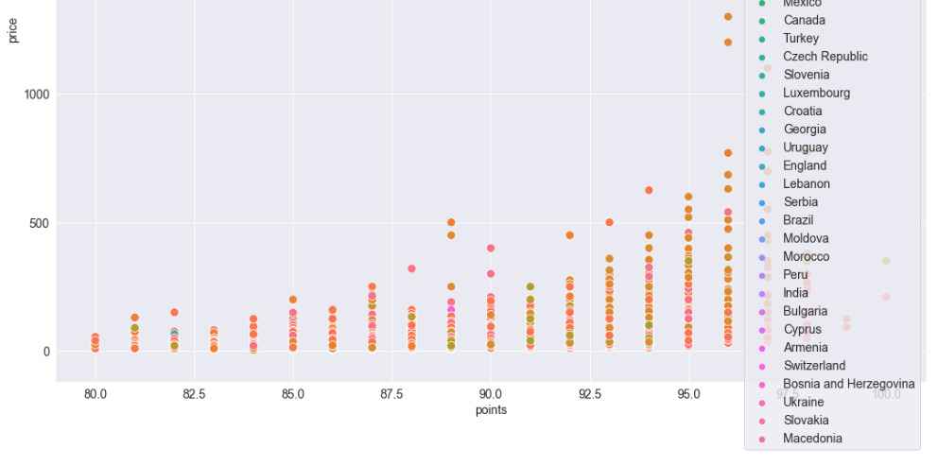
Scatter Plot of Price and Points

Slide 15
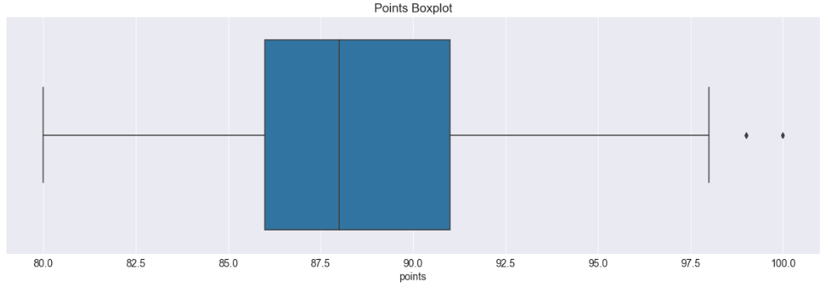
List of Outliers in Points

Slide 16
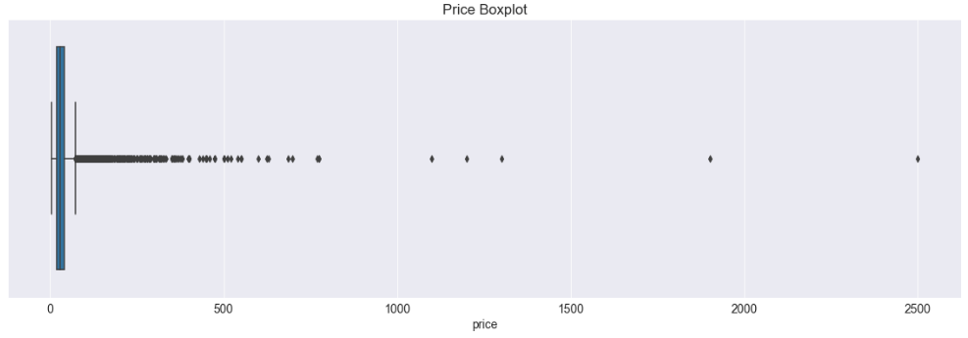
List of Outliers in Price

Slide 17
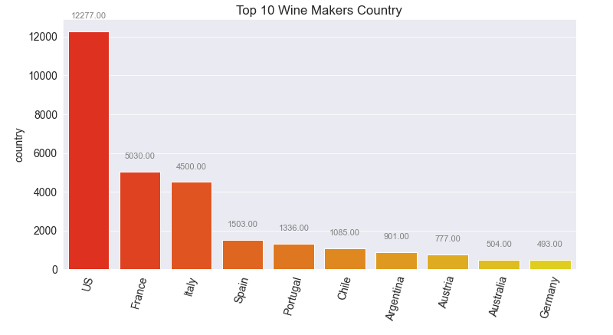
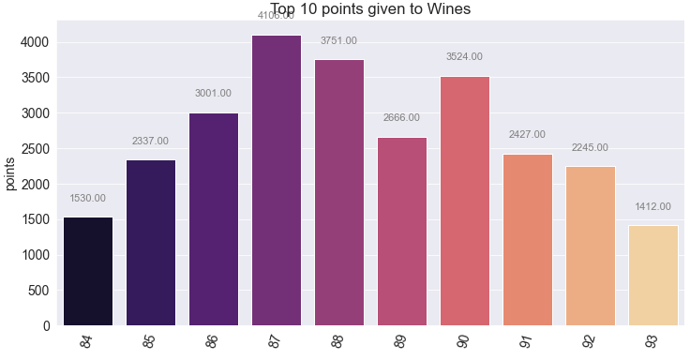
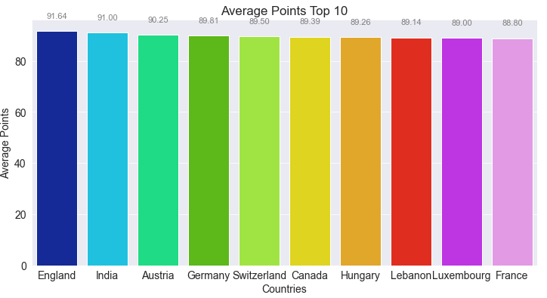
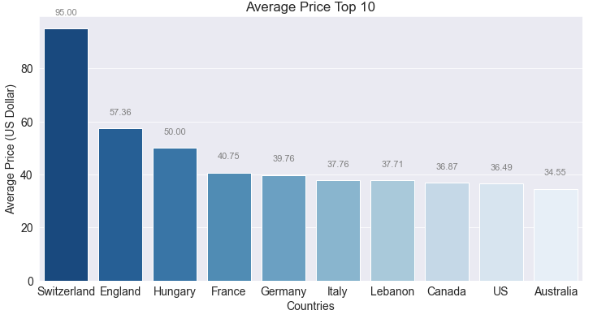
Top 10 Wine makers Country, Top 10 points given to Wines, Average points scored by Top 10 Countries, Average Wine Price by Top 10 Countries

Slide 18
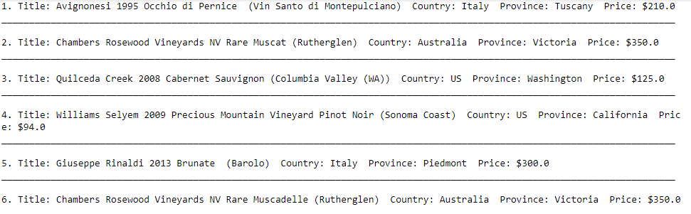
Best Varieties Worldwide

Slide 19
Conclusion
We saw that Italy has the most rated wine in the world, followed closely by the USA and Australia.
It's clear that the Spanish wine is highly priced per unit rating. Portugal, Italy, US, and Argentina follow in that order.
The least rated wines all have a tie of 80 points each and be found fairly in all the wine making nations.
There are 247 different varieties of wines in the world.
Italy's Red Blend and France's Chardonnay are the top-rated wine in the world with each 100 points.

