Slide 1

Analyzing Bot Activity and Political Discourse in the 2024
U.S. Presidential Election: A Machine Learning Approach to
Misinformation and Manipulation
Authors: Koshik Debanath¹, Sagor Aich², Azmain Yakin Srizon³
Affiliation: Department of Computer Science & Engineering, Rajshahi University of Engineering & Technology
Conference: 2nd International Conference on Next-Generation Computing, IoT and Machine Learning (NCIM 2025)

Slide 2
Agenda
Introduction & Motivation: The problem of automated influence in elections.
Research Context: Building on prior work in bot detection.
Methodology: Our hybrid approach to identifying bots.
Dataset and Preprocessing
Bot Score Calculation & ML Refinement
Threshold and Partisan Analysis
Key Findings & Analysis: What our results reveal.
Conclusion & Implications: Takeaways for election integrity.
Limitations & Future Work
2nd International Conference on Next-Generation Computing, IoT and Machine Learning (NCIM 2025)

Slide 3
Introduction: The Digital Battlefield
Problem: Social media is a primary battleground for political discourse, where automated accounts (bots) are used to shape public opinion.
Context: The 2024 U.S. Presidential Election provides a critical case study for understanding modern computational propaganda [1].
Objective: To analyze bot prevalence, partisan leanings, and strategic influence on Twitter (X) during the election cycle.
Core Question: How have bot strategies evolved since 2016, and what is their measurable impact on political conversations?
2nd International Conference on Next-Generation Computing, IoT and Machine Learning (NCIM 2025)

Slide 4
Key Contributions of This Study
Quantified Reduction in Bot Prevalence: We found a 76% reduction in overall bot activity (2.22%) compared to the 2016 election (9.7%) [3].
Identified Strategic Concentration: Bots are not just spamming; they are strategically concentrated in divisive, cross-party discourse.
Measured Engagement Disparity: Human-generated content is overwhelmingly more engaging (15:1 ratio), but targeted bots show disproportionate effectiveness in specific niches.
2nd International Conference on Next-Generation Computing, IoT and Machine Learning (NCIM 2025)

Slide 5
Methodology Overview
Data Collection: Gathered 50,191 tweets related to the 2024 U.S. Election (May-July 2023).
Initial Bot Scoring: Used the Botometer API for a baseline bot score on 33,792 posts.
ML Model Refinement: Trained a Random Forest Regressor on an extended feature set to improve accuracy and address platform-specific biases.
Result: MSE: 0.0071, R²: 0.779
Threshold Analysis: Applied conservative, balanced, and liberal thresholds to understand sensitivity.
Partisan & Engagement Analysis: Analyzed bot activity across political affiliations using a novel party-normalized engagement metric (Ep) [5].
2nd International Conference on Next-Generation Computing, IoT and Machine Learning (NCIM 2025)

Slide 6
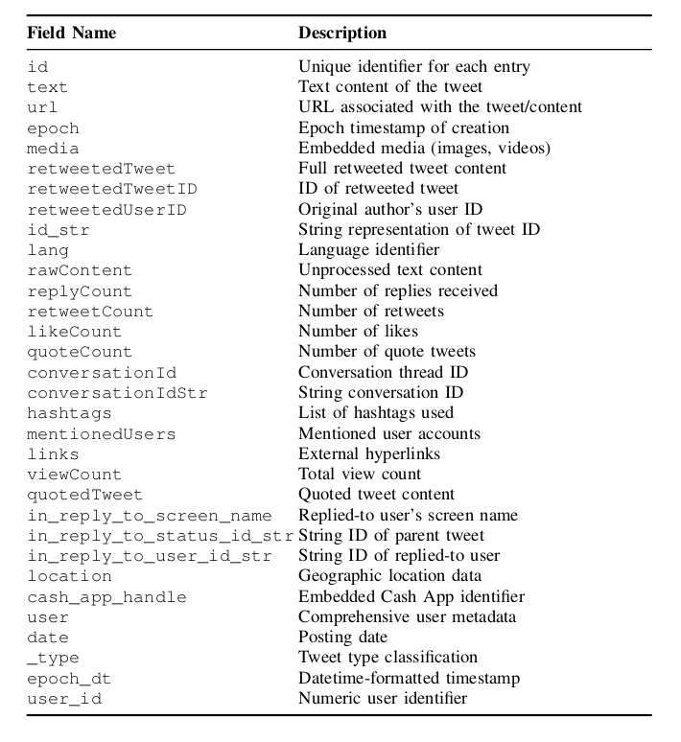
The Dataset
Source: A public dataset of 50,191 tweets from May-July 2023 [10].
Scope: Content related to the 2024 U.S. Presidential Election.
Features: The analysis uses a rich set of 46 features, including user metadata, tweet content, and engagement statistics.
TABLE I: Features of the datasets
2nd International Conference on Next-Generation Computing, IoT and Machine Learning (NCIM 2025)

Slide 7
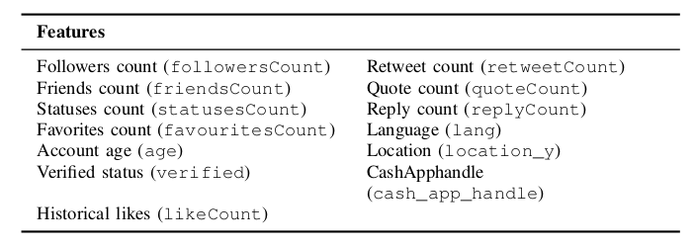
Bot Detection: A Hybrid API-ML Approach
Phase 1: Botometer API
Provides an initial bot score (b) for each account based on a feature vector (x) of 13 key metrics [2].
b = Σ Wk * fk(x)
Phase 2: Random Forest Regressor
We refined these scores using a Random Forest model trained on a more extensive feature set.
This addresses known limitations of API-only methods, such as platform bias [7].
This step is crucial for achieving high accuracy (R² = 0.779) on election-specific data.
TABLE II: Feature vector of 13 features
2nd International Conference on Next-Generation Computing, IoT and Machine Learning (NCIM 2025)

Slide 8
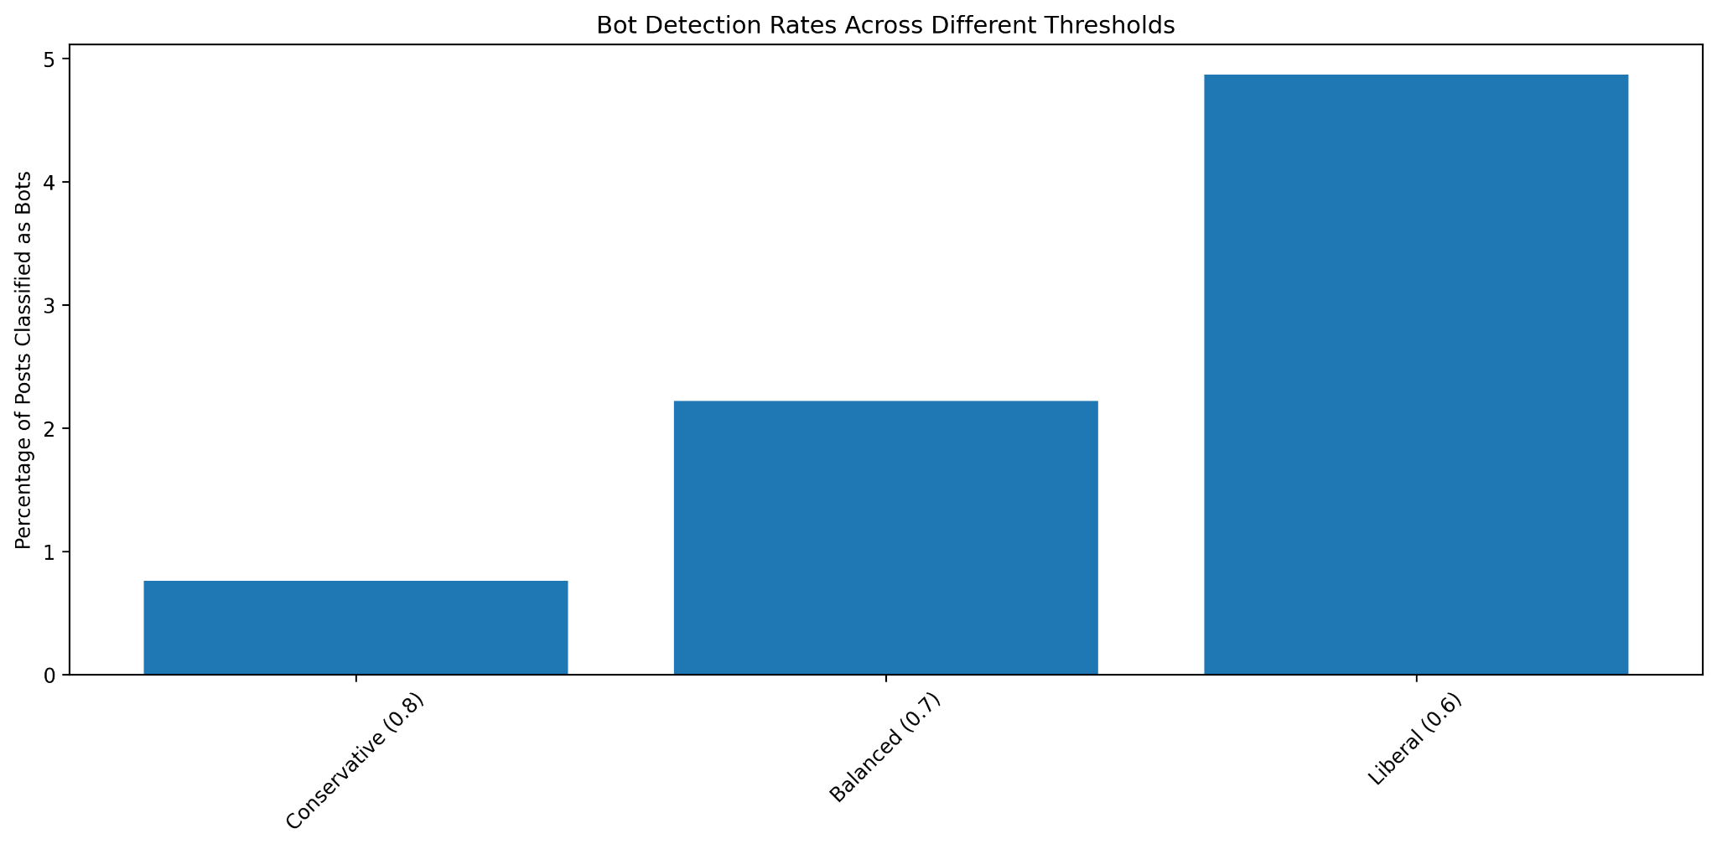
Finding the Balance: Threshold Sensitivity
Choosing the right threshold is critical. A single value does not fit all contexts.
Conservative (0.8): Minimizes false positives, but may miss sophisticated bots (0.76% detected).
Liberal (0.6): Maximizes recall, but increases false positives (4.87% detected).
Balanced (0.7): Our selected threshold, providing an optimal tradeoff between precision and recall for electoral data analysis.
Figure 1: Threshold sensitivity analysis
2nd International Conference on Next-Generation Computing, IoT and Machine Learning (NCIM 2025)

Slide 9
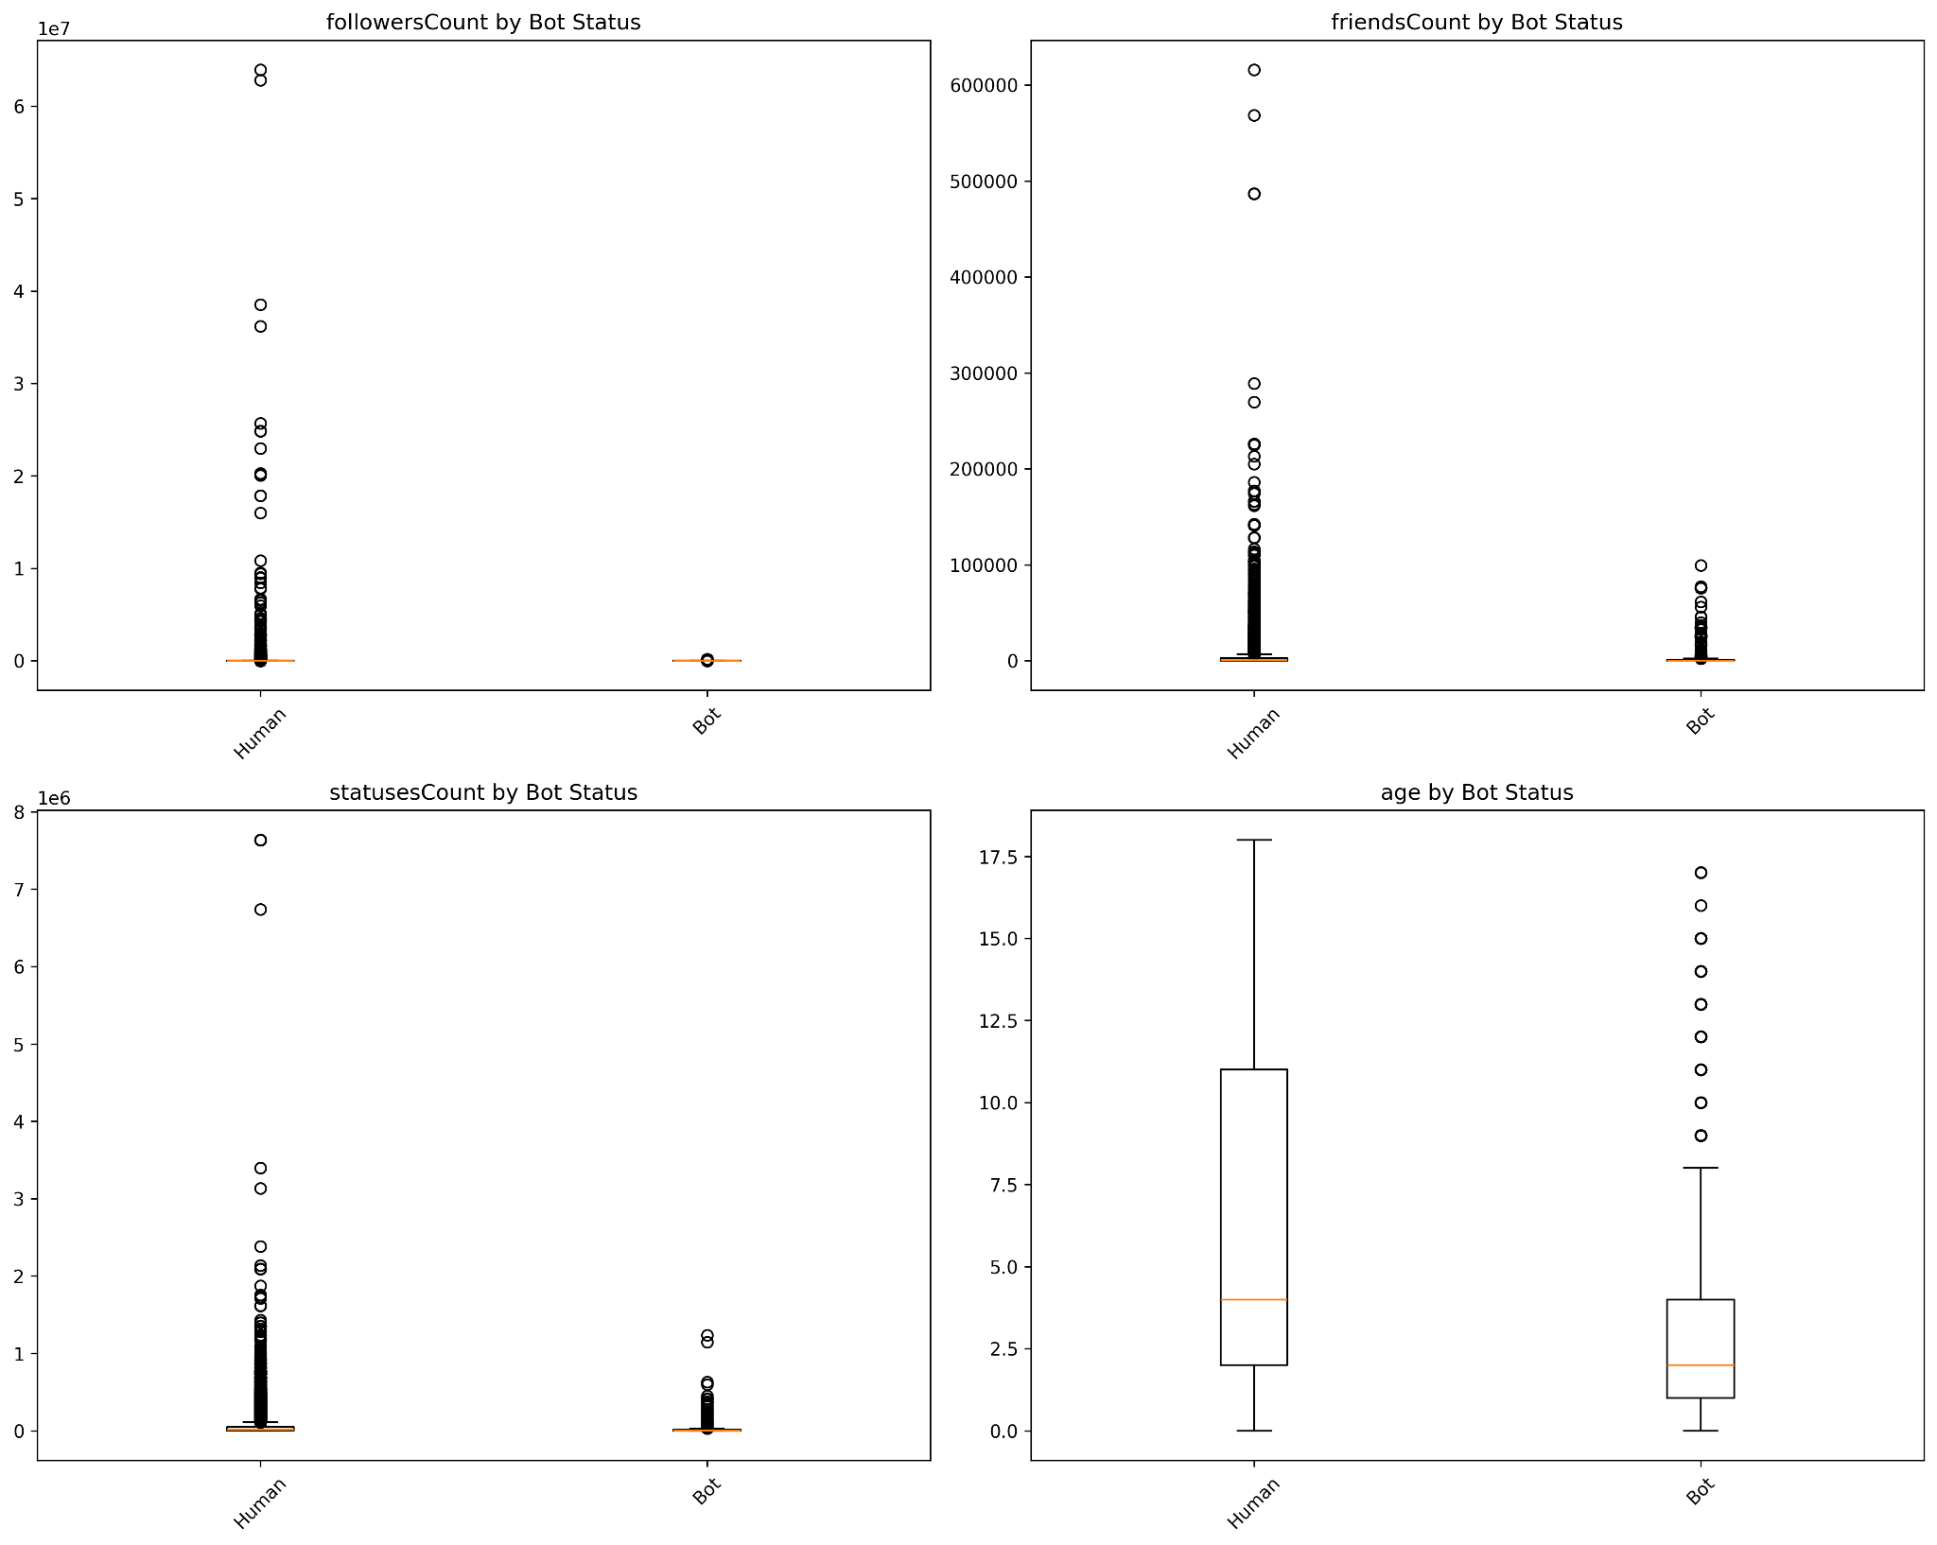
Result: The Profile of a Political Bot
Follower Counts: Bots have significantly fewer followers (Median: 28 vs. 1,120 for humans).
Posting Frequency: Bots are more automated, posting 2x more frequently on average.
Focus: Bots prioritize content volume over building an organic, engaged following.
Figure 2: Comparative distributions of follower counts, posting
frequencies, and account ages between bot and human ac-
counts. Error bars represent 95% confidence intervals.
2nd International Conference on Next-Generation Computing, IoT and Machine Learning (NCIM 2025)

Slide 10
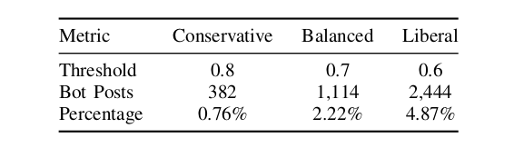
Result : Overall Bot Prevalence
Using our balanced threshold of 0.7, we identified 1,114 bot posts, constituting 2.22% of the total dataset.
This represents a significant decline from the 9.7% bot prevalence reported in studies of the 2016 election [3].
Platform policies and improved detection may be contributing to this reduction.
TABLE III: Bot Prevalence by Detection Threshold
2nd International Conference on Next-Generation Computing, IoT and Machine Learning (NCIM 2025)

Slide 11
Result : The Human Engagement Advantage
While bots generate content, humans drive the conversation.
Engagement Dominance: Human-generated content received 15 times more engagement on average than bot-generated content (18.96 vs. 1.25 engagements/post).
This suggests that the persuasive impact of bots through sheer volume is limited. Their influence must be more strategic.
2nd International Conference on Next-Generation Computing, IoT and Machine Learning (NCIM 2025)

Slide 12
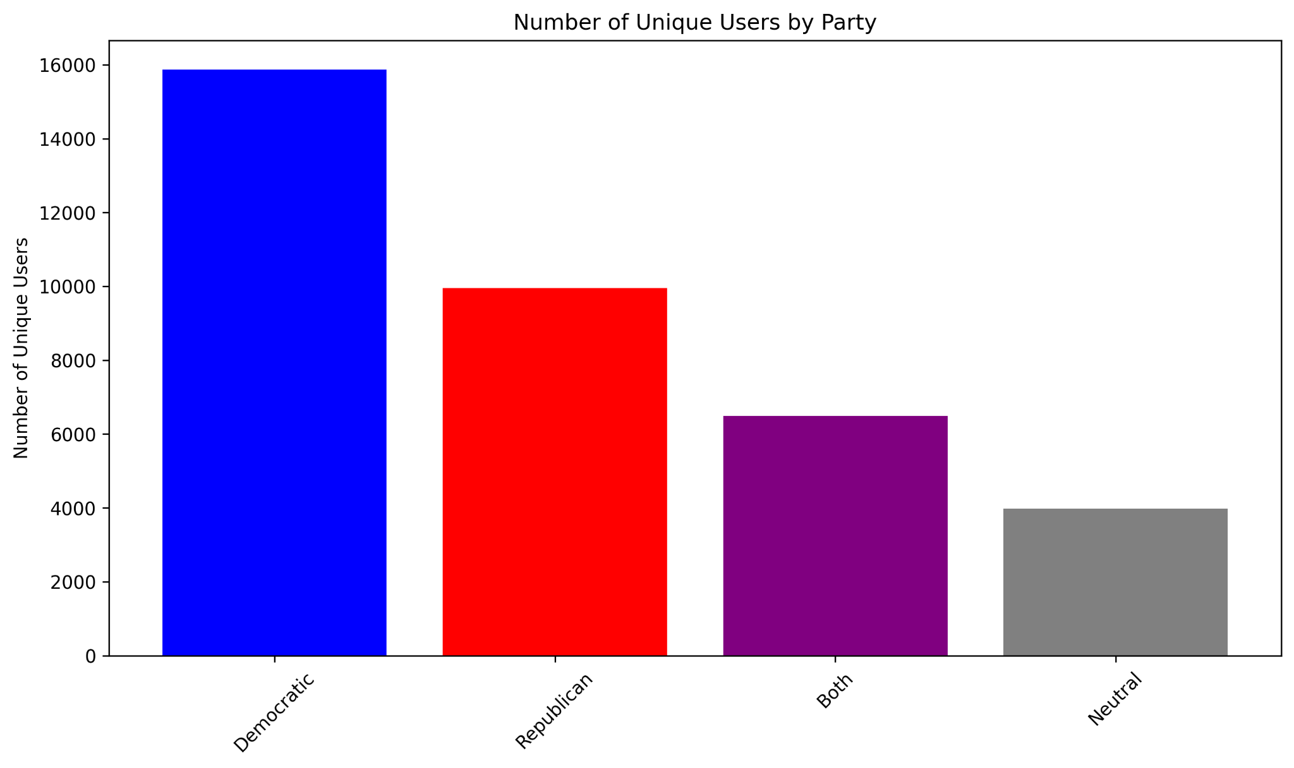
Partisan Landscape: User Distribution
Before analyzing bot activity, it's important to understand the user landscape in our dataset.
The discourse was numerically dominated by Democratic-affiliated users.
Democratic Users: 15,871
Republican Users: 9,956
Figure 3: Unique user counts by political affiliation. Error bars
represent Poisson confidence intervals.
2nd International Conference on Next-Generation Computing, IoT and Machine Learning (NCIM 2025)

Slide 13
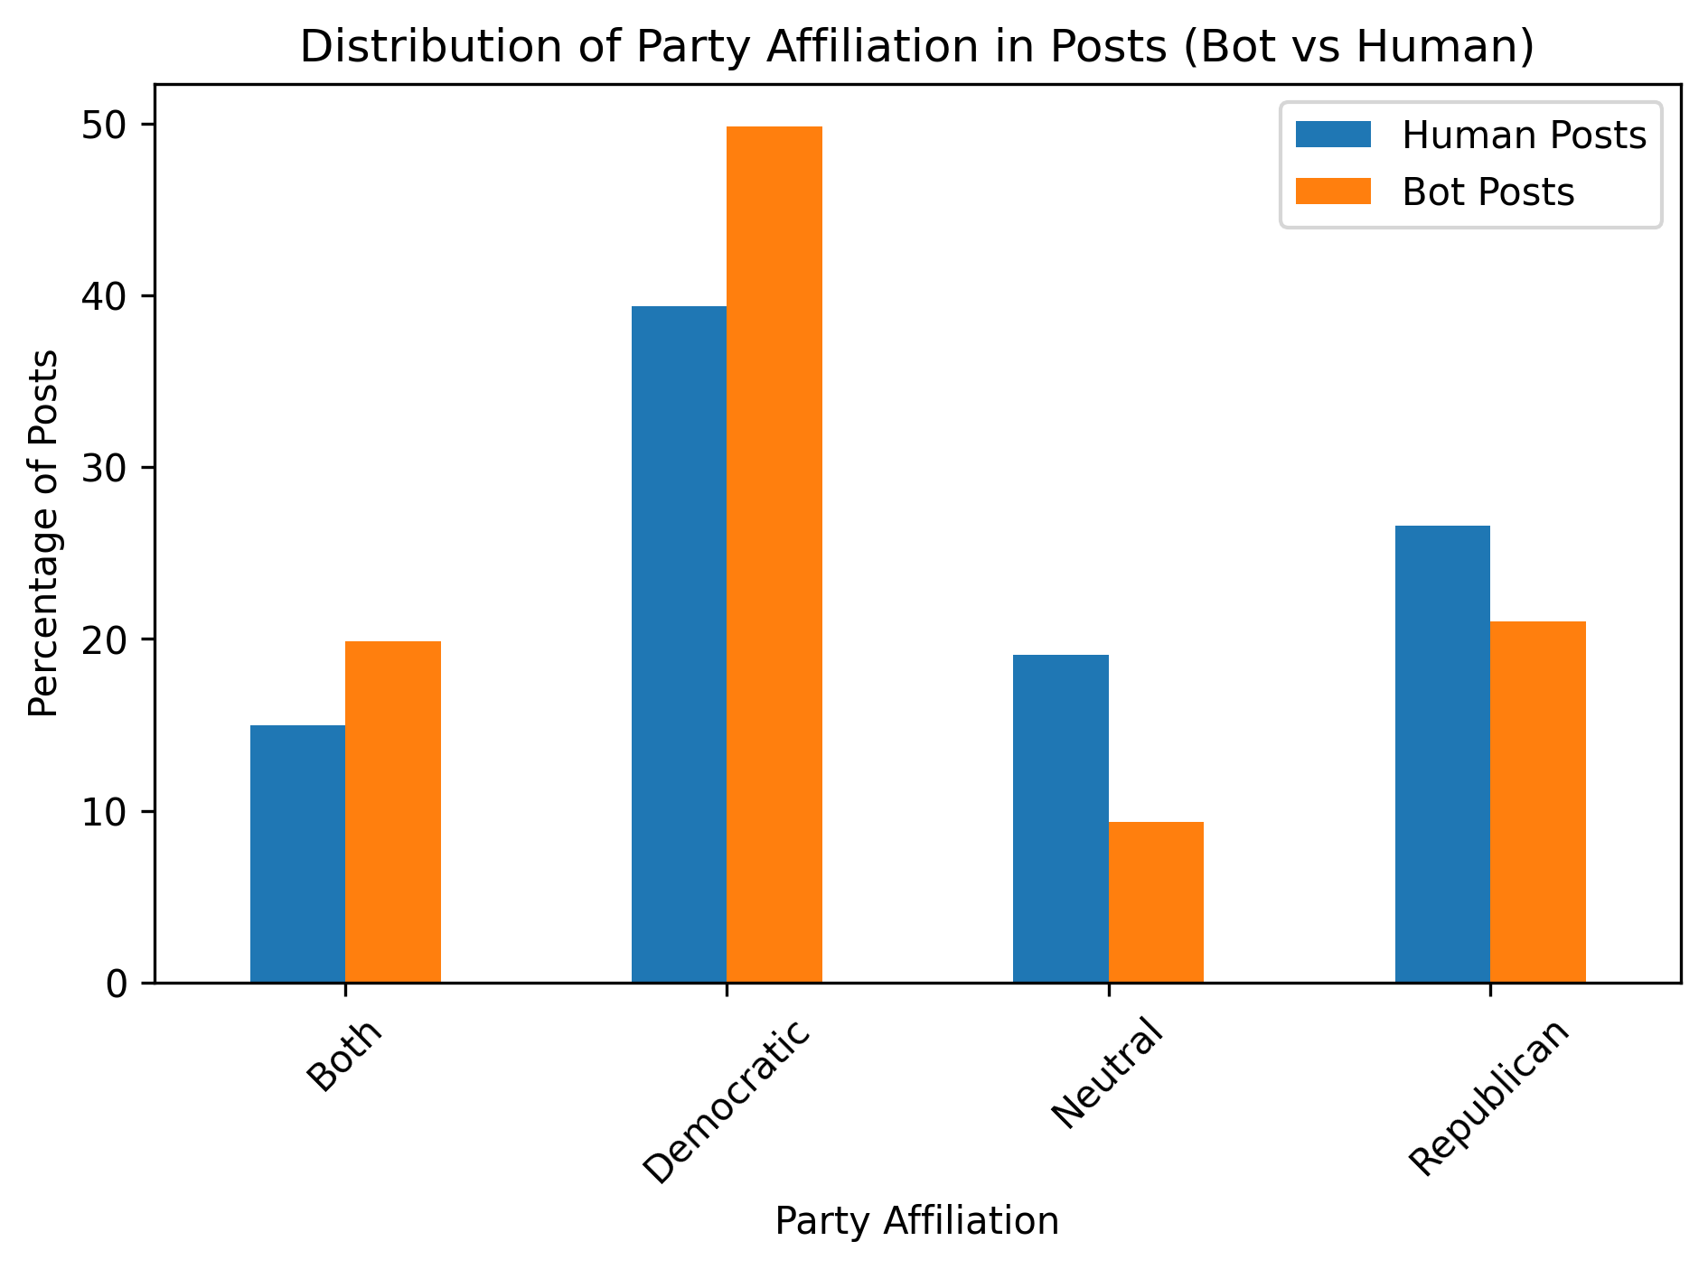
Bot Infiltration Across Party Lines
We calculated the proportion of bot-generated posts within each political category.
Findings:
Cross-Party: 2.92% (Highest Infiltration)
Democratic: 2.79%
Republican: 1.76% (Lowest Infiltration)
Bots are most prevalent in content designed to cross political boundaries.
Figure 4: Bot prevalence across political affiliations, calculated
using Equation (1). Percentages reflect proportion of bot posts
within each category.
2nd International Conference on Next-Generation Computing, IoT and Machine Learning (NCIM 2025)

Slide 14
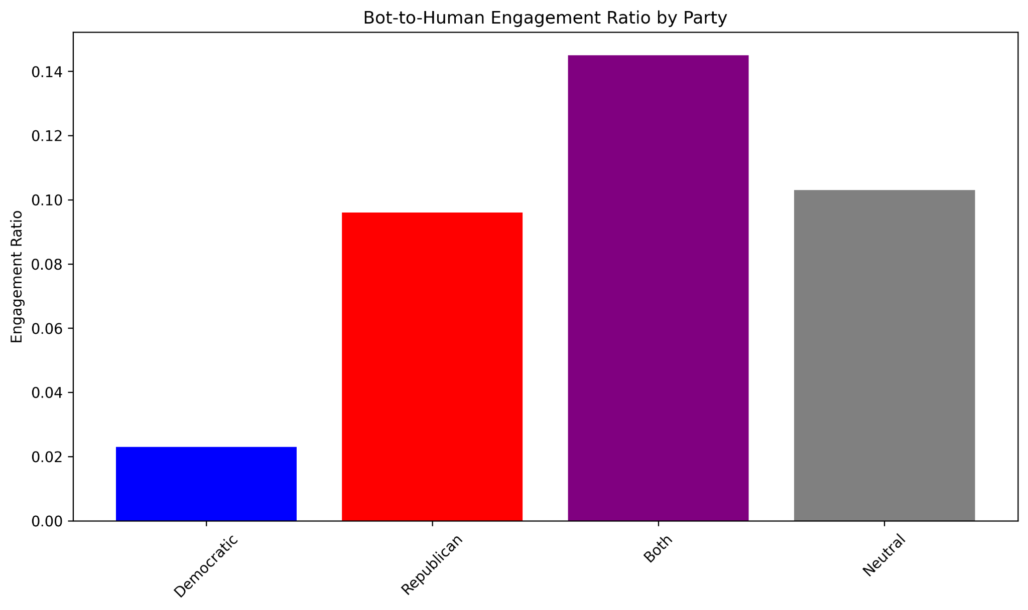
The Nuance: Where Bots Are Effective
Infiltration is not the same as effectiveness. We measured the bot-to-human engagement ratio.
Key Insight: Bots achieve their highest relative engagement success when amplifying cross-party and Republican-aligned content.
Cross-Party Ratio: 0.145 (Most effective)
Republican Ratio: 0.096
Democratic Ratio: 0.023 (Least effective)
This shows a strategic focus on polarizing discourse where bots can have a disproportionate impact.
Figure 5: Engagement ratio (bot engagements/human engage-
ments) across political affiliations. Error bands represent boot-strapped 95% CIs.
2nd International Conference on Next-Generation Computing, IoT and Machine Learning (NCIM 2025)

Slide 15
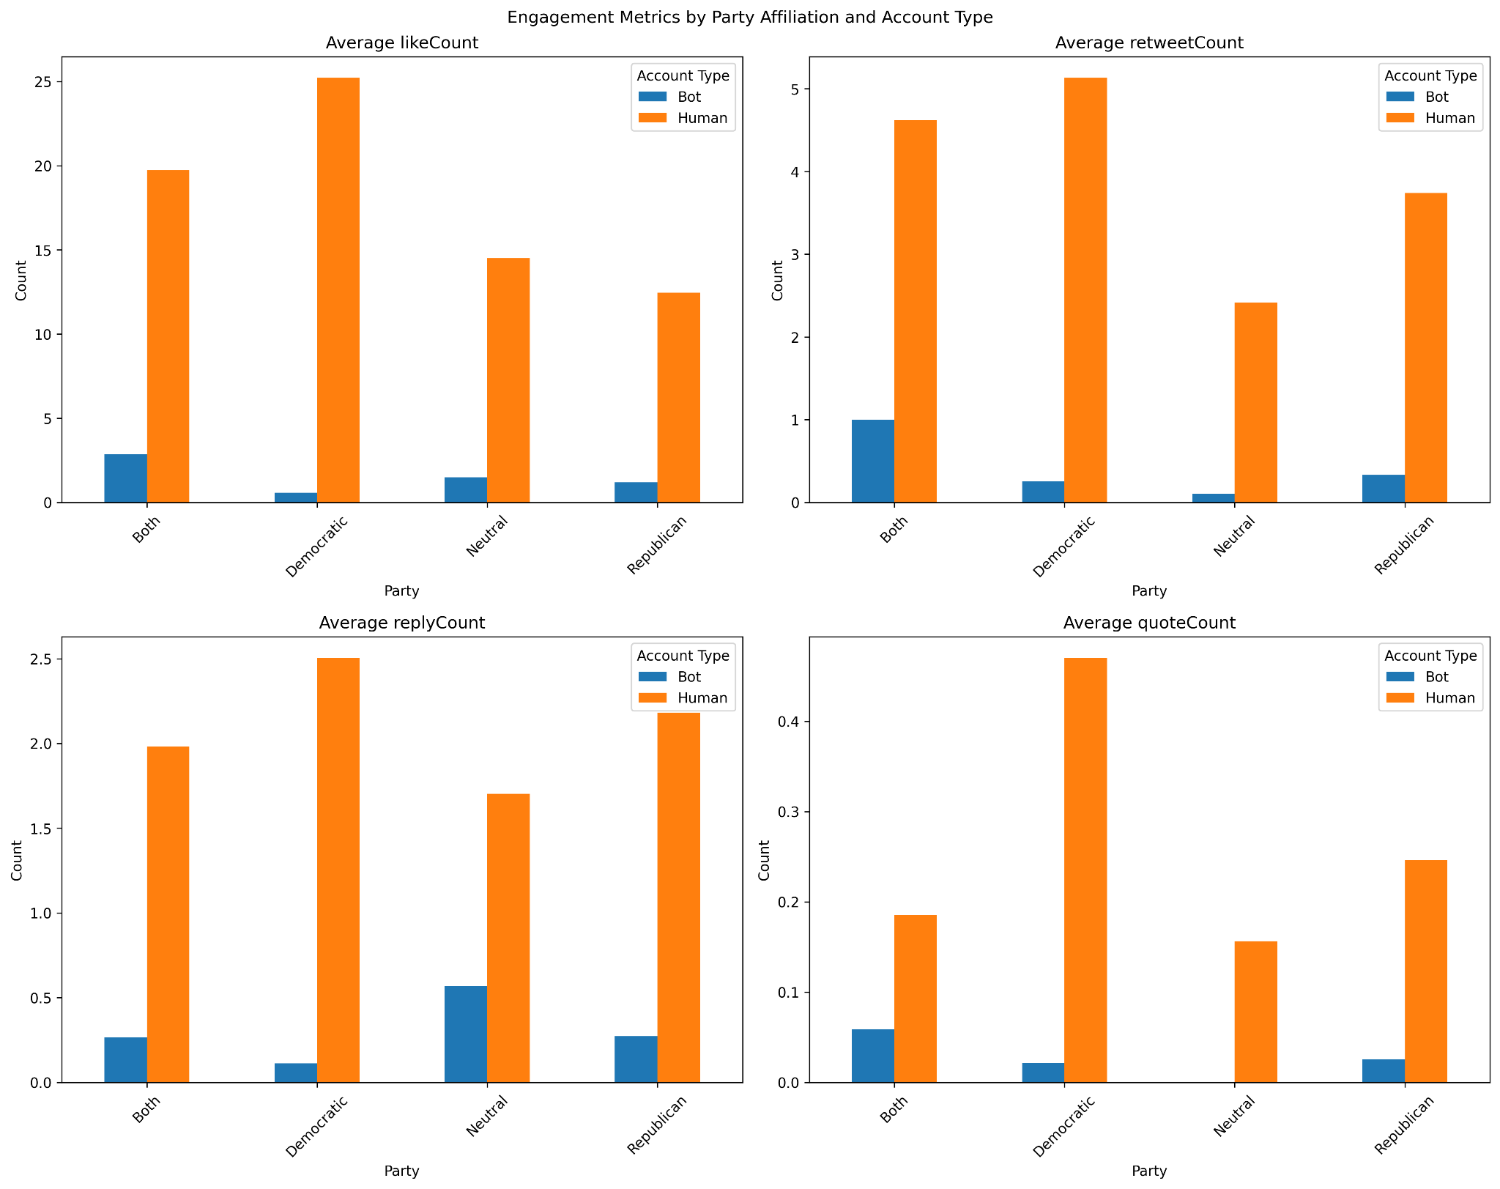
Engagement Breakdown by Party and Account
A deeper look at engagement types (likes, retweets, replies, quotes) confirms these patterns.
Human engagement consistently dwarfs bot engagement across all categories.
However, the relative activity of Republican and Cross-Party bots in retweeting and quoting content is notable, supporting the amplification strategy.
Figure 6: Distribution of mean engagements per post by political
affiliation and account type. Boxplots show median values and
interquartile ranges.
2nd International Conference on Next-Generation Computing, IoT and Machine Learning (NCIM 2025)

Slide 16
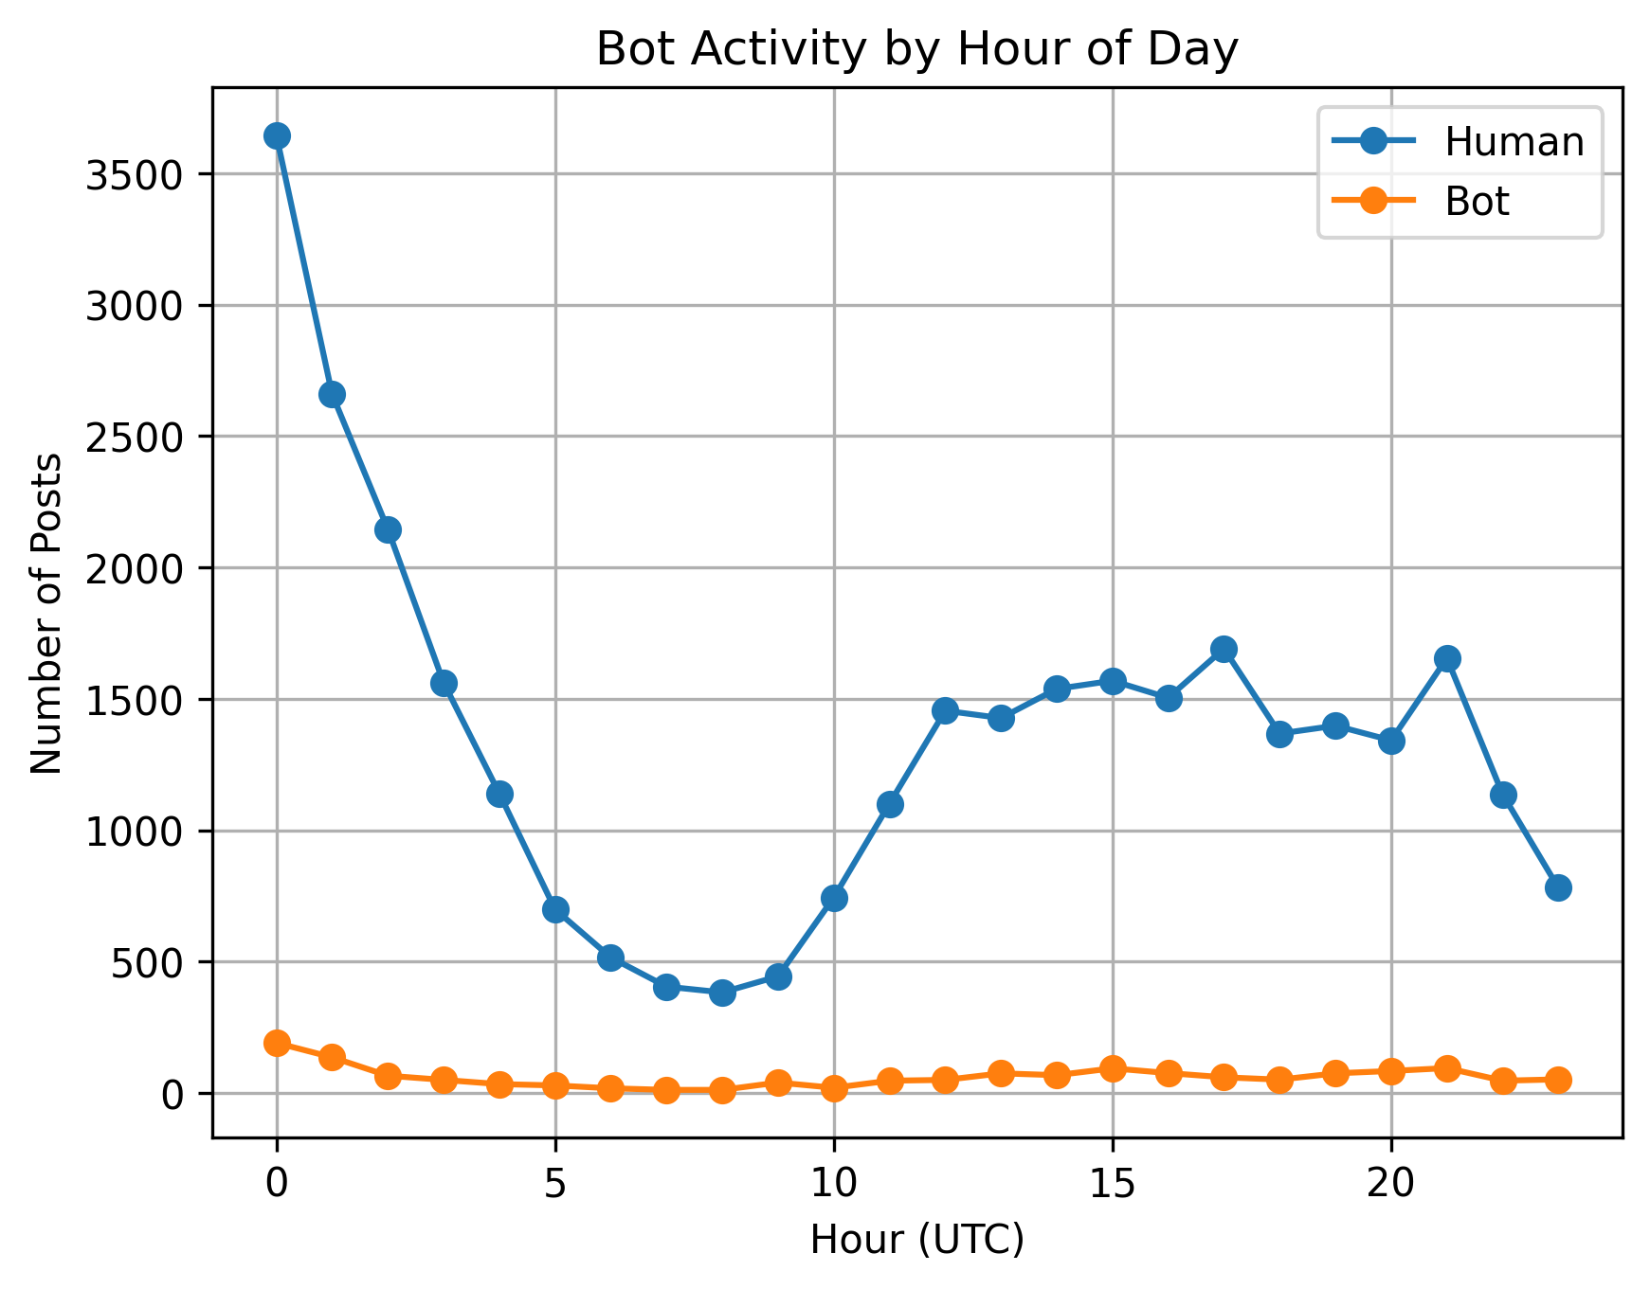
Temporal Analysis: Bots Never Sleep
Activity patterns over a 24-hour cycle reveal another key difference.
Humans: Follow a clear circadian rhythm, with engagement peaking in the evening (UTC) and dropping during sleep hours.
Bots: Maintain a consistent, low-level activity around the clock, designed for continuous content injection.
Figure 7: Hourly activity patterns normalized by account type.
Shaded regions represent kernel density estimates.
2nd International Conference on Next-Generation Computing, IoT and Machine Learning (NCIM 2025)

Slide 17
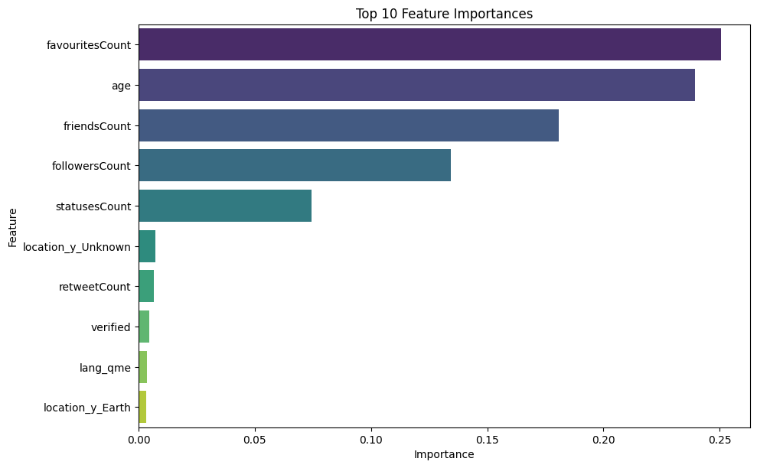
Model Performance: What Features Matter Most?
Our Random Forest model performed well, but what features were most predictive of bot activity?
Top Discriminators:
favouritesCount (Number of likes a user has given)
age (Account age)
friendsCount (Number of accounts followed)
followersCount
Insight: Account metadata and historical behavior are stronger indicators of automation than the content of a single tweet.
Figure 8: Feature importance rankings from gradient boosting
classification. Values represent mean decrease in Gini impu-
rity.
2nd International Conference on Next-Generation Computing, IoT and Machine Learning (NCIM 2025)

Slide 18
Conclusion
Bot Prevalence has Declined: Overall bot activity is lower than in 2016, but bots have not disappeared.
Strategy has Shifted from Volume to Targeting: Bots are now used for more sophisticated, targeted amplification, especially in cross-party discourse to fuel polarization [8, 9].
Engagement Remains Human-Dominated: Bots are not "winning" the engagement war, but their role in agenda-setting and amplifying fringe narratives remains a concern.
Hybrid Detection is Essential: A robust, ML-refined detection framework is necessary to accurately identify and analyze modern bot activity.
2nd International Conference on Next-Generation Computing, IoT and Machine Learning (NCIM 2025)

Slide 19
Implications for Election Integrity
Continuous Monitoring is Non-Negotiable: Platforms and researchers must continuously monitor for evolving bot tactics.
Context is Key: Simply detecting a bot is not enough; we must understand its partisan alignment and strategic goals.
Focus on Amplification: The biggest threat may not be bots creating content, but strategically amplifying divisive human-generated content.
Our party-normalized metrics provide a new tool for identifying these previously obscured micro-targeting patterns.
2nd International Conference on Next-Generation Computing, IoT and Machine Learning (NCIM 2025)

Slide 20
Limitations & Future Work
Limitations:
Analysis is limited to a single platform (Twitter/X).
Party affiliation is inferred from keywords, which may have biases.
The data covers a limited timeframe (May-July 2023).
Future Work:
Integrate multi-modal analysis (text + images/videos).
Develop real-time threshold adjustment to counter evolving tactics.
Expand analysis to other platforms and longer time periods.
2nd International Conference on Next-Generation Computing, IoT and Machine Learning (NCIM 2025)

Slide 21
References
[1] P. N. Howard, B. Kollanyi, et al. "Social media, news and political information during the US election..." CoRR, 2018.
[2] C. A. Davis, O. Varol, et al. "Botornot: A system to evaluate social bots," CoRR, 2016.
[3] A. Bovet and H. Makse. "Influence of fake news in twitter during the 2016 us presidential election," Nature Communications, 2019.
[4] M. Stella, E. Ferrara, and M. De Domenico. "Bots increase exposure to negative and inflammatory content..." PNAS, 2018.
[5] R. Gorwa, R. Binns, and C. Katzenbach. "Algorithmic content moderation..." Big Data Society, 2020.
[6] E. Ferrara, O. Varol, et al. "The rise of social bots," CoRR, 2014.
[7] A. Rauchfleisch and J. Kaiser. "Deplatforming the far-right: An analysis of youtube and bitchute," SSRN Electronic Journal, 2021.
[8] C. Shao, G. L. Ciampaglia, et al. "The spread of fake news by social bots," CoRR, 2017.
[9] D. Broniatowski, A. Jamison, et al. "Weaponized health communication: Twitter bots and russian trolls..." American journal of public health, 2018.
[10] A. Balasubramanian, V. Zou, et al. "A public dataset tracking social media discourse about the 2024 u.s. presidential election..." 2024.
2nd International Conference on Next-Generation Computing, IoT and Machine Learning (NCIM 2025)

Slide 22
Thank You!
If you have any questions please feel free to ask
2nd International Conference on Next-Generation Computing, IoT and Machine Learning (NCIM 2025)

