Slide 1

Distinguishing Human-Written and AI-Generated Text: A Comprehensive Study Using Explainable Artificial Intelligence in Text Classification
Authors
Sagor Aich Dept. of Computer Science & Engineering, Rajshahi University of Engineering and Technology, Email: sagor.aichh@gmail.com | Koshik Debanath Dept. of Computer Science & Engineering, Rajshahi University of Engineering and Technology, Email: koshik.debanath@gmail.com | Azmain Yakin Srizon Assistant Professor, Dept. of Computer Science & Engineering, Rajshahi University of Engineering and Technology, Email: azmainsrizon@gmail.com

Slide 2
Outlines
Introduction
Problem Statement
Related work
Dataset description
Methodology
Experimental analysis
Conclusion
References

Slide 3
Introduction
Explores the integration of Explainable Artificial Intelligence (XAI) techniques with advanced machine learning models
Utilizing the Local Interpretable Model-Agnostic Explanations (LIME) framework to provide transparency
For achieving state-of-the-art performance used fine-tuned BERT model

Slide 4
Problem Statement
Growing reliance on machine learning models demands interpretability and transparency
Powerful models like Random Forests and BERT often lack transparency
Explainable AI (XAI) tackles this
We have enhanced interpretability without compromising accuracy in text classification.

Slide 5
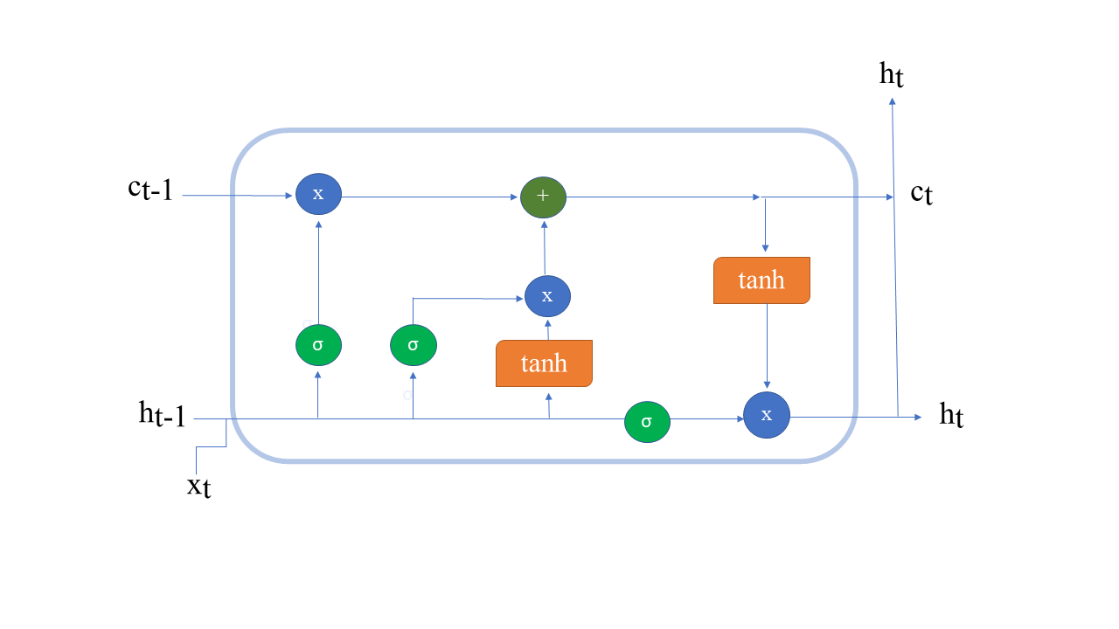
Related work
Attention is not Explanation [1]
Fig.1: Long Short-Term Memory (LSTM) Network Architecture for Capturing Long-Range Dependencies

Slide 6
Related work
A Unified Approach to Interpreting Model Predictions [2]
Train Data
Model
Test Data
Predictions
XAI(LIME/SHAP)
Explanation
Fig. 2: Understanding XAI (SHAP/LIME).

Slide 7
Dataset Description
44,868 documents in total
Human written text (label 0) accounts for 61.0004% (27,371 samples)
AI-generated text (label 1) constitutes 38.9996% (17,497 samples)

Slide 8
Methodology
Random Forest
Classifier
Embedding (all-MiniLM-L6-v2) with Random Forest Classifier
Data
Preprocessing
Classification
Embedding (BERT) with Random Forest Classifier
XAI
BERT
Fine-Tuning

Slide 9
Methodology
Data Preprocessing:
Testing data 30%
stratified splitting was applied
TF-IDF (Term Frequency Inverse Document Frequency) vectorization with bi-grams
BERT for tokenizing (length = 512)
beginning of the sequence = [CLS]
end of the sequence = [SEP]

Slide 10
Methodology
Random Forest Classifier:
200 decision trees
Maximum depth unlimited
class weights are balanced to address the minority class

Slide 11
Methodology
Embedding (all-MiniLM-L6-v2) with Random Forest Classifier:
Convert text to 384 dimensional vectors.
Applied layer normalization
[CLS] token to represent entire text sequences.
200 decision trees

Slide 12
Methodology
Embedding (BERT) with Random Forest Classifier:
12 layer transformer
Generate 768D vectors
200 decision trees

Slide 13
Methodology
BERT Fine-Tuning:
Model BERT-base (110M parameters)
Cross-entropy loss
AdamW Optimizer
Batch size 16
Epochs 3

Slide 14
Methodology
Model Interpretability with Local Interpretable Model-Agnostic Explanations (LIME):
generates local explanations by approximating the model’s behavior
Use gaussian kernel

Slide 15
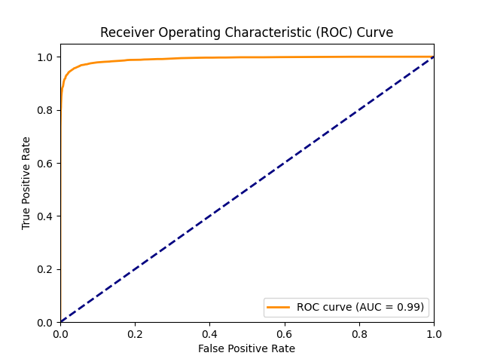
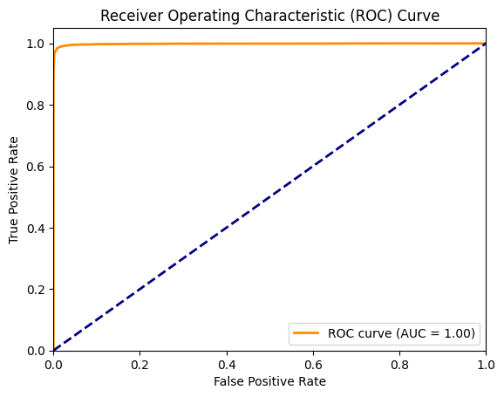
Experimental analysis
Fig. 3: ROC Curve of the Random Forest Classifier.
Fig. 4: ROC Curve for Embedding (all-MiniLM-L6-v2)
with Random Forest Classifier.

Slide 16

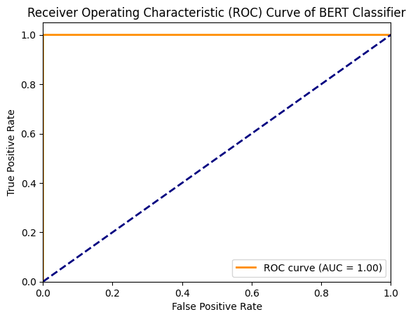
Experimental analysis
Fig. 5: ROC Curve for Embedding (BERT) with Random Forest Classifier.
Fig. 6: ROC Curve for the Fine-Tuned BERT Model.

Slide 17
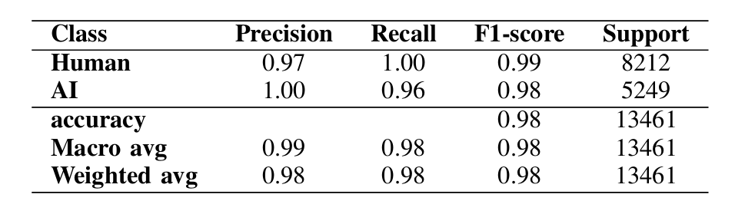
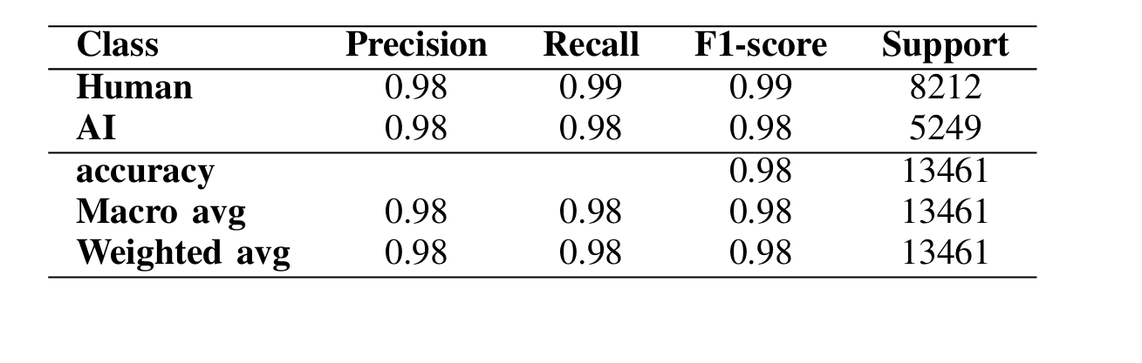
Experimental analysis
Table I: Class-wise performance metrics for RF classifier after hyperparameter tuning
Table I I : Class-wise performance metrics for BERT embeddings with RF classifier

Slide 18
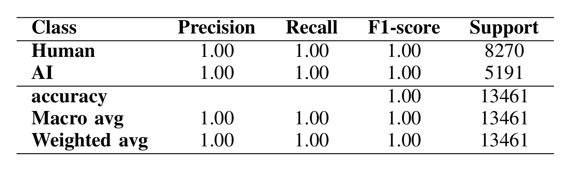
Experimental analysis
Table I I I : Class-wise performance metrics for fine-tuned BERT model

Slide 19
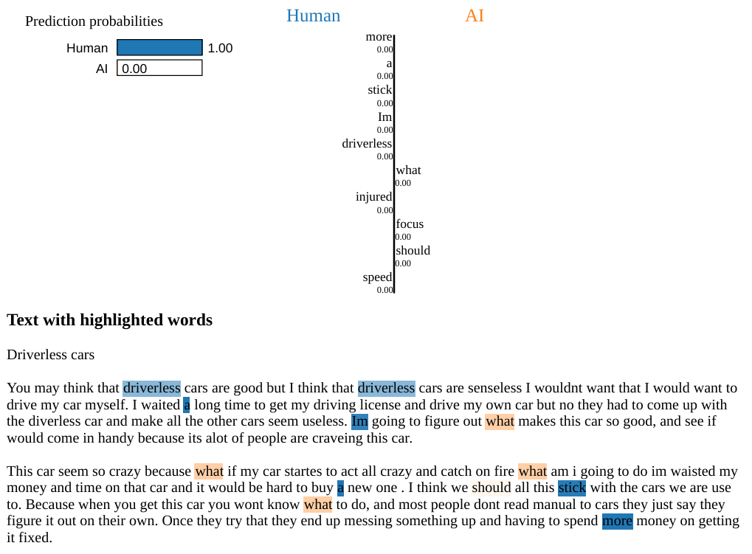
Experimental analysis
Fig.7 : LIME Output Illustrating the Explanation of a Human-Generated Text.

Slide 20
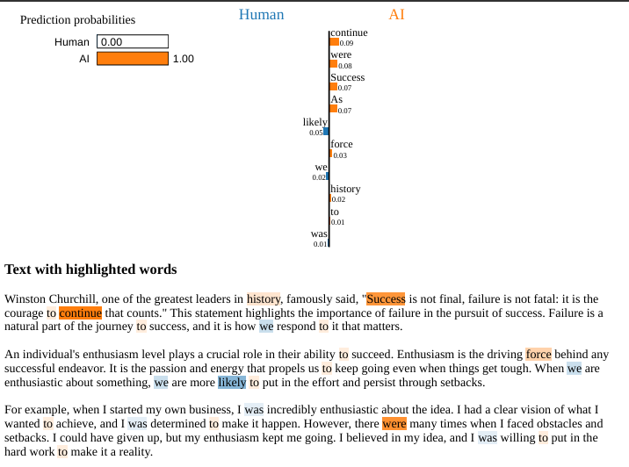
Experimental analysis
Fig. 8: LIME Output Illustrating the Explanation of an AI-Generated Text.

Slide 21
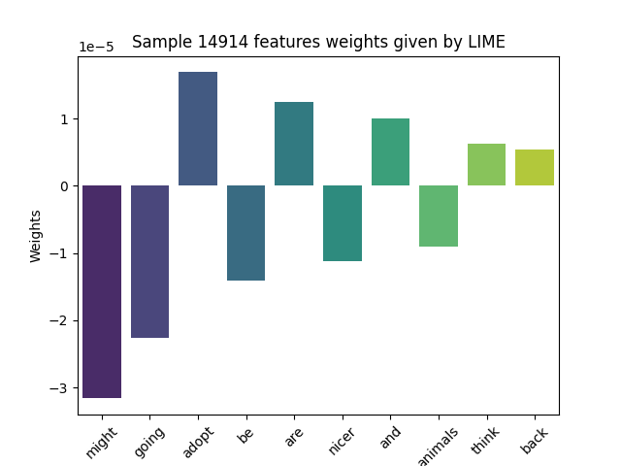
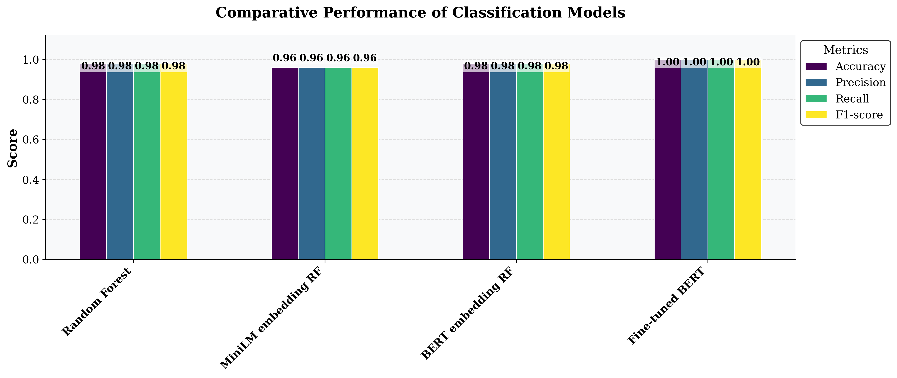
Experimental analysis
Fig.9: Comparison of Model Performance.
Fig.10: Significance of Feature Weights in LIME Explanations.

Slide 22
Conclusion
Highlights the effectiveness of fine-tuned BERT
Distinguishing between AI-generated and human-authored text
fine-tuned BERT Achieving superior performance across all evaluation metrics.

Slide 23
References
[1] S. Jain and B.C. Wallace, “Attention is not explanation,”2019.
[2] S.M. Lundberg and S. I. Lee, “A unified approach to interpreting model predictions,”in Proceedings of the 31stInternational Conference on Neural Information Processing Systems(NeurIPS),2017,pp.4765 4774.

Slide 24
Thank You

