Slide 1
Auto Test SOP
Koshino
2025/01/15

Slide 2
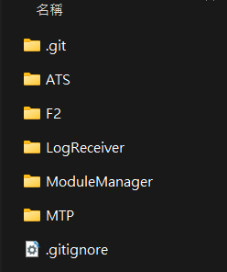
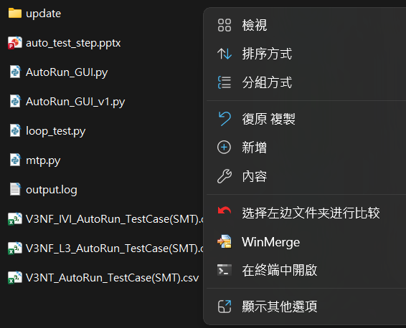
Test step
安装Python
所用电脑需要有python环境，并建议安装版本为3.10及以上
進到MTP資料夾裡面
打開terminal
在terminal輸入 python .\AutoRun_GUI.py
1.
2.
3.

Slide 3

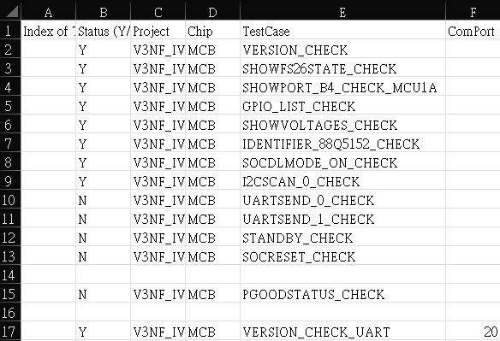
Test step
打開”裝置管理員”查看COM port
將”V3NF_IVI_AutoRun_TestCase(SMT)csv”裡的欄位E裡的COM port 改成對應的port
將”V3NF_L3_AutoRun_TestCase(SMT)csv”裡的欄位E裡的COM port 改成對應的port

Slide 4
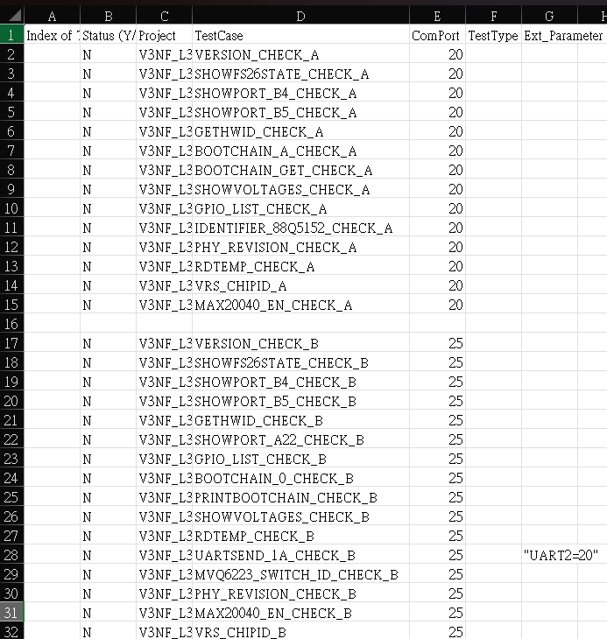
Note
欄位名稱:
Status (Y/N) : 是否要測試
Project : 案子名稱
Chip : 要測試的chip
TestCase : 程式碼裡對應的測試function
ComPort : 連接的Uart com port
Ext_Parameter : 額外參數
SpecFile : 導入criteria file
”V3NF_L3_AutoRun_TestCase(SMT)csv”需要對應MCU1A or MCU1B 在欄位E裡的COM port 改成對應的port

Slide 5
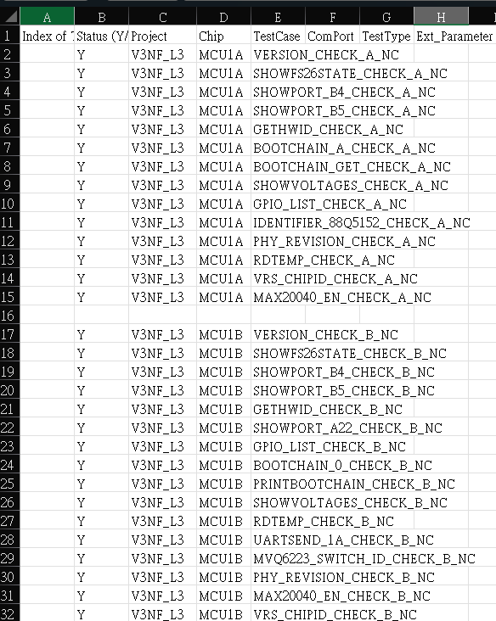
Note
Chip :
預設是留空。
如果要使用跟SoC team整合的MTP，需要額外的參數Chip
實際執行的command: python mtp.py -s sn_auto -p V3NF_IVI -chip MCB -t VERSION_CHECK

Slide 6
Note – criteria.json
如果 SpecFile留空，就不會判斷criteria，只會直接把output輸出，如果需要判斷criteria，以下格式範例供參考:
“測試項目(TestCase)": {
"check_required": "Y",
"items": [
{"name": “value_name”, “criteria”: “criteria"}
]
},
Example: "VERSION_CHECK": {
"check_required": "Y",
"items": [
{"name": "MCB_VERSION_CHECK", "criteria": "V1.1.7"}
]
},

Slide 7
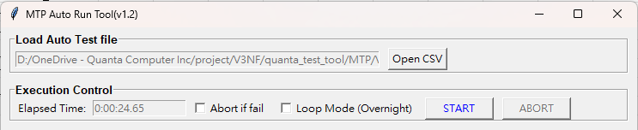
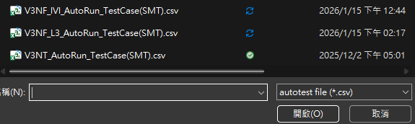
Test step
打開Import file
選擇” V3NF_IVI_AutoRun_TestCase(SMT).csv”(or “V3NF_L3_AutoRun_TestCase(SMT).csv”)
4.
5.

Slide 8
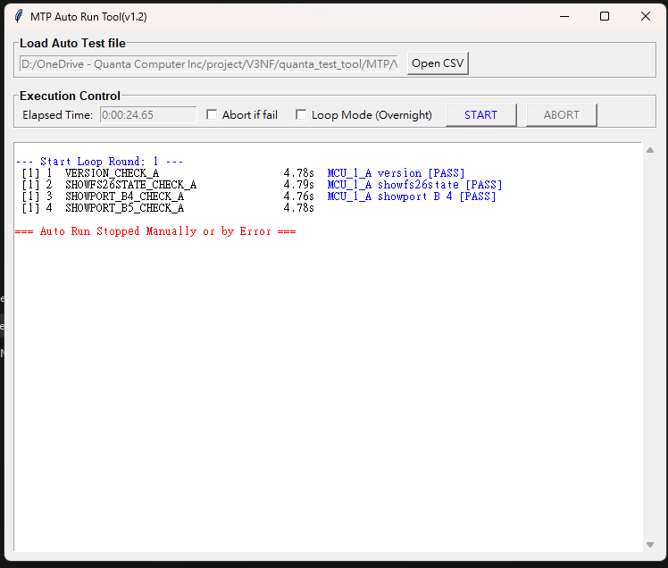
Test step
按下start
6.

Slide 9
Test step (for loop test)
勾選 Loop Mode
按下start
7.
6.

Slide 10
Appendix
AV_Ext test function (MCU1A):
VERSION_CHECK_MCU1A
SHOWFS26STATE_CHECK_MCU1A
SHOWPORT_B4_CHECK_MCU1A
SHOWPORT_B5_CHECK_MCU1A
GETHWID_CHECK_MCU1A
BOOTCHAIN_A_CHECK_MCU1A
BOOTCHAIN_GET_CHECK_MCU1A
GPIO_LIST_CTRL_CHECK_MCU1A
GPIO_LIST_CHECK_MCU1A
SHOWVOLTAGES_CHECK_MCU1A
IDENTIFIER_88Q5152_CHECK_MCU1A
PHY_REVISION_CHECK_MCU1A
RDTEMP_CHECK_MCU1A
VRS_CHIPID_CHECK_MCU1A
MAX20040_EN_CHECK_MCU1A
I2CSCAN_0_CHECK_MCU1A
SHOWCURRENT_CHECK_MCU1A
SPI_CHECK_MCU1A
SAFETY_MCU1A_TO_MCU1B_CHECK
SAFETY_MCU1B_TO_MCU1A_CHECK

Slide 11
Appendix
AV_Ext test function (MCU1B):
VERSION_CHECK_MCU1B
SHOWFS26STATE_CHECK_MCU1B
SHOWPORT_B4_CHECK_MCU1B
SHOWPORT_B5_CHECK_MCU1B
SHOWPORT_A22_CHECK_MCU1B
GETHWID_CHECK_MCU1B
BOOTCHAIN_0_CHECK_MCU1B
PRINTBOOTCHAIN_CHECK_MCU1B
GPIO_LIST_CTRL_CHECK_MCU1B
PGOODSTATUS_CHECK_MCU1B
GPIO_LIST_THERM_CHECK_MCU1B
GPIO_LIST_CHECK_MCU1B
SHOWVOLTAGES_CHECK_MCU1B
RDTEMP_CHECK_MCU1B
VRS_CHIPID_CHECK_MCU1B
MVQ6223_SWITCH_ID_CHECK_MCU1B
PHY_REVISION_CHECK_MCU1B
MAX20040_EN_CHECK_MCU1B
PHY_MVQ3244_MCU1B
I2CSCAN_0_CHECK_MCU1B
UARTHS_MCU1A_CHECK
UARTHS_3B_CHECK_MCU1B
SPI_CHECK_MCU1B

Slide 12
Appendix
AV_Ext test function (MCU3B):
VERSION_CHECK_MCU3
FS04_CHECK_MCU3
I2C_HKII2C_CHECK_MCU3
I2C_SCAN1_CHECK_MCU3
SPI_REM_TEST_MCU3
PCIE_CHECK_MCU3
EOUT_CHECK_MCU3
VERSION_CHECK_MCU3_UART
FS04_CHECK_MCU3 _UART
I2C_HKII2C_CHECK_MCU3 _UART
I2C_SCAN1_CHECK_MCU3 _UART
SPI_REM_TEST_MCU3 _UART
PCIE_CHECK_MCU3 _UART
EOUT_CHECK_MCU3 _UART

Slide 13
Appendix
IVI test function :
VERSION_CHECK
SHOWFS26STATE_CHECK
GPIO_LIST_CHECK
SHOWVOLTAGES_CHECK
PGOODSTATUS_CHECK
IDENTIFIER_88Q5152_CHECK
SOCDLMODE_ON_CHECK
SOCRESET_CHECK
I2CSCAN_0_CHECK
UARTSEND_0_CHECK
UARTSEND_1_CHECK
STANDBY_CHECK
VERSION_CHECK_UART

Slide 14


