Slide 1


FINAL REPORT
Multimodal Human-AI Collaborative Novel Creation Research
Group Members：Ma Xin, Wang Yiru, Hong Liya
Date: June 14, 2026
Presenters：Wang Yiru, Hong Liya

Slide 2
01
Background
02
Architecture design
CONTENTS
03
Evaluation
04
Demo video
05
Conclusion

Slide 3
01
Background

Slide 4
01 BACKGROUND AND SIGNIFICANCE
A Polarized, Unfilled Gap in Multimodal Fiction Creation Tools
Serious-literature focus
Survey of “Text – Image – Audio” creation tools
Fiction generated by “one-click” AI-tools are lack of literary depth
Academic multimodal creation AI platform like Co-Creating Visual Stories and StoryNodes just remains in research-stage and not productized
Neither covers: serious-literature × multimodal × human-led, AI-assisted creation
Target gap:
serious literature ×
human-led × multimodal
(Super Story)
Academic
multimodal
prototypes
The cross-modal challenge
Text, image and music rely on different interfaces and they do not share story context
Industrial multimodal
web-fiction / audiobook tools
Productization
Figure: positioning of existing tools vs. the unaddressed creative niche
Notes:
我们调研发现，现有工具呈现出明显的两极分化：一端是面向网文的工业化"一键生成"式平台，缺乏文学深度；另一端是学术界提出的多模态协同创作原型，例如 Co-Creating Visual Stories、StoryNodes、MM-StoryAgent 等，它们更关注人机协作机制本身，但还停留在研究阶段，没有形成可用的产品。
也就是说，"有文学深度的创作 × 人类主导、AI辅助"这样一个细分场景，目前几乎是空白的。右边这张定位图也展示了这一点：横轴是产品化程度，纵轴是对严肃文学创作的支持程度，可以看到工业化工具和学术原型分别占据两个角落，而我们希望切入的，正是右上角这个尚未被填补的目标区域。
除此之外，跨模态本身也存在挑战：文本、图像、音乐、语音生成依赖完全不同的模型架构和接口，彼此之间缺乏共享的故事上下文。比如图像生成中常见的角色"走形"问题。因此我们选择将文本生成内容作为图像生成部分和音频生成部分的输入，以此保持多模态内容生成的一致性。

Slide 5



01 BACKGROUND · SIGNIFICANCE
Why Long-Form Story Generation Still Falls Short
Current shortcomings of AI-generated novel products both domestically and internationally:
They have poor controllability and the generated context are highly template-based, which makes it difficult for users to have the AI write based on their own ideas.
General-purpose LLMs
One-click web-fiction tools
Overseas writing tools
ChatGPT / DeepSeek (chat)
彩云小梦 / 量子探险
Sudowrite / NovelAI
No structured creative workflow
Generation length uncontrollable
Weak customization & version mgmt.
Highly black-box, results uncontrollable
“Web-fiction” style, highly templated
Plain prose, limited literary craft
Plot and character-setting drift
No visual / structural editing aids
Plan-and-Write / Hierarchical Neural Story Generation: “plan storyline first, then write” — but via fine-tuned models

Slide 6
02
Architecture design

Slide 7
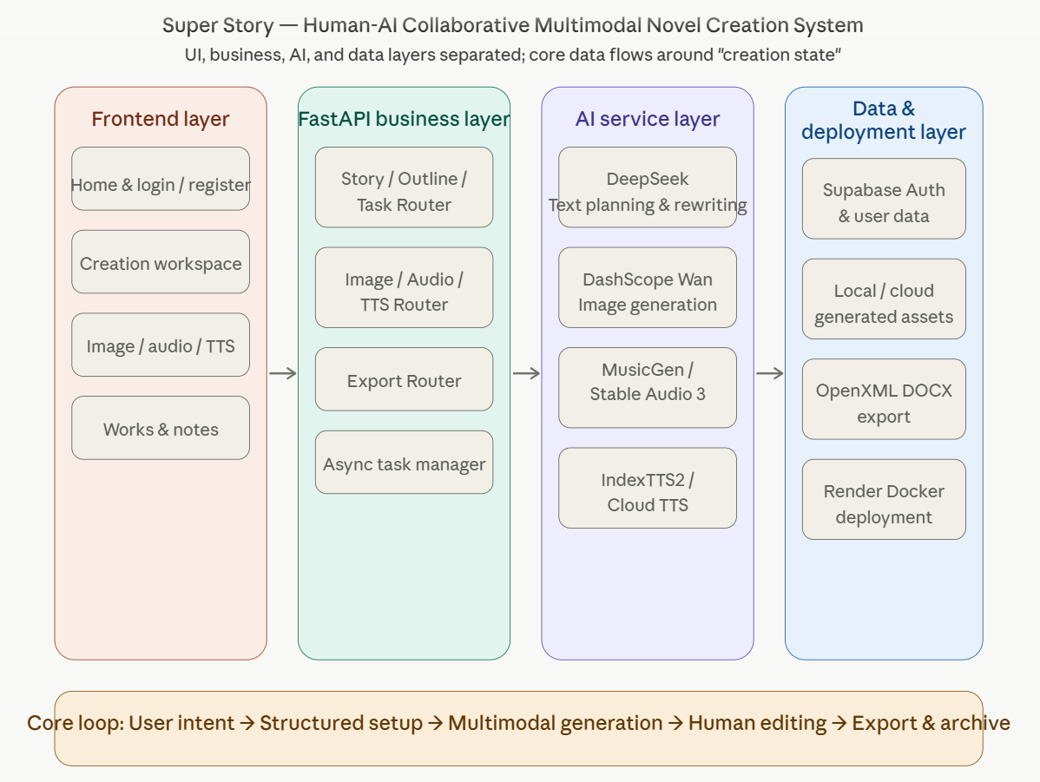
02 SYSTEM ARCHITECTURE

Slide 8
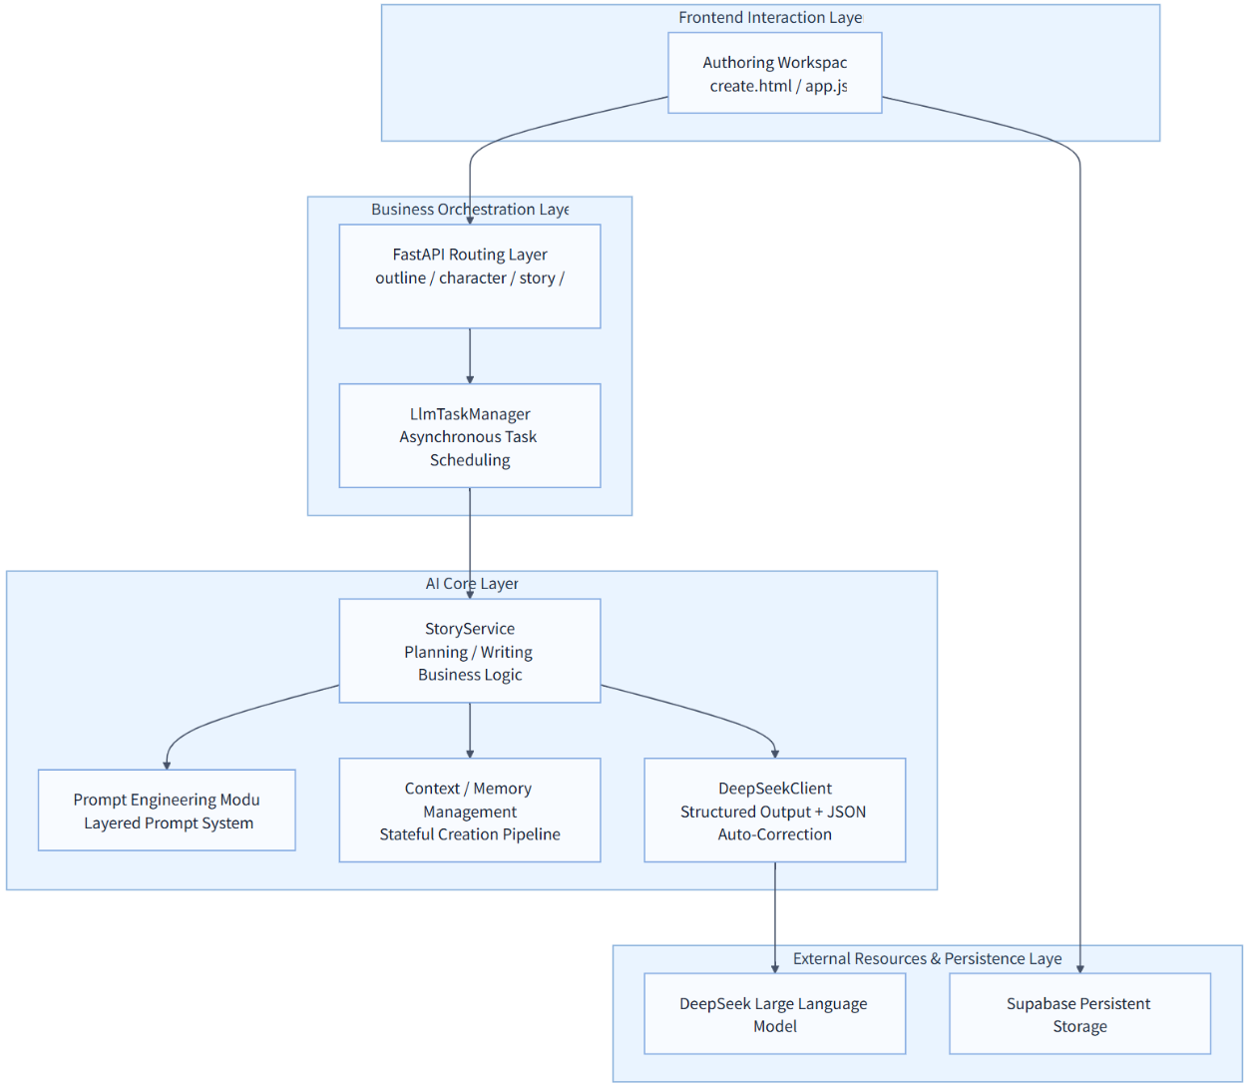
02 SYSTEM ARCHITECTURE · NOVEL GENERATION
A Prompt-Driven Planning–Generation Architecture
The problem with one-shot generation
General LLMs generate narrative in a single dialogue turn
Global constraints — logical consistency, character-arc continuity, foreshadowing payoff — can't be held reliably across one pass
Prompt-driven planning: training-time → inference-time
Plan-and-Write: “plan, then write” via trained extraction + generation models
This project: zero fine-tuning — prompts dynamically build Planning + Generation Layers at inference time via DeepSeek's in-context learning, so “plan → write” becomes prompt-driven
Five-stage creative pipeline
World &
Setting
Character Cards
& Relations
Outline Planning
(4-act + briefs)
Chapter-by-Chapter
Generation
Local
Rewrite

Slide 9
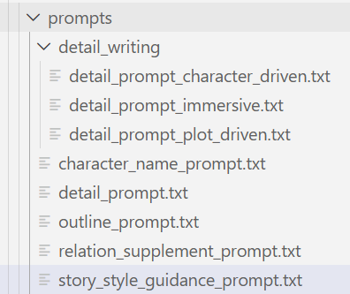
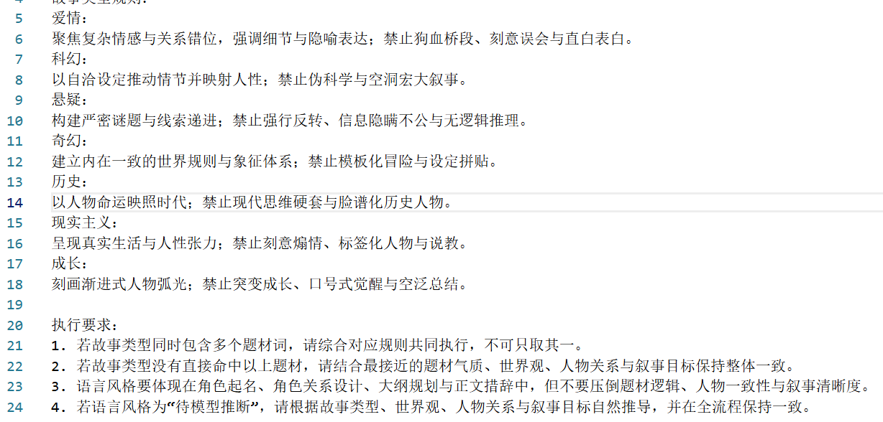
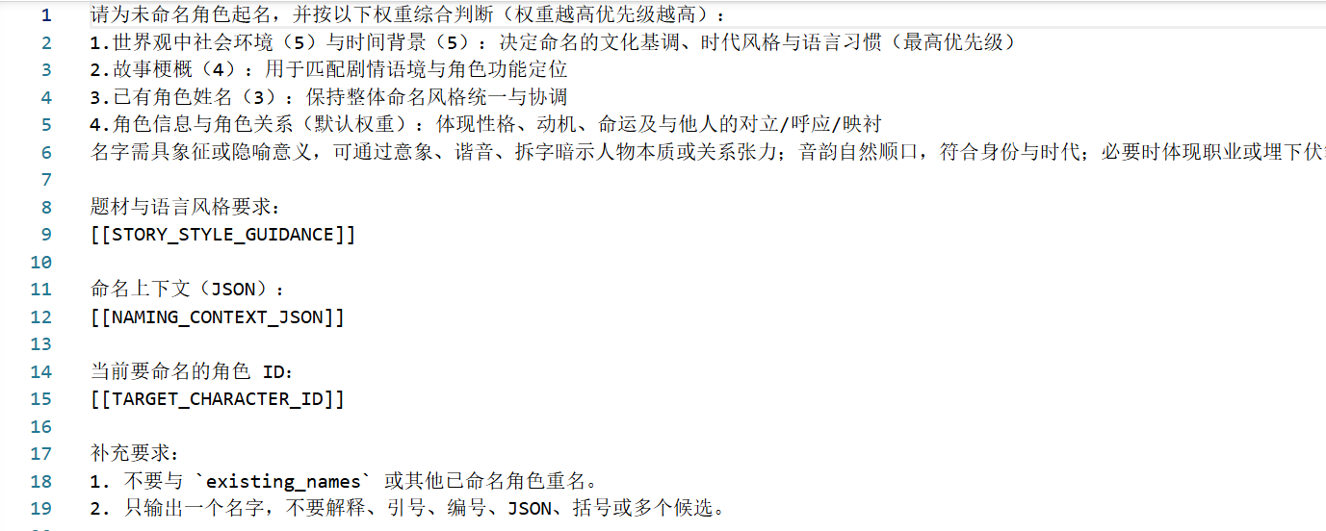
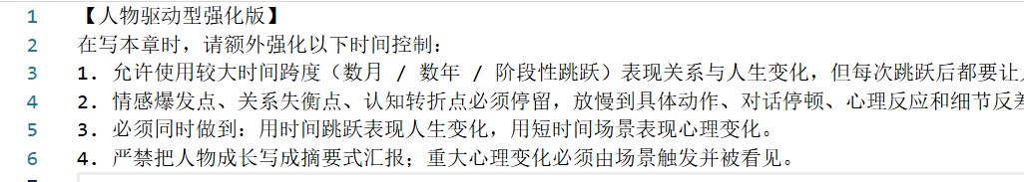
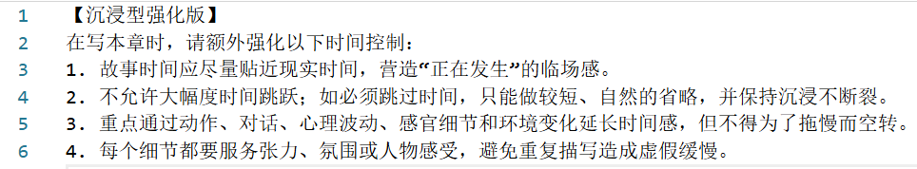
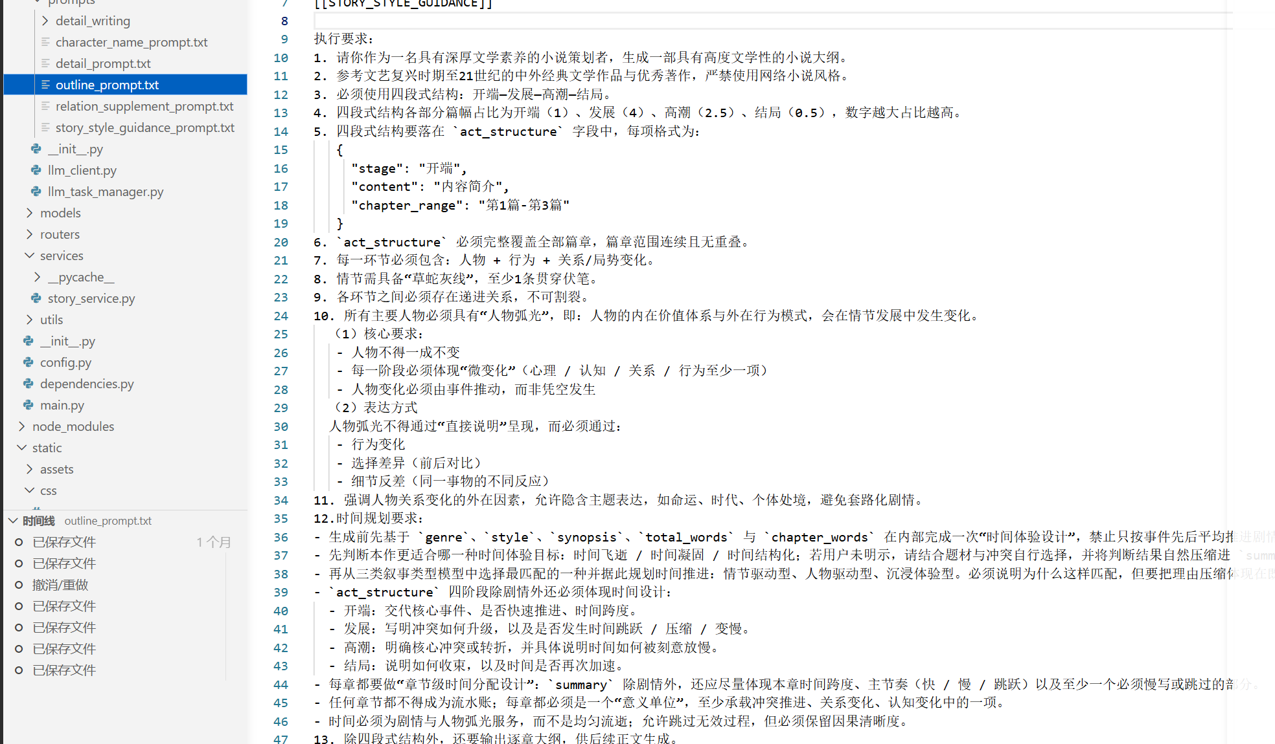
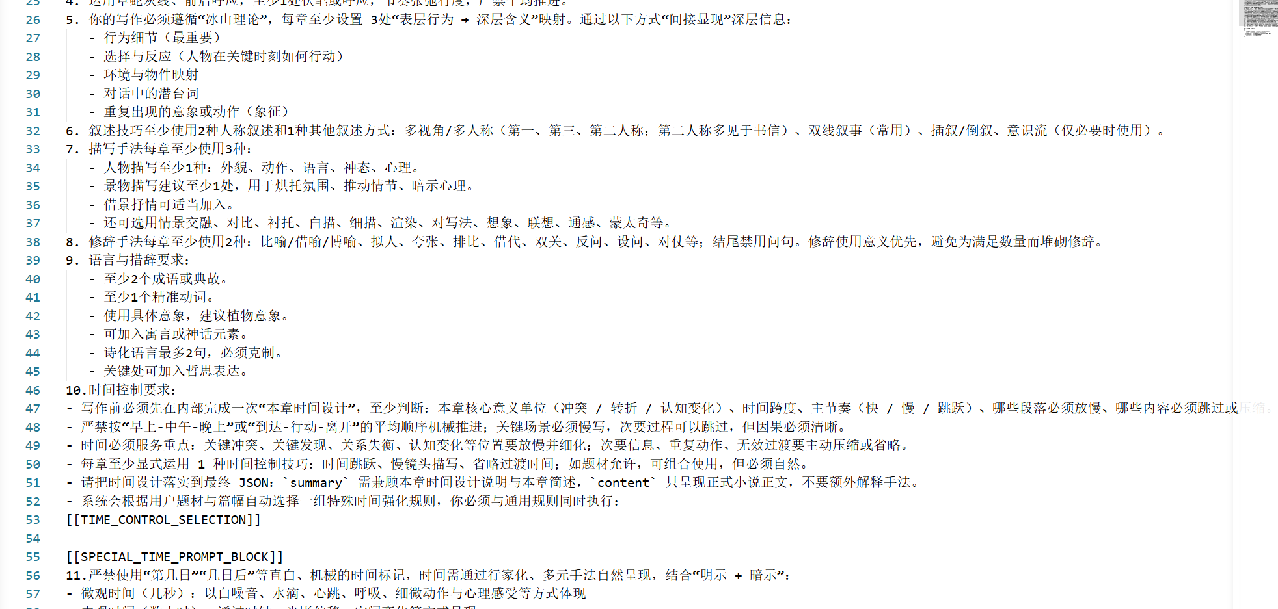
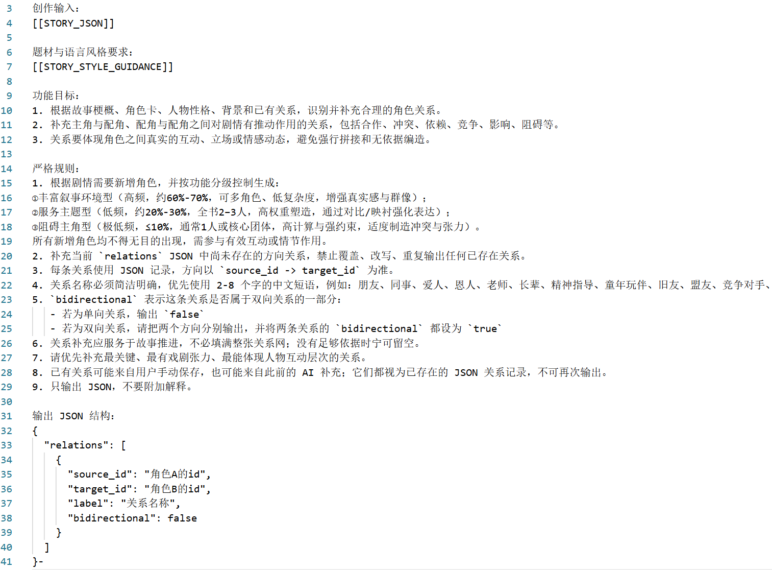
02 SYSTEM ARCHITECTURE · NOVEL GENERATION
Dual-Layer Prompts: Literary Theory as Generation Constraints
(0) prompt catalogue
(1) story type prompt
(2) character naming prompt
(3) character relation generating prompt
(4) outline writing prompt
(5) detail writing prompt

Slide 10
02 SYSTEM ARCHITECTURE · NOVEL GENERATION
A Stateful Pipeline: Field-Pruned Context + Summary-Driven Memory
Upstream output = downstream input
Context is field-pruned and assembled on demand — not raw-text concatenation
Chapter generation draws on 5 structured fields (right): story setup, full outline, prior-chapter summaries, current-chapter brief, and style rules
STORY_JSON
setup, synopsis, style
OUTLINE_JSON
global plan (“future”)
Chapter N
Text Generation
CONTINUITY_SUMMARIES
prior chapters (“past”)
Summary-driven memory
CHAPTER_SPEC
current-chapter brief
After each chapter, the model also returns a summary → appended to CONTINUITY_SUMMARIES
Recursive compression: summary growth rate ≪ text growth rate
OUTLINE_JSON = “future” view, CONTINUITY_SUMMARIES = “past” view — lightweight, no vector DB / external retrieval
STORY_STYLE_GUIDANCE
genre & style rules
Returns a chapter summary → feeds back into CONTINUITY_SUMMARIES for chapter N+1
Notes:
接下来是AI核心层的第二个子模块——上下文与记忆管理。
我们整个创作流程是一个"有状态"的流水线，遵循"上游输出即下游输入"的原则。具体到逐章生成这一步，我们并不是把所有历史文本简单拼接起来扔给模型，而是按字段做"按需裁剪、结构化拼装"。如右图所示，每次生成一章时，会组装五类结构化字段：故事的整体设定 STORY_JSON（包括题材、简介、世界观、风格）、完整大纲 OUTLINE_JSON（代表"未来"）、此前各章的摘要 CONTINUITY_SUMMARIES（代表"过去"）、当前章节的具体写作要求 CHAPTER_SPEC，以及风格指导 STORY_STYLE_GUIDANCE。
记忆管理方面，我们采用的是"摘要驱动"的轻量级机制：每生成完一章，模型会同时返回这一章的摘要，追加到 CONTINUITY_SUMMARIES 中，作为下一章生成的输入之一。这是一种递归压缩的过程——摘要的增长速度远远小于正文的增长速度，因此随着章节数增加，记忆部分的体量也不会失控地膨胀。结合大纲所代表的"未来"视角和摘要所代表的"过去"视角，模型在生成每一章时，相当于同时拥有了过去、现在、未来三个时间维度的信息，而且整个机制完全通过提示词字段实现，不依赖向量数据库或外部检索系统，非常轻量。

Slide 11
02 SYSTEM ARCHITECTURE · IMAGE GENERATION
A "Parse-Rewrite-Generate" Architecture for Visual Storytelling
Core Design Philosophy
The image generation module is a key link in the multimodal creation process. It follows the "Parse-Rewrite-Generate" principle to solve the problem of poor image generation caused by non-visual information in the original text.
Novel Content Input Layer
AI Model Coordination & Execution Layer
Visual Analysis
Model Invocation
Resource Management
Core Workflow
Information Input
Prompt Construction
Model Invocation
Result Presentation
User Interaction & Preview Layer
Image Generation Process
Text Extraction
Prompt Reconstruction
Model Inference
Result Refinement
Asset Storage
Notes:
小说生图模块并非孤立工具，而是整个多模态创作流程的关键环节。它的设计目标是能够视觉化小说，给用户多样的体验。它与文生小说模块紧密相连，共享小说的基础设定、角色信息和章节内容，遵循“解析-重写-生成”原则，确保生成的图片符合小说的整体风格。整体的流程是，先导入小说的核心信息，进行文本提取。将结构化的文本重组成适合图像生成的提示词，调用后端的模型生成图像，再将生成结果反馈给用户。实现高效、可控的人机协同创作工作流。

Slide 12
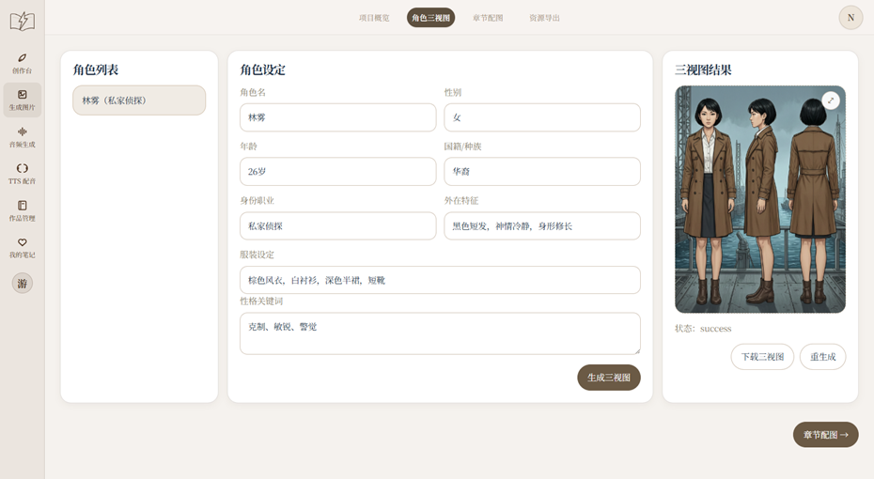
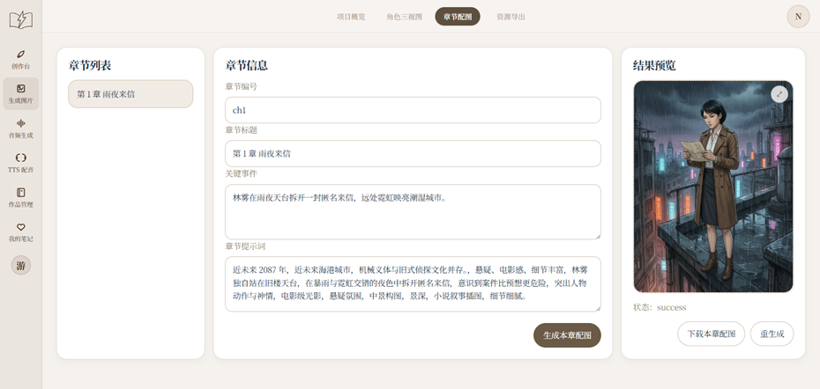
02 SYSTEM ARCHITECTURE · IMAGE GENERATION
Dual-Workflow Design: Character Consistency & Scene Illustration
Core Function Overview
The module contains two core workflows: character tri-view generation and chapter illustration generation, which collectively enhance the novel's narrative expressiveness.
CHARACTER TRI-VIEWS
CHAPTER ILLUSTRATIONS
Credibility, Immersion, Seamless Transition.
Notes:
主要的功能有两个，生成角色三视图和章节配图。角色三视图页面会共享前面生成小说时的角色设定，并且可以补充设定。通过输入角色的结构化信息，系统能自动生成正面、侧面和背面的图片，这对于保证角色在后续所有插图中的一致性至关重要。第二个工作流是“章节配图生成”，它专注于将文本情节转化为生动的场景插图。系统会智能分析章节内容，提炼出关键事件、场景、人物、动作等视觉元素，自动生成提示词去生成章节配图。这两个工作流共同构成了我们小说生图模块的核心功能。

Slide 13
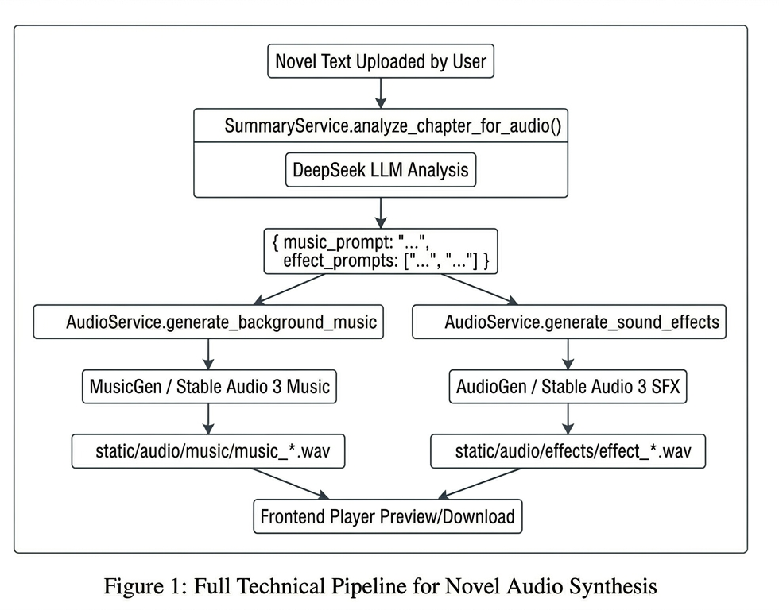



02 SYSTEM ARCHITECTURE · SOUND GENERATION
Audio Generation Submodule Implementation
MusicGen & AudioGen
300M Parameters · Meta 2023
Compresses audio at 50x ratio via EnCodec codec, runs on consumer GPUs with real-time inference. Loaded via HuggingFace Transformers with lazy loading strategy, supports CUDA auto-detection and float16 precision acceleration.
Stable Audio 3
459M Parameters · Stability AI 2024
Uses semantic-acoustic encoder (SAME) to compress audio 4096x into latent space, supports up to 6 min 20s generation. Small version generates 0.44s on H200 GPU, with inpainting editing capability.
Sound Effect Generation
Stable Audio 3 SFX Specialized Model
Uses Stable Audio 3 SFX specialized model, as AudioGen's AudioCraft framework has compatibility issues on Windows systems, optimized for short environmental and action sound generation.
Notes:
MusicGen 和 AudioGen均是由Meta AI于23年提出的音频生成模型，是早期⽂⽣⾳领域的⼯业级落地标杆⼯作。二者采用EnCodex编解码器，可将原始音频50倍压缩，对硬件友好。Stable Audio 3 是26年5月份由Stability AI发布的最新一代音频生成模型，包含small（459M）、medium（1.4B）、large（2.7B）三个版本，分为音乐（music）和音效（sfx）两种专用变体。右图是音频生成的数据流，用户通过输入小说文本内容，先通过大模型对小说文本内容进行分析，分别生成音乐生成提示词与音效生成提示词，发送给相应变体模型进行生成，下载模型至本地并调用本地算力进行推理后，即可输出wav音频文件。

Slide 14
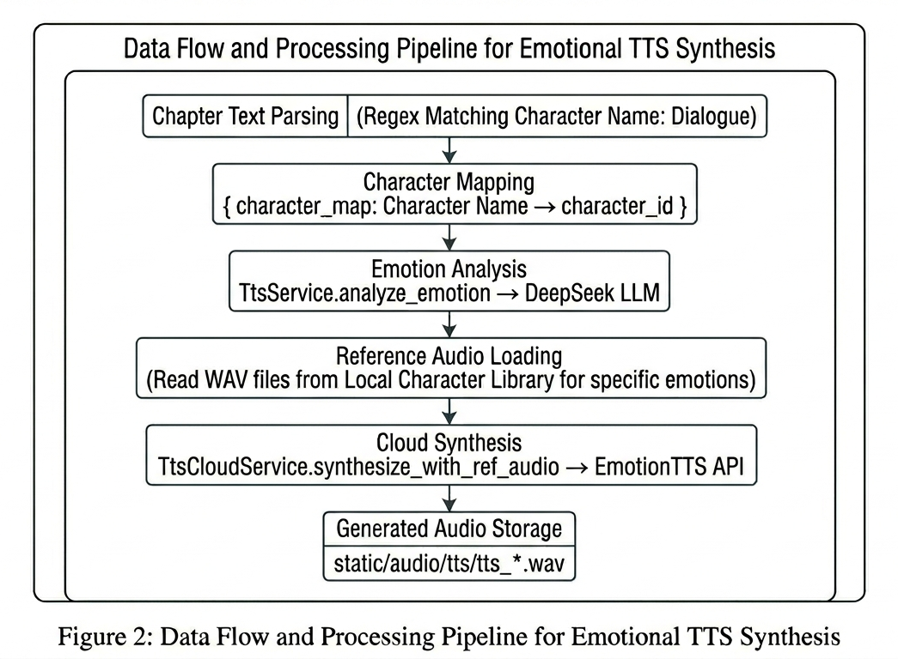

02 SYSTEM ARCHITECTURE · SOUND GENERATION
TTS Dubbing Submodule Implementation
Core Implementation Details
Cloud API Architecture
Connects to external EmotionTTS cloud service with OpenAI-compatible endpoint /v1/audio/speech avoids local deployment of GB-scale IndexTTS2 model, supports independent cloud model iteration and GPU computing offloading.
Emotion Analysis Pipeline
DeepSeek LLM analyzes dialogue as dubbing director, outputs structured emotion data mapped to IndexTTS2's 8-dimensional emotion vector: happiness, anger, sadness, fear, disgust, depression, surprise, neutral
End-to-End Chapter Dubbing Workflow
Text parsing → character mapping → voice library matching → emotion analysis → Base64 encoding → cloud synthesis → local WAV file storage, with 7 basic emotion reference audio libraries per character.
,
.
Notes:
TTS配音板块选择了bilibili人工智能平台部提出的自回归零样本文本到语音模型IndexTTS2，其能够实现精确的时长与情感控制。配音的核心亮点是智能情感匹配，将大模型作为 “配音导演”，专门解析角色对话内容，自动识别情绪，并转化为 IndexTTS2 定义的8 维情感向量，分别是：开心、愤怒、悲伤、恐惧、厌恶、低落、惊讶、中立，覆盖小说角色绝大多数情绪表现。完整的章节配音流程分为 6 步：文本解析→角色匹配→音色库匹配→情感分析→Base64 编码→云端合成→本地存储。同时为每个角色搭建了本地音色库，包含 7 类基础情绪的参考音频，保障配音音色统一。左图是TTS配音的数据流，通过正则表达式匹配文本，区分角色名称与对应台词，然后通过角色映射表，让角色名与角色id进行匹配，再交由大模型进行情感分析，通过从本地角色库中调用参考音频，将文本、参考音频发送给云端完成配音，再输出返回给本地。

Slide 15
03
Evaluation

Slide 16
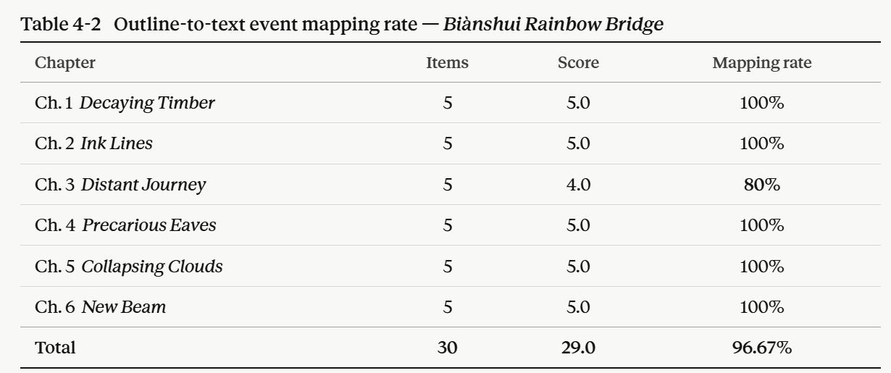
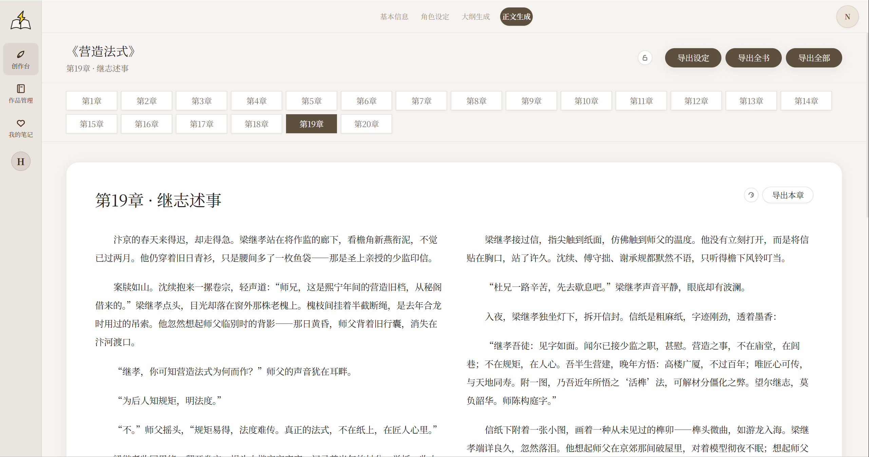

03 EVALUATION · NOVEL GENERATION
Test sample: 6-chapter historical fiction outline Biànshui Rainbow Bridge (《汴水虹桥》), 12,000-word target (~2,000 words/chapter)
Scoring: fully realized = 1.0, partially realized = 0.5, absent = 0.0. Each chapter comprises 4 key plot events + 1 chapter-ending hook (5 items). Ch. 3 contains two partial realizations: a location discrepancy in the defective-timber discovery scene, and an indirect rather than explicit sample-delivery action.
96.67%
Conclusion: the planning layer exerts a real, observable constraint on the generation layer
Performance Test
《营造法式》 — 44k words
Relations (56): 1m 01s · Naming + outline: 1m 53s
Full-text generation: 9m 22s
Notes:
最后一页评估，关注结构化输出的自纠错效果以及系统整体性能。
这套JSON自纠错机制分三级：① 先检查模型输出是否非空且结构完整闭合，否则视为截断，触发截断重生成；② 通过则直接 json.loads 解析，失败先做本地规则修复（全角转半角、去尾逗号、补全括号引号）再次解析；③ 仍失败则将原始输出连同"仅修复JSON格式"的要求回传模型，与截断重生成路径汇合后统一降温（≤0.2）重试。最终解析成功即返回结构化结果，否则抛出异常并附原始输出片段供排查。
我们构造了40个人为注入错误的样本，其中10个本身就是合法JSON，20个属于可以通过本地规则修复的轻微格式错误，剩下10个需要模型重新生成。如图所示：如果只用最基础的 json.loads 直接解析，成功率是25%（也就是那10个本身合法的样本）；加上本地规则修复之后，累计成功率提升到75%；再加上降低 temperature 后的模型重试，最终累计达到100%——也就是这40个样本全部都能被解析为合法的JSON。
性能方面，我们给出了两个实际生成案例：《营造法式》目标约4.4万字，56条人物关系补全耗时1分01秒，命名加大纲生成耗时1分53秒，全文生成耗时9分22秒。

Slide 17
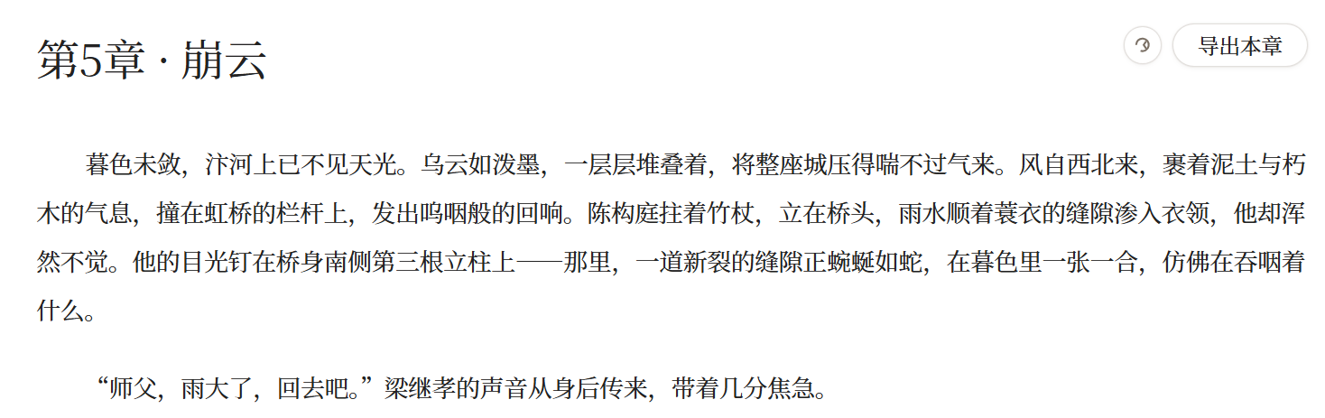
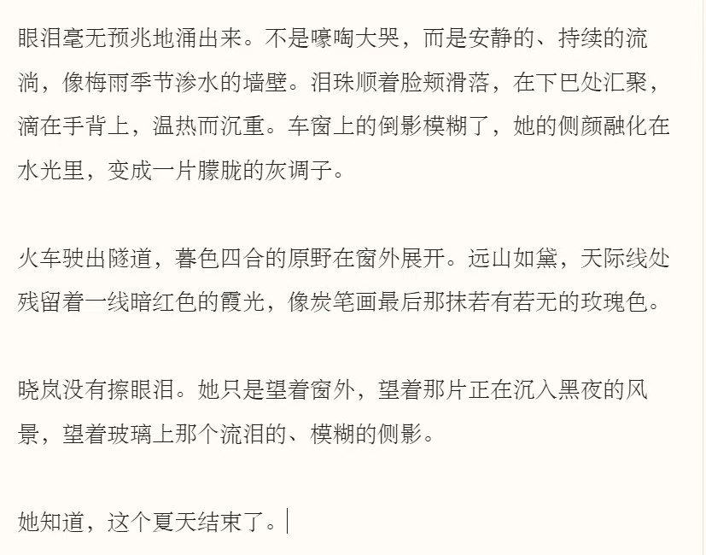
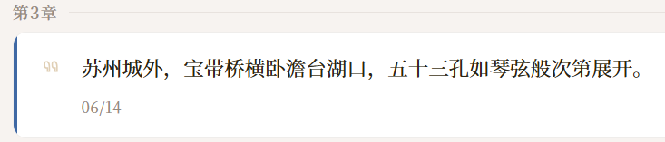
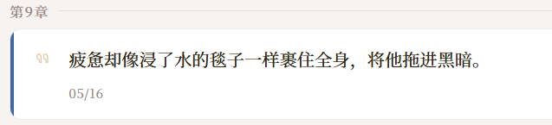
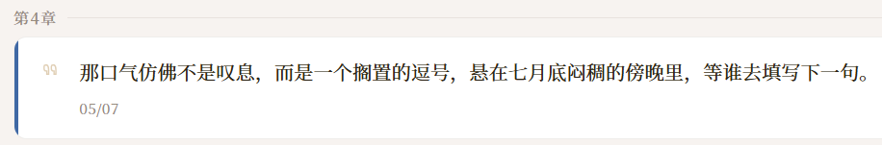
03 EVALUATION · NOVEL GENERATION
Literary Expressiveness of Text Generated by SuperSotry
Notes:
最后一页评估，关注结构化输出的自纠错效果以及系统整体性能。
这套JSON自纠错机制分三级：① 先检查模型输出是否非空且结构完整闭合，否则视为截断，触发截断重生成；② 通过则直接 json.loads 解析，失败先做本地规则修复（全角转半角、去尾逗号、补全括号引号）再次解析；③ 仍失败则将原始输出连同"仅修复JSON格式"的要求回传模型，与截断重生成路径汇合后统一降温（≤0.2）重试。最终解析成功即返回结构化结果，否则抛出异常并附原始输出片段供排查。
我们构造了40个人为注入错误的样本，其中10个本身就是合法JSON，20个属于可以通过本地规则修复的轻微格式错误，剩下10个需要模型重新生成。如图所示：如果只用最基础的 json.loads 直接解析，成功率是25%（也就是那10个本身合法的样本）；加上本地规则修复之后，累计成功率提升到75%；再加上降低 temperature 后的模型重试，最终累计达到100%——也就是这40个样本全部都能被解析为合法的JSON。
性能方面，我们给出了两个实际生成案例：《营造法式》目标约4.4万字，56条人物关系补全耗时1分01秒，命名加大纲生成耗时1分53秒，全文生成耗时9分22秒。

Slide 18
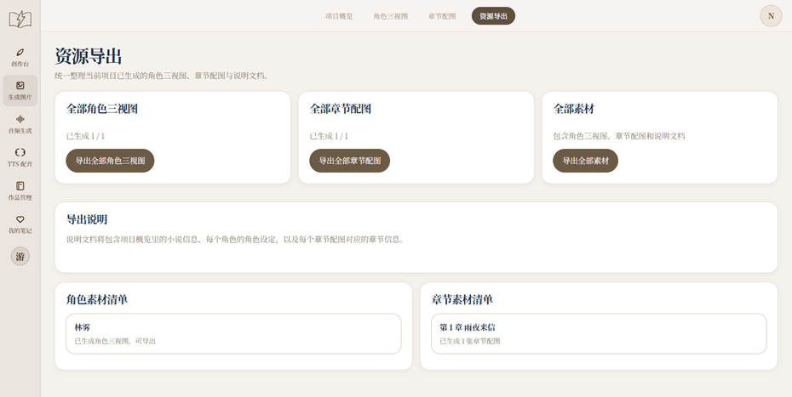
03 EVALUATION · IMAGE GENERATION
Evaluation Methodology: An Engineering Perspective Beyond Aesthetics
Core Evaluation Dimensions
Functional Completeness:Verify a smooth, breakpoint-free workflow.
Consistency & Controllability:Evaluate the system's ability to maintain character consistency and allow user intervention.
System Integration:Evaluate smooth collaboration between modules.
Evaluation Methods & Processes
Workflow & Functional Testing:Simulate user operations to verify functional closure.
API & Module Stability:Conduct unit and stress tests on backend interfaces for stability and low-latency response.
Subjective Utility Validation:A proposed human evaluation scheme to assess relevance, consistency, and satisfaction.
This interface demonstrates the system's ability to manage and export all generated visual assets in a unified manner, confirming the completeness of the workflow.
Notes:
接下来是评估部分。对于图片生成模块，我们的评估重点放在了工程实现的完整性和工作流的可用性上。我们主要从功能完整性、一致性与可控性、系统集成度这几个核心维度进行考察，确保全流程通畅、角色形象稳定且模块协同顺畅。为此，我们执行了端到端的流程与功能测试、后端API稳定性测试，并规划了主观效用验证方案。右侧的截图展示了我们的资源导出界面，这正是我们对工程完整性与资源管理承诺的直观体现。

Slide 19

03 EVALUATION · IMAGE GENERATION
Evaluation Results & Insights: Function, Performance, and Consistency
Systematic verification results show that the "Novel-to-Image" module has met its design goals in terms of functionality, performance, and consistency.
Core Conclusions
•Functional Completeness: Achieved a complete and effective workflow.
•System Integration: Successfully shares context with other modules, enabling smooth collaboration.
•Consistency Control: Improved visual consistency across different scenes at the engineering level.
Core Function & Workflow Verification Results
Test Type | Key Execution Points | Result
Workflow & Function | Complete end-to-end simulation | Functional
API Module | Backend API response under high concurrency | Stable & Reliable
System Integration | Cross-module data flow and state synchronization | Process Ready
Core Value:Engineering Implementation (web interface, prompt organization, resource management). AI generation is a step in the process, not the final conclusion.
Notes:
测试结果显示，我们的“小说生图”模块在工程层面是成功的。流程与功能测试验证了端到端的工作流是通畅且有效的。接口测试也证明了后端服务的稳定性和可靠性。虽然主观的人工美学评价尚未实施，但这并不影响我们当前的结论：我们成功构建了一个功能完整、集成良好的多模态创作工具。它能够在工程层面保证角色的一致性和场景的连贯性，为用户提供了从文本到视觉的无缝创作体验。这标志着我们的图片生成模块达到了预期的设计目标。

Slide 20

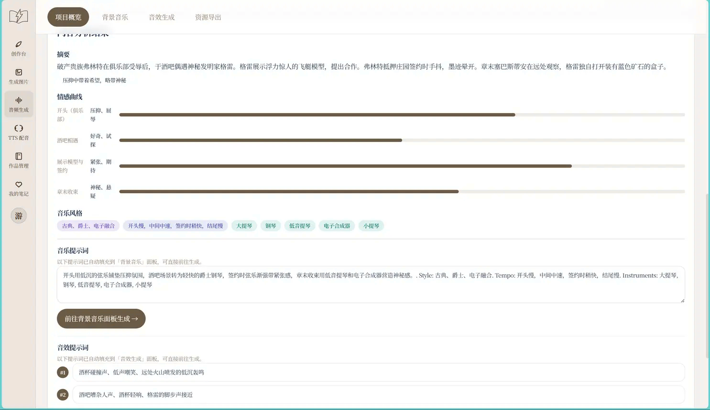

03 EVALUATION · SOUND GENERATION
Analysis of Novel Content
After uploading the document for analysis, it can correctly recognize the content and structure of the novel, and output reference prompts into the background music generation and sound effect generation module.
Notes:
首先展示大模型的分析效果，输入小说文本内容，将自动识别小说格式，提取小说类型摘要，以及情节变化，从而匹配音乐风格，生成相应的音乐参考提示词与音效参考提示词，并输出给音乐音效生产的页面中。这一步主要是用于用户了解小说内容并协助写提示词。

Slide 21
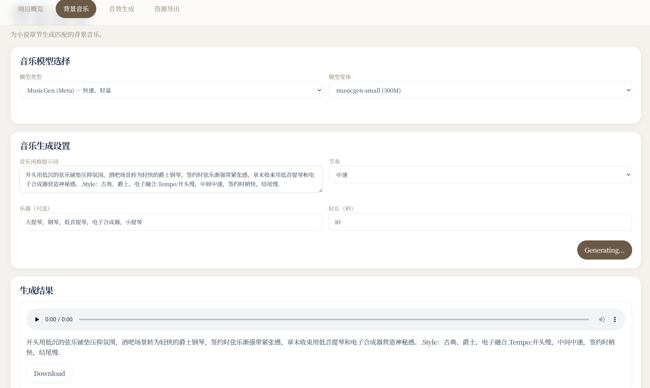
03 EVALUATION · SOUND GENERATION
Music and SFX Generation
You can generate audio using the MusicGen model. However, the AudioGen model relies on Meta's open-source AudioCraft library for model loading and inference, which is hard to do on Windows. The Stable Audio 3 model uses a gated access system hosted on HuggingFace Hub, so it's limited by network and permissions.
Notes:
轻量化的MusicGen模型，能够很好地完成生成任务。在预期设想里，用户能够自行切换不同的模型来匹配自己的本机配置来达到不同的效果。但是在实际落地的时候，AudioGen 依赖 AudioCraft 库，Windows 系统兼容性差，无法正常部署使用；而 Stable Audio 3 托管在 HuggingFace 平台，采用访问权限管控，实际使用会受到网络、权限的制约。

Slide 22
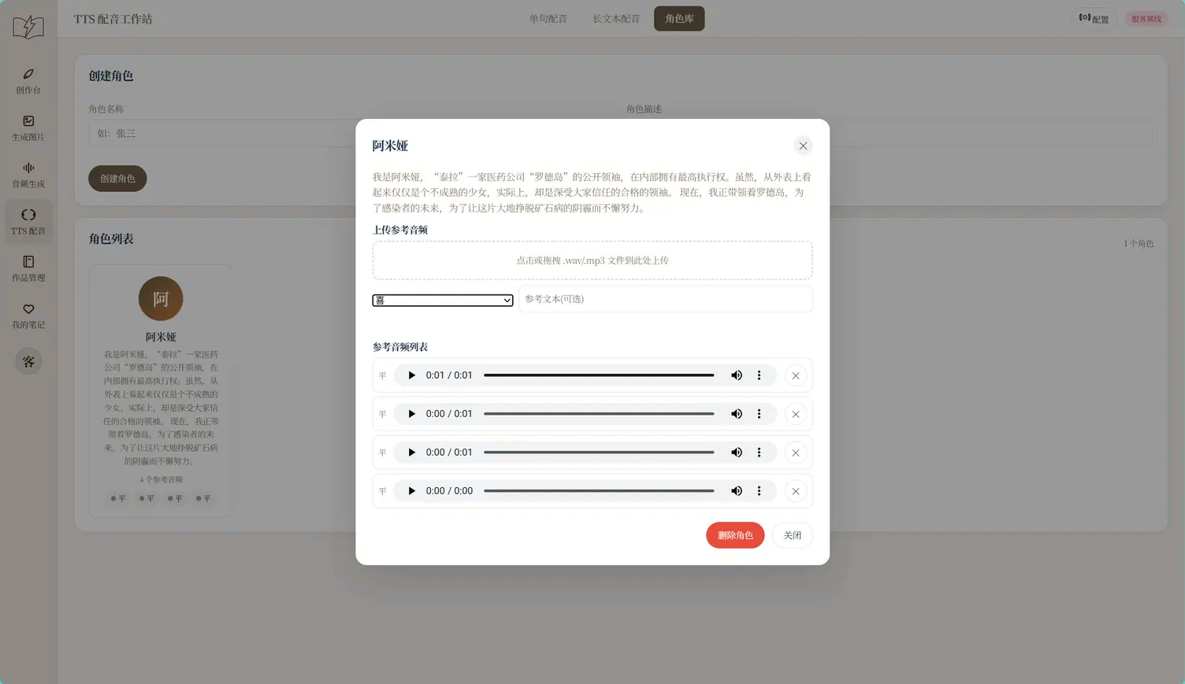
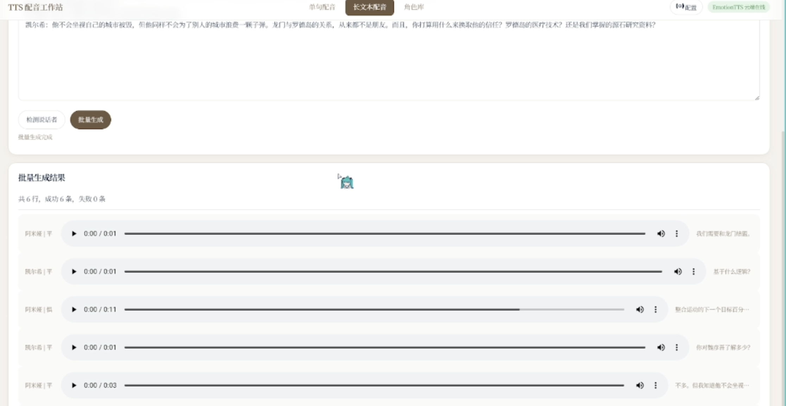
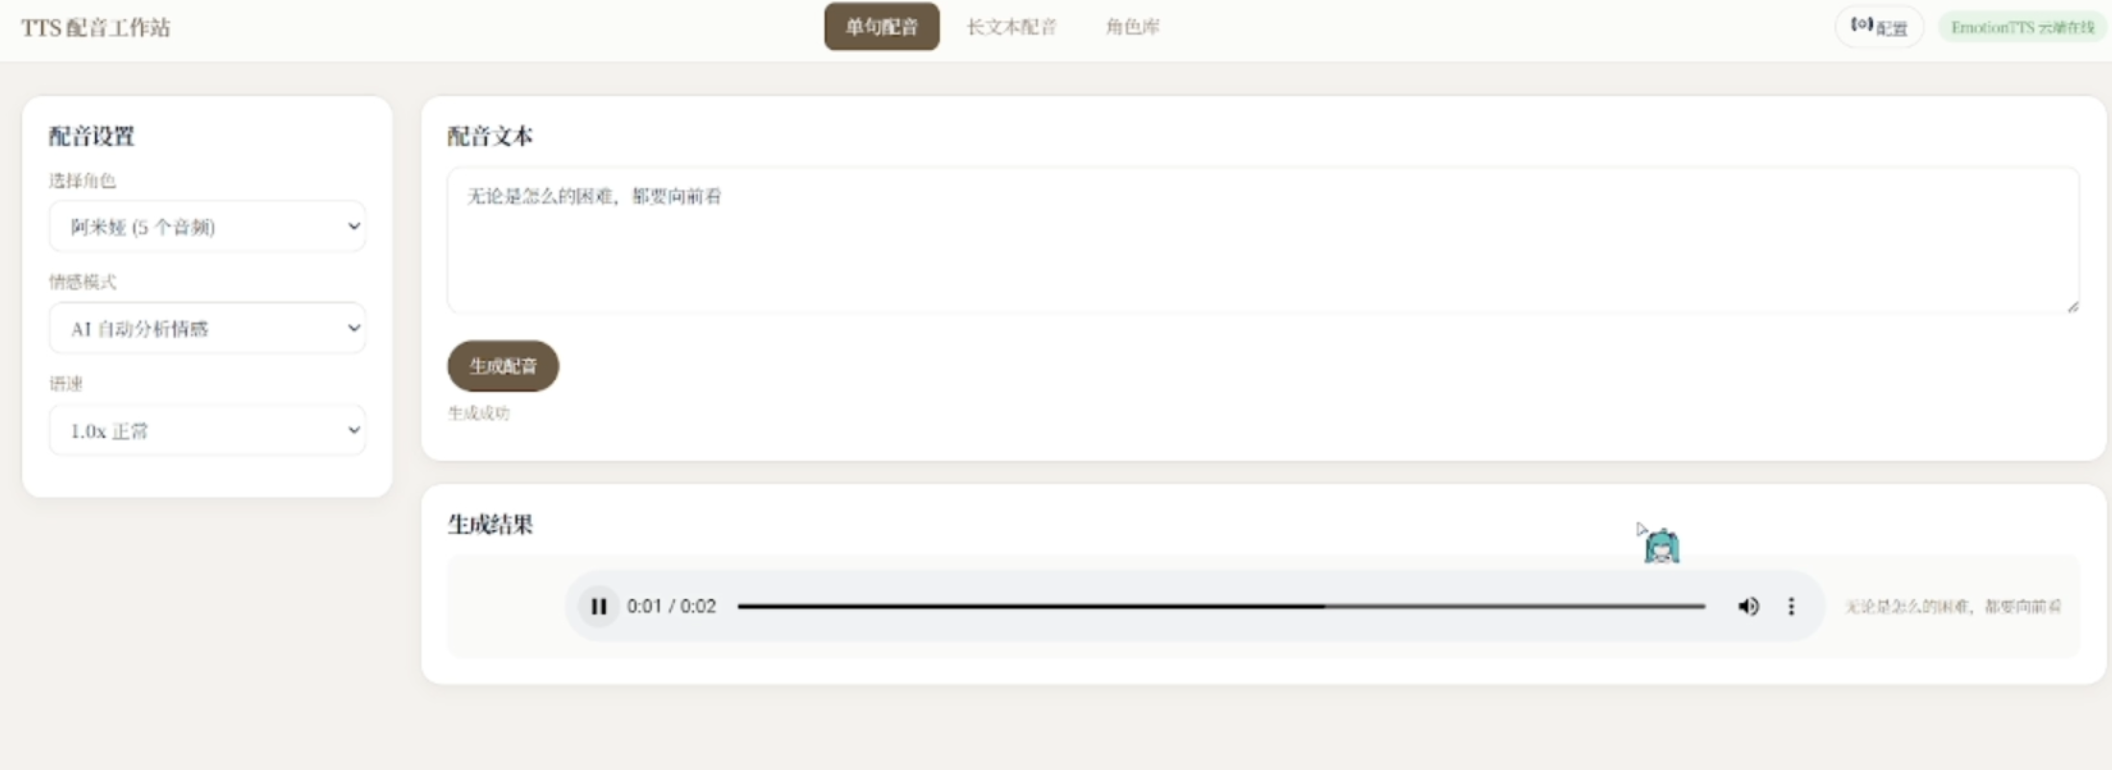
03 EVALUATION · SOUND GENERATION
TTS Dubbing
By calling the cloud server API for inference, you can create a character library, do single-sentence dubbing, and handle full-length text.
Notes:
TTS配音主要分为两个使用场景，单句配音与长文本配音，在调用TTS之前，需要用户将自己的角色加入进角色库中，进行拟写其人物设定提示词并提供参考音频即可创建角色。在配置上，同时实现本地配置与云端配置，云端即调用云端服务器的API，本地则会检测IndexTTS2本地部署后的默认端口9800，并将文本与音频发送给该端口，在实际落地上，受限于硬件，仅测试云端调用的功能。

Slide 23
04
Demo video

Slide 24
05
Conclusion

Slide 25
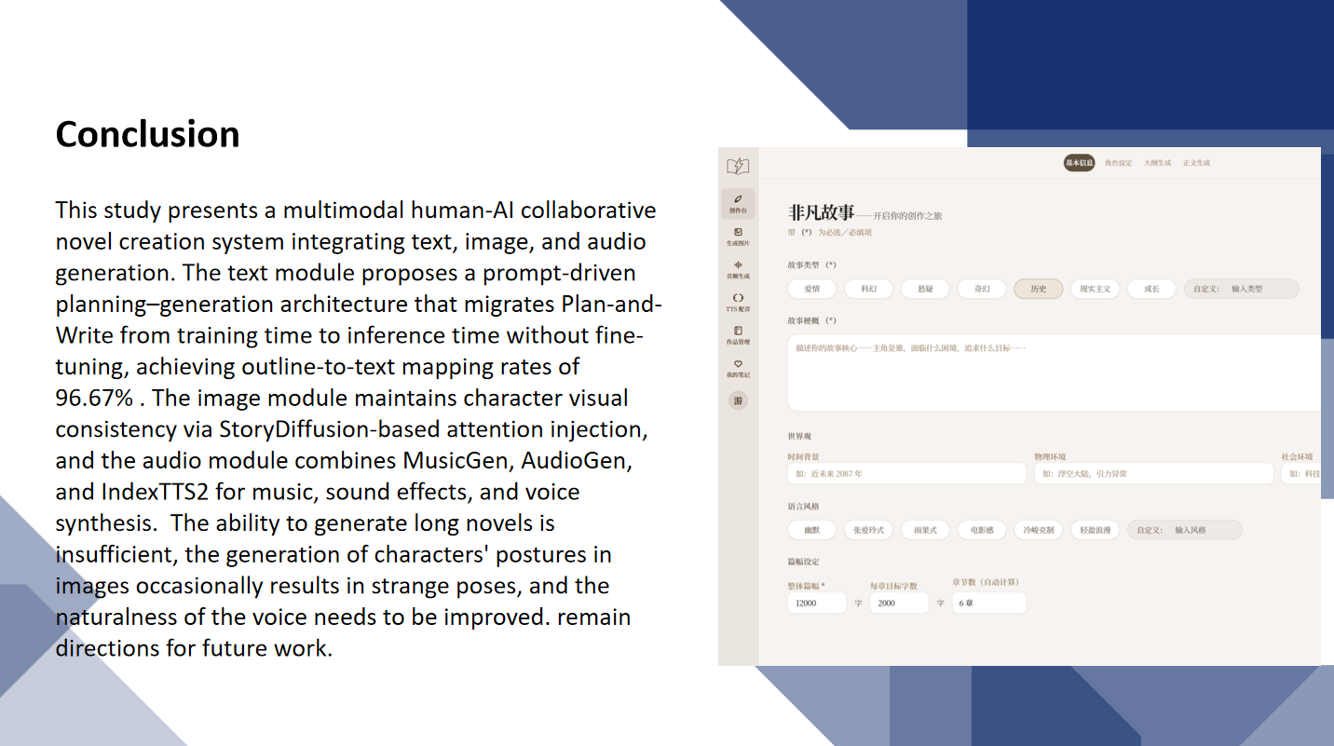
0

Slide 26
Thank you for watching
Presenters：Wang Yiru, Hong Liya

