Slide 1
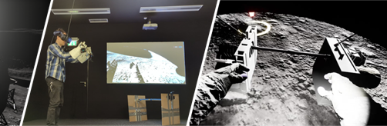

Touching the Moon: Leveraging Passive Haptics, Embodiment and Presence for Operational Assessments in Virtual Reality
汇报人：马鑫

Slide 2
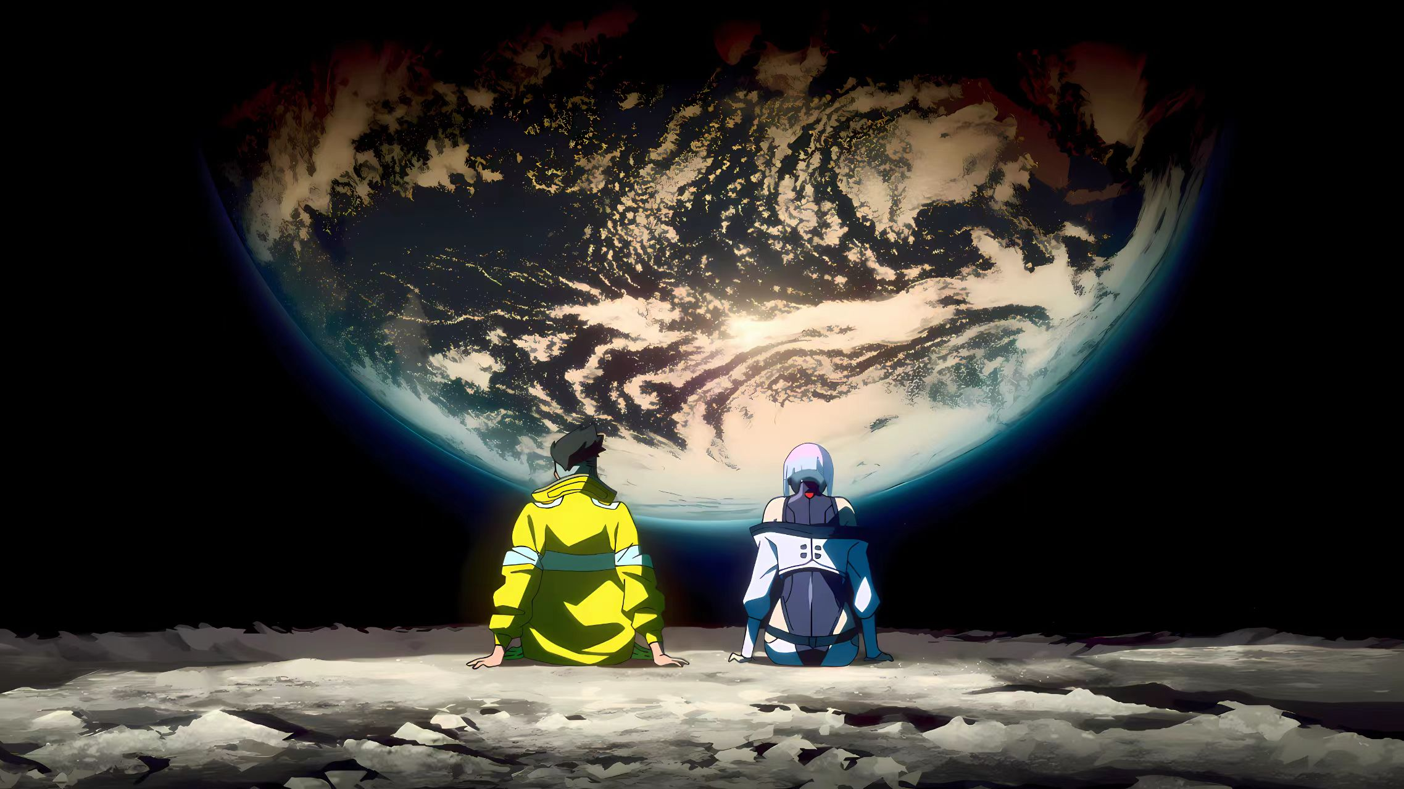
First impression: touch the moon + virtual reality
Animation Cyberpunk Edgerunners screenshot

Slide 3
VR + Aerospace
Passive Haptics
Operational Assessment
Embodiment
Presence

Slide 4
目录
CONTENT
01
02
03
04
Related Work
&
Experiment
Results
&
Discussion
Limitations
Future Work
Conclusion
Introduction

Slide 5
Introduction
Artemis program
Difficulty: assess lunar ConOps
In tradition: the use of analogues in the form of either natural terrains & artificial facilities. This practice is notorious for incurring substantial logistical costs, frequent project delays and budget overruns. Analogue studies are likewise characterised by several limitations impairing their fidelity and utility.
Alternative technology: AR
PART.01

Slide 6
Related Work
Real-World ConOps Assessments
Purpose: Organize human resources, hardware and software into coherent operations while managing potential frictions between all these aspects
Three key aspect: Environmental Fidelity, Mockup Fidelity, Operations Fidelity
Challenges: recurrent cost overruns and planning delays
PART.02

Slide 7
Related Work
Validity of Using Virtual Reality
improving the fidelity of VR-based simulations requires considering two aspects inherent to this medium: sense of presence and embodiment.
PART.02

Slide 8
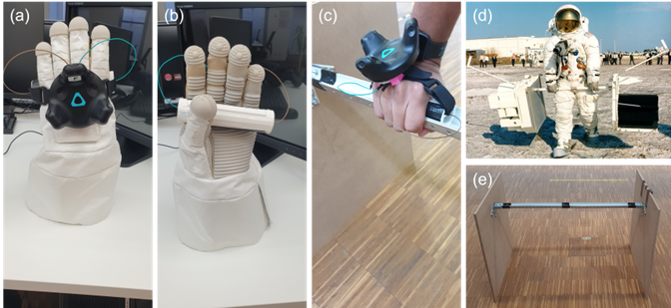
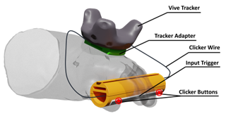
Experiment
The Apollo 12 Case Study
Research object and outline procedure
Virtual Simulation
Environment establishment
Apparatus
Audiovisual apparatus and passive haptic interface
Experimental Design
Two variables for this experiment following a mixed design
Participants
Relevant experts in the field of human spaceflight
Procedure and Measurements
Three procedures and four hypotheses
PART.02

Slide 9
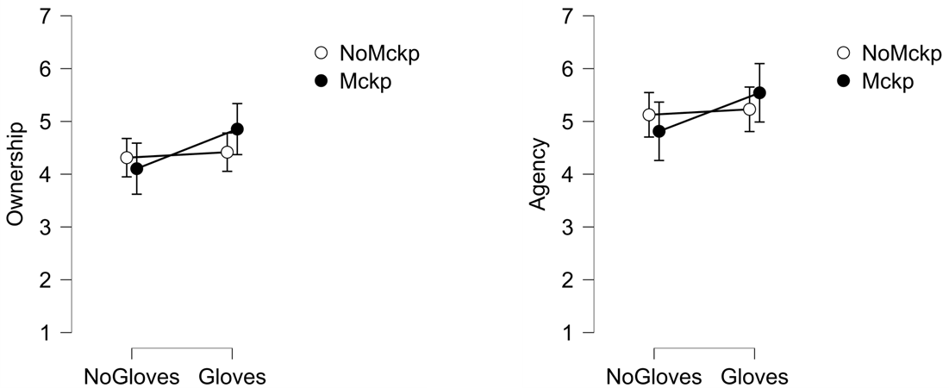
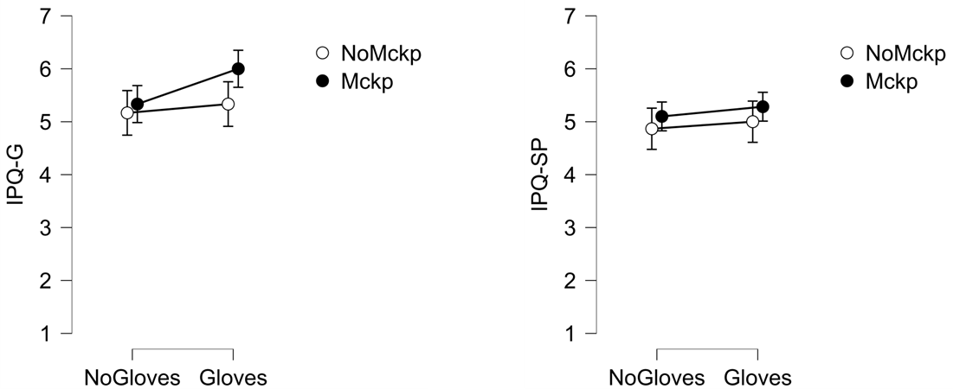
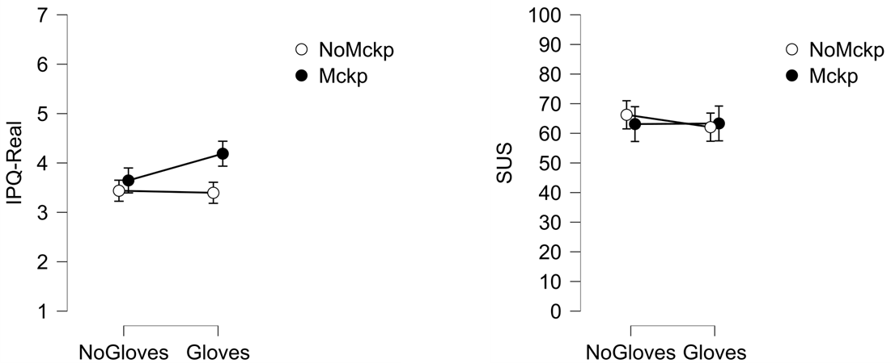
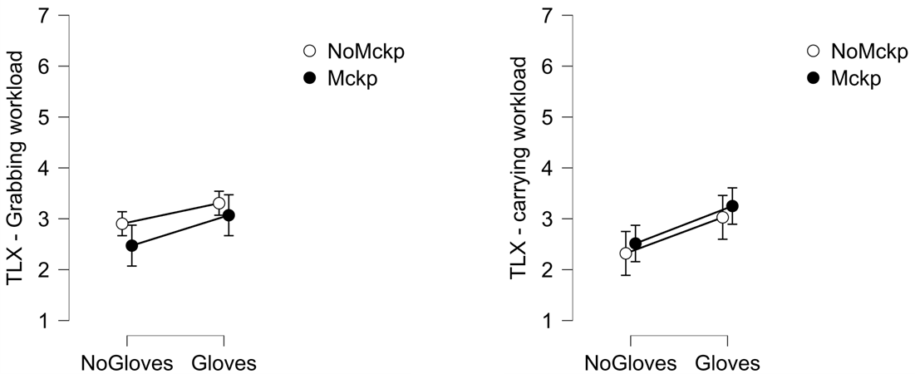
Result
Quantitative analysis
(a) Ownership (b) Agency
 | No Mockup |  |  | Mockup
 | 𝑥¯ | 𝜎 | 𝑥¯ | 𝜎
Age | 32.4 | 12.1 | 35.8 | 10.0
Gaming frequency (0-5) | 1.5 | 1.68 | 1.75 | 1.66
VR experience | 4.25 | 1.86 | 3.83 | 1.99
(c) IPQ: general presence (d) IPQ: spatial presence
Wearing gloves can enhance the user's sense of ownership, realism, and general presence in VR simulations, but it also increases the workload of grasping and handling tasks. The use of analog barbells reduces the time requirement in some ways but increases the physical demand.
(e) IPQ: realness (f) System usability
PART.03
(g) TLX: objects grabbing task (h) TLX: barbell carrying task

Slide 10
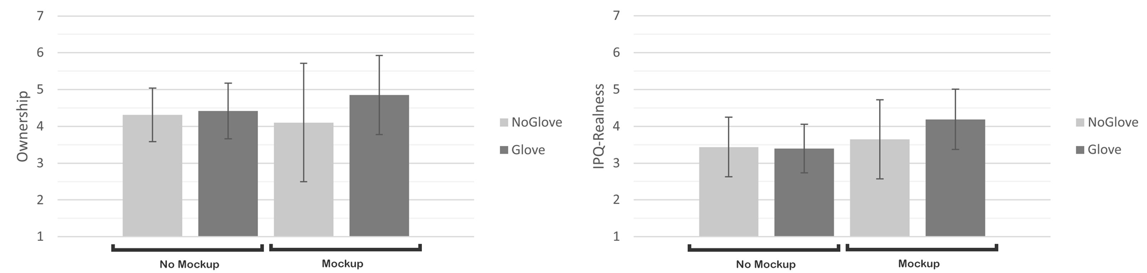
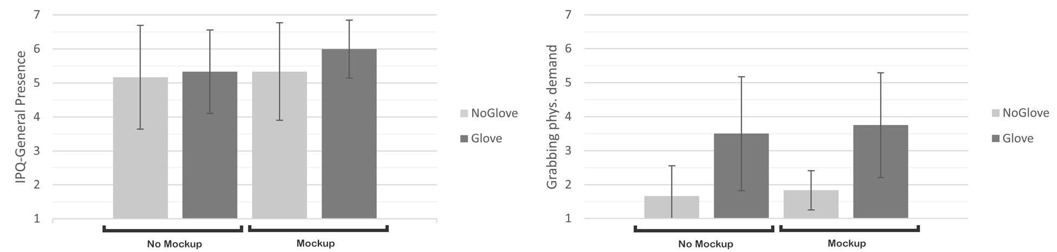
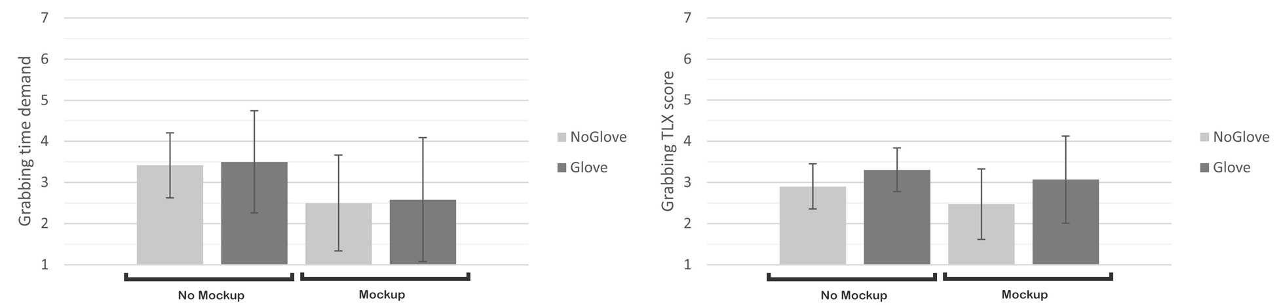
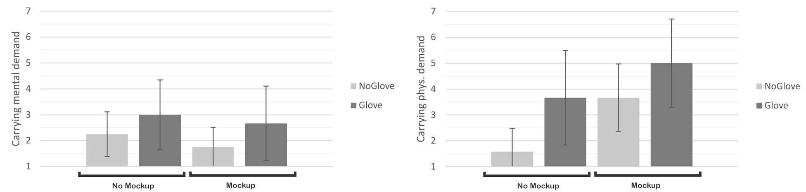
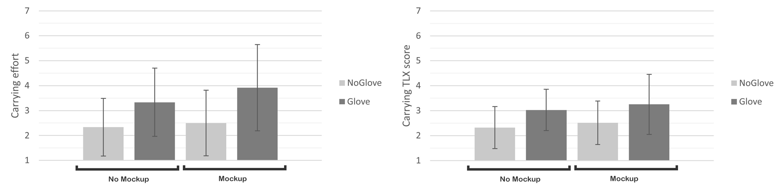
Result
(a) Ownership (b) IPQ: realness
Qualitative analysis
Element | Apollo Feedback Compilation | Quote
Placing objects | Keeping objects in place on the lunar surface was challenging due to reduced gravity, with dust contamination being brought up as a recurring issue. | "We got back to the ALSEP and started a normal deployment.[...] as soon as we put the packages down on the surface, they began to accumulate dust" (Charles Conrad Jr., Apollo 12, 1969).
Gloves | Holding the grip on tools was inducing some muscle fatigue as astronauts needed to exert constant pressure. | "the gloves don’t want to stay closed".(Alan Bean, Apollo 12, 1969)
Barbell carrying task | It was hard to carry packages due to their weights, restricted body movements and the gloves that were not really closing and thus causing a poor grip. | "The workload carrying it out was just about the same as I had guessed from working on Earth. The hard part is holding that weight in your hands. [...] the combination of the weight, the fact you’re moving along, and the fact that the gloves don’t want to stay closed tends to make it fairly difficult task." (Alan Bean, Apollo 12, 1969)
Muscle tiredness | Tiredness was mainly felt through the hands and arms for the barbel carrying task. | "It’s not your legs that get tire; it’s a combination of your hands and arms and it just makes you tired." (Alan Bean, Apollo 12, 1969)
ConOps improvements | The crew advised that for long distances, some technical aids should be considered rather than hand carrying. | "I would say it would be acceptable to carry it this way for distances up to 500 feet. You will want to have a strap that fits over your shoulder, or something like that." (Alan Bean, Apollo 12, 1969)
(c) IPQ: general presence (d) TLX: grabbing task physical demand
(e) TLX: grabbing task time demand (f) TLX: grabbing task score
(g) TLX: carrying task mental demand (h) TLX: carrying task phys. demand
(i) TLX: carrying task effort (j) TLX: carrying task score
Passive Haptics interfaces enhance the user’s physical sensation, presence and simulation fidelity.
PART.03

Slide 11
Discussion
Aims: Investigate the impact of different passive haptic modalities on the senses of presence, embodiment and workload in the context of VR-based assessments of ConOps for future lunar surface activities.
Result: Wearing gloves improves the senses of embodiment and general presence and realness of the IVE. But there is no significant interaction between wearing the gloves and carrying the physical mockup on body ownership and the physical mockup did not influence any of the dimensions of presence.
Validity of ConOps Assessment: The gloves and barbell design make the transportation task relatively difficult. Combination of the gloves and controllers improve the perceived fidelity.
PART.03
PART.03

Slide 12
Limitations
Future Work
Conclusion
Need exercising caution when attempting to apply these findings to other contexts.
Investigating the use of a built-in solution combining finger tracking and haptics in a single glove.
Explore combinations of the utilised haptic interfaces with mixed feedback concepts or software-based illusion techniques.
Having a full virtual body representation of the EVA suit.
PART.04

