Slide 1
Introduction
龙飞 flong@xmu.edu.cn Office: 海韵办公楼A503C
助教：陈斌 17816189411

Slide 2
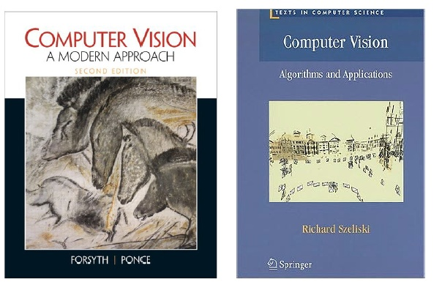
Textbooks
Forsyth and Ponce. Computer Vision -- A Modern Approach (英文影印版) (http://luthuli.cs.uiuc.edu/~daf/book/book.html)
Richard Szeliski著, 艾海舟等译. 计算机视觉: 算法与应用. 清华大学出版社, 2012.

Slide 3
Resources
Links
  CVonline
  The Computer Vision Home Page
  Intel OpenCV
Conferences
  ICCV, CVPR, ECCV
Journals
  PAMI, IJCV, CVIU, PR, IVC

Slide 4
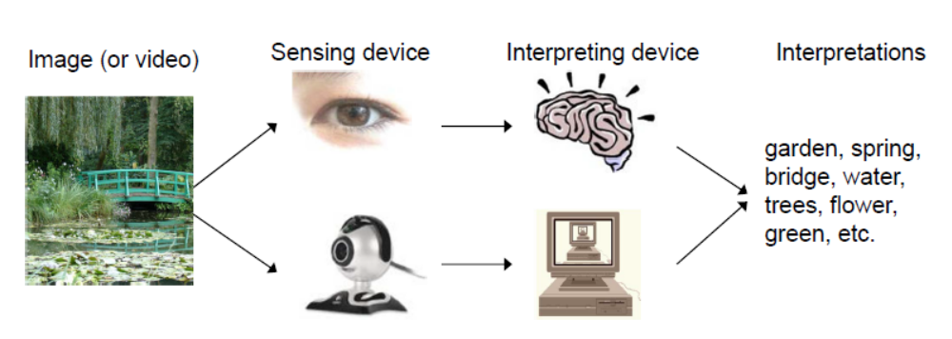
What is computer vision
Computer vision -- teaching computer to see like a human

Slide 5
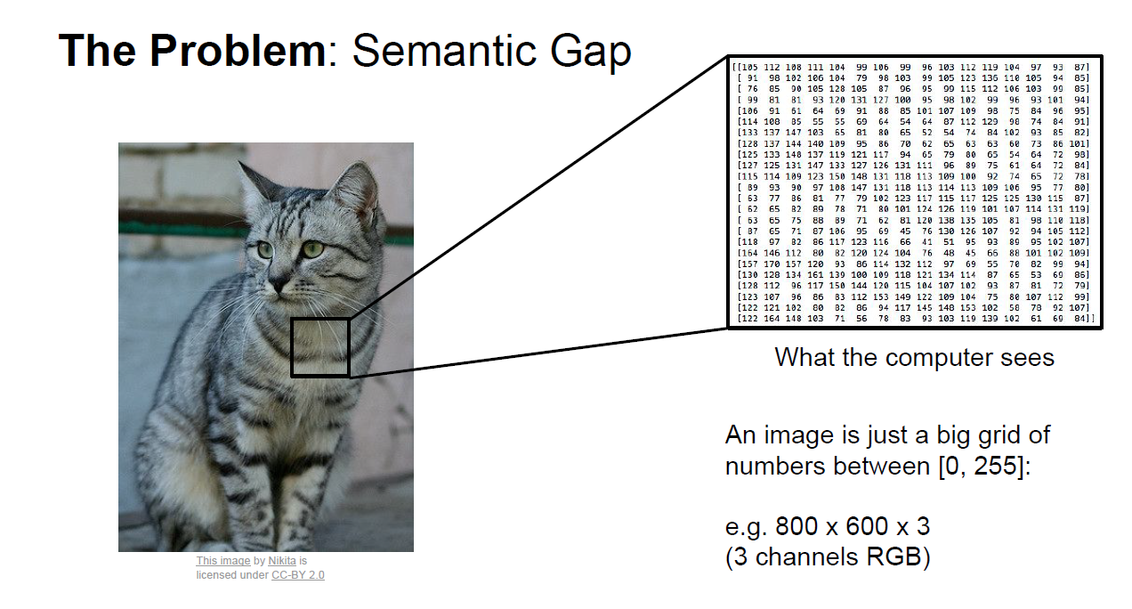
The goal of CV:
to bridge the gap between pixels and “meaning”

Slide 6
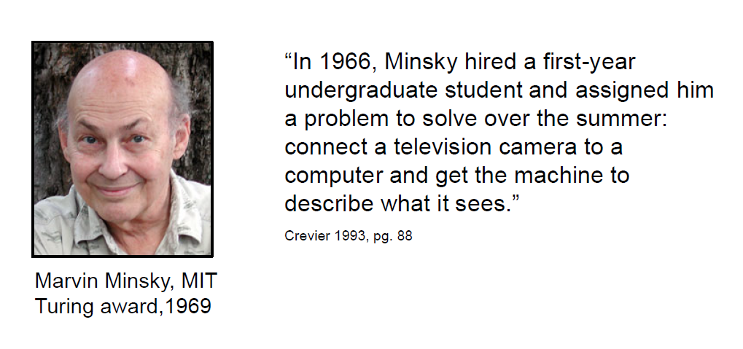

Slide 7
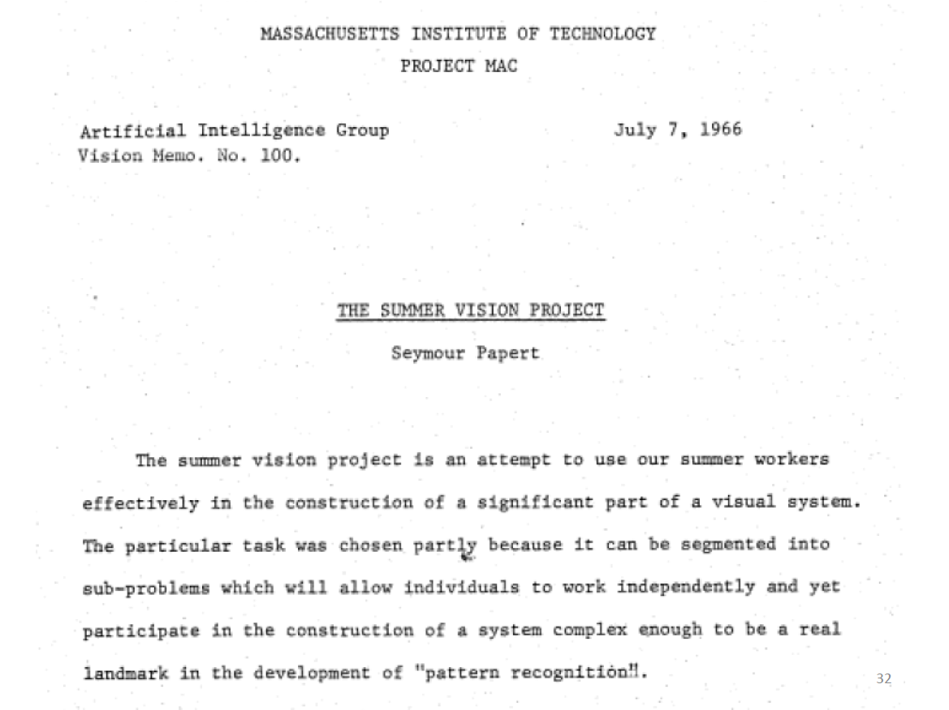

Slide 8
What is computer vision
Trucco and Verri-- Computing properties of the 3-D world from one or more digital images
Sockman and Shapiro-- To make useful decisions about real physical objects and scenes based on sensed images
Ballard and Brown-- The construction of explicit, meaningful description of physical objects from images
Forsyth and Ponce-- Extracting descriptions of the world from pictures or sequences of pictures

Slide 9
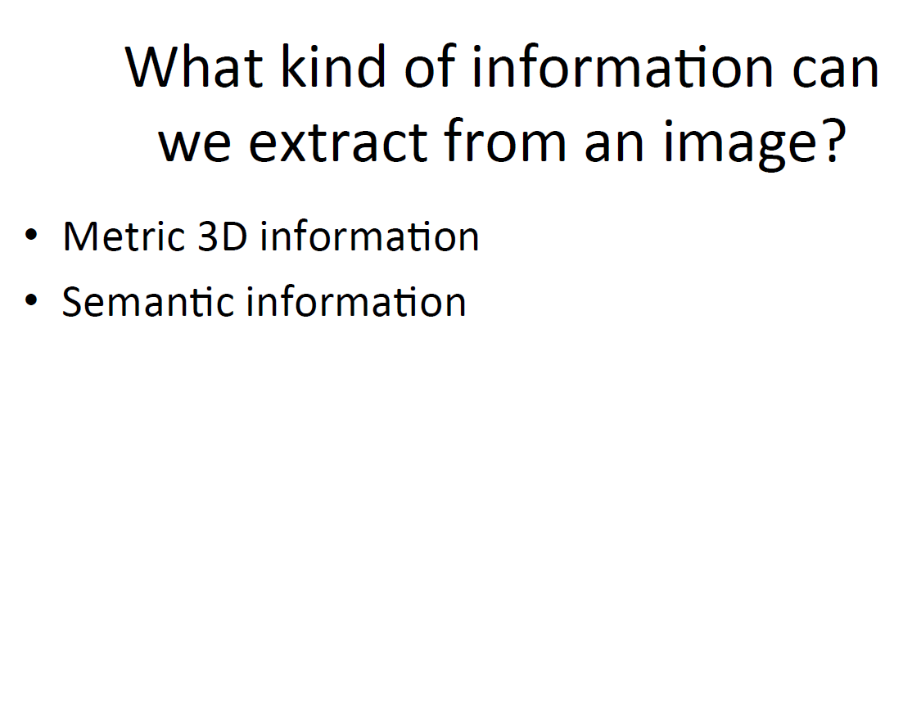

Slide 10
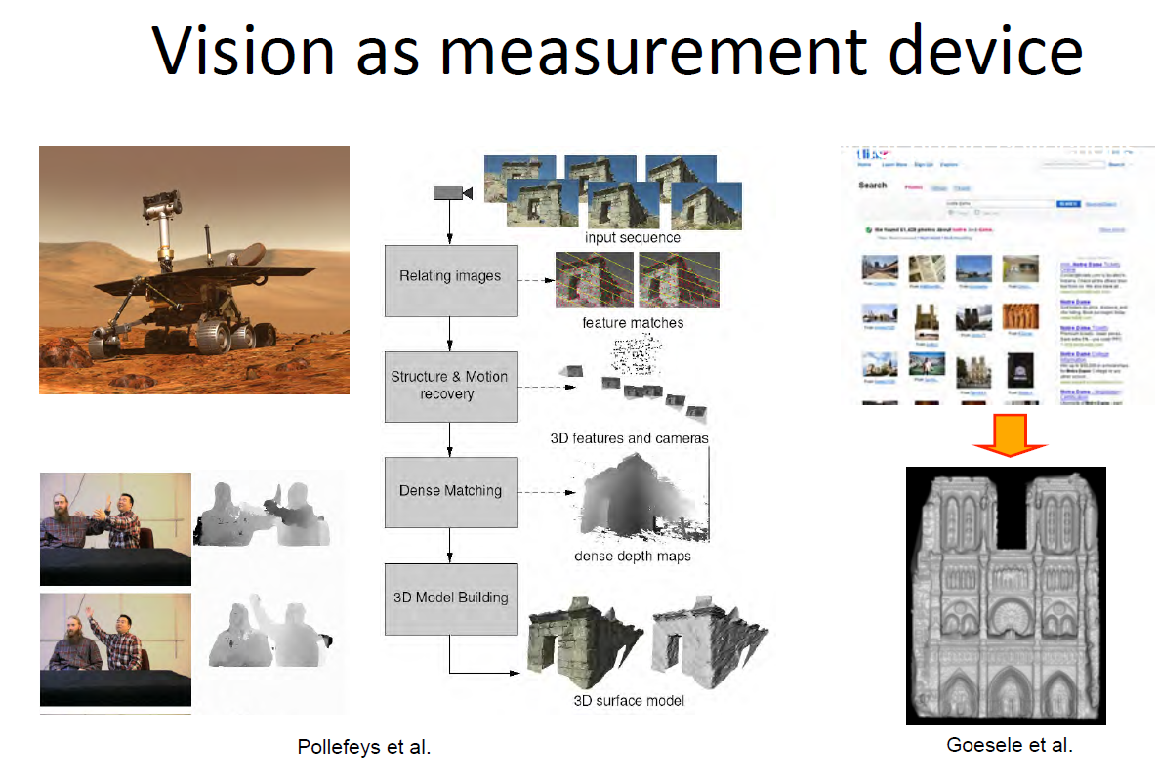

Slide 11
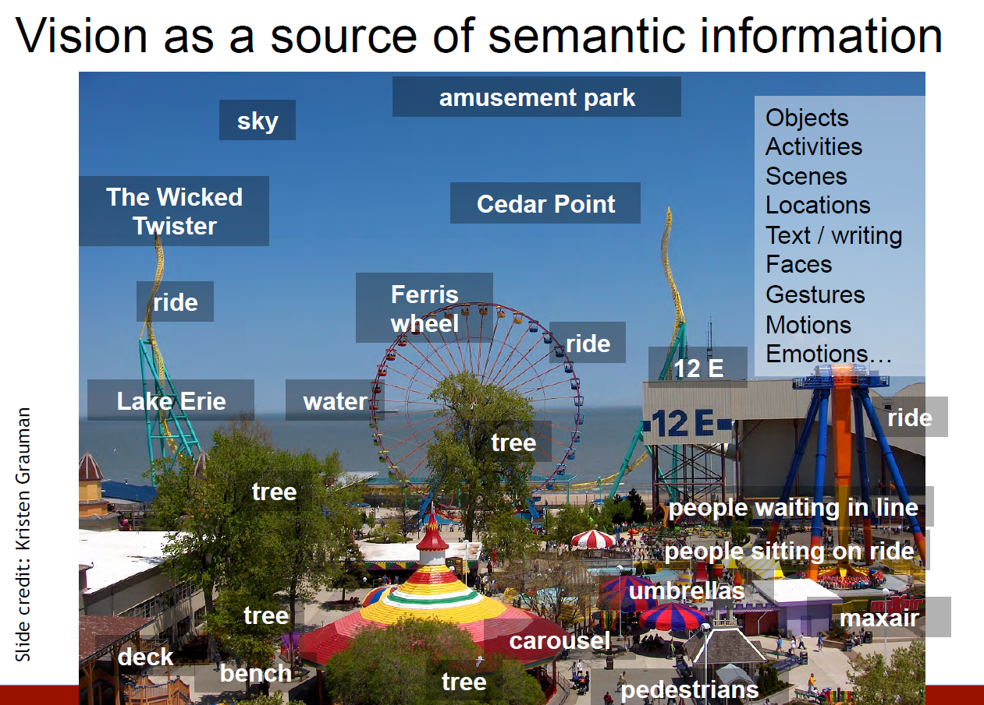

Slide 12
Why study computer vision
Fast-growing collection of useful applications
  building representations of the 3D world from pictures
  automated surveillance (who’s doing what)
  movie post-processing (special effects)
  Biometrics (face recognition)
Greater understanding of human vision

Slide 13
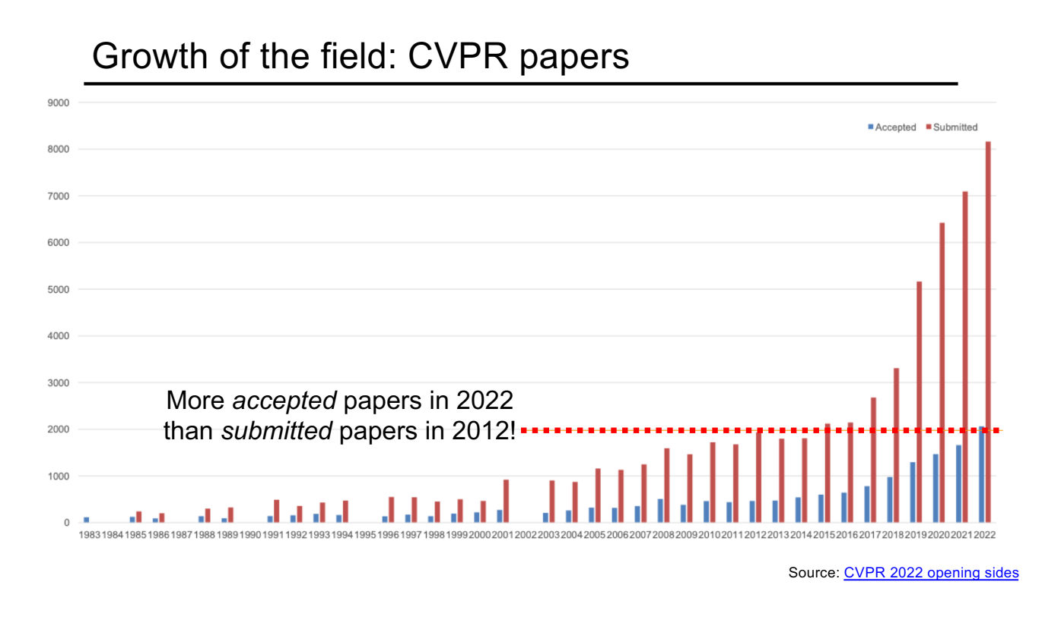

Slide 14
Related fields
Image Processing
Computer Graphics
Pattern Recognition
Artificial Intelligence
Machine Learning

Slide 15
Image Processing vs Computer Vision
Image Processing (focus on syntax, low level features)
Computer Vision (focus on semantics, symbolic or geometric descriptions)
image
image
Faces
People
Chairs
etc.
image

Slide 16
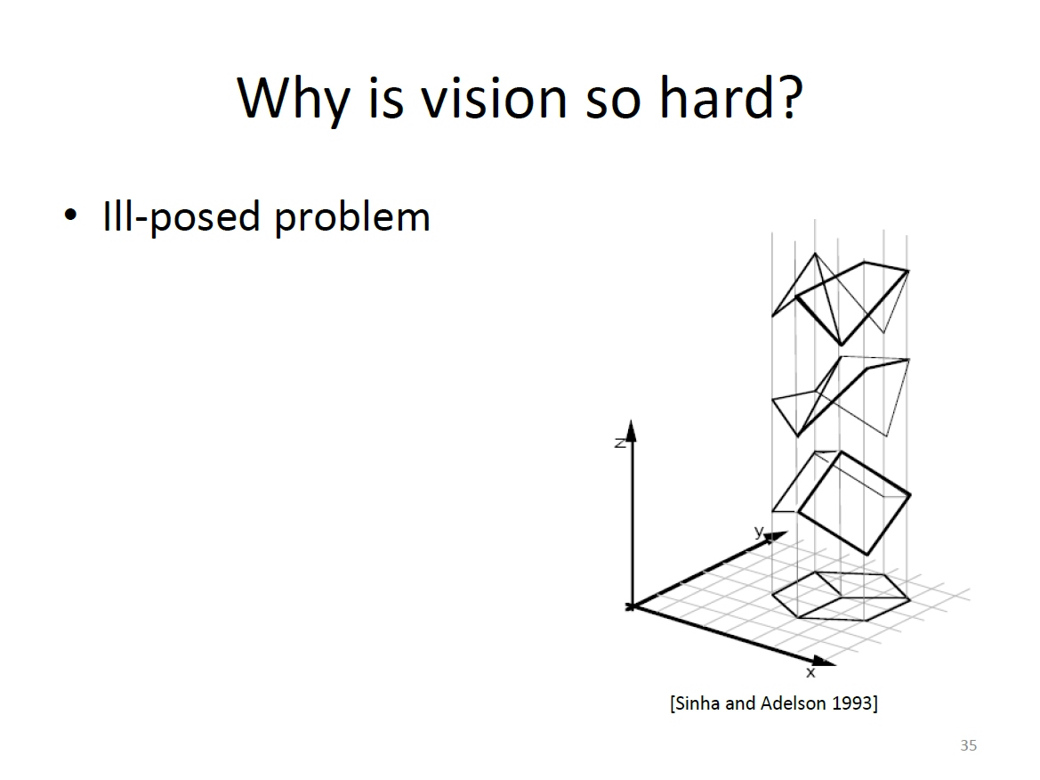

Slide 17
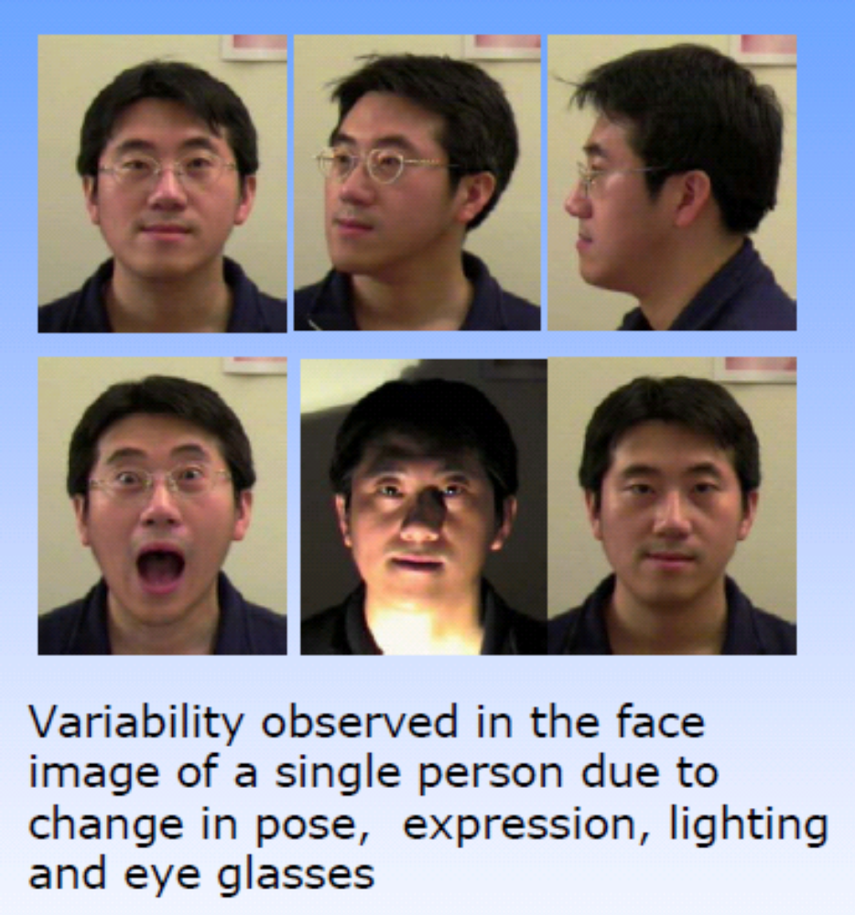
Why is computer vision difficult?
Intra-class and Inter-class Variations

Slide 18
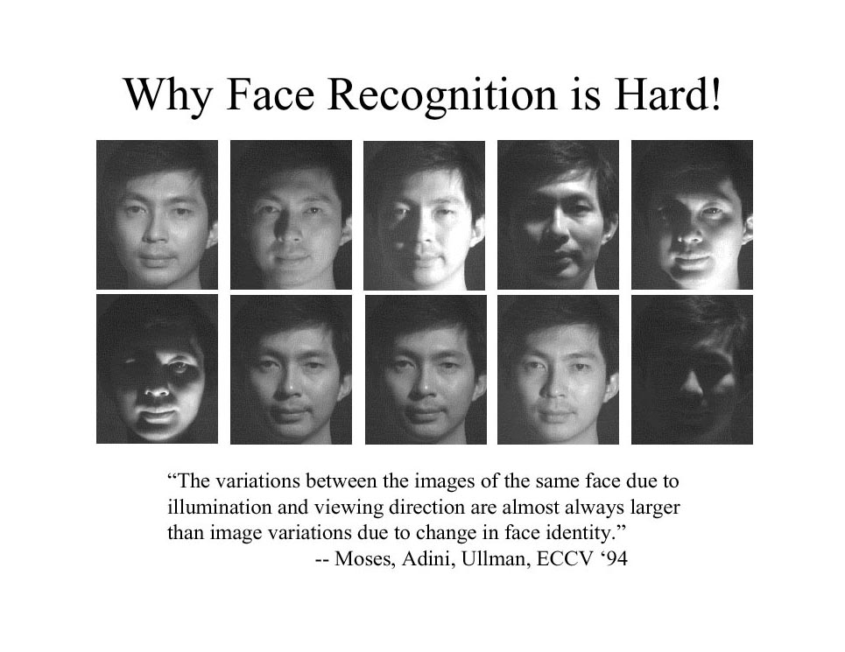
Why is computer vision difficult?

Slide 19
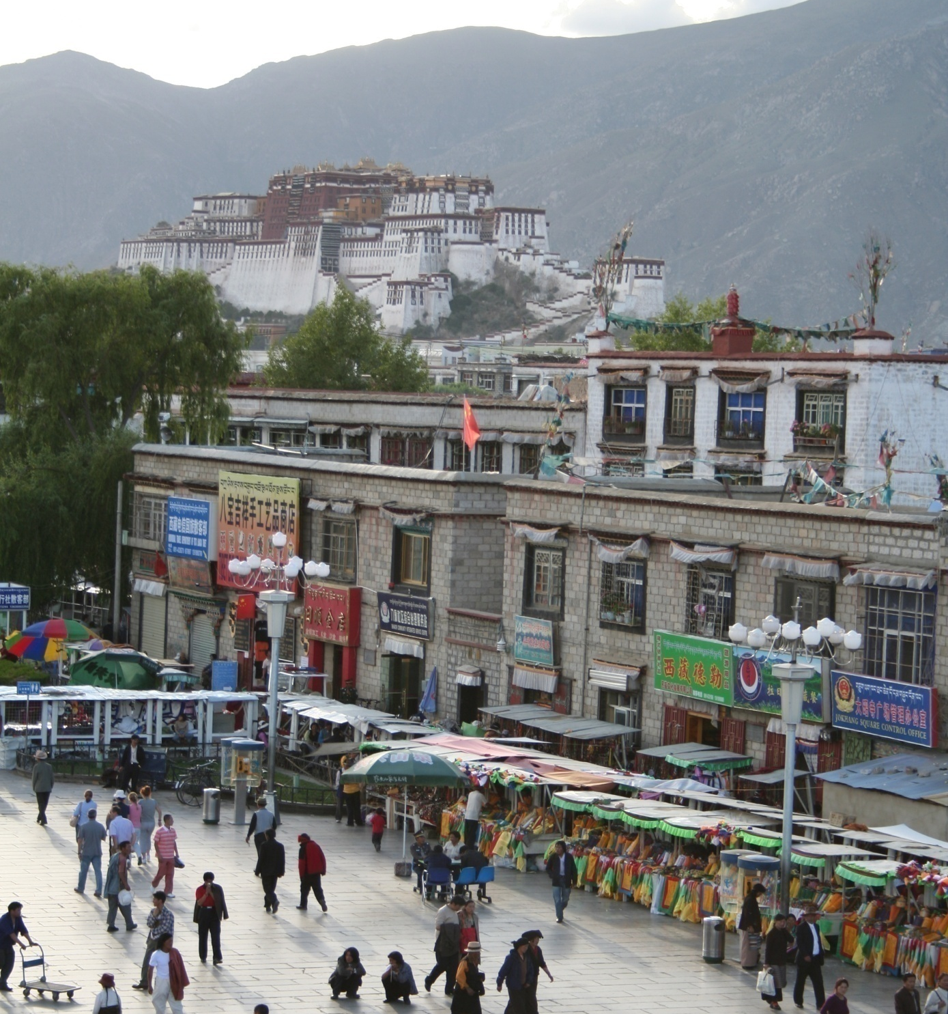
Common recognition tasks

Slide 20
Image classification
outdoor/indoor
city/forest/factory/etc.

Slide 21
Object detection
find pedestrians

Slide 22
Activity recognition
walking
shopping
rolling a cart
sitting
talking
…

Slide 23
Image description
This is a busy street in an Asian city. Mountains and a large palace or fortress loom in the background. In the foreground, we see colorful souvenir stalls and people walking around and shopping. One person in the lower left is pushing an empty cart, and a couple of people in the middle are sitting, possibly posing for a photograph.

Slide 24
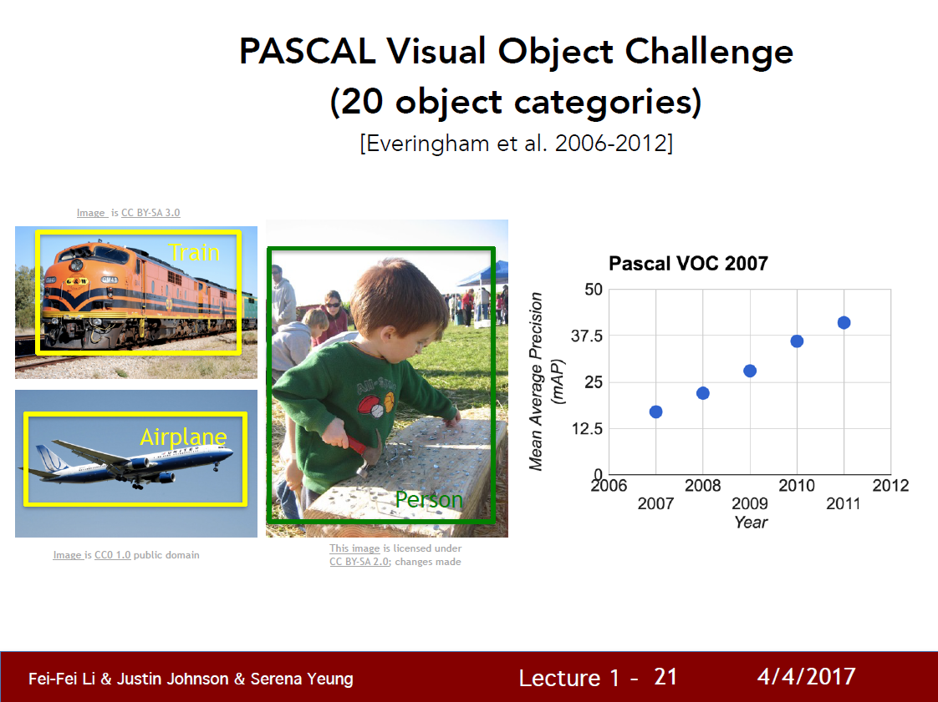
Source: Fei-Fei Li

Slide 25
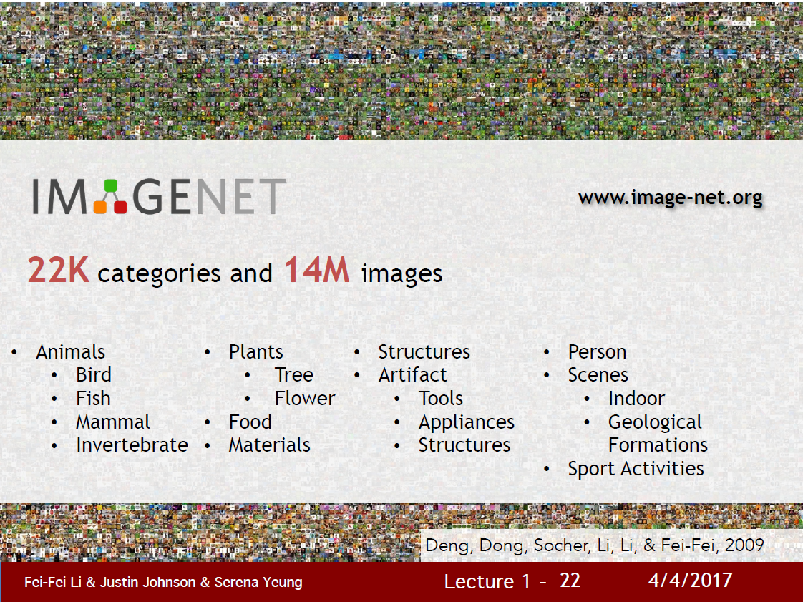
Source: Fei-Fei Li

Slide 26
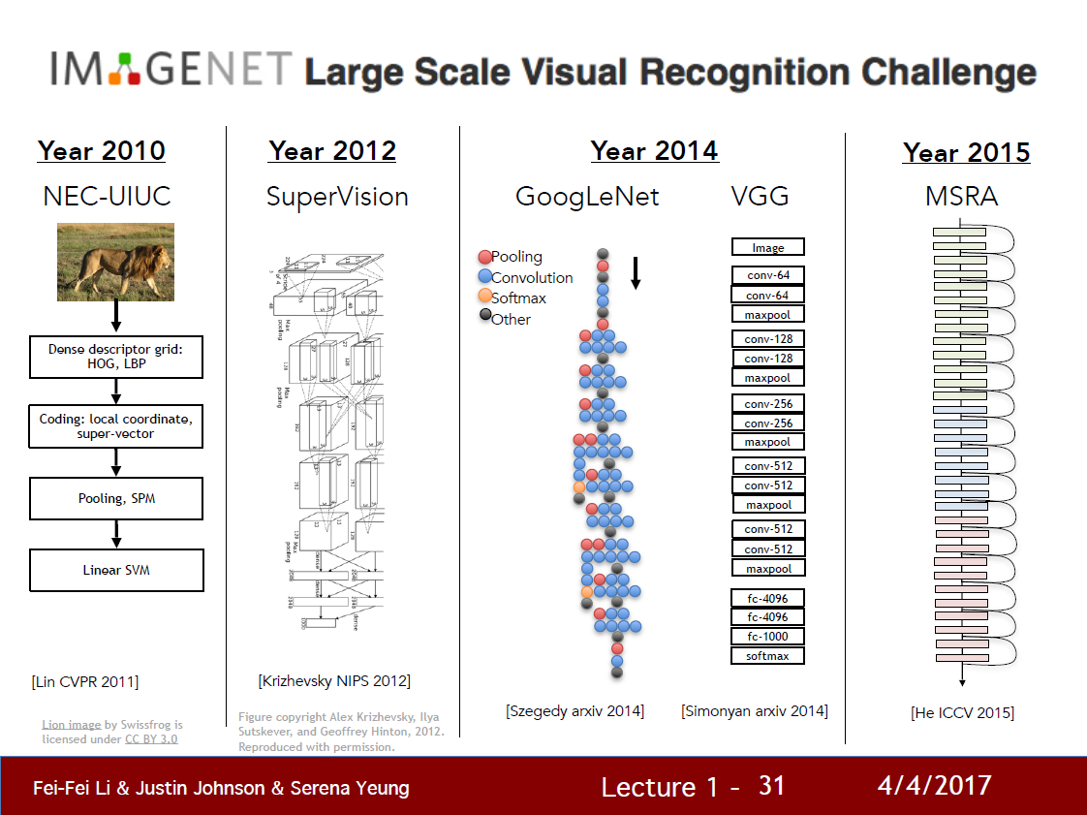
Source: Fei-Fei Li

Slide 27
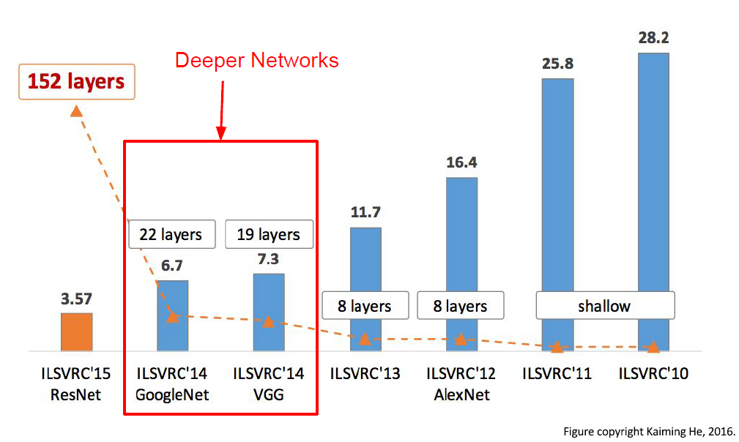
ImageNet Large Scale Visual Recognition Challenge

Slide 28
Applications
Movies
Surveillance
HCI: hand gesture, facial expression
Military
Medical: pathology, surgery, diagnosis
Face recognition and Biometrics
Road monitoring
Industrial inspection (usually machine vision)
Robotic control
Autonomous driving
Space: planetary exploration, docking

Slide 29
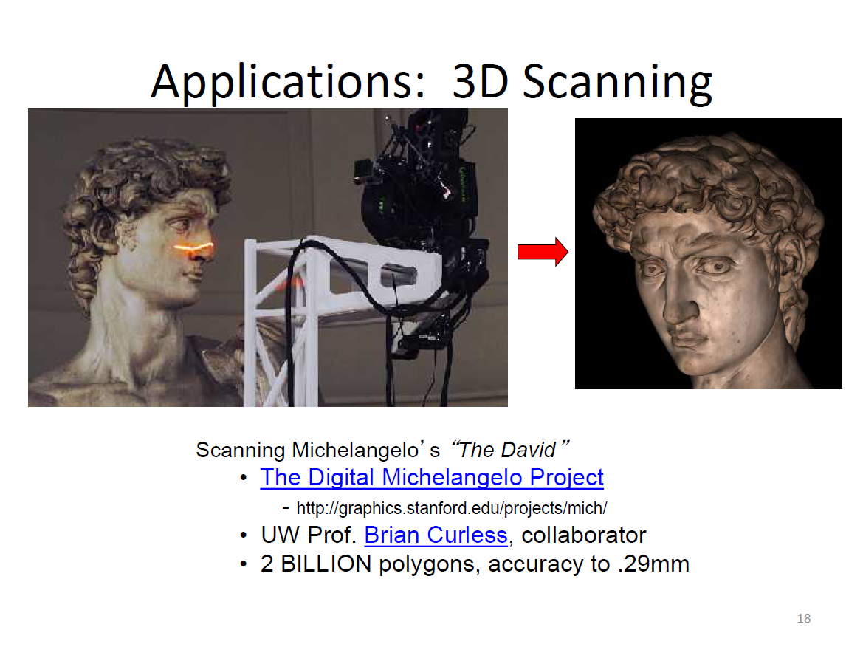

Slide 30
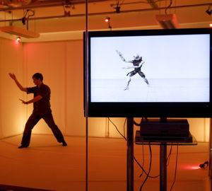
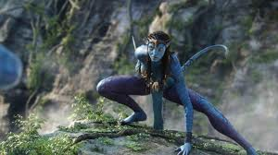
Computer vision based motion capture

Slide 31
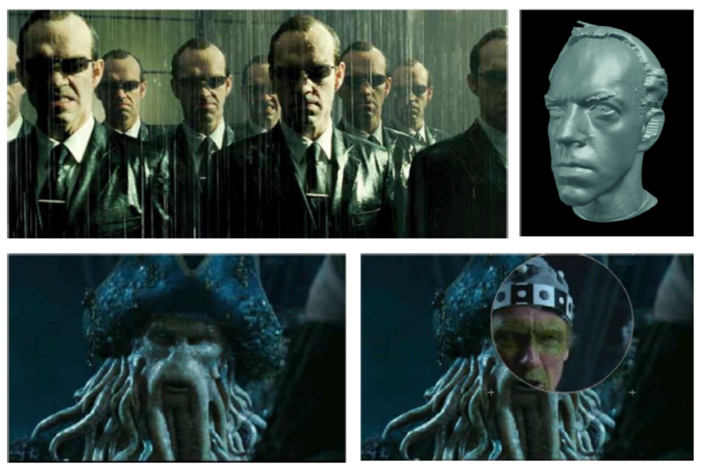
Special effects: shape and motion capture

Slide 32
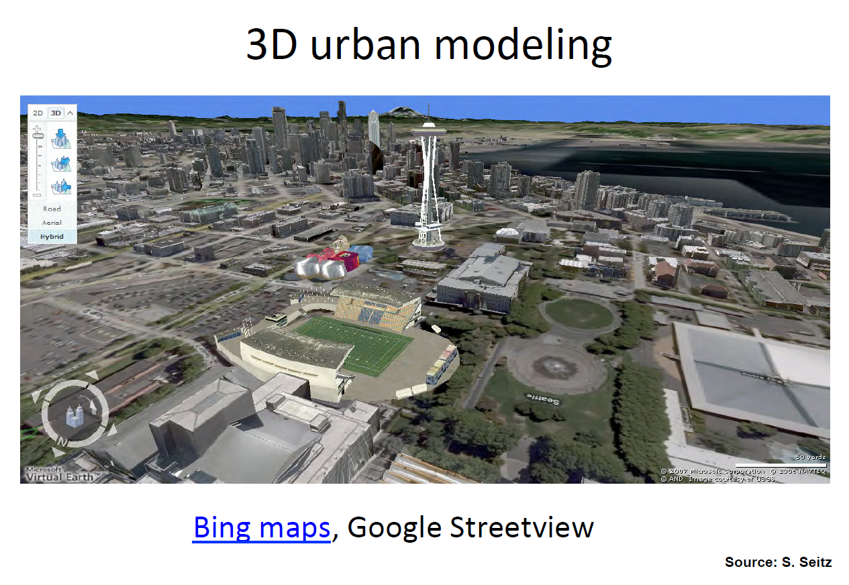

Slide 33
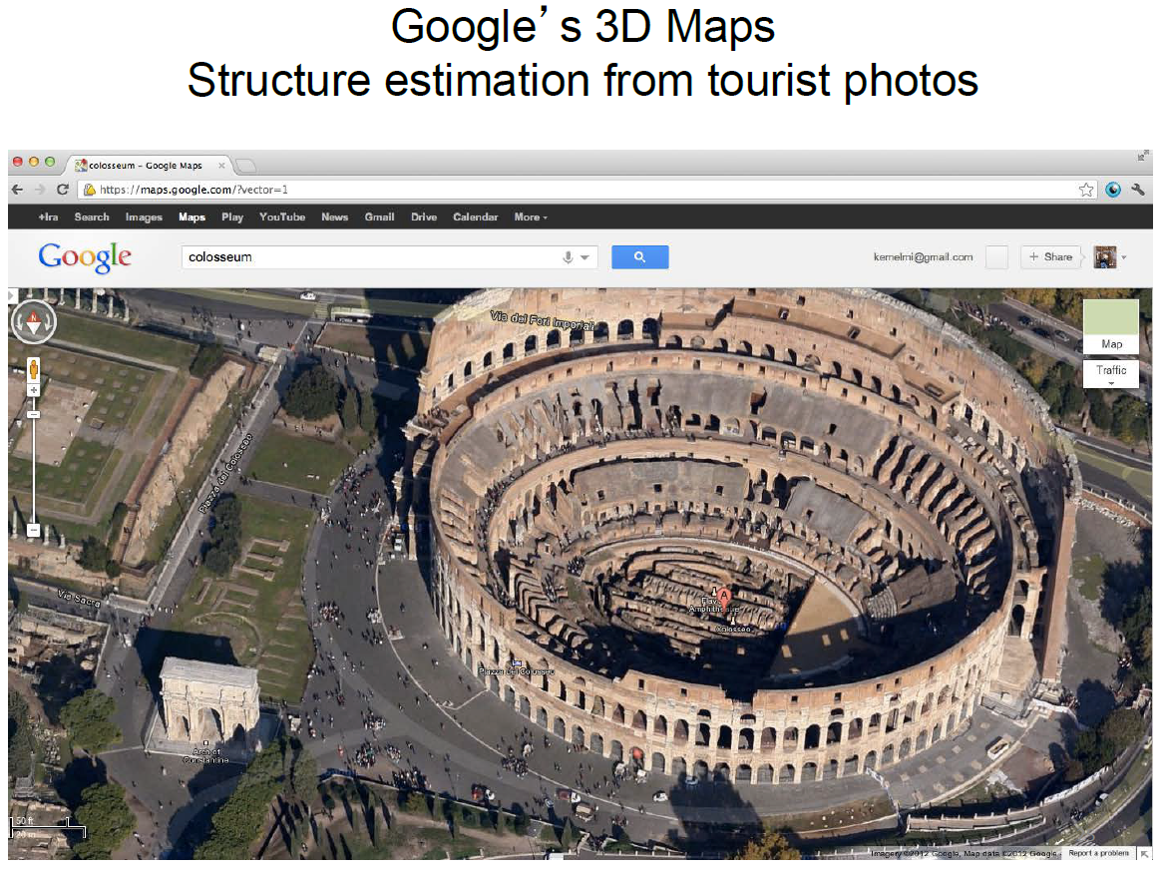

Slide 34
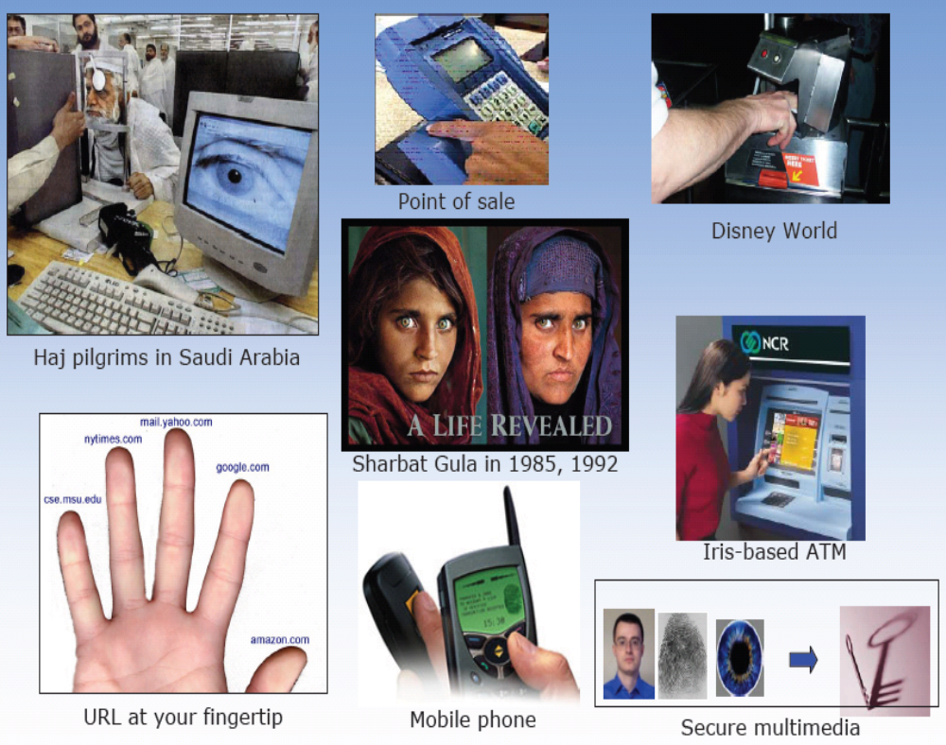
Biometrics

Slide 35
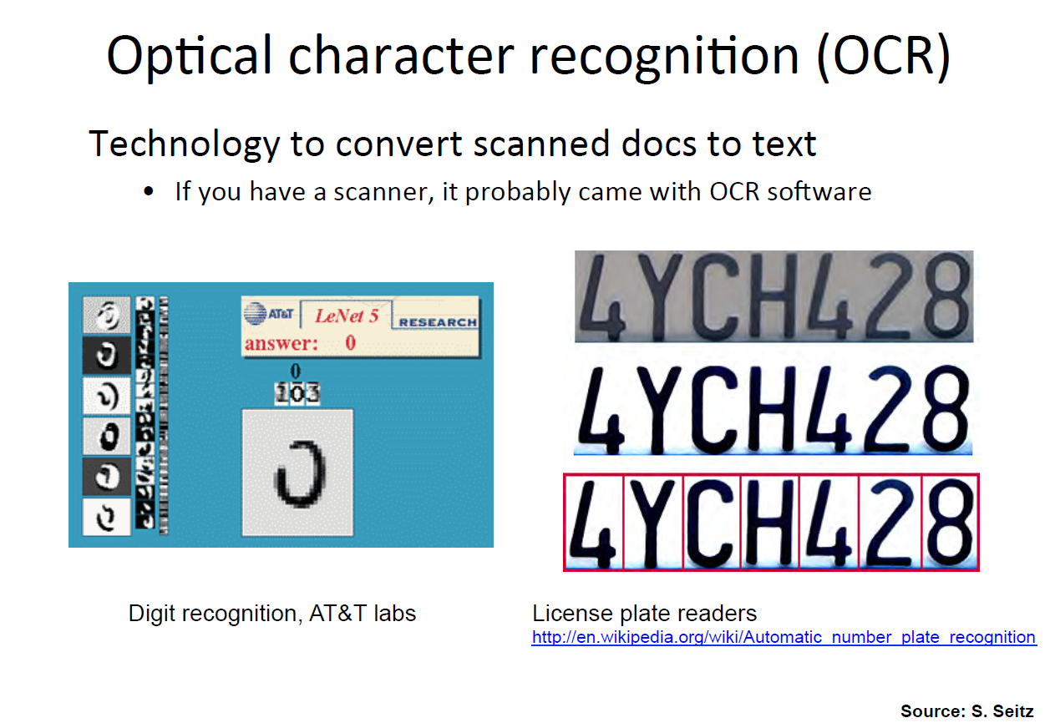

Slide 36
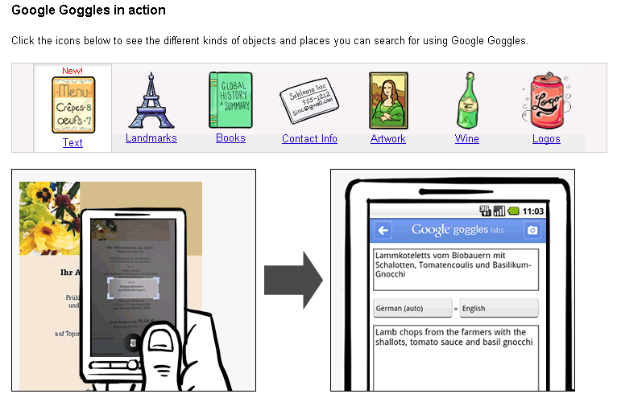
Mobile visual search

Slide 37
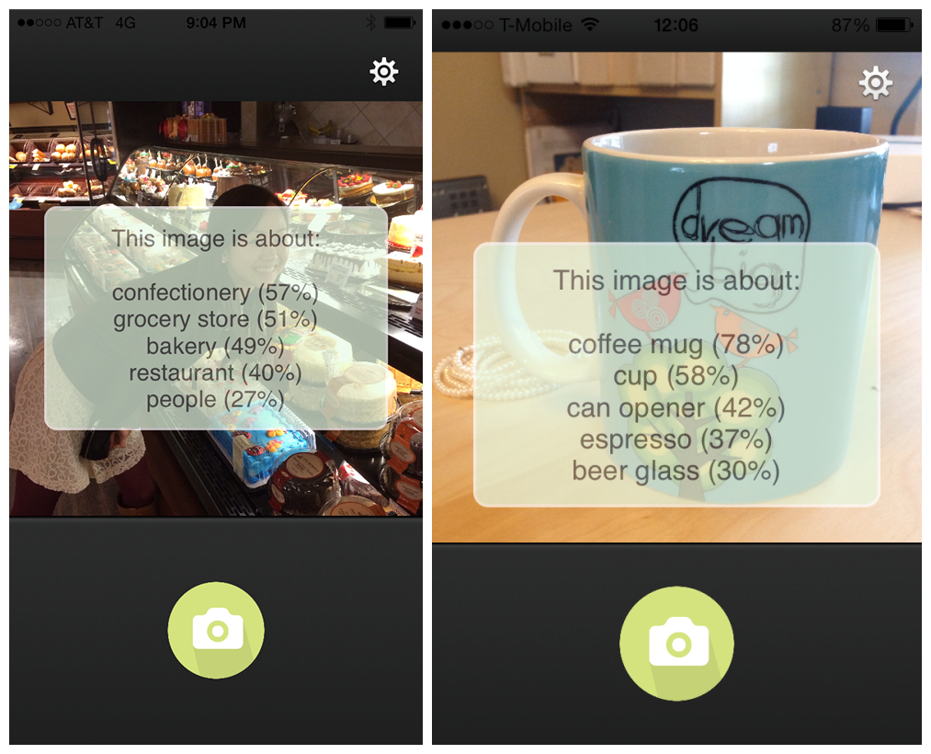
Mobile visual search

Slide 38
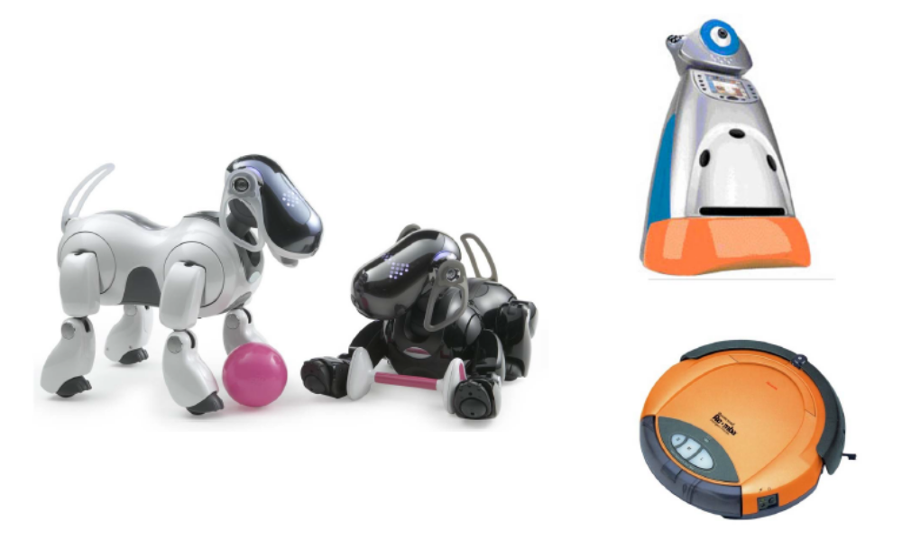
Toys and robots

Slide 39
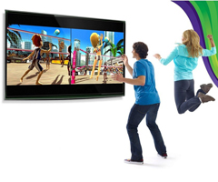
Human computer interaction
Microsoft Kinect: “You are the controller”

Slide 40
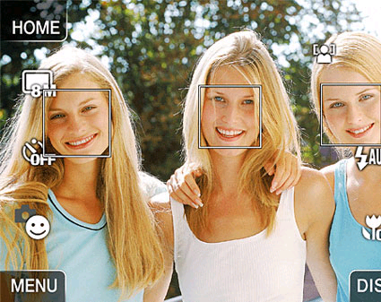

Smile detection
Smile shutter: when the camera detects a smile, the shutter is released automatically

Slide 41
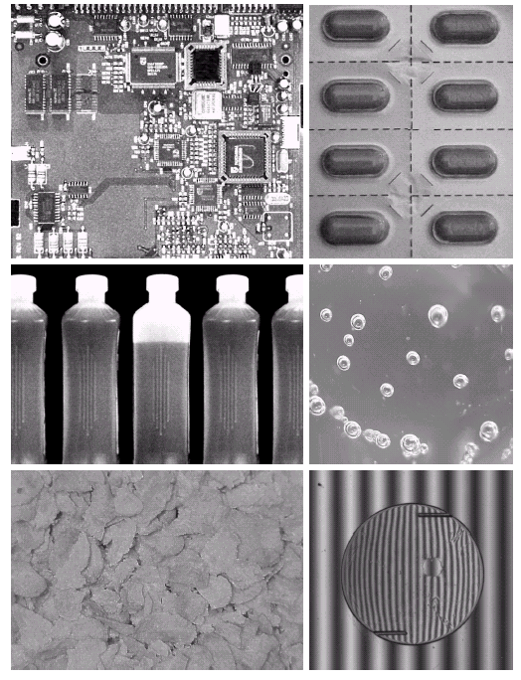
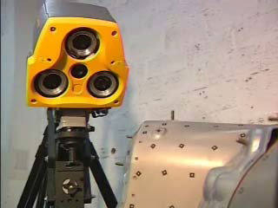
Industrial Automation

Slide 42
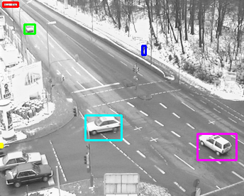
Surveillance

Slide 43
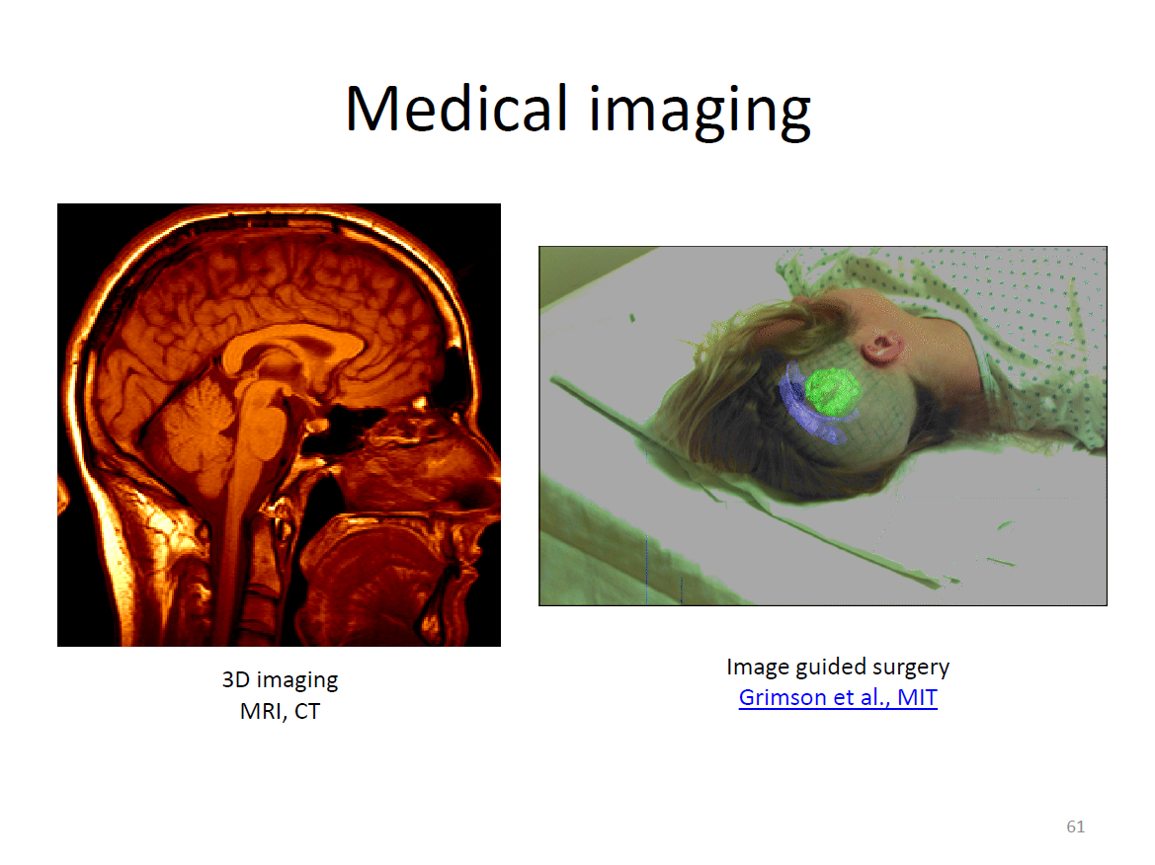

Slide 44
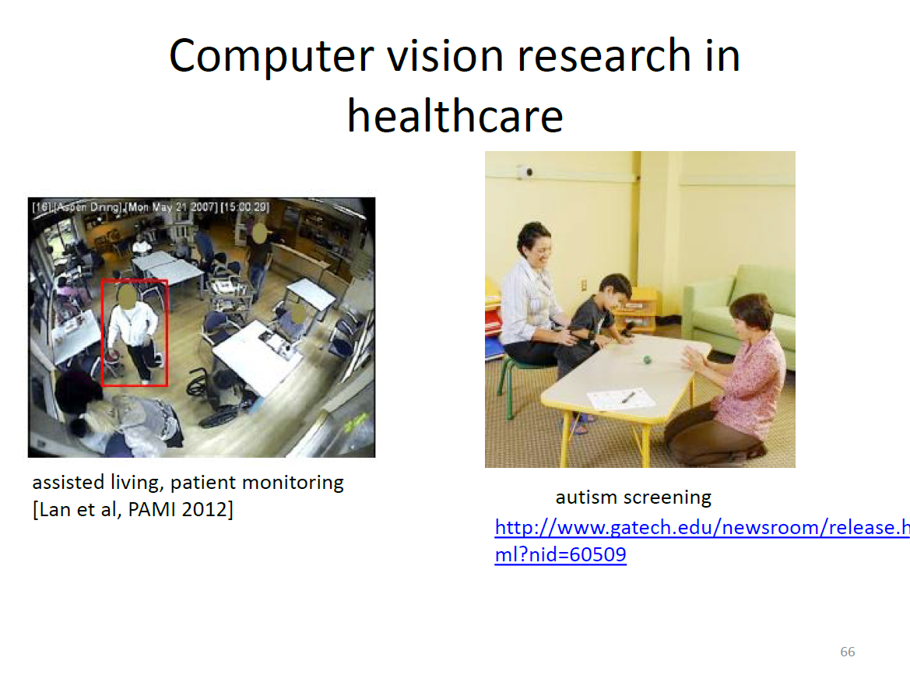

Slide 45

Autonomous vehicles

Slide 46
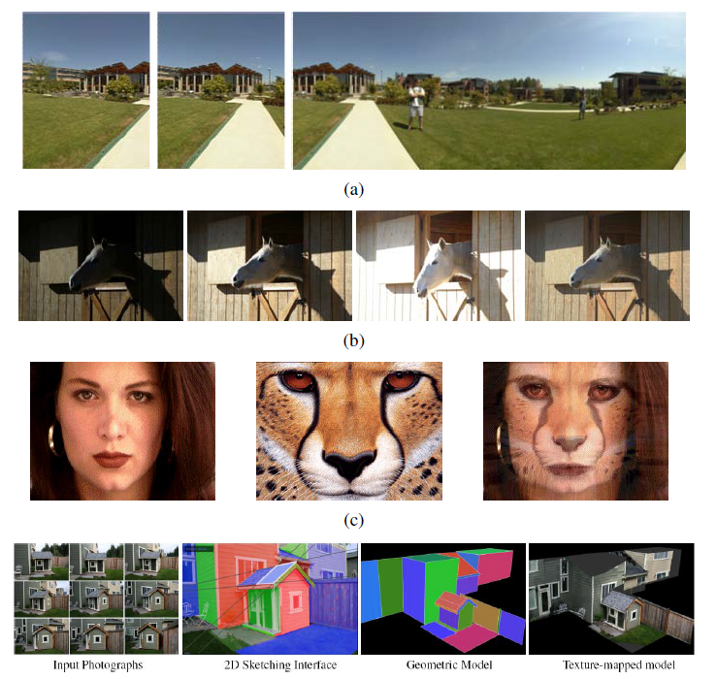
image stitching
exposure
bracketing
morphing
3D modeling

Slide 47
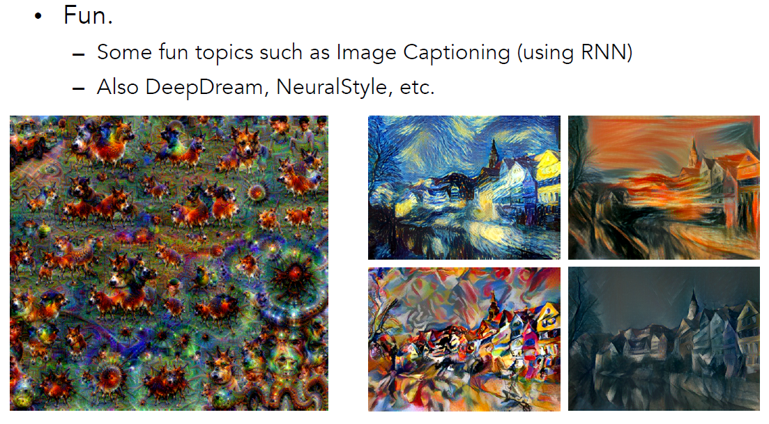
Source: Fei-Fei Li

Slide 48
Pattern Recognition

Slide 49
模式识别和模式的概念
我们在生活中时时刻刻都在进行模式识别
  能认出周围的物体是桌子、椅子；能认出对面的人是张三、李四
  能区分是汽车驶过还是玻璃破裂，是猫叫还是人语、是谁在说话、说的内容是什么
  能知道是炸带鱼还是臭豆腐
我们所具备的这些模式识别能力看起来极为平常，但是当人们企图用计算机来实现人或动物所具备的模式识别的能力时，它的难度才逐步为人们所认识

Slide 50
模式识别和模式的概念
什么是模式？
  广义地说，存在于时间和空间中可观察的物体，如果我们可以区别它们是否相同或是否相似，都可以称之为模式。
模式识别
  模式识别是把具体事物归入某一类别的过程
  Pattern recognition is the study of how machines can observe the environment, learn to distinguish patterns of interest from their background, and make sound and reasonable decisions about the categories of the patterns. (by Anil K. Jain)

Slide 51
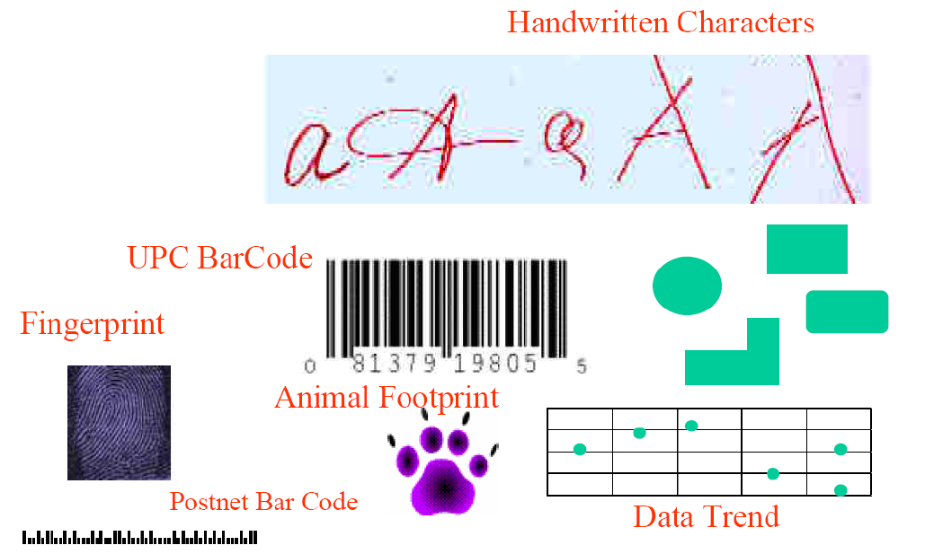
模式举例

Slide 52
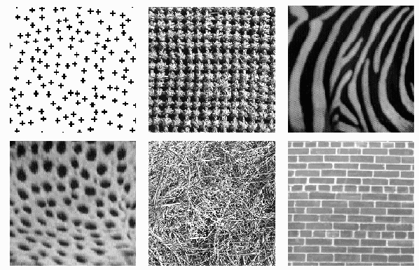
模式举例

Slide 53
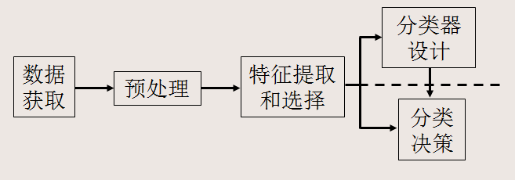
模式识别系统
模式识别系统的基本构成

Slide 54
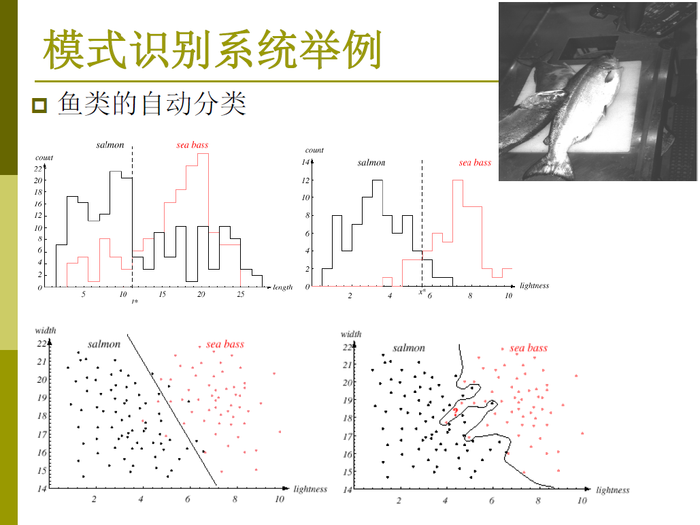


Slide 55
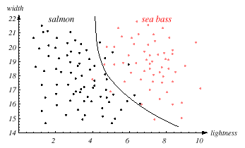
the central aim of designing a classifier is to correctly classify novel input
Issue of generalization!

Slide 56
解决模式识别问题的几类方法
基于知识的方法(Knowledge-based)
  AI、专家系统(Expert Systems)
  句法(结构)模式识别(Syntax PR or Structural PR)
基于数据的方法(Data-based)
  统计模式识别方法(Statistical PR)
  人工神经网络(ANN)、支持向量机(SVM)
混合方法(Hybrid Methods)

Slide 57
Topics of this course
Image formation and camera models
low-level image processing
  filtering, edge detection, corner detection
mid-level vision
  segmentation and clustering, fitting, stereo vision
high-level vision
  object recognition, object detection, activity recognition

Slide 58
Grading policy
Attendance (5%)
Midterm (10%)
Programming assignments (35%)
Final project (50%)

Slide 59
Course project
Team of 2-3 people
  Number of people will be taken into account when grading
Potential course projects
  Apply a new or improved method (model, algorithm) to existing vision tasks
  Comparing and analysis of different methods on a CV benchmark
  Re-implement an interesting CV paper (new and top conference papers)

Slide 60
Course project
Project proposal (due Mar 31)
  题目
  项目的背景及意义
  所使用方法，如何改进
  所使用的数据
  如何评价你的算法
  主要参考文献
In-class presentations
Project papers

