Slide 1
Recognition
Slide courtesy: S.Savarese, S.Lazebnik, D.Hoiem, Fei-Fei Li

Slide 2
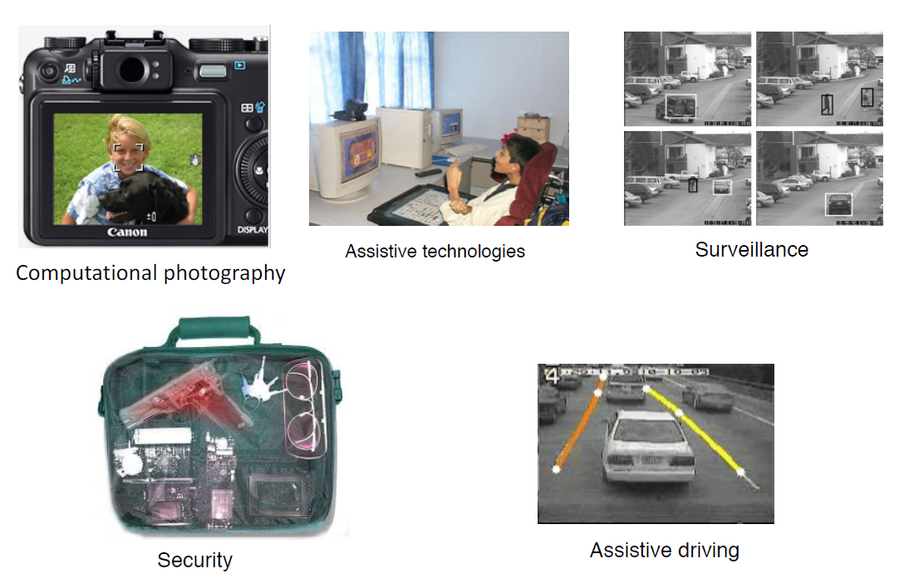
Applications of visual recognition

Slide 3
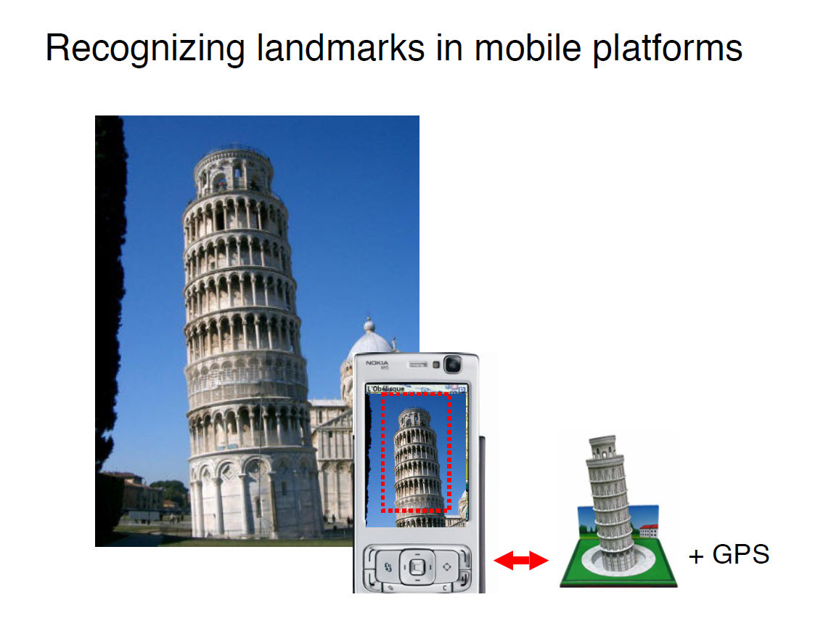

Slide 4
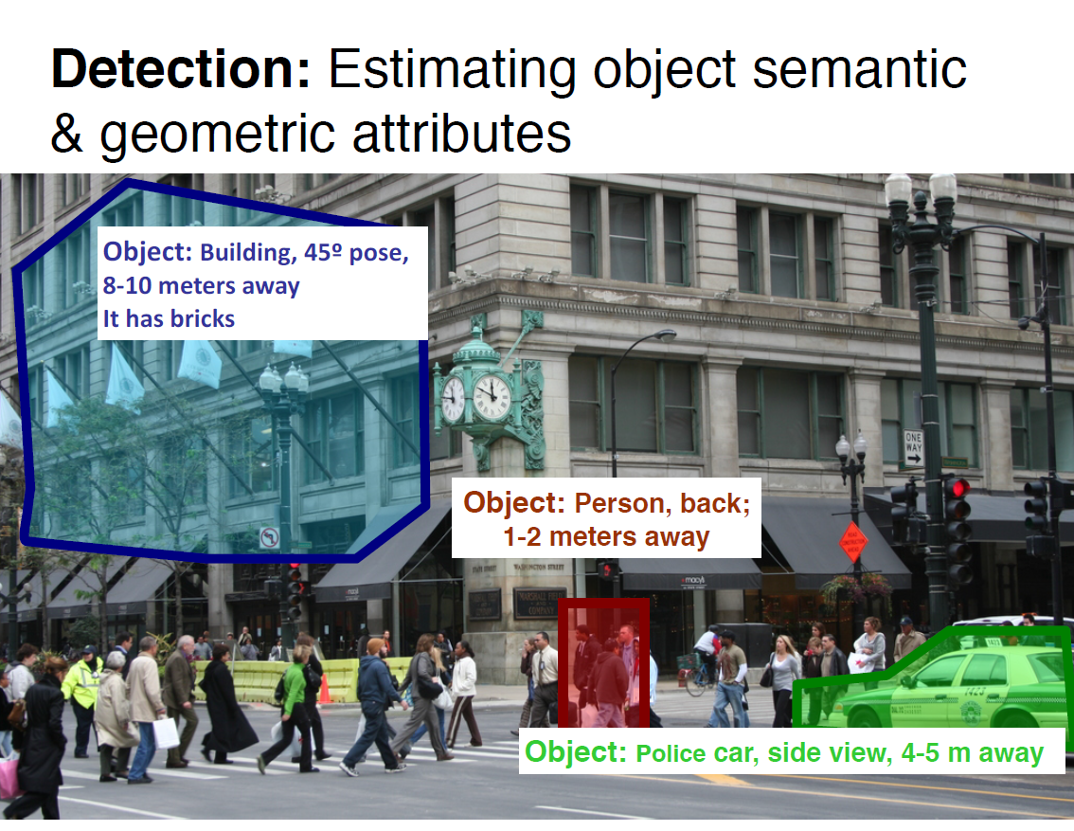

Slide 5
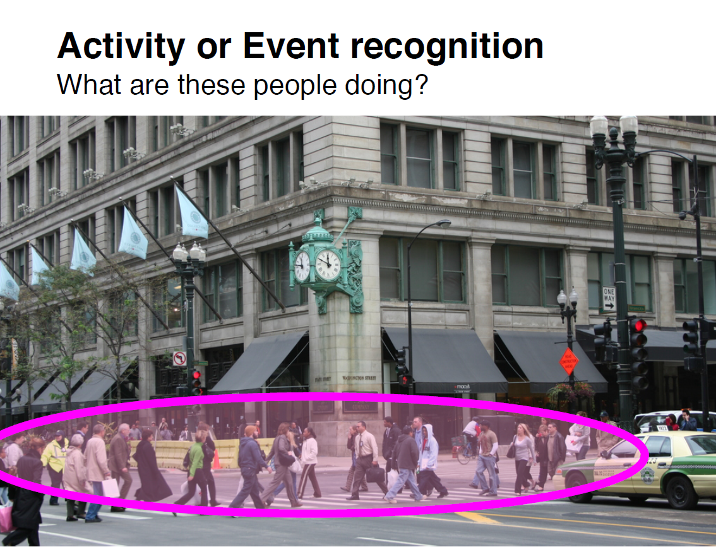

Slide 6
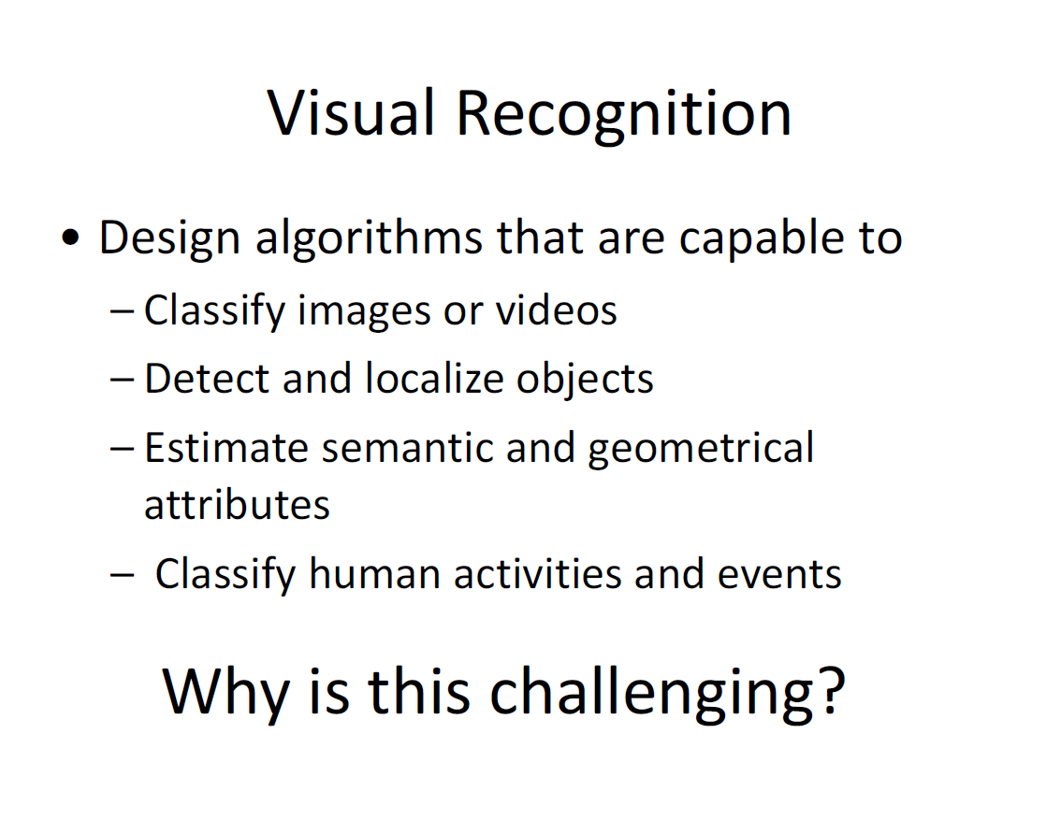

Slide 7
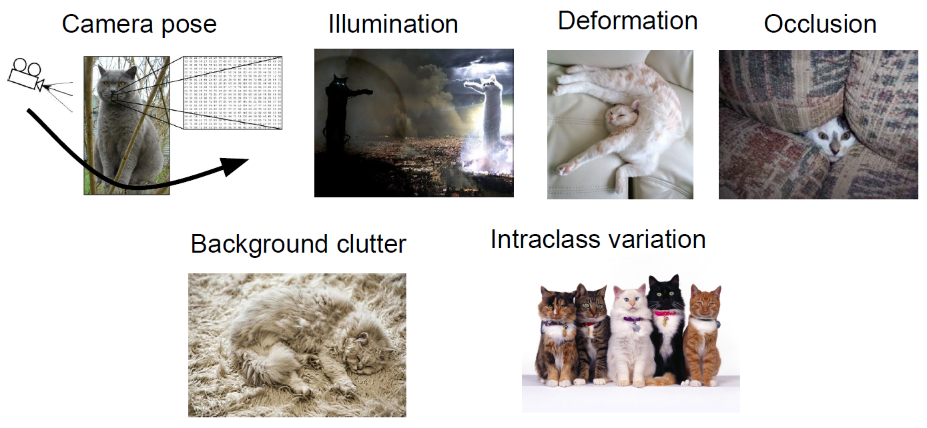
Visual Recognition Challenges

Slide 8
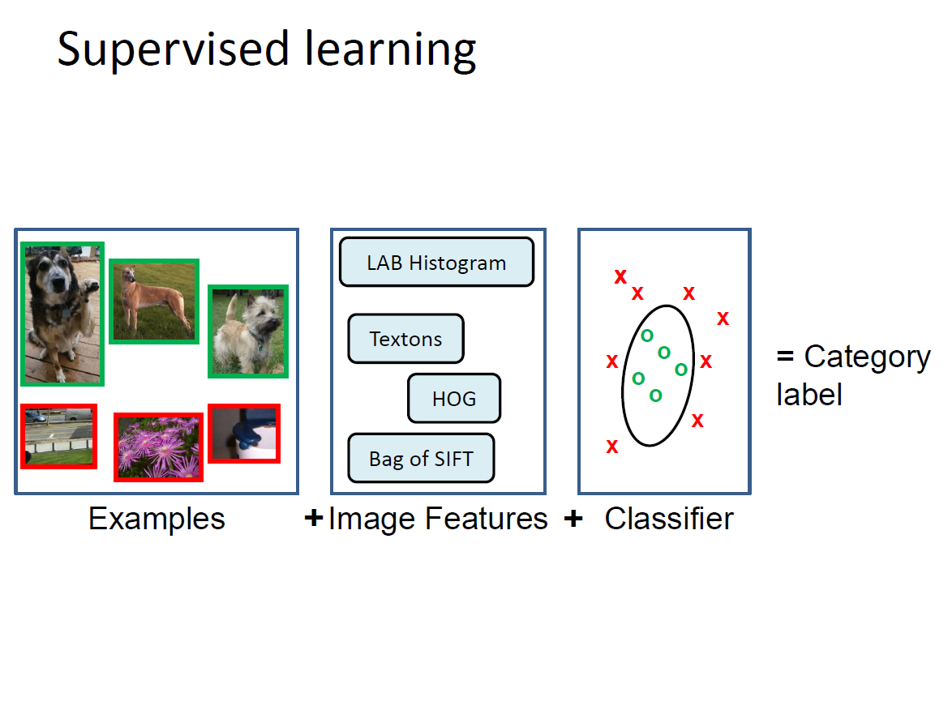

Slide 9
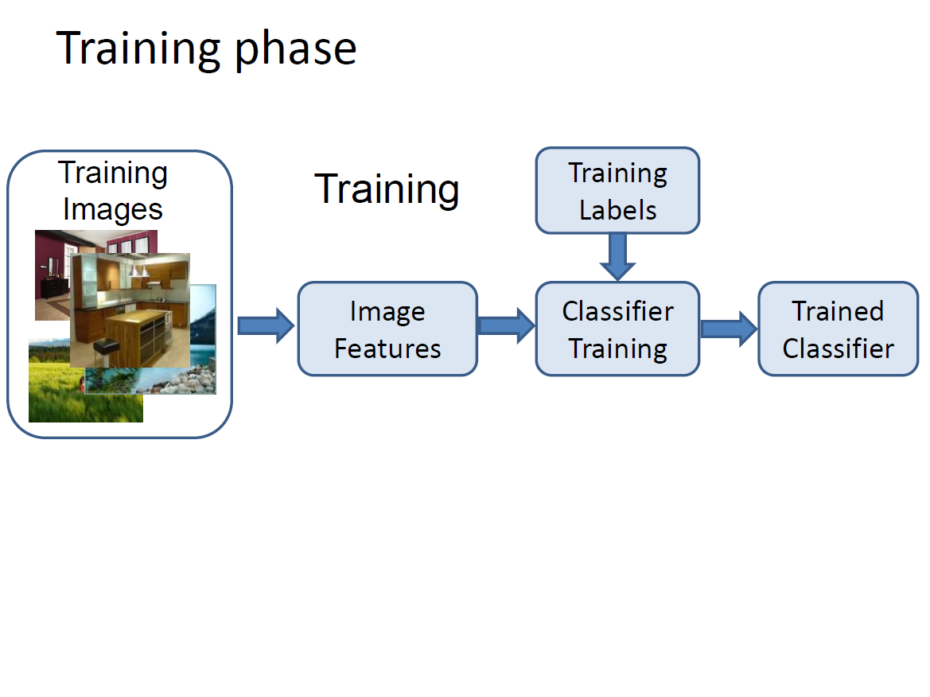

Slide 10
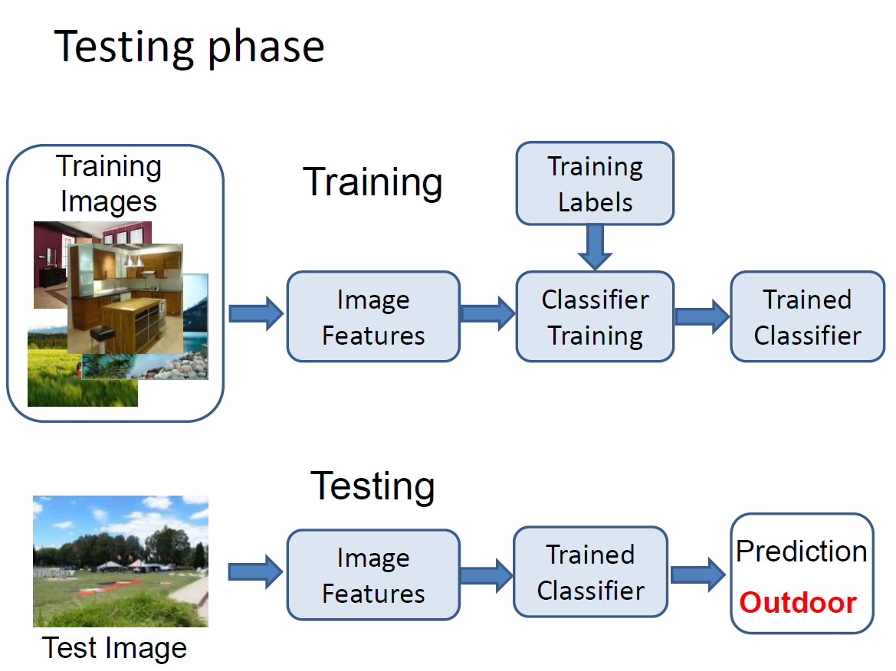

Slide 11
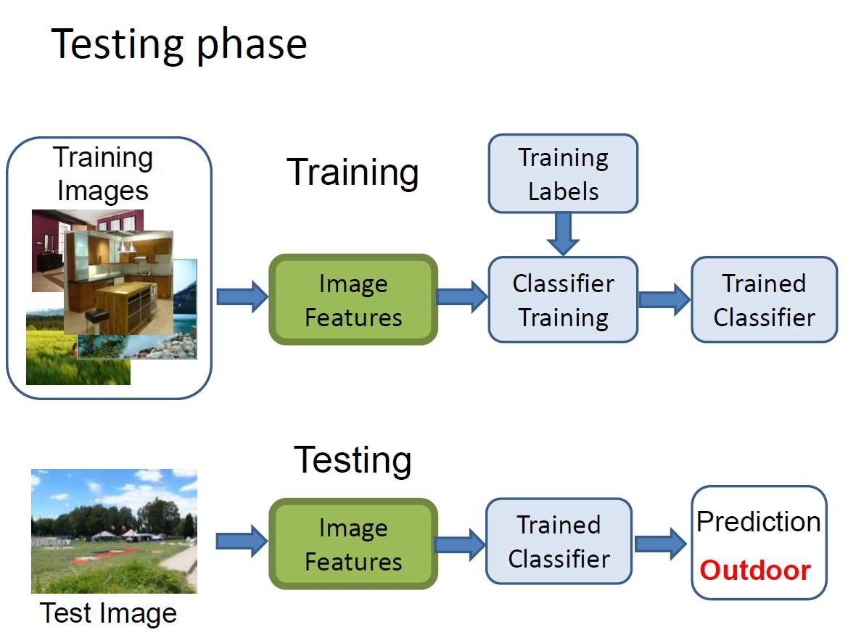

Slide 12
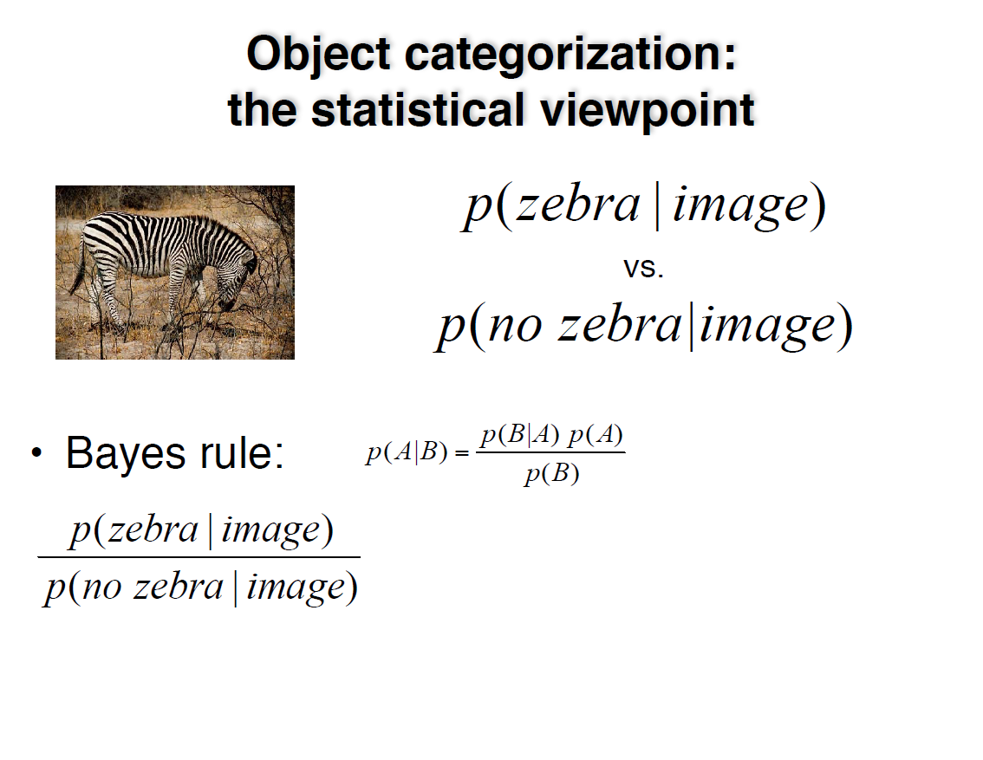

Slide 13
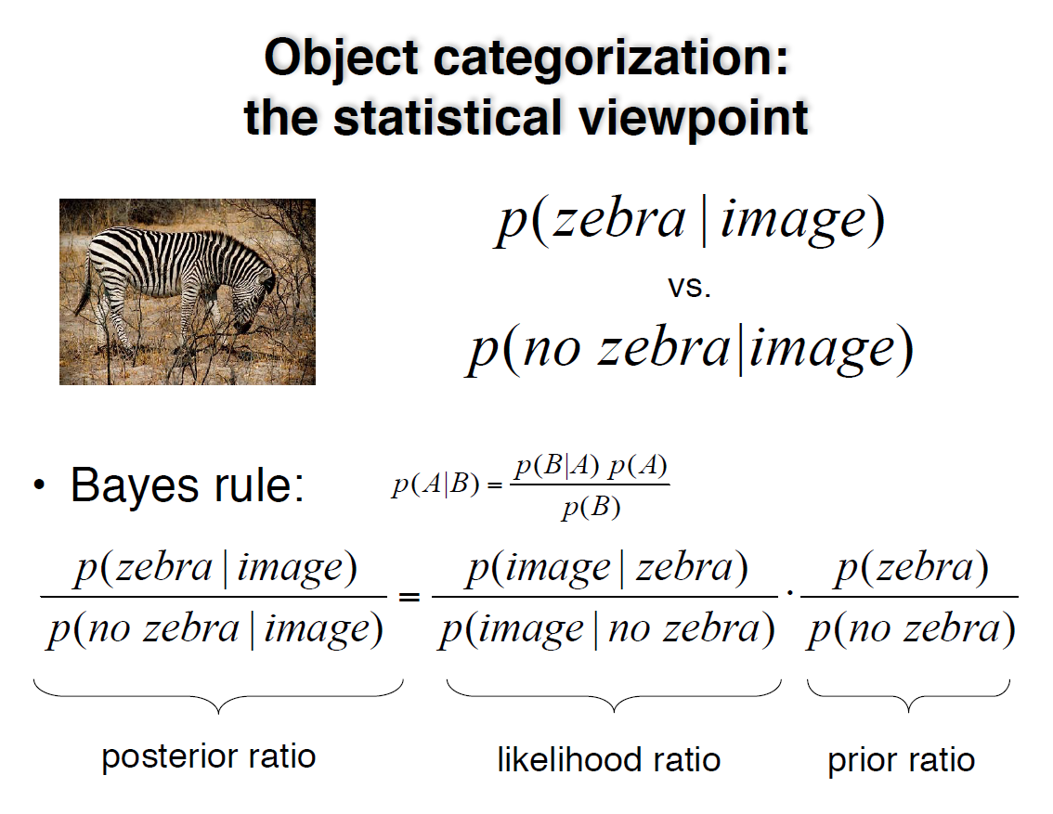

Slide 14
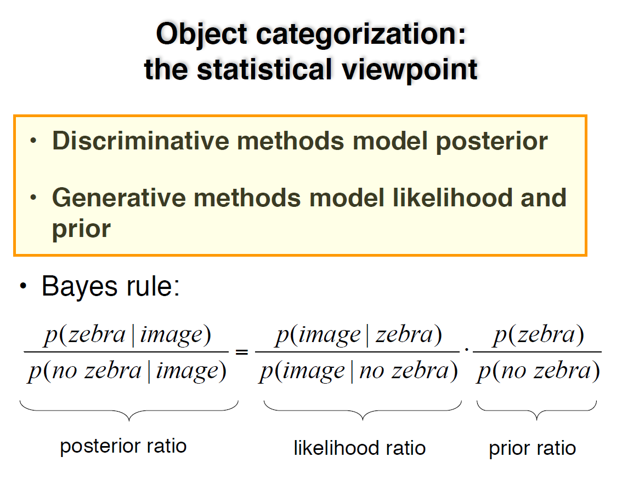

Slide 15
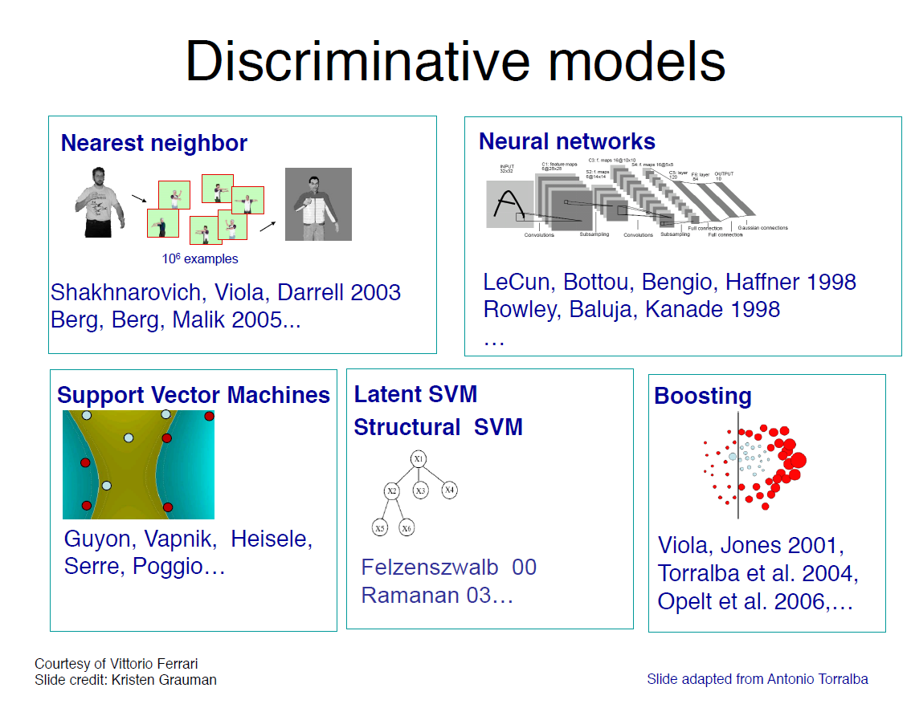

Slide 16
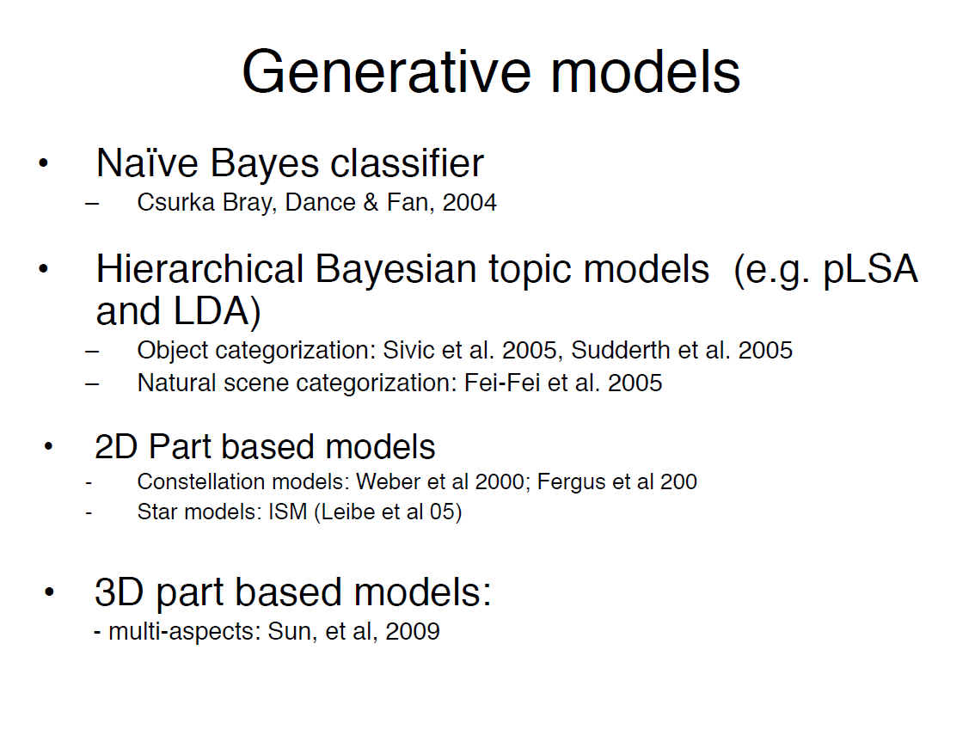

Slide 17
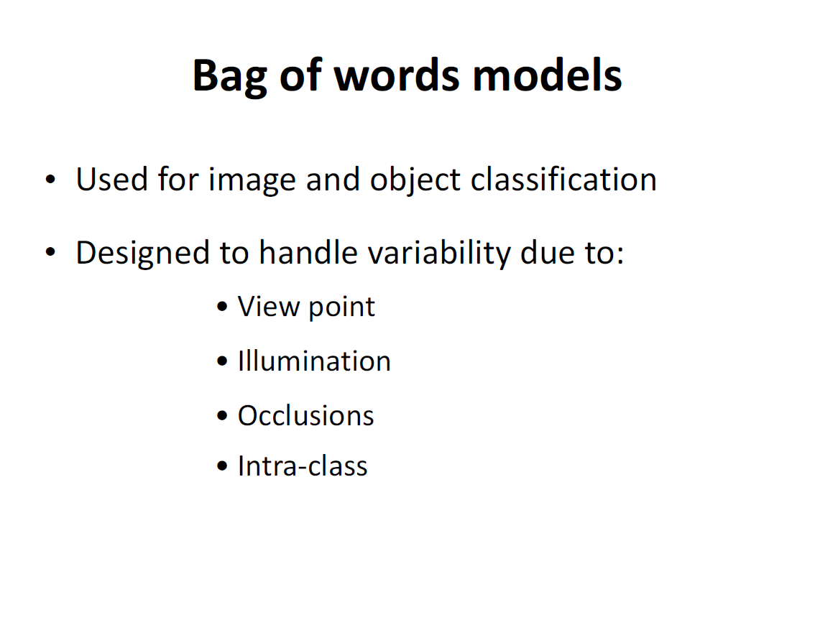

Slide 18
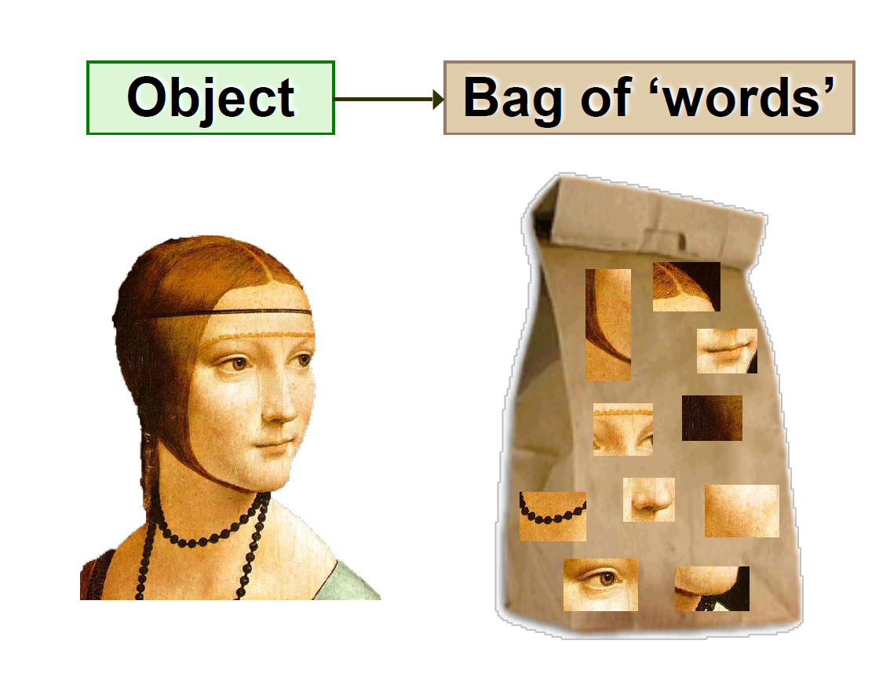

Slide 19
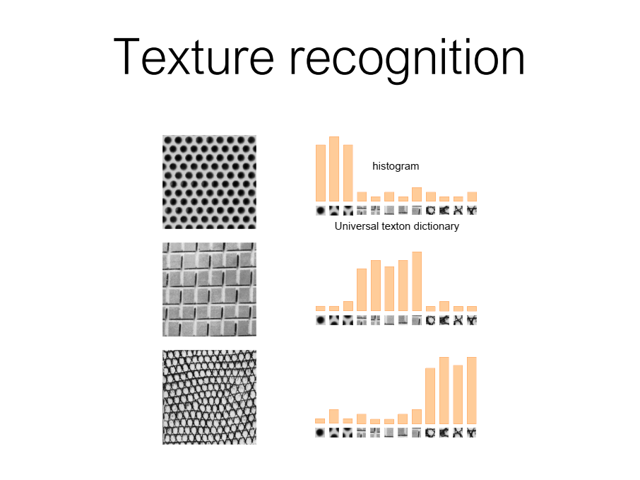

Slide 20
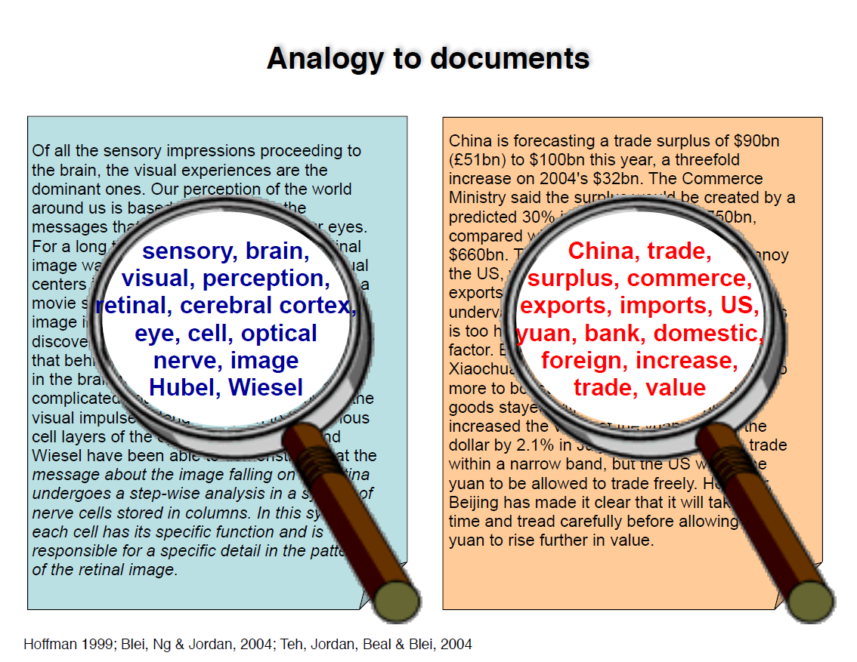

Slide 21
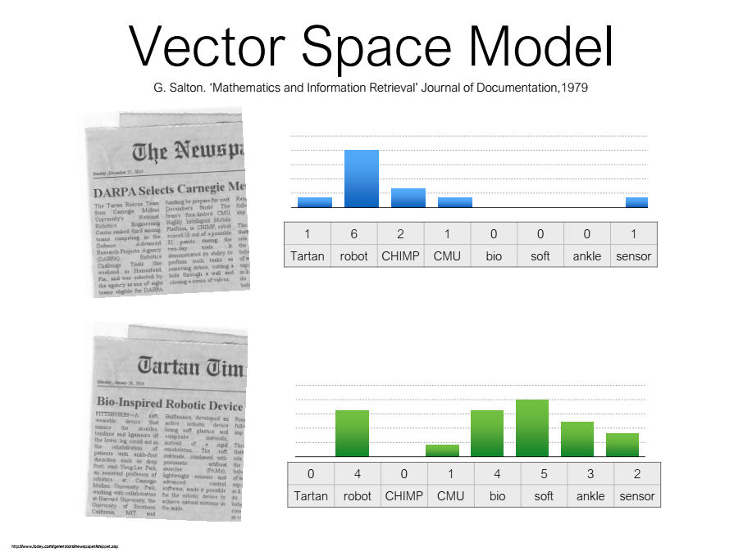

Slide 22
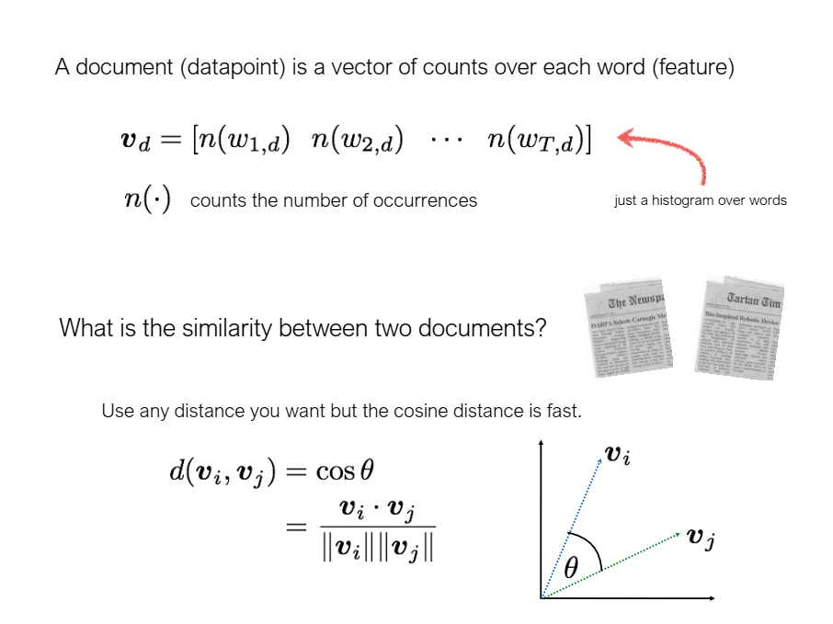

Slide 23
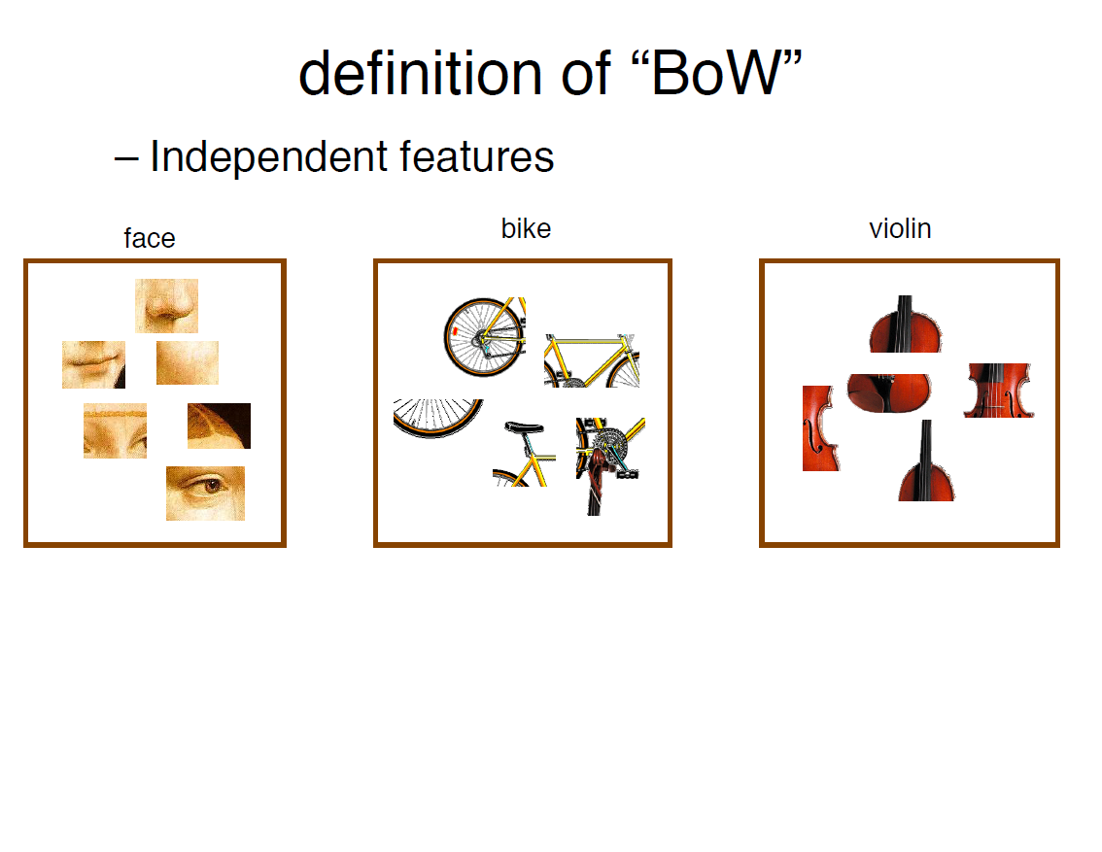

Slide 24
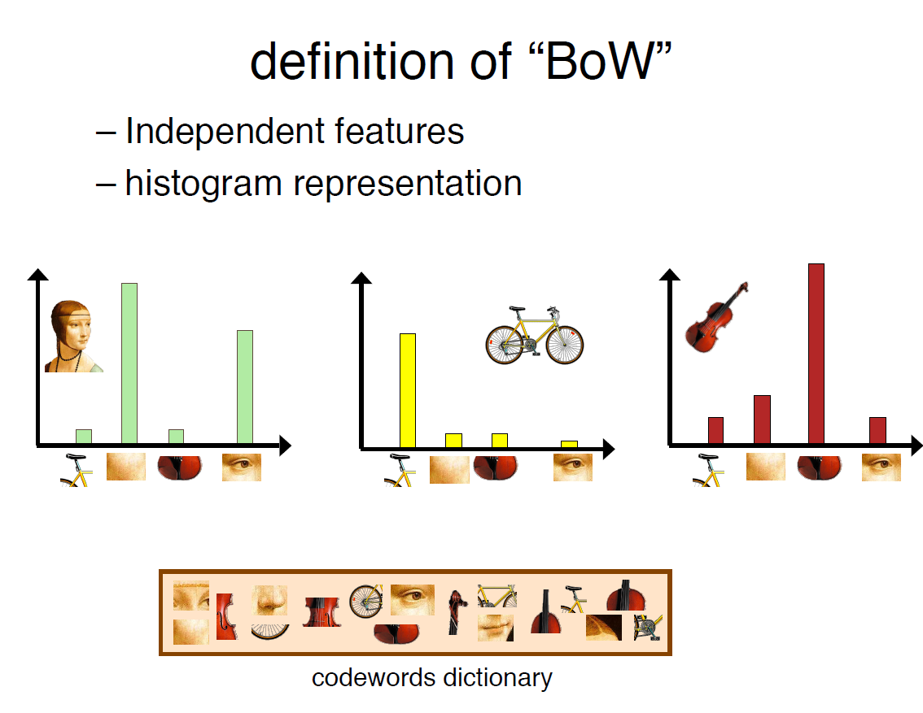

Slide 25
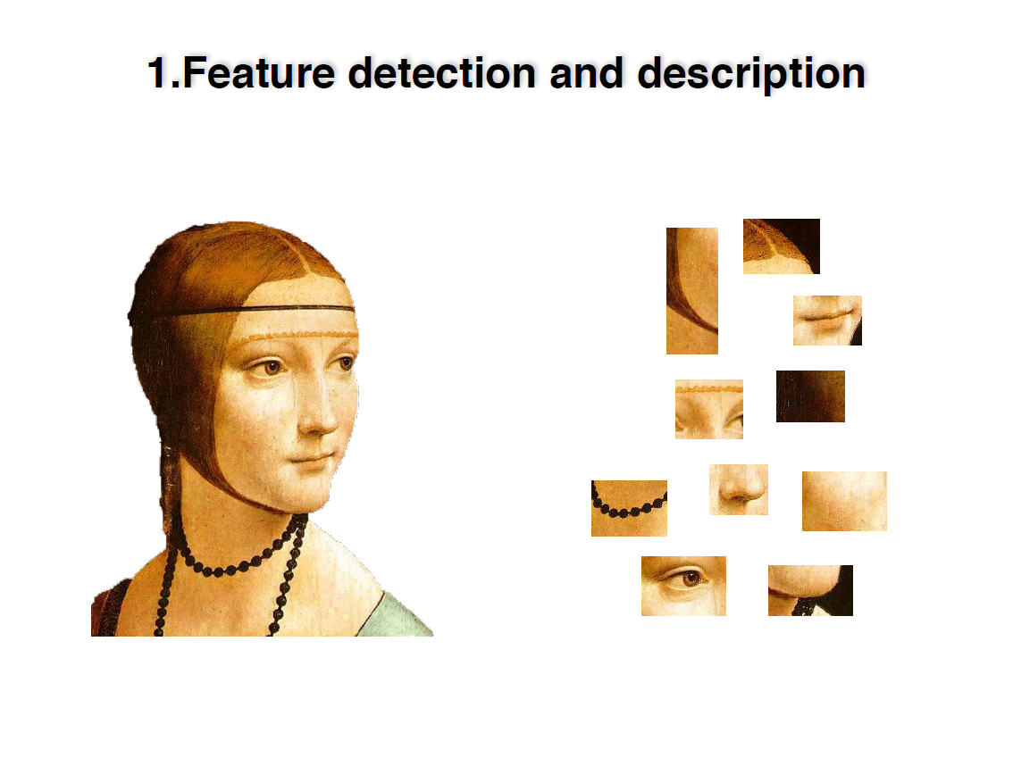

Slide 26
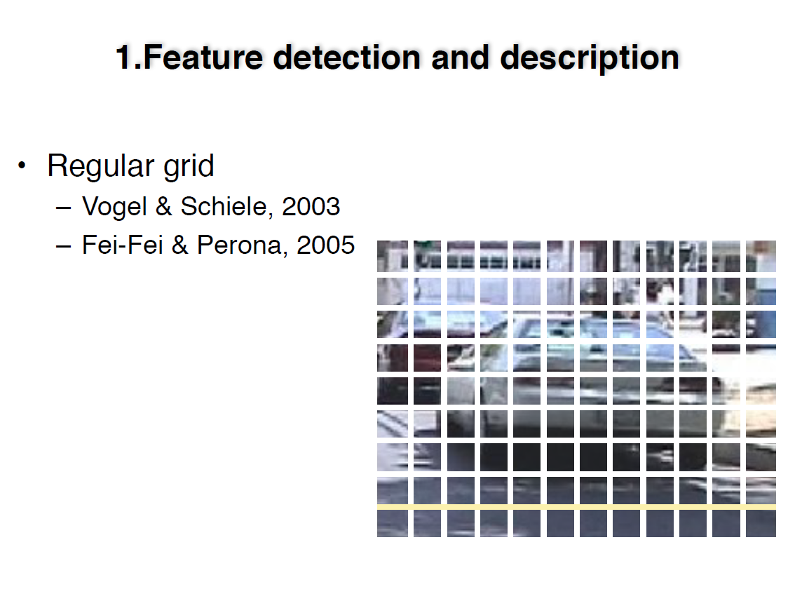

Slide 27
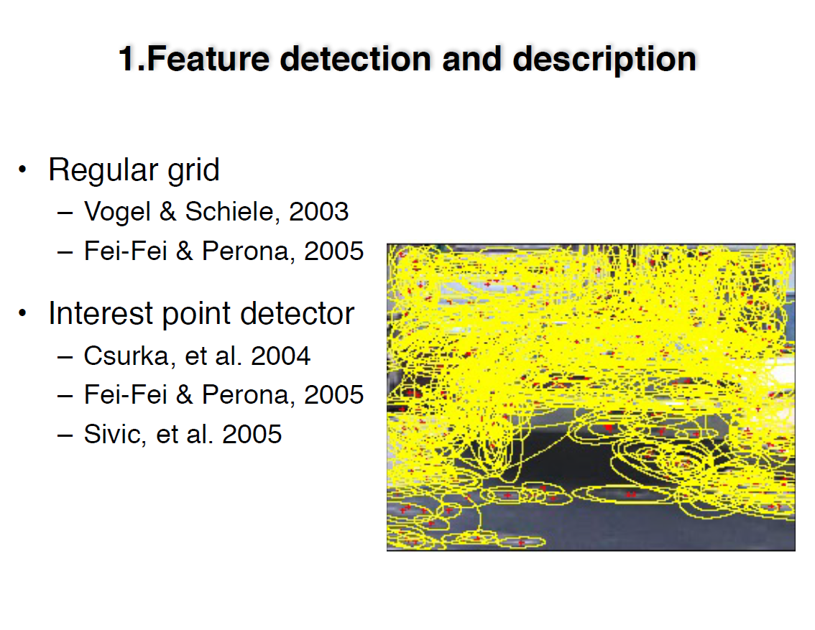

Slide 28
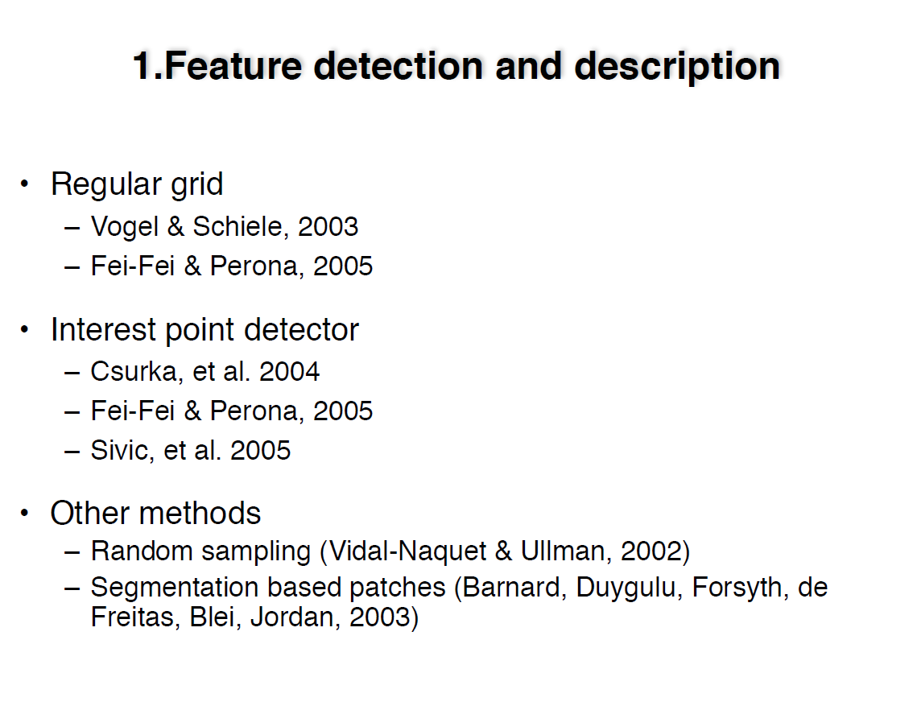

Slide 29
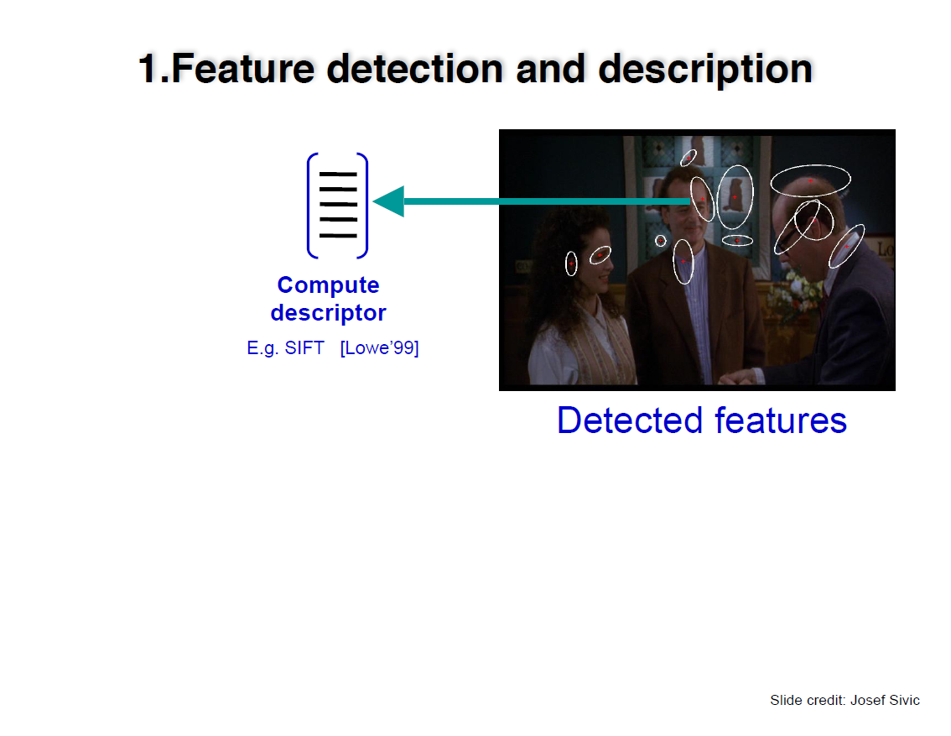

Slide 30
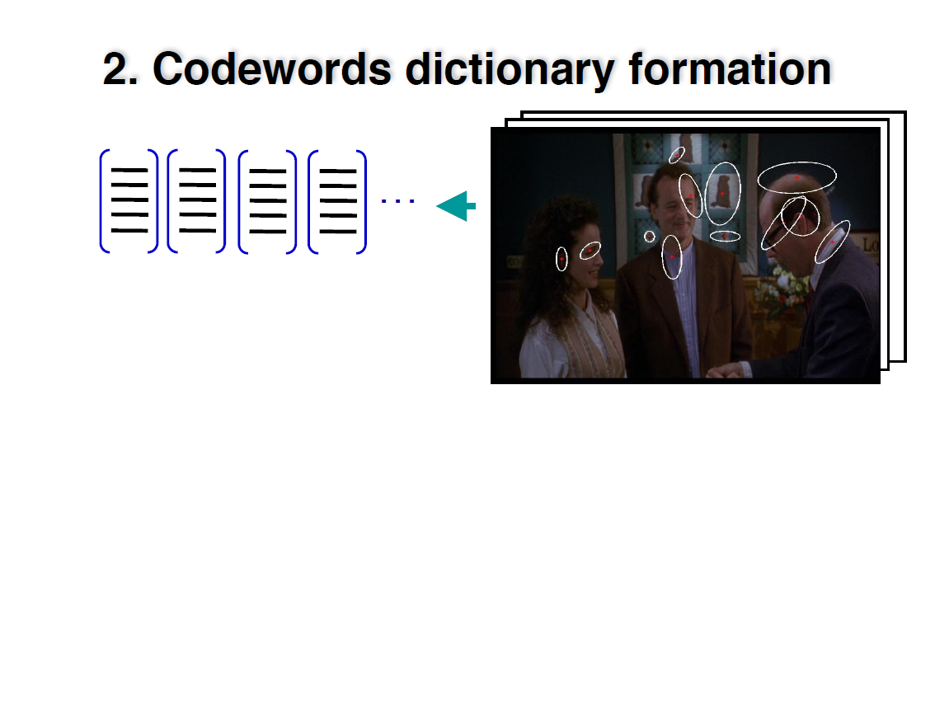

Slide 31
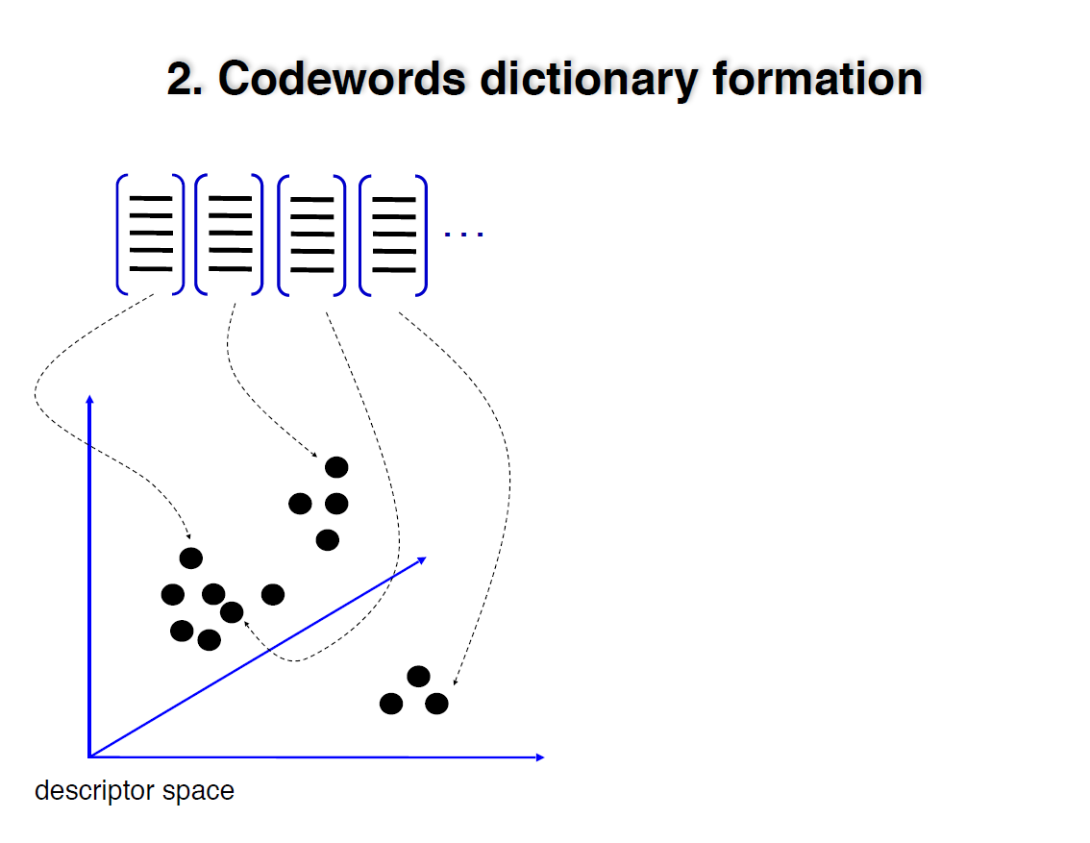

Slide 32
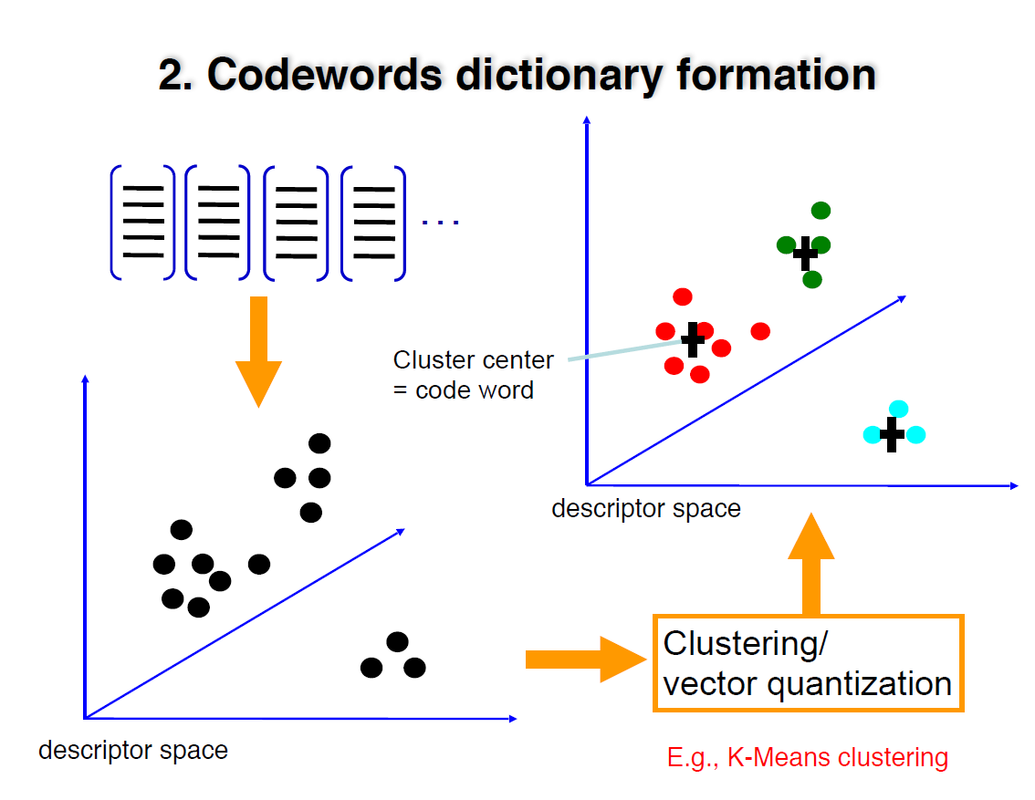

Slide 33
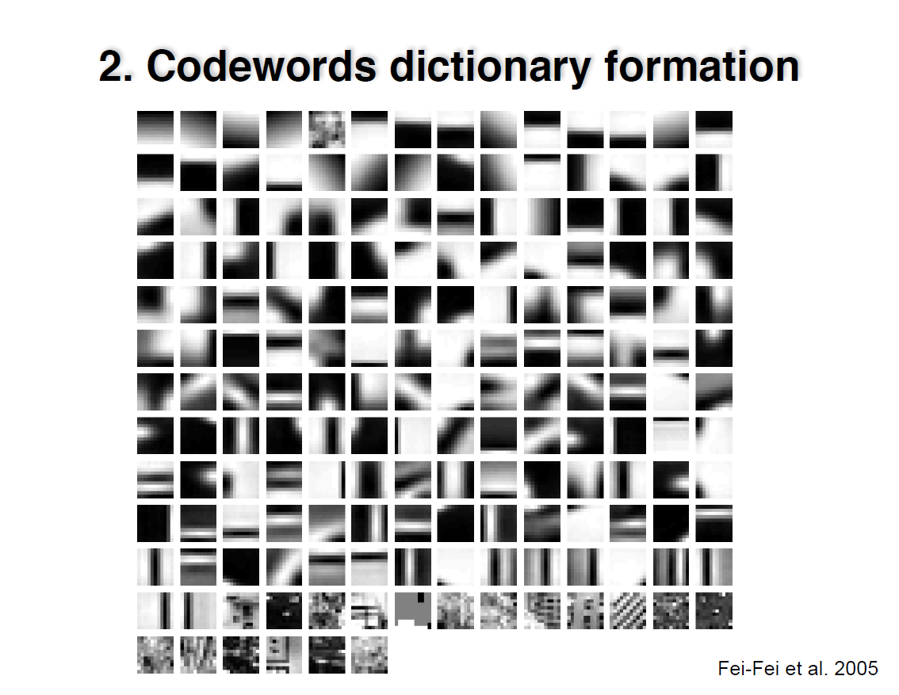

Slide 34
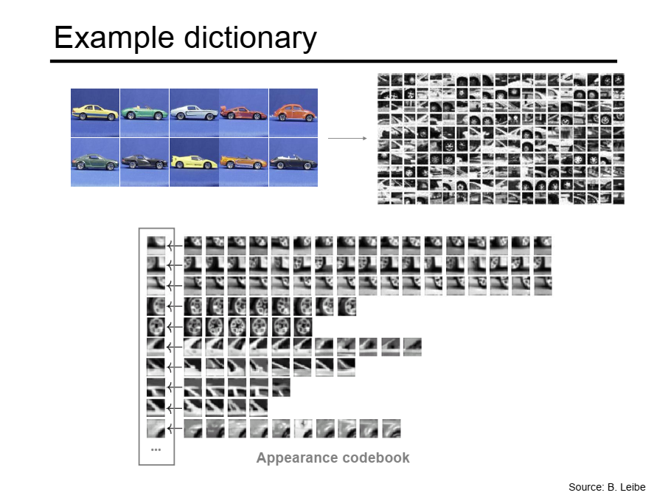

Slide 35
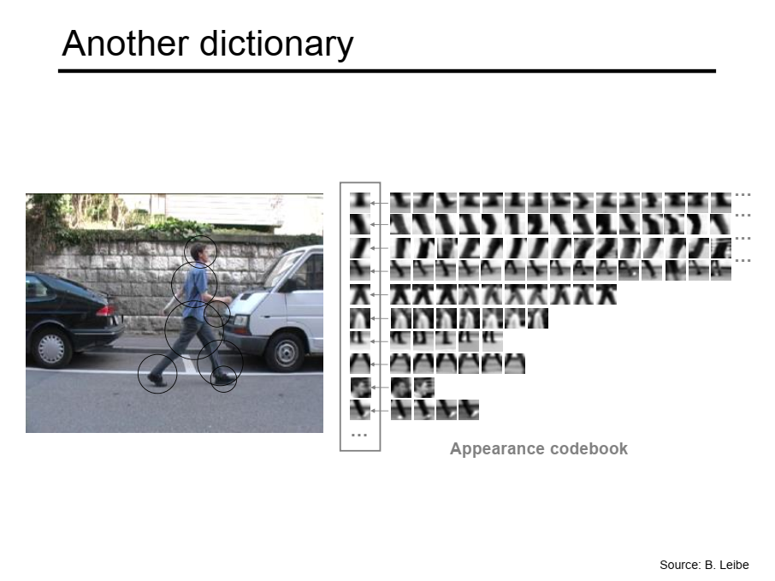

Slide 36
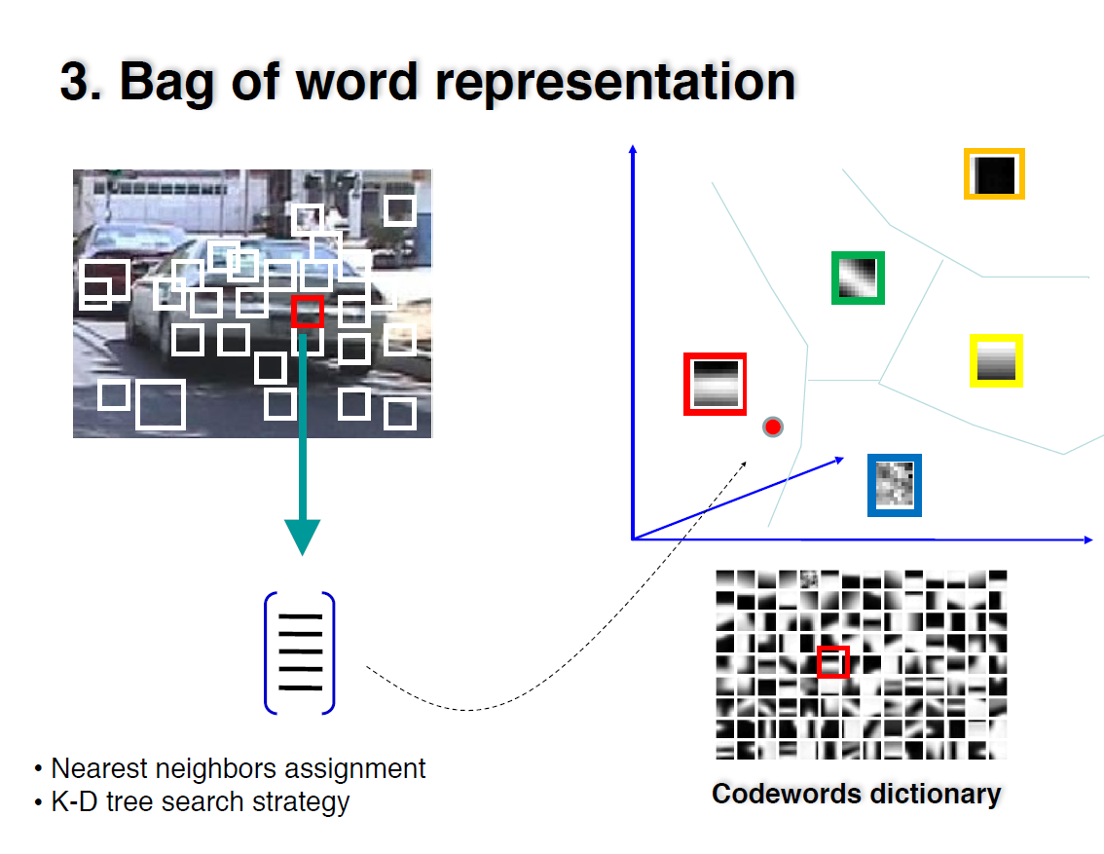

Slide 37
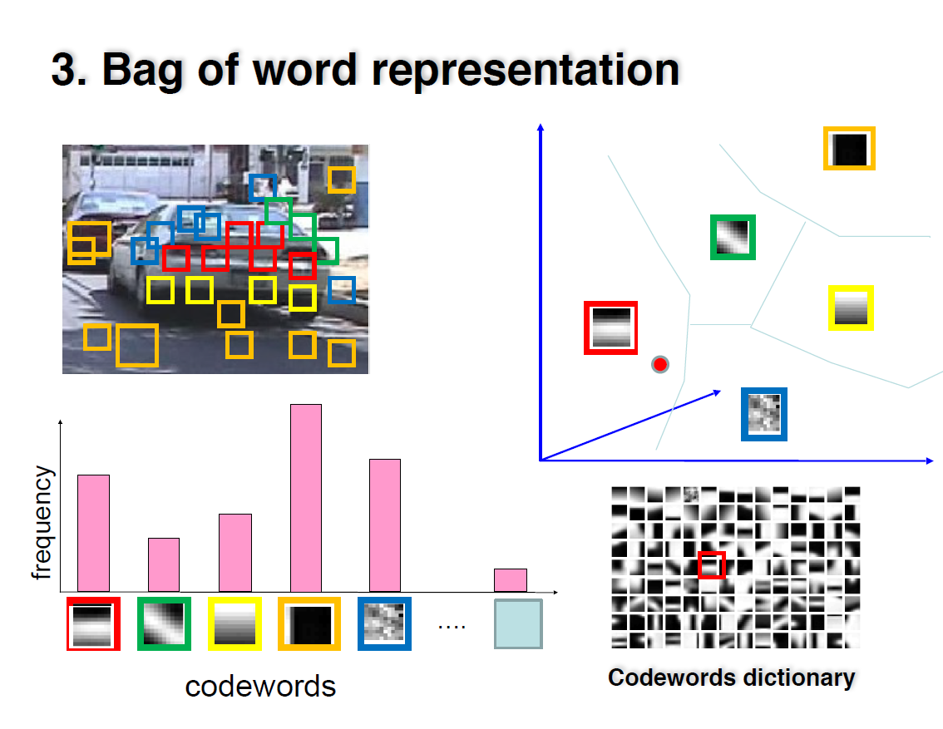

Slide 38
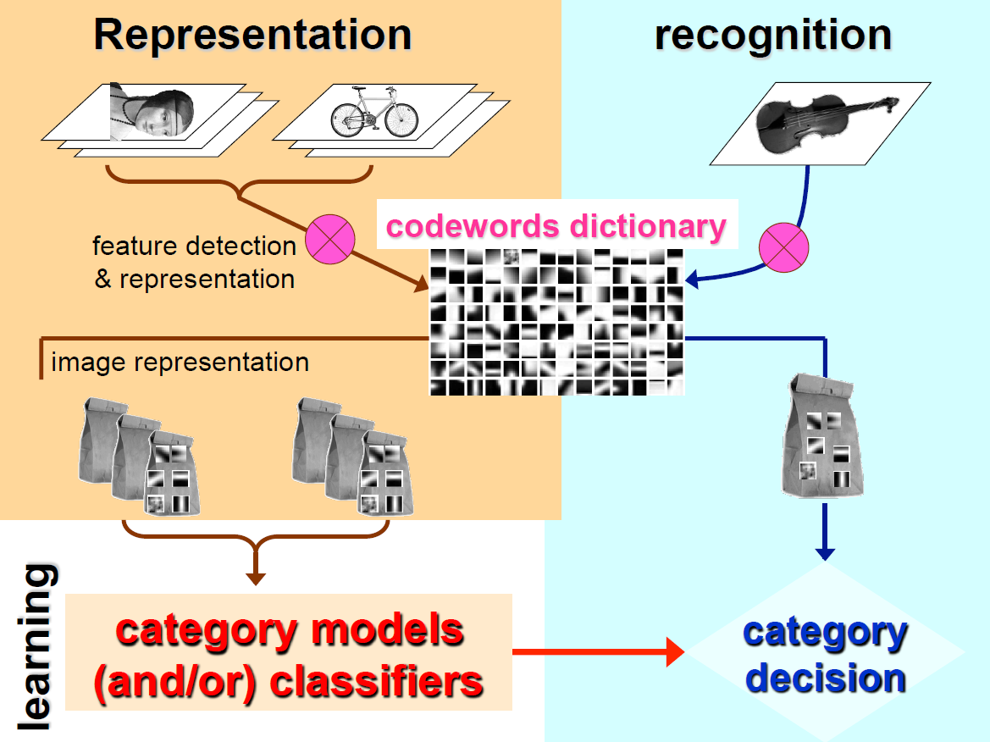

Slide 39
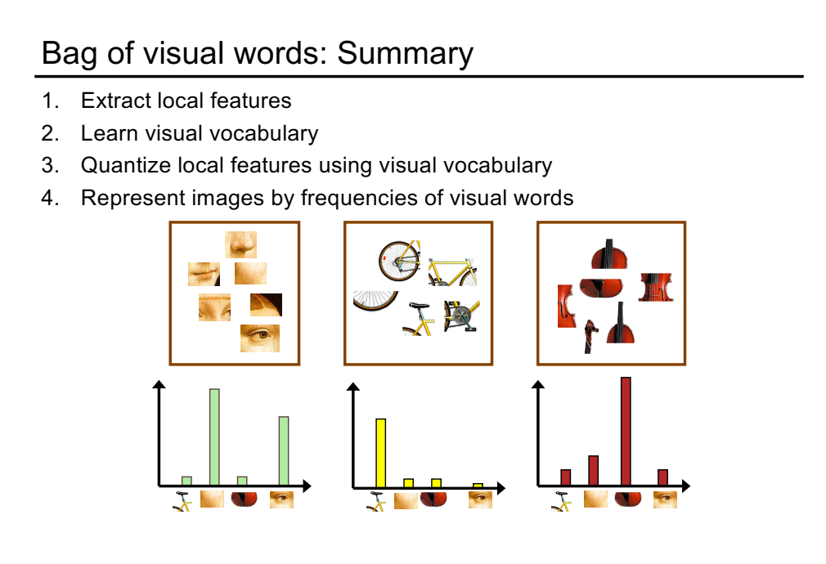

Slide 40
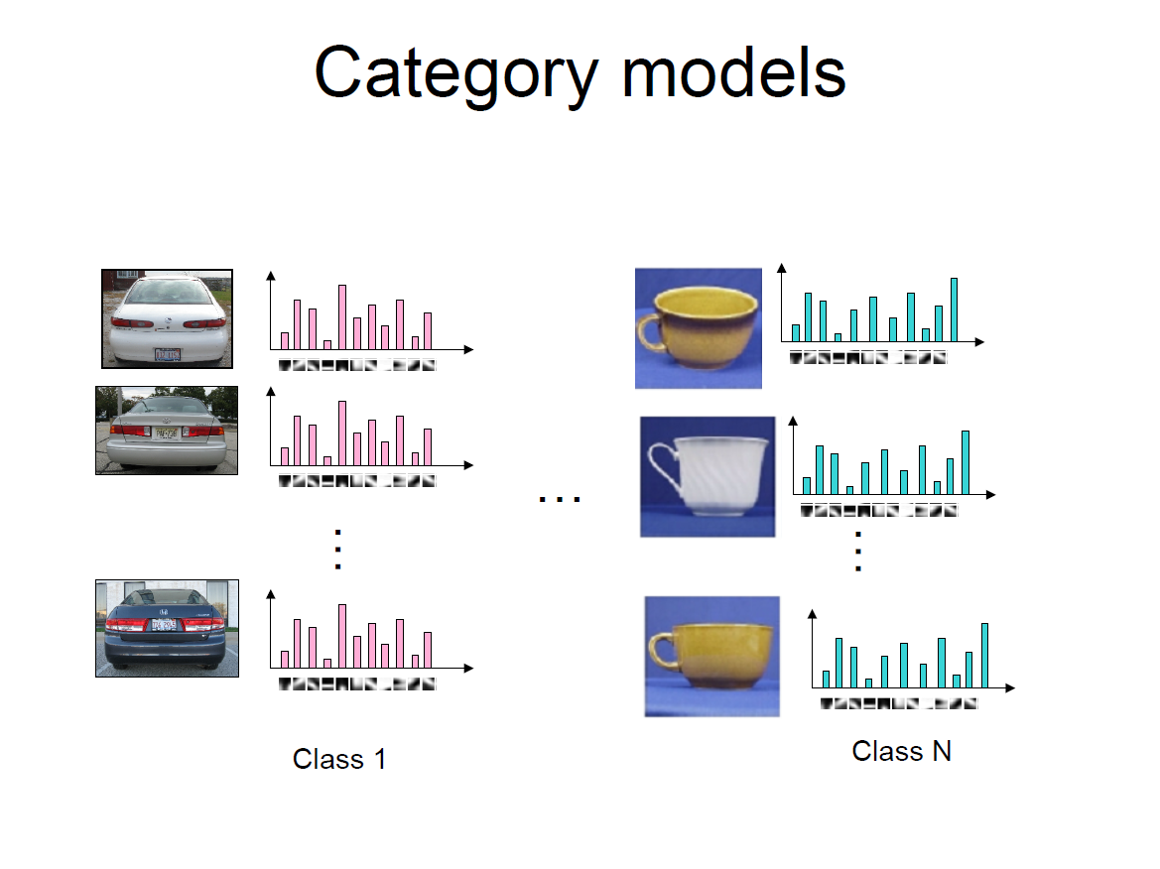

Slide 41
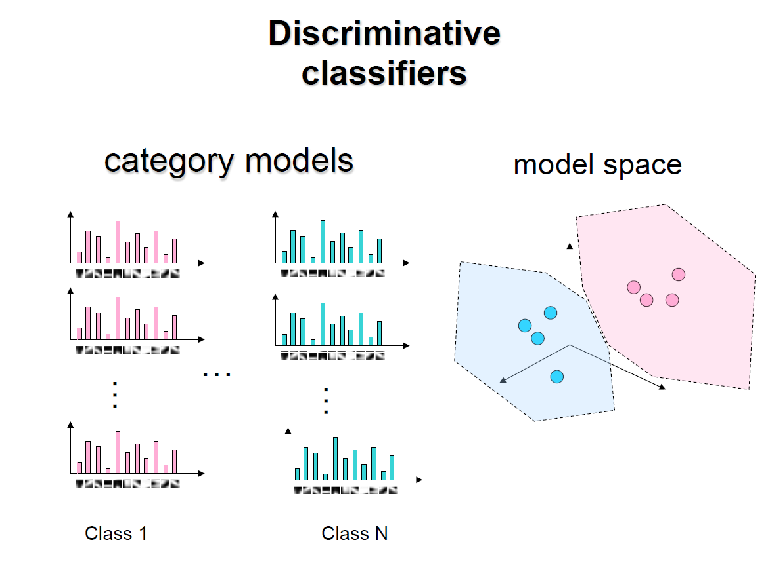

Slide 45
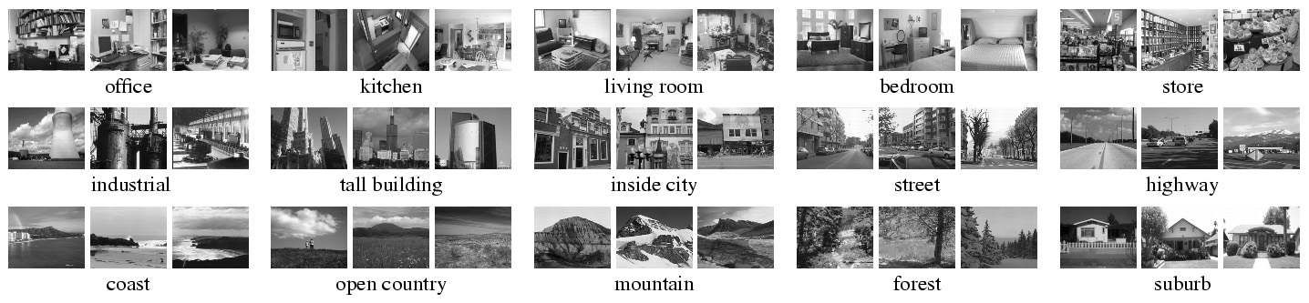
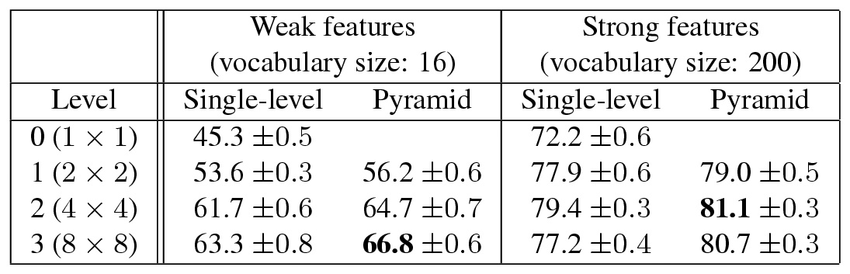
Spatial pyramids
Scene classification results

Slide 46
The machine learning framework
y = f(x)
Training: given a training set of labeled examples {(x₁,y₁), …, (x_{N},y_{N})}, estimate the prediction function f by minimizing the prediction error on the training set
Testing: apply f to a never before seen test example x and output the predicted value y = f(x)
output
prediction function
Image feature

Slide 47
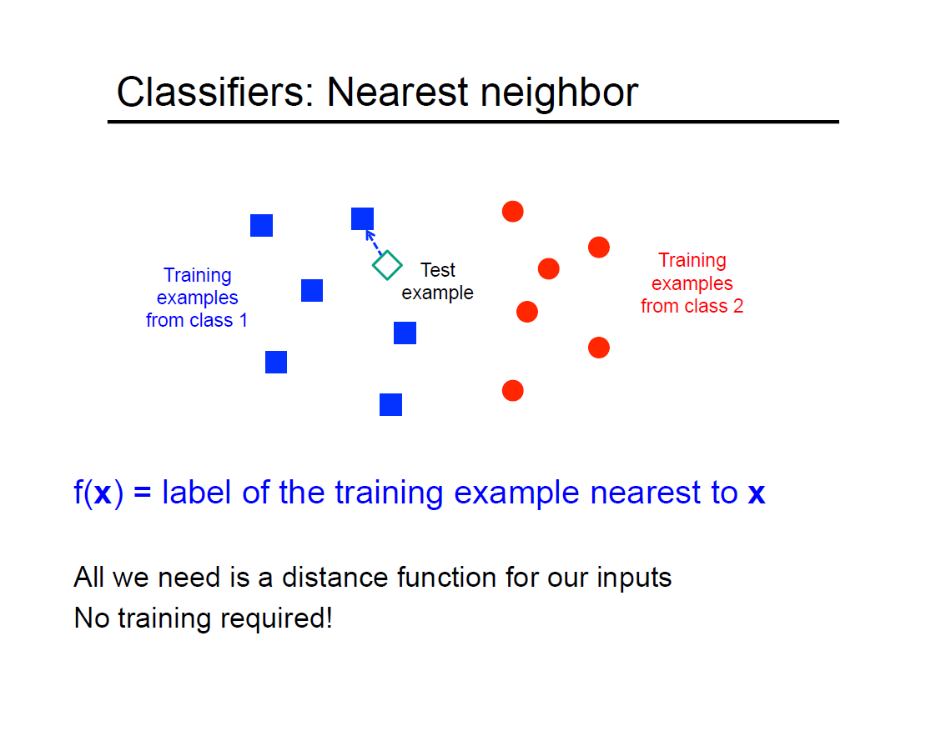

Slide 48
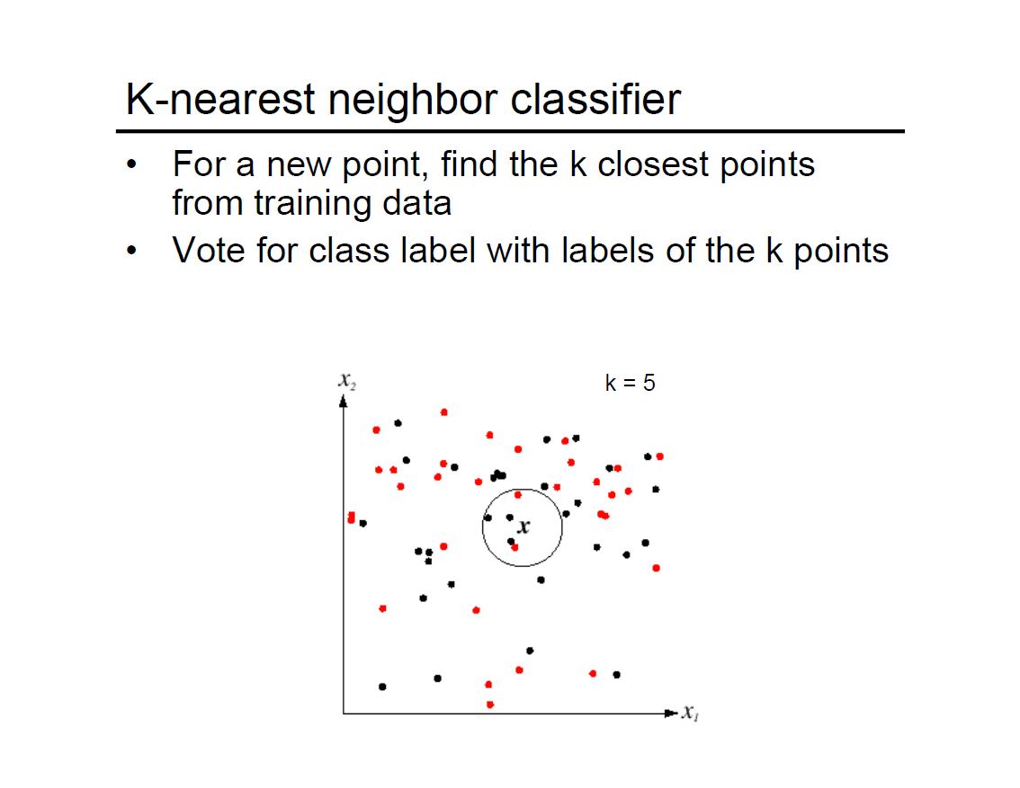

Slide 49
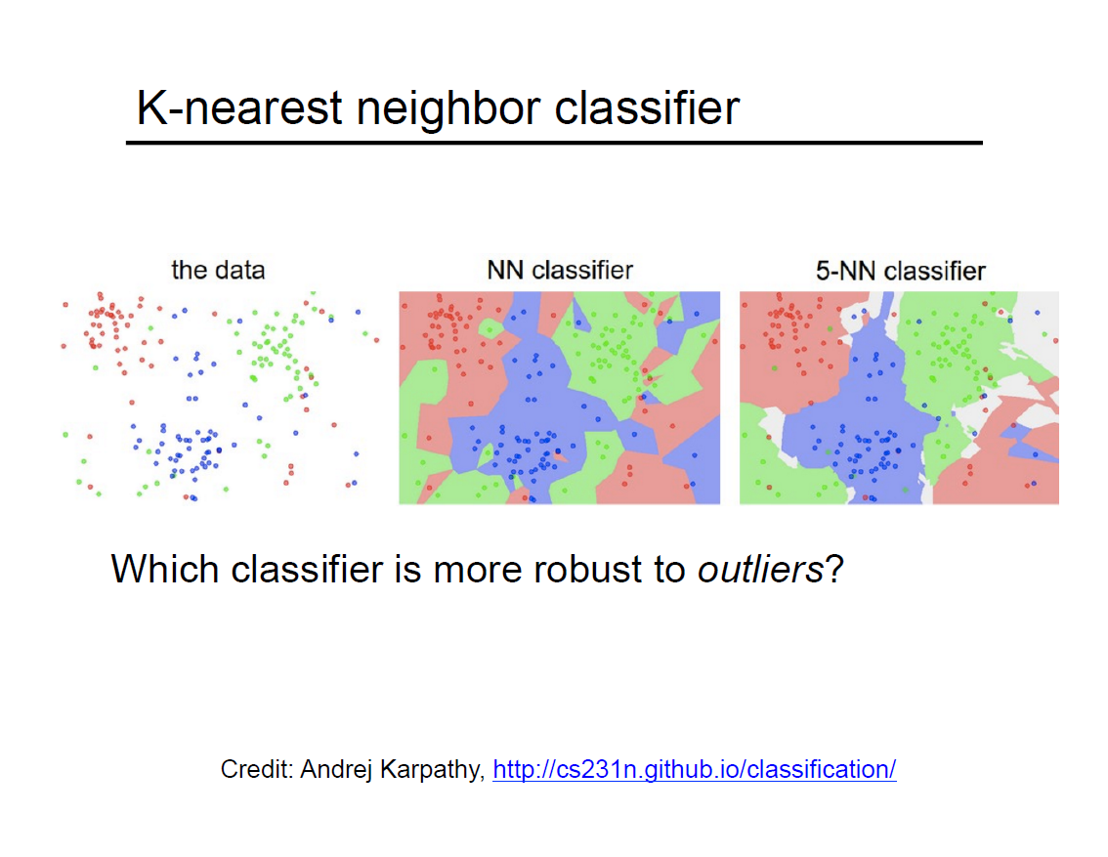

Slide 50
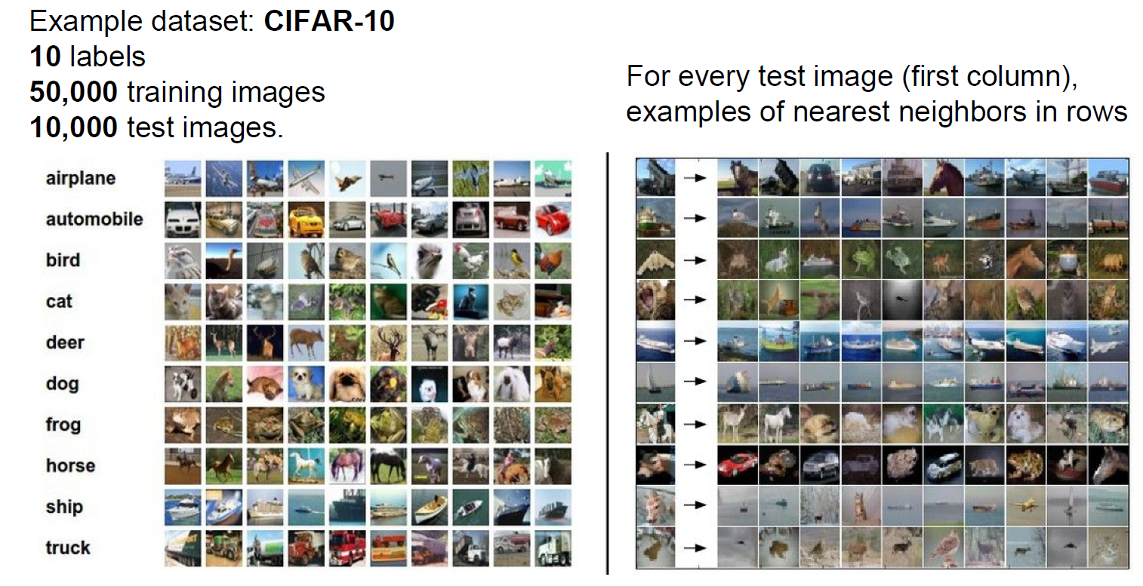

Slide 51
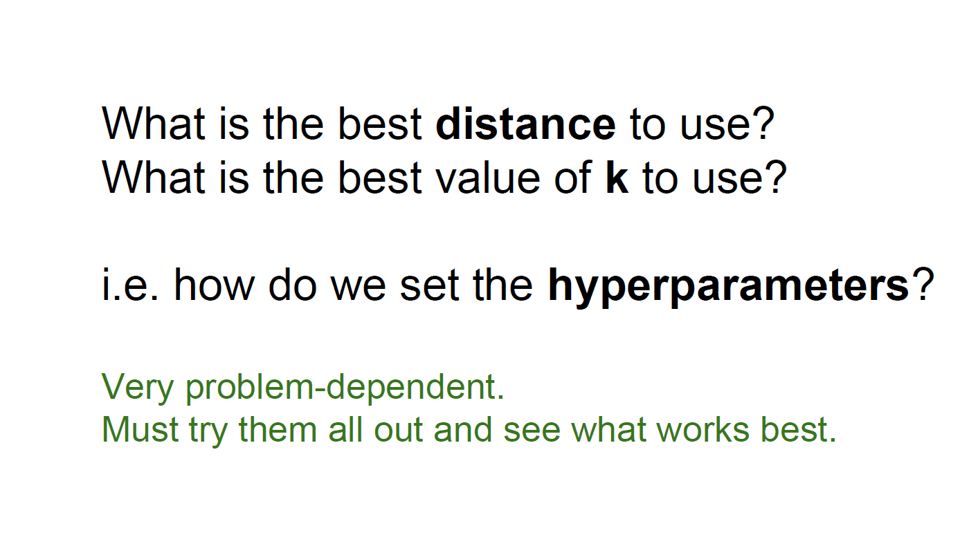

Slide 52
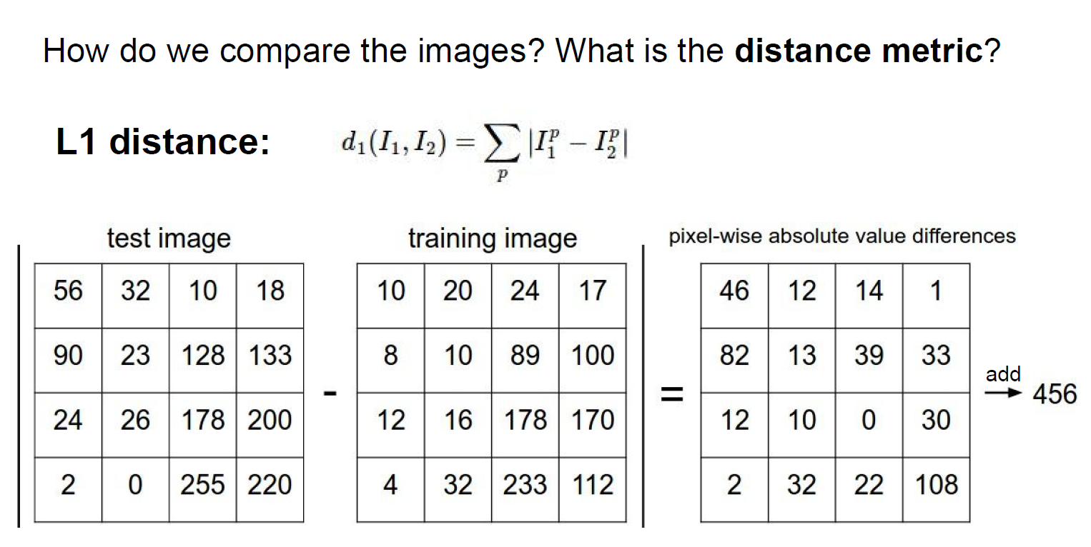
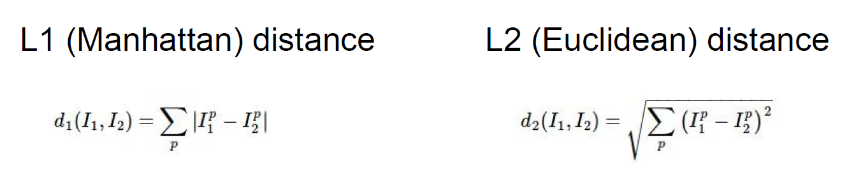

Slide 53
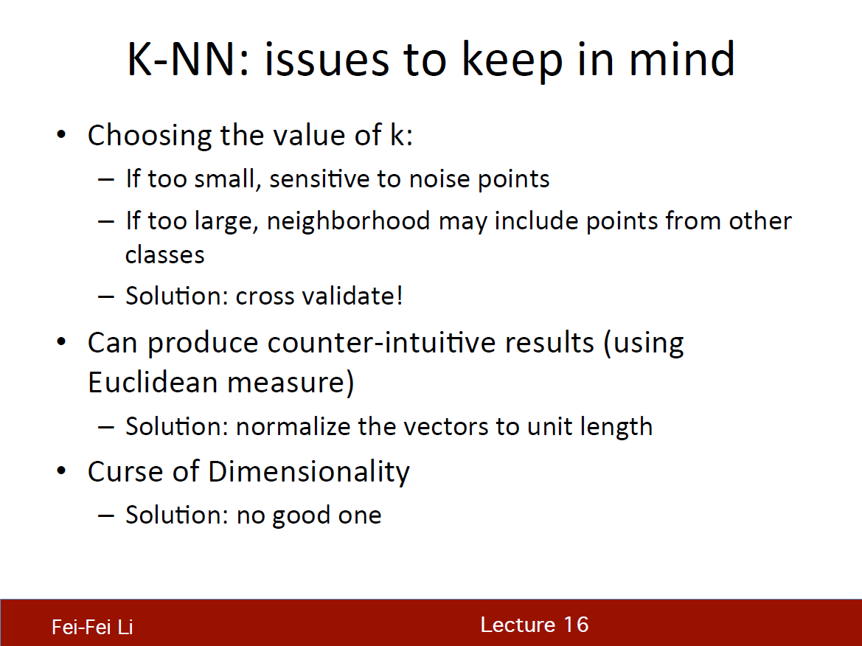

Slide 54


Slide 55


Slide 56


Slide 57

Linear discriminant function
It is a function that is a linear combination of the components of x
y(x) = w^{T}x + b
where w is called a weight vector, and b is a bias
x ∈ C₁, if y(x) >= 0
x ∈ C₂, otherwise
The equation y(x) = 0 defines the decision surface that separates points assigned to the category C₁ from points assigned to the category C₂
When y(x) is linear, the decision surface is a hyperplane

Slide 58


Linear discriminant function
Consider two points x_{A} and x_{B} both of which lie on the decision surface.
y(x_{A}) = y(x_{B}) = 0
w^{T}(x_{A}−x_{B}) = 0
hence the vector w is orthogonal to every vector lying within the decision surface, and so w determines the orientation of the decision surface
Consider an arbitrary point x and let x⊥ be its orthogonal projection onto the decision surface
Multiplying both sides by w^{T} and adding b
So, y(x) gives a signed measure of the perpendicular distance r of the point x from the decision surface.

Slide 59


Slide 60


Slide 61


Slide 62


Slide 63


Slide 64


Slide 65


Slide 66


Slide 67


Slide 68


Slide 69


Slide 70


Slide 71


Slide 72


Slide 73


Slide 74


Slide 75


Slide 76


Slide 77


Slide 78


Slide 79


Slide 80


