Slide 1
Convolutional Neural Networks
Slide courtesy: S. Lazebnik, D. Hoiem, Fei-Fei Li

Slide 2
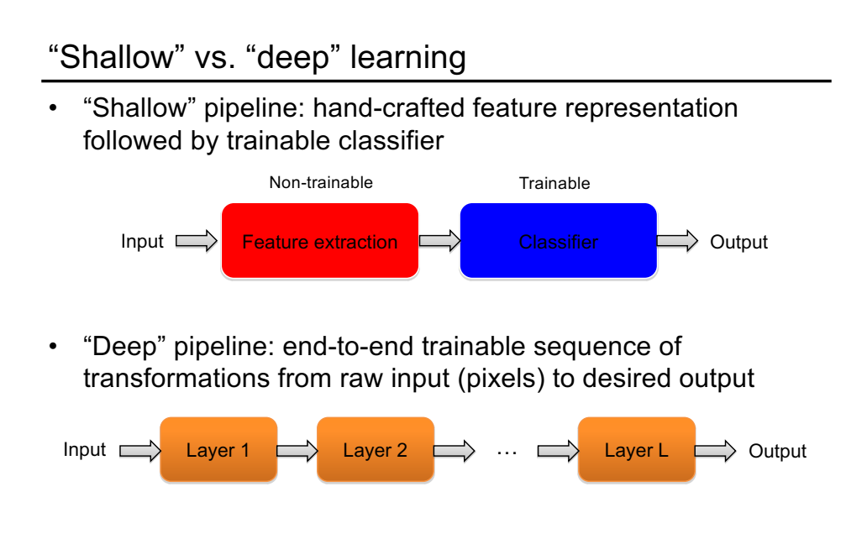

Slide 3
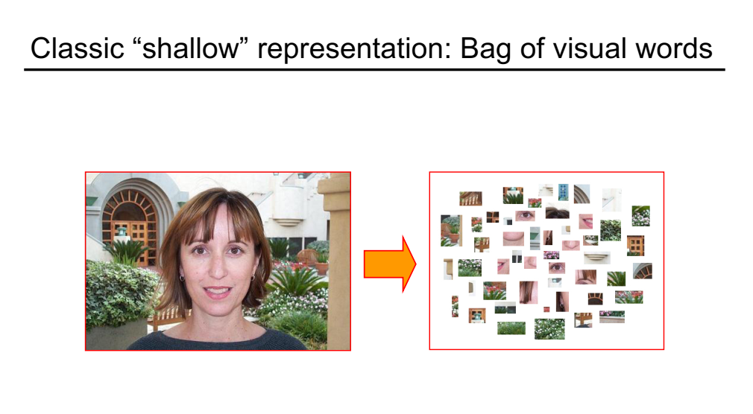

Slide 4
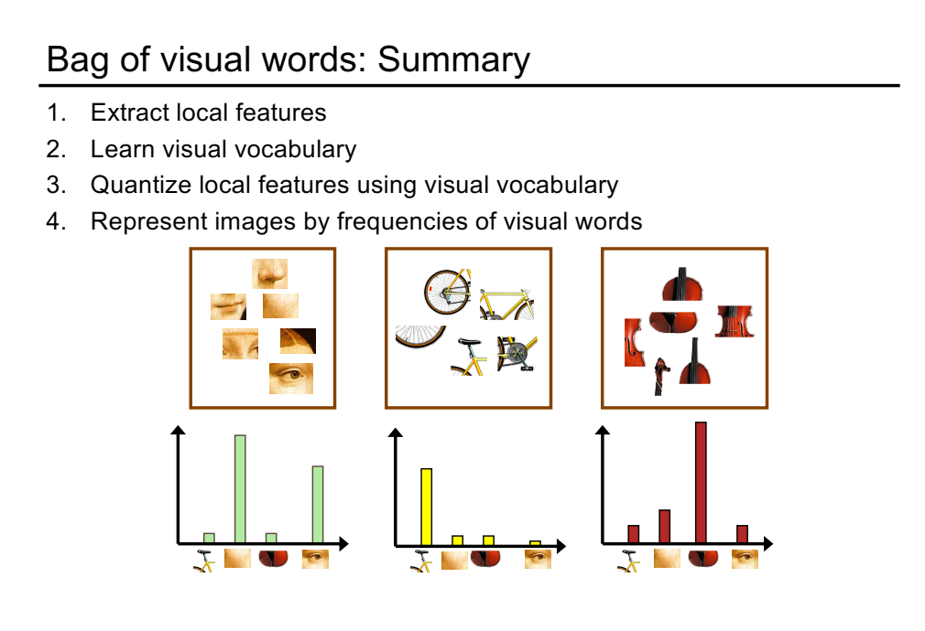

Slide 5
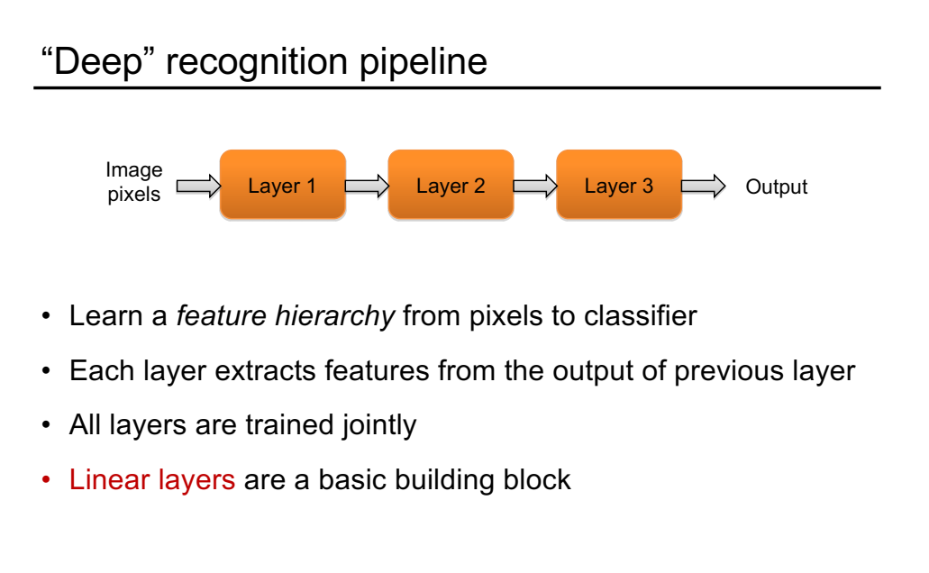

Slide 6
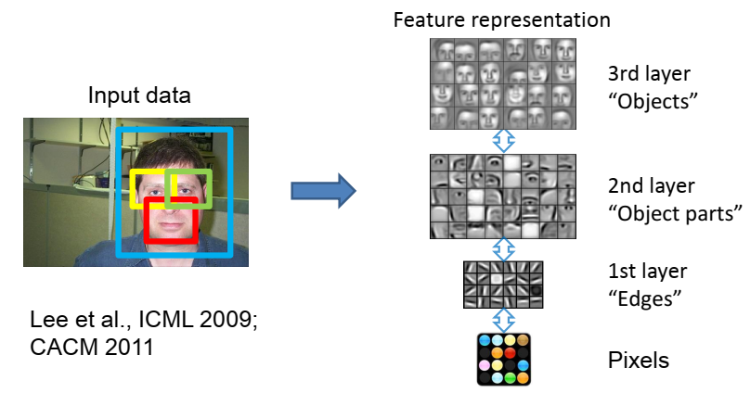
Learning Feature Hierarchy

Slide 7
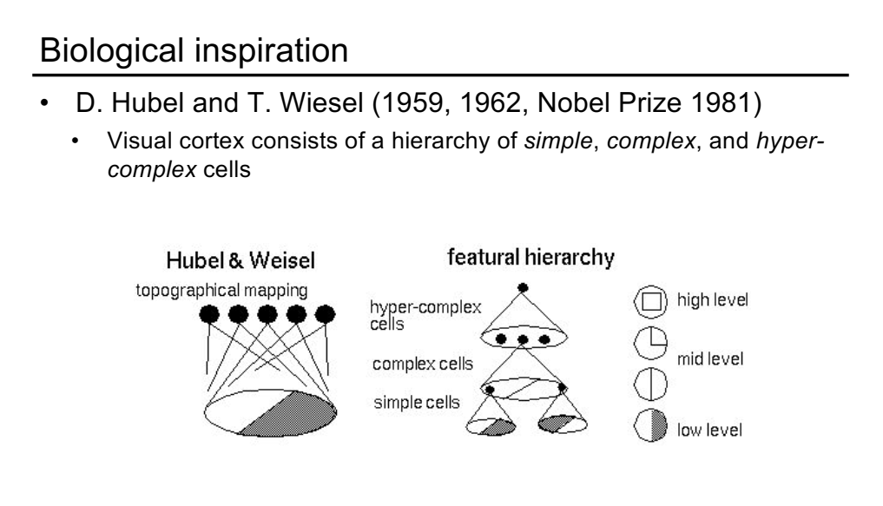

Slide 9
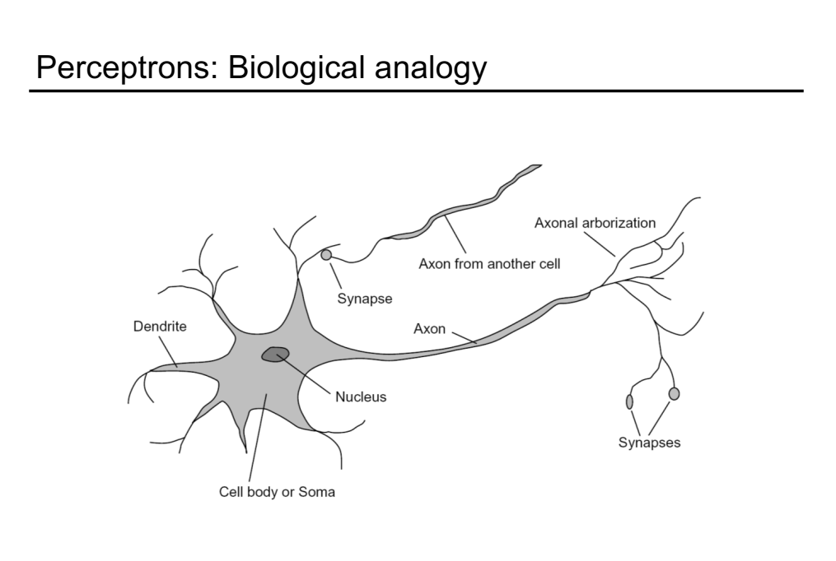

Slide 11
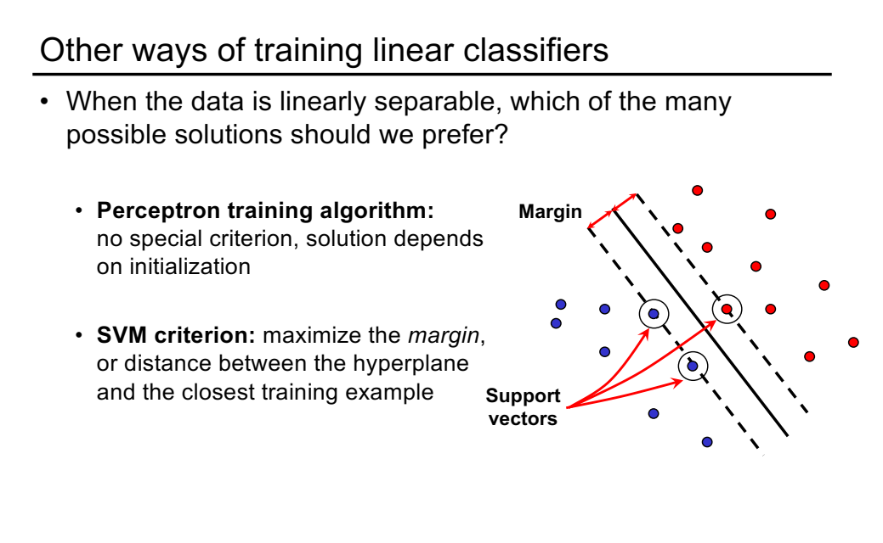

Slide 12


From linear classifiers to multi-layer networks
$$x$$
$$y=w^{T}x$$

Slide 13



From linear classifiers to multi-layer networks
Linear layer
$$y^{(1)}=w^{(1)}∙x$$
$$y^{(2)}=w^{(2)}∙x$$
$$x$$
$$⋮$$

Slide 14
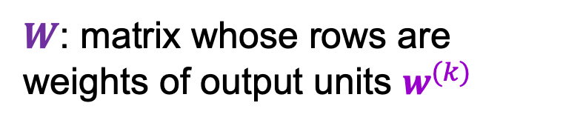

From linear classifiers to multi-layer networks
Linear layer
$$x$$
$$y=Wx$$
$W$: matrix whose rows are weights of output units $w^{(k)}$

Slide 15



From linear classifiers to multi-layer networks
Linear layer
Nonlinearity
$$y$$
$$x$$
$$z=g(y)$$
$$y=Wx$$

Slide 16
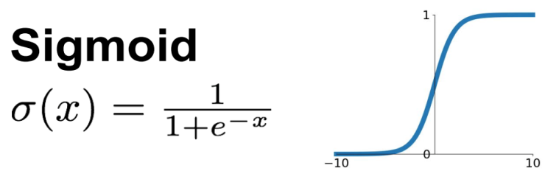
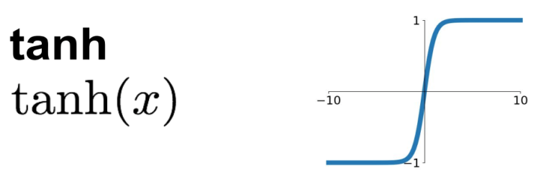
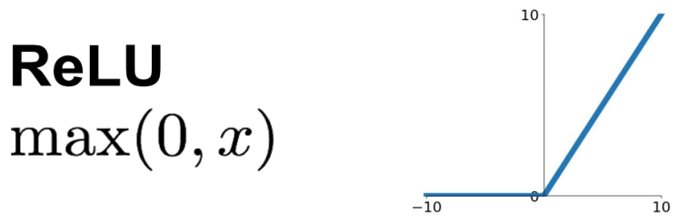
Common nonlinearities (or activation functions)
Source: Stanford 231n

Slide 17
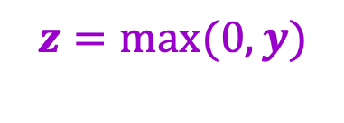
From linear classifiers to multi-layer networks
Linear layer
Nonlinearity
$$y$$
$$x$$
$$z=g(y)$$
…
Why do we need the nonlinearity?
$$y=Wx$$
$$z=max(0,y)$$

Slide 18



Two-layer neural network
Individual dimensions of $x$
Output of hidden layer: $g(W_{1}x)$
Final output: $g\left(W_{2}g(W_{1}x)\right)$

Slide 19
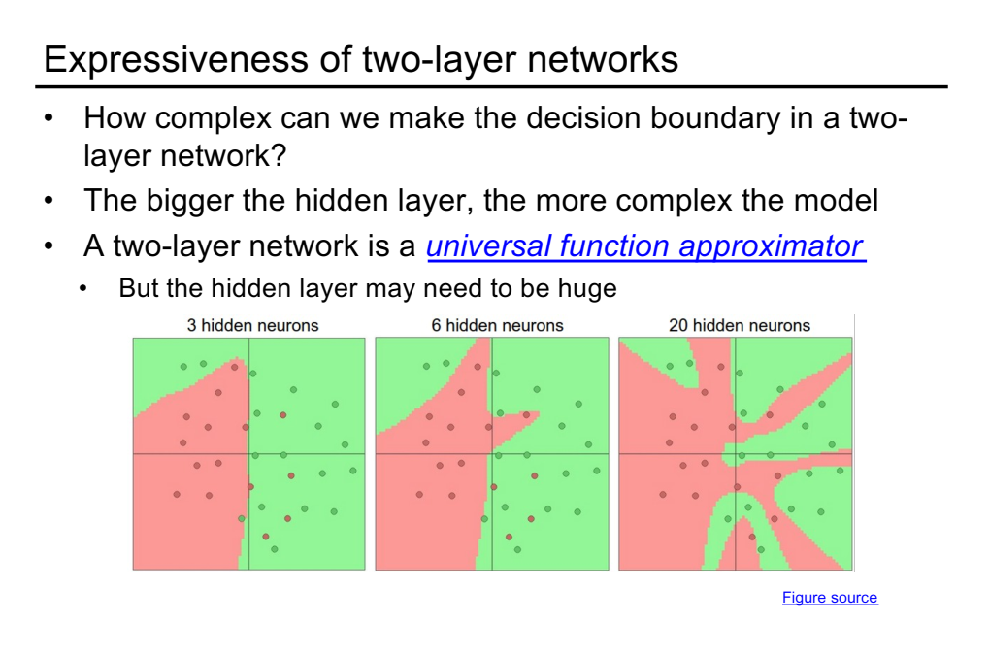

Slide 20
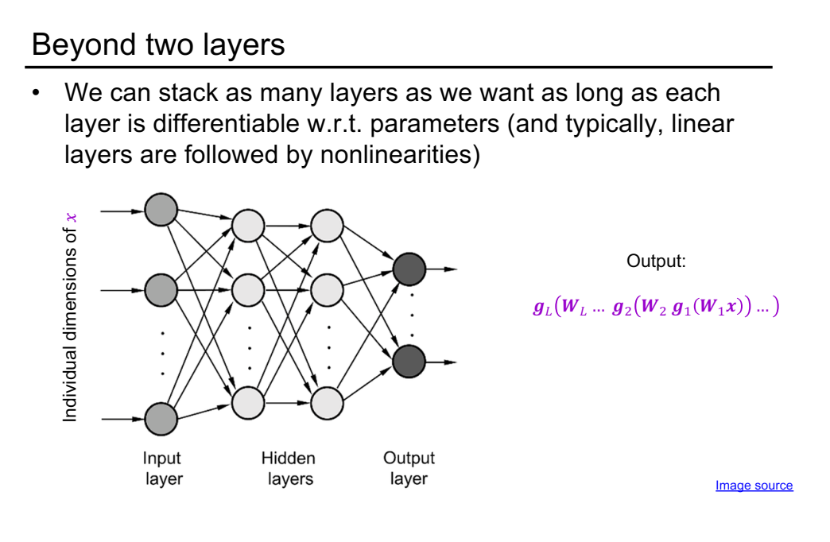

Slide 21
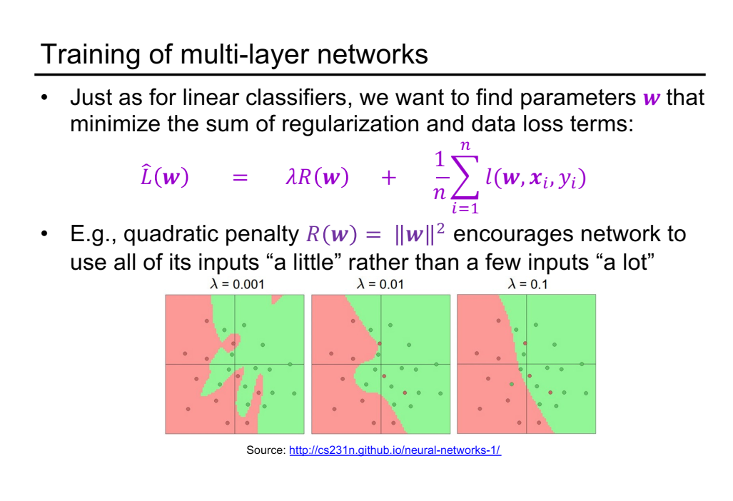

Slide 22
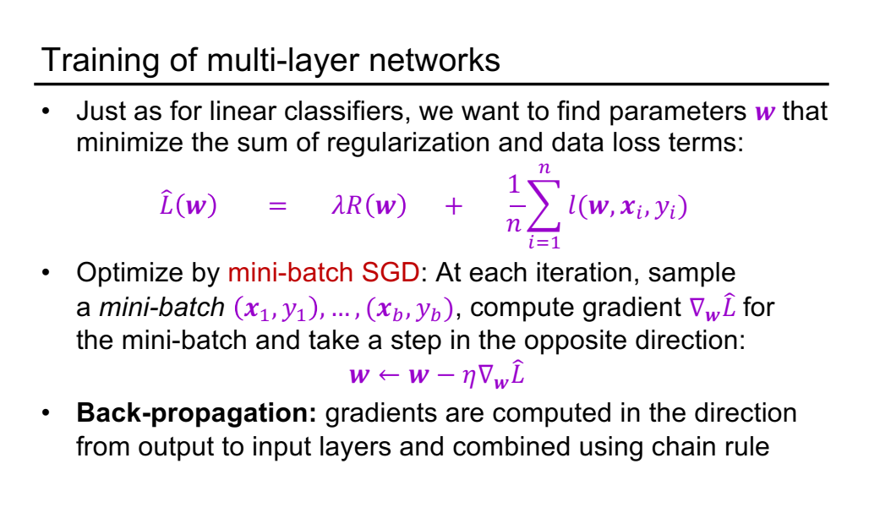

Slide 23
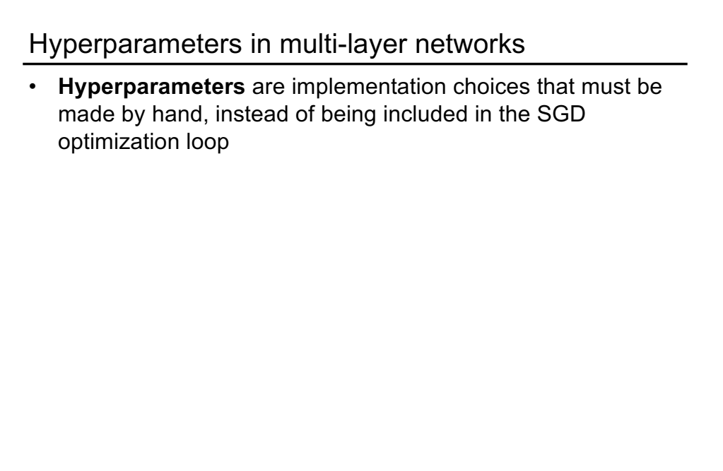

Slide 24
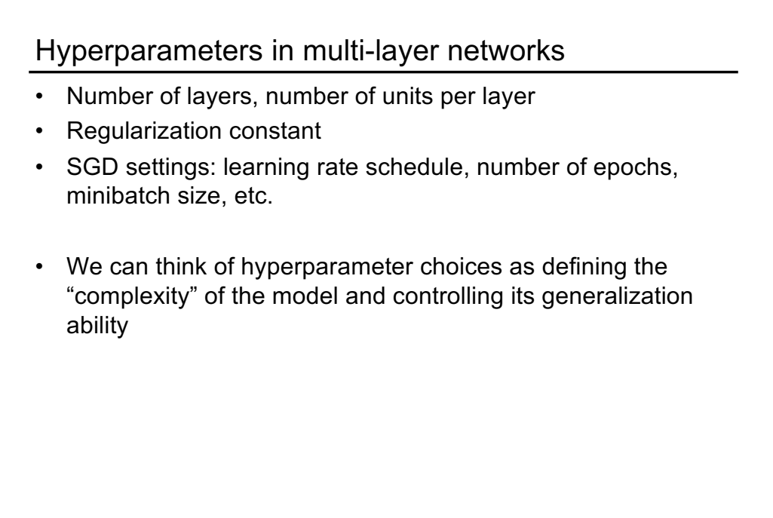

Slide 25
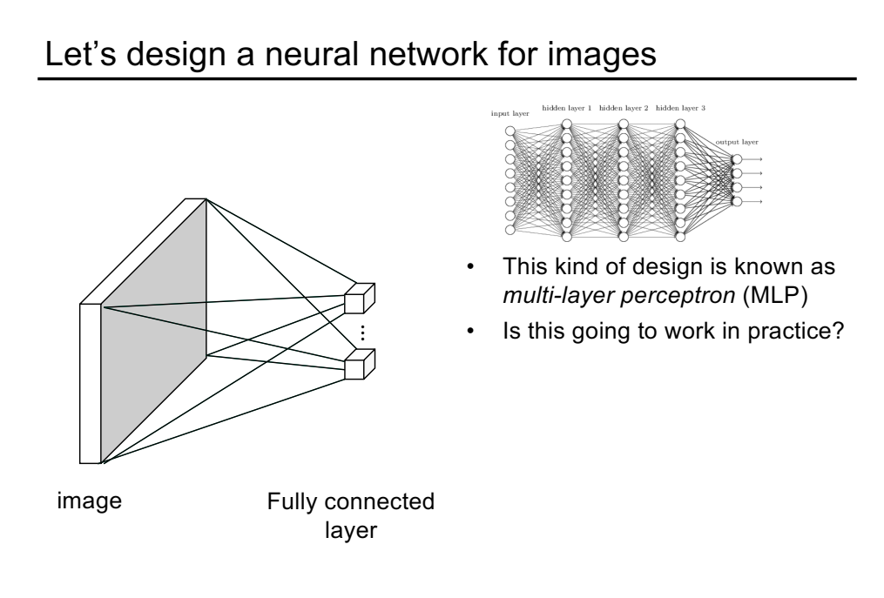

Slide 26
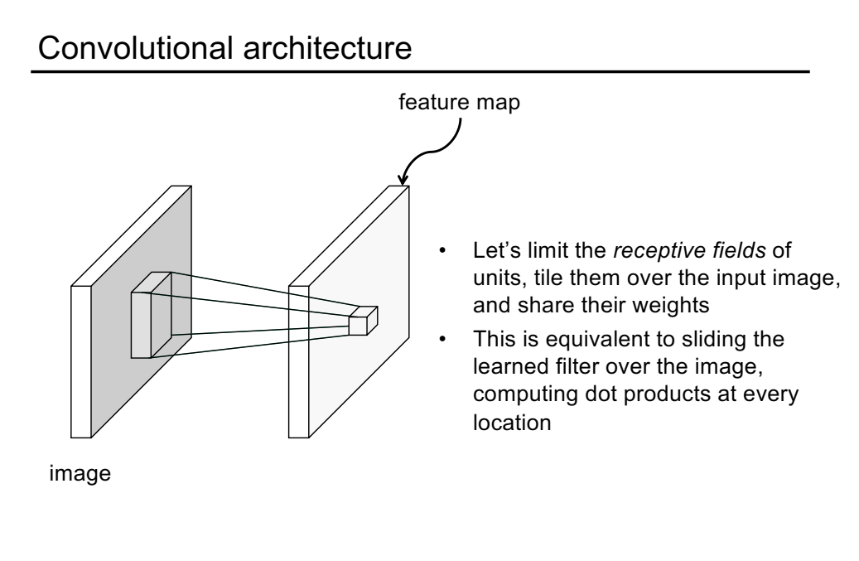

Slide 27
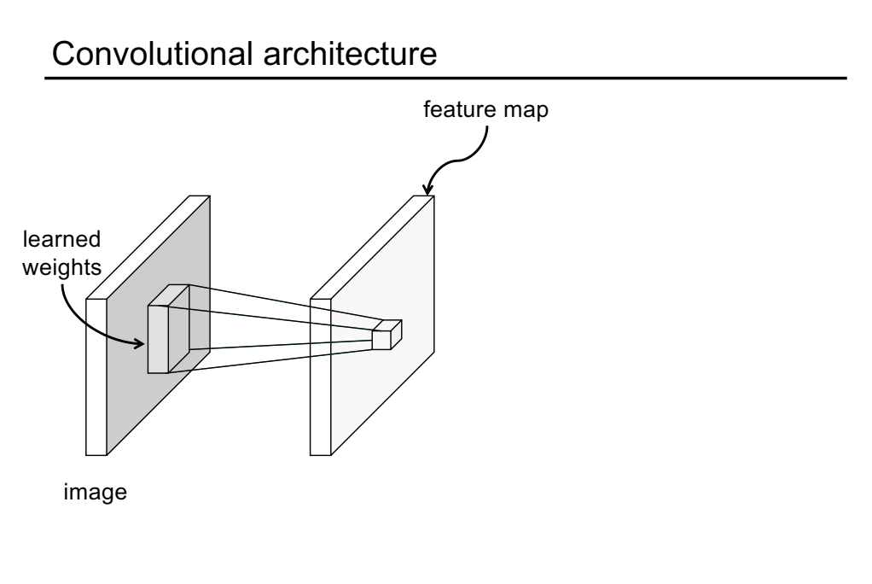

Slide 28
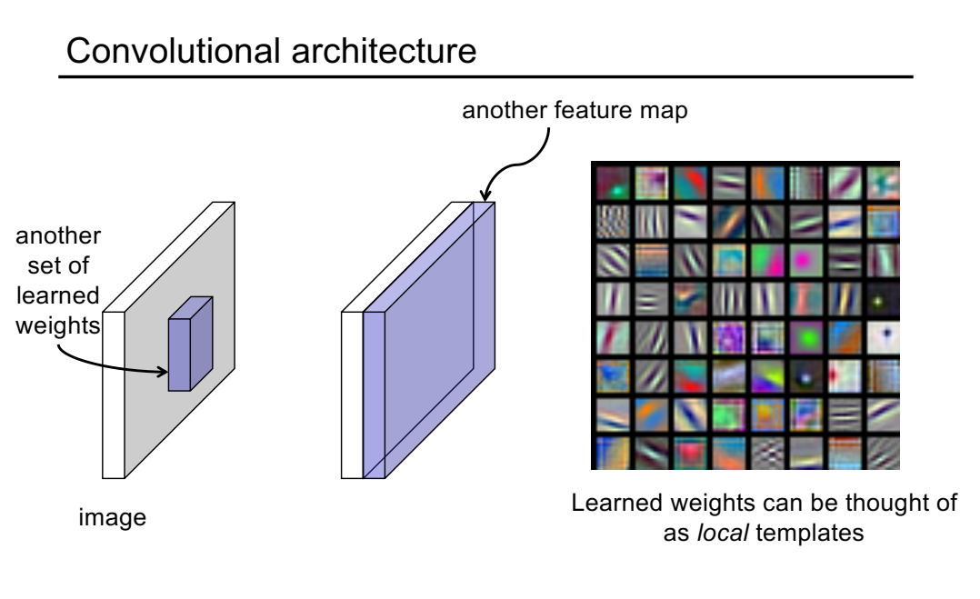

Slide 29
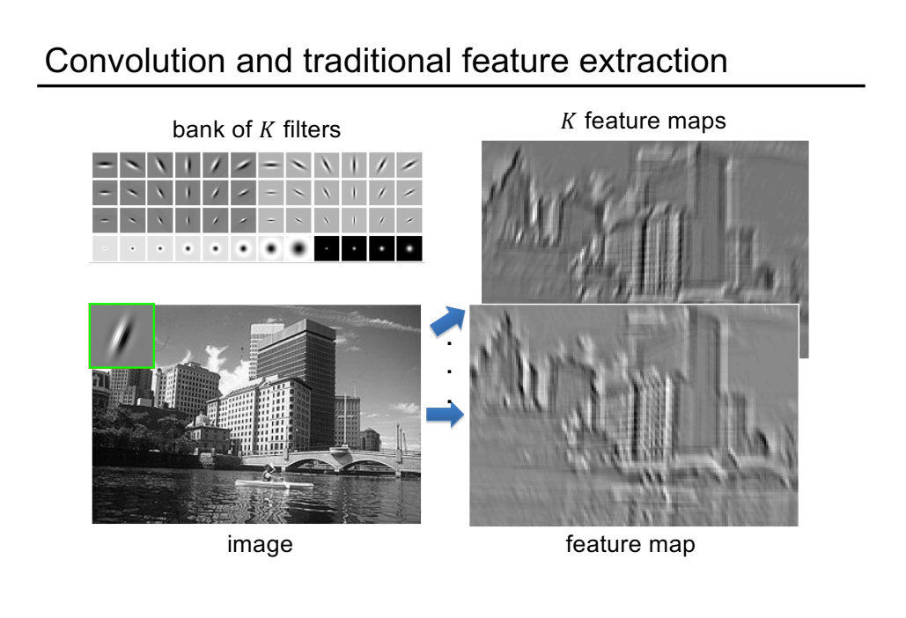

Slide 30
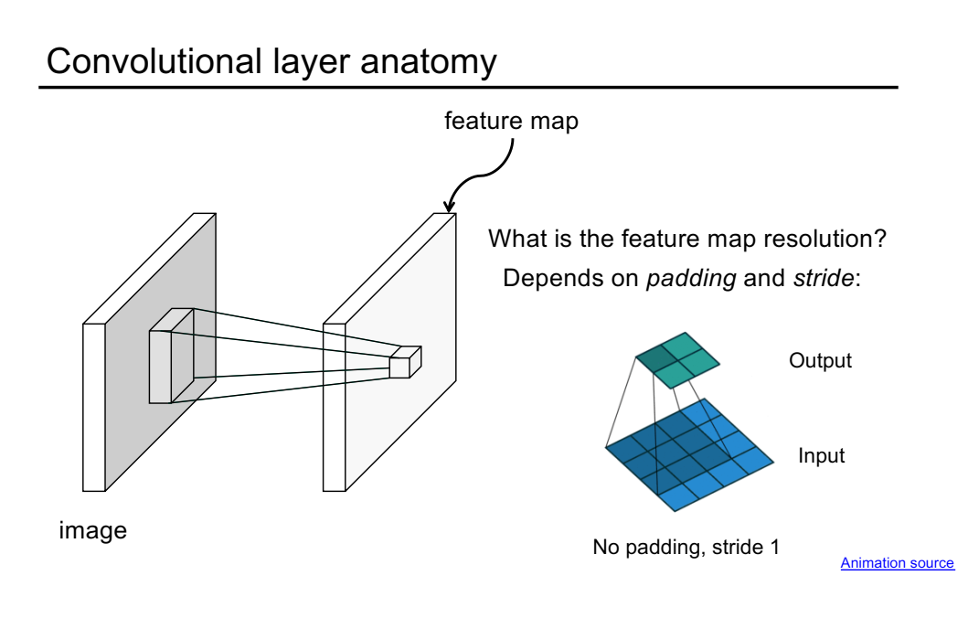

Slide 31
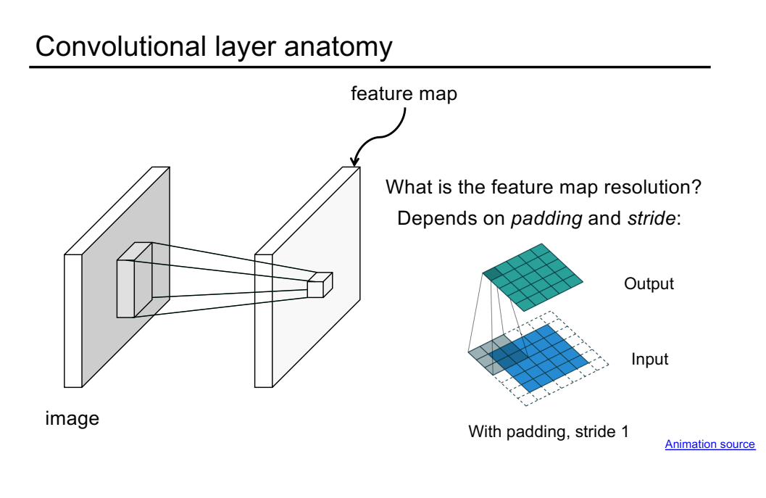

Slide 32
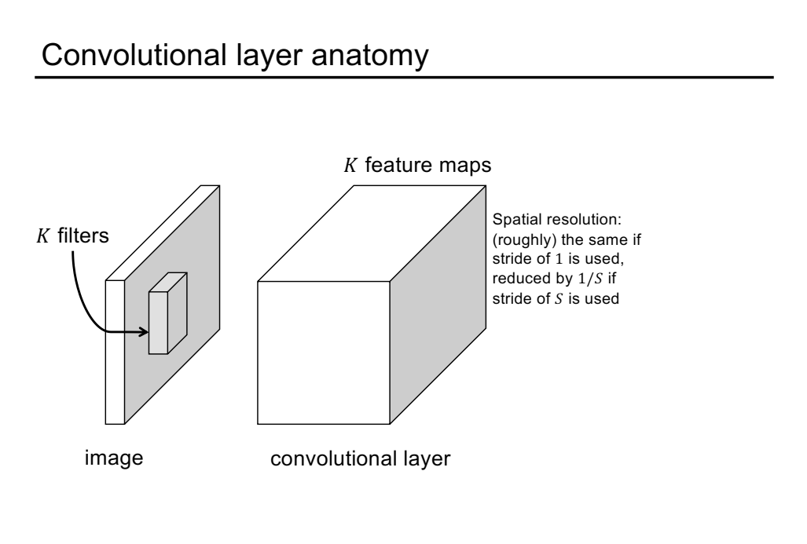

Slide 33
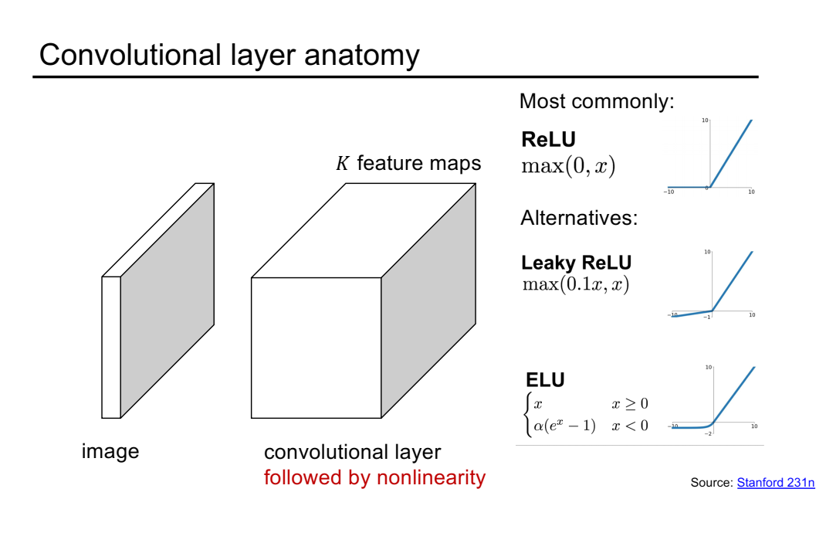

Slide 34
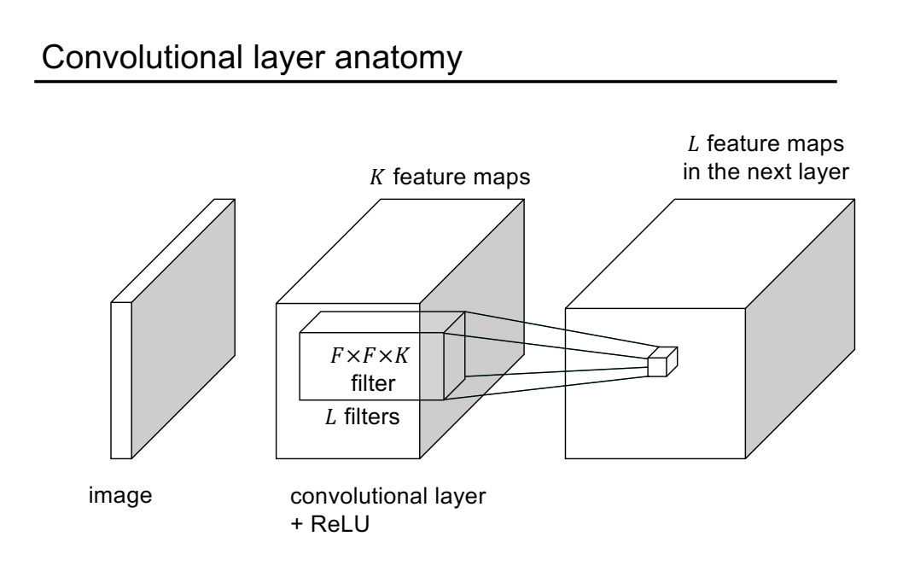

Slide 35
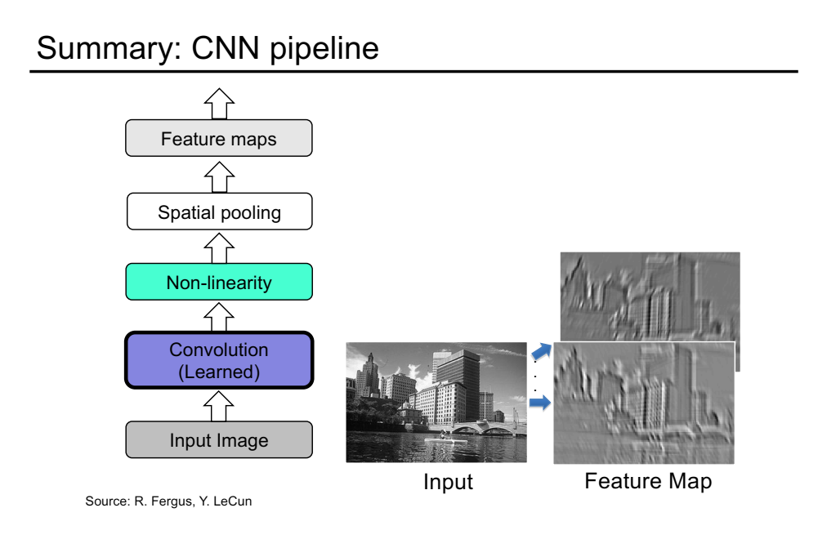

Slide 36
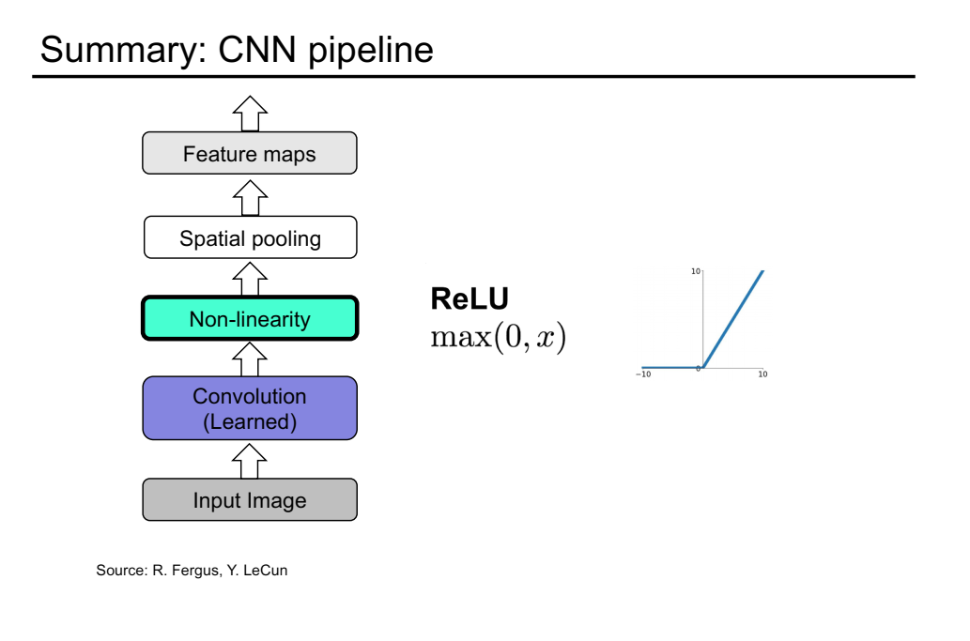

Slide 37
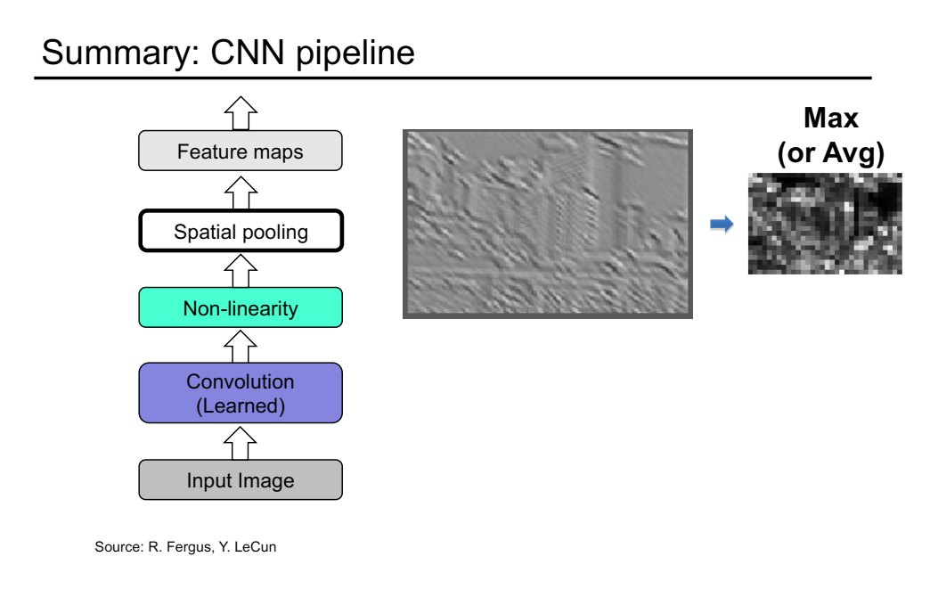

Slide 40
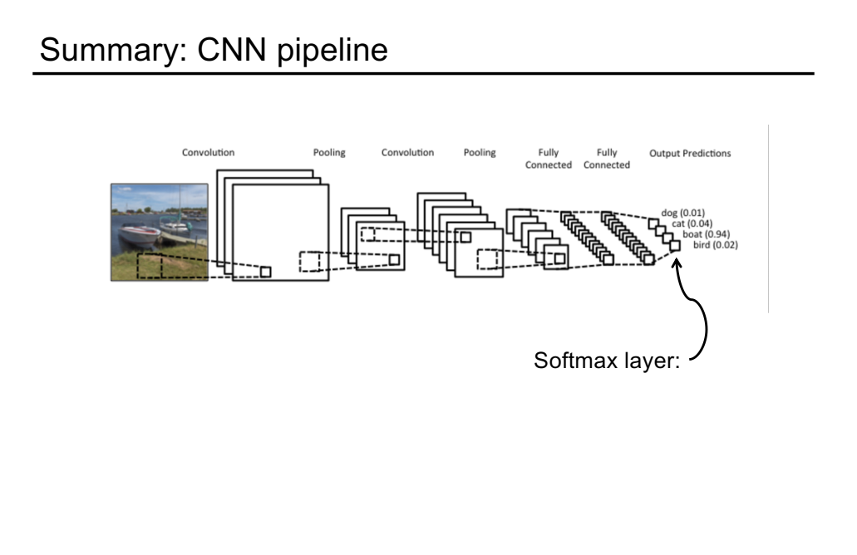

Slide 41
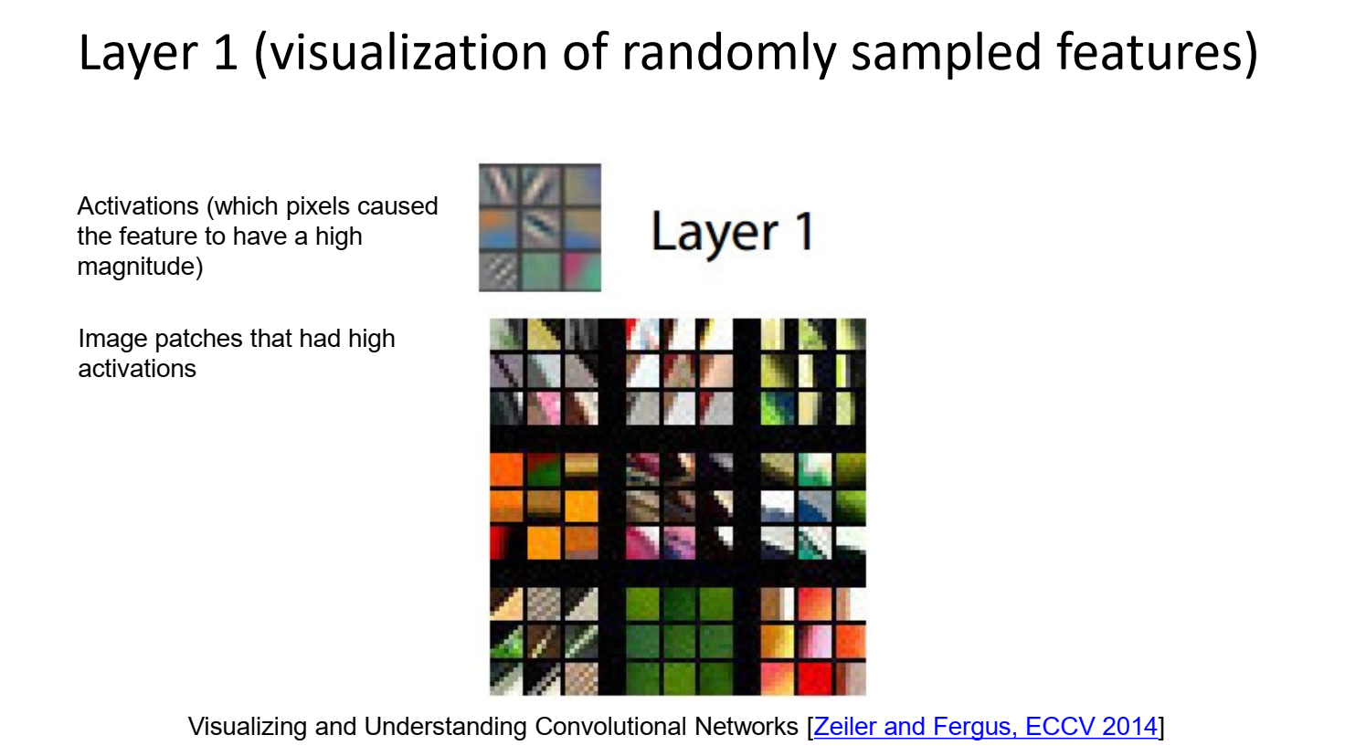

Slide 42
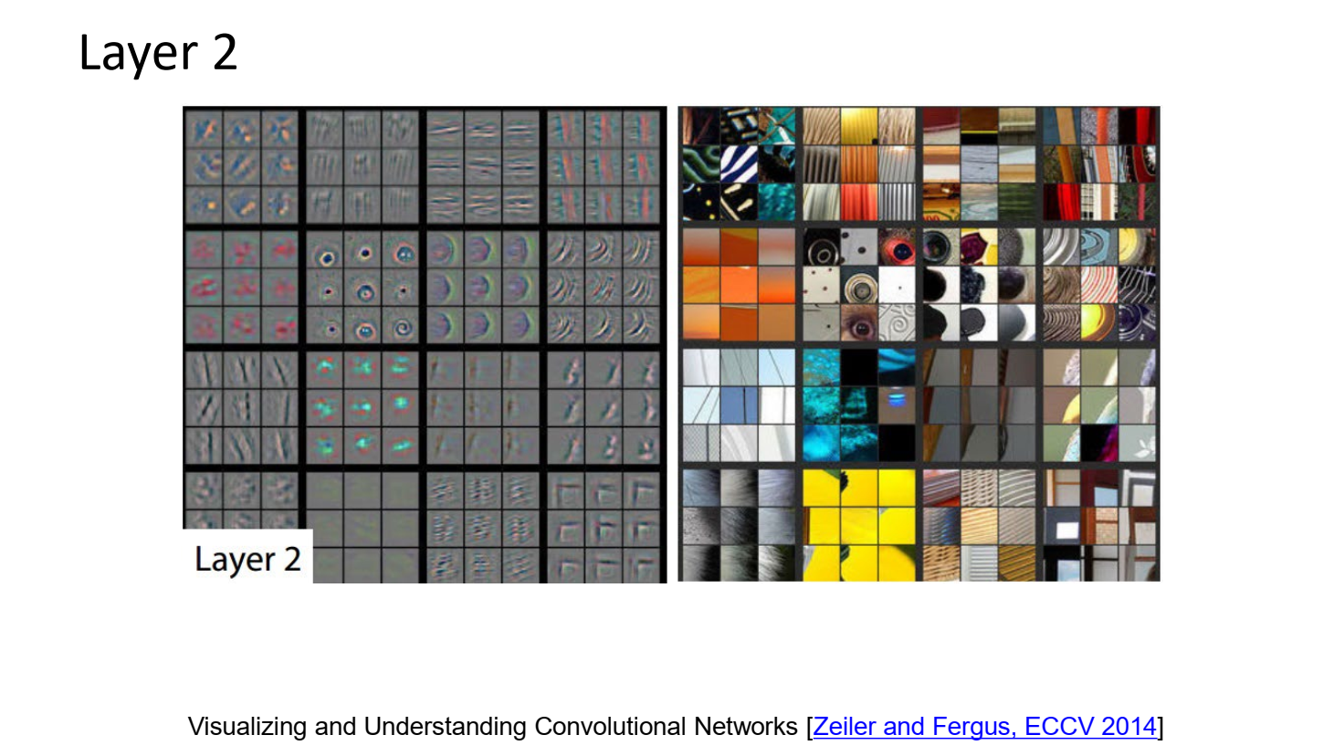

Slide 43
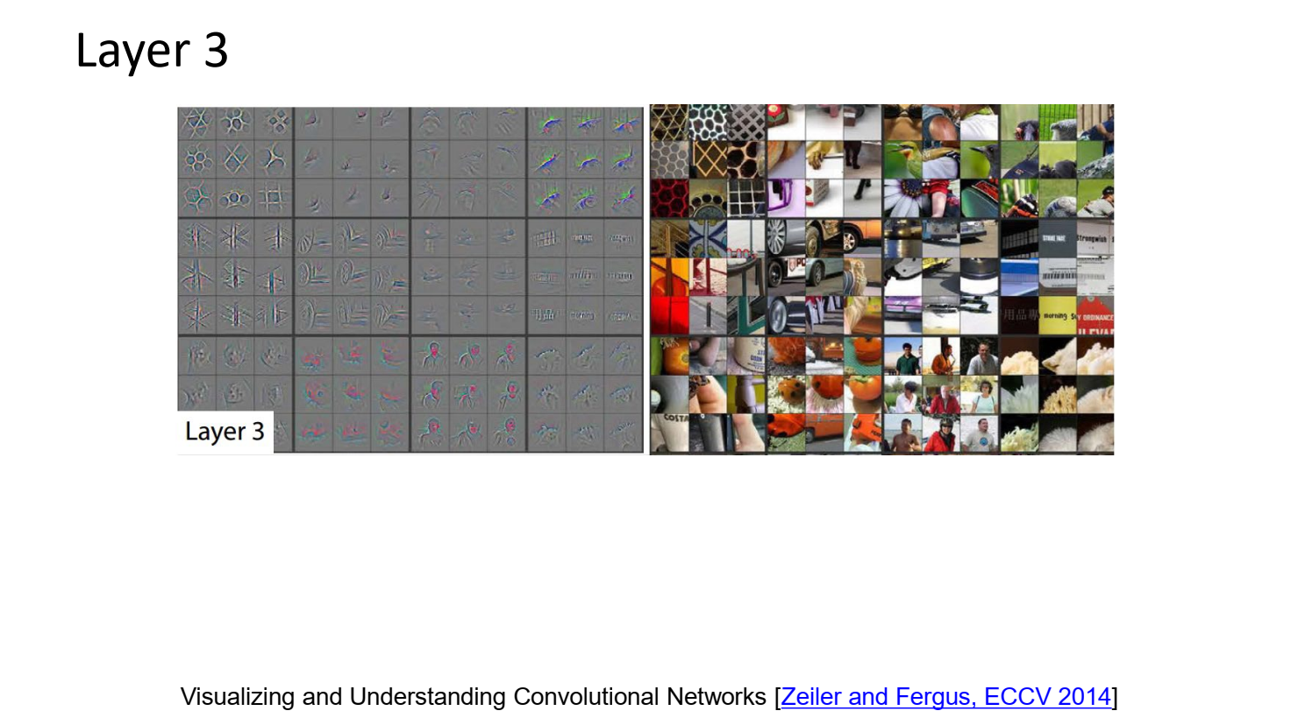

Slide 44
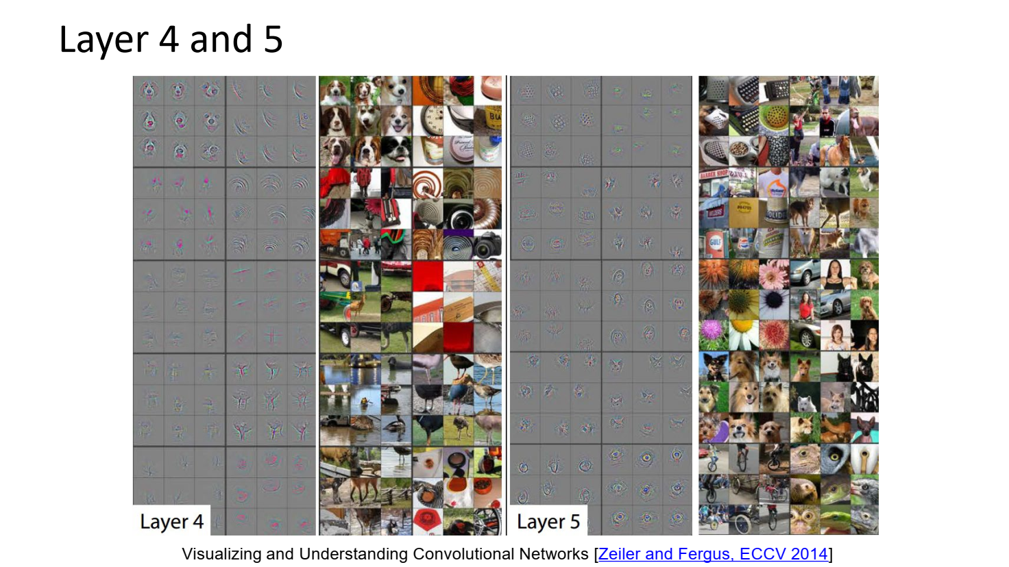

Slide 46
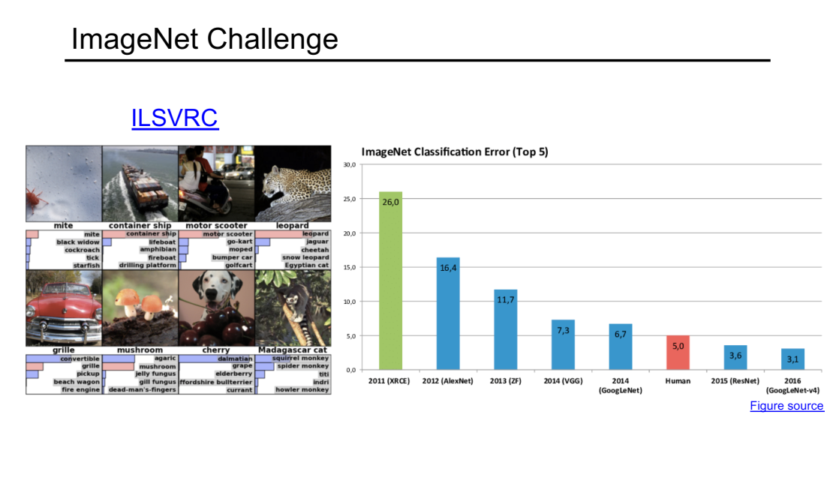

Slide 48
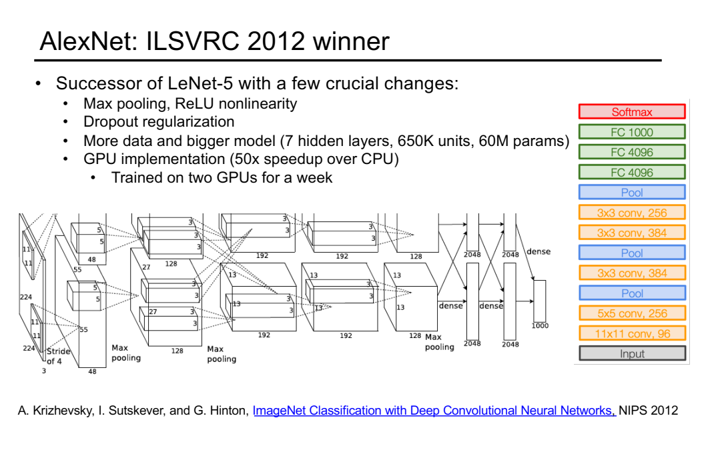

Slide 49
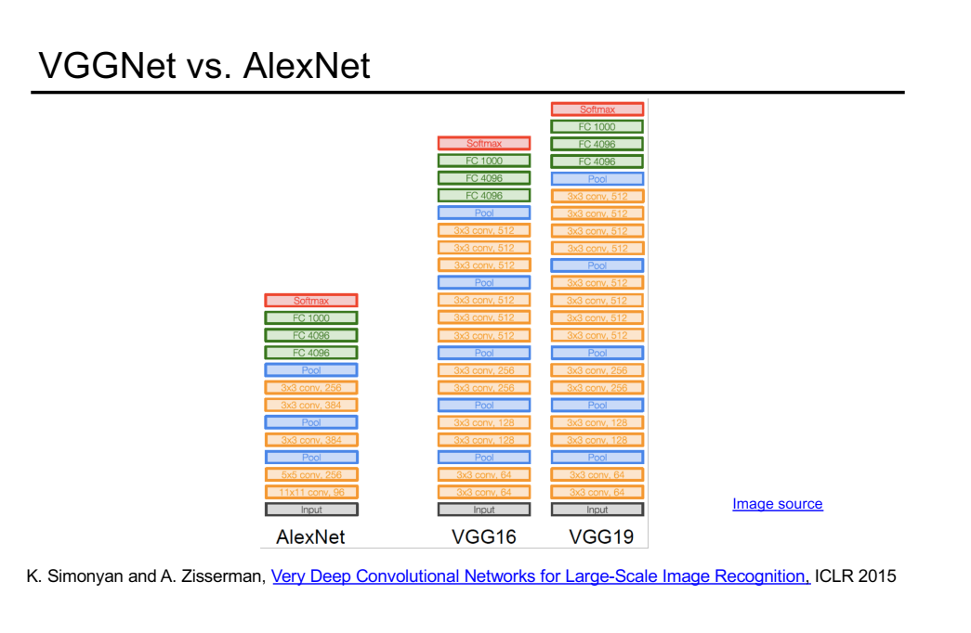

Slide 50
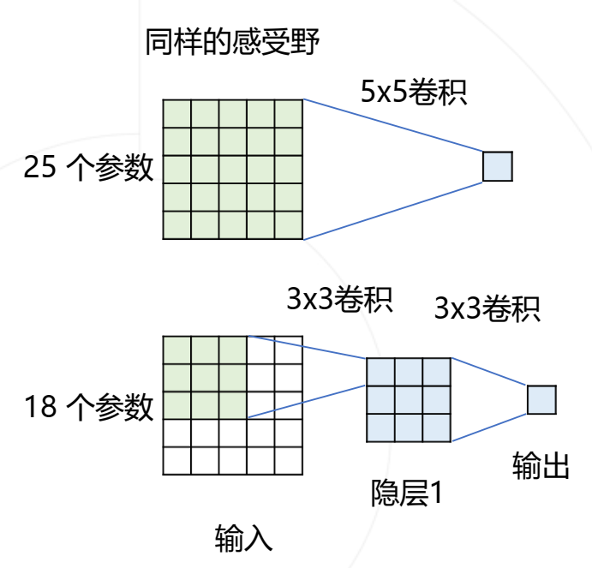

Slide 51
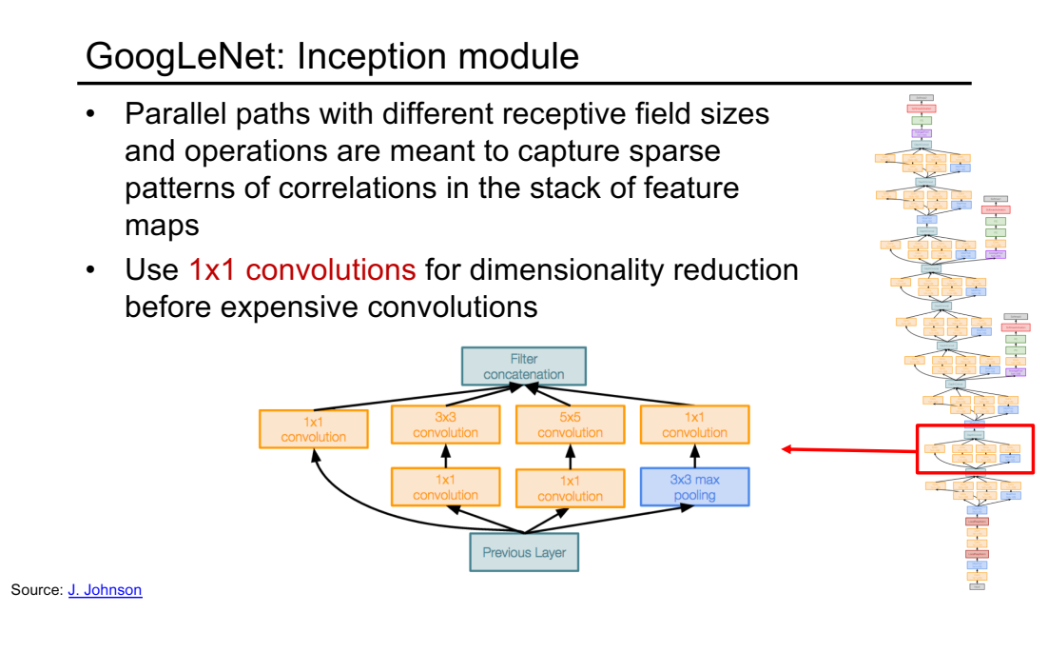

Slide 52
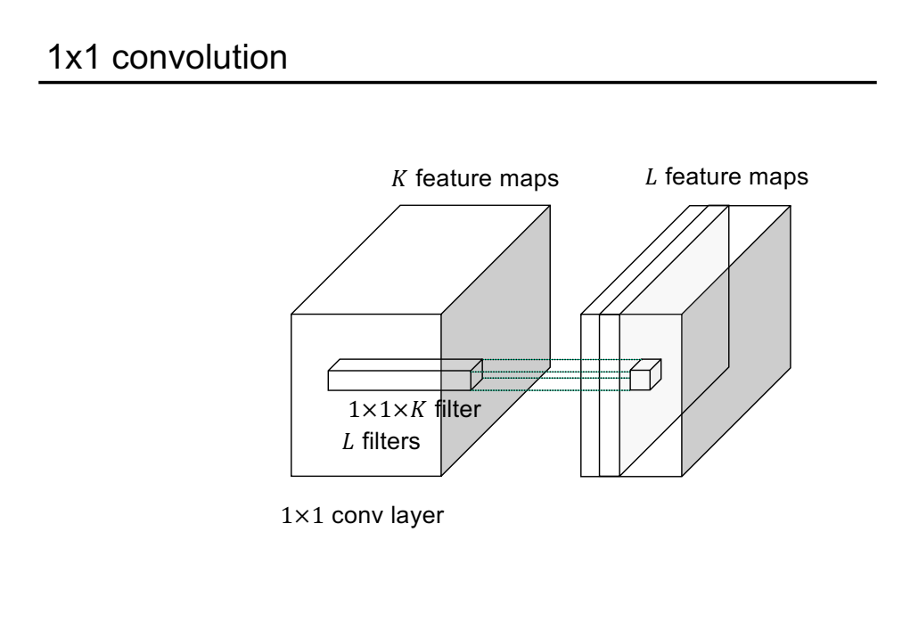

Slide 56
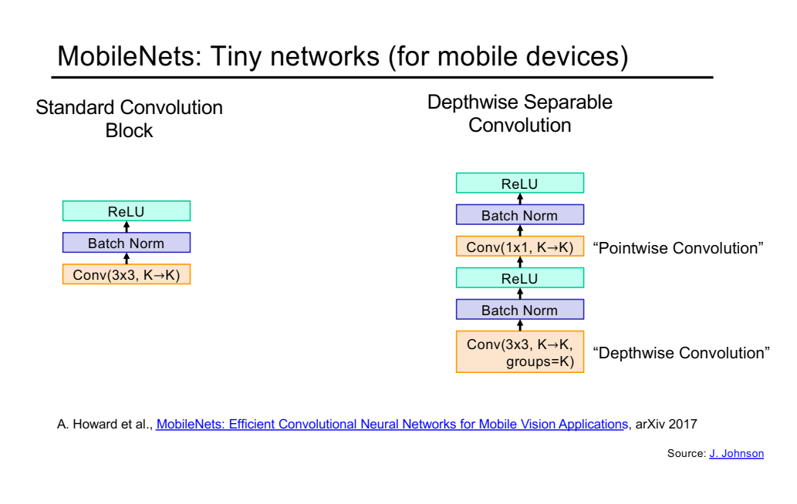

Slide 57
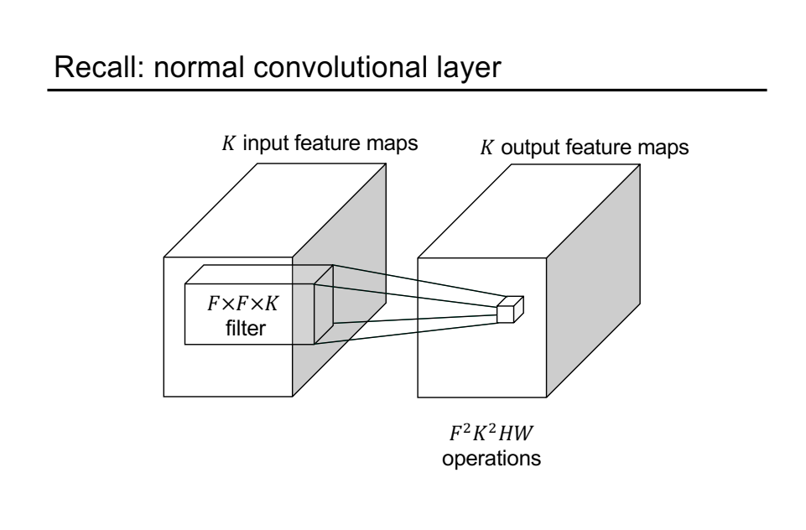

Slide 58
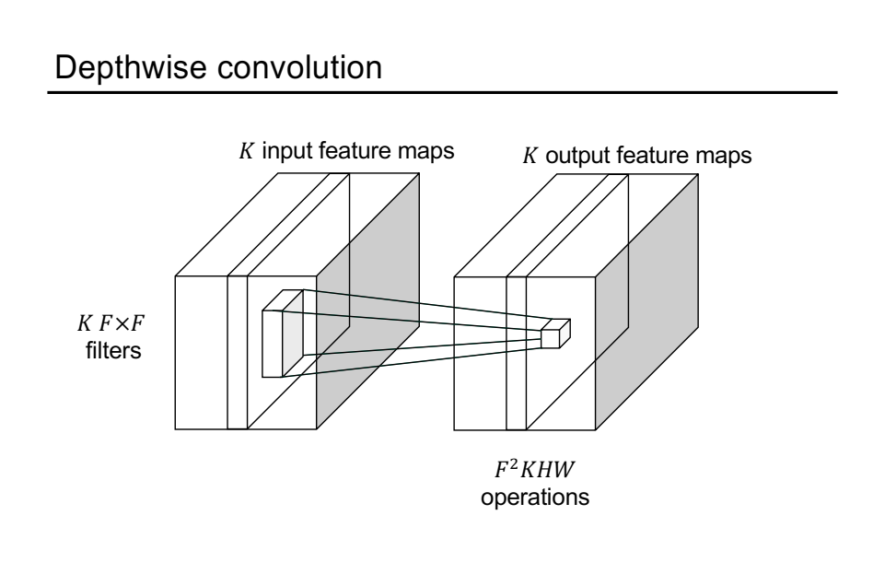

Slide 59
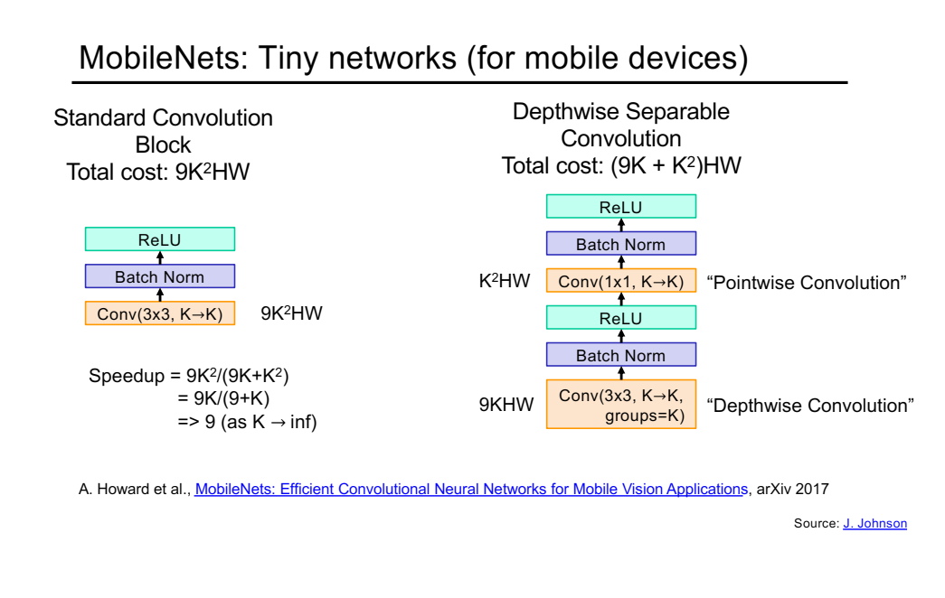

Slide 60
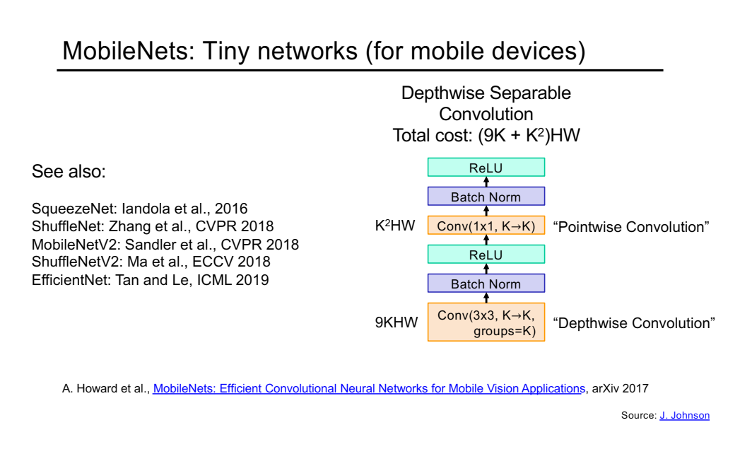

Slide 62
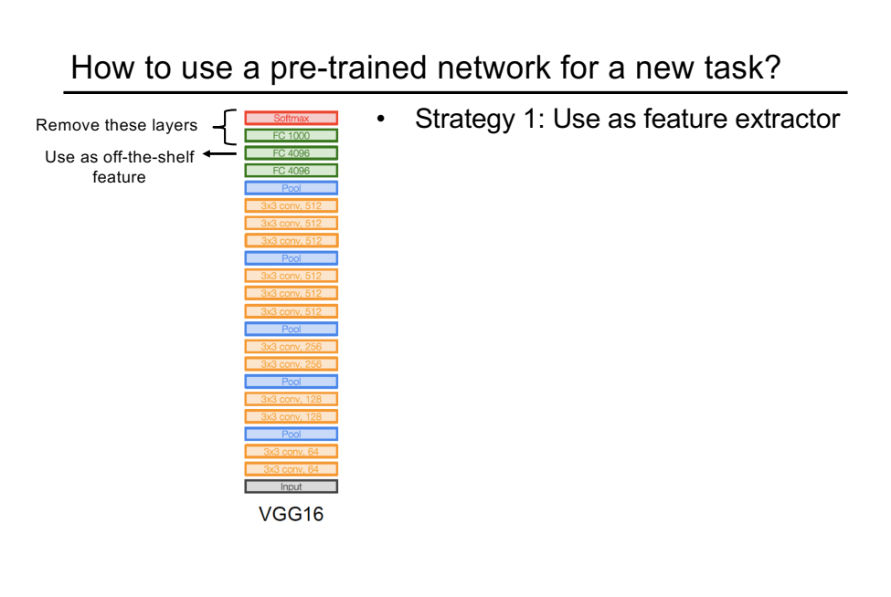

Slide 63
