Slide 1

Unreal Engine 6
Redefining the Future of
XR Development
VR · AR · MR — The Next Frontier in Immersive Technology
Xin Ma | 青蓝计划
Based on official announcements, industry analysis & cross-engine comparison
1/22

Slide 2
AGENDA
01
Why UE6 Now?
The announcement & timeline
02
Core Technical Breakthroughs
Multithreading · Verse · Scene Graph · Fortnite Ecosystem
03
XR Revolution: VR / AR / MR
New possibilities for immersive development
04
Engine Landscape Comparison
UE6 vs Unity vs Godot
05
Industry Impact & Outlook
Personal Analysis
2/22

Slide 3
01
Why UE6 Now?
The announcement, timeline & strategic context

Slide 4
01 INTRODUCTION
Why UE6 Matters Right Now
“Single-threaded execution was once a choice for simplicity. Now it has become an obstacle.”
— Tim Sweeney, CEO, Epic Games | Unreal Fest Tokyo, Nov 2025
RLCS 2026 Paris
First UE6 Game
2.5-Year Transition
Epic unveiled UE6 through a Rocket League teaser trailer at the championship event
Rocket League becomes the first confirmed title migrating to Unreal Engine 6
Tim Sweeney announced the transition to UE6 will take approximately 2.5 years
3/22

Slide 5

01 INTRODUCTION
4/22

Slide 6
02 TIMELINE
UE6: From Announcement to Reality
2020
2022
Nov 2025
May 2026
2027- 2028
2028- 2029
UE5 First Revealed
UE6 Graphics Revealed
UE6 Commercial
UE5 Full Launch
UE6 Roadmap
UE6 Preview
Nanite & Lumen technologies unveiled
General availability for all developers
Tokyo Unreal Fest: Verse + Scene Graph
Rocket League teaser at RLCS Paris Major
Expected preview/build available for developers
First UE6 titles on the market
Key Insight: UE4 → UE5 took ~8 years. UE5 → UE6 takes only ~6 years. This accelerated cycle reflects Epic's aggressive push toward a unified 3D internet infrastructure.
4/22

Slide 7
01
Core Technical Breakthroughs
Multithreading · Verse · Scene Graph · Fortnite Ecosystem Integration

Slide 8
01 BREAKTHROUGH
Full Multithreading Architecture
UE6's most transformative change: a complete redesign of its internal architecture
✖ UE5: The Achilles' Heel
✔ UE6: Parallel Computing Revolution
• Single-threaded simulation model • Game logic (AI, physics, animation) on one thread • 12-24 core CPUs severely underutilized • Causes stuttering, frame drops in many titles • 'ARC Raiders' abandoned Nanite due to CPU limits • Community criticism: 'UE5 optimization is poor'
• AI, physics, simulation, animation — all parallel • Multi-threaded texture streaming • Multi-threaded dynamic lighting • GPU + CPU co-scheduling optimization • Fully utilizes 12-24 core modern processors • Unlocks previously unattainable performance
UE5 Single-Thread Model
UE6 Multi-Thread Model
AI + Physics + Anim + Sim → 1 Core
→
Core 0: Game Logic | Core 1: AI | Core 2: Physics
Cores 1-15: Idle / Underutilized
Core 3: Animation | Core 4: Scene | Core 5-N: ...
6/22

Slide 9
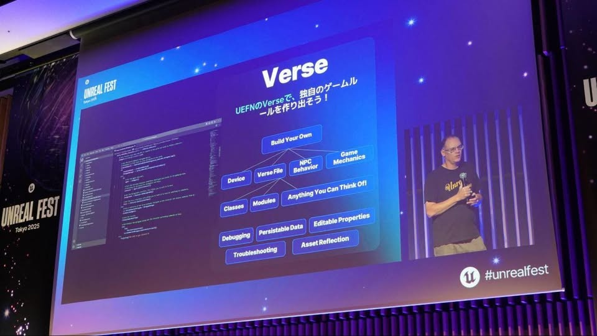
02 BREAKTHROUGH
Verse Language
Verse Programming Language
• Epic's own language, currently used in UEFN • Easier to learn than C++, comparable performance • Built-in memory safety & parallel primitives • Designed for 100+ person AAA team collaboration • Seamless C++ interoperability • Lowers XR content creation barrier significantly
Language Comparison
 | C++ (UE5) | Verse (UE6) | C# (Unity)
Learning Curve | Very Steep | Moderate | Moderate
Memory Mgmt | Manual | Auto GC + Safety | Auto GC
Concurrency | Manual threads | Built-in primitives | async/await
Collaboration | Complex deps | Designed for scale | Mature toolchain
Performance | Highest | High (~C++) | Medium-High
7/22

Slide 10
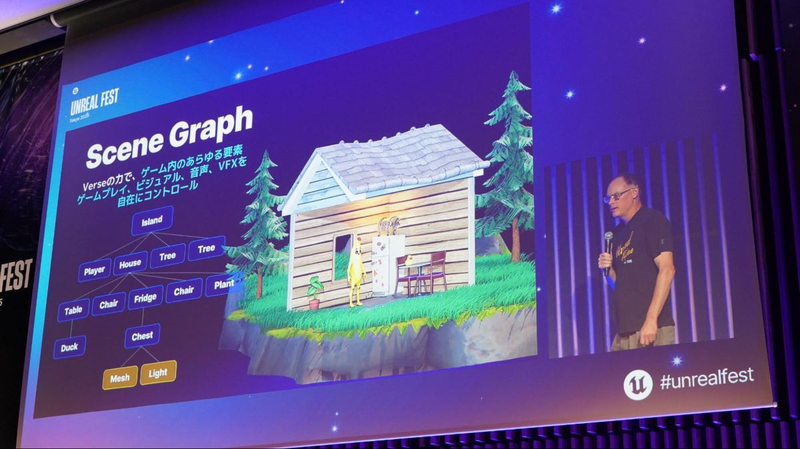
03 BREAKTHROUGH
Scene Graph Architecture
Scene Graph Architecture
• Next-gen content realization platform • Optimized for MMO / open-world scale projects • Multi-developer shared code & resource co-work • Dynamic scene loading/unloading for XR • Smooth scaling as project size grows • Foundation for metaverse-scale virtual spaces
7/22

Slide 11
04 BREAKTHROUGH
Fortnite Ecosystem Integration
UE6 merges two fragmented pipelines into a single, modular foundation
Current State: Fragmented
UE6: Unified & Modular
• Studio branch: traditional game dev • Fortnite branch: 7-platform custom version • Incompatible tools & workflows • Duplicated effort for cross-platform support • Technology fragmentation
• Single, modular codebase • Unified network layer • Unified scripting system (Verse) • Unified file management protocol • Portable across all target platforms
Fortnite Ecosystem by the Numbers
112B+
260K+
$722M
7
Hours played in UEFN games
Game versions created
Creator payout (~5.129B CNY)
Platforms supported
8/22

Slide 12
02
XR Revolution: VR / AR / MR
New possibilities for immersive development with UE6

Slide 13
XR TRANSFORMATION
How UE6 Solves XR's Hardest Problems
XR Challenge | UE6 Solution | Impact
90Hz+ frame rate requirement | Multi-threaded rendering pipeline | Stable high FPS without drops
<20ms motion-to-photon latency | Parallel computation reduces frame time | Smoother, more comfortable experience
Complex scenes (high poly + dynamic light) | Multi-threaded Nanite/Lumen + GPU/CPU co-scheduling | Cinematic VR in real-time
Massive virtual worlds (metaverse-scale) | Scene Graph efficient management | Seamless loading of enormous spaces
Multiplayer XR interaction | Unified network layer + scalable architecture | Thousands of concurrent users
Cross-device deployment | Unified modular foundation (Quest, Vision Pro, PSVR2) | Write once, deploy everywhere
WHY THIS MATTERS XR development has been trapped in a fundamental paradox: Higher visual quality requires more compute, but XR devices (especially standalone headsets) are severely compute-limited. UE6's multithreading breaks this trade-off, potentially delivering 50-150% more usable performance on the same hardware.
10/22

Slide 14
XR REVOLUTION
High-Fidelity VR & Mixed Reality
◆ Cinematic VR Graphics
◆ Mixed Reality Enhancement
• Nanite + Lumen became VR-capable in UE5.3 (2024) • But single-thread bottleneck made them impractical • UE6: Multi-threaded Nanite in VR becomes practical • Real-time ray tracing enters mainstream VR • 'Rocket League' UE6 trailer shows high-end RT • More realistic reflections, shadows, global lighting
• More precise spatial mapping & occlusion • Multi-threaded: scene understanding + physics + rendering • Critical for Apple Vision Pro & Meta Quest • Lower power consumption through efficient CPU use • Direct impact on wireless headset battery life • Enables always-on AR experiences
◆ Advanced Rendering Techniques
◆ Device Ecosystem Support
• FFR: Fixed Foveated Rendering • ETFR: Eye-Tracked Foveated Rendering • GPU load reduced by 30-50% • Multi-threaded scheduling enhances all techniques
• Meta Quest 2/3/Pro — Meta XR Plugin • Apple Vision Pro — visionOS C++ support • PSVR2 — Official Sony SDK • PC VR (Valve Index, HP Reverb) — OpenXR/SteamVR • HoloLens 2 — Microsoft OpenXR
11/22

Slide 15
XR REVOLUTION
Metaverse-Scale Worlds & AI-Native XR
☆ Metaverse-Scale Virtual Worlds
☰ AI-Native XR Interactions
• Scene Graph + multi-thread simulation → MMO-class VR worlds become feasible • Thousands of concurrent users, real-time interaction • Cross-platform asset interop (Quest / Vision Pro / PC) • Unified architecture = same assets run everywhere • A key step toward Open Metaverse • USD and glTF industry-standard support via Khronos
• Multi-threaded AI: each NPC on its own core • Real-time behavior decisions in VR • Natural language NPC conversations • Emotional AI response & environment awareness • Intelligent procedural generation • Adaptive difficulty based on player behavior
Epic's Ultimate Vision
“UE6 as the universal browser for the metaverse.” Future scenario: A player drives Studio A's car, uses Team B's weapon, and interacts with Company C's AI-NPCs — all in one shared city, in real time.
12/22

Slide 16
EVOLUTION
UE5 → UE6: XR Capability Leap
UE5 XR Capabilities (Current)
UE6 XR Capabilities (Expected)
✔ Nanite/Lumen basic VR support (5.3+) ✔ Foveated rendering (FFR + ETFR) ✔ Meta Quest dedicated optimization ✔ Apple Vision Pro support (C++ only) ✔ PSVR2 official support ✔ OpenXR founding member ✖ Single-thread game logic bottleneck ✖ Limited large-scale scene handling ✖ Fragmented development pipelines ✖ C++/Blueprint only ✖ Manual performance tuning required ✖ 'Optimization is poor' community criticism
★ Multi-thread accelerated high-quality rendering ★ Nanite/Lumen truly practical in VR ★ AI + Physics + Animation all parallel ★ Scene Graph: metaverse-scale spaces ★ Unified cross-platform XR deployment ★ Verse: rapid XR prototyping ★ Stable VR frame rates (multi-thread) ★ Smart multi-core scheduling ★ Lower XR optimization barrier ★ Open Metaverse foundations ★ Reduced power/thermal for standalone
→
13/22

Slide 17
03
Engine Landscape Comparison
UE6 vs Unity vs Godot vs WebXR — the complete picture

Slide 18
COMPARISON
XR Engine Comparison Matrix (2026)
Sources: Nilo Blog 2026, CSDN, Util.cn, RocketBrush, StraySpark Studio, Epic Dev Community
_{Dimension} | _{Unity 6} | _{UE5 → UE6} | _{Godot 4.x}
_{Render Pipeline} | _{URP/HDRP} | _{Lumen+Nanite (Cinematic)} | _{Standard 3D (Light)}
_{VR/XR Maturity} | _{★★★★★ Best} | _{★★★★ Rapid Growth} | _{★★ Basic}
_{Language} | _{C#} | _{C++/BP/Verse (UE6)} | _{GDScript}
_{Learning Curve} | _{Medium} | _{Steep (UE6 improves)} | _{Gentle}
_{Visual Ceiling} | _{Close to AAA} | _{Industry Best} | _{Medium}
_{Mobile VR Opt.} | _{★★★★★ Mature} | _{★★★★ Quest Optimized} | _{★★ Limited}
_{OpenXR} | _{Official + Preferred} | _{Founding Member} | _{Community Plugin}
_{Meta Quest} | _{★★★★★ Best} | _{★★★★ Official} | _{★★ Basic}
_{Vision Pro} | _{PolySpatial} | _{C++ Project Support} | _{Not Supported}
_{Best Use Case} | _{Mobile VR / Indie XR} | _{AAA VR / High-End MR} | _{Education / Experiments}
_{Pricing} | _{Seat-based Subscription} | _{Free + 5% royalty >$1M} | _{Free (MIT)}

Slide 19
04
Industry Impact & Outlook
Personal analysis

Slide 20
ANALYSIS
Why UE6 Is a Watershed Moment for XR
_{ARGUMENT 1}
Multithreading solves the fundamental XR performance paradox
XR has always faced a painful trade-off: you want cinematic visuals, but standalone headsets have limited compute. UE5 proved it could deliver stunning graphics (Nanite/Lumen), but single-thread bottlenecks made them impractical in VR. UE6's multi-threading promises 50-150% more usable performance on the SAME hardware. This means Quest 3-level standalone devices could potentially deliver PC VR-grade visuals.
_{ARGUMENT 2}
Scene Graph provides the first viable 'metaverse' technical foundation
The industry has talked about 'the metaverse' for years, but lacked an engine that could support truly massive shared virtual spaces. Scene Graph, combined with unified multi-thread simulation and networking, may be the first engine-level solution for 'thousands of users interacting in one high-fidelity virtual world simultaneously.'
_{ARGUMENT 3}
Verse language democratizes XR content creation
The biggest XR bottleneck isn't hardware — it's content creation cost. If Verse is truly 'much easier than C++' and 'designed for large-scale collaboration,' it could dramatically lower the barrier to XR app development, attracting a new wave of creators into the ecosystem.
_{18/22}

Slide 21
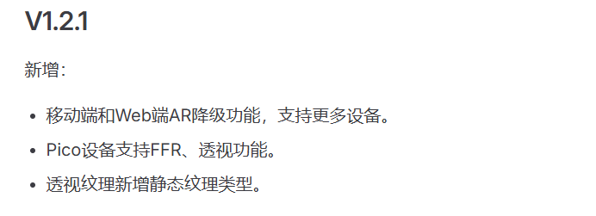


OTHERS
About Cocos
On November 12, 2025, the domestic game engine Cocos was wholly acquired by Sudden Technology (SUD) for 510 million RMB, and Cocos's business and team will be deeply integrated into SUD.

Slide 22
REFERENCES
Sources & Further Reading
• Epic Games Official — unrealengine.com • Notebookcheck — UE6 Graphics Revealed (May 24, 2026) • TechOlam — UE6 Multithreading Overhaul (May 24, 2026) • MundoGamer — UE6 Architecture & Unified Focus • GizNewsDaily — UE6 Rocket League Reveal • IT Home — Epic UE6 Roadmap (Nov 15, 2025) • ZOL — Verse & Scene Graph at Tokyo Unreal Fest • Sohu Tech — UE6 Official Launch (May 25, 2026) • 36Kr — UE6 First Reveal, 6-Year Iteration Cycle • Tencent News — UE6 New Generation Engine
• Nilo Blog — 3D Engine Comparison 2026 (Apr 2026) • CSDN — XR Development: Unity vs Unreal (Nov 2025) • Util.cn — Unity vs Unreal vs Godot Analysis (Jan 2026) • RocketBrush — Unity vs Unreal 2026 Comparison • Hyper3D — Best Game Engines 2026 • Game-Developers.org — Unity 6.3 vs UE5.7 (Jan 2026) • StraySpark Studio — VR Dev Meta Quest UE5 2026 • Epic Dev Community — Vision Pro Quick Start (Apr 2024) • Epic Dev Community — FFR & ETFR Optimization (Dec 2024) • Meta Developers — Meta XR Plugin Documentation
THANK YOU
22/22

