Slide 1
medCafe Tech Brief
Gail Hamilton and Jeff Hoyt
703-983-7855 • ghamilton@mitre.org
703-983-6241 • jchoyt@mitre.org
703-983-7043 • mgreer@mitre.org
MITRE Internal Information
For Limited External Release
Not approved for further distribution

Slide 2
medCafe Background
medCafe was funded as 1.5 yr effort to develop a
Prototype/ proof of concept
Prototype applying a modular system design to the healthcare domain. Specifically, examine:
Feasibility of composable approach
Engineering issues encountered
Potential future issues
As a result, many components typically present in production level systems were considered out of scope
To demonstrate ways to give
caregivers more time to do what matters most
Notes:
Multiple Data sources. No standard – too many standards
EHRs don’t communicate seamlessly
One size – different people, different roles, need to see different aspects of patient health record. And each patient will have specific data and unique information.
No way to highlight what is important.
Outside Records: Dr estimates 80% workload is taken dealing with these records
Uncategorized scanned in pdfs. Generally labeled with radiologist name. No real way to distinguish what it shows without looking at it.
And many more issues….
CCoD Principles:
Allow for a composable interface, giving users maximum flexibility to configure the interface to their needs
Create a framework in which to run standalone composable components
Create a set of standalone components that can be composed together to build a complete patient record.
Use an accepted data standard for all communication to components
Allow for distributing and creation of templates that mirror physician's workflow

Slide 3
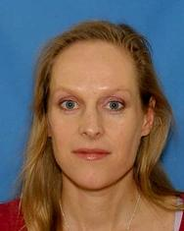
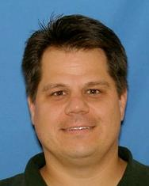
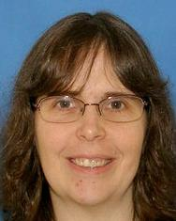
MedCafe People
Gail Hamilton (Pi) Jeff Hoyt (CoPi) Mary Greer
SME: Christian Donohue M.D.
VA Physician , Raleigh, Durham
National Primary Care Redesign Workgroup
Durham VA Systems Redesign Steering Committee
Durham VA Primary Care Redesign Committee
Notes:
Andy Gregorwitz: hData
Cheryl Clark: Medical Fact Extraction
David Harris: Categorization of discharge summaries PDFs
Christian Donohue M.D.:
National Primary Care Redesign Workgroup
Durham VA Systems Redesign Steering Committee
Durham VA Primary Care Redesign Committee
Dr. Donohue is currently a physician (since 2007) at the Department of Veterans Affairs, working at the Raleigh Clinic.
Jean Stanford, Mary Pulvemacher

Slide 4




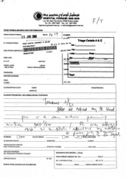
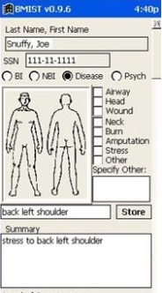

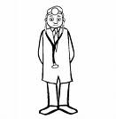
VA: The Current Workflow
Phone
Email
Fax
Vista
AHLTA
Outside Records
Has 15 minutes per patient
Notes:
They have, on average only 15 minutes to spend with each patient.
And have even less face time with a patient.
In this time they must
access the situation ,
to diagnose problem and
verify that old and new data confirms/ refutes this hypothesis
recommend treatment
To do this the doctor has to sift through a large amount of information, from various sources some of it not readily available.
These sources of information include:
VISTA – The system that they will currently be using to store patient records, or using as a messaging system
Email – generally Outlook
Fax – for any information that has been faxed from other clinicians or from outside sources
Phone – After a phone call, the physician has to write down the salient points of the call
And any scanned in records that are generically labeled “outside records”, and ,may include records from
AHLTA – The DoD medical system.
As a physician put it: “Everyday you need to search all these sources of information for data.”
Which leads to this…
All this information must be searched through and correlated in the physician’s head.
Which leads to this…

Slide 5
medCafe Goal
Goal: To demonstrate ways to improve interaction with patient records and increase efficiency to allow clinicians more time to interact with patient
Problem Addressed: Electronic Health Record (EHR) frustrations with:
Multiple data sources
“one size fits all” UI
Difficult to add new capabilities
Outside records/images
To demonstrate ways to give
caregivers more time to do what matters most
Notes:
Multiple Data sources. No standard – too many standards
EHRs don’t communicate seamlessly
One size – different people, different roles, need to see different aspects of patient health record. And each patient will have specific data and unique information.
No way to highlight what is important.
Outside Records: Dr estimates 80% workload is taken dealing with these records
Uncategorized scanned in pdfs. Generally labeled with radiologist name. No real way to distinguish what it shows without looking at it.
And many more issues….
CCoD Principles:
Allow for a composable interface, giving users maximum flexibility to configure the interface to their needs
Create a framework in which to run standalone composable components
Create a set of standalone components that can be composed together to build a complete patient record.
Use an accepted data standard for all communication to components
Allow for distributing and creation of templates that mirror physician's workflow

Slide 6
medCafe Technical Objectives
Develop an Open Source framework with:
Composable Architecture
Substitutable Components
Build a completely composable, easy to use patient record interface
Develop new ways for clinicians to interact with patient records
Design for flexibility, adaptability and evolution of the system
Provide relief from ‘pain points’ in common physician workflow
Provide an open framework
To allow users to build and add any desired capability
To provide more efficient ways for physicians to interact with patient records

Slide 7
MedCafe Objectives
We built a prototype to explore these issues
Web based (fully web 2.0)
Extensible architecture
CCoD¹ principles
Allow for Best of Breed
Listened to SMEs (Dr. Donohue)
¹Composable Capability on Demand
Notes:
Multiple Data sources. No standard – too many standards
EHRs don’t communicate seamlessly
One size – different people, different roles, need to see different aspects of patient health record. And each patient will have specific data and unique information.
No way to highlight what is important.
Outside Records: Dr estimates 80% workload is taken dealing with these records
Uncategorized scanned in pdfs. Generally labeled with radiologist name. No real way to distinguish what it shows without looking at it.
And many more issues….
CCoD Principles:
Allow for a composable interface, giving users maximum flexibility to configure the interface to their needs
Create a framework in which to run standalone composable components
Create a set of standalone components that can be composed together to build a complete patient record.
Use an accepted data standard for all communication to components
Allow for distributing and creation of templates that mirror physician's workflow

Slide 8
Scope
Due to limited funding and time, medCafe is a tightly scoped project
Prototype applying a modular system design to the healthcare domain. Specifically, examine:
Feasibility of composable approach
Engineering issues encountered
Potential future issues
As a result, many components typically present in production level systems were considered out of scope
Security (OAuth)
Role based access
Notes:
Why: History, Ideas, Goals and Objectives, Principles
How: Architecture, designed to allow plug and play of components, demo how to add component
What: Wish List, Development Milestones, Future Plans
So What: Why the MedCafe design aligns well to the direction of EHR

Slide 9

Small Pieces (Components)
Independent framework and many small, independent pieces
Allows use of “Best of Breed” components
Prevents vendor lock-in
Can replace part of the UI if it is insufficient or a better one appears
Easy to specialize
Purchase only what you need to cater to specialty
Smooth transition
Can start small and add capability over time
Notes:
Small components
Run standalone
Independent – can be added and dropped at will without affecting overall functionality
Allows Best of Breed

Slide 10

User Defined Interface
Default views (templates)
Start with default collection of components
Good for those who don’t want to customize
Clinician defined views
Some specialists, advanced users wish to customize their view for their patients
Per patient views
Some patients are not “fit the mold”
Modify a view for specific patient and save it
Speeds re-engagement with a patient
Notes:
Templates:
Give physicians starting point to build from :
quick way to acquire various commonly required data
Template will be a default collection of components, labeled according to clinicians needs – e.g. PTSD
Specialists – specific needs

Slide 11

Consistent Access to Data
All data sources are presented in an identical format
Allows all components to speak the same language
Components can access all data the same way
All data sources can be expressed through all available components
More component choices -> more data sources willing to play
More data sources -> more component developers
Notes:
We access the data the same way using hData
All components can display this data format.
Display can be changed – without changing data
Data can be changed without changing Display

Slide 12
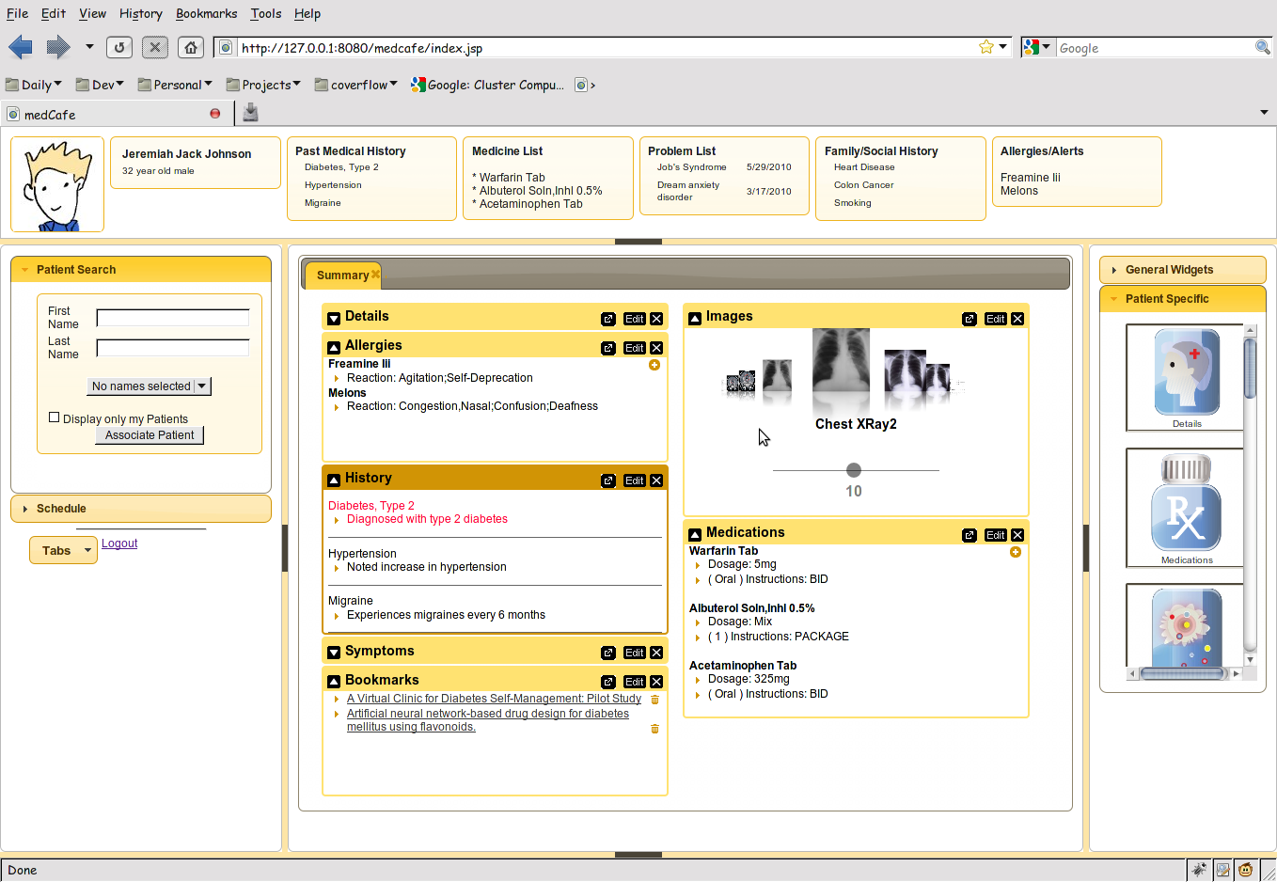
medCafe Interface
Top Pane: Coversheet containing commonly required patient data.
Left pane contains
Patient look up
and
scheduling functionality
Right hand pane contains list of
components that can be drag and dropped
into the center pane
Center pane contains composable patient record
Flexible 5 pane interface, adaptable to clinician’s needs. Panes can be hidden or shown.
Notes:
Framework overview:
5 major panes, North, South, etc,..
Can hide, show each pane.
Each pane can have multiple objects within it, such as tabs, widgets, sliders,treeviews etc,..

Slide 13
What We Learned
Use Modular Methodology in System Design
Building a Pluggable Architecture is Key to Composability
Choosing Good Loose Couplers is Key
Additional Important Points to Consider

Slide 14
MedCafe : Industry Feedback
From meeting with Open Health Tools
Rob Kolodner,
Chief Technology Officer for Open Health Tools
Former National Coordinator for Health IT
Skip McGaughey
(Executive Director) of Open Health Tools
Co Founder of Eclipse
“You solved a lot of the really hard problems”
“there are many who want to work to solve the next generation of the UI [user-defined GUIs], which you've already thought through most of”
From Demo to Clinical Groupware Collaborative
David Kibbe
Former Director of the Center for Health Information Technology for the American Academy of Family Physicians (AAFP)
“You have done some really strong stuff here”
Positively Impacting how MITRE is viewed in
Health care community

Slide 15
MedCafe : Industry Feedback
Veteran’s Affairs
Peter Levin (CTO)
“You have a very cool thing here!”
Doug Rosendale
Dir. of Joint Interoperability Ventures within the Veterans Health Administration (VHA) Office of Health Information (OHI)
“Wow – awesome,”
“I love the componentized nature of this.”
“You had me at drop box…”
Jim Demetriades (and Nancy Wilck)
Director, Emerging Health Technologies at Department of Veterans Affairs
“We tried to do something similar 5 years ago”
“You have (by accident) developed exactly the kind of GUI that users want…[they] want iGoogle interface”

Slide 16
Impacts External
OpenVista
Clinical Groupware Collaboration
medJ: CCR -> JSON Effort with David Kibbe
Veterans Affairs
DoD/VA EHR Joint Presentation
VAi2
BlueButton
Open Health Tools
nexJ
Positively Impacting how MITRE is viewed in
Health care community

Slide 17
Impacts Internal
Health research proposals plan to leverage medCafe infrastructure
Patient Toolkit: Empowering patients to effectively coordinate their care
Closing the Gap – Integrating Person Device Data with Tunable Clinical Alerting and Workflows
DOD/EHR Joint Presentation Layer
Provided inputs to presentation layer requirement slides
Upcoming demo to Rich Byrne (4/28/11)
Showing example of how CCoD Principles have been applied to Healthcare domain

Slide 18
Upcoming Efforts
White Paper
Presentation at an (unidentified) Healthcare conference
nexJ collaboration
CCR JSON web server
Open Health Tools (OHT) develop GUI for them (RFI)
Transition code to OHT
Transition write back code to medSphere (Open Vista)
VistA Modernization Effort: Help inform direction

Slide 19
Use Modular Methodology in System Design
Underlying code structure is modular
Separate code into following sections
Infrastructure
Loose coupler (hData)
Presentation (through JQuery/ AJAX)
Data Layer (RESTful service layer)
Benefits
Minimizes impact on other sections if one has to be changed
E.g. If there were a federal mandate to use a different loose coupler, this code could be modified without impacting the system as a whole
Separate presentation layer completely from data layer for maximum flexibility

Slide 20
Building a Pluggable Architecture is Key
Best Practices
Each component communicates through one data standard
XML Configuration file used to list components available to system
Move to one configuration xml file per component
A list of functions that each component can perform should be enumerated and documented, for example:
Provide the ability to obtain a snapshot of the data contained in component at any time
Benefits
Allows for components to be swapped in and out of the
System (by an Administrator)
Presentation of the Patient Record (by the user)
Truly Composable System
System is adaptable to practices’ needs, individual clinicians needs and patient’s individual circumstance
System evolution is designed into the framework
Allows for Best of Breed of Components
Notes:
We access the data the same way using hData
All components can display this data format.
Display can be changed – without changing data
Data can be changed without changing Display

Slide 21
Determining a Good Loose Coupler is Key
Loose coupler is data standard around which components and services communicate
Best Practices
Loose coupler should be simple, optimized for most use cases (think KML)
C32 is too complex and will not be good loose coupler
Analyze current events / messages, look for 80% solution
Optimizing loose coupler to be used for all cases has drawbacks
Not optimized for performance
Will not be the best data standard for a single purpose
System may use multiple loose couplers
But components should only display information from a single format
“Extra” couplers should be built around real need
Images, Business Analytics
Benefits
If all components understand data context -> much richer user interface
Notes:
We access the data the same way using hData
All components can display this data format.
Display can be changed – without changing data
Data can be changed without changing Display

Slide 22
Important Points To Consider
Building a system to a composable, substituable design methodology is not easy
Design focus should be on building usable underlying framework not on user components
Goal is for components to evolve and adapt over time
Evolution of components and system HAS to be easy
First set of components should quickly become obsolete as new components become available
Build system as flexible as possible at the start, then build in constraints
Translation of source format to the loose coupler will be a large effort
Each service provider will need to provide data to this format, involving a large initial effort, possibly small return for first few components, may act as barrier to adoption

Slide 23
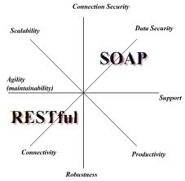
Important Points To Consider (cont)
Focus on Reuse
Where possible use / adapt existing components
Use existing presentation framework
JQuery enabled use of existing plug-ins
Allowed for extremely rapid development of components
Consider RESTful architectures
This framework is robust and flexible ^{[1]}
Allows for quick development and integration
Consider granularity of components in design
Chaining of components
Should be possible to chain together services and components for complex functionality
Dependencies on services
Where there is heavy dependency on a critical service or component, allow for duplication
[2]
¹MITRE Systems Engineering Guide, Composable Capabilities on Demand (CCoD)
²http://nicolas-zozol.developpez.com/tutorial/java/rest-jsp-english/

Slide 24
Open Source
Open source repositories:
Open Health Tools: https://projects.openhealthtools.org/sf/sfmain/do/home
Open Source EHR in Use
FreeMED
OpenEMR
OpenEMR Current
OpenEMR Virtual Appliance
FreeB
SmartCare
Xchart
OpenMRS
Open Dental Software
ClearHealth

Slide 25
EHR: The Way Forward?
PCAST recommendation
Use meta-data tags for loose coupler
VA VistA Modernization
ACT-IAC Vista Modernization
Carnegie Mellon report recommending Open Source solution for VistA
Patient Centric approach
Clinical Groupware
ONC commits $60 million to 4 grants to solve EHR problems
Harvard SMART (Substitutable Medical Applications, Re-useable Technology) $15 million
“The approach could impact both the EHR industry…..(in) 1-3 years”¹
Clinical Groupware Consortium
New Data Delivery Platforms
iPad Apps, smart phone apps,..
Modularization Certification
HHS Certification process ("meaningful use of certified EHR technology”) for modular apps
CCHIT certification program for components of EHRs
¹http://www.thehealthcareblog.com/the_health_care_blog/2010/10/update-on-modular-ehr-technology-harvards-smart-research.html
Notes:
SMART: creating a “medical apps store” based on the iPhone/iPad model of substitutable applications running on a device or platform.
The approach could impact both the EHR industry and the federal regulatory and standards process, possibly within a relatively short period, i.e., 1-3 years, so we think it merits your attention.
ONC: Office of the National Coordinator for Health Information Technology

