Slide 1
medCafe
A MITRE Research Project
Gail Hamilton : ghamilton@mitre.org
Jeff Hoyt : jchoyt@mitre.org
Mary Greer : mgreer@mitre.org
April 28th, 2011
MITRE Internal Information

Slide 2




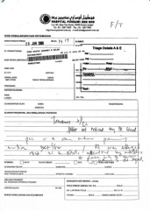
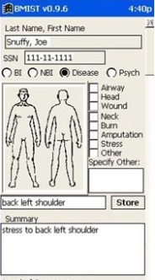


VA Clinician: The Current Workflow
Phone
Email
Fax
Vista
AHLTA
Outside Records
Has 15 minutes per patient
Notes:
They have, on average only 15 minutes to spend with each patient.
And have even less face time with a patient.
In this time they must
access the situation ,
to diagnose problem and
verify that old and new data confirms/ refutes this hypothesis
recommend treatment
To do this the doctor has to sift through a large amount of information, from various sources some of it not readily available.
These sources of information include:
VISTA – The system that they will currently be using to store patient records, or using as a messaging system
Email – generally Outlook
Fax – for any information that has been faxed from other clinicians or from outside sources
Phone – After a phone call, the physician has to write down the salient points of the call
And any scanned in records that are generically labeled “outside records”, and ,may include records from
AHLTA – The DoD medical system.
As a physician put it: “Everyday you need to search all these sources of information for data.”
Which leads to this…
All this information must be searched through and correlated in the physician’s head.
Which leads to this…

Slide 3
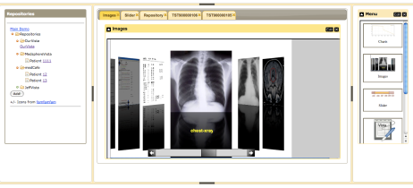





medCafe Architecture
Composable Framework
RESTful Web Services
CCR
Tabs
Coverflow
Date Slider
Image Viewers
Charts
Tomcat Web server
T
openVista
JAVA/ J2EE
Web Services
Additional
data servers
AJAX
medCafe Interface
Application server
Health-data server
medCafe architecture composed of multiple distinct, separable layers: front-end, application, loose coupler
and data server.
Notes:
This shows the architecture of the framework that we have built.
We have four distinct pieces that make up the medcafe composable framework.

Slide 4

Small Pieces (Components)
Independent framework and many small, independent pieces
Allows use of “Best of Breed” components
Prevents vendor lock-in
Can replace part of the UI if it is insufficient or a better one appears
Can replace (substitute) components when better ones become available
Easy to specialize
Purchase only what you need to cater to specialty
Smooth transition
Can start small and add capability over time
Notes:
Small components
Run standalone
Independent – can be added and dropped at will without affecting overall functionality
Allows Best of Breed

Slide 5
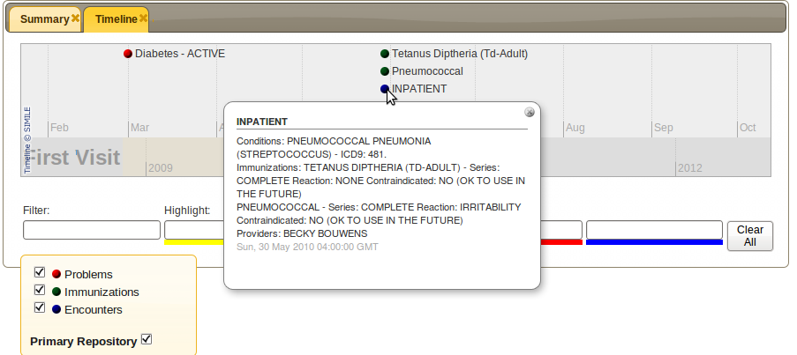
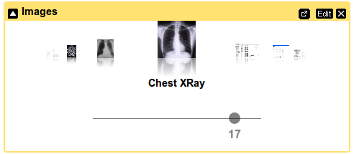
medCafe Components
Timeline visualizes patient history
Image viewer displays images and pdf
documents

Slide 6

User Defined Interface
Customizable via Component composition
User selects which components to use
Default views (templates)
Start with default collection of components
Good for those who don’t want to customize
Clinician defined views
Some specialists, advanced users wish to customize their view for their patients
Aligns with patient use cases
Per patient views
Some patients do not “fit the mold”
Modify a view for a specific patient and save it
Speeds re-engagement with a patient
Notes:
Templates:
Give physicians starting point to build from :
quick way to acquire various commonly required data
Template will be a default collection of components, labeled according to clinicians needs – e.g. PTSD
Specialists – specific needs

Slide 7

Loose Coupler: Consistent Access to Data
All data sources are presented in an identical format
Allows all components to speak the same language
Components can access all data the same way
Consistent method of access
Data sources transparent to user
More component choices -> more data sources willing to play
More data sources -> more component developers
Notes:
We access the data the same way using hData
All components can display this data format.
Display can be changed – without changing data
Data can be changed without changing Display

Slide 8
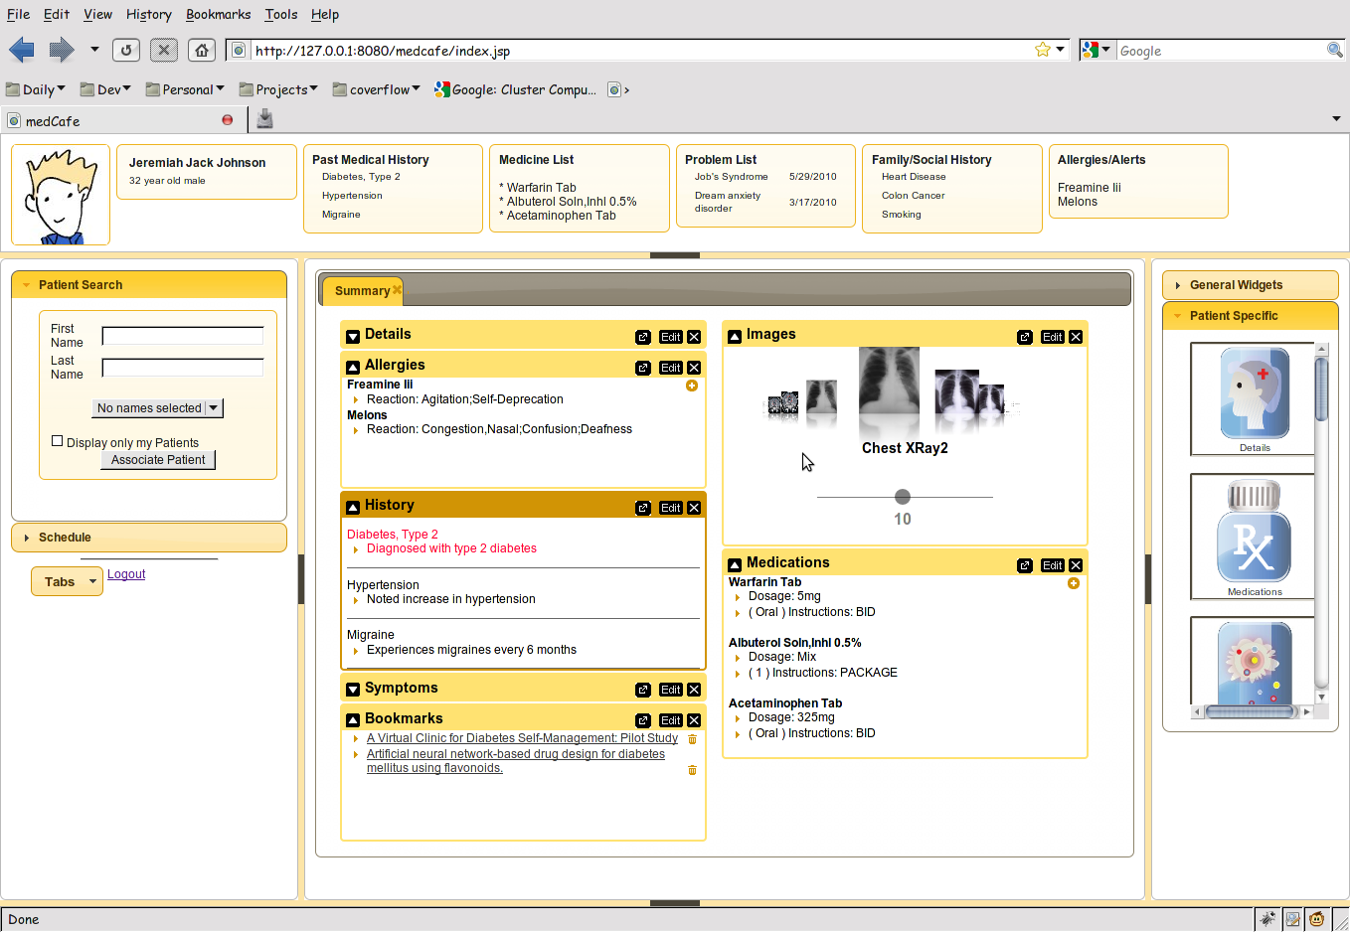
medCafe Interface
Top Pane: Coversheet containing commonly required patient data.
Left pane contains
Patient look up
and
scheduling functionality
Right hand pane contains list of
components that can be drag and dropped
into the center pane
Center pane contains composable patient record
Flexible 5 pane interface, adaptable to clinician’s needs. Panes can be hidden or shown.
Notes:
Framework overview:
5 major panes, North, South, etc,..
Can hide, show each pane.
Each pane can have multiple objects within it, such as tabs, widgets, sliders,treeviews etc,..

Slide 9
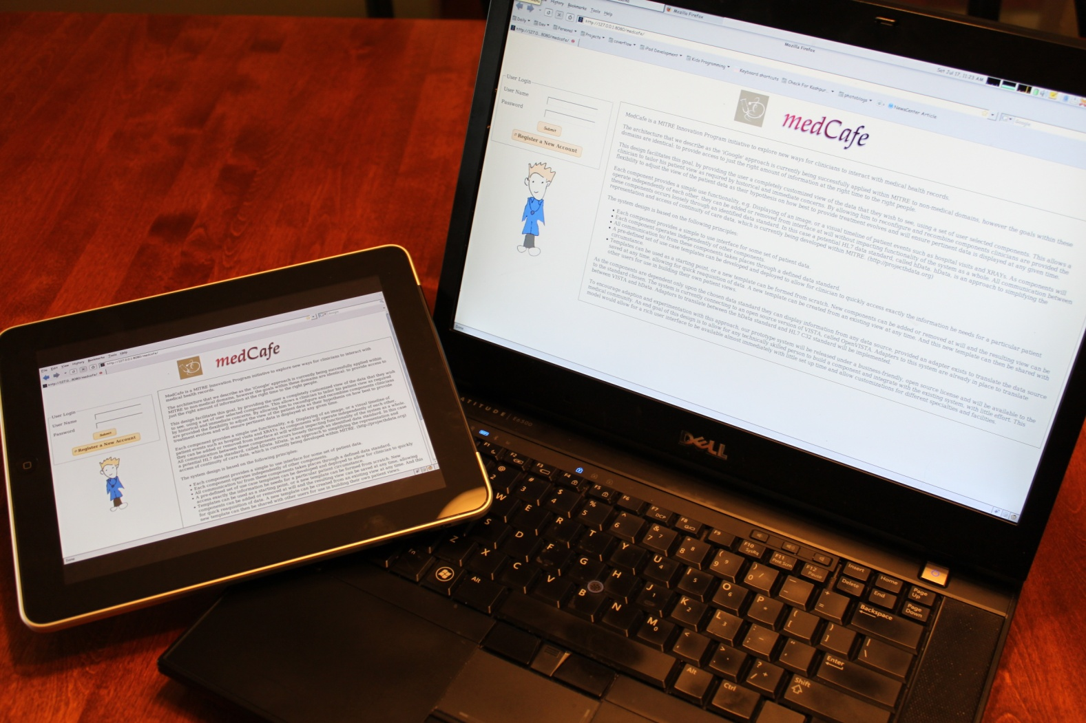
New Delivery Platforms
Notes:
iPad delivery through Browser. Added Touch gestures to allow for interfacing with data.

