Slide 1
medCafe
Gail Hamilton and Jeff C. Hoyt
703-983-7855 • ghamilton@mitre.org
703-983-6241 • jchoyt@mitre.org
MITRE Internal Information
For Limited External Release

Slide 2
Overview
We want to demonstrate ways to give
caregivers more time to do what matters most
Showcase CCoD¹ principles to provide relevant data quickly
Provide components to streamline their current workflow
¹Composable Capability on Demand
Notes:
In our MIP we hope to provide a means to demonstrate to the clinicians a way to access to the most relevant data when they need it.
This will help the caregivers to spend more time providing effective care.
We plan to do this through using CCoD principles to provide relevant and timely information to the clinician.
And are provid a small number of compelling components,to be used within this framework to help streamline the physicians current workflow.

Slide 3
How do we do it?
Providing an extensible User Defined Interface for clinicians to allow them to be more efficient
Create composable record view
Templates
Providing a way for physicians to process the non categorized “Outside records”
Work closely with SMEs
Christian Donahue, M.D. (Durham Medical Center, NC)
National Primary Care Redesign Workgroup
Durham VA Systems Redesign Steering Committee
Durham VA Primary Care Redesign Committee
Notes:
We planned to
By tackling the problems by applying Composable capabilty on demand principles to the Healthcare domain.
The first part is to provide a flexible, easily extensible User defined interface.
The second is to provide a way for physicians to deal with the cumbersome and time consuming “Outside records”. By providing a means of categorizing the pdf data through text extraction.

Slide 4
Key Deliverable: FY10 Prototype
User Defined Interface
Categorize images outside records
MyInterface
Customizable to clinician’s requirements
Templates
Components
Coverflow interface to review images
Filter criteria
‘See’ what other components were used to review patient’s history
Add new SME identified components (e.g. Timeline)
Notes:
These are the key deliverables that we expect to deliver.
We already have the framewrk in place for the User Defined Interface.
And are working on adding more components to this interface.
We plan to provide a customizable interface that the clinician can save and return to.
As well as providing templates for easy data retrieval.

Slide 5
Projected Project Timeline
Total cost/duration: 1 yr/$325,000
Notes:
Here was our timeline that we mapped out.

Slide 6
Actual Project Timeline
Total cost/duration: 1 yr/$325,000
Notes:
Have moved the 2nd quarter goal of developing a prototype composable framework to 1st goal. Moved the 1st quarter goal of categorization of pdf to second quarter.
Two goals were parallel and not dependant upon one another. So no impact on longer term goals.

Slide 7
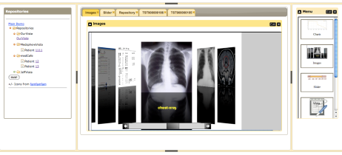





medCafe Architecture
Composable Framework
RESTful Web Services
Tomcat Web server
T
Tabs
Coverflow
Date Slider
Image Viewers
Charts
openVista
AJAX
JAVA/ J2EE
Additional
Data servers
medCafe Interface
Health-data server
Notes:
This shows the architecture of the framework that we have built.
We have two distinct pieces that make up the medcafe composable framework.

Slide 8
medCafe Front End Architecture
VISUAL
WIDGETS
Coverflow
Image Viewer
Date Slider
Charts
Tables
TreeView
Image Zoom
…

Slide 9
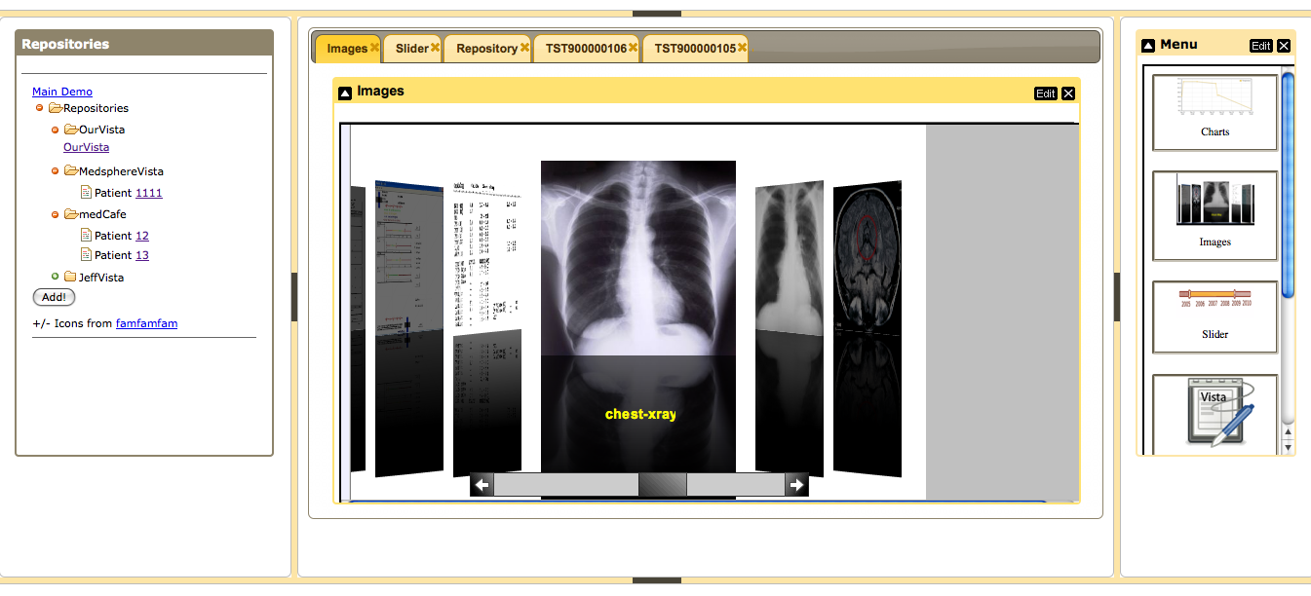
medCafe Interface
Notes:
Framework overview:
5 major panes, North, South, etc,..
Can hide, show each pane.
Each pane can have multiple objects within it, such as tabs, widgets, sliders,treeviews etc,..

Slide 10
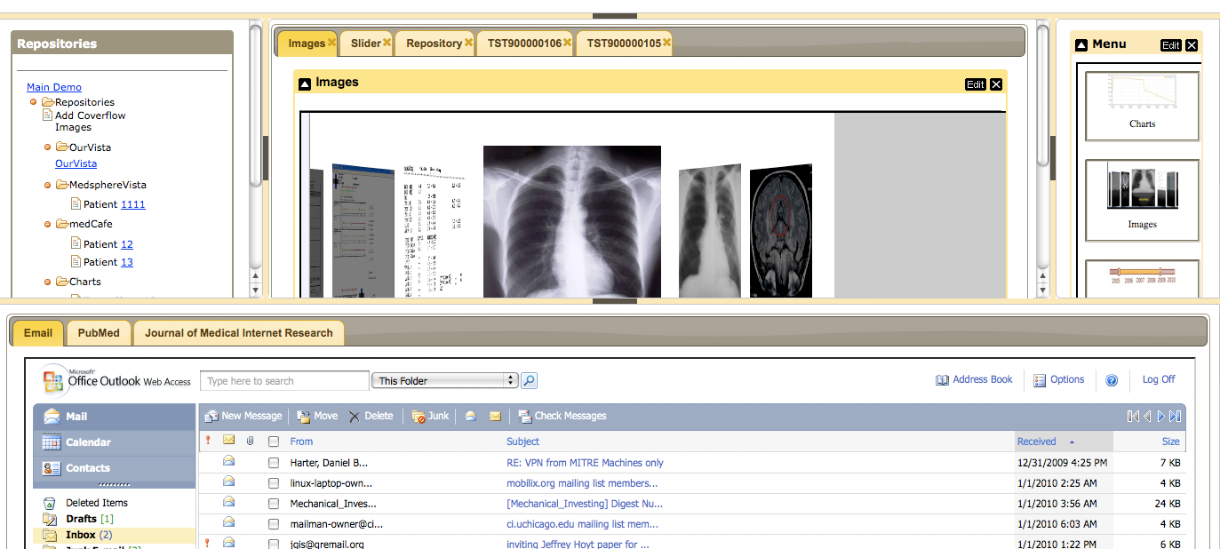
medCafe Interface (cont.)

Slide 11
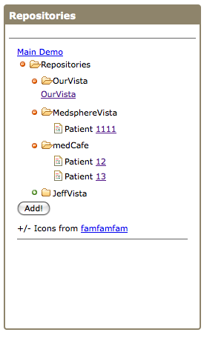
Repository List
Repository retrieves RESTful web service
Treeview Display, using display template
Treeview widget can be used to display any type of data.
Data display independent of data being displayed

Slide 12
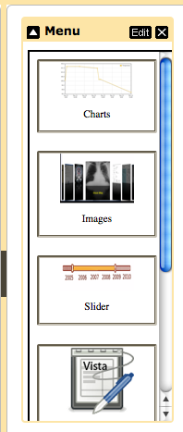
Widget List
Widget List from RESTful web service
Click to have appear in main display
Display formatting through templates
Custom JQuery code automatically applies functionality based on class of HTML element

Slide 13
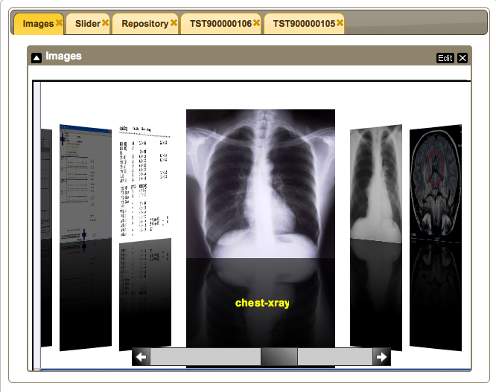
Coverflow Widget
Images retrieved from RESTful service
http://127.0.0.1:8080/medcafe/c/repositories/OurVista/patients/1/images
JSON data reformatted through display templates to XML format
XML format read by Coverflow widget
Clicking on image brings up new widget on new tab object

Slide 14
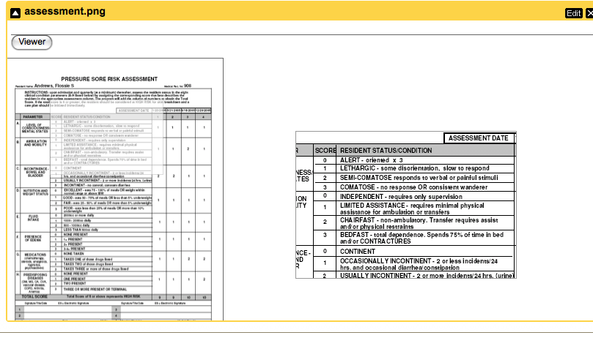
Image Viewer
ImageViewer:
Dual image display
Full image
Zoomed in image of area of focus
Button Click for Image Zoomer

Slide 15
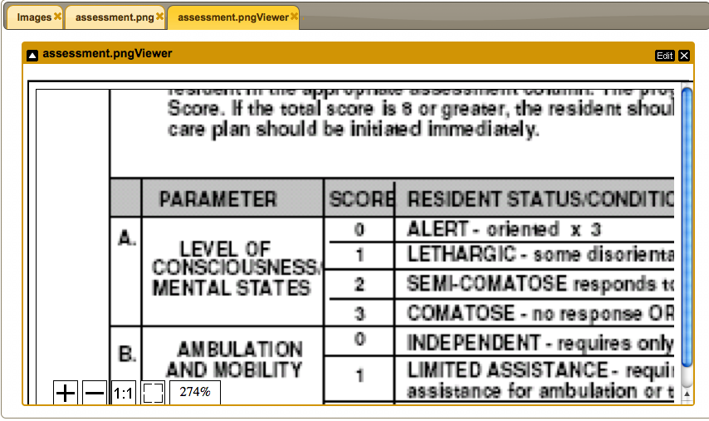
Image Zoomer
ImageZoom:
Allows for enlarging of image
For reading of small text on pdf images
Examining detail on radiology images

Slide 16
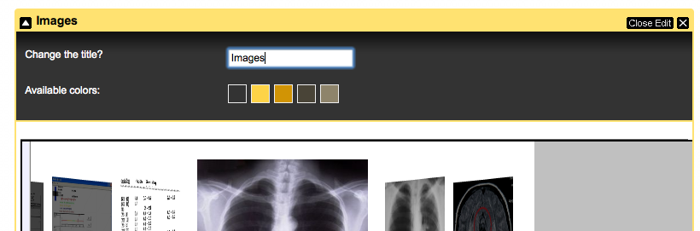
Edit Widget
Edit Widget, can change Title and color of bar. To emphasize important information.
Can minimize widget.

Slide 17
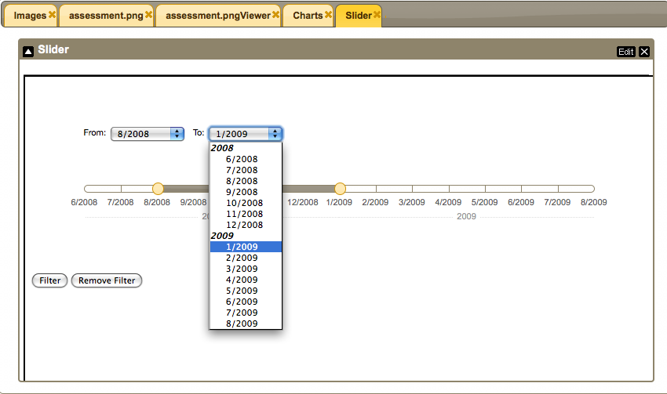
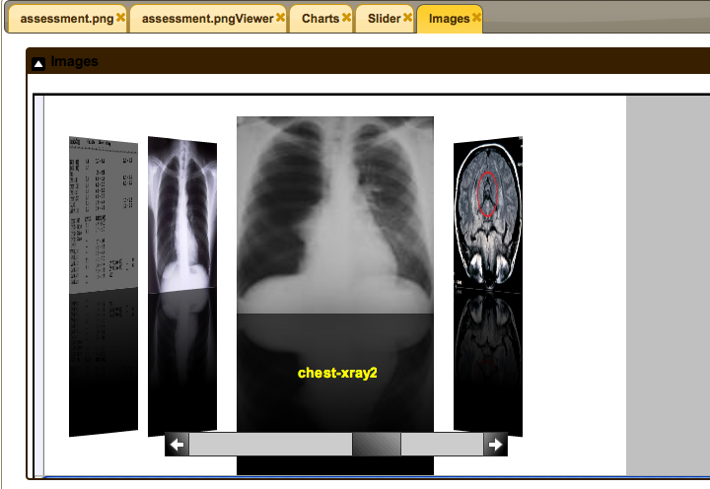
Interactive Date Slider
Interactive date slider
Displays data from RESTful service
Takes start and end date as input
Will filter data on other widgets according to dates specified
Automatically interacts through Event Pooling with any other registered widget.
E.g. Coverflow Image Widget

Slide 18
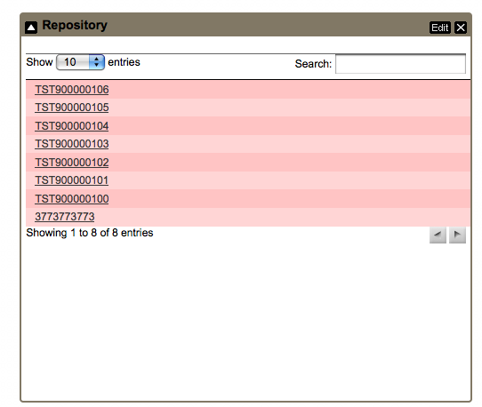
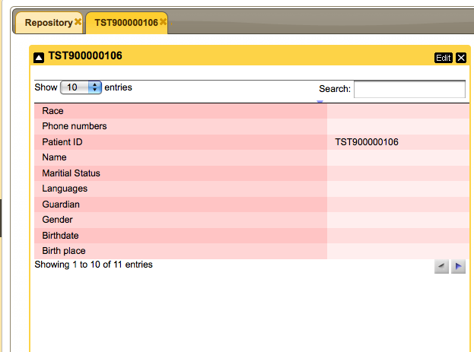
OpenVista Data Display
Data from RESTful web service
Formatted to HTML through formatting templates
Displayed in table format after data retrieved
Search and filter capability
Navigator for multiple page views
Click on patient ID value for detail listing of patient data on new tab.

Slide 19
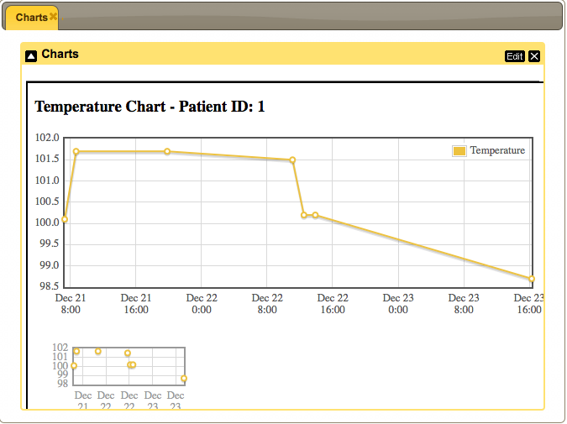
Charts
Data from RESTful web service
Chart widget takes JSON data as input
Can display any 2 dimensional array
Zoom on any point in chart
Duplicate chart at bottom for zooming out.

Slide 20
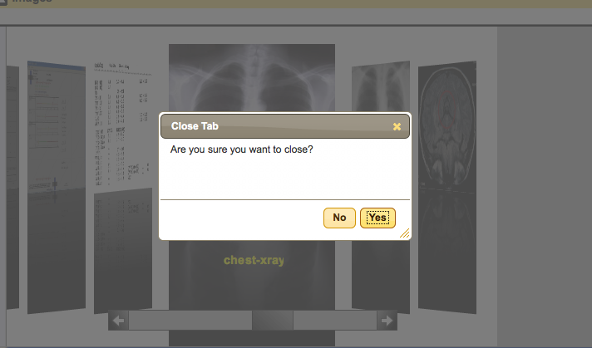
JQuery Styling, functionality
JQuery had powerful styling capability
Can change look and feel easily
Can leverage built in functionality such as ‘Close Tabs’

Slide 21
Health-data Server Architecture
RESTful Web Services
Tomcat Web server
T
openVista
JAVA/ J2EE
Additional
Data servers
Health-data server

Slide 22

Using hData
hData design and decisions
RESTful web services
HTML, XML, JSON, etc.
Schema
/repositories
/repositories/OurVista
/repositories/OurVista/patients
/repositories/OurVista/patients/T019965034
Tomcat Web server
T
Composable Framework
hData
FileMan
openVista
JAVA/ J2EE
Health-data server
Notes:
One benefit of getting this OpenVista up and running was that Keri Sarver, working on Peter Mork’s project, was able to evaluate it’s use for their MIP project

Slide 23
Repositories are Seamless
All data is converted as it is brought in
Accessed the same way
/repositories/OurVista/patients/T019965034
Tomcat Web server
FileMan
T
openVista
hData
JAVA/ J2EE
hData
Health-data server
/repositories/andyhData/patients/AE0042573

Slide 24
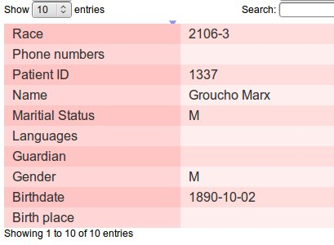
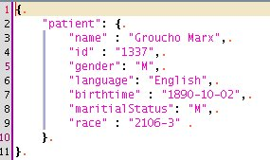
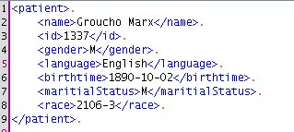
Converting Data to GUI
Converting hData to JSON
JavaScript is the language for dynamic web interfaces
Trivial mapping
Templates allow the transformation anywhere
Velocity and Velocity2JS
Remember all the formats (HTML, XML, JSON, etc.)?
Separates data from view
Component builder

Slide 25
Next Steps (next quarter)
Widget Development
Chart enhancements (thresholding etc.)
Timeline showing events, office visits etc,
Clickable to bring up associated chart
Text editor
Copy text between widgets
Filter on categories
Overall
Add additional data-sources
PDF Text extraction
Categorize the data
Save state of patient data so physician can return on login
Security – login page

Slide 26
Collaborations
Meeting with Christian Donahue Feb 15th
kick off working meetings with him
LAIKA (Andy Gregorowicz, existing work)
Provide data, hData
Automating Fact Extraction from Medical Records, (Cheryl Clark, proposed MSR)
Medical fact extraction to enhance “outside record” categorization
Security: Enforceable Specification of Policy (Peter Mork)
Using OpenVista instance
Multimodal Medical Data Capture and Representation (Qian Hu, existing MSR)
Speech to text capability
Notes:
We have been actively collaborating with both Andy Gregorowicz for hData.
And Cheryl Clark. Who have supplied us with pdfs of discahrge papers.
Are not yet ready to engage with Qian fpr Speech to text facility. Expect that this will happen 2nd to 3rd quarter.

Slide 27
Demo
For live demo:
http://medcafe:8081/medcafe
Notes:
We have been actively collaborating with both Andy Gregorowicz for hData.
And Cheryl Clark. Who have supplied us with pdfs of discahrge papers.
Are not yet ready to engage with Qian fpr Speech to text facility. Expect that this will happen 2nd to 3rd quarter.

Slide 28
Impact If Successful
Demonstrate ways to give
caregivers more time to do what matters most.

Slide 29
Thank you!

Slide 30
Possible Follow-ons
Speech to Text
Transcribe doctors dictation notes
Alerts
Alert other clinicians through system, rather than email
Email, paper to patient automatically through system
Automatically call patient, leave text message
Note plugin
allow for cutting and pasting from other components

Slide 31
C3H Strategic Roadmap
Help VA Physicians to be more efficient, by allowing them to be able to compose interface to meet individual needs

Slide 32
Transition Strategy
We have excellent connections with sponsors that can influence adoption of these methods
Work closely with Christian Donahue, M.D., Veterans Administration, who helped shape this proposal
He is on the VA working group that is planning the future of VA healthcare management and information systems
Brief Vice Chief of Staff, Washington VA Medical Center
Colleague of Tom Neal, M.D. (V600)
Public release as an open source project
Jim Inskeep will identify additional VA sponsors
Finally, any new, specialized loose couplers and widgets generated will be transitioned to other CCoD efforts
Notes:
JCH -> All components of our system will be publicly released and as an open source project (Apache 2.0 license, most likely) to encourage vendors to evaluate and adopt our work. The Apache 2.0 open source license is very business friendly, which is important to ensuring the work reaches the widest audience possible in this domain.
Any new components will be written to be as domain independent as possible, to allow for transition to other CCoD efforts within MITRE.

