Slide 1
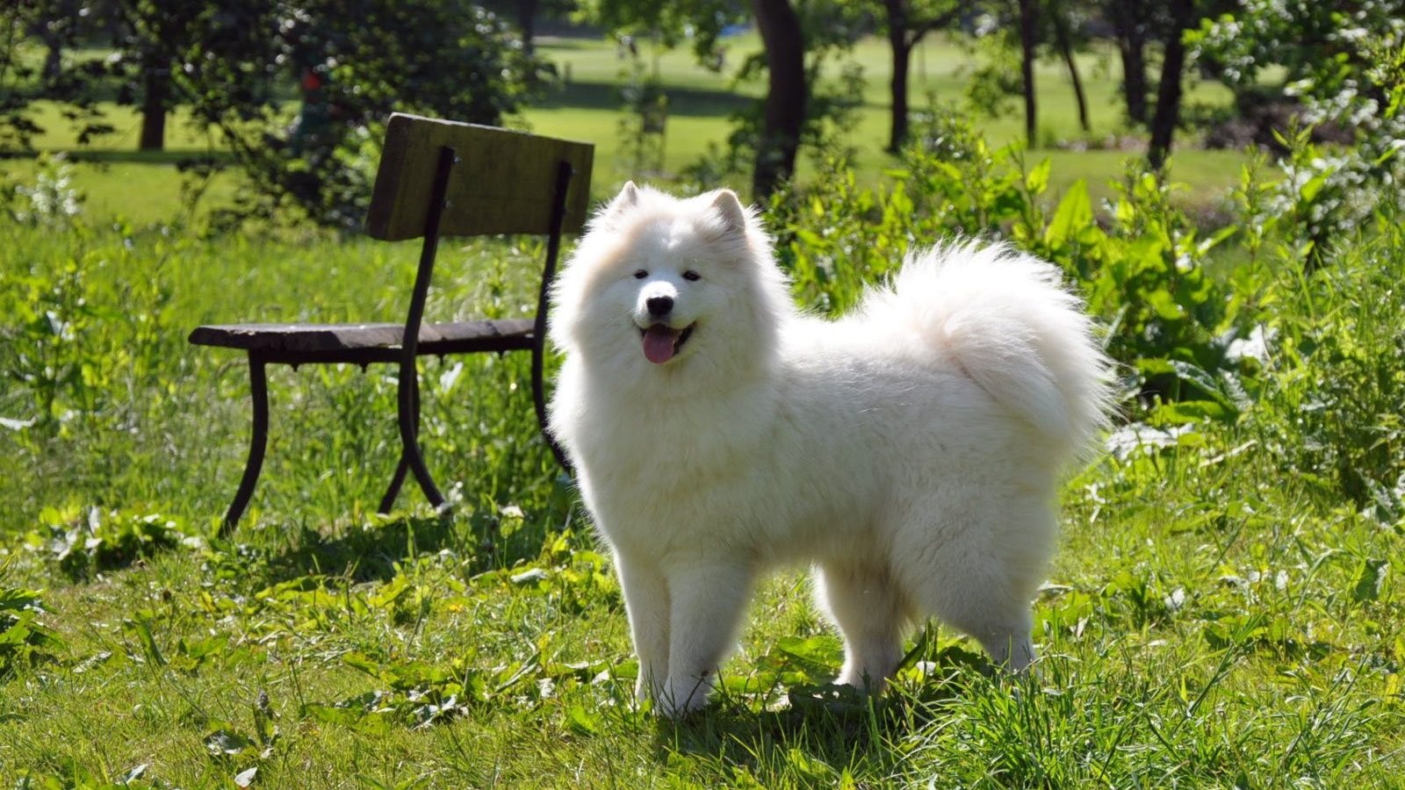

ESD G1T6
Adogtion
Presented by:
Sim Xuesi
Jun Wei
Keith Loh
Lim Kai Yao, Josh
Benjamin Ng

Slide 2



Problem Statement
Paper-based
administrative procedures
Repetitive mundane tasks
Tedious inter-department data exchange

Slide 3
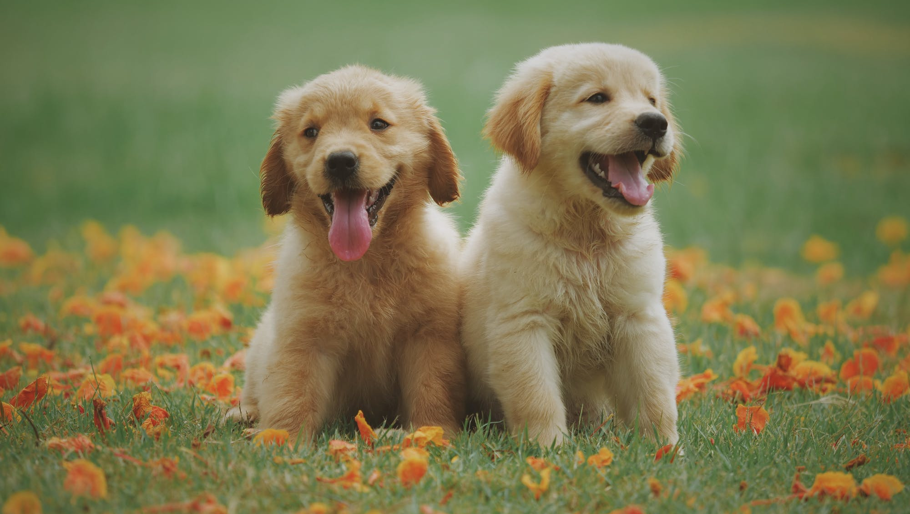






One-Stop Platform for Adoption Services
Weekly Newsletter
Subscription
Dog Adoption Application
Payment
Outcome
Notifications
Dog Management

Slide 4
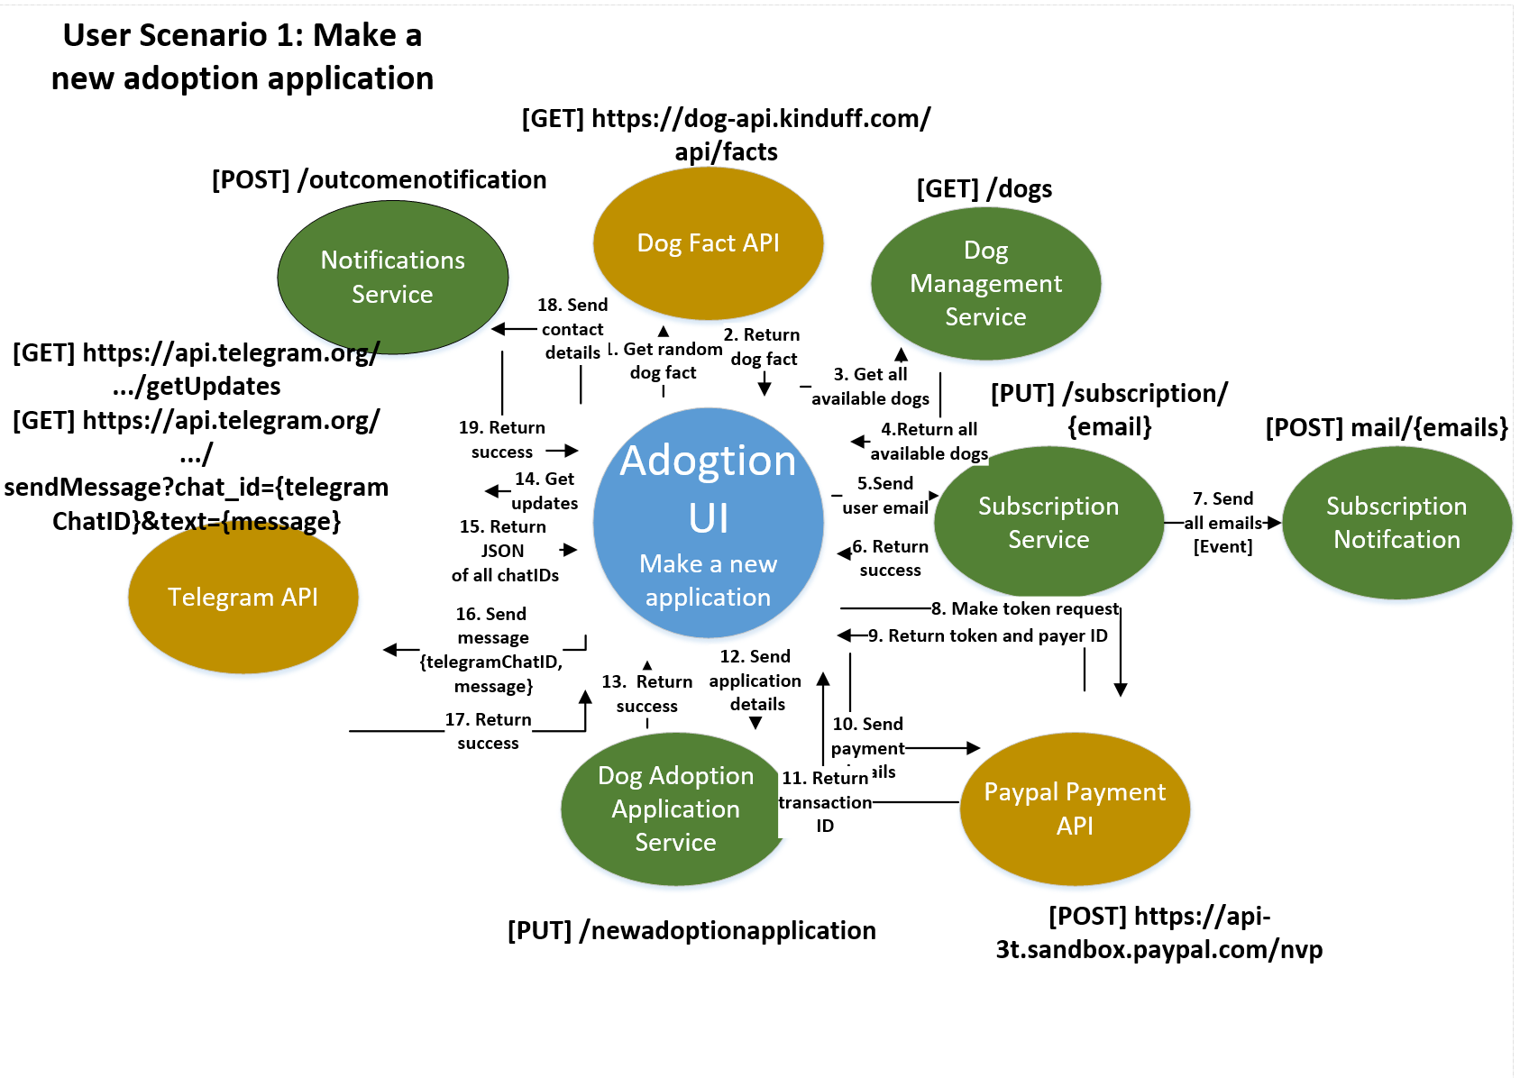
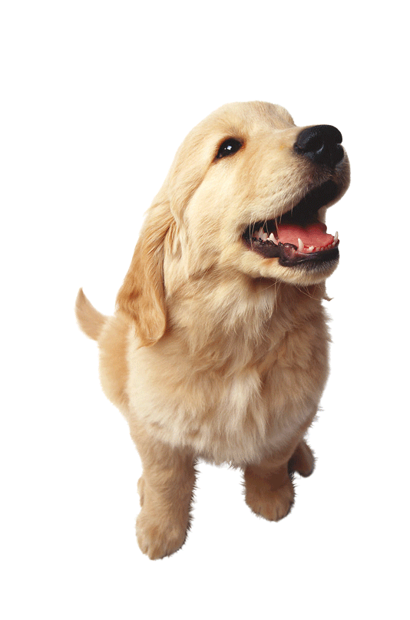

Slide 5
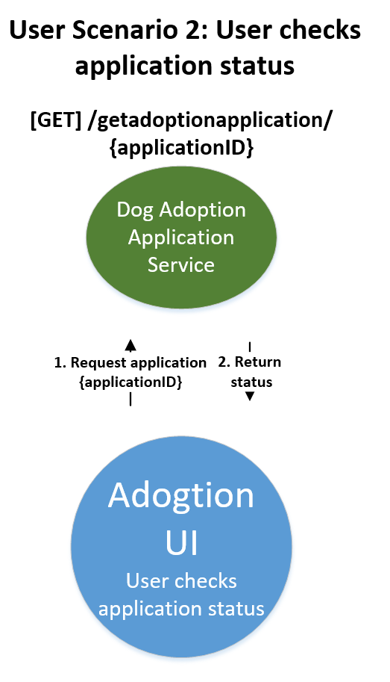

Slide 6
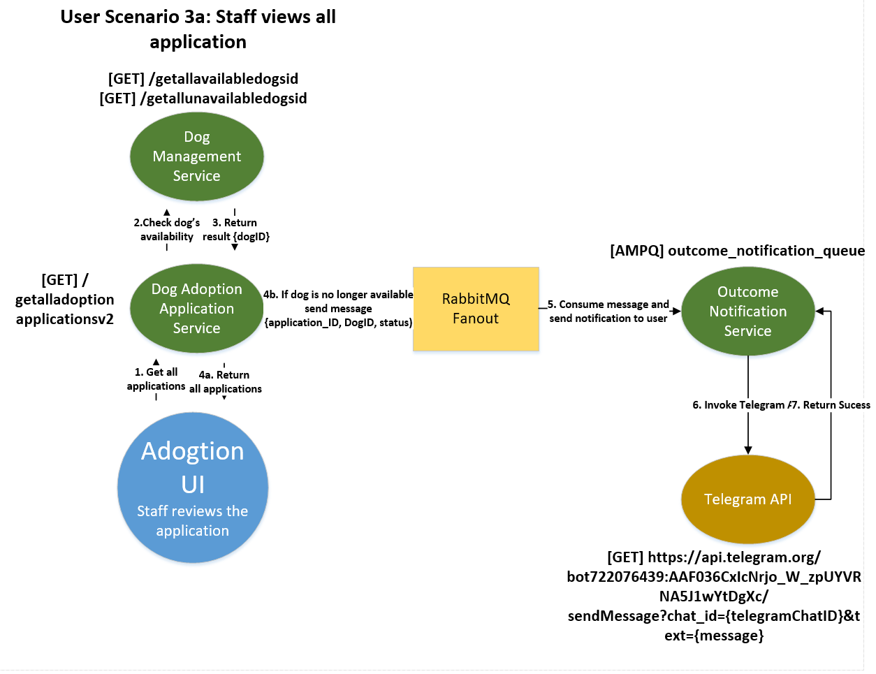

Slide 7
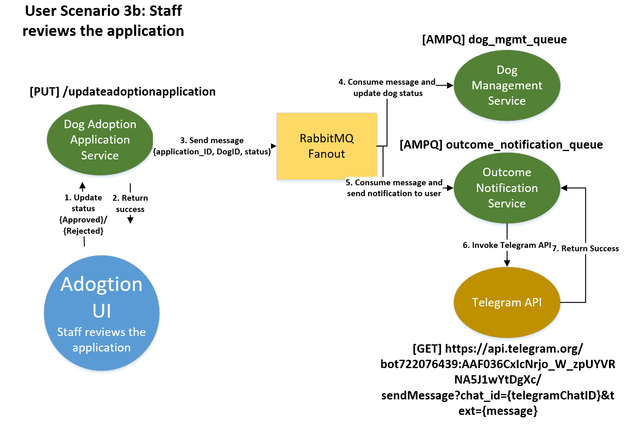

Slide 8
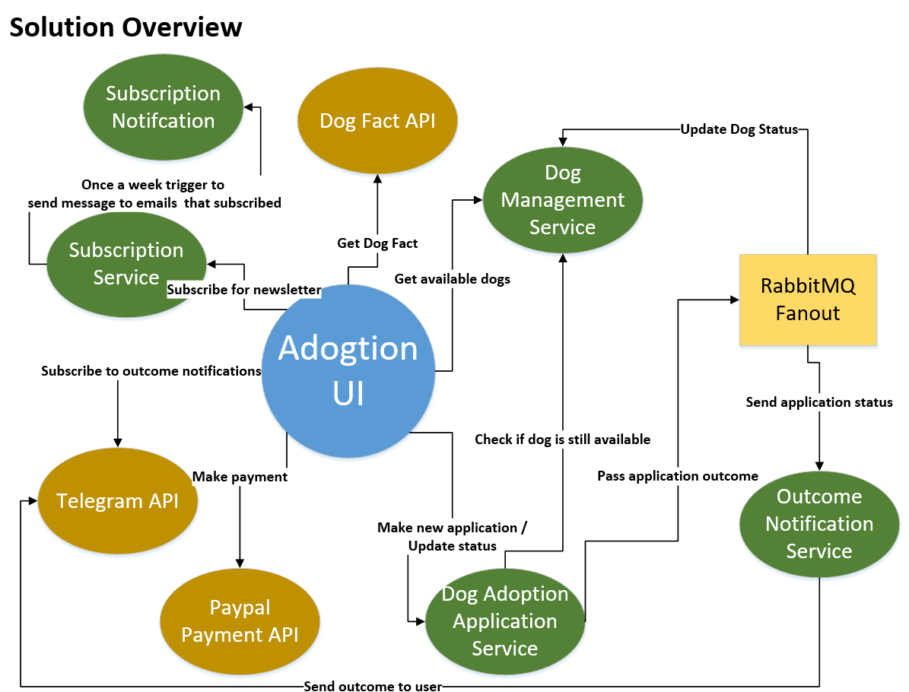

Slide 9
One-Stop Platform for Adoption Services
Dog Adoption Application
Payment
Outcome Notifications
Weekly Newsletter Subscription
Dog Management

Slide 10



Outcome Notification
Technical Overview Diagram
[POST] Outcome_notification_v2
[AMQP] Receive_AMQP
[AMQP] Availability_receive_AMQP
Dog Management
[GET] dogs/get *getalldogs
[GET] dog/get *get dog by id
[POST] add_dog
[PUT] change_status
[GET] latest_dogs
[GET] getallavailabledogsid
[GET] getallunavailabledogsid
[AMPQ] dog_mgmt_queue
Application_id varchar(32)
Email varchar(32)
Chat_id int(9)
telegram_username varchar(32)
Staff UI
Get all applications
Approve/reject applications
User Adoption UI
Search for dog
Make new application
Check application status
Subscribe to weekly letter
Dog Adoption Application
[POST] newadoptionapplication
[GET] getalladoptionapplicationsV2
[GET] getadoptionapplication
[PUT]updatedadoptionapplicationV2
Application_ID varchar(255) PRIMARY KEY,
FirstName varchar(255),
LastName varchar(255),
Address varchar(255),
PostalCode int(6),
Email varchar(255) UNIQUE,
PhoneNo int(8),
Reason TEXT,
DogID int(25),
Application_Status varchar(25), #See if application is approved, pending or rejected
Payment_Status varchar(25)
Subscription
Notification
Subscription
Doginfo
id int(8)
name varchar(20)
age varchar(5)
breed varchar(30)
size varchar(10)
sex varchar(10) status varchar(6)
altered varchar(7)
hasShots varchar(8)
houseTrained`varchar(12)
dateAdded date
description varchar(20000)
pic1 varchar(100)
pic2 varchar(100)
Dog_Application
[POST] subscription
[PUT] unsubscribe
[Timer] WeeklyUpdate
[POST] mail
No Database needed
Subscription_emails
email varchar(100)

Slide 11
Synchronous Communication | Command
Outcome Notification
Dog Adoption Microservice
POST HTTP Request
Dog Management
Microservice
Return successful response code
Dog Adoption
Microservice
Created new adoption application
Insert new record in database

Slide 12
Synchronous Communication | Query
Obtaining information from dog_mgmt_microservice
Dog Adoption Microservice
GET HTTP Request
Dog Management Microservice
Return all available dogs
Dog Adoption Microservice
Retrieve all
available dogs

Slide 13

Synchronous Communication | Event
Weekly Newsletter Subscriptions
Subscription
Microservice
Subscription Notification Service
Every Week
(Trigger)
Return successful response code

Slide 14
Asynchronous | RabbitMQ FanOut
Queue 1
Consumer
Approved
Approved
Dog_Mgmt_Queue
Dog
Management
Microservice
Binding
Dog Adoption Microservice
Outcome Notification Exchange
- Remove dog from database
Binding
Queue 2
Consumer
Publisher
FanOut
Exchange
Outcome Notification
Microservice
Outcome_Notification
_Queue
- Notify applicants of outcome

Slide 15
Asynchronous | RabbitMQ Direct
Not available
Queue
Consumer
Routing Key = "Availability"
Dog Adoption Microservice
Availability Exchange
Availability_Queue
Outcome Notification
Microservice
Direct Exchange
- Notify applicants that dog is not available
Publisher

Slide 16

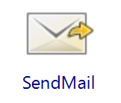


Beyond Labs | New Tibco Activities
Retrieve email template
Created SMTP Server
RabbitMQ FanOut
For-Each Loop

Slide 17




Beyond Labs | External APIs
To pay for administrative charges
Notify customers of application outcome
Share dog images through Facebook
Dog API - Get random dog tips

