Slide 1
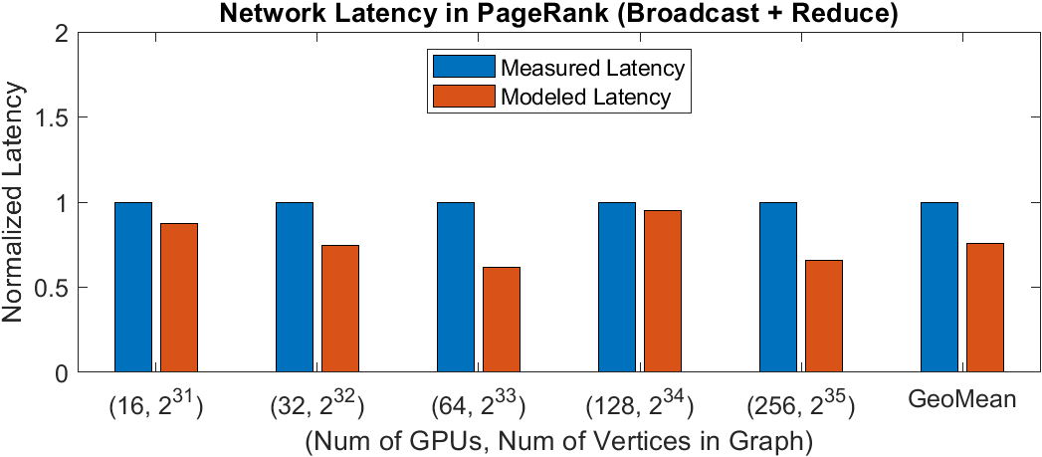
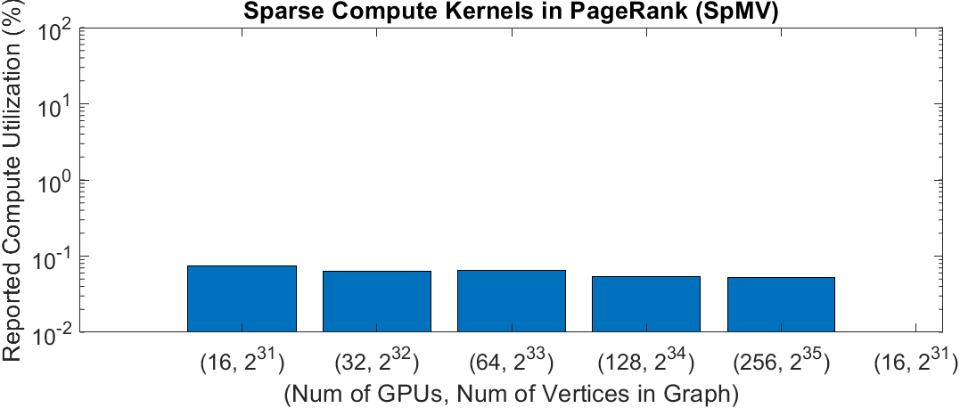
PageRank Modeling
Compared w/ [1], PageRank on A100 GPUs
Network latency can be accurately modeled
Sparse compute latency cannot be modeled, since DFModel only models dense kernels and on-chip inefficiency caused by sparse kernels in graph workloads cannot be modeled (low compute utilization)
[1] Seunghwa Kang et al. "Analyzing multi-trillion edge graphs on large gpu clusters: A case study with pagerank." 2022 IEEE High Performance Extreme Computing Conference (HPEC). IEEE, 2022.
Notes:
Explain the bouncing up and down in the top graph

