Slide 1
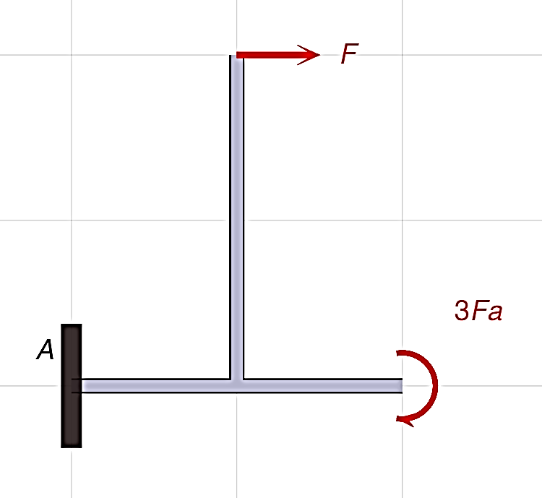
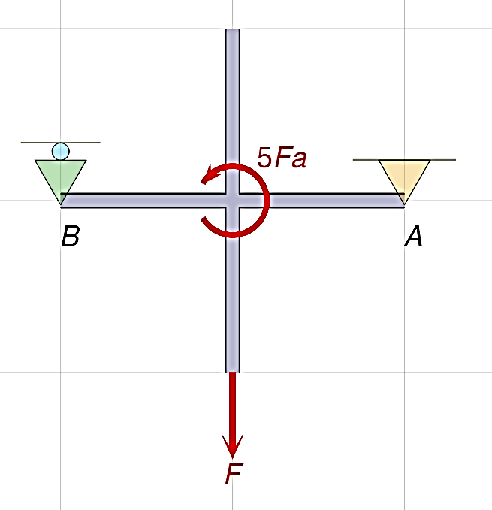
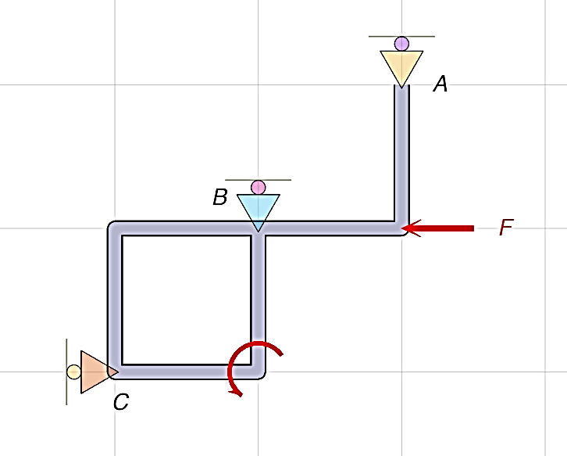
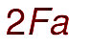
Single-Rigid Body Module
Structure: Single Non-Deformable Body (2D)
Loading: Forces and Couples
Supports: Pins, Rollers, Fixed Support

Slide 2
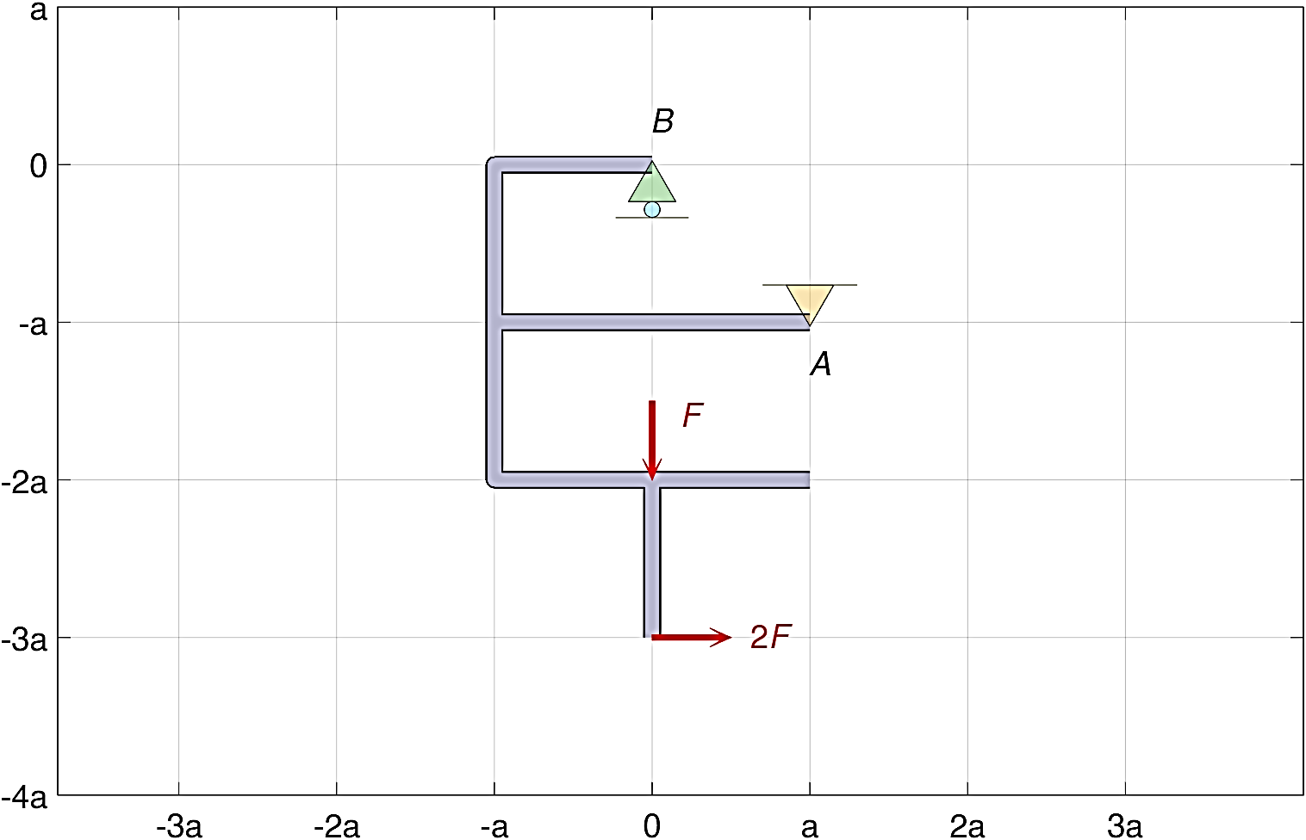
Single-Rigid Body Module
Example Problem
Required Understanding
  Force Systems
  Load and Support Types
  2D Equilibrium Conditions
  Resolving Forces into Components
  Transmissibility Principle
  Varignon’s Theorem
Sign convention
R_{x} > 0 (to the right)
R_{y} > 0 (upwards)

Slide 3
Single-Rigid Body Module
Example Problem
Required Understanding
Sign convention
R_{x} > 0 (to the right)
R_{y} > 0 (upwards)

Slide 4
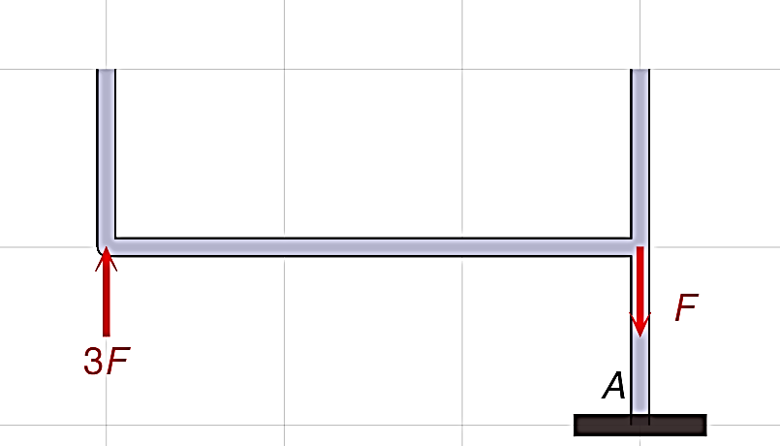
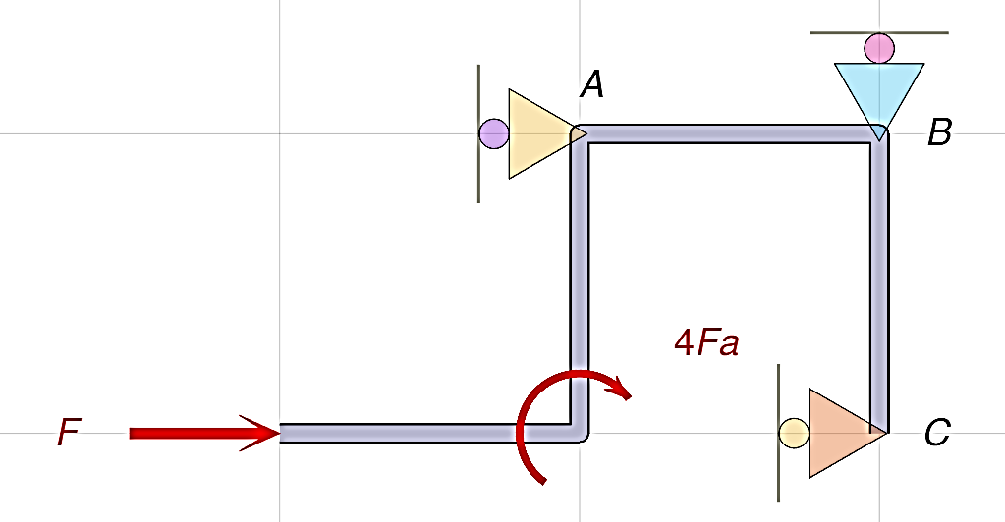
Extensive Parameterization
Number, Type, & Placement of Loads
Directions and Magnitudes of Loads
Support Types and Orientations
Body Size and Geometry

Slide 5
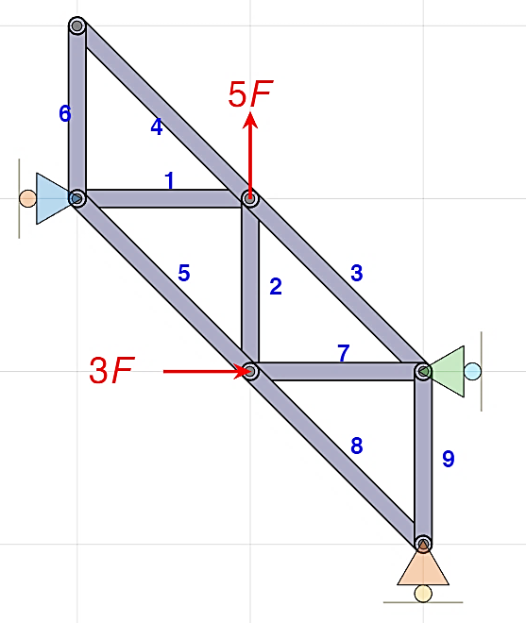
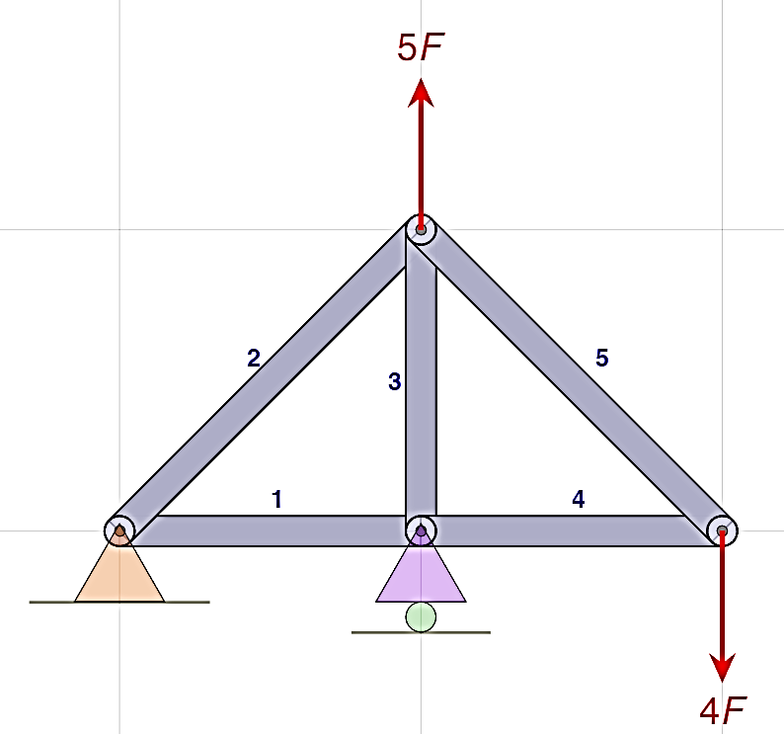
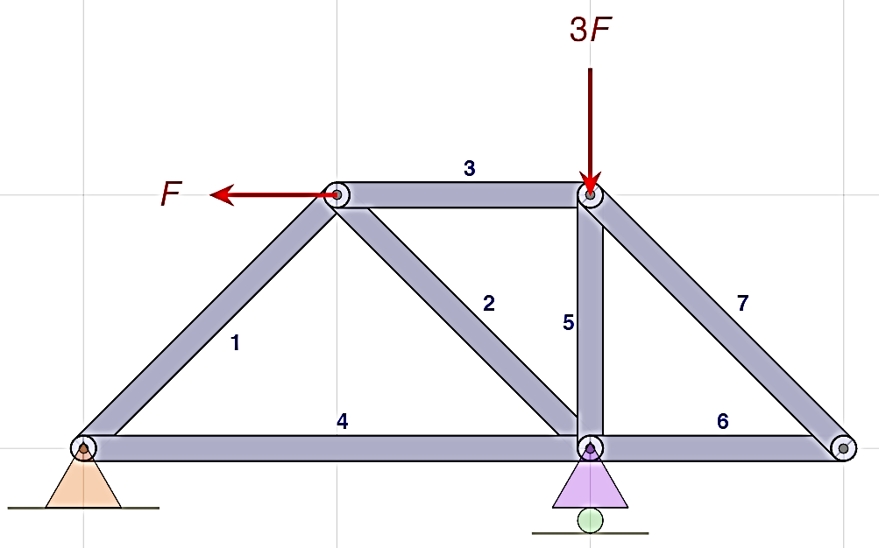
Truss Module
n: number of nodes
m: number of members
Structure: Planar Truss (2n = m + 3)
Loads: Forces at Nodes
Supports: Pin & Roller ––or–– Three Rollers

Slide 6
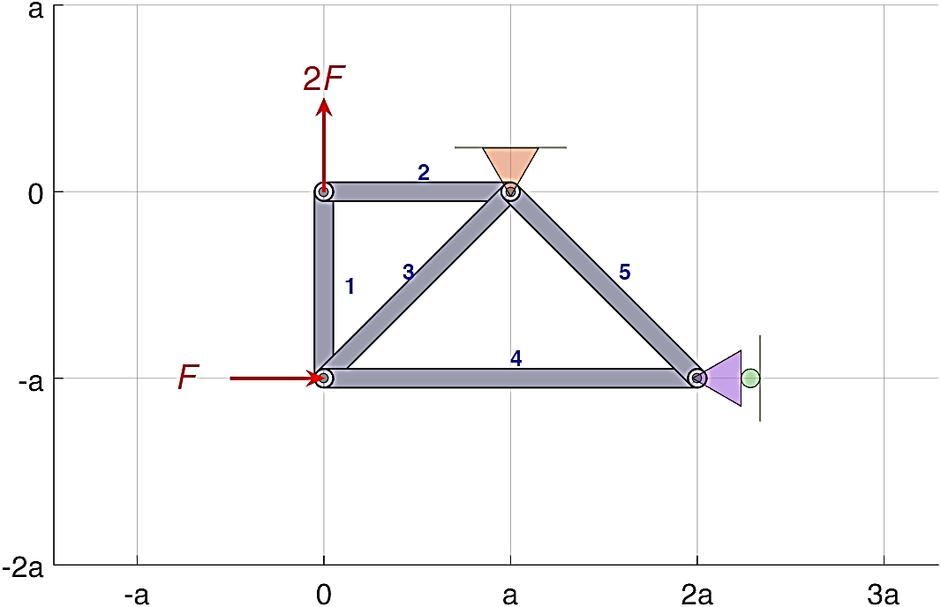
Truss Module
Example Problem
Required Understanding
  Joints Method
  Sections Method
Sign convention
S_{i} > 0 ⇒ tension
S_{i} < 0 ⇒ compression

Slide 7
Truss Module
Example Problem
Required Understanding
Sign convention
S_{i} > 0 ⇒ tension
S_{i} < 0 ⇒ compression

Slide 8
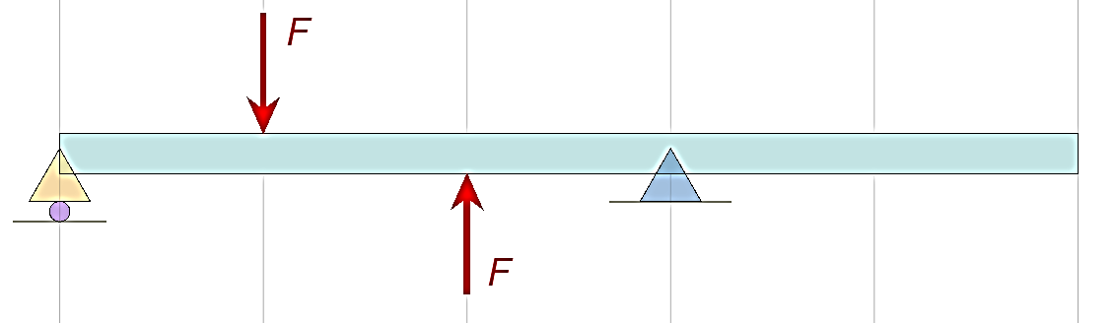
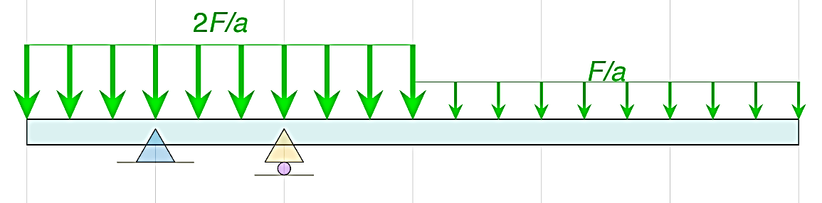
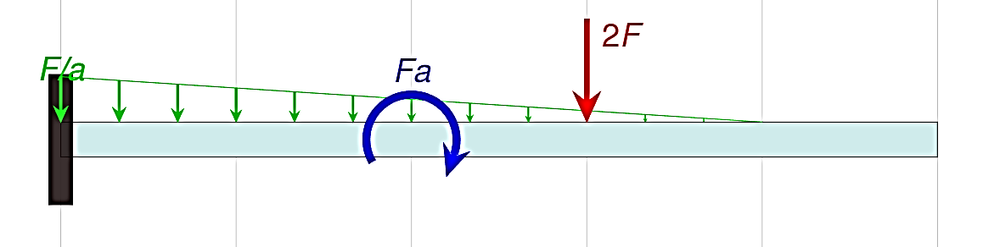
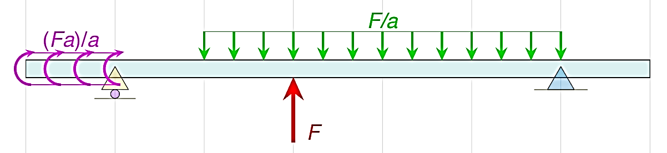
Beam Module
Structure: Beam
Loads: Concentrated and Distributed Forces and Couples
Supports: Pin & Roller, Three Rollers, or Fixed Support

Slide 9
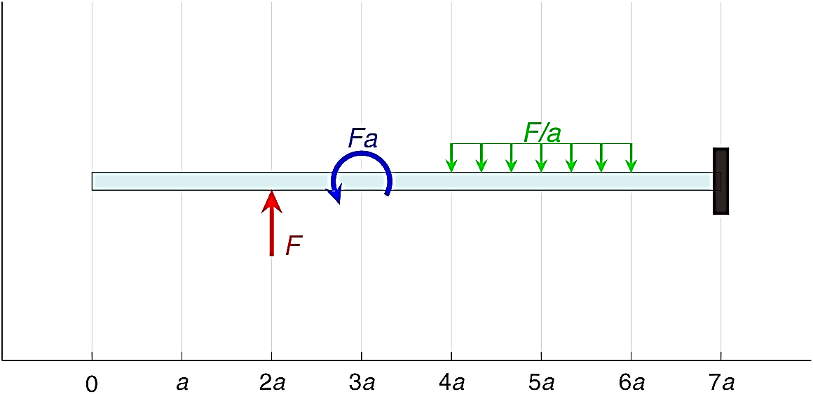
Beam Module
Example Problem 1
Required Understanding
  Statically Equivalent Loads
  External Load Effect on Internal Response
  Diff. Rel. btw/ Distributed Loads, Shear Force, and Bending Moments
Sign convention
R_{y} > 0 (upwards)
M > 0 (CCW)

