Slide 1
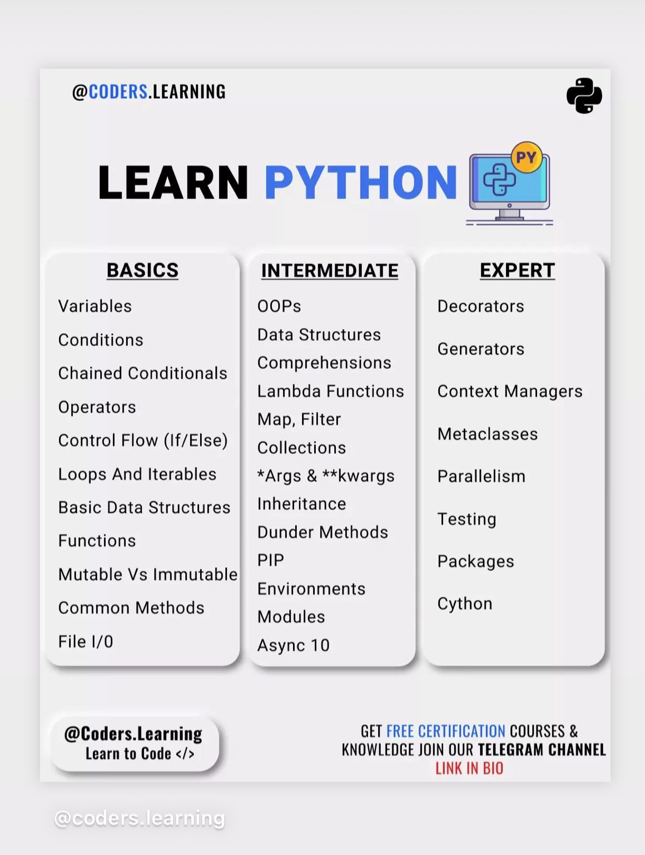

Slide 2
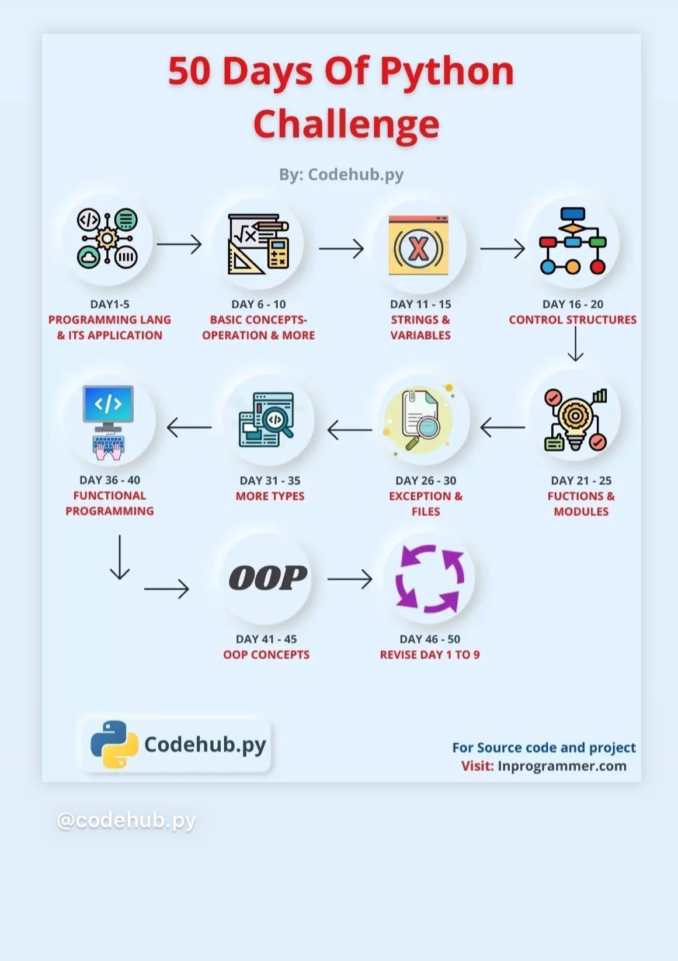

Slide 3
Introduction to Object Oriented Programming in Python
Object Oriented Programming is a way of computer programming using the idea of “objects” to represents data and methods. It is also, an approach used for creating neat and reusable code instead of a redundant one

Slide 4
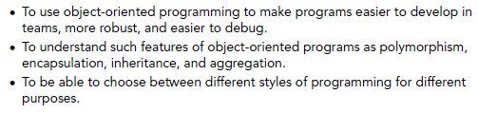
Chapter Objectives

Slide 5
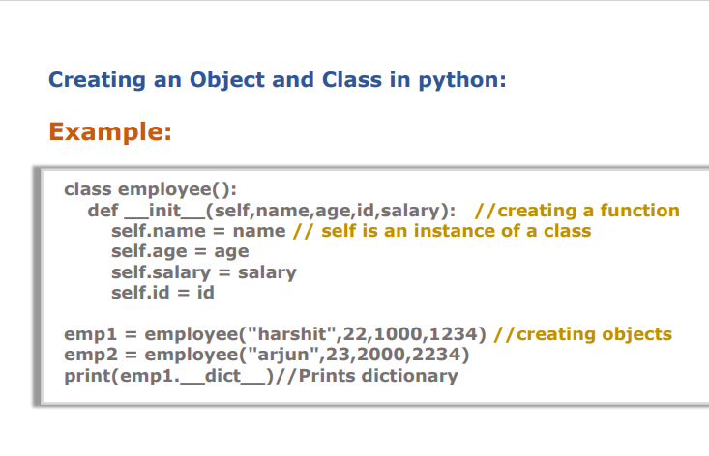

Slide 6
Object-Oriented Programming methodologies:
Inheritance
Polymorphism
Encapsulation
Abstraction

Slide 7
Inheritance
Ever heard of this dialogue from relatives “you look exactly like your father/mother” the reason behind this is called ‘inheritance’. From the Programming aspect, It generally means “inheriting or transfer of characteristics from parent to child class without any modification”. The new class is called the derived/child class and the one from which it is derived is called a parent/base class.

Slide 8
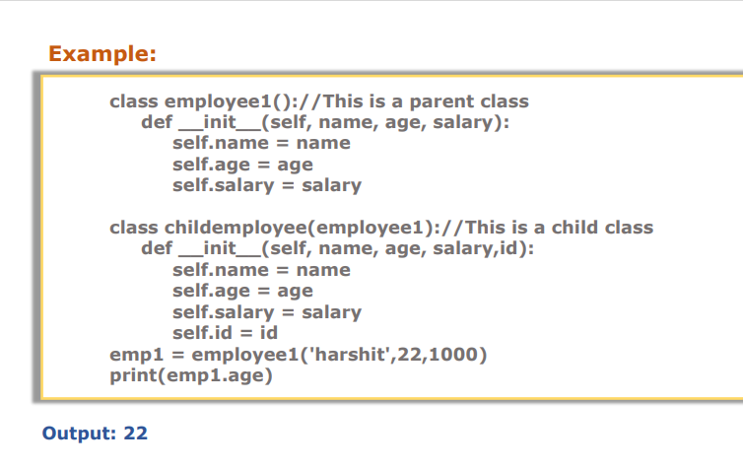

Slide 9
Defining an object
Objects know things.
Data that is internal to the object.
We often call those instance variables.
Objects can do things.
Behavior that is internal to the object.
We call functions that are specific to an object methods.
But you knew that one already.
We access both of these using dot notation
object.variable
object.method()

Slide 10
Classes
Objects are instances of classes in many object-oriented languages.
Including Smalltalk, Java, JavaScript, and Python.
A class defines the data and behavior of an object.
A class defines what all instances of that class know and can do.

Slide 11
Creating new instances
We are going to create new instances by calling the class name as if it were a function.
That will automatically create a new instance of the class.

Slide 12
Creating new instances
We are going to create new instances by calling the class name as if it were a function.
That will automatically create a new instance of the class.

Slide 13
Object Methods
def name(self, parameter, ..., parameter):
statements
self must be the first parameter to any object method
represents the "implicit parameter" (this in Java)
must access the object's fields through the self reference
class Point:
def translate(self, dx, dy):
self.x += dx
self.y += dy
...
Notes:
13

Slide 14
Constructors
def __init__(self, parameter, ..., parameter):
statements
a constructor is a special method with the name __init__
Example:
class Point:
def __init__(self, x, y):
self.x = x
self.y = y
...
How would we make it possible to construct a Point() with no parameters to get (0, 0)?
Notes:
14

