Slide 1
Loops and Iteration
Chapter 5
WHILE and FOR
Python for Everybody
www.py4e.com

Slide 2
Repeated Steps
n = 5
Program:
n = 5
while n > 0 :
print(n)
n = n – 1
print('Blastoff!')
print(n)
Output:
5
4
3
2
1
Blastoff!
0
No
n > 0 ?
Yes
print(n)
n = n -1
Loops (repeated steps) have iteration variables that change each time through a loop. Often these iteration variables go through a sequence of numbers.
print('Blastoff')

Slide 3
The while Loop

Slide 4

The while Loop
Executes a block of code repeatedly
while loop repeatedly executes an indented block of statements
As long as a certain condition is met
Form
Continuation condition is a boolean expression

Slide 5
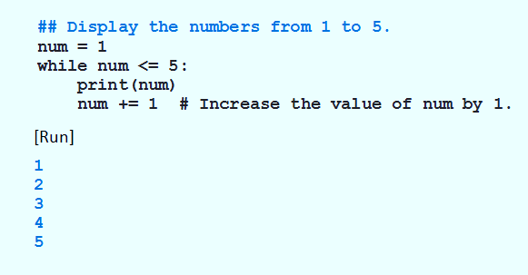
The while Loop
Example 1: Program displays 1 – 5, after loop terminates, num will be 6

Slide 6
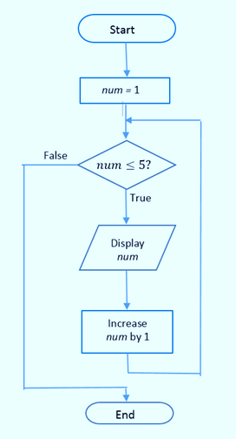
The while Loop
FIGURE 3.22 Flowchart for Example 1.

Slide 7
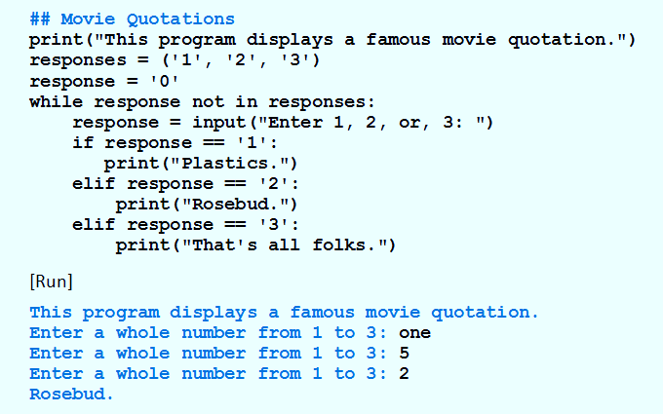
The while Loop
Example 2: Input validation.

Slide 8
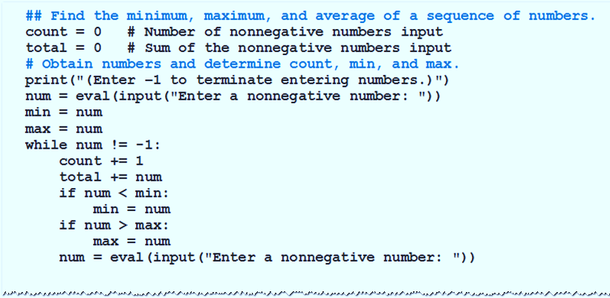
The while Loop
Example 3: Find min, max, average.

Slide 9
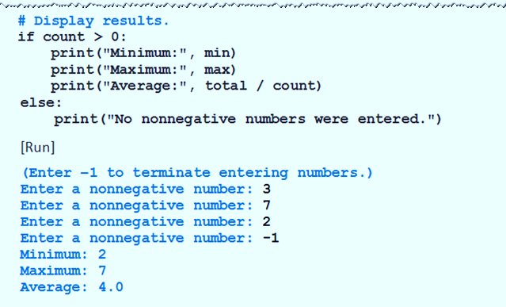
The while Loop
Example 3: Find min, max, average.

Slide 10
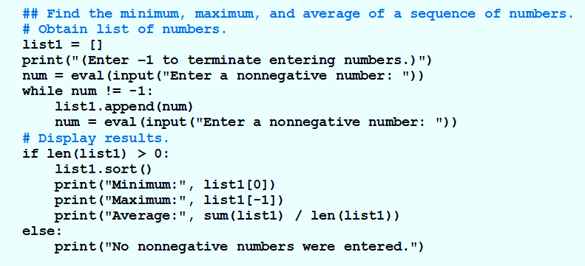
The while Loop
Example 4: Stores the numbers in a list, and then uses list methods and functions to determine the requested values.

Slide 11
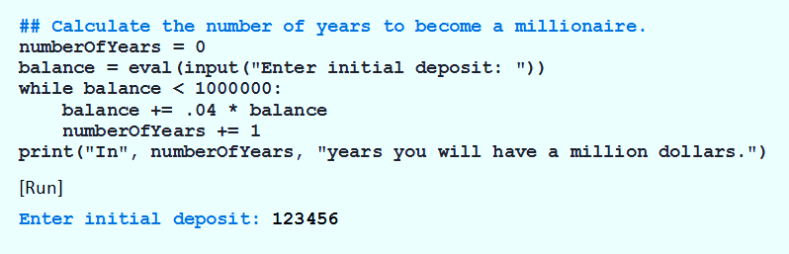
The while Loop
Example 5: Determines when bank deposit reaches one million dollars

Slide 12
The break Statement
Causes an exit from anywhere in the body of a loop
When break is executed
Loop immediately terminates
Break statements usually occur in if statements

Slide 13
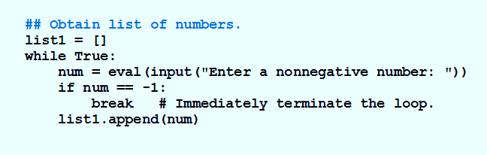
The break Statement
Example 6: Program uses break to avoid two input statements.

Slide 14
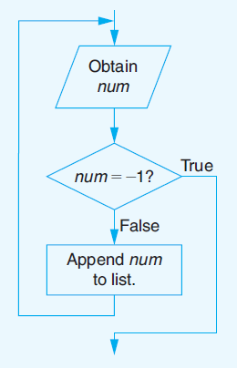
The break Statement
FIGURE 3.23 Flowchart for Example 6

Slide 15
The continue Statement
Current iteration of the loop terminates
Execution returns to the loop’s header
When continue executed in a while loop, it will continue from the next loop, instead of continuing.

Slide 16
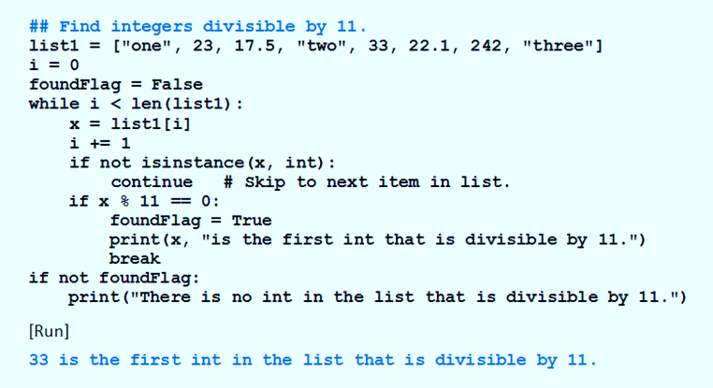
The continue Statement
Example 7: Searches a list for the first int object that is divisible by 11.

Slide 17
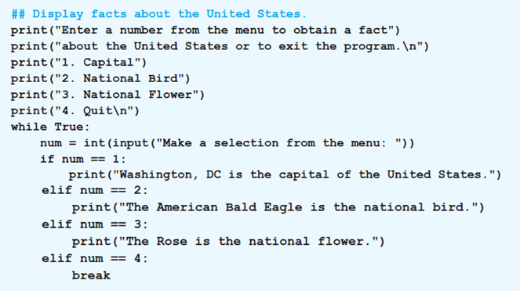
Creating a Menu
Example 8: Uses a menu to obtain facts about the United States.

Slide 18
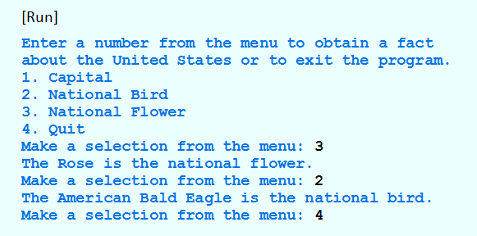
The continue Statement
Example 8: Uses a menu to obtain facts about the United States.

Slide 19
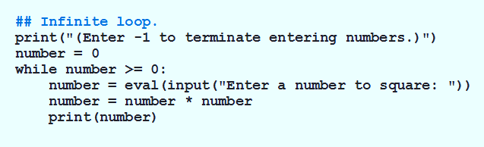
Infinite Loops
Example 9: Condition number >= 0 always true.

Slide 20
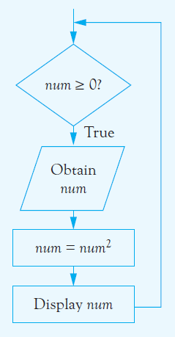
Infinite Loops
FIGURE 3.24 Program Containing an Infinite Loop.

Slide 21
Breaking Out of a Loop
The break statement ends the current loop and jumps to the statement immediately following the loop
It is like a loop test that can happen anywhere in the body of the loop
while True:
line = input('> ')
if line == 'done' :
break
print(line)
print('Done!')
> hello there
hello there
> finished
finished
> done
Done!

Slide 22
Breaking Out of a Loop
The break statement ends the current loop and jumps to the statement immediately following the loop
It is like a loop test that can happen anywhere in the body of the loop
while True:
line = input('> ')
if line == 'done' :
break
print(line)
print('Done!')
> hello there
hello there
> finished
finished
> done
Done!

Slide 23
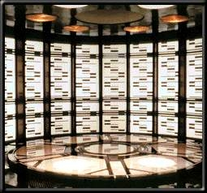
No
True ?
Yes
while True:
line = input('> ')
if line == 'done' :
break
print(line)
print('Done!')
....
break
...
http://en.wikipedia.org/wiki/Transporter_(Star_Trek)
print('Done')

Slide 24
Finishing an Iteration with continue
The continue statement ends the current iteration and jumps to the top of the loop and starts the next iteration
while True:
line = input('> ')
if line[0] == '#' :
continue
if line == 'done' :
break
print(line)
print('Done!')
> hello there
hello there
> # don't print this
> print this!
print this!
> done
Done!

Slide 25
Finishing an Iteration with continue
The continue statement ends the current iteration and jumps to the top of the loop and starts the next iteration
while True:
line = input('> ')
if line[0] == '#' :
continue
if line == 'done' :
break
print(line)
print('Done!')
> hello there
hello there
> # don't print this
> print this!
print this!
> done
Done!

Slide 26
No
True ?
Yes
while True:
line = raw_input('> ')
if line[0] == '#' :
continue
if line == 'done' :
break
print(line)
print('Done!')
....
continue
...
print('Done')

Slide 27
Indefinite Loops
While loops are called “indefinite loops” because they keep going until a logical condition becomes False
The loops we have seen so far are pretty easy to examine to see if they will terminate or if they will be “infinite loops”
Sometimes it is a little harder to be sure if a loop will terminate

Slide 28
Definite Loops
Iterating over a set of items…

Slide 29
Definite Loops
Quite often we have a list of items of the lines in a file - effectively a finite set of things
We can write a loop to run the loop once for each of the items in a set using the Python for construct
These loops are called “definite loops” because they execute an exact number of times
We say that “definite loops iterate through the members of a set”

Slide 30
A Simple Definite Loop
5
4
3
2
1
Blastoff!
for i in [5, 4, 3, 2, 1] :
print(i)
print('Blastoff!')

Slide 31
A Definite Loop with Strings
Happy New Year: Joseph Happy New Year: Glenn
Happy New Year: Sally
Done!
friends = ['Joseph', 'Glenn', 'Sally']
for friend in friends :
print('Happy New Year:', friend)
print('Done!')

Slide 32
A Simple Definite Loop
Yes
Done?
No
Move i ahead
5
4
3
2
1
Blastoff!
for i in [5, 4, 3, 2, 1] :
print(i)
print('Blastoff!')
print(i)
Definite loops (for loops) have explicit iteration variables that change each time through a loop. These iteration variables move through the sequence or set.
print('Blast off!')

Slide 33
Looking at in...
The iteration variable “iterates” through the sequence (ordered set)
The block (body) of code is executed once for each value in the sequence
The iteration variable moves through all of the values in the sequence
Five-element sequence
Iteration variable
for i in [5, 4, 3, 2, 1] :
print(i)

Slide 34
No
Yes
Done?
The iteration variable “iterates” through the sequence (ordered set)
The block (body) of code is executed once for each value in the sequence
The iteration variable moves through all of the values in the sequence
Move i ahead
print(i)
for i in [5, 4, 3, 2, 1] :
print(i)

Slide 35
i = 5
No
Yes
Done?
print(i)
Move i ahead
i = 4
print(i)
print(i)
i = 3
print(i)
i = 2
for i in [5, 4, 3, 2, 1] :
print(i)
print(i)
i = 1
print(i)

Slide 36
Loop Idioms: What We Do in Loops
Note: Even though these examples are simple, the patterns apply to all kinds of loops

Slide 37
Making “smart” loops
The trick is “knowing” something about the whole loop when you are stuck writing code that only sees one entry at a time
Set some variables to initial values
for thing in data:
Look for something or do something to each entry separately, updating a variable
Look at the variables

Slide 38
Finding the Largest Value
$ python largest.py
Before -1
9 9
41 41
41 12
41 3
74 74
74 15
After 74
largest_so_far = -1
print('Before', largest_so_far)
for the_num in [9, 41, 12, 3, 74, 15] :
if the_num > largest_so_far :
largest_so_far = the_num
print(largest_so_far, the_num)
print('After', largest_so_far)
We make a variable that contains the largest value we have seen so far. If the current number we are looking at is larger, it is the new largest value we have seen so far.

Slide 39
More Loop Patterns…

Slide 40
Counting in a Loop
$ python countloop.py
Before 0
1 9
2 41
3 12
4 3
5 74
6 15
After 6
zork = 0
print('Before', zork)
for thing in [9, 41, 12, 3, 74, 15] :
zork = zork + 1
print(zork, thing)
print('After', zork)
To count how many times we execute a loop, we introduce a counter variable that starts at 0 and we add one to it each time through the loop.

Slide 41
Summing in a Loop
$ python countloop.py
Before 0
9 9
50 41
62 12
65 3
139 74
154 15
After 154
zork = 0
print('Before', zork)
for thing in [9, 41, 12, 3, 74, 15] :
zork = zork + thing
print(zork, thing)
print('After', zork)
To add up a value we encounter in a loop, we introduce a sum variable that starts at 0 and we add the value to the sum each time through the loop.

Slide 42
Finding the Average in a Loop
$ python averageloop.py
Before 0 0
1 9 9
2 50 41
3 62 12
4 65 3
5 139 74
6 154 15
After 6 154 25.666
count = 0
sum = 0
print('Before', count, sum)
for value in [9, 41, 12, 3, 74, 15] :
count = count + 1
sum = sum + value
print(count, sum, value)
print('After', count, sum, sum / count)
An average just combines the counting and sum patterns and divides when the loop is done.

Slide 43
Filtering in a Loop
print('Before')
for value in [9, 41, 12, 3, 74, 15] :
if value > 20:
print('Large number',value)
print('After')
$ python search1.py
Before
Large number 41
Large number 74
After
We use an if statement in the loop to catch / filter the values we are looking for.

Slide 44
Search Using a Boolean Variable
$ python search1.py
Before False
False 9
False 41
False 12
True 3
True 74
True 15
After True
found = False
print('Before', found)
for value in [9, 41, 12, 3, 74, 15] :
if value == 3 :
found = True
print(found, value)
print('After', found)
If we just want to search and know if a value was found, we use a variable that starts at False and is set to True as soon as we find what we are looking for.

Slide 45
How to Find the Smallest Value
$ python largest.py
Before -1
9 9
41 41
41 12
41 3
74 74
74 15
After 74
largest_so_far = -1
print('Before', largest_so_far)
for the_num in [9, 41, 12, 3, 74, 15] :
if the_num > largest_so_far :
largest_so_far = the_num
print(largest_so_far, the_num)
print('After', largest_so_far)
How would we change this to make it find the smallest value in the list?

Slide 46
Finding the Smallest Value
smallest_so_far = -1
print('Before', smallest_so_far)
for the_num in [9, 41, 12, 3, 74, 15] :
if the_num < smallest_so_far :
smallest_so_far = the_num
print(smallest_so_far, the_num)
print('After', smallest_so_far)
We switched the variable name to smallest_so_far and switched the > to <

Slide 47
Finding the Smallest Value
$ python smallbad.py
Before -1
-1 9
-1 41
-1 12
-1 3
-1 74
-1 15
After -1
smallest_so_far = -1
print('Before', smallest_so_far)
for the_num in [9, 41, 12, 3, 74, 15] :
if the_num < smallest_so_far :
smallest_so_far = the_num
print(smallest_so_far, the_num)
print('After', smallest_so_far)
We switched the variable name to smallest_so_far and switched the > to <

Slide 48
Finding the Smallest Value
smallest = None
print('Before')
for value in [9, 41, 12, 3, 74, 15] :
if smallest is None :
smallest = value
elif value < smallest :
smallest = value
print(smallest, value)
print('After', smallest)
$ python smallest.py
Before
9 9
9 41
9 12
3 3
3 74
3 15
After 3
We still have a variable that is the smallest so far. The first time through the loop smallest is None, so we take the first value to be the smallest.

Slide 49
The is and is not Operators
Python has an is operator that can be used in logical expressions
Implies “is the same as”
Similar to, but stronger than ==
is not also is a logical operator
smallest = None
print('Before')
for value in [3, 41, 12, 9, 74, 15] :
if smallest is None :
smallest = value
elif value < smallest :
smallest = value
print(smallest, value)
print('After', smallest)

Slide 50
Summary
While loops (indefinite)
Infinite loops
Using break
Using continue
None constants and variables
For loops (definite)
Iteration variables
Loop idioms
Largest or smallest

