Slide 1
Learn python – Part 4 List and Dict
1/3 Overview
2/3 What are List and its functions
3/3 Dict and its functions

Slide 2
Info
That’s all for Data Types.
We just need to take care of List and Dict.
(I havent used Tuples in my professional career – no idea why ). Let’s see.

Slide 3
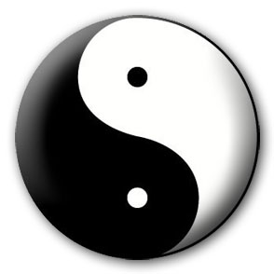




A Story of Two Collections..
List
A linear collection of values that stay in order
Dictionary
A “bag” of values, each with its own label

Slide 4
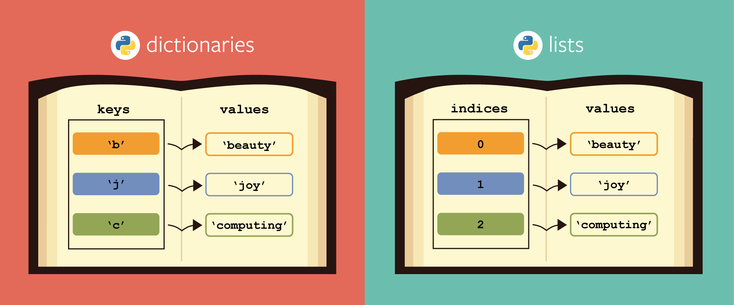
Overview

Slide 5
List
Lists are mutable(Xmen) data types in Python. Lists is a 0 based index datatype meaning the index of the first element starts at 0. Lists are used to store multiple items in a single variable. Lists are one of the 4 data types present in Python i.e. Lists, Dictionary, Tuple & Set.

Slide 6
city_list=['Agra','Chennai', 'Ahmedabad', 'Surat', 'Lucknow', 'Coimbatore']
print(city_list[2]) Ahmedabad
print(city_list[-1]) Coimbatore
print(city_list[2:5]) ['Ahmedabad', 'Surat', 'Lucknow']

Slide 7
Updating list
Append (only one element)
city_list=['Agra','Chennai',] city_list.append('Bangalore')
print(city_list)
=['Agra','Chennai',’Bangalore’]
Extend (more than one element)
city_list=['Agra','Chennai',] city_list.append(['Bangalore‘, ‘Random’)
print(city_list)
=['Agra','Chennai',’Bangalore’,’Random’]

Slide 8
Change the list (Xmen-mutable)
[10, 20, 30, 40, 50, 60, 70, 80, 90, 100, 110, 120, 130, 140, 150] num_list[7]= 200
print(num_list)
[10, 20, 30, 40, 50, 60, 70, 200, 90, 100, 110, 120, 130, 140, 150]

Slide 9
Insert list
city_list=['Agra','Chennai', 'Ahmedabad', 'Surat', 'Lucknow', 'Coimbatore'] city_list.insert(4,'Vadodara')
print(city_list)
['Agra', 'Chennai', 'Ahmedabad', 'Surat', 'Vadodara', 'Lucknow', 'Coimbatore']

Slide 10
Delete list
Deleting items in a list
city_list=['Agra','Chennai', 'Ahmedabad', 'Surat', 'Lucknow', 'Coimbatore'] del city_list[4]
print(city_list)
['Agra', 'Chennai', 'Ahmedabad', 'Surat', 'Coimbatore'] ## Length of list = len(city_list)

Slide 11
list = [ 'abcd', 786 , 2.23, 'john', 70.2 ]
tinylist = [123, 'john']
print list # Prints complete list
print list[0] # Prints first element of the list
print list[1:3] # Prints elements starting from 2nd till 3rd
print list[2:] # Prints elements starting from 3rd element
print tinylist * 2 # Prints list two times
print list + tinylist # Prints concatenated lists
Output:
['abcd', 786, 2.23, 'john', 70.2]
abcd
[786, 2.23]
[2.23, 'john', 70.2]
[123, 'john', 123, 'john']
['abcd', 786, 2.23, 'john', 70.2, 123, 'john']

Slide 12
Dict
Length of the dictionary
dict_salesinfo= {'SID':Fiat, 'Sales': 20000 'LaunchDay':'Wed' 'Cost': 500000}
print(len(dict_salesid)) # 5

Slide 13
dict = {}
dict['one'] = "This is one"
dict[2] = "This is two“
tinydict = {'name': 'john','code':6734, 'dept': 'sales'}
print dict['one'] # Prints value for 'one' key
print dict[2] # Prints value for 2 key
print tinydict # Prints complete dictionary
print tinydict.keys() # Prints all the keys
print tinydict.values() # Prints all the values
OUTPUT:
This is one
This is two
{'dept': 'sales', 'code': 6734, 'name': 'john'}
['dept', 'code', 'name']
['sales', 6734, 'john']

Slide 14

Dictionaries
tissue
calculator
perfume
money
candy
http://en.wikipedia.org/wiki/Associative_array

Slide 15
Dictionaries
Dictionaries are Python’s most powerful data collection
Dictionaries allow us to do fast database-like operations in Python
Dictionaries have different names in different languages
Associative Arrays - Perl / Php
Properties or Map or HashMap - Java
Property Bag - C# / .Net
http://en.wikipedia.org/wiki/Associative_array

Slide 16
Dictionaries
Lists index their entries based on the position in the list
Dictionaries are like bags - no order
So we index the things we put in the dictionary with a “lookup tag”
>>> purse = dict()
>>> purse['money'] = 12
>>> purse['candy'] = 3
>>> purse['tissues'] = 75
>>> print purse
{'money': 12, 'tissues': 75, 'candy': 3}
>>> print purse['candy']
3
>>> purse['candy'] = purse['candy'] + 2’
>>> print purse
{'money': 12, 'tissues': 75, 'candy': 5}

Slide 17
Comparing Lists and Dictionaries
Dictionaries are like Lists except that they use keys instead of numbers to look up values
>>> ddd = dict()
>>> ddd['age'] = 21
>>> ddd['course'] = 182
>>> print ddd
{'course': 182, 'age': 21}
>>> ddd['age'] = 23
>>> print ddd
{'course': 182, 'age': 23}
>>> lst = list()
>>> lst.append(21)
>>> lst.append(183)
>>> print lst[21, 183]
>>> lst[0] = 23
>>> print lst[23, 183]

Slide 18
>>> lst = list()
>>> lst.append(21)
>>> lst.append(183)
>>> print lst
[21, 183]
>>> lst[0] = 23
>>> print lst
[23, 183]
List
Key
Value
[0]
21
lll
[1]
183
>>> ddd = dict()
>>> ddd['age'] = 21
>>> ddd['course'] = 182
>>> print ddd
{'course': 182, 'age': 21}
>>> ddd['age'] = 23
>>> print ddd
{'course': 182, 'age': 23}
Dictionary
Key
Value
['course']
183
ddd
['age']
21

Slide 19
Dictionary Literals (Constants)
Dictionary literals use curly braces and have a list of key : value pairs
You can make an empty dictionary using empty curly braces
>>> jjj = { 'chuck' : 1 , 'fred' : 42, 'jan': 100}
>>> print jjj
{'jan': 100, 'chuck': 1, 'fred': 42}
>>> ooo = { }>>> print ooo{}
>>>

Slide 20
Dictionary Tracebacks
It is an error to reference a key which is not in the dictionary
We can use the in operator to see if a key is in the dictionary
>>> ccc = dict()
>>> print ccc['csev']
Traceback (most recent call last):
File "<stdin>", line 1, in <module>
KeyError: 'csev'
>>> print 'csev' in ccc
False

Slide 21
When we see a new name
When we encounter a new name, we need to add a new entry in the dictionary and if this the second or later time we have seen the name, we simply add one to the count in the dictionary under that name
counts = dict()
names = ['csev', 'cwen', 'csev', 'zqian', 'cwen']
for name in names :
if name not in counts:
counts[name] = 1
else :
counts[name] = counts[name] + 1
print counts
{'csev': 2, 'zqian': 1, 'cwen': 2}

Slide 22
Get() in dict
We should always use get() in the dictionary instead of [].
Because in case of get(), if the “key” is not present, it will return None instead of an error.
Whereas in case of [], it will throw KeyError.

