Slide 1

Learn Python
Some material adapted from Upenn cmpe391 slides and other sources

Slide 2
Overview
1/5 History
2/5 Python Types and Differences
3/5 Installing & Running Python
4/5 Python Basics
5/5 Python examples

Slide 3
1/5 Brief History of Python
Invented in the Netherlands, early 90s by Guido van Rossum
Open sourced from the beginning
Used by Google from the beginning
Increasingly popular

Slide 4
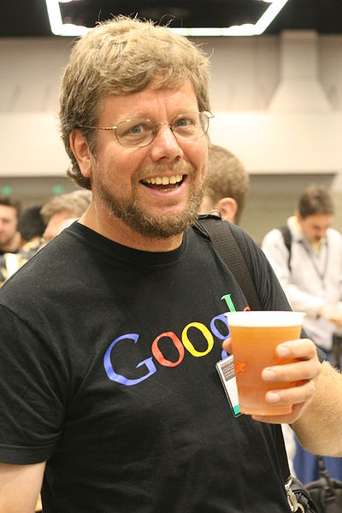
Python’s Benevolent Dictator For Life
“Python is an experiment in how much freedom program-mers need. Too much freedom and nobody can read another's code; too little and expressive-ness is endangered.”
- Guido van Rossum

Slide 5
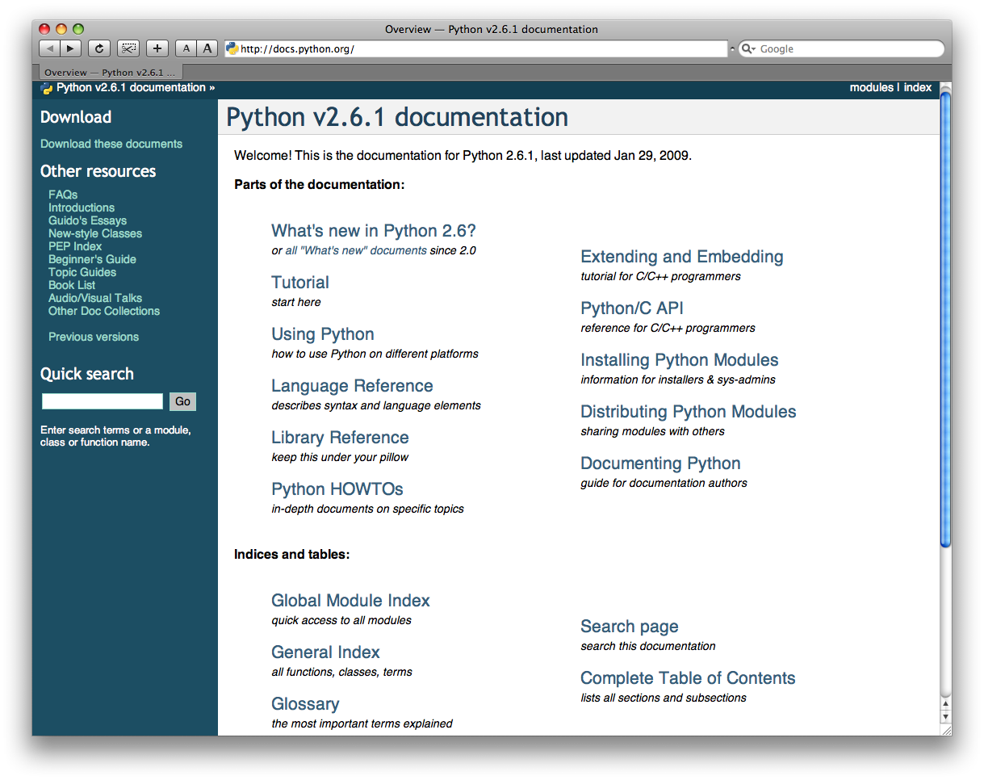
http://docs.python.org/

Slide 6
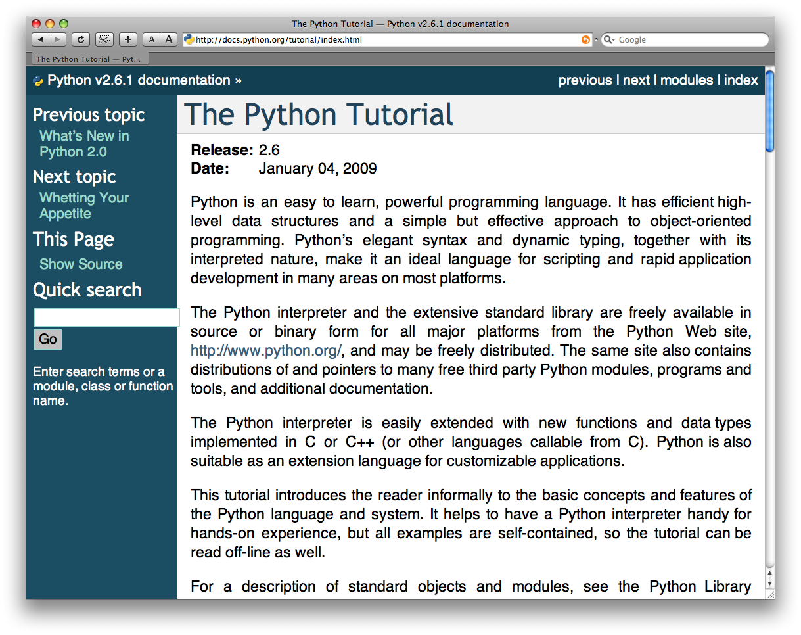
The Python tutorial is good!

Slide 7
2/5 Python Types

Slide 8
Python2 vs Python3
Python2 and Python3
Latest: 3.8.3 - some new features/ libraries in built
Python2.x last support date was Jan 1 2020. No new libraries will be on python2
print 'Hello, Geeks' # Python 3.x doesn't support (designed for only python2.x)
print('Hope You like these facts') # Python3 support
raw_input() will return the string in python2
input() in python3 in integer
As we can see, if we use parentheses in python 2.x then there is no issue but if we don’t use parentheses in python 3.x, we get SyntaxError.

Slide 9
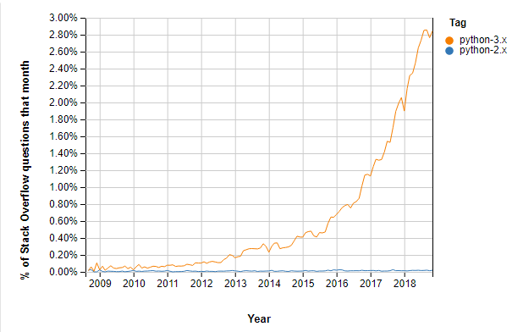
Python3 is important
Many recent developers are creating libraries which you can only use with Python 3. That’s because Python 2 won’t be available after 2020. Mass Python 3 adoption is the clear direction of the future. https://www.guru99.com/images/1/032219_1004_Python2vsPy2.png

Slide 10
3/5 Running Python

Slide 11
Running Python
It can be executed in two different ways
(1) Type python on the terminal like below
It can be only used to verify a single line code or logic. And get deleted once you exit the terminal
[finin@linux2 ~]$ python
Python 2.4.3 (#1, Jan 14 2008, 18:32:40)
[GCC 4.1.2 20070626 (Red Hat 4.1.2-14)] on linux2
Type "help", "copyright", "credits" or "license" for more information.
>>> def square(x):
... return x * x
...
>>> map(square, [1, 2, 3, 4])
[1, 4, 9, 16]
>>>

Slide 12
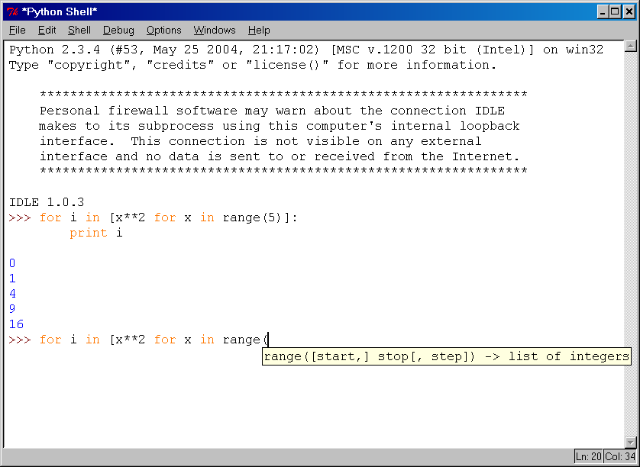
IDLE Development Environment
IDLE is an Integrated DeveLopment Environ-ment for Python, typically used on Windows
Multi-window text editor with syntax highlighting, auto-completion, smart indent and other.
Python shell with syntax highlighting.
Integrated debugger with stepping, persis- tent breakpoints, and call stack visi- bility

Slide 13
Running Interactively on UNIX
On Unix…
% python
>>> 3+3
6
Python prompts with ‘>>>’.
To exit Python (not Idle):
In Unix, type CONTROL-D
In Windows, type CONTROL-Z + <Enter>
Evaluate exit()

Slide 14
Python Scripts
When you call a python program from the command line the interpreter evaluates each expression in the file
Python also has mechanisms to allow a python program to act both as a script and as a module to be imported and used by another python program

Slide 15
The Python Execution types
(2) Python file
Create a file using <filename>.py.
Go to that file location and execute the below:
python3 <filename>.py
This is the best way to code in python for more number of lines of code.

Slide 16
Installing
Python is pre-installed on most Unix systems, including Linux and MAC OS X
The pre-installed version may not be the most recent one (2.6.2 and 3.1.1 as of Sept 09)
Download from http://python.org/download/
Python comes with a large library of standard modules
There are several options for an IDE
IDLE – works well with Windows
Emacs with python-mode or your favorite text editor
Eclipse with Pydev (http://pydev.sourceforge.net/)

Slide 17
The Basics

Slide 18
A Code Sample (in IDLE)
x = 34 - 23 # A comment.
y = “Hello” # Another one.
z = 3.45
if z == 3.45 or y == “Hello”:
x = x + 1
y = y + “ World” # String concat.
print x
print y

Slide 19
Enough to Understand the Code
Indentation matters to code meaning
Block structure indicated by indentation
First assignment to a variable creates it
Variable types don’t need to be declared.
Python figures out the variable types on its own.
Assignment is = and comparison is ==
For numbers + - * / % are as expected
Special use of + for string concatenation and % for string formatting (as in C’s printf)
Logical operators are words (and, or, not) not symbols
The basic printing command is print

Slide 20
Basic Datatypes
Integers (default for numbers)
z = 5 / 2 # Answer 2, integer division
Floats
x = 3.456
Strings
Can use “” or ‘’ to specify with “abc” == ‘abc’
Unmatched can occur within the string: “matt’s”
Use triple double-quotes for multi-line strings or strings than contain both ‘ and “ inside of them: “““a‘b“c”””

Slide 21
Whitespace
Whitespace is meaningful in Python: especially indentation and placement of newlines
Use a newline to end a line of code
Use \ when must go to next line prematurely
No braces {} to mark blocks of code, use consistent indentation instead
First line with less indentation is outside of the block
First line with more indentation starts a nested block
Colons start of a new block in many constructs, e.g. function definitions, then clauses

Slide 22
Comments
Start comments with #, rest of line is ignored
Can include a “documentation string” as the first line of a new function or class you define
Development environments, debugger, and other tools use it: it’s good style to include one
def fact(n):
“““fact(n) assumes n is a positive integer and returns facorial of n.””” assert(n>0)
return 1 if n==1 else n*fact(n-1)

