Slide 1
Presentation
Vehicle Insurance claim Analysis & Prediction
By – koshy mathew

Slide 2
Index
Data understanding - 3-12
Data preparations - 13-14
Model building & evaluations - 15 -16
Best model - 17-19
Summary & Recommendation - 20
Business Recommendations - 21-22

Slide 3
Data Understanding
Data dimensionality and info :-
Data given for training has 105000 records and data on which to be predicted has 45000 records
It has 18 columns or features
Data types – float(6) , int64(5) , object(7)
There are no null values present in the data

Slide 4
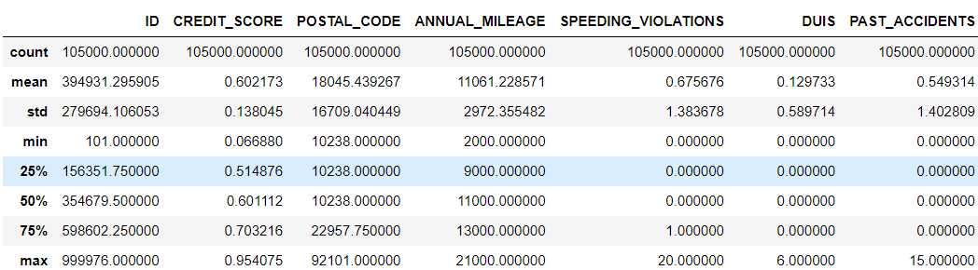
Data understanding continued…….
3. Summary statistics :-
univariate analysis –
- we can see median for credit score is 0.60 and max going 0.95 and mean and median is almost equal so a
kind of normal distribution observed
- annual mileage median is 11000 and maximum in record is 21000 with minimum2000 , here also mean
mean and median almost equal so a normal distribution statistically observed

Slide 5
Continued ……….
- for speed violation median and minimum is 0 and maximum 20 , could be having high outliers here and
mean is more than median so positively skewed
- for DUIS also median and minimum is 0 and maximum is 6 , could be having high outliers and mean is more
than median so positively skewed
- for past accidents as well minimum and median is 0 and maximum is 15 , high outliers could be there and
mean is more than median so positively skewness can be observed

Slide 6
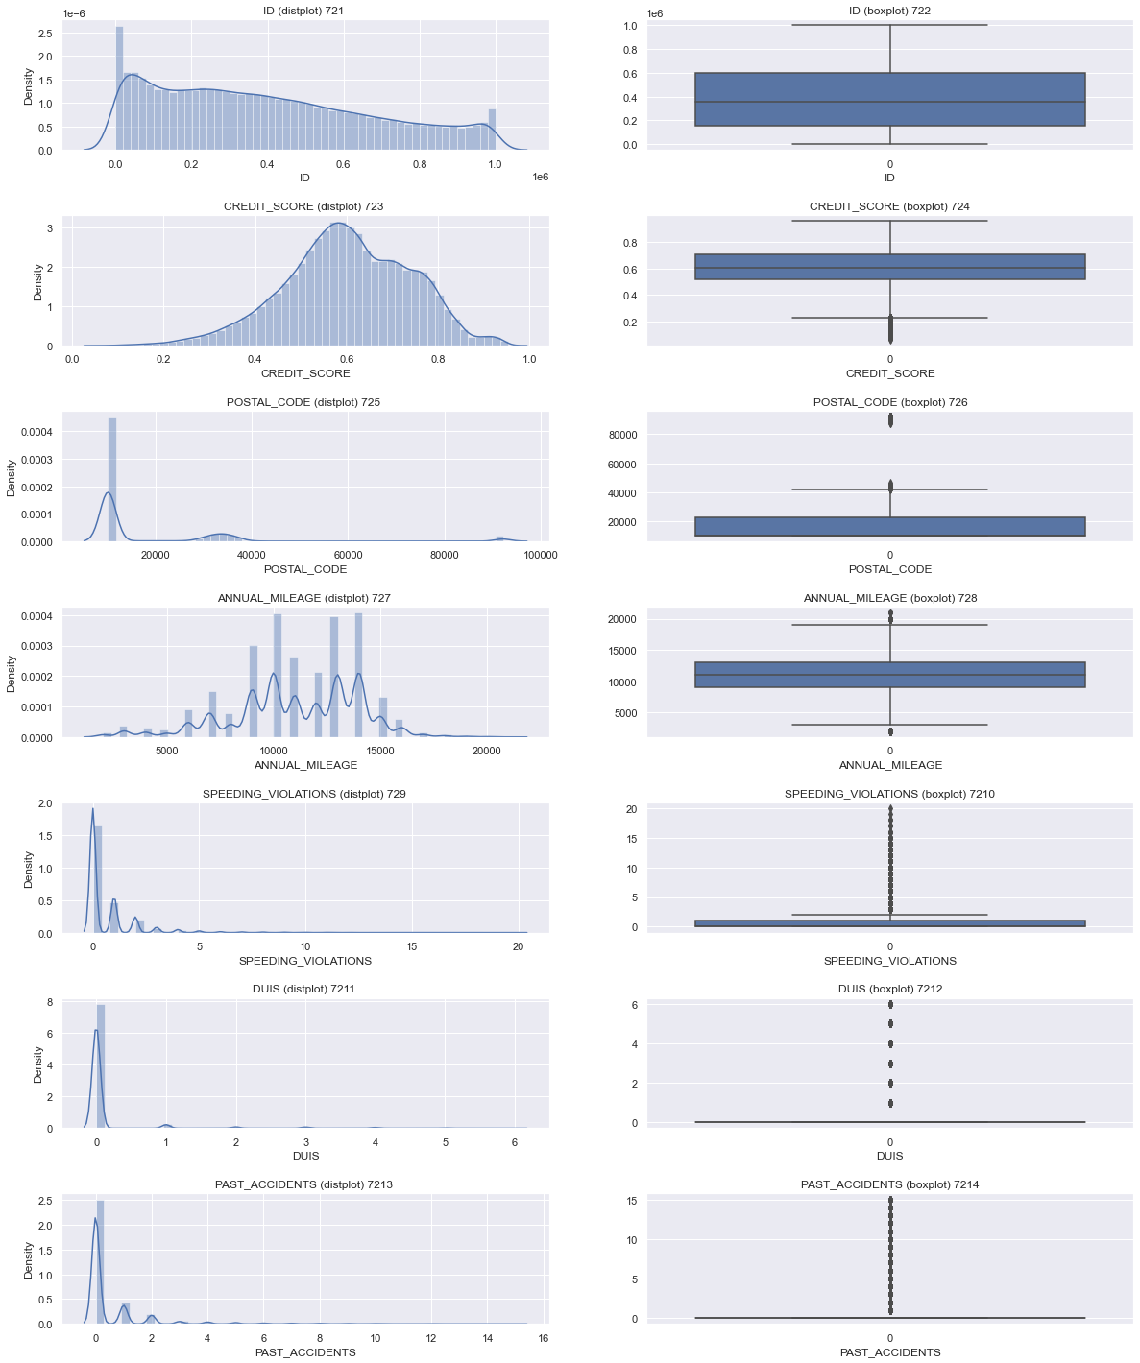
continued ………
-we can see credit score and annual mileage having normal distribution shape and less outliers
- Speeding violations , DUIS and past accidents is highly right skewed with many outliers but one thing to be noticed is that values are discrete

Slide 7
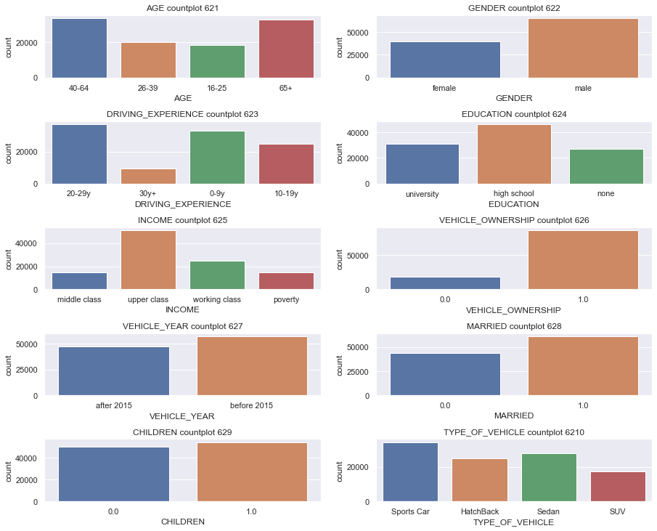
continued ……
We can see age groups above 40 and 65 have more record of insurance applicants
Male applicants are more
Driving exp 0-9 and 20-29 are more the applicants
High school graduates are more among the records
Upper class people are significantly high in records
Married people slightly high on records
Sports vehicle category is much higher on claim applicants

Slide 8
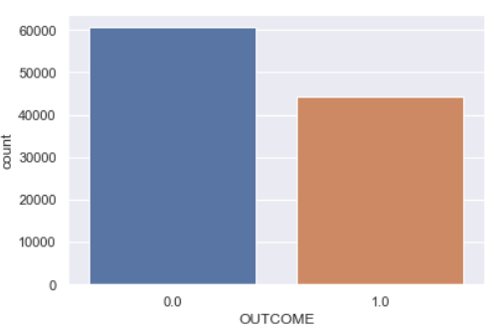

continued …..
Target variable (OUTCOME) distribution
We can see 0 i.e rejected claims are more than accepted one denoted by 1 in given data , but not that much of a difference

Slide 9
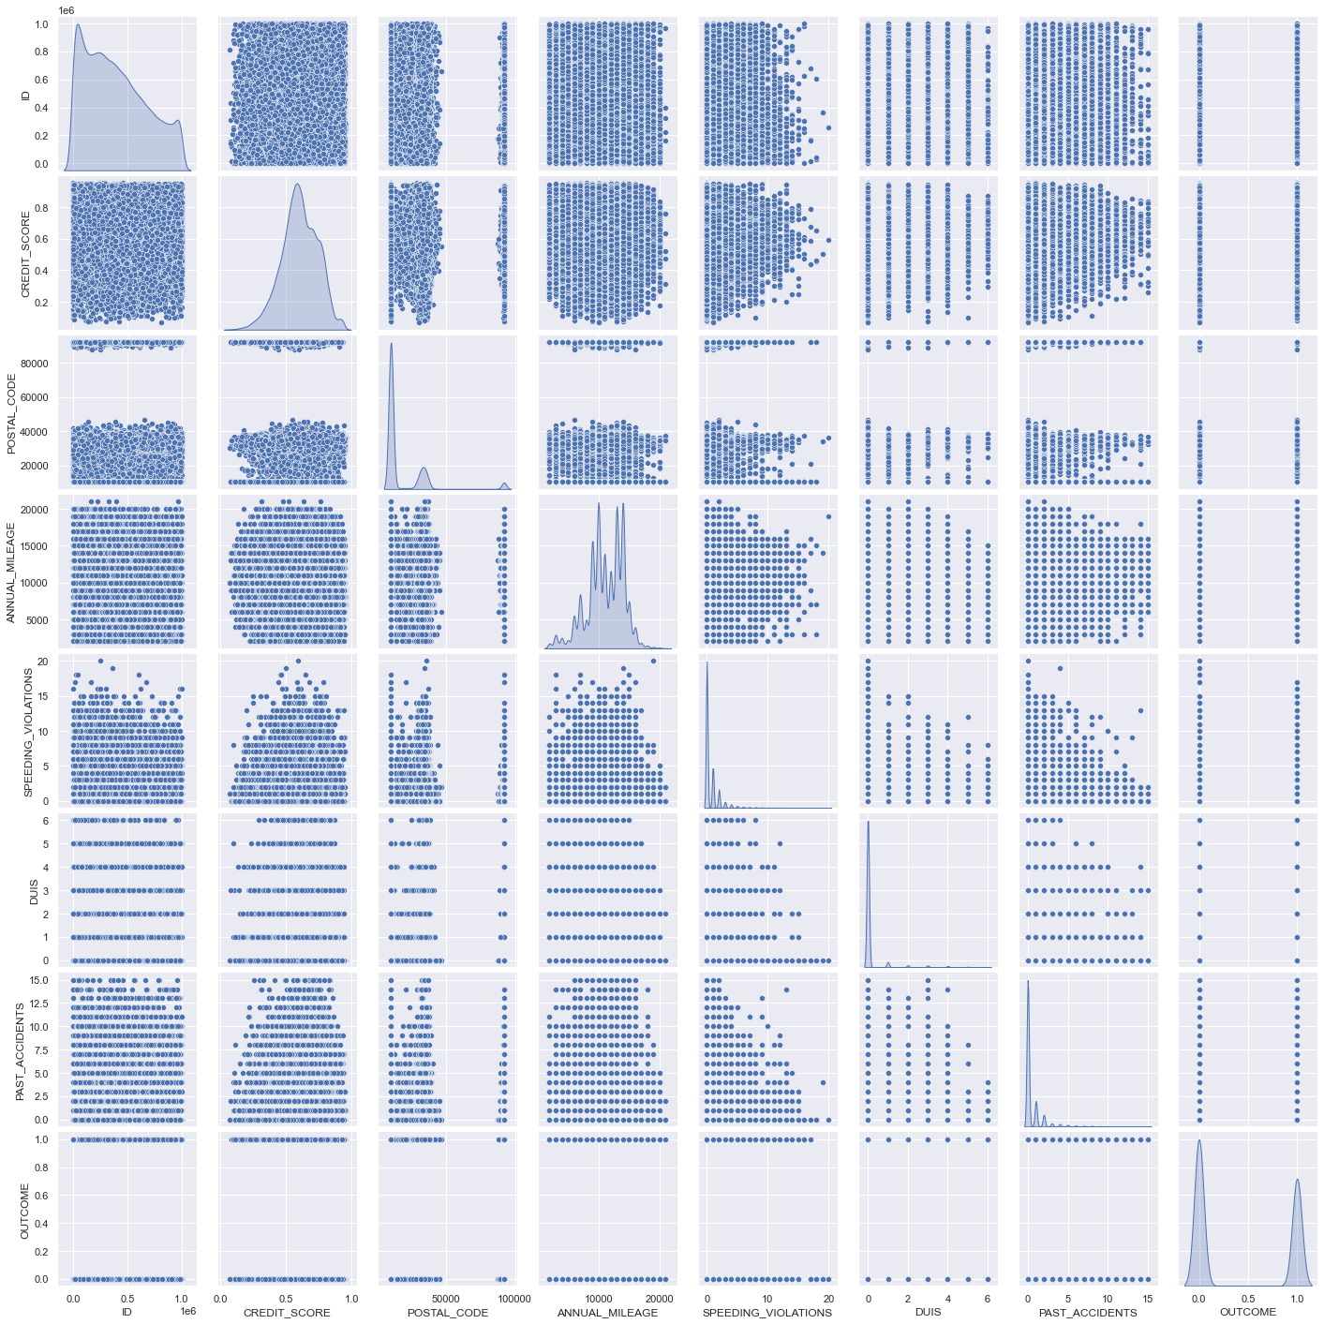
Bivariate variate analysis – numerical pair plot
- We can see not much of linear relations among features
- If we just see comparison of target variable (OUTCOME) with other variables we can see both categories of outcome some what equal in distribution among the feature except some which we we will identify in next comparison

Slide 10
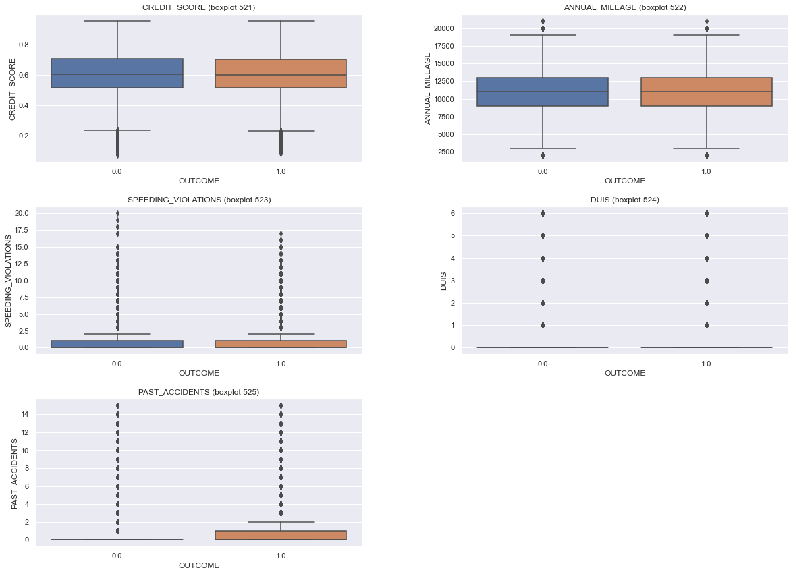
Boxplot comparison between target variable (OUTCOME) & numerical features
-We can see outcome categories are equally distributed along range of credit score and annual mileage as the medians are equal for 0 and 1 , for DUIS also
- For speed violations we can see the rejected claim records are maximum with speed violations
- For past accidents we can see rejected claim records highly positive skewed while for accepted claims there is some level of median

Slide 11
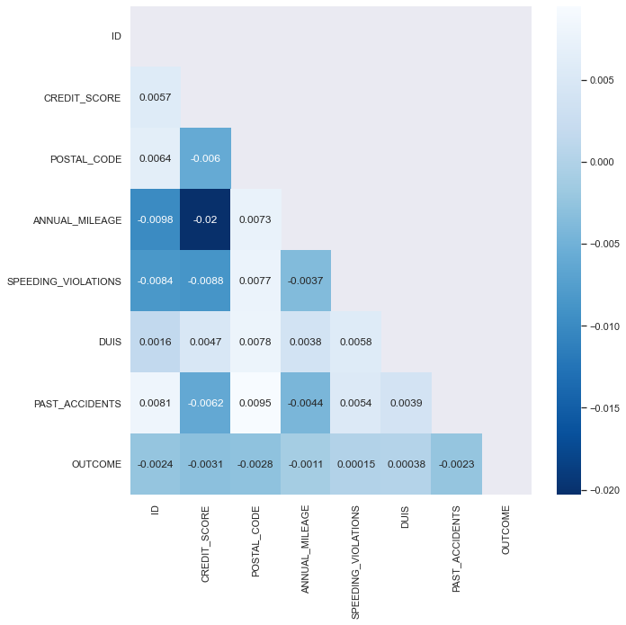
Correlation heat map – numerical variables
As we had observed in pair plot graph also. there were no significant linear relation among variables .
Here also we can see , there are no significant correlation among variables as the values of correlation are very low

Slide 12
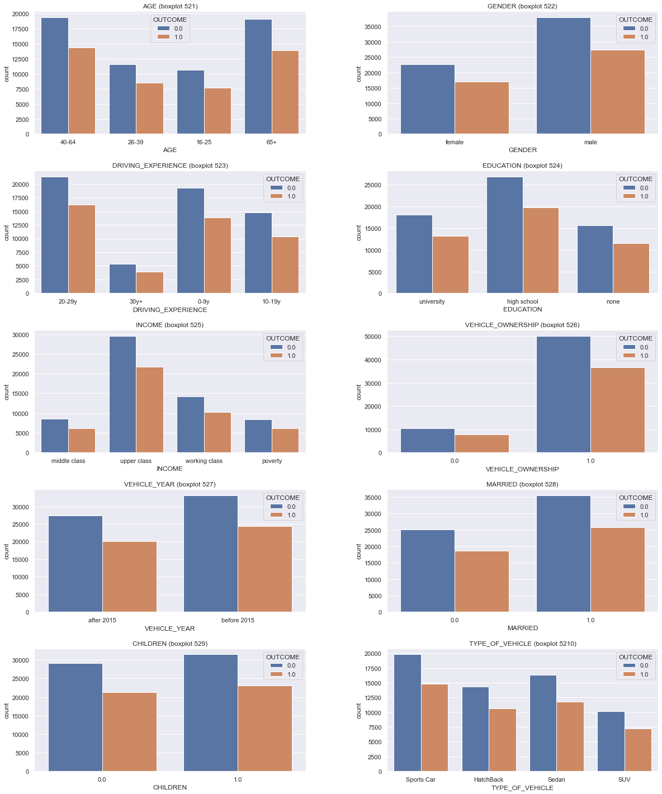
We can see ages greater than 40 have high rejection to acceptance ratio
Males have higher rejection to acceptance ratio for claims
People with driving exp 0-9have high rejection to acceptance ratio
High school qualified have higher rejection ratio
Upper class people have high rejection to acceptance ratio
Vehicles older than 2015 have higher rejection to acceptance ratio
Sports car have higher rejection to acceptance ratio

Slide 13
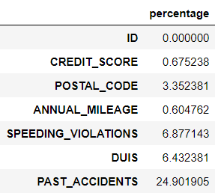
Data Preparation
Null values :- there were no null values in the data
Postal codes and id features were removed as it will not contribute to the training
Outliers :-
- we can see high outliers in features PAST_ACCIDENTS , DUIS , SPEEDING_VIOLATIONS , but as we have
have seen in the univariate analysis they are discrete continuous and each value has some frequency
so treating them would change data and impact training

Slide 14
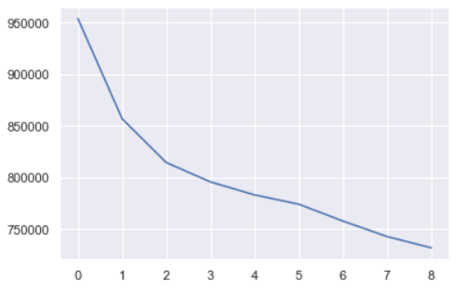
Data preparation cont….
Feature engineering –
Binning of data – features ANNUAL MILEAGE , SPEEDING VIOLATIONS , DUIS , PAST ACCIDENTS , CREDIT SCORE were binned , they were cut based on the higher frequency range to lower
Data encoding was done for categorical variables with one hot encoding and ordinal encoding
Clustering – To have a feature which divides complete variables based on there characteristics , so clustering was done . Now we can see after binning, whole features became categorical , so K-Mode clustering was done Optimal k was choosen based on wss plot as below which was 3
Train / test split :- now in order to check trained data for stability and accuracy we split data in train and test data . So out of the given data 70 % used for training and 30% for testing

Slide 15
Model Building & Evaluation
Few models were tried out but it was observed that simple tree based model or distance based models were not performing good
Ensemble models like Xgboost , Light GBM started to give relatively good results
Finally CATBOOST model gave the best after certain hyper tuning
Evaluation metrics used is Log loss Metrics
Details of performance of some the models can be seen in following slide

Slide 16
Different Model performances on train and test set (log loss metrics used )
serial no. | Models | Train | Test
1 | Random forest | 0.2717 | 0.8326
2 | Logistic regression | 0.6819 | 0.6805
3. | XGB classifier | 0.6800 | 0.6812
4 | LGBM classifier | 0.6798 | 0.6719
5 | Neural networks | 0.6808 | 0.6817
6 | CAT boost classifier (best) | 0.6795 | 0.6818
- random forest is highly overfitting
Logistic regression , xgb classifier , LGBM classifier , neural networks have relatively good repeatability but are low on accuracy on final test set
Cat Boost classifier was considered best in accuracy and repeatability

Slide 17
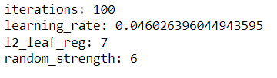
Best Model
CAT boost classifier :- this algorithm performed well in terms of accuracy as well as stability on final testing .
main reason for good performance could be that all features were categorical and CAT boost best performs
on categorical features
Hyper tuning of the model was done using OPTUNA :
it was tuned on mainly iterations , learning rate , random strength and l2_leaf_reg
Best parameters after 20 trials were as follows :-

Slide 18
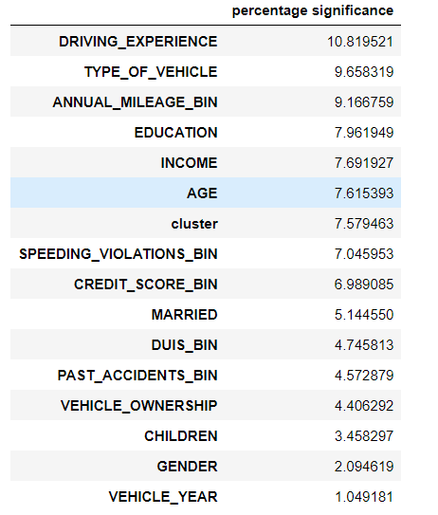
Best Model cont….
We can see in important features driving experience , type of vehicle and annual mileage are top contributors to prediction
Above features will play important role while considering future claims
Other important features that followed are education , income and age

Slide 19
Best Model cont…..
Model gave good accuracy with relatively consistent repeatability
Comparing other model it can be deployed as it showed good stability i.e less overfitting and good accuracy
Business insight from the model we can see driver experience , type of vehicle and annual mileage as important parameter for prediction

Slide 20
summary and recommendations
Summary :-
Most of the applicants for claim are above 40
Male applicants are more with higher rejection ratios
People with less driving experience have higher rejection ratio
People with higher past accidents have higher rejection ratio
Sports vehicle claim request are more with high rejection
Upper class claims are more and have high rejection ratio
Very less correlation among variables
CAT boost is the best algorithm decided based on accuracy and stability
Recommendations:-
more diverse data is required for further study and high accuracy, like gender feature was un balanced with more male applicants , upper class category in income feature are relatively high in data , claims had more record with sports vehicle category
Cat boost is best algorithm to deploy in production

Slide 21
business Recommendations
We can see drivers with less experience have higher claims and higher rejection ratio and most of the claims are from the owners of the car . So it can be assumed relatively new cars are up for claims . In that case following can be ensured for good business
Higher premium on new cars that should be basic
stringent measures on seeing the authenticity of claims specially for new cars
Records with higher past accidents should be checked stringently as higher rejections are recorded on analysis
Drivers under influence are very basic on rejection to claims so should be thoroughly checked
Higher number of claims can be noted from people having age more than 65 + with high rejections so thoroughly examined claims before acceptance for such age limit

Slide 22
business Recommendations
Thorough examination to be done on claims with higher number of speed violation plus higher past accidents they are most probably rejected because of there mistakes
Further high applicants hold sport cars and their rejection ratio are also high , so it should be carefully seen as accidents might have caused of there negligence in rash driving

