Slide 1
ACTIVE DIRECTORY SET-UP
ON VMWARE
Building a self-contained Windows Server + Active Directory + Windows 10 lab environment in VMware Workstation
A step-by-step technical walkthrough

Slide 2
WHAT WE’LL COVER
01
Installing Windows Server on VMware
02
Windows Server OS Set-Up
Create the VM and boot into setup
Edition, license, disk & first login
03
Active Directory Set-Up
04
User Profile Set-Up
Add AD DS role & promote to domain controller
Create a domain user account
05
IP Address Set-Up
06
Installing Windows 10 VM
Assign a static IP to the server
Create the client VM
07
Windows 10 Guest OS Set-Up
Network config, domain join & sign-in
2

Slide 3
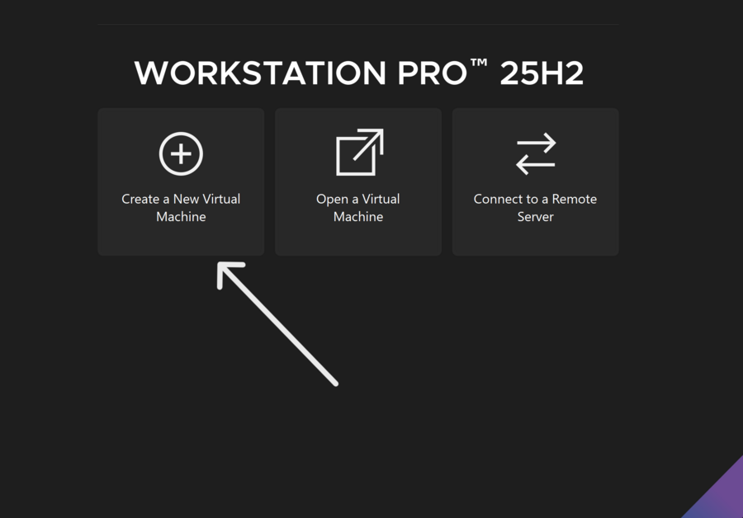
SECTION 1
Installing Windows Server on VMware
1
Create a new virtual machine and browse to the Windows Server ISO
2
Skip the product key, pick the disk size (60GB) and split into multiple files
3
Remove the unneeded virtual floppy from VM settings, then power on
4
Boot the ISO and enter the Windows Server setup wizard
3

Slide 4
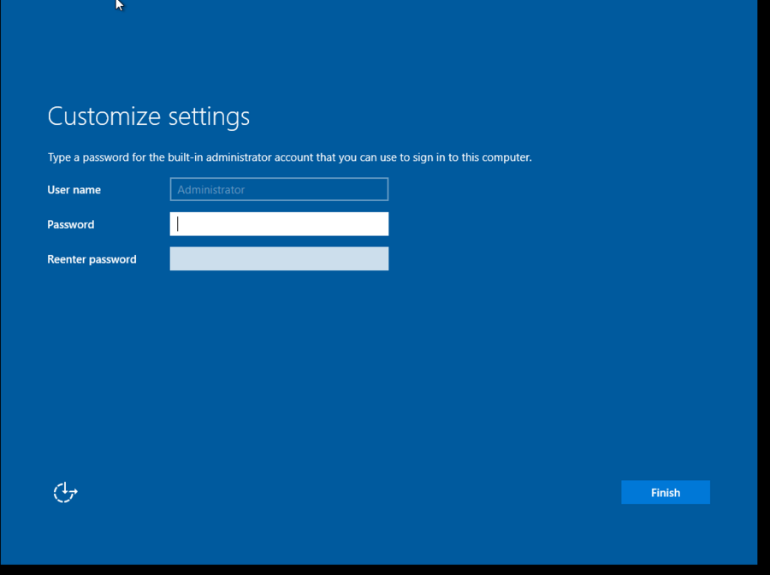
SECTION 2
Windows Server OS Set-Up
1
Choose language and click Install now
2
Select Windows Server Standard Evaluation (Desktop Experience)
3
Accept the license terms and choose Custom install
4
Partition the disk, wait for install, then set the Administrator password
4

Slide 5
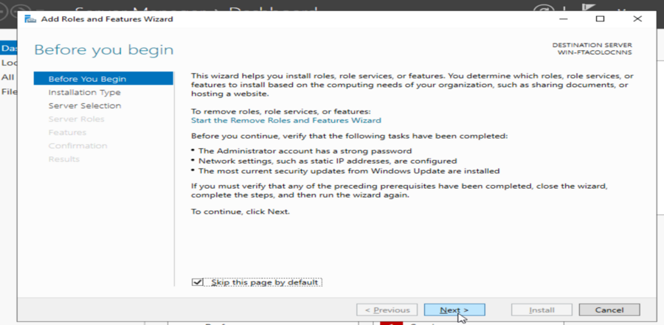
SECTION 3 – PART 1
Adding the Active Directory Role
1
Open Server Manager and launch "Add roles and features"
2
Choose Role-based or Feature-based installation
3
Select the server, then check "Active Directory Domain Services"
4
Add the required management tools and features, then install
5

Slide 6
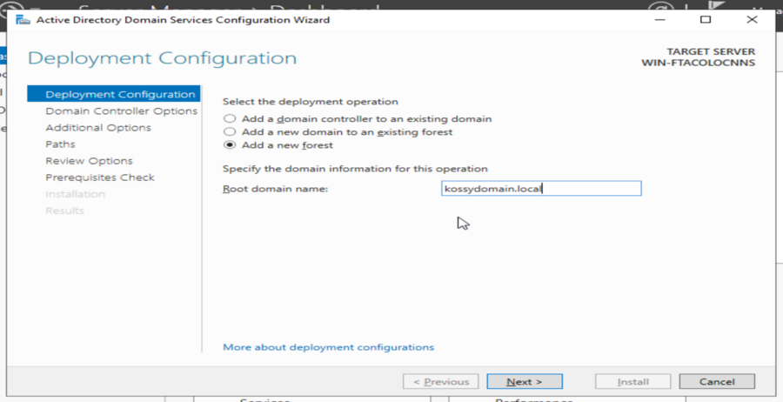
SECTION 3 – PART 2
Promoting the Server to a Domain Controller
1
From the Server Manager notification flag, choose "Promote this server"
2
Select "Add a new Forest" and enter a root domain name
3
Set the Directory Services Restore Mode password
4
Confirm DNS, NetBIOS and paths, run the prerequisite check, then install
6

Slide 7
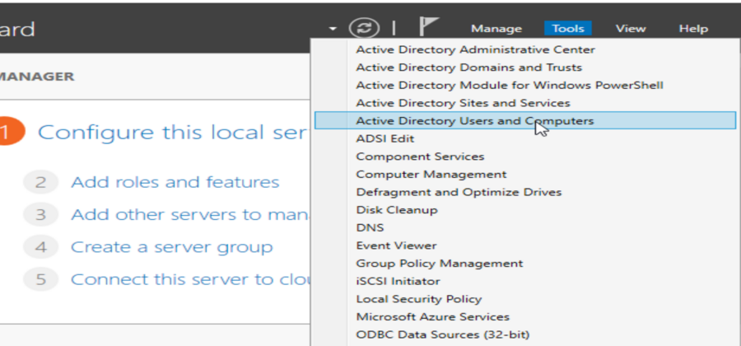
SECTION 4
Creating a Domain User Profile
1
Open "Active Directory Users and Computers" from Server Manager Tools
2
Right-click the Users folder → New → User
3
Enter the name and logon name for the account
4
Set a password (Password never expires) and finish
7

Slide 8
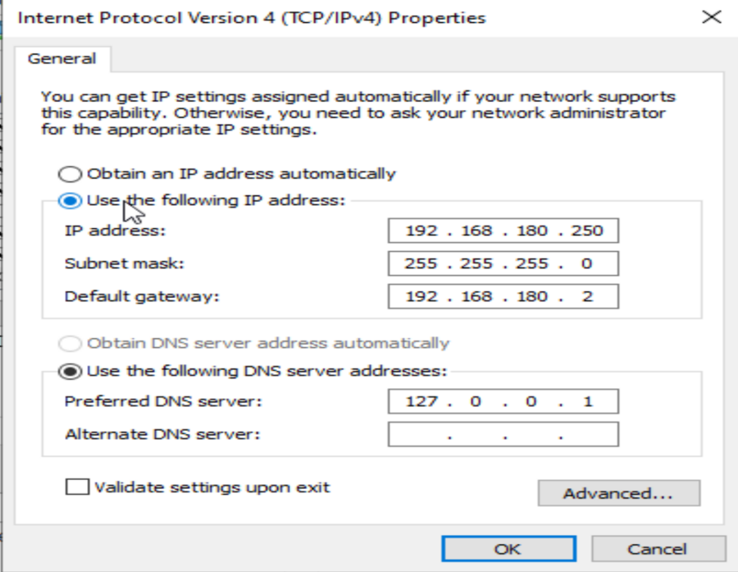
SECTION 5
Assigning a Static IP Address
1
Open Network Settings → Change Adapter Options
2
Right-click Ethernet0 → Properties → IPv4
3
Enter a static IP, subnet mask and default gateway
4
Confirm the configuration with "ipconfig" in PowerShell
8

Slide 9
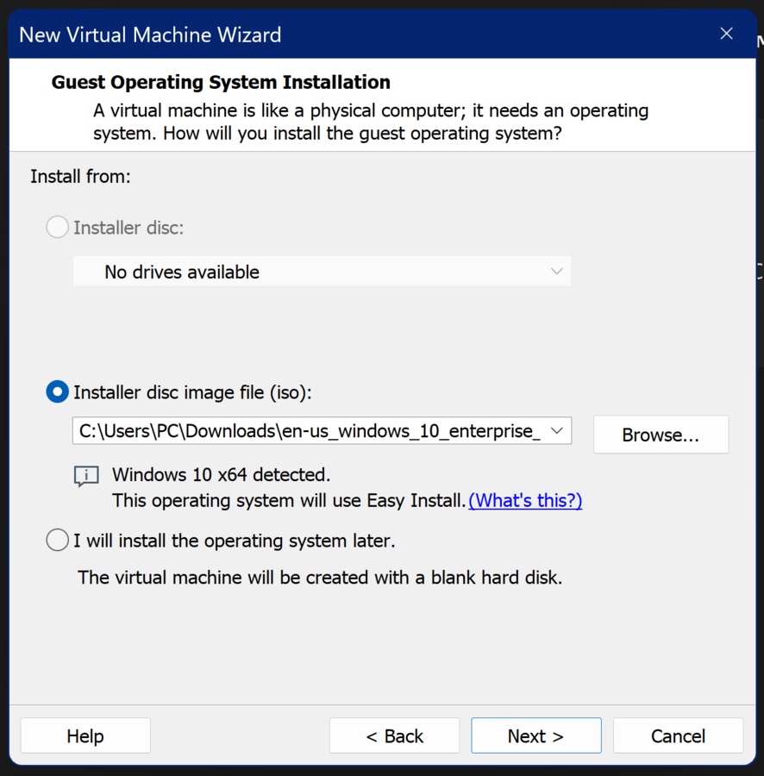
SECTION 6
Installing the Windows 10 Client VM
1
Create a new virtual machine and browse to the Windows 10 ISO
2
Select "Windows 10 Pro" as the version to install
3
Name the machine and set disk size (60GB, split into multiple files)
4
Click Finish and wait for the VM to be created
9

Slide 10
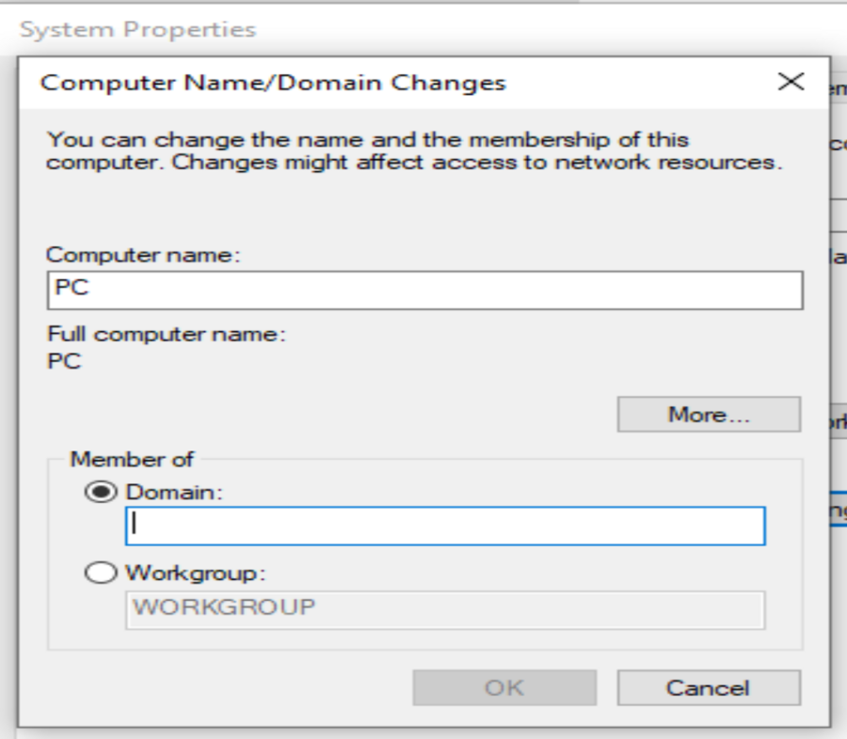
SECTION 7 – PART 1
Windows 10: Network Configuration & Domain Join
1
Install Windows 10 Enterprise LTSC and boot into the desktop
2
Configure a static IP on Ethernet0 to match the server’s subnet
3
Open System Properties → Rename this PC (advanced)
4
Join the machine to the Active Directory domain (e.g. codeforge.local)
10

Slide 11
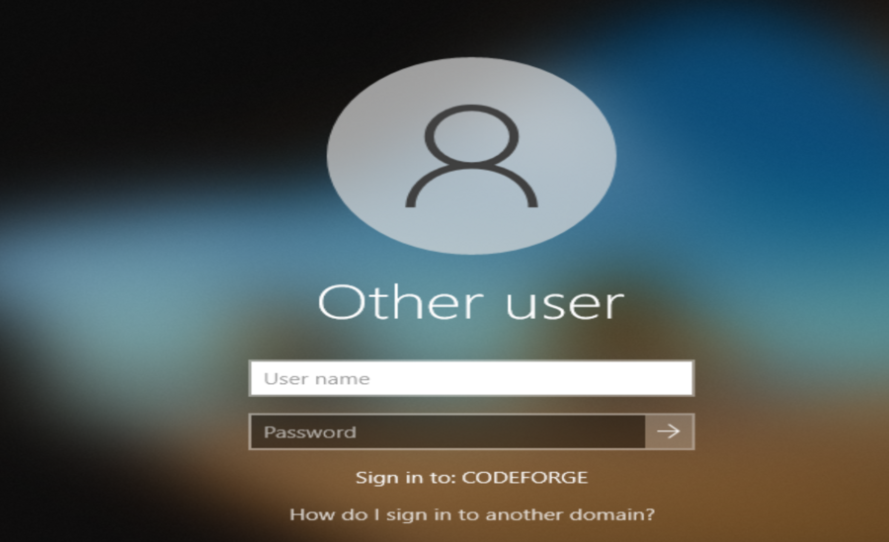
SECTION 7 – PART 2
Signing In to the Domain
1
Accept the "Welcome to the domain" notification and restart
2
At the lock screen, choose "Other user"
3
Sign in using the domain user account created in Active Directory
4
The environment now simulates a real client/server domain network
11

Slide 12
LAB ENVIRONMENT COMPLETE
Windows Server 2022
Static Networking
Domain Controller running Active Directory Domain Services
Server and client both configured with fixed IP addresses
Domain User Account
Windows 10 Pro Client
Created in AD and used to sign in from the client
Joined to the domain and verified via sign-in
12

Slide 13
Questions?
Thank you
13

