Slide 1

.
Development of a chat messenger for different professions

Slide 2

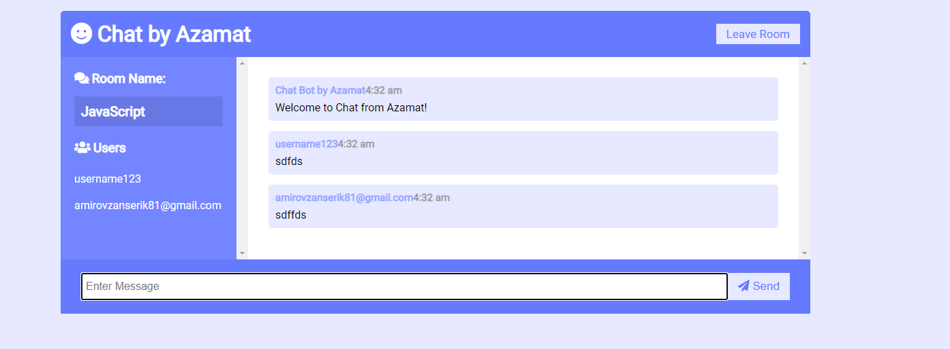
This is an application similar to discord. Where everyone can choose a narrow topic and chat to each other
Chat app

Slide 3




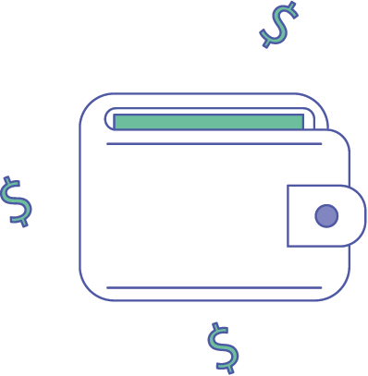
users from different countries
Brainstorm
Opportunities
Different topics
Streaming
Video call

Slide 4
Workers
Helpers:
FAQ;
Support.
3. Bloggers.
4. Gamers.
5. Interlocutors.
The main directions in chat app

Slide 5



Benefits of chat over apps
does not take up memory
No need to update
Boot with slow internet

Slide 6
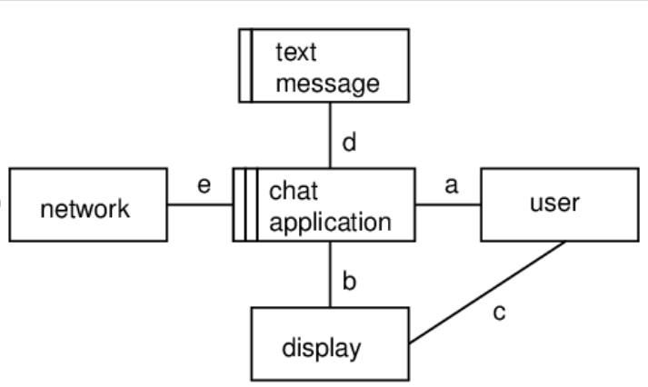
Context diagram for a Chat App

Slide 7
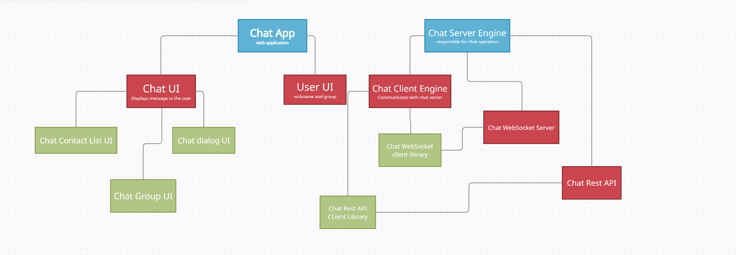

Project architecture

Slide 8
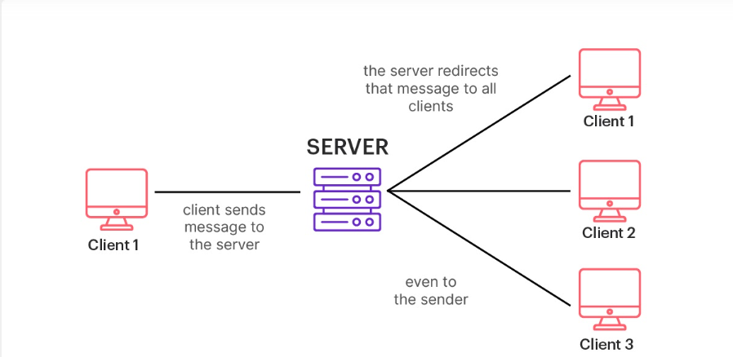
How does it work?

Slide 9

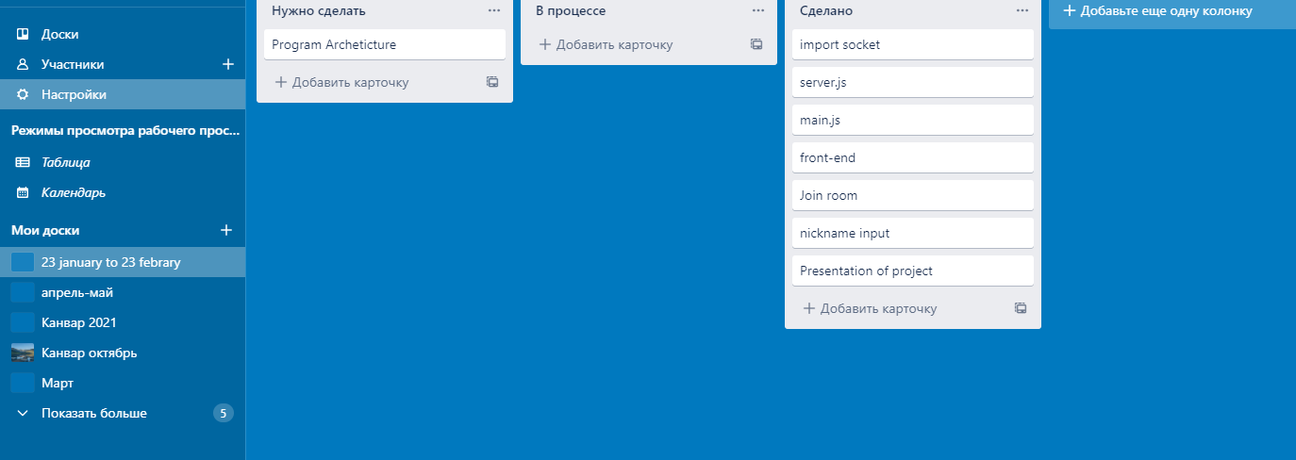
How I managed the work

Slide 10
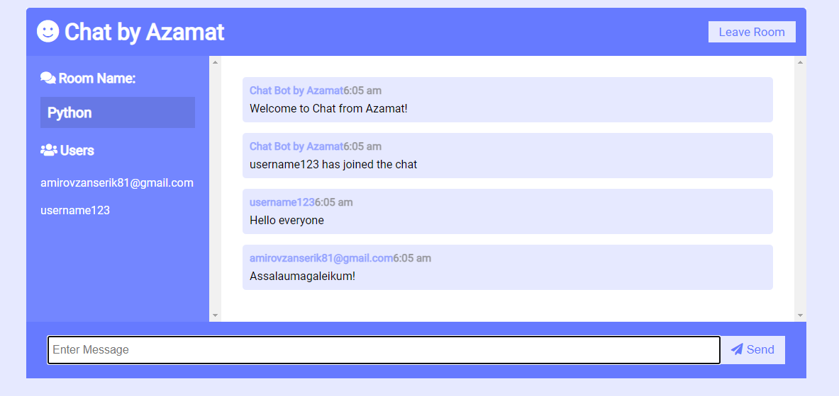
Dialog,Users,Groups page

Slide 11
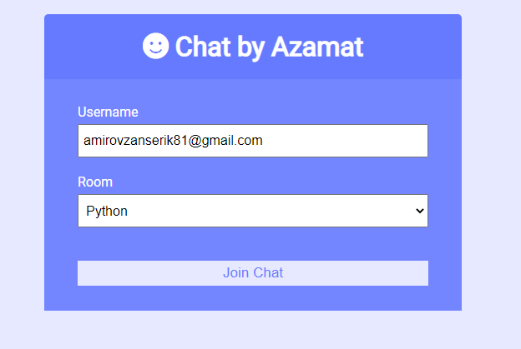
Authorization page

Slide 12
Video call
Audio call
Streaming
Monetization
Sending photos and videos
Future of the project

Slide 13
Thank you for your attention

