Slide 1
Space-Age DevOps
Integrating ESA's NanoSat MO Framework with Kubernetes
for Seamless Satellite Operations
Dimitris Fotiou

Slide 2
Table of contents
01
The Problem
03
Demo!
02
The solution
04
Implementation
Problems that arose in the New Space age with thousands of small sats deployed
Following the steps of ESA’s NMF and evolving it using Kubernetes
In-depth presentation of architecture and how we brought DevOps into space

Slide 3
01
The Problem
Problems that arose in the New Space age with thousands of small sats deployed

Slide 4

SmallSats Evolution
The ever-evolving field of space exploration demands innovative approaches to satellite mission operations. While developments within the “New Space” era with the rise of small satellites offer unique advantages, including reduced costs and faster development cycles, they also present operational challenges that require system modernization and increased automation at par with advances in general software engineering.
Notes:
Μικρότεροι χρόνοι για development + deployment
Αυξημένη υπολογιστικη ισχύ σε μικρότερο μέγεθος
Παλιο μοντελο πολυετούς ανάπτυξης λογισμικού με πολύ low level programming μπορεί να μην ανταποκρίνεται σε αρκετές περιπτώσεις
Constellations
Pico/femto sensors + smallsats

Slide 5
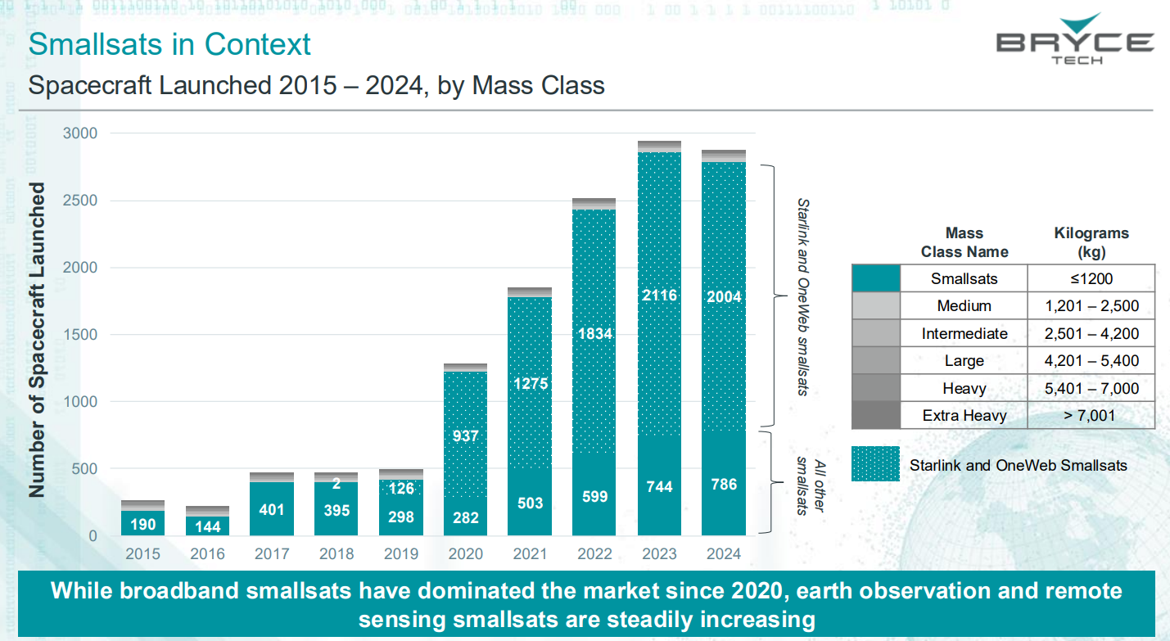
SmallSats dominate spacecraft launches
since 2020
https://brycetech.com/reports/report-documents/smallsats-2025/

Slide 6
Statistics are very clear about
the rise of Smallsats
97%
81%
73%
of all spacecraft launches in 2024 (2023: 97%)
of spacecraft upmass in 2024 (2023: 63%)
of all spacecraft launches in 2024 (2015-2024: 25%) for larger SmallSats
Notes:
Νέοι παίκτες εκτοξεύουν δορυφόρους (παρότι κυριαρχούν one web + starlink)
Commercial αυξηση (και πέρα από τη διάδα) και κάπως gov defence
Remote sensing (πέρα από διάδα)

Slide 7
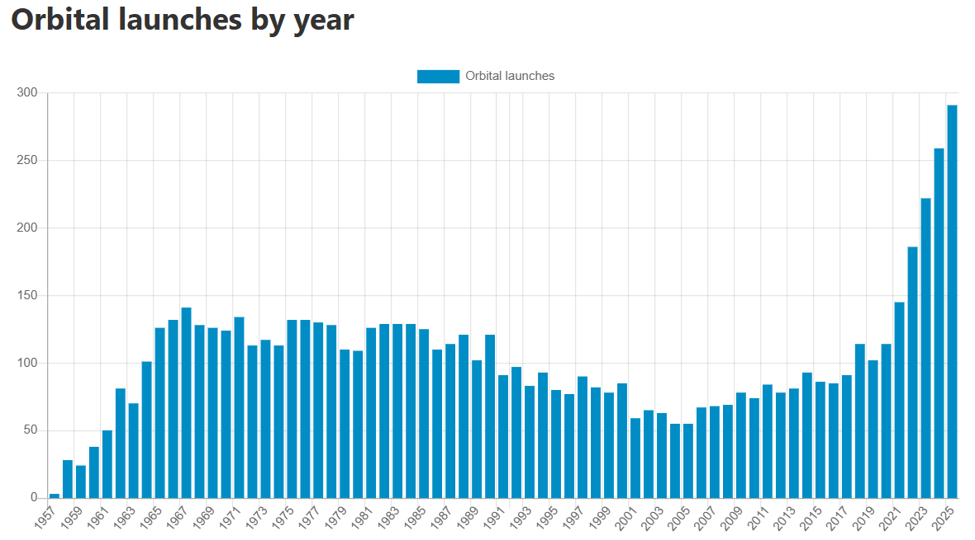
Spacecraft launch rate
Increased
Time to launch
decreased
https://spacestatsonline.com/launches

Slide 8
Space Edge computing
“New Space” also enables edge computing capabilities onboard satellites, allowing data to be processed in space rather than relying solely on ground-based infrastructure.
This reduces communication latency, optimizes bandwidth usage, and supports more autonomous and resilient mission operations but requires great autonomy and scalability in space software.

Slide 9
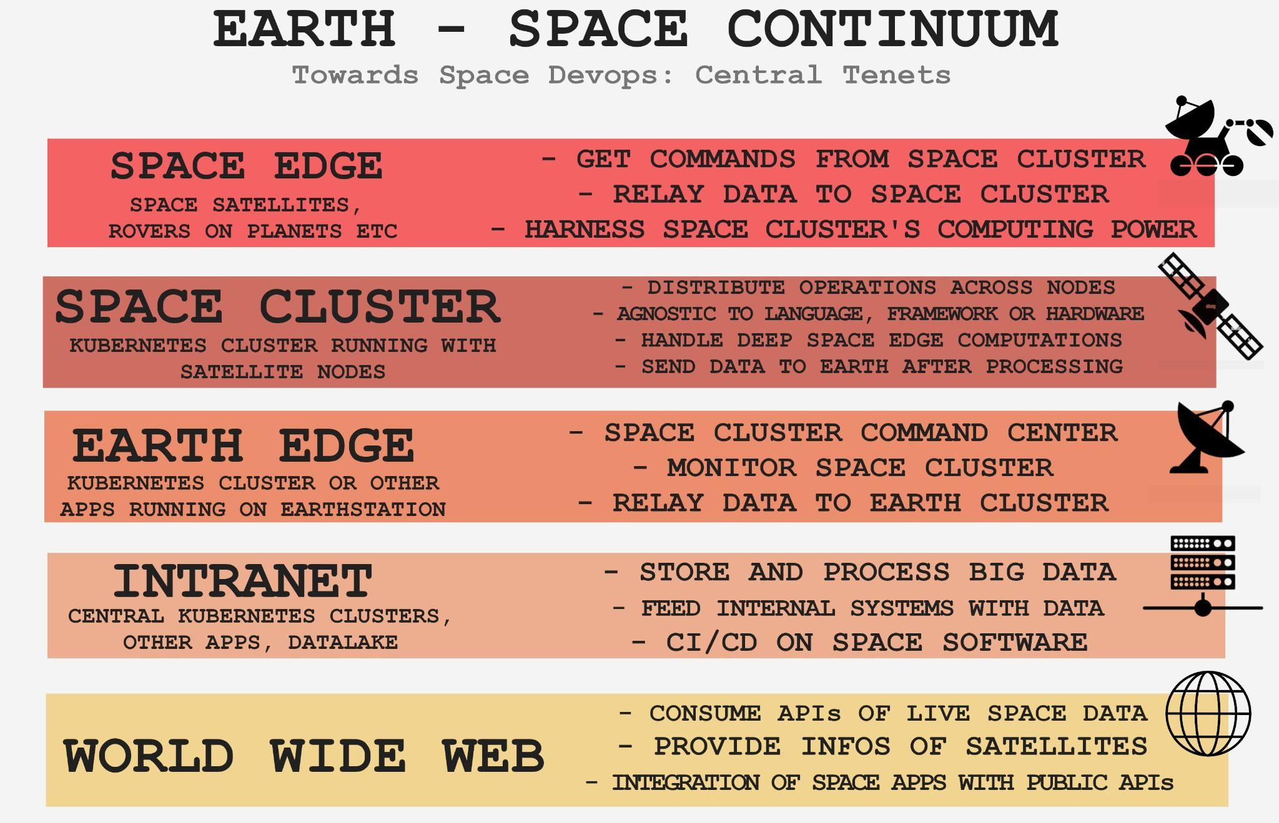

Slide 10
Need for modernization
Operational needs that derive from SmallSats and Space Edge computing require a modern space software approach and architecture.
Notes:
Payload switching

Slide 11
02
The solution
Following the steps of ESA’s NMF and evolving it using Kubernetes

Slide 12
DevOps to the rescue
Agility
Efficiency
Adaptability
Enables dynamic responses to evolving mission requirements and unforeseen challenges through continuous integration and rapid deployment
Streamlines operations and development cycles via automation, reducing the traditionally extended timeframes
Allows space systems to iterate and innovate more swiftly, fundamentally changing how space agencies manage their missions
Notes:
Agility: iterative development-deployment -> καλύτερο για smaller cycles of smallsats.
Efficiency: Automation (testing, deployment, monitoring) vs manual
Adaptability: Payload switching δένει με το iteration του DevOps. Ανεβάζω ένα προσχέδιο και το βελτιώνω στην πορεία

Slide 13
DevOps is a collection of practices, philosophies, and tools designed to enhance the velocity of software development, shorten the time to market, and improve both software quality and system reliability.
Notes:
The "Assembly Line" Analogy like with car Automated: A script automatically deploys your code.Fast Feedback: Automated tests tell you it's broken in minutes."Collaborative: Everyone is responsible for the app's health.

Slide 14
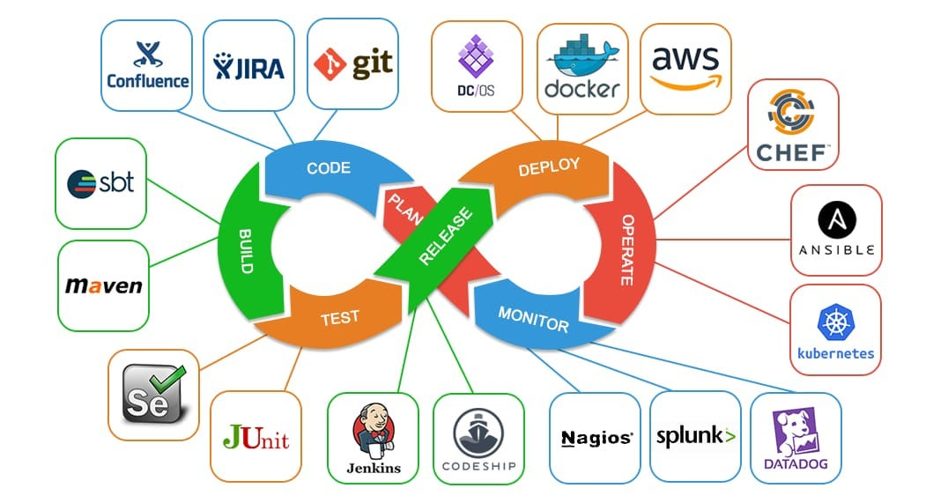
A blink at DevOps lifecycle
tool ecosystem
Notes:
Συνοπτικά για docker/Kubernetes

Slide 15
Looking for a
real world example

Slide 16
ESA’s OPS-SAT
A flying laboratory, ESA's OPS-SAT is the first of its kind, with the sole purpose of testing and validating new techniques in mission control and on-board satellite systems.

Slide 17
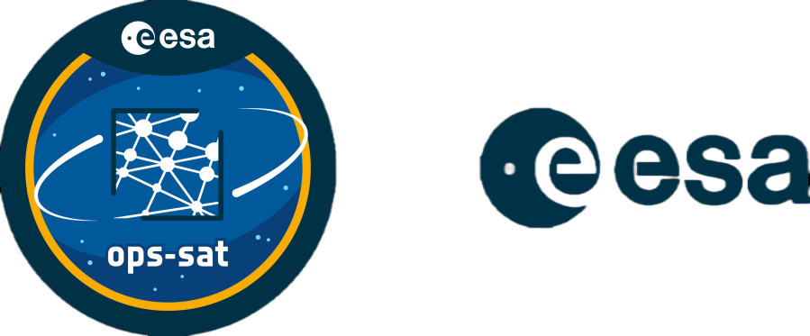
OPS-SAT payload
Hardware
Software
3U Cubesat, 30cm high
2 Critical Link MityARM 5CSX
1 GB DDR3 RAM
Dual-core 800 MHz ARM Cortex-A9
Cyclone V SoC FPGA board
Peripherals for ADCS, GPS, Camera, Communication
NanoSat MO Framework, open-source software framework Java implementation
Embedded Linux OS

Slide 18
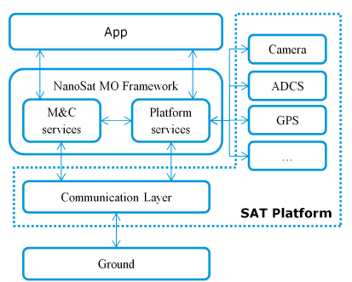
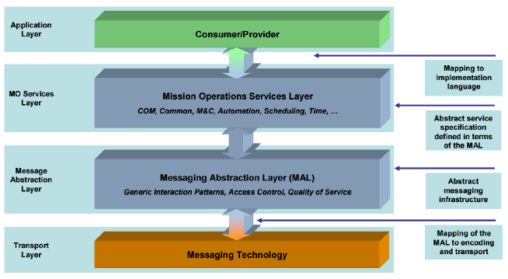
NanoSatMO Framework & CCSDS
The NanoSatMO Framework is a modular software framework designed for nanosatellites to facilitate mission operations, onboard software management, and payload control using a service-oriented architecture. It builds on CCSDS standards to ensure interoperability and reliable communication between satellite subsystems and ground stations.
Notes:
ccsds : πρωτοκολλα επικοινωνίας μεταξύ των services (MAL, like wsdl)
Nmf: java implementation of ccsds -> tested in opssat -> με εργαλείο όπως supervisor, ctt, platform services (specific device implementations)
SOA -> coupling με supervisor -> π΄ρωτο καλό βήμα από το μονόλιθο -> ανεβάζω κατεβάζω apps, αλλάζω jars -> διαφορετικοί devs, ops για κάθε service κτλ μεγαλύτερη αυτονομία και ταχύτητα

Slide 19
NMF limitations
Portability
Scalability
NMF components require specific tailoring for each satellite OS
No option to scale an app
Supervisor tight-coupling
Isolation
All NMF apps are tightly-coupled with Supervisor
On-board apps can potentially impact or crash each other due to shared JVM and OS resources
Manual Processes
Manual processes to build, test, deploy and monitor NMF apps

Slide 20
—César Coelho Lead architect of ESA’s NMF
“Another possible solution would be to start and stop Docker containers instead of processes from the Apps Launcher service. Docker is a software container platform that intends to eliminate “works on my machine” problems when collaborating on code with co-workers and also to run and manage apps side-by-side in isolated containers.”
“Apps can be deployed in isolate containers however this might make the framework platform-dependent depending on how the isolation is done and therefore it needs to be carefully assessed.”
https://github.com/esa/nanosat-mo-framework/blob/ops-sat/sdk/sdk-package/src/main/resources/docs/Dissertation__Cesar_Coelho.pdf
https://arc.aiaa.org/doi/pdf/10.2514/6.2016-2624

Slide 21
DevOps powered NMF
Scalability
Technology
agnostic
Administration
Deployments
Portability
Self-healing
Apps can be scaled down and up according to specific orbital needs, manually or automatically based on rules and scheduled jobs.
Enable the usage of diverse languages & frameworks for the same satellite.
Better software administration with easily parameterized and configurable applications. Advanced resource management
Zero-downtime, automated and quick deployments of new app versions.
Independence and isolation from the underlying OS
Application self-healing that handles app crashes, triggers restarts, limits traffic. Rollback options available

Slide 22
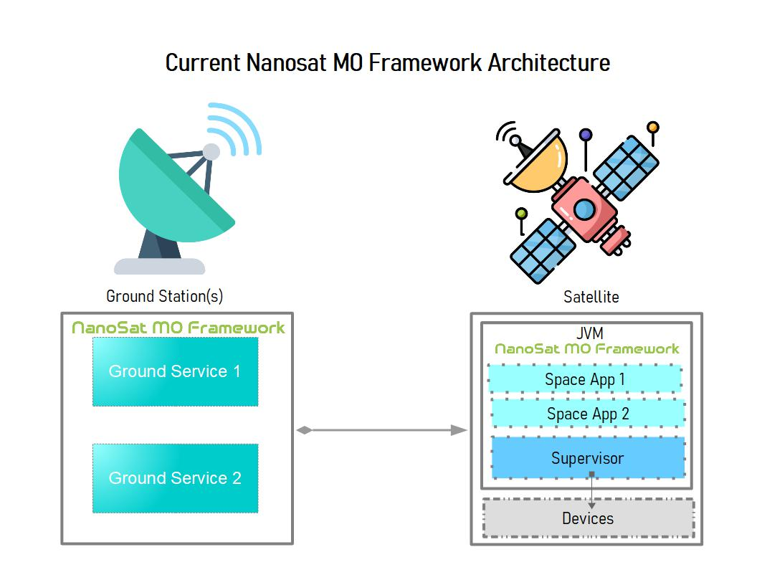
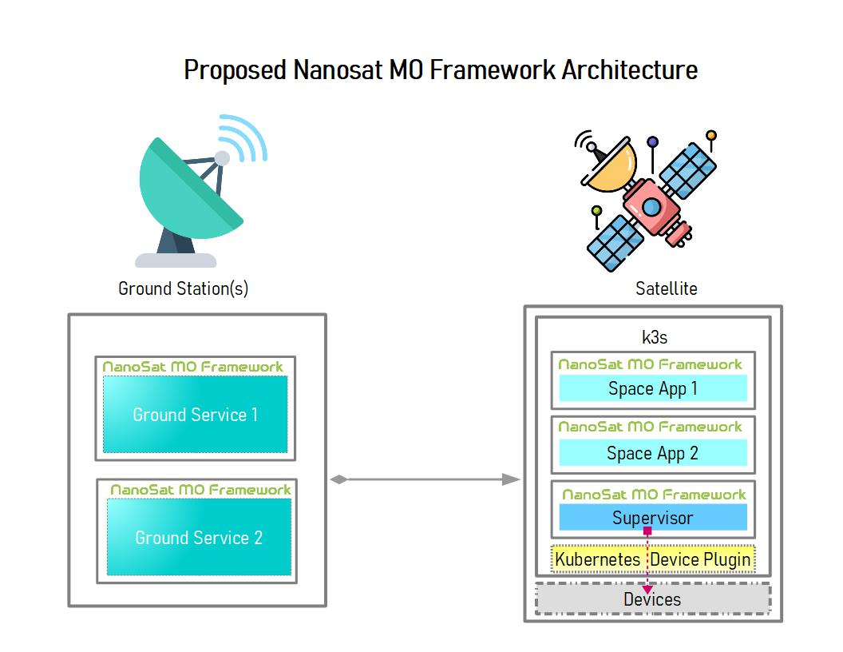

Slide 23
03
Demo!
Notes:
Use cases: (flow to be defined but we can start with generic kubernetes traits and end up with the final NMF advantages
Nothing exists - deploy exeryting with Jenkins or helm install
Showcase version control & rolling update
Showcase scaling down of unused services
Show logs easy troubleshooting
Architecture highlight a pod running without supervisor that was not possible before && microservices running in different pods
Error Control: Upload wrong version and show that it keeps playing
Observability? Metrics? ????
Take picture with nmf poc nmf space -> ground app
Example with language agnostic app

Slide 24
04
Implementation
In-depth presentation of architecture and how we brought DevOps into space

Slide 25
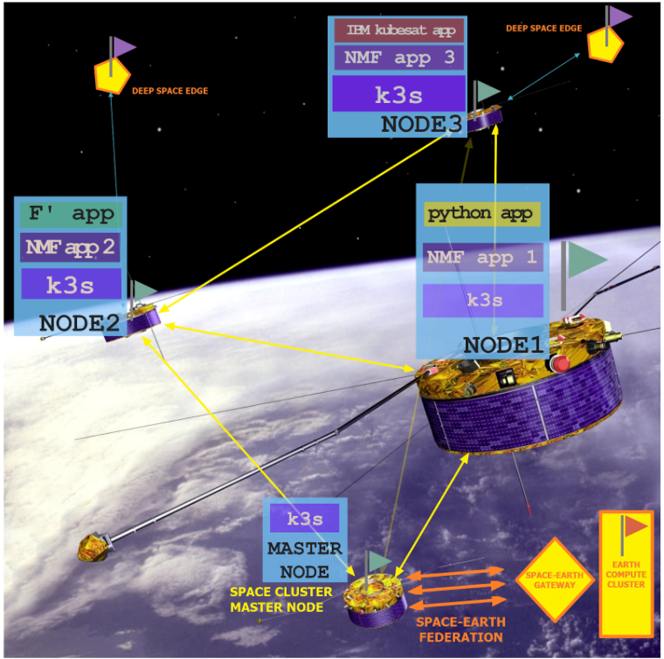
Technology agnostic Space Edge clustered Kubernetes architecture
Notes:
VISION: space edge clustered (constellation) architecture, different languages/os/libraries, k8s flacours, deep space or femto/pico (akri)

Slide 26
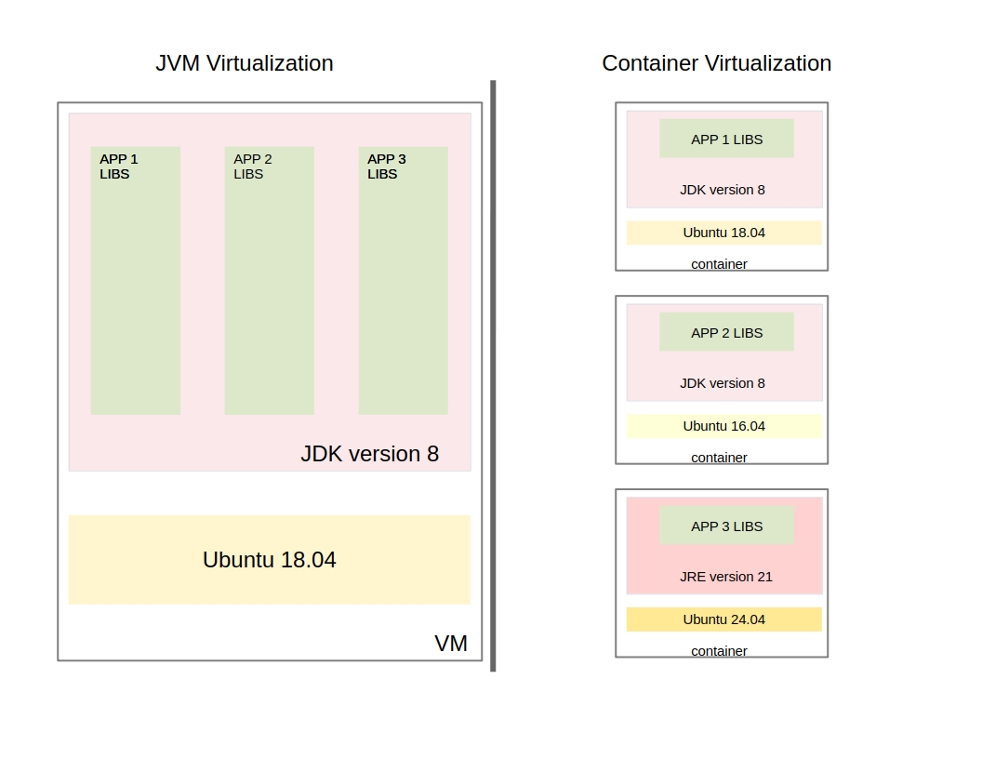
Single JVM & Container Virtualization Comparison
Notes:
Helps upgrades (java, linux can be done gradually or not completely anyway)
Jre lighter or jdk if you want specific other tools (jstat, jstack for monitoring) or jlink

Slide 27
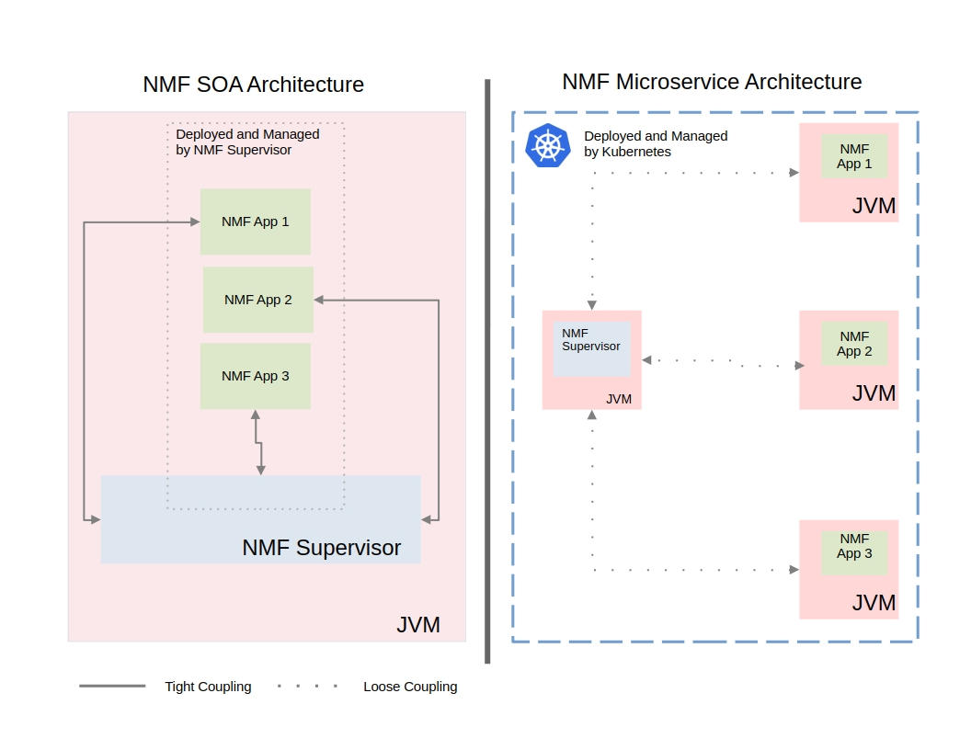
NMF SOA & Microservice Architecture Comparison
Notes:
Network isolation, filesystem isolation, loosely coupled with Supervisor in new setup

Slide 28
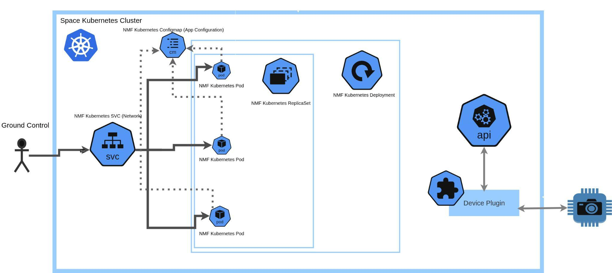
NMF service integration with Kubernetes
Notes:
More than one replicas
HPA for resource management and autoscaling
Configmap for configurations

Slide 29
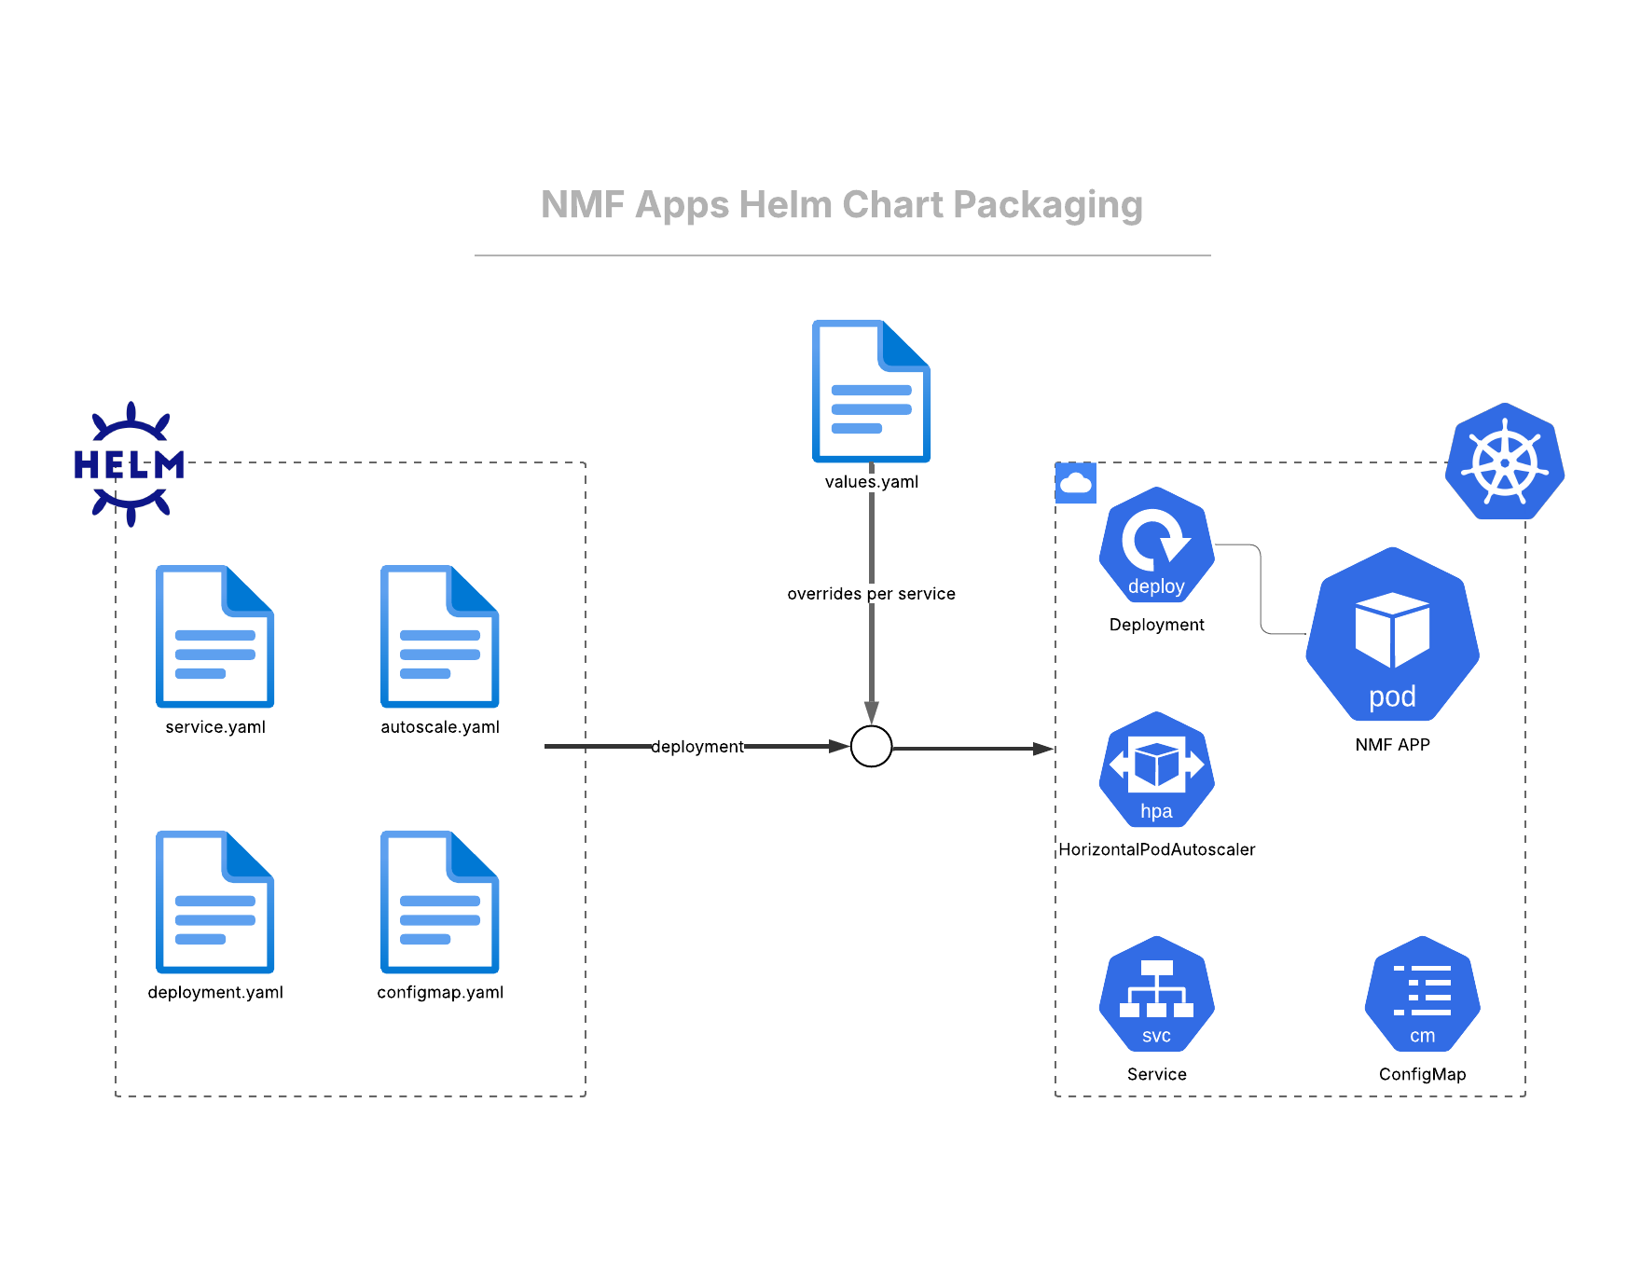
NMF Apps Helm Chart Packaging
Notes:
Deployment standardization

Slide 30
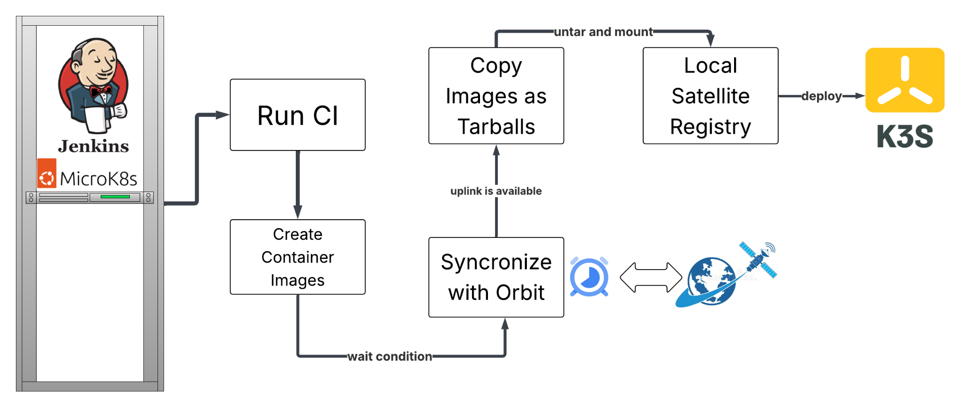
Jenkins CI/CD pipeline for NMF apps

Slide 31
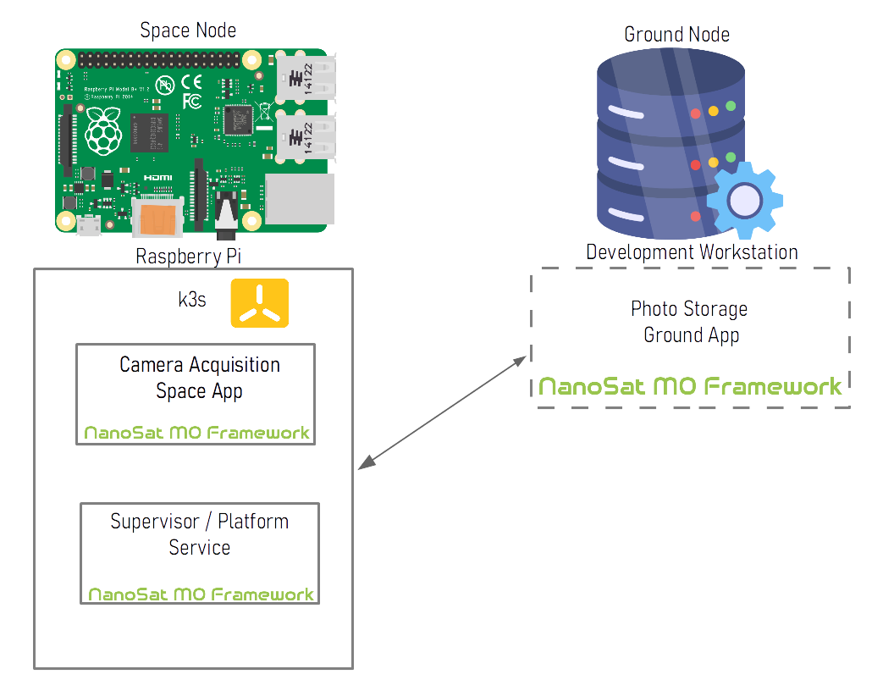
Proof of Concept NMF App Architecture

Slide 32
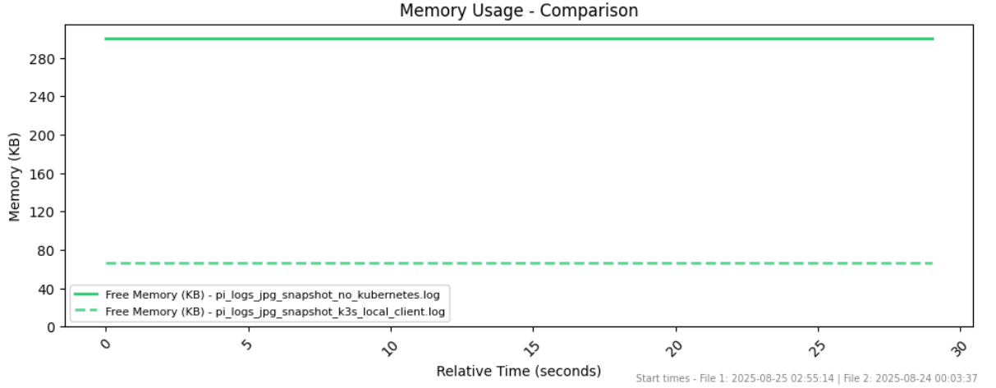
What about
memory usage?
The overhead using the proposed k3s-powered NMF architecture is very low.
Only 200+Mb more memory is used for the full-blown PoC example.

Slide 33
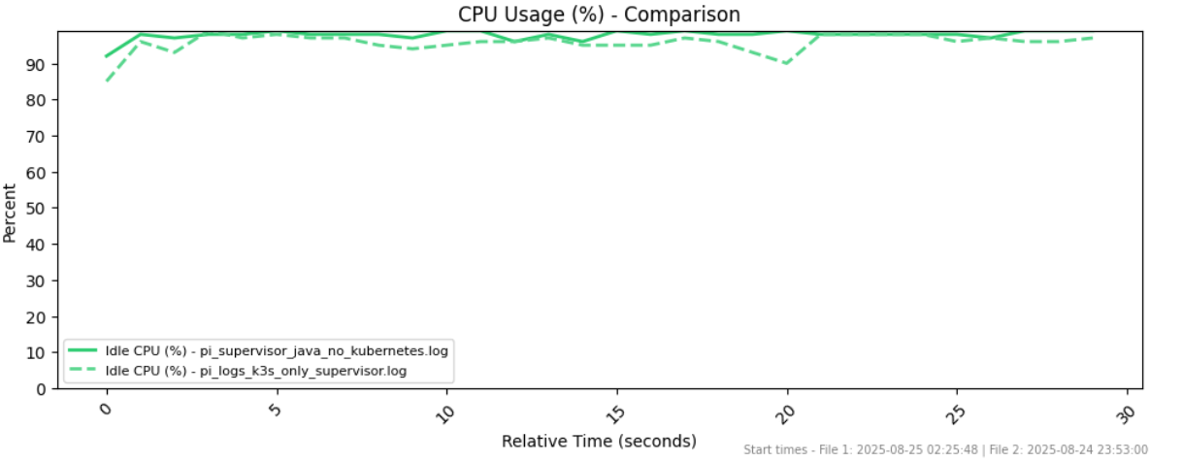
What about
CPU usage?
The CPU overhead using the proposed k3s architecture is almost negligible.
<5% average utilization difference comparing a deployed Supervisor with & without k3s.

Slide 34
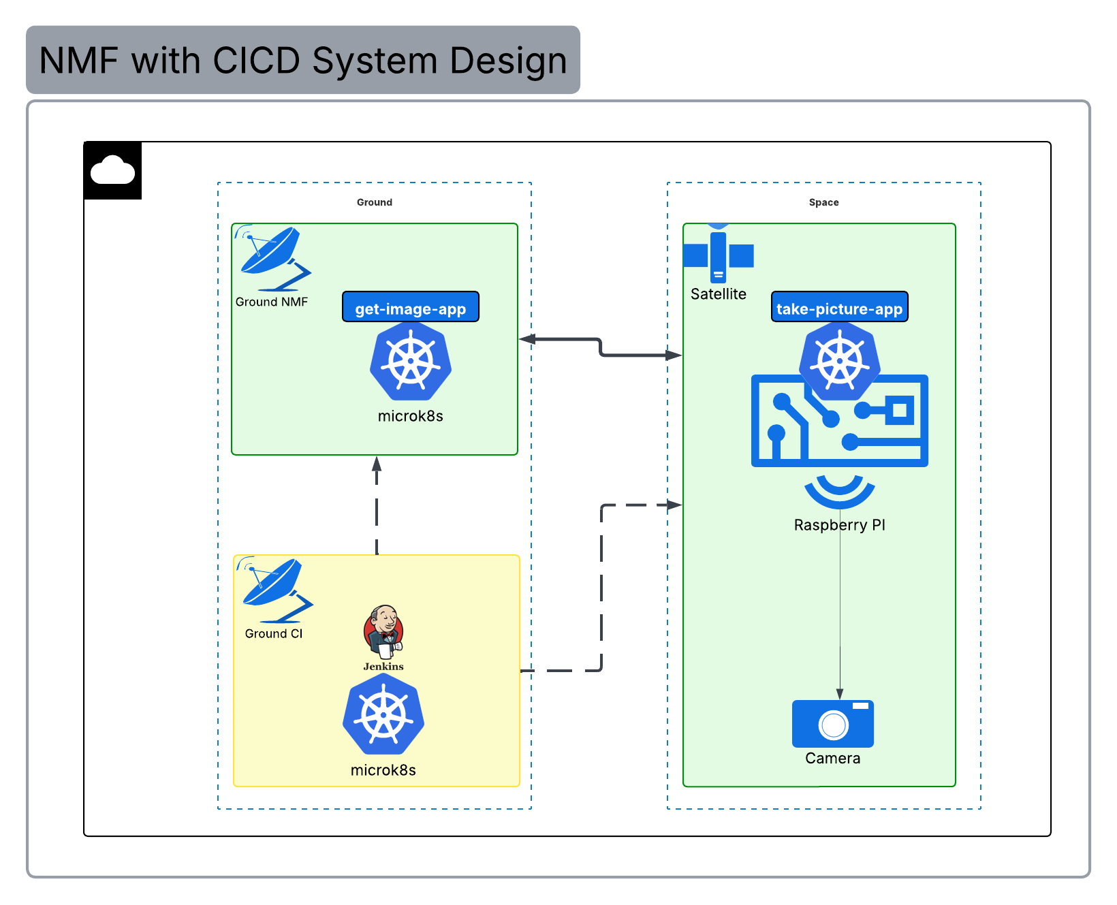
Proof of Concept NMF with CICD System Design

Slide 35
Q&A
Notes:
Future work
re-architecting of the NMF Supervisor // lightweight platform service
Poc in actual opssat platform
Poc with different languages and frameworks
Poc Constellation
Kubernetes operator
cfdp

Slide 36
Thanks!
Does anyone have any questions?
Feel free to contact me!
dfotiou.tech@gmail.com
linkedin.com/in/dimitris-fotiou/
https://github.com/fotioudim
dfotiou.gr

