Slide 1
Java SE 7
Module 1
Java Basics
Notes:
In this module we always explain things with actual live coding.
Use this slides as general plan.

Slide 2
Tools
JDK ( Java Development Kit )
IntelliJ IDEA (The best tool for Java coding)
Notes:
Tell about this a little bit.

Slide 3

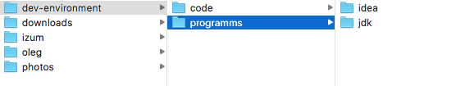
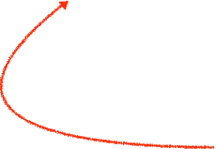
Folder Structure
there is no SPACEs here
Notes:
Recommended folder structure.

Slide 4
IntelliJ IDEA Usage
Create new project
Syntax highlighting
Suggestions
How to run your code
Notes:
List of things to show when writing your first programm.
I put this slide here just to summarize things we need to talk about.

Slide 5
public class FileStructure {
public static void main(String[] args) { // comments looks like this // your code here between { } }
}

Slide 6

public class FileStructure {
public static void main(String[] args) { // comments looks like this // your code here between { } }
}
Notes:
Tell about the class

Slide 7

public class FileStructure {
public static void main(String[] args) { // comments looks like this // your code here between { } }
}
Notes:
Tell about the entry point (main method)

Slide 8
public class FileStructure {
public static void main(String[] args) { // comments looks like this // your code here between { } }
}
Notes:
Tell that green box introduce method and you can have multiple of these inside the class. (No method explanation here)

Slide 9
Part 1
Numbers & Strings

Slide 10
Integer Math
part1.E0_Integers
public static void main(String[] args) { System.out.println( 232 ); System.out.println( 34 ); System.out.println( 10 + 6 ); }
Notes:
Explain general idea of a method here.
Like some code that you can call by name and send input parameters to it.

Slide 11
Quick Task
Calculate number of seconds in 9 weeks.
Notes:
Idea of this task to make sure that people have everything setup, unerstand where to write the code, and how to run their programms.

Slide 12
Integer Division
part1.E0_Integers
System.out.println( 10 / 3 );
Notes:
Tell that Java has several built in types to describe values and one of them is int.
Then describe int type.

Slide 13
Reminder
part1.E0_Integers
System.out.println( 10 % 4 );

Slide 14
Integer
part1.E0_Integers
public static void main(String[] args) { System.out.println(Integer.MIN_VALUE); System.out.println(Integer.MAX_VALUE); }
Notes:
max, min values
Also you can tell about long type here.

Slide 15
Integer
part1.E0_Integers
public static void main(String[] args) { System.out.println(Integer.MIN_VALUE - 1); }
Notes:
Type cycling

Slide 16
Integer Math
part1.E0_Integers
public static void main(String[] args) { System.out.println("Max + 1: " + (Integer.MAX_VALUE + 1)); }
Notes:
String prefix to sout.

Slide 17
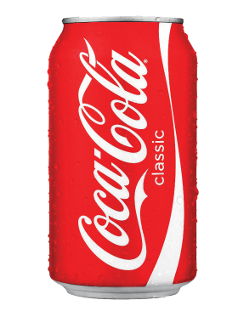
Variable
[ int ]
[ int ]
type nameCamelCase = <expression> ;

Slide 18
Variable
part1.E1_Variables
int countOfSeconds = 90; int countOfHoursInOneWeek = 24 * 7; int randomExpressionExample =
9 * 34 - 14 * (43 + 90) / 80 % 3;
type nameCamelCase = <expression>;

Slide 19
Variables in memory
part1.E1_Variables
Type | Name | Value
int | countOfSeconds | 60
int | countOfHoursInOneWeek | 168
int | randomExpressionExample | 304

Slide 20
Variable
part1.E1_Variables
int secondsInMinute = 60;
int tenMinutes = 10 * secondsInMinute;
type nameCamelCase = <expression>;

Slide 21
Quick Task
Calculate number of seconds in 9 weeks.
Please use variables now!

Slide 22
Real numbers
part1.E2_RealNumbers
double randomPrice = 459.98; double youCanAlsoDoTheMathHere = 34.9 + 98 * 6;
float iNeedFloat = 4.05f;
type nameCamelCase = <expression>;

Slide 23
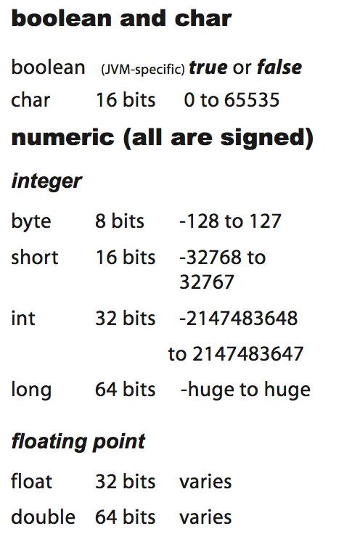
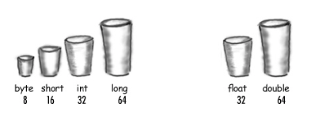
Primitive types

Slide 24
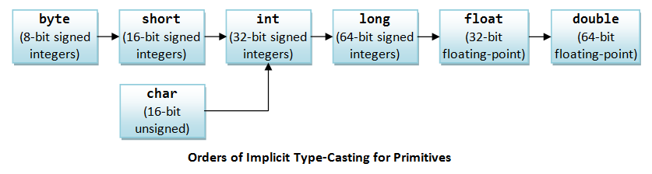
Primitive data types casting

Slide 25
Primitive data types casting
part1.E3_Casting
int i = 19; long l = 455L; l = i; i = (int) l;

Slide 26
String
part1.E5_String
String oleg = new String("Oleg");
String irina = "Irina";
type nameCamelCase = <expression>;

Slide 27
String in memory
part1.E5_String
Type | Name | Value
String | oleg | Ref
String | irina | Ref
Heap
"Oleg"
"Irina"

Slide 28
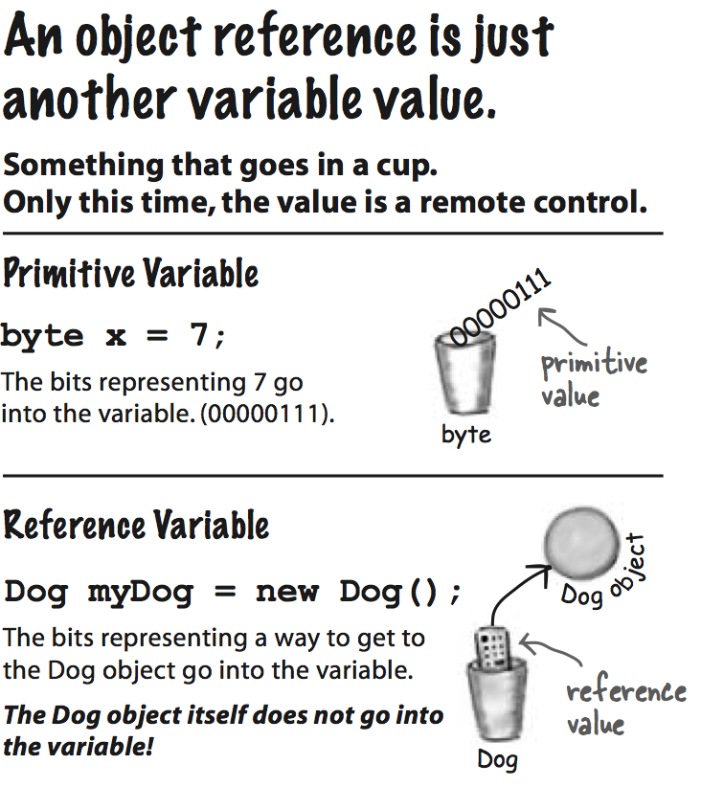
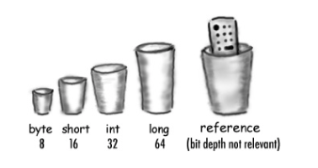
Reference Type

Slide 29
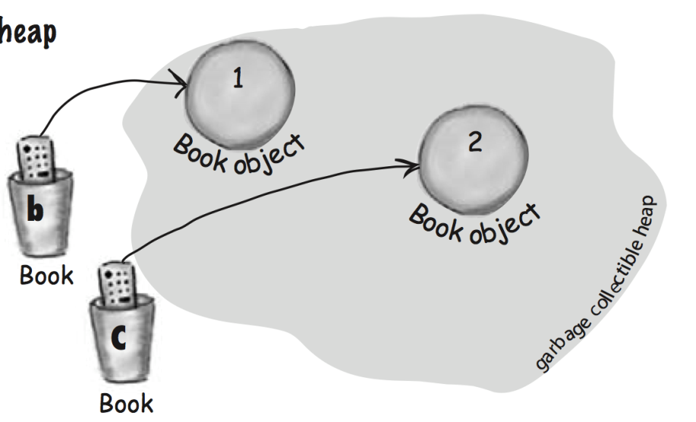
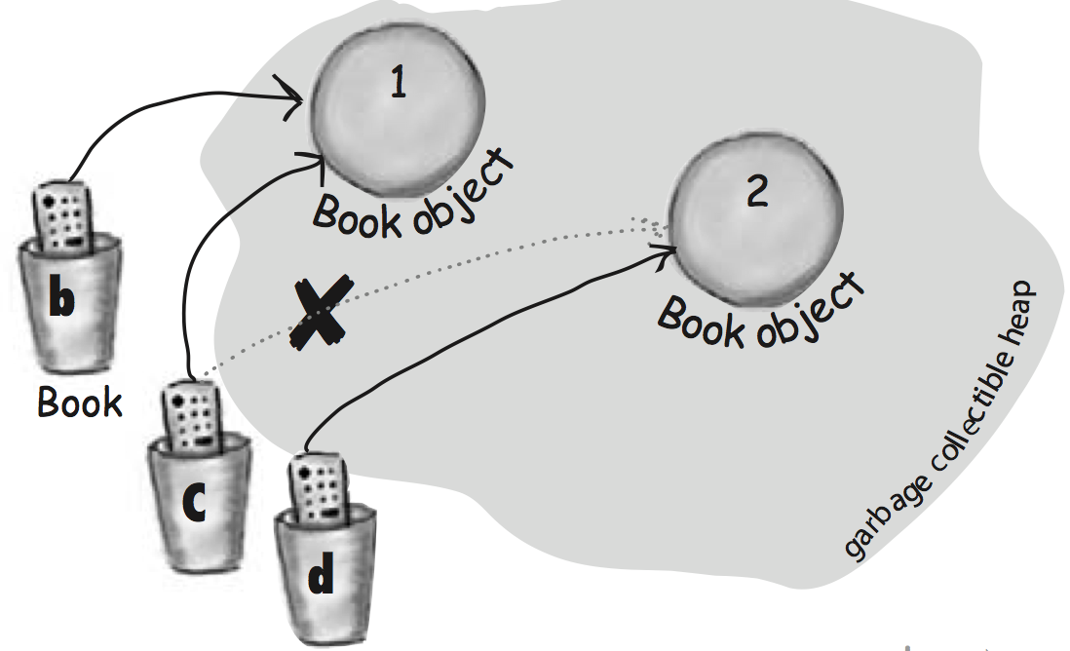
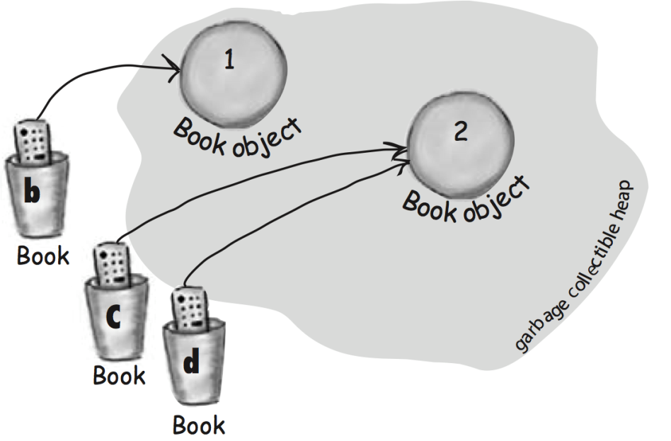
Heap life
Book b = new Book(); Book c = new Book();
c = b;
Book d = c;

Slide 30
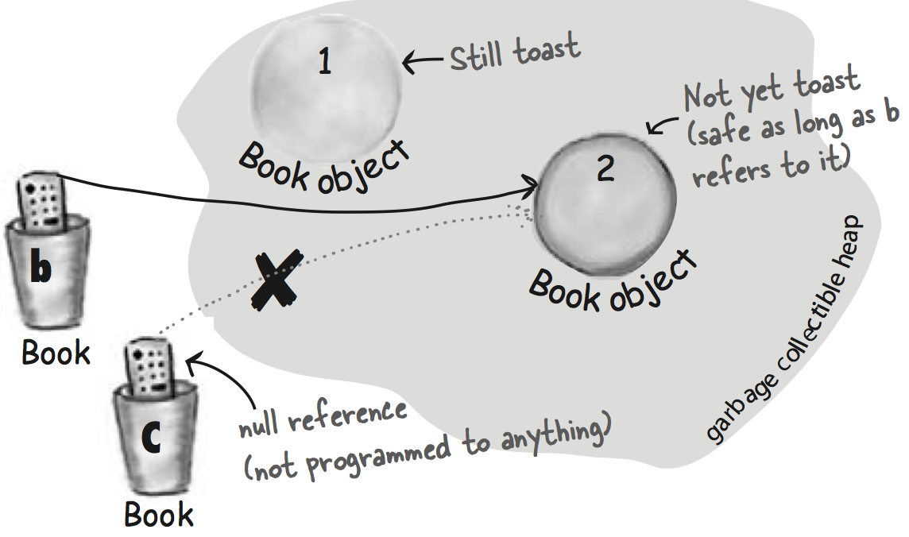
Heap life
Book b = new Book(); Book c = new Book();
b = c; c = null;

Slide 31
String concatenation
part1.E5_String
String oleg = new String("Oleg"); System.out.println("0: " + oleg); oleg += "!"; System.out.println("1: " + oleg);
Output:
0: Oleg
1: Oleg!

Slide 32
String length
part1.E6_StringLength
String name = "Alexandra"; int length = name.length(); System.out.println(name + " contains "
+ length + " letters.");

Slide 33
Runtime exception
part1.E7_NPE
String str = "abcdefg..."; System.out.println("0: " + str); str = null; System.out.println("1: " + str.length());

Slide 34
Type char
part1.E8_Char
char a = 'a'; System.out.println(a); char A = 65; System.out.println(A);
Char range: 0 - 65535

Slide 35
String in memory
part1.E5_String
Type | Name | Value
String | oleg | Ref
String | irina | Ref
Heap
O | l | e | g
I | r | i | n | a

Slide 36
Chars in String
part1.E9_CharsInString
String galaxy = "Milky Way"; char ch = galaxy.charAt(0);
int index

Slide 37
Chars in String
part1.E9_CharsInString
String galaxy = "Milky Way"; galaxy.indexOf('y');
galaxy.indexOf('y', 5);
int ch
int ch, int fromIndex

Slide 38
String comparison
part1.E10_StringComparison
Use == to check that variables referencing the same object.
Use .equals to check that objects equals accoring to our comparison rules.

Slide 39
String methods, substring
part1.E11_StringMethods
String str = "Programming is cool.";
String substring = str.substring(3);
substring = str.substring(11, 14);
int beginIndex
int beginIndex, int endIndex

Slide 40
String methods, replace
part1.E11_StringMethods
String str = "Programming is cool.";
String replaced = str.replaceAll("is", "-");
String regex, String replacement

Slide 41
Quick Task
part1.T0_Split
You have random double number. Write a program that prints to the output whole and fractional parts separately.
For example:
343.36
3.069
.2
whole: 343, fract: 36
whole: 3, fract: 069
whole: 0, fract: 2

Slide 42
Quick Task
part1.T1_BattleField
| A B C D E F G H I
--|------------------
1 | B B B B B B B B B
2 |
3 | B B B B B B B
4 | B B B B B B B
5 | B B B B B B B
6 | B B B B B B
7 | B B B B B B
8 | B B B B B B
9 | B B B T E B B B
B - Brick
T - Tank
E - Eagle (headquarters)
Notes:
Here students should design their personal Battle Field 9x9 and create a program to output it.

Slide 43
Part 2
Methods

Slide 44
What method is?
Input
Output

Slide 45
Method signature
any existing java type
*
any existing java type or void
public static return_type nameCamelCase(p1_type p1, p2_type p2) { [return 0]; }
required if method return_type is not void
*
void - means nothing to return.

Slide 46
Quick Task
part2.T0_Tanks
Implement method moveForward(). Tank should move one quadrant right after each call.
Notes:
Run the code, show and describe how game works and how battle field created.
Demostrate how to use repaint() and sleep(int) functions and explain why we need it here.

Slide 47
Quick Task
part2.T1_Tanks
Implement method getTankQuadrant(int x, int y).
Method should return name of the quadrant according to given coordinates.
Notes:
Run the code, show and describe how it works and what to do.

Slide 48
Method params.
How Java calls methods and send parameters to it.
Notes:
Just explain it using whiteboard and live code debugging.
Explain 2 cases:
when param of primitive type (int, boolean, etc)
when param if String type and why it stays unmoified

Slide 49
Method overloaing.
part2.E0_Methos
You can declare methods with ientical name if param types are different.
public static int sum(int a, int b) { return a + b; } public static long sum(long a, long b) { return a + b; }

Slide 50
Method overloaing.
part2.E0_Methos
You can declare methods with ientical name if param types are different.
public static int sum(int a, int b) { return a + b; } public static int sum(int a, int b, int c) { return a + b + c; }

Slide 51
Visibility
Variable are visible and can be used within a block where it's declared.
Notes:
Just do live demo, it is the best possible way to explain this.

Slide 52
if statement
part2.E1_if_Statement
any boolean expression
if (a % 2 == 0) { a *= 2;
}
this code will be executed only if boolean expression returns true

Slide 53
if-else statement
part2.E2_if_else_Statement
if (a % 2 == 0) {
a *= 2; } else {
a /= 3; }
boolean expression == true
boolean expression == false

Slide 54
else-if statement
part2.E3_else_if_Statement
if (a > 8) { System.out.println("--> if a > 8"); a += 3; } else if (a > 3) { System.out.println("--> if a > 3"); a += 2; } else { System.out.println("--> else"); a += 1; }

Slide 55
while Loop
part2.E4_while_Loop
int counter = 0; while (counter < 10) { System.out.println(counter++);
}
any boolean expression
this code will be executed until boolean expression returns true

Slide 56
break
part2.E5_Loops_break
while (counter < totalCycles) { if (counter == 7) { break; } System.out.println(counter++); }
will break the loop

Slide 57
continue
part2.E5_Loops_continue
while (counter < totalCycles) { if (counter % 3 == 0) { counter++; continue; } System.out.println(counter++); }
will start next iteration

Slide 58
Quick Task
part2.T2_Tanks
Implement logic that forces a tank moving forward and then backward forever.
Tank should slowly move from quadrant A1 to A9, then from A9 to A1 and so on…
Notes:
Show the template and explain the logic on visual example.
This task force stuent to use every aspect he/she learned on part 2 ( if, while, method call ).

Slide 59

Quick Task
part2.T3_Tanks
Implement method void move(int direction).
One method call should smoothly move the tank one quarant according to given direction parameter value.
direction
1 - up
2 - right
3 - down
4 - left
1
4
3
2
Notes:
This task force stuent to use every aspect he/she learned on part 2 ( if, while, method call )
and also teach how to separate logic.

Slide 60
Part 3
Arrays

Slide 61
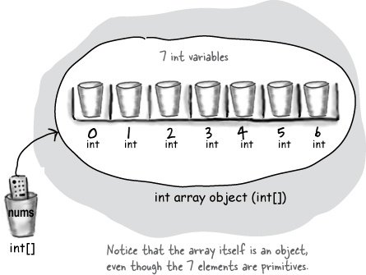
What is array?
Data structure that keeps limited number of objects with defined type.

Slide 62
How to create array
any valid Java type
type[] anyName = new type[number_of_objects];

Slide 63
How to create array, examples
part3.E0_CreateArray
int[] numbers = new int[10]; double[] prices = new double[10]; int[] ints = new int[] {1, 2, 3}; int[] data = {1, 2, 3, 4, 5, 6, 7};

Slide 64
Array, data access
part3.E1_ArrayReaWrite
int[] numbers = {0, 1, 2, 3, 4, 5, 6, 7, 8, 9}; int num;
num = numbers[3]; num = numbers[7]; numbers[0] = 100; numbers[6] = 600;

Slide 65
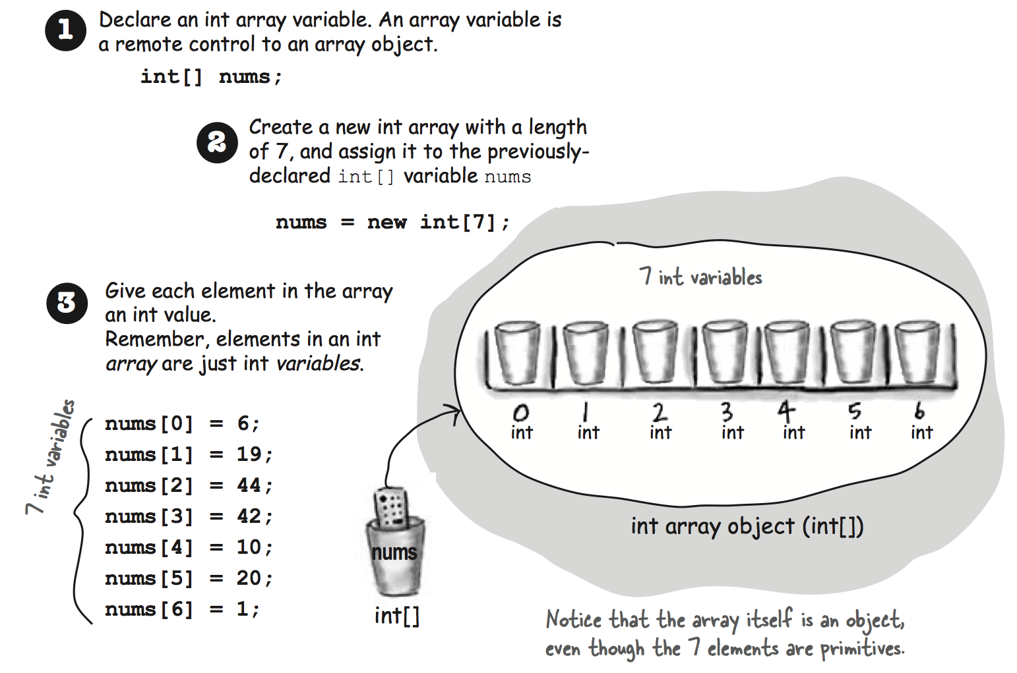
Array, data access

Slide 66
What this code prints?
part3.E2_ArrayParameter
public static void main(String[] args) { int[] numbers = {0, 1, 2, 3, 4, 5, 6, 7, 8, 9}; setValue(numbers, 3, 300); System.out.println(Arrays.toString(numbers)); } public static void setValue(int[] data, int idx, int value) { data[idx] = value; }
Notes:
Explain why this code will modify numbers array.

Slide 67
Quick Task
part3.T0_Swap
Implement method void swap(int[] data, int idx1, int idx2).
Method should exchange values with idx1 and idx2 in data array.

Slide 68
for loop
part3.E3_for_Loop
int[] numbers = {0, 1, 2, 3, 4, 5, 6, 7, 8, 9}; for (int i = 0; i < numbers.length; i++) { int n = numbers[i]; System.out.println(n); }
initialization
condition
increment

Slide 69
Quick Task, use for Loop
part1.T1_BattleField
| A B C D E F G H I
--|------------------
1 | B B B B B B B B B
2 |
3 | B B B B B B B
4 | B B B B B B B
5 | B B B B B B B
6 | B B B B B B
7 | B B B B B B
8 | B B B B B B
9 | B B B T E B B B
B - Brick
T - Tank
E - Eagle (headquarters)
Notes:
Here studets sould update the task from part1 to use for loop.

Slide 70
for-each loop
part3.E4_for_each_Loop
int[] numbers = {0, 1, 2, 3, 4, 5, 6, 7, 8, 9}; for (int n : numbers) { System.out.println(n); }
data structure to iterate
current element

Slide 71
Quick Task
part3.T1_Sort
Implement method void sortAsc(int[] data).
Method should sort data array ascending order.

Slide 72
Array of Strings (objects)
part3.E5_ArrayOfStrings
String[] names = new String[10]; System.out.println(Arrays.toString(names)); names[3] = "Anna"; names[9] = "Max";

Slide 73
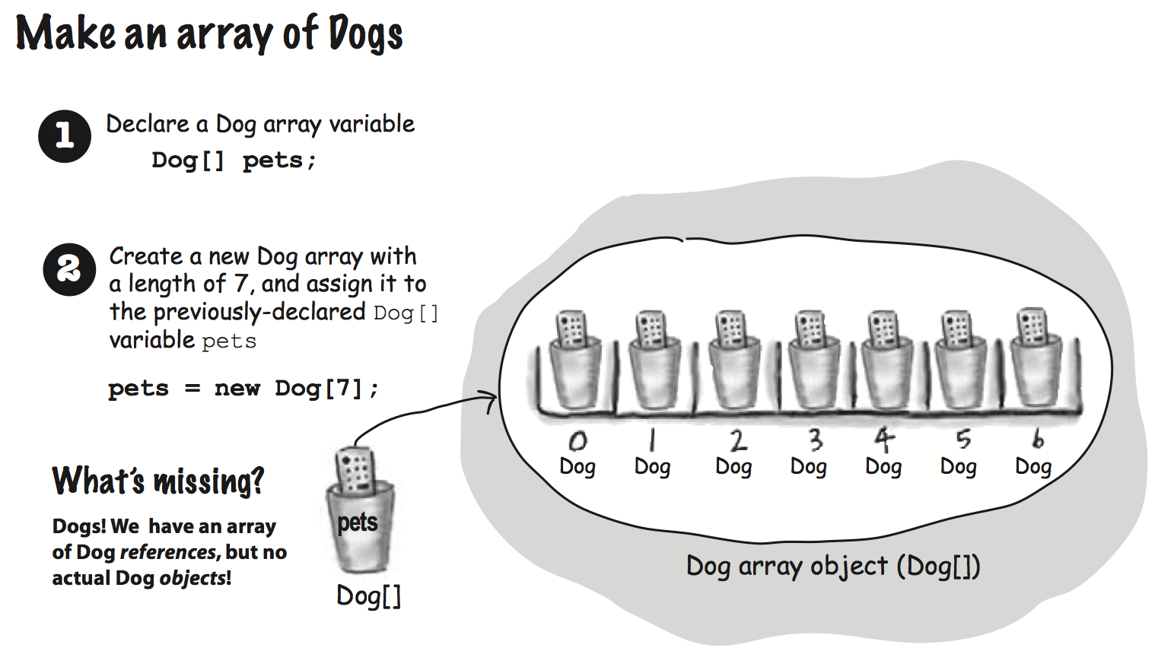
Array of Strings (objects)
Notes:
In this module we do not explain object concept so tell students to replace Dog with String here.

Slide 74
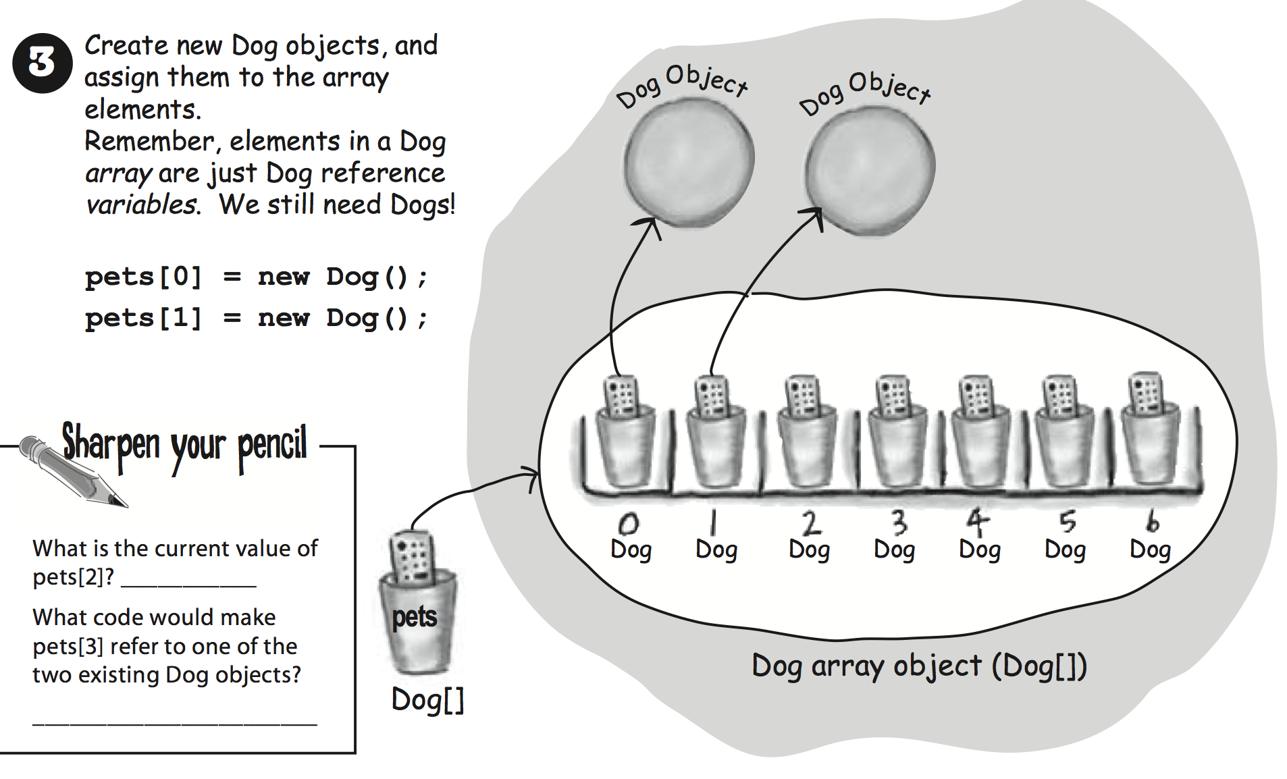
Array of Strings (objects)
Notes:
In this module we do not explain object concept so tell students to replace Dog with String here.

Slide 75
Multidimensional array
any valid Java type
type[][] name = new type[number_of_objects][];

Slide 76
Multidimensional array, usage example
part3.E6_MultidArray
int[][] data = new int[10][]; data[0] = new int[] {1, 2, 3}; data[1] = new int[] {1, 2}; int[] numbers = data[0];
int number = data[0][1]; data[1][0] = 1000;

Slide 77
Quick Task, use String [][]
part1.T2_BattleField
| A B C D E F G H I
--|------------------
1 | B B B B B B B B B
2 |
3 | B B B B B B B
4 | B B B B B B B
5 | B B B B B B B
6 | B B B B B B
7 | B B B B B B
8 | B B B B B B
9 | B B B T E B B B
B - Brick
T - Tank
E - Eagle (headquarters)
Notes:
Here studets sould update the task from part1 and use String[][] to store data.
Ask them to print just battle field without axes info like expl. bellow
—-
B B B B B B B B B
B B B B B B B
B B B B B B B
B B B B B B B
B B B B B B
B B B B B B
B B B B B B
B B B T E B B B

Slide 78
Task
part3.T3_TanksFire
Implement method void fire().
When called tank should produce new bullet.
This bullet should smoothly move to the opposite side.
Bullet should be destroyed when rich the opposite side.
Ignore all the objects on battle field for now.

Slide 79
Task
part3.T4_TanksShoot
Implement method boolean checkAndProcessInterception().
Should return true if bullet located in non-empty quadrant.
Also update your void fire() method.
When the bullet shoot something method should clean appropriate quadrant and destroy the bullet.

Slide 80
Final Task
Old friend Nikolay said that he just opened a shop where he is selling birds and you immediately gave him an advice to use a computer program.
You explained that you are a programmer and you will write this program for Nikolay right now.

Slide 81
Final Task, continue
Nikolay said that he has some notes and showed you the next:
- Bird name (crow, eagle, duck)
- Current price in USD (crow - 1, eagle - 5, duck - 0.5)
- Count of birds in the store (crow - 20, eagle - 23, duck - 4)
- Birds sold (crow - 3, eagle - 1, duck - 23)

Slide 82
Final Task, continue
Implement your programm in file Birds.
Implement next methods:
how many birds sold
how many birds of given type in stock
what types of birds less then 3 in stock
Make this program useful for your friend !!!
Notes:
How the code should look like (rus) https://youtu.be/DjX2BZWUqOw

Slide 83
Tasks (optional)
Exercise 1

Slide 84
Home Work (Optional)
part2.T4_Tanks
Implement method void randomMove().
One method call should smoothly move the tank one quarant to random direction.
Do not use java.util.Random

Slide 85
Home Work (Optional)
part2.T5_Tanks
Implement method
void moveToQuadrant(String quadrant).
Where quadrant - quadrant name in format a4, h6, i8.
Tank should detect given quadrant and smoothly move to it.

Slide 86
Task (Optional)
part2.T3_CleanBattleField
Implement method void clean().
When method called tank should destroy all the objects on battle field in less then 30 seconds.

