Slide 1
DDS Performance Evaluation
Douglas C Schmidt
Ming Xiong
Jeff Parsons

Slide 2
Agenda
Motivation
Benchmark Targets
Benchmark Scenario
Testbed Configuration
Empirical Results
Results Analysis

Slide 3
Motivation
Gain familiarities with different DDS DCPS implementations
  DLRL implementations don’t exist (yet)
Understand the performance difference between DDS & other pub/sub middleware
Understand the performance difference between various DDS implementations

Slide 4
Benchmark Targets
Name | Description
DDS | New OMG pub/sub middleware standards for data-centric real-time applications
Java Messaging Service | Enterprise messaging standards that enable J2EE components to communicate asynchronously & reliably
TAO Notification Service | OMG data interoperability standards that enable events to be sent & received between objects in a decoupled fashion
WS-Pub/Sub | XML-based (SOAP)

Slide 5
Benchmark Targets (cont’d)
Name | Description
DDS1 | DDS DCPS implementation by vendor XYZ
DDS2 | DDS DCPS implementation by vendor ABC
DDS3 | DDS DCPS implementation by vendor 123

Slide 6
Benchmark Scenario
Two processes perform IPC in which a client initiates a request to transmit a number of bytes to the server along with a seq_num (pubmessage), & the server simply replies with the same seq_num (ackmessage).
  The invocation is essentially a two-way call, i.e., the client/server waits for the request to be completed.
The client & server are collocated.
DDS & JMS provides topic-based pub/sub model.
Notification Service uses push model.
SOAP uses p2p schema-based model.

Slide 7
Testbed Configuration
Hostname
  blade14.isislab.vanderbilt.edu
OS version (uname -a)
Linux version 2.6.14-1.1637_FC4smp (bhcompile@hs20-bc1-4.build.redhat.com)
GCC Version
g++ (GCC) 3.2.3 20030502 (Red Hat Linux 3.2.3-47.fc4)
CPU info
Intel(R) Xeon(TM) CPU 2.80GHz w/ 1GB ram

Slide 8
Empirical results (1/5)
// Complex Sequence Type
struct Inner {
string info;
long index;
};
typedef sequence<Inner> InnerSeq;
struct Outer {
long length;
InnerSeq nested_member;
};
typedef sequence<Outer> ComplexSeq;
Average round-trip latency & dispersion
Message types:
  sequence of bytes
  sequence of complex type
Lengths in powers of 2
Ack message of 4 bytes
100 primer iterations
10,000 stats iterations

Slide 9
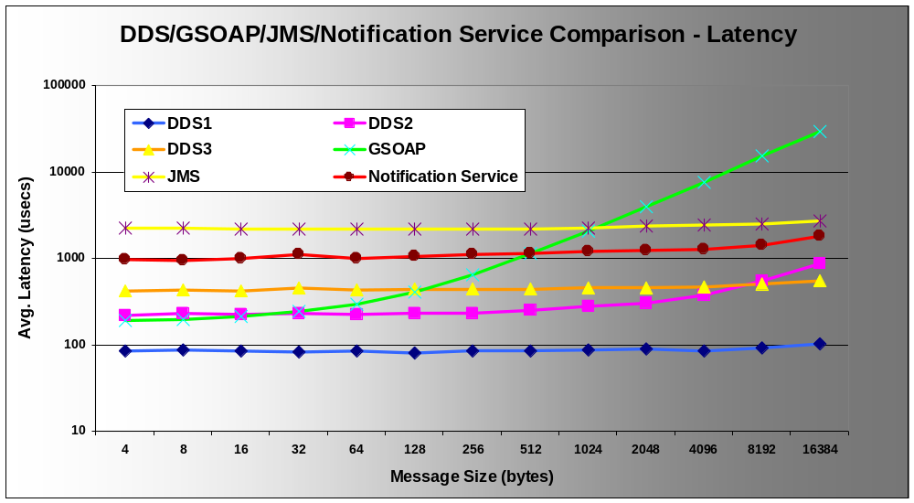
Empirical results (2/5)

Slide 10
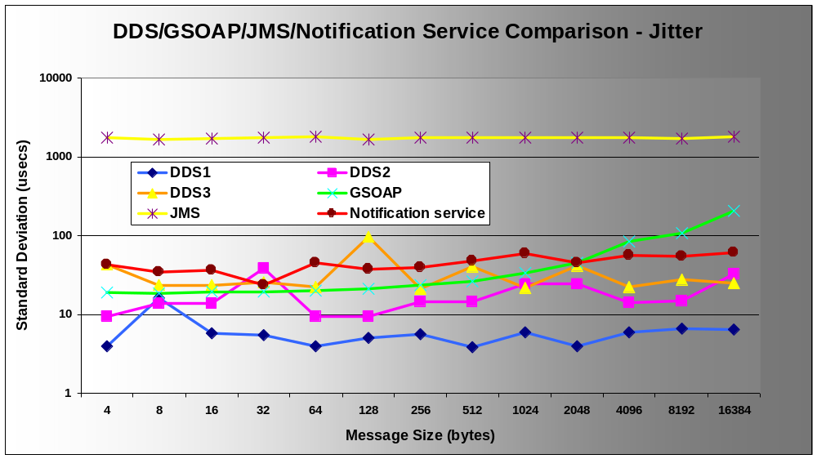
Empirical results (3/5)

Slide 11
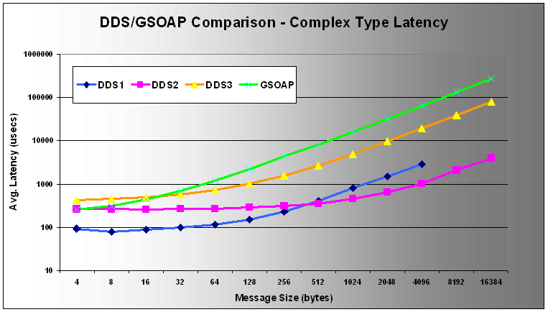
Empirical results (4/5)

Slide 12
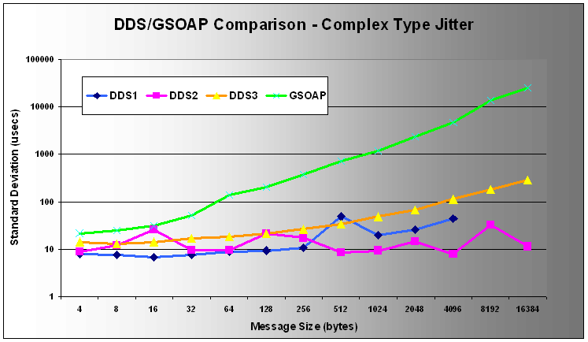
Empirical results (5/5)

Slide 13
Results Analysis
From the results we can see that DDS has significantly better performance than other SOA & pub/sub services.
Although there is a wide variation in the performance of the DDS implementations, they are all at least twice as fast as other pub/sub services.

Slide 14
Encoding/Decoding (1/5)
Measured overhead and dispersion of
  encoding C++ data types for transmission
  decoding C++ data types from transmission
DDS3 and GSOAP implementations compared
Same data types, platform, compiler and test parameters as for roundtrip latency benchmarks

Slide 15
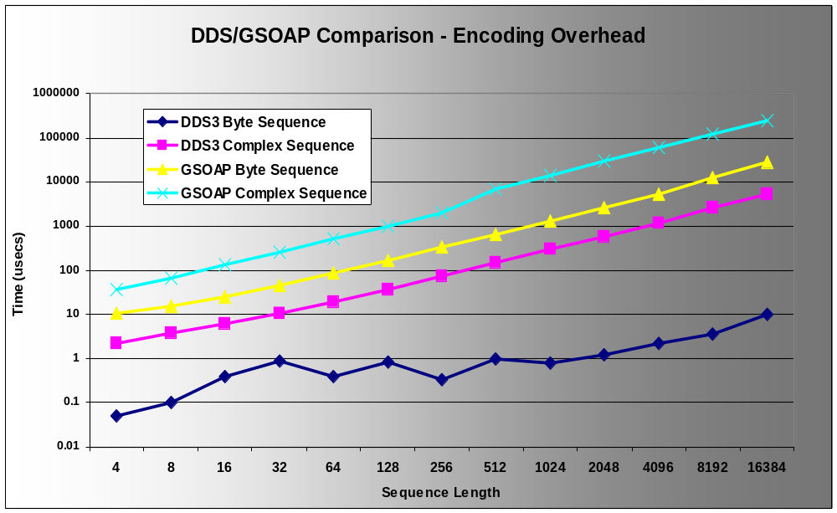
Encoding/Decoding (2/5)

Slide 16
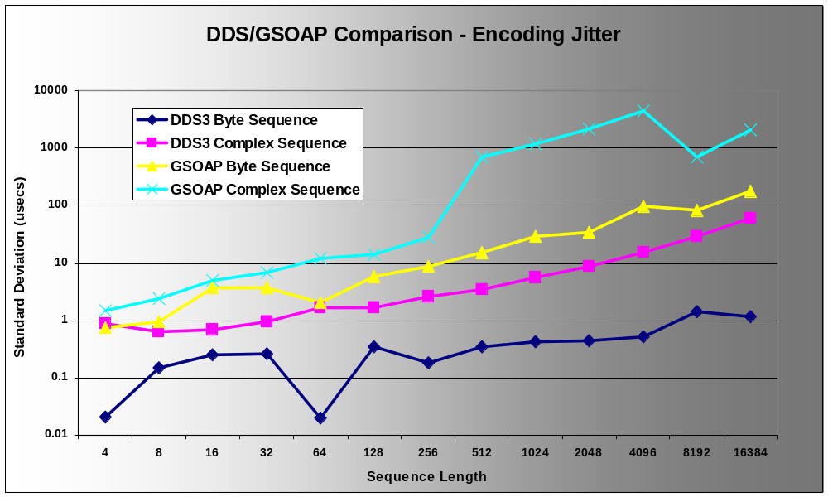
Encoding/Decoding (3/5)

Slide 17
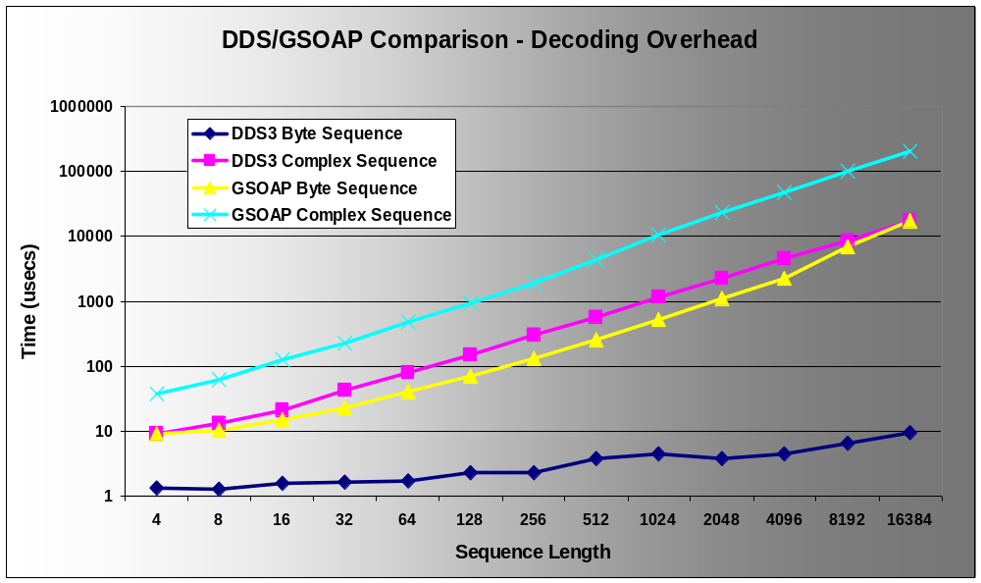
Encoding/Decoding (4/5)

Slide 18
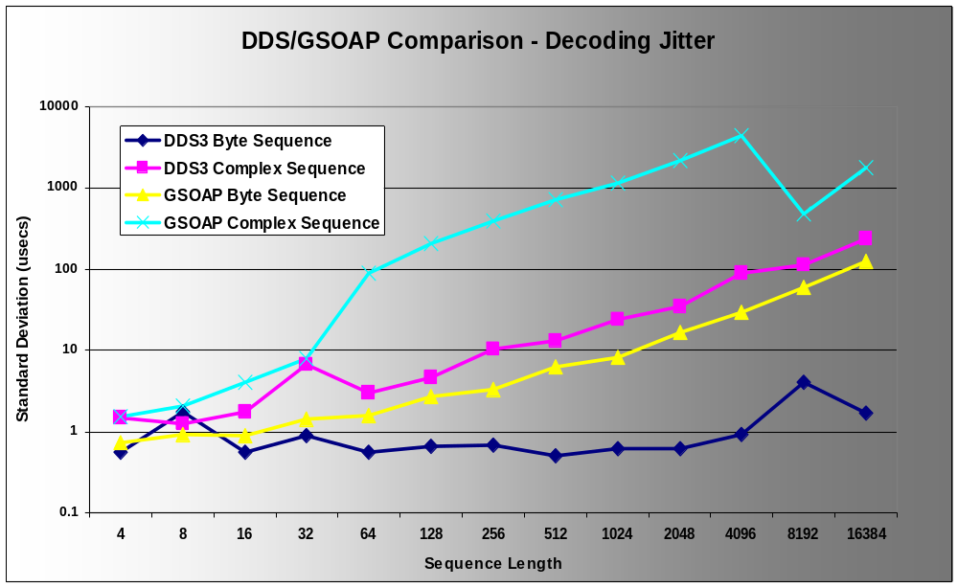
Encoding/Decoding (5/5)

Slide 19
Results Analysis
Slowest DDS implementation is compared with GSOAP.
DDS is faster.
  Almost always by a factor of 10 or more.
  GSOAP is encoding XML strings.
Difference is larger for byte sequences.
  DDS implementation has optimization for byte seq.
    Encodes sequence as a single block – no iteration.
  GSOAP always iterates to encode sequences.
Jitter discontinuities occur at consistent payload sizes.

Slide 20
Future Work
Measure
The scalability of DDS implementations, e.g., using one-to-many & many-to-many configurations in our 56 dual-CPU node cluster called ISISlab.
DDS performance on a broader/larger range of data types & sizes.
The effect of DDS QoS parameters , e.g., TransPortPriority, Reliability (BestEffort vs Reliable/FIFO), etc.) on throughput, latency, jitter, & scalability.
The performance of DLRL implementations (when they become available).

