Slide 1
Project 1: Branch Prediction CMU 18-640: Foundations of Computer Architecture
Due 11:59pm, 2/11/2014
TA: Berkin Akin

Slide 2
Preliminaries
In this project, you will model the Alpha 21264’s branch predictor in a trace-driven simulator. Your trace-driven simulator will be fed a sequence of program counter and other info about a branch from a trace file. For each branch, your simulated branch predictor should return a branch decision (taken or not taken). After each prediction, your simulated branch predictor will then be given the branch outcome for learning/training.
This project assumes you are proficient in C and Unix. This project must be completed in groups of 3 or 4 students. After forming a group, the designated “lead student” from the team should email the TA (Berkin) with the names and ECE email addresses of all members by January 31. Use the subject heading “18640 Project 1 Group”.

Slide 3
Traces
A collection of 16 traces can be found in: /afs/ece/class/ece640/project/project1/traces
The trace files are in plain-text format. If you wish to write your own traces for testing, branch traces are formatted as:
[PC] [Branch Target] [Is Indirect] [Is Conditional] [Is Call] [Is Return] [Is Taken]
Note the branch targets are included in the trace. They can be ignored for this project. You will only predict direction.
40ee8a 40eeb8 0 1 0 0 0
40eea9 40eed3 0 0 0 0 1
40eed7 40f306 0 1 0 0 0
40efb4 488420 0 1 0 0 0
40f308 40f34f 0 1 0 0 0

Slide 4
Simulator
You are provided with the skeleton code of the simulator in /afs/ece/class/ece640/project/project1/release.
The skeleton code manages trace processing and drives the four functions (prescribed below) to be implemented by you. These four functions are to be compiled with the provided skeleton code to form a complete trace-driven simulator.
void initPredictor()
int getPrediction(branch_record_t *branch)
void updatePredictor(branch_record_t *branch, int is_taken)
void dumpStats()

Slide 5
Simulator
initPredictor( ) is called before any processing begins for you to initialize your data structures.
int getPrediction(branch_record_t *branch) is called once every branch in the trace. The argument provided is a branch record that contains information on the branch PC. If the branch is predicted to be taken, getPrediction( ) should return 1, otherwise return 0. The following is a table with the branch record fields:
void updatePredictor( ) is called right after getPrediction( ) to return the actual outcome to your branch predictor for training.
void dumpStats( ) is called after all of the branch traces have been processed. Use this function to print out any internal statistics at the end of the simulation.
branch_record_t:
uint instruction_addr | The branch’s program counter
int is_indirect | 1 if the target is not PC-relative; 0 if it’s PC-relative
int is_conditional | 1 if the branch is conditional type
int is_call | 1 if the branch is a call type
int is_return | 1 if the branch is a return type

Slide 6
Simulator Main Loop
{
initPredictor();
while(…trace is not EOF…) {
branch_record_t *branch = <branch from the trace file>
prediction = getPrediction(branch)
… check your prediction
… count statistics
… notify your predictor of the outcome
updatePredictor(branch, isTaken);
}
… print out stats including your misprediction rate …
dumpStats();
}
Provided as “main.o” in the release

Slide 7
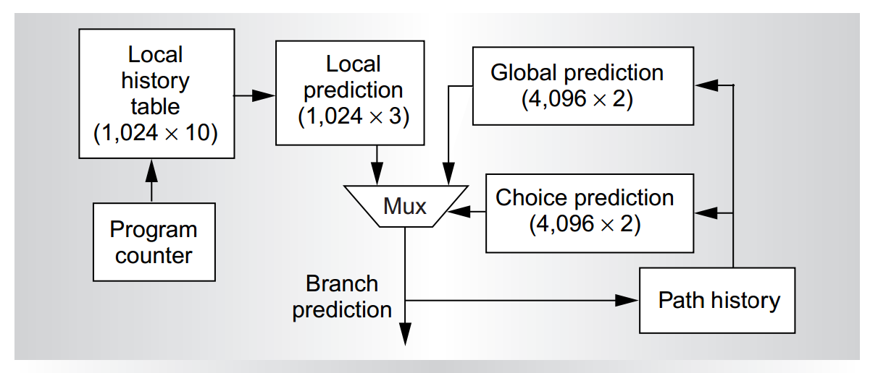
Alpha 21264 Tournament Predictor
Local history table | 1024 entries, indexed by PC; each entry is a 10-bit history of a specific branch’s set of previous outcomes
Local prediction table | 1024 entries, indexed by the 10-bit history from the local history table, each entry is a 3-bit saturating counter
Global history register | A single 12-bit register that encodes the last 12 branch outcomes
Global prediction table | 4096 entries, indexed by the global history register, each entry is a 2-bit saturating counter
Chooser prediction table | 4096 entries, indexed by the global history register, each entry is a 2-bit saturating counter

Slide 8
Alpha 21264 Tournament Predictor
The local history table maintains history entries for individual branches. Each 10-bit history (which encodes the last 10 outcomes for this branch) is used to index into a local prediction table, which maintains entries that have 3-bit saturating counters. When a 3-bit saturating counter reaches 100₂ or above, a “taken” prediction is made.

Slide 9
Alpha 21264 Tournament Predictor
The global history register maintains a single 12-bit history (which encodes the outcomes for the previous 12 branches) used to index into the global prediction table, which has 2-bit saturating counters per entry. When a 2-bit saturating counter reaches 10₂ or above, a “taken” prediction is made.

Slide 10
Alpha 21264 Tournament Predictor
The local and global predictions are compared against one another, and if they agree, the prediction is made. However, if they disagree, they should consult the chooser prediction table, which is also indexed by the global history register. If the saturating counter is 10₂ or above, the global predictor’s decision should be used; otherwise, the local predictor’s decision is picked. The chooser prediction table is updated depending on the outcome of disagreeing predictors. Depending on whether a predictor chose correctly, the saturating counter is incremented or decremented.

Slide 11
Constraints
Some specific implementation decisions are open to your implementation. If your predictor is designed correctly, it should have an overall branch misprediction rate of at most 5%
Overall misprediction means adding up all of the branch mispredictions for all of the benchmarks and dividing by the total number of branches for all of the benchmarks. (Do not take the average of the branch misprediction rates of individual traces)
You are allowed to deviate from the baseline design subject to the following restrictions. (Note that you are allowed more storage bits than you need for the baseline design. Use the extra bits well to improve your misprediction rate.)
Design constraints
Total number of storage used must be less than 33792 bits.
All storage tables must have power-of-2 entries
If you employ associativity, it must be 8-way or less
If you employ a random replacement policy, it must be reproducible
Extravagant logic functions (such as dividing/multiplying by non-constants or non-powers of 2) are not allowed

Slide 12
Requirements
The following is a list of what we expect for a completed project:
All source files
Makefile
Readme file
Project Report
You may use any operating system for your project, but your project will be tested on the ECE Linux cluster (e.g. ece000.ece.cmu.edu). Please make sure your final submission works on those machines. You may use any language as long as you can provide a wrapper that will interface to our object code developed for C (you must use the provided main.o).
When testing your predictor, we will issue the command “make predictor” against your Makefile; this should build an executable called “predictor”. We will issue the command “zcat tracefile.gz | ./predictor” to run your simulator against a compressed trace file. Please test your project submission on one of the ECE Linux cluster machines.

Slide 13
Grading
Performance based scoring:
Top quarter: 15
2nd quarter: 10
3rd quarter: 5
Bottom quarter: 0
Rest of the logistics and details are in the project handout
40 pts | Predictor builds and runs without crashing with branch misprediction rate of at most 10%
25 pts | Branch misprediction rate of at most 5%
15 pts | Performance based scoring
20 pts | Report

