Slide 1

10-minute conference presentation
Critical Analysis of European Digital Innovation Hubs in the Agri-Food Sector
Kostadin Penchev; Konstantin Stoyanov
Trakia University, Stara Zagora, Bulgaria
6
country cases
4
evaluation criteria
10
minutes
Notes:
Good morning. This presentation summarizes a critical analysis of European Digital Innovation Hubs, or EDIHs, in the agri-food sector. The paper focuses on six national contexts: Bulgaria, Romania, Slovenia, Greece, Spain, and Turkey. The central question is not whether EDIHs exist as policy instruments, but how effectively their service model responds to agricultural users, especially small farms and smaller agri-food enterprises. I will focus on the research problem, the qualitative comparative methodology, the main findings on participation and service relevance, and the conclusions for more inclusive agricultural digitalization.

Slide 2
Research Problem
Why EDIH effectiveness matters for agri-food digitalization
Digital transformation is now a strategic priority in European agriculture.
Yet adoption remains uneven, especially among small and medium-sized farms.
The main barriers are not only technical: cost, uncertain returns, skills gaps and fragmented support limit uptake.
Adoption is socio-technical
technology + economics + routines
Small farms need mediation
testing, advice and trusted support
Assessment lens
accessibility and inclusion
Core question: do EDIHs create practical conditions for inclusive agri-food digital uptake?
Notes:
The article starts from a tension in European agricultural digitalization. Digital technologies such as precision farming systems, sensor-based monitoring, artificial intelligence, farm management software, and data-driven decision-support tools are presented as key enablers of smarter and more sustainable agri-food systems. At the same time, practical uptake remains uneven. This is especially visible among small and medium-sized farms, where high investment costs, uncertain economic returns, limited digital skills, fragmented production structures, and insufficient advisory support constrain adoption. The article also stresses that agriculture is a demanding context because production is shaped by biological variability, seasonal dependence, climate exposure, and diverse levels of technological readiness. For this reason, the effectiveness of EDIHs cannot be evaluated only by asking whether hubs are formally available. It also has to be evaluated through the practical accessibility of support for smaller agricultural actors.

Slide 3
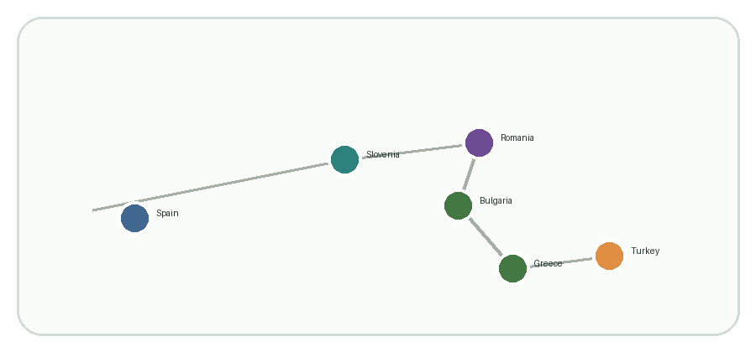
Aim and Contribution
Aim: critically assess the potential of EDIHs to support the agri-food digital transition.
The presentation compares Bulgaria, Romania, Slovenia, Greece, Spain and Turkey.
Contribution 1
moves from description to evaluation
Contribution 2
links EDIHs to rural inclusion
Contribution 3
compares different ecosystem conditions
Bulgaria
Romania
Slovenia
Greece
Spain
Turkey
Notes:
The aim of the study is to critically assess the potential of EDIHs to support digital transition in the agri-food sector across six national contexts. The article examines economic viability, operational efficiency, environmental sustainability, and the inclusiveness of access for smaller agricultural actors. The contribution is twofold. First, it moves beyond a general description of EDIHs and evaluates their practical relevance in agriculture. Second, it places EDIHs within the wider debate on rural innovation, digital inclusion, and governance of agri-food transformation in Europe. The paper therefore treats EDIHs as potentially important, but not automatically successful, instruments.

Slide 4
Materials and Methods
Qualitative comparative design
Evidence base combines peer-reviewed literature with institutional and policy documents.
The six cases were selected to capture different agri-food innovation ecosystems.
Scope
Bulgaria, Romania, Slovenia, Greece, Spain and Turkey
1
Review
scientific literature on EDIHs, agriculture and digital adoption
2
Document analysis
EU, national and hub-level sources
3
Comparative interpretation
country patterns and structural constraints
Notes:
Methodologically, the study uses a qualitative comparative design. It combines a structured review of scientific literature on digital agriculture, innovation ecosystems, and technology adoption with a critical analysis of institutional and policy documents concerning European digital innovation initiatives. The literature review focused mainly on sources from 2020 to 2025, while earlier foundational studies were included where they provided conceptual insights. The empirical scope covers Bulgaria, Romania, Slovenia, Greece, Spain, and Turkey. These countries were selected purposively to reflect variation in agri-food specialization, EDIH visibility, ecosystem maturity, and regional institutional context. The design does not claim statistical representativeness, but supports analytical comparison across contrasting cases.

Slide 5
Analytical Framework
Four criteria structure the comparison.
Barriers are treated as contextual conditions that shape whether services become usable.
Economic viability
Operational efficiency
ROI, cost and payback
resource and workflow gains
Sustainability outcomes
Accessibility
Contextual barriers
digital literacy, broadband connectivity, finance, fragmented holdings
inputs, monitoring, resilience
reach for smaller actors
Notes:
The comparison is structured around four principal analytical indicators. Economic viability refers to expected return on investment and cost efficiency. Operational efficiency concerns farm management, decision-support processes, and resource optimization. Sustainability outcomes relate to environmental monitoring, efficient input use, and resilience of production systems. Accessibility refers to whether small farms and rural enterprises can reach innovation support services and integrate digital solutions into practice. The study also considers structural barriers such as limited digital literacy, insufficient broadband connectivity in rural areas, financial constraints, and fragmented agricultural holdings. These barriers help interpret the practical relevance of EDIH services under real-world conditions.

Slide 6
Network Reach vs. Agricultural Uptake
Percentages and counts reported in the article
The EDIH network is broad, but agriculture appears under-represented among reported beneficiaries.
Manufacturing beneficiaries
28%
Agricultural users
1.7%
Agri-food-related hubs
36%
Exclusive agricultural mandate
5%
254
EDIHs by May 2025
93
agri-food support
12
exclusive mandate
>18k
service interactions
Notes:
One of the strongest quantitative findings is the mismatch between the formal presence of agri-food in the EDIH network and the actual intensity of agricultural participation. The article reports that agricultural users accounted for only approximately 1.7 percent of EDIH beneficiaries as of late 2024, while manufacturing represented close to 28 percent. By May 2025, the network had grown to 254 hubs. Of these, 93, or approximately 36 percent, provided some form of agri-food-related support, while only 12, or roughly 5 percent, operated with an exclusive agricultural mandate. In parallel, the wider network had engaged over 200,000 participants, organized about 5,000 events, and processed more than 18,000 service interactions. These figures support a careful interpretation: EDIHs are active as a network, and agri-food is formally present in many hubs, but agricultural users remain weakly represented among beneficiaries. The issue is therefore not network inactivity, but shallow penetration into agricultural practice.

Slide 7
How EDIHs Can Add Value
The strongest value proposition is not technology promotion alone, but reducing risk and translating digital tools into farm-level practice.
Uncertainty
context-specific returns
Test before invest
realistic farm conditions
Training
skills and routines
Finance & networks
implementation pathways
Critical qualification
EDIHs create conditions under which benefits become more plausible; they do not guarantee outcomes.
Notes:
The article identifies several mechanisms through which EDIHs may support agricultural digital adoption. Test-before-invest services are particularly important because farmers often hesitate to adopt technologies when expected returns are uncertain or context-dependent. Experimentation environments can reduce perceived risk by allowing technologies to be tested under realistic farm conditions. Training and digital skills development form a second mechanism, because the usefulness of digital tools depends on users' capacity to interpret data and integrate technologies into farm routines. A third mechanism is innovation intermediation and access to finance. EDIHs can connect agricultural actors with funding opportunities, investment instruments, and innovation networks. However, the article is careful: these services are more effective when translated into sector-relevant formats rather than delivered generically.

Slide 8
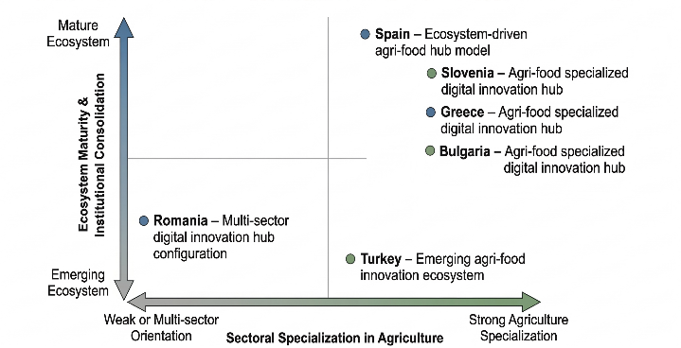
Comparative Country Patterns
Bulgaria
explicit agri-food positioning
Greece
sector-specialized hub
Slovenia
dedicated and multi-sector structures
Spain
mature ecosystem and coordination platform
Turkey
emerging agri-food innovation ecosystem
Romania
heterogeneous multi-sector configuration
Notes:
The six-country comparison shows that effectiveness is shaped less by the formal existence of hubs and more by the interaction between specialization, ecosystem maturity, and accessibility. Bulgaria, Greece, and Slovenia offer clearer examples of explicit agri-food positioning, with hub missions and services framed around agricultural digitalization, demonstration environments, and sector-specific training. Spain illustrates a mature ecosystem model in which hubs operate within denser networks involving research institutions, technology providers, competence centres, and public programmes. Turkey represents an emerging ecosystem, with strategic narratives around agricultural modernization and AgriFood 4.0. Romania is more heterogeneous, with agricultural applications appearing within broader digitalization portfolios. The article treats this as a structural divide rather than a purely national ranking. Support appears more likely to be effective where a clear agri-food mission is combined with sector-relevant service translation, stronger ecosystem embedment, and lower access barriers for smaller farms and agri-food SMEs.

Slide 9
Discussion and Conclusions
EDIHs are potentially valuable intermediary structures, but their effectiveness is conditional rather than automatic.
1. Sector adaptation
services must become concrete agricultural use cases
2. Inclusive access
formal availability does not ensure uptake by small farms
3. Governance alignment
EU, national and regional levels need closer coordination
Future research should examine user experience, post-adoption outcomes and measurable farm-level effects.
Notes:
The discussion and conclusions emphasize a measured interpretation. EDIHs have meaningful potential to support agricultural digitalization, but their practical impact is uneven across national contexts and user categories. Their effectiveness depends strongly on the adaptation of services to farm realities. Experimentation environments, advisory support, and user-oriented service design are central for translating technological opportunities into practical agricultural use. Accessibility for small farms is decisive. Where services remain too costly, complex, or weakly adapted, smaller agricultural actors have difficulty benefiting from available innovation support. From a policy perspective, the article argues for stronger sector-specific specialization, improved affordability for smaller users, and closer coordination between digital innovation hubs, rural advisory systems, infrastructure development, and financing mechanisms. The article also highlights a limitation: the study relies on literature and institutional sources rather than farm-level performance data. Future research should therefore examine user experiences and measurable post-adoption outcomes more directly.

Slide 10
Final Message
EDIHs can support agri-food digitalization when services are sector-specific, affordable and locally embedded.
Inclusive impact depends on practical accessibility for smaller agricultural actors.
Take-home message
Relevance depends on specialization, ecosystem capacity and real accessibility.
Thank you for your attention
Notes:
To conclude, the main message is that EDIHs can support agri-food digitalization, but only when their services are adapted to the realities of agriculture. The article does not present EDIHs as a guaranteed solution. Instead, it argues that inclusive impact requires sector-specific specialization, affordability for smaller users, practical intelligibility, and better coordination with rural advisory systems, infrastructure development, and financing mechanisms. Thank you for your attention. I welcome your questions.

