Slide 1
The Java Virtual Machine Architecture
First Presentation June 14, 2005
At SUST
Second Presentation May 08, 2007
At KAZ
Maruf Maniruzzaman
kuasha@acm.org
1

Slide 2

Virtual Machine Parts
Execution Engine
BOOT LOADER
VM
OS Shell
Heap
Class Heap
Ptr
GC
Class Loader
Class File
VM Stack

Slide 3
The Class File Structure
ClassFile {
  u4 magic; // = 0xCAFEBABE
  u2 minor_version;
  u2 major_version;
  u2 constant_pool_count;
  cp_info constant_pool[constant_pool_count-1];
  u2 access_flags;
  u2 this_class;
  u2 super_class;
  u2 interfaces_count;
  u2 interfaces[interfaces_count];
  u2 fields_count;
  field_info fields[fields_count];
  u2 methods_count;
  method_info methods[methods_count];
  u2 attributes_count;
  attribute_info attributes[attributes_count];
}

Slide 4
Constant Pool
Table (pool) per class/interface
Used to identify objects like string
cp_info {
  u1 tag;
  u1 info[];
}
CONSTANT_Class
CONSTANT_Fieldref
CONSTANT_Methodref
CONSTANT_String
CONSTANT_Integer
CONSTANT_Utf8
....
[Ljava/lang/Object; <- Utf8 bytes[]
CONSTANT_Class_info {
  u1 tag;
  u2 name_index;
}
CONSTANT_Methodref_info{
  u1 tag;
  u2 class_index;
  u2 name_and_type_index;
}
CONSTANT_Utf8_info {
  u1 tag;
  u2 length;
  u1 bytes[length];
}
Ultimately most of them are Utf8 String

Slide 5
Method Info Structure
method_info
{
    u2 access_flags; // indicates public/ private
    u2 name_index; // points to IsPrime
    u2 descriptor_index; // (I)Z
    u2 attributes_count;
    attribute_info attributes[attributes_count];
}

Slide 6
Code Attribute of Method
Code_attribute
{
  u2 attribute_name_index;
  u4 attribute_length;
  u2 max_stack;
  u2 max_locals; // is used to construct frame stack
  u4 code_length;
  u1 code[code_length];
  u2 exception_table_length;
  Struct {
    u2 start_pc;
    u2 end_pc;
    u2 handler_pc;
    u2 catch_type;
  }exception_table[exception_table_length];
  u2 attributes_count;
  attribute_info attributes[attributes_count];
}

Slide 7
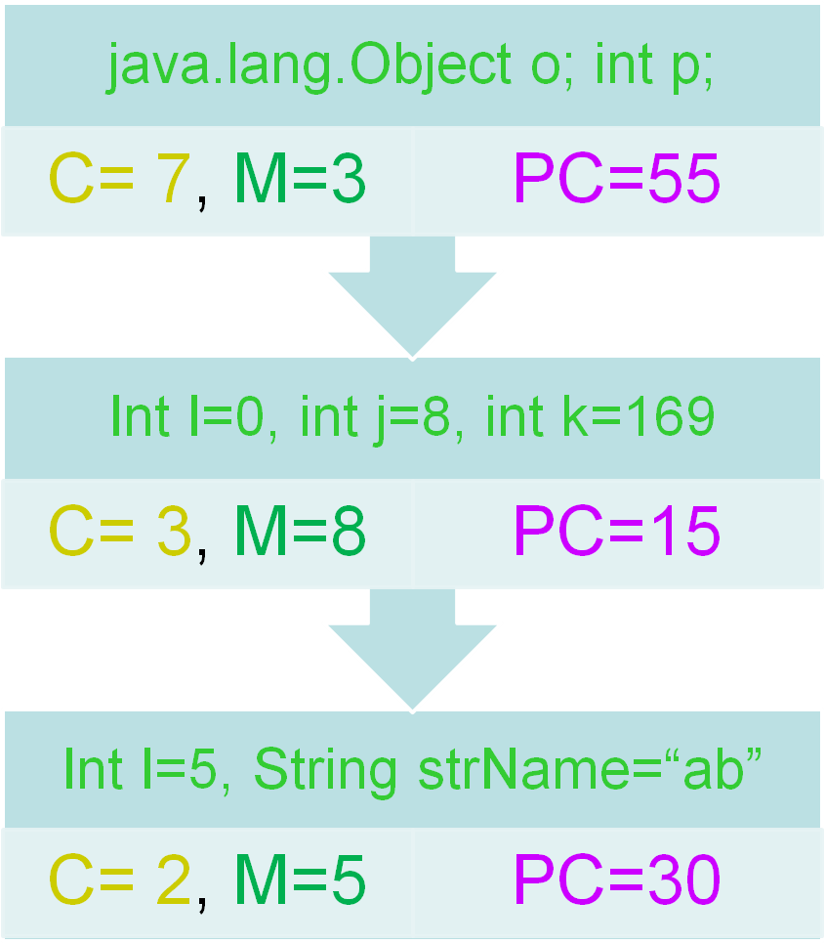
The VM Stack
Current Frame
Created on method call inst
Deleted on method return inst
Stack elements are invocation frames
Each stack element contains
  Class ref,
  Method ref,
  Program counter (pc)
  Local variables
Top frame is current frame (if implementer is not sick)
The stack trace is just the listing from top to bottom where PC is converted to line number from source line attribute.

Slide 8
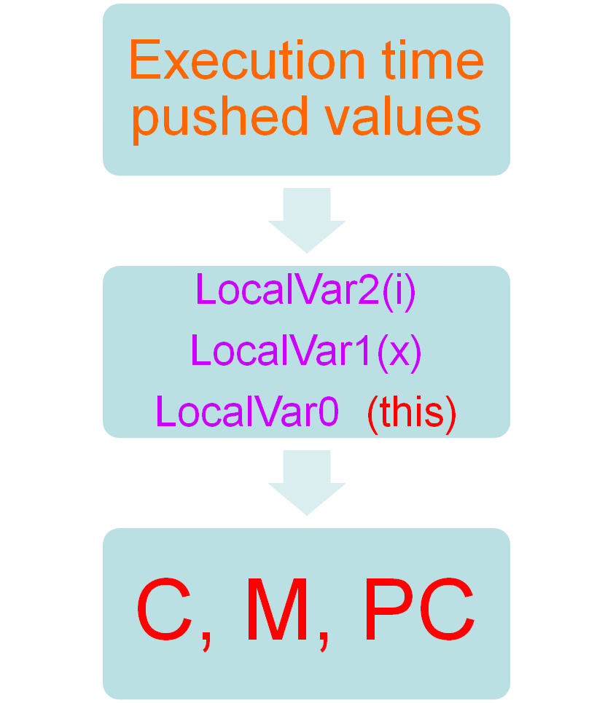
Frame Structure
Each frame is technically another stack
It can be expanded and contracted while instructions are executed
Stacks are not directly altered by java apps…
Instruction iadd
  Pop 2 numbers
  add them
  push result
20
10
30

Slide 9
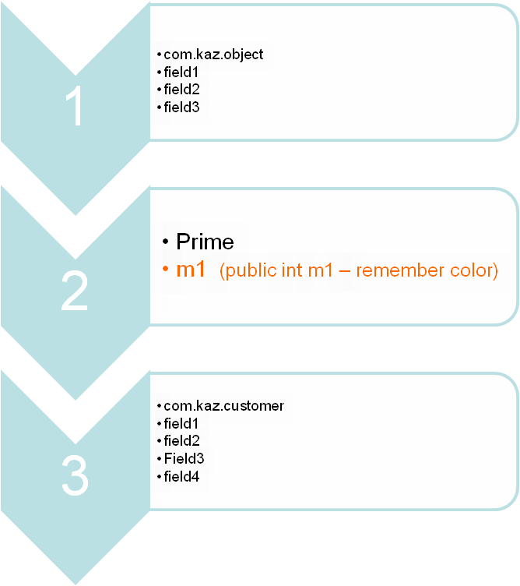
JVM Heap
100% Implementation dependent
Need not to be contiguous
Never managed by application (by gc instead)
Table is maintained in most implementations
Class Heap is also a part – theoretically.

Slide 10
JVM Instruction Set
iload, istore..
iadd, isub..
i2b, i2c, i2s..
new, newarray, anewarray, multianewarray, getfield, putfield
iload, istore
ifeq, iflt, ifle, ifne, ifgt..
invokevirtual , invokeinterface
ireturn, return..
Load / Store
Arithmetic
Type Conversion
Object Creation / Manipulation
Operand Stack Management
Control Transfer
Method Invocation
Return
……

Slide 11
Execution Unit
do {
  fetch an opcode;
  if (operands)
  fetch operands;
  execute the action;
} while (more to do);
Creates frames
Executes Instructions
Create objects
Return values
Deletes frames
Communicates with GC

Slide 12
Garbage Collector
Start from stack frames (all on stack)
Mark all objects that stack(both) points
Mark recursively – to build a tree
Delete all objects that are not marked
  Call the finalize method of that object
  Delete the reference from heap

Slide 13
public class Prime
{
public int m1; //< Can u remember this color ??>
boolean IsPrime(int x)
{
for(int i=2;i<x;i++)
{
if(x%i==0) return false;
}
return true;
}
}
IsPrime (I)Z
0 iconst_2
1 istore_2
2 goto 16
5 iload_1
6 iload_2
7 irem
8 ifne 13
11 iconst_0
12 ireturn
13 iinc 2 1
16 iload_2
17 iload_1
18 if_icmplt 5
21 iconst_1
22 ireturn
public class MyApp
{
public static void main(String ar[])
{
boolean bTest;
Prime prm=new Prime();
bTest=prm.IsPrime(5); return; // optional – for clarity
}
}
Method main
0 new #2
3 dup
4 invokespecial#3
7 astore_2
8 aload_2
9 iconst_5
10 invokevirtual #4
13 istore_1
14 return

Slide 14
m1
2
-1
-1
-1
0
Object Heap
PC = 0
public class Prime
Garbage Collector
Class Heap
Object Allocator
Class Loader
Storeage (HDD)
5
Method void main(java.lang.String[])
0 new #2 <Class Prime>
3 dup <otherwise will be removed after call - this>
4 invokespecial #3 <Method Prime()>
7 astore_2
8 aload_2
9 iconst_5
10 invokevirtual #4 <Method boolean IsPrime(int)>
13 istore_1
14 return
0
prm = 0
bTest = false
My App [main] 13
VM Stack

Slide 15
Method = IsPrime(I)Z
Class = Prime
m1
2
-1
-1
-1
0
Object Heap
PC = 0
public class Prime
IsPrime (I)Z
0 iconst_2
1 istore_2
2 goto 16
5 iload_1
6 iload_2
7 irem
8 ifne 13
11 iconst_0
12 ireturn
13 iinc 2 1
16 iload_2
17 iload_1
18 if_icmplt 5
21 iconst_1
22 ireturn
Class Heap
LocalVar2(i)
5
LocalVar1(x)
0
this ptr

Slide 16
Method = IsPrime(I)Z
Class = Prime
m1
2
-1
-1
-1
0
Object Heap
PC = 1
public class Prime
IsPrime (I)Z
0 iconst_2
1 istore_2
2 goto 16
5 iload_1
6 iload_2
7 irem
8 ifne 13
11 iconst_0
12 ireturn
13 iinc 2 1
16 iload_2
17 iload_1
18 if_icmplt 5
21 iconst_1
22 ireturn
Class Heap
2
LocalVar2(i)
5
LocalVar1(x)
0
this ptr

Slide 17
Method = IsPrime(I)Z
Class = Prime
m1
2
-1
-1
-1
0
Object Heap
PC = 2
public class Prime
IsPrime (I)Z
0 iconst_2
1 istore_2
2 goto 16
5 iload_1
6 iload_2
7 irem
8 ifne 13
11 iconst_0
12 ireturn
13 iinc 2 1
16 iload_2
17 iload_1
18 if_icmplt 5
21 iconst_1
22 ireturn
Class Heap
2
LocalVar2(i)
5
LocalVar1(x)
0
this ptr

Slide 18
Method = IsPrime(I)Z
Class = Prime
m1
2
-1
-1
-1
0
Object Heap
PC = 16
public class Prime
IsPrime (I)Z
0 iconst_2
1 istore_2
2 goto 16
5 iload_1
6 iload_2
7 irem
8 ifne 13
11 iconst_0
12 ireturn
13 iinc 2 1
16 iload_2
17 iload_1
18 if_icmplt 5
21 iconst_1
22 ireturn
Class Heap
2
LocalVar2(i)
5
LocalVar1(x)
0
this ptr

Slide 19
Method = IsPrime(I)Z
Class = Prime
m1
2
-1
-1
-1
0
Object Heap
PC = 17
public class Prime
IsPrime (I)Z
0 iconst_2
1 istore_2
2 goto 16
5 iload_1
6 iload_2
7 irem
8 ifne 13
11 iconst_0
12 ireturn
13 iinc 2 1
16 iload_2
17 iload_1
18 if_icmplt 5
21 iconst_1
22 ireturn
Class Heap
2
2
LocalVar2(i)
5
LocalVar1(x)
0
this ptr

Slide 20
Method = IsPrime(I)Z
Class = Prime
m1
2
-1
-1
-1
0
Object Heap
PC = 18
public class Prime
IsPrime (I)Z
0 iconst_2
1 istore_2
2 goto 16
5 iload_1
6 iload_2
7 irem
8 ifne 13
11 iconst_0
12 ireturn
13 iinc 2 1
16 iload_2
17 iload_1
18 if_icmplt 5
21 iconst_1
22 ireturn
Class Heap
5
2
2
LocalVar2(i)
5
LocalVar1(x)
0
this ptr

Slide 21
Method = IsPrime(I)Z
Class = Prime
m1
2
-1
-1
-1
0
Object Heap
PC = 5
public class Prime
IsPrime (I)Z
0 iconst_2
1 istore_2
2 goto 16
5 iload_1
6 iload_2
7 irem
8 ifne 13
11 iconst_0
12 ireturn
13 iinc 2 1
16 iload_2
17 iload_1
18 if_icmplt 5
21 iconst_1
22 ireturn
Class Heap
2
LocalVar2(i)
5
LocalVar1(x)
0
this ptr

Slide 22
Method = IsPrime(I)Z
Class = Prime
m1
2
-1
-1
-1
0
Object Heap
PC = 6
public class Prime
IsPrime (I)Z
0 iconst_2
1 istore_2
2 goto 16
5 iload_1
6 iload_2
7 irem
8 ifne 13
11 iconst_0
12 ireturn
13 iinc 2 1
16 iload_2
17 iload_1
18 if_icmplt 5
21 iconst_1
22 ireturn
Class Heap
5
2
LocalVar2(i)
5
LocalVar1(x)
0
this ptr

Slide 23
Method = IsPrime(I)Z
Class = Prime
m1
2
-1
-1
-1
0
Object Heap
PC = 7
public class Prime
IsPrime (I)Z
0 iconst_2
1 istore_2
2 goto 16
5 iload_1
6 iload_2
7 irem
8 ifne 13
11 iconst_0
12 ireturn
13 iinc 2 1
16 iload_2
17 iload_1
18 if_icmplt 5
21 iconst_1
22 ireturn
Class Heap
2
5
2
LocalVar2(i)
5
LocalVar1(x)
0
this ptr

Slide 24
Method = IsPrime(I)Z
Class = Prime
m1
2
-1
-1
-1
0
Object Heap
PC = 8
public class Prime
IsPrime (I)Z
0 iconst_2
1 istore_2
2 goto 16
5 iload_1
6 iload_2
7 irem
8 ifne 13
11 iconst_0
12 ireturn
13 iinc 2 1
16 iload_2
17 iload_1
18 if_icmplt 5
21 iconst_1
22 ireturn
Class Heap
1
2
LocalVar2(i)
5
LocalVar1(x)
0
this ptr

Slide 25
Method = IsPrime(I)Z
Class = Prime
m1
2
-1
-1
-1
0
Object Heap
PC = 13
public class Prime
IsPrime (I)Z
0 iconst_2
1 istore_2
2 goto 16
5 iload_1
6 iload_2
7 irem
8 ifne 13
11 iconst_0
12 ireturn
13 iinc 2 1
16 iload_2
17 iload_1
18 if_icmplt 5
21 iconst_1
22 ireturn
Class Heap
2
LocalVar2(i)
5
LocalVar1(x)
0
this ptr

Slide 26
Method = IsPrime(I)Z
Class = Prime
m1
2
-1
-1
-1
0
Object Heap
PC = 16
public class Prime
IsPrime (I)Z
0 iconst_2
1 istore_2
2 goto 16
5 iload_1
6 iload_2
7 irem
8 ifne 13
11 iconst_0
12 ireturn
13 iinc 2 1
16 iload_2
17 iload_1
18 if_icmplt 5
21 iconst_1
22 ireturn
Class Heap
3
LocalVar2(i)
5
LocalVar1(x)
0
this ptr

Slide 27
Method = IsPrime(I)Z
Class = Prime
m1
2
-1
-1
-1
0
Object Heap
PC = 17
public class Prime
IsPrime (I)Z
0 iconst_2
1 istore_2
2 goto 16
5 iload_1
6 iload_2
7 irem
8 ifne 13
11 iconst_0
12 ireturn
13 iinc 2 1
16 iload_2
17 iload_1
18 if_icmplt 5
21 iconst_1
22 ireturn
Class Heap
3
3
LocalVar2(i)
5
LocalVar1(x)
0
this ptr

Slide 28
Method = IsPrime(I)Z
Class = Prime
m1
2
-1
-1
-1
0
Object Heap
PC = 18
public class Prime
IsPrime (I)Z
0 iconst_2
1 istore_2
2 goto 16
5 iload_1
6 iload_2
7 irem
8 ifne 13
11 iconst_0
12 ireturn
13 iinc 2 1
16 iload_2
17 iload_1
18 if_icmplt 5
21 iconst_1
22 ireturn
Class Heap
5
3
3
LocalVar2(i)
5
LocalVar1(x)
0
this ptr

Slide 29
Method = IsPrime(I)Z
Class = Prime
m1
2
-1
-1
-1
0
Object Heap
PC = 5
public class Prime
IsPrime (I)Z
0 iconst_2
1 istore_2
2 goto 16
5 iload_1
6 iload_2
7 irem
8 ifne 13
11 iconst_0
12 ireturn
13 iinc 2 1
16 iload_2
17 iload_1
18 if_icmplt 5
21 iconst_1
22 ireturn
Class Heap
3
LocalVar2(i)
5
LocalVar1(x)
0
this ptr

Slide 30
Method = IsPrime(I)Z
Class = Prime
m1
2
-1
-1
-1
0
Object Heap
PC = 6
public class Prime
IsPrime (I)Z
0 iconst_2
1 istore_2
2 goto 16
5 iload_1
6 iload_2
7 irem
8 ifne 13
11 iconst_0
12 ireturn
13 iinc 2 1
16 iload_2
17 iload_1
18 if_icmplt 5
21 iconst_1
22 ireturn
Class Heap
5
3
LocalVar2(i)
5
LocalVar1(x)
0
this ptr

Slide 31
Method = IsPrime(I)Z
Class = Prime
m1
2
-1
-1
-1
0
Object Heap
PC = 7
public class Prime
IsPrime (I)Z
0 iconst_2
1 istore_2
2 goto 16
5 iload_1
6 iload_2
7 irem
8 ifne 13
11 iconst_0
12 ireturn
13 iinc 2 1
16 iload_2
17 iload_1
18 if_icmplt 5
21 iconst_1
22 ireturn
Class Heap
3
5
3
LocalVar2(i)
5
LocalVar1(x)
0
this ptr

Slide 32
Method = IsPrime(I)Z
Class = Prime
m1
2
-1
-1
-1
0
Object Heap
PC = 8
public class Prime
IsPrime (I)Z
0 iconst_2
1 istore_2
2 goto 16
5 iload_1
6 iload_2
7 irem
8 ifne 13
11 iconst_0
12 ireturn
13 iinc 2 1
16 iload_2
17 iload_1
18 if_icmplt 5
21 iconst_1
22 ireturn
Class Heap
2
3
LocalVar2(i)
5
LocalVar1(x)
0
this ptr

Slide 33
Method = IsPrime(I)Z
Class = Prime
m1
2
-1
-1
-1
0
Object Heap
PC = 13
public class Prime
IsPrime (I)Z
0 iconst_2
1 istore_2
2 goto 16
5 iload_1
6 iload_2
7 irem
8 ifne 13
11 iconst_0
12 ireturn
13 iinc 2 1
16 iload_2
17 iload_1
18 if_icmplt 5
21 iconst_1
22 ireturn
Class Heap
3
LocalVar2(i)
5
LocalVar1(x)
0
this ptr

Slide 34
Method = IsPrime(I)Z
Class = Prime
m1
2
-1
-1
-1
0
Object Heap
PC = 16
public class Prime
IsPrime (I)Z
0 iconst_2
1 istore_2
2 goto 16
5 iload_1
6 iload_2
7 irem
8 ifne 13
11 iconst_0
12 ireturn
13 iinc 2 1
16 iload_2
17 iload_1
18 if_icmplt 5
21 iconst_1
22 ireturn
Class Heap
4
LocalVar2(i)
5
LocalVar1(x)
0
this ptr

Slide 35
Method = IsPrime(I)Z
Class = Prime
m1
2
-1
-1
-1
0
Object Heap
PC = 17
public class Prime
IsPrime (I)Z
0 iconst_2
1 istore_2
2 goto 16
5 iload_1
6 iload_2
7 irem
8 ifne 13
11 iconst_0
12 ireturn
13 iinc 2 1
16 iload_2
17 iload_1
18 if_icmplt 5
21 iconst_1
22 ireturn
Class Heap
4
4
LocalVar2(i)
5
LocalVar1(x)
0
this ptr

Slide 36
Method = IsPrime(I)Z
Class = Prime
m1
2
-1
-1
-1
0
Object Heap
PC = 18
public class Prime
IsPrime (I)Z
0 iconst_2
1 istore_2
2 goto 16
5 iload_1
6 iload_2
7 irem
8 ifne 13
11 iconst_0
12 ireturn
13 iinc 2 1
16 iload_2
17 iload_1
18 if_icmplt 5
21 iconst_1
22 ireturn
Class Heap
5
4
4
LocalVar2(i)
5
LocalVar1(x)
0
this ptr

Slide 37
Method = IsPrime(I)Z
Class = Prime
m1
2
-1
-1
-1
0
Object Heap
PC = 5
public class Prime
IsPrime (I)Z
0 iconst_2
1 istore_2
2 goto 16
5 iload_1
6 iload_2
7 irem
8 ifne 13
11 iconst_0
12 ireturn
13 iinc 2 1
16 iload_2
17 iload_1
18 if_icmplt 5
21 iconst_1
22 ireturn
Class Heap
4
LocalVar2(i)
5
LocalVar1(x)
0
this ptr

Slide 38
Method = IsPrime(I)Z
Class = Prime
m1
2
-1
-1
-1
0
Object Heap
PC = 6
public class Prime
IsPrime (I)Z
0 iconst_2
1 istore_2
2 goto 16
5 iload_1
6 iload_2
7 irem
8 ifne 13
11 iconst_0
12 ireturn
13 iinc 2 1
16 iload_2
17 iload_1
18 if_icmplt 5
21 iconst_1
22 ireturn
Class Heap
5
4
LocalVar2(i)
5
LocalVar1(x)
0
this ptr

Slide 39
Method = IsPrime(I)Z
Class = Prime
m1
2
-1
-1
-1
0
Object Heap
PC = 7
public class Prime
IsPrime (I)Z
0 iconst_2
1 istore_2
2 goto 16
5 iload_1
6 iload_2
7 irem
8 ifne 13
11 iconst_0
12 ireturn
13 iinc 2 1
16 iload_2
17 iload_1
18 if_icmplt 5
21 iconst_1
22 ireturn
Class Heap
4
5
4
LocalVar2(i)
5
LocalVar1(x)
0
this ptr

Slide 40
Method = IsPrime(I)Z
Class = Prime
m1
2
-1
-1
-1
0
Object Heap
PC = 8
public class Prime
IsPrime (I)Z
0 iconst_2
1 istore_2
2 goto 16
5 iload_1
6 iload_2
7 irem
8 ifne 13
11 iconst_0
12 ireturn
13 iinc 2 1
16 iload_2
17 iload_1
18 if_icmplt 5
21 iconst_1
22 ireturn
Class Heap
1
4
LocalVar2(i)
5
LocalVar1(x)
0
this ptr

Slide 41
Method = IsPrime(I)Z
Class = Prime
m1
*
-1
-1
-1
0
Object Heap
PC = 13
public class Prime
IsPrime (I)Z
0 iconst_2
1 istore_2
2 goto 16
5 iload_1
6 iload_2
7 irem
8 ifne 13
11 iconst_0
12 ireturn
13 iinc 2 1
16 iload_2
17 iload_1
18 if_icmplt 5
21 iconst_1
22 ireturn
Class Heap
4
LocalVar2(i)
5
LocalVar1(x)
0
this ptr

Slide 42
Method = IsPrime(I)Z
Class = Prime
m1
2
-1
-1
-1
0
Object Heap
PC = 16
public class Prime
IsPrime (I)Z
0 iconst_2
1 istore_2
2 goto 16
5 iload_1
6 iload_2
7 irem
8 ifne 13
11 iconst_0
12 ireturn
13 iinc 2 1
16 iload_2
17 iload_1
18 if_icmplt 5
21 iconst_1
22 ireturn
Class Heap
5
LocalVar2(i)
5
LocalVar1(x)
0
this ptr

Slide 43
Method = IsPrime(I)Z
Class = Prime
m1
2
-1
-1
-1
0
Object Heap
PC = 17
public class Prime
IsPrime (I)Z
0 iconst_2
1 istore_2
2 goto 16
5 iload_1
6 iload_2
7 irem
8 ifne 13
11 iconst_0
12 ireturn
13 iinc 2 1
16 iload_2
17 iload_1
18 if_icmplt 5
21 iconst_1
22 ireturn
Class Heap
5
5
LocalVar2(i)
5
LocalVar1(x)
0
this ptr

Slide 44
Method = IsPrime(I)Z
Class = Prime
m1
2
-1
-1
-1
0
Object Heap
PC = 18
public class Prime
IsPrime (I)Z
0 iconst_2
1 istore_2
2 goto 16
5 iload_1
6 iload_2
7 irem
8 ifne 13
11 iconst_0
12 ireturn
13 iinc 2 1
16 iload_2
17 iload_1
18 if_icmplt 5
21 iconst_1
22 ireturn
Class Heap
5
5
5
LocalVar2(i)
5
LocalVar1(x)
0
this ptr

Slide 45
Method = IsPrime(I)Z
Class = Prime
m1
2
-1
-1
-1
0
Object Heap
PC = 21
public class Prime
IsPrime (I)Z
0 iconst_2
1 istore_2
2 goto 16
5 iload_1
6 iload_2
7 irem
8 ifne 13
11 iconst_0
12 ireturn
13 iinc 2 1
16 iload_2
17 iload_1
18 if_icmplt 5
21 iconst_1
22 ireturn
Class Heap
5
LocalVar2(i)
5
LocalVar1(x)
0
this ptr

Slide 46
Method = IsPrime(I)Z
Class = Prime
m1
2
-1
-1
-1
0
Object Heap
PC = 22
public class Prime
IsPrime (I)Z
0 iconst_2
1 istore_2
2 goto 16
5 iload_1
6 iload_2
7 irem
8 ifne 13
11 iconst_0
12 ireturn
13 iinc 2 1
16 iload_2
17 iload_1
18 if_icmplt 5
21 iconst_1
22 ireturn
Class Heap
1
5
LocalVar2(i)
5
LocalVar1(x)
0
this ptr

Slide 47
Method = main
Class = MyApp
PC = 13
m1
2
-1
-1
-1
0
VM does the following….
Save Returned Value
Remove Entire Method Frame
Push the returned value on stack
Restore Class And Program Counter
and continue
Method void main(java.lang.String[])
0 new #2 <Class Prime>
3 dup
4 invokespecial #3 <Method Prime()>
7 astore_2
8 aload_2
9 iconst_5
10 invokevirtual #4 <Method boolean IsPrime(int)>
13 istore_1
14 return
1
VM Stack

Slide 48
Process Migration (Saving Phase)
Save Object Heap
Save Class and Method References
Save VM Stack
Save Registers
Save VM States
Remote System
Load and Run

Slide 49
Process Migration (Loading Phase)
Load Object Heap
Load Classes that were open
Load VM Stack
Load Registers
Fix References with new reference of class, method and objects in Heap and Stack
Start the execution Engine

Slide 50
Thank You

