Slide 1
Prometheus
for Docker and Kubernetes monitoring

Slide 2
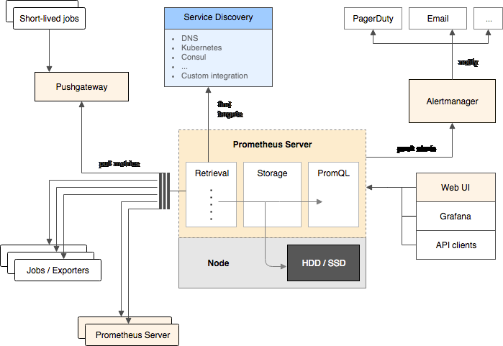
Prometheus Stack

Slide 3
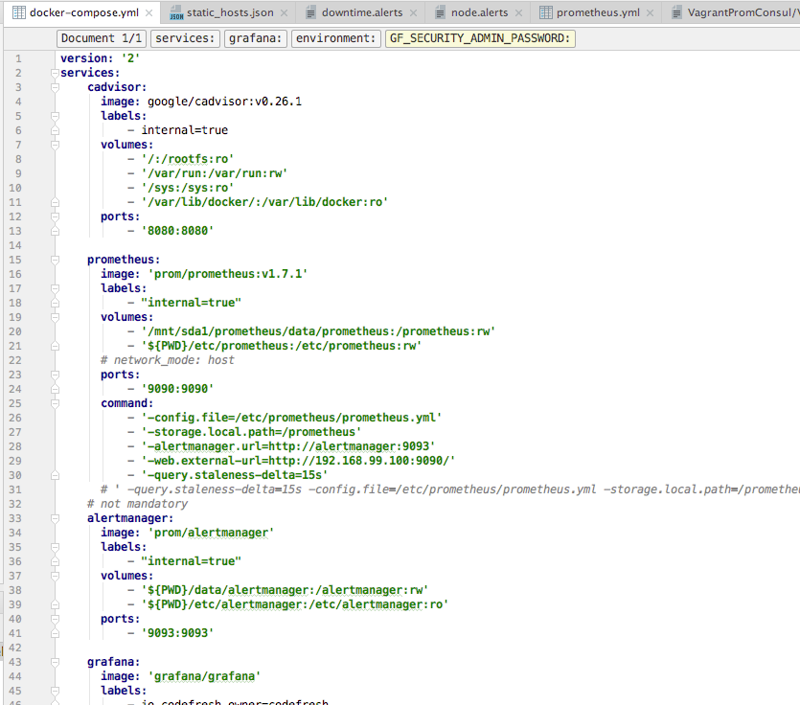
Starting on Local
* before Docker 17.05

Slide 4

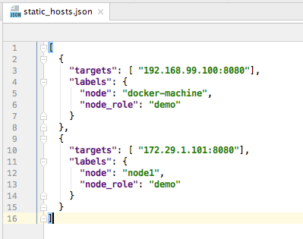
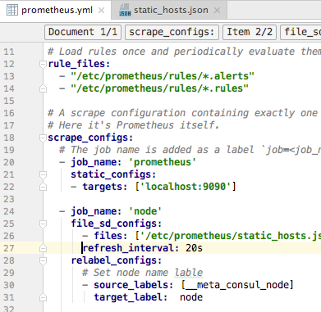
Scrape Explained

Slide 5
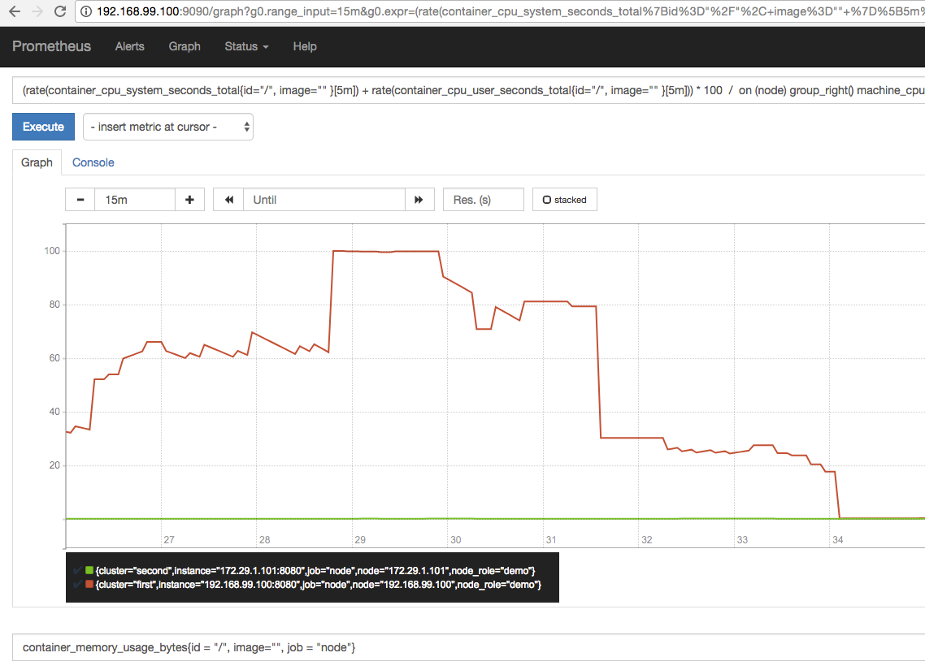
PromQL Explained

Slide 6
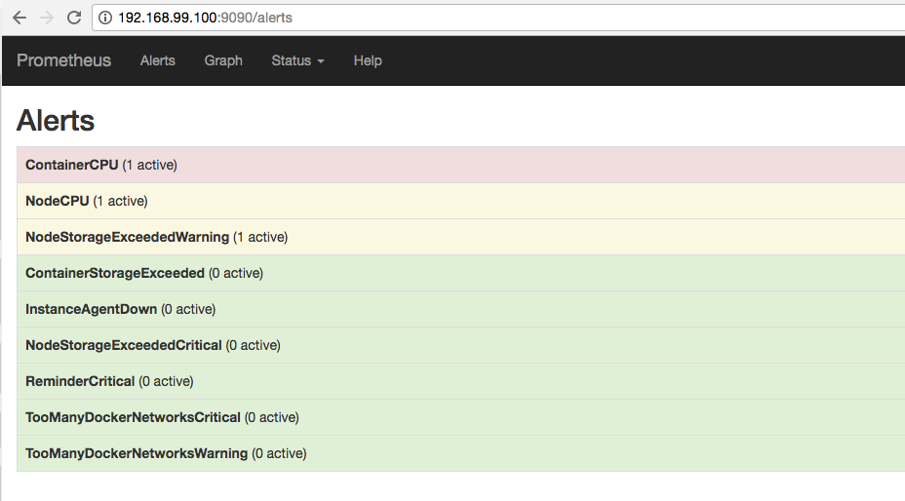
Alerting

Slide 7

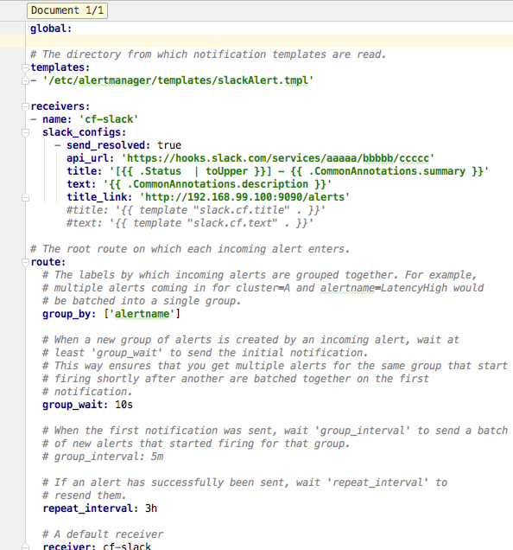
Alert Manager

Slide 8
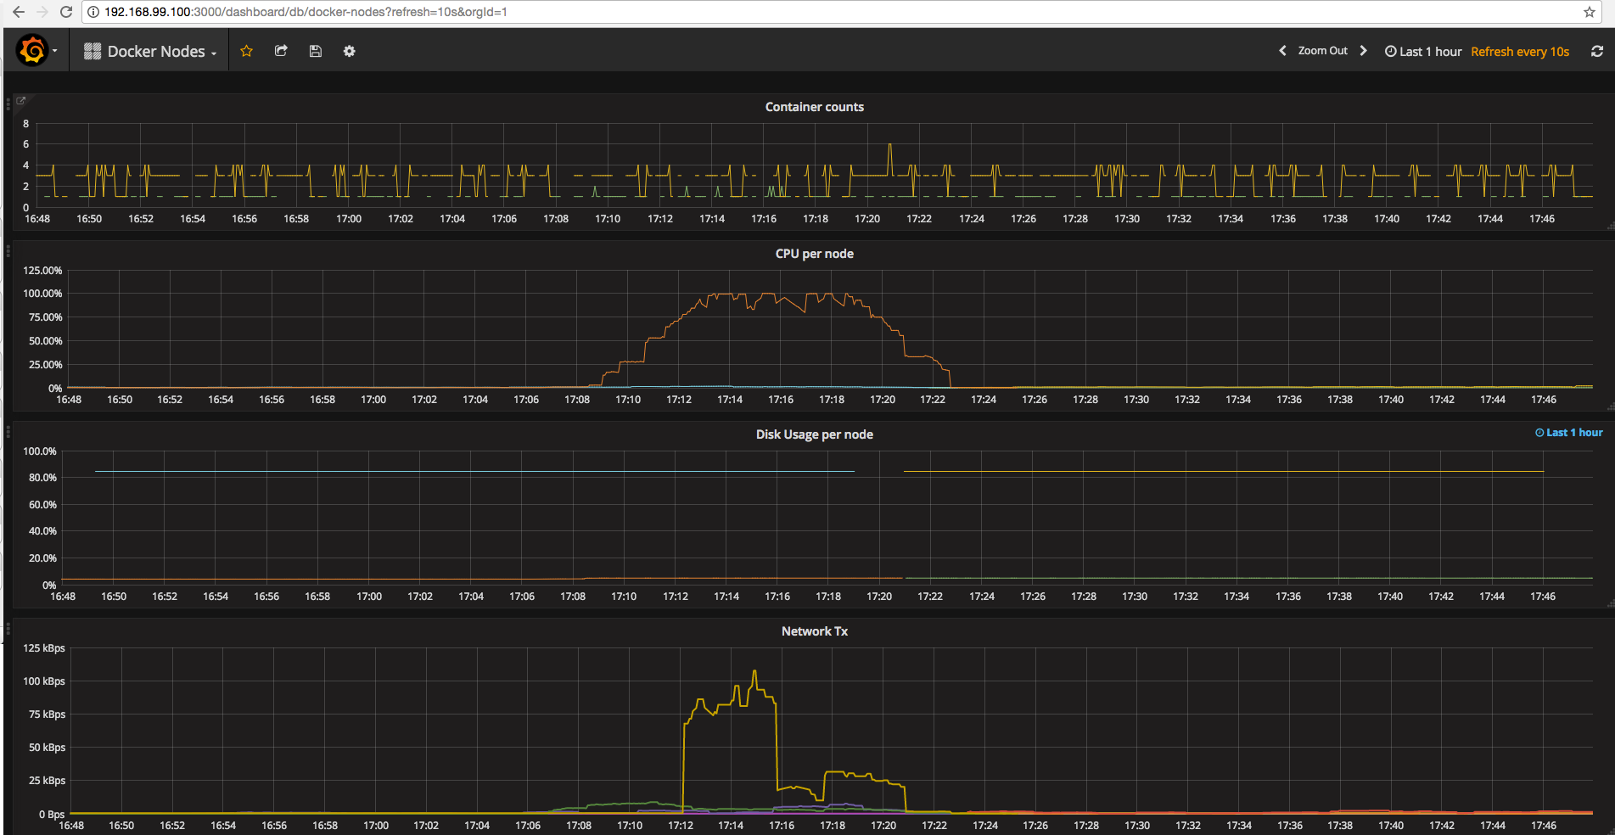
Grafana

Slide 9



Kubernetes
https://prometheus.io/docs/alerting/configuration/#configuration

Slide 10
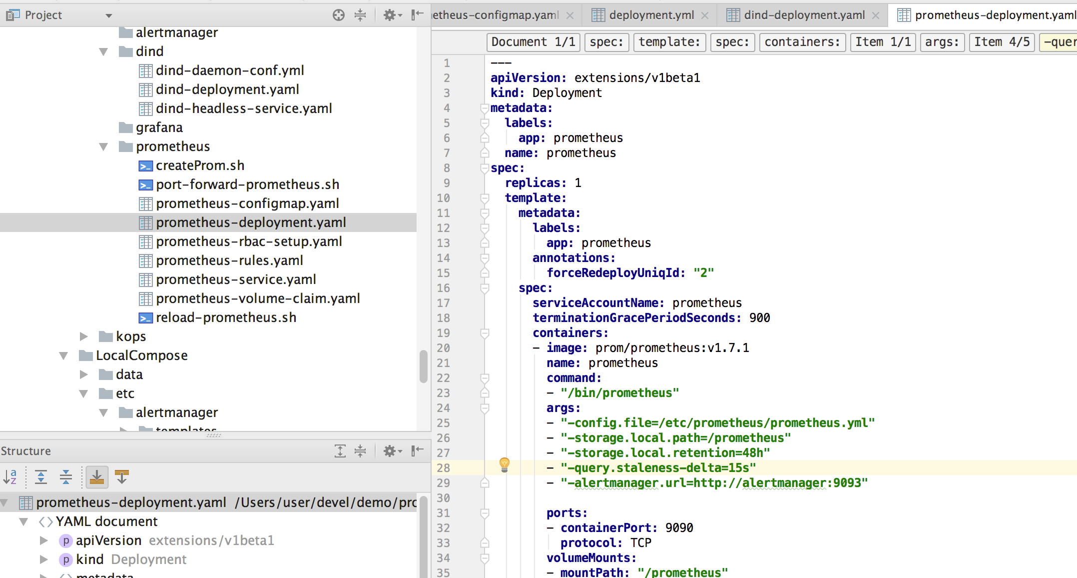
Kubernetes
{__name__ =~ ".*", job = "kubernetes-pods"}

