Slide 1

Variables and Strings

Slide 2
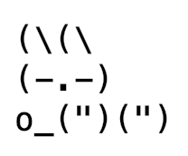
Variables and Strings
Draw this bunny
using the variables and strings that we have studied so far

