Slide 1
Variables
📦

Slide 2
Variables
A variable is like a container for data

Slide 3
Variables
A variable is like a container for data
Creating (assigning) a variable
var tvShowsWatched = “many”
var dogs = 3

Slide 4
Variables
A variable is like a container for data
Creating (assigning) a variable
Changing a variable
var tvShowsWatched = “many”
var dogs = 3
var age = 25
age = 26
var newAge = age + 1

Slide 5
Variables
A variable is like a container for data
Creating (assigning) a variable
Changing a variable
Cannot change a variable’s type
var tvShowsWatched = “many”
var dogs = 3
var age = 25
age = 26
var newAge = age + 1
var age = 25
age = “many” // Error

Slide 6
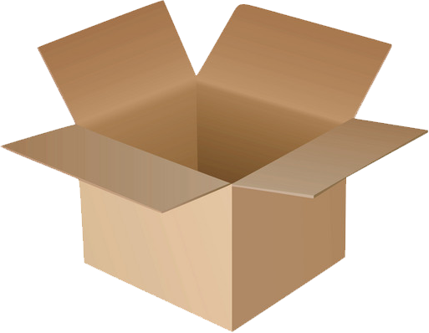
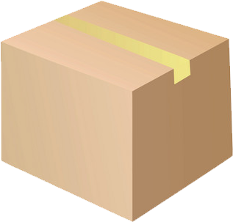
Variables

Slide 7
Variables
Changeable (mutable)
Read only (immutable)

Slide 8
Variables
Changeable (mutable)
var
Read only (immutable)
val

Slide 9
Variables
var color = “blue” // OK
color = “red” // OK

Slide 10
Variables
var color = “blue” // OK
color = “red” // OK
val color = “blue” // OK
color = “red” // Error

