Slide 1
Collections
🐶 🐱 🦊

Slide 2
Collections
A way to group elements together

Slide 3
Collections
A way to group elements together
Zero or more elements

Slide 4
Collections
A way to group elements together
Zero or more elements
Same type

Slide 5
Collections
A way to group elements together
Zero or more elements
Same type
[1, 2, 3, 632 ,9, 52, 6]
[“January”, “February”, “March”]
[ ]

Slide 6
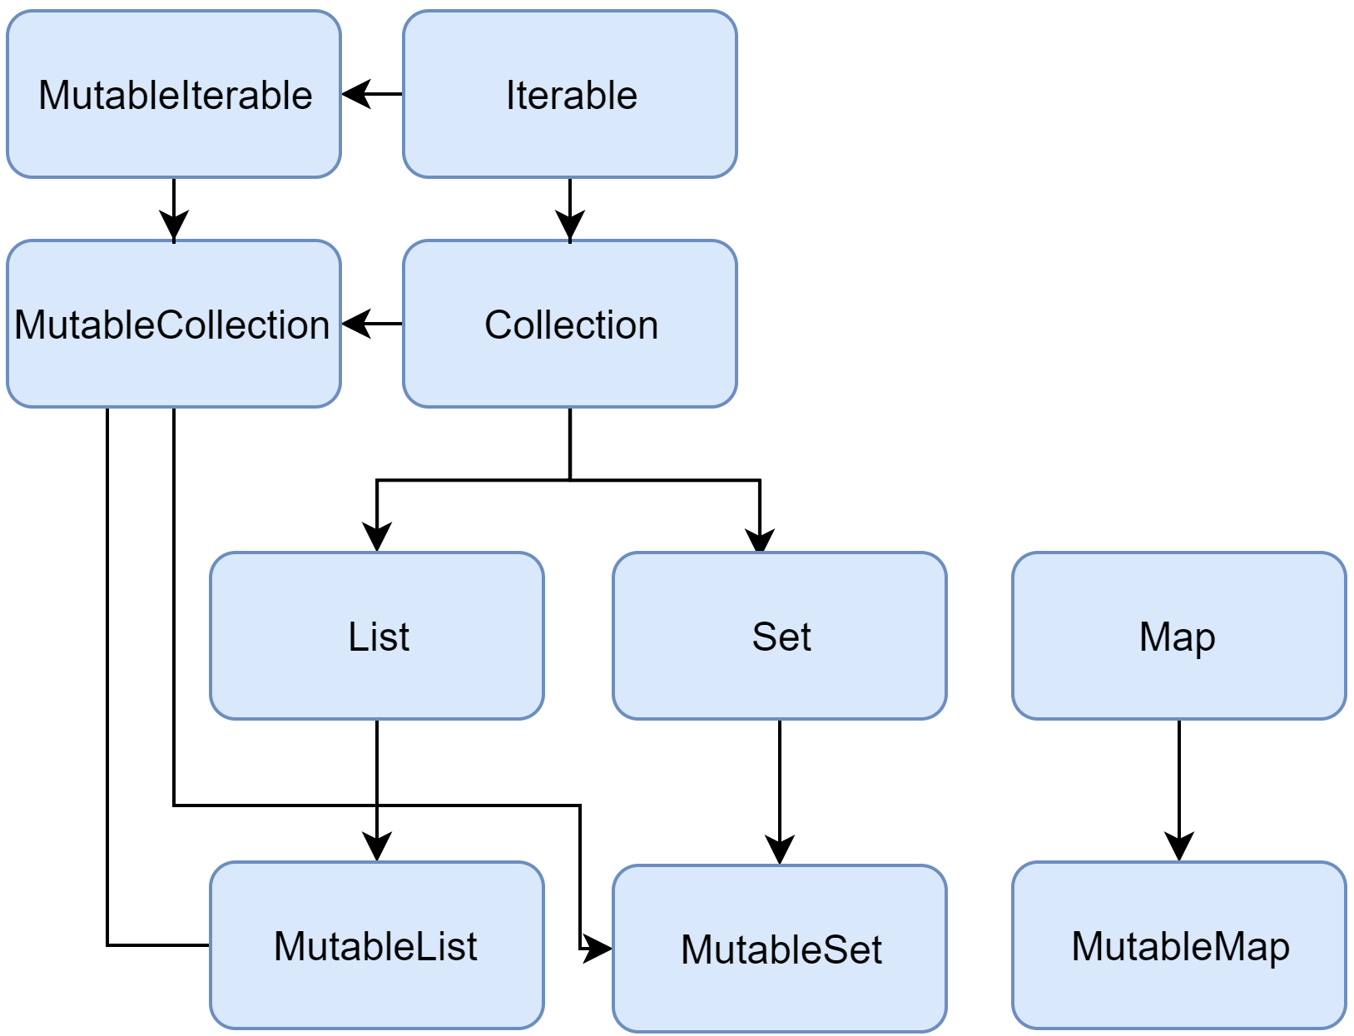
Collections

Slide 7
Collections

Slide 8
Collections
immutable

Slide 9
Collections
immutable
mutable

