Slide 1
Flow control
🔀

Slide 2
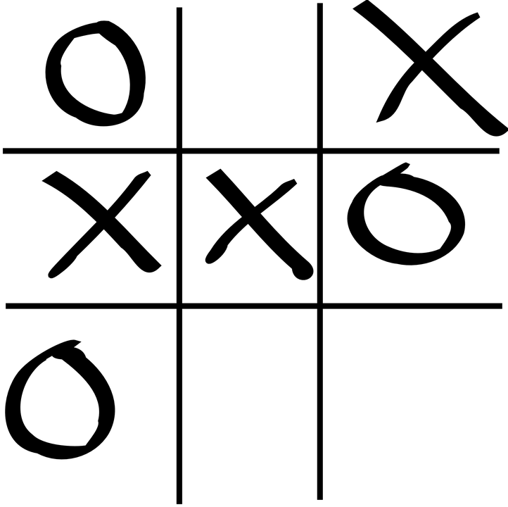
Flow control

Slide 3
Flow control
Change the direction of execution of a program

Slide 4
Flow control
Change the direction of execution of a program
Make decisions

Slide 5
Flow control
Change the direction of execution of a program
Make decisions
Run part of code multiple times

Slide 6
Flow control
Change the direction of execution of a program
Make decisions
Run part of code multiple times
Stop execution of a part of code

